Slide 1
Functional Programming Techniques in C#

Slide 2
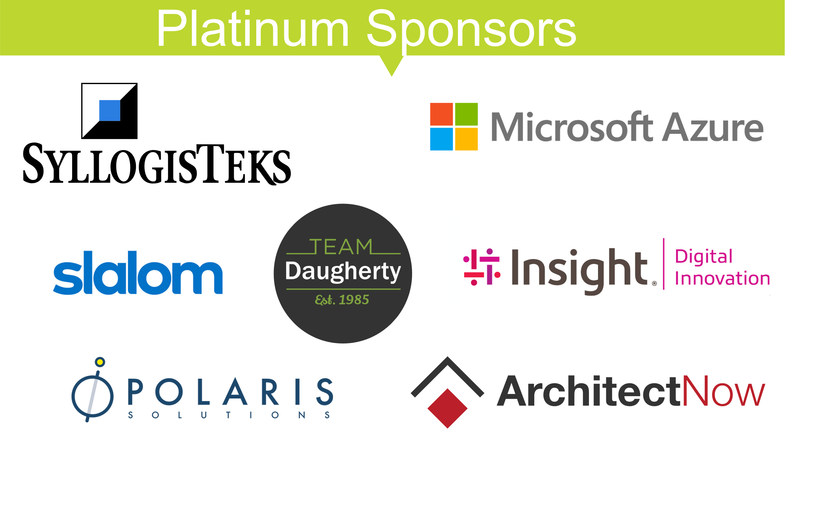
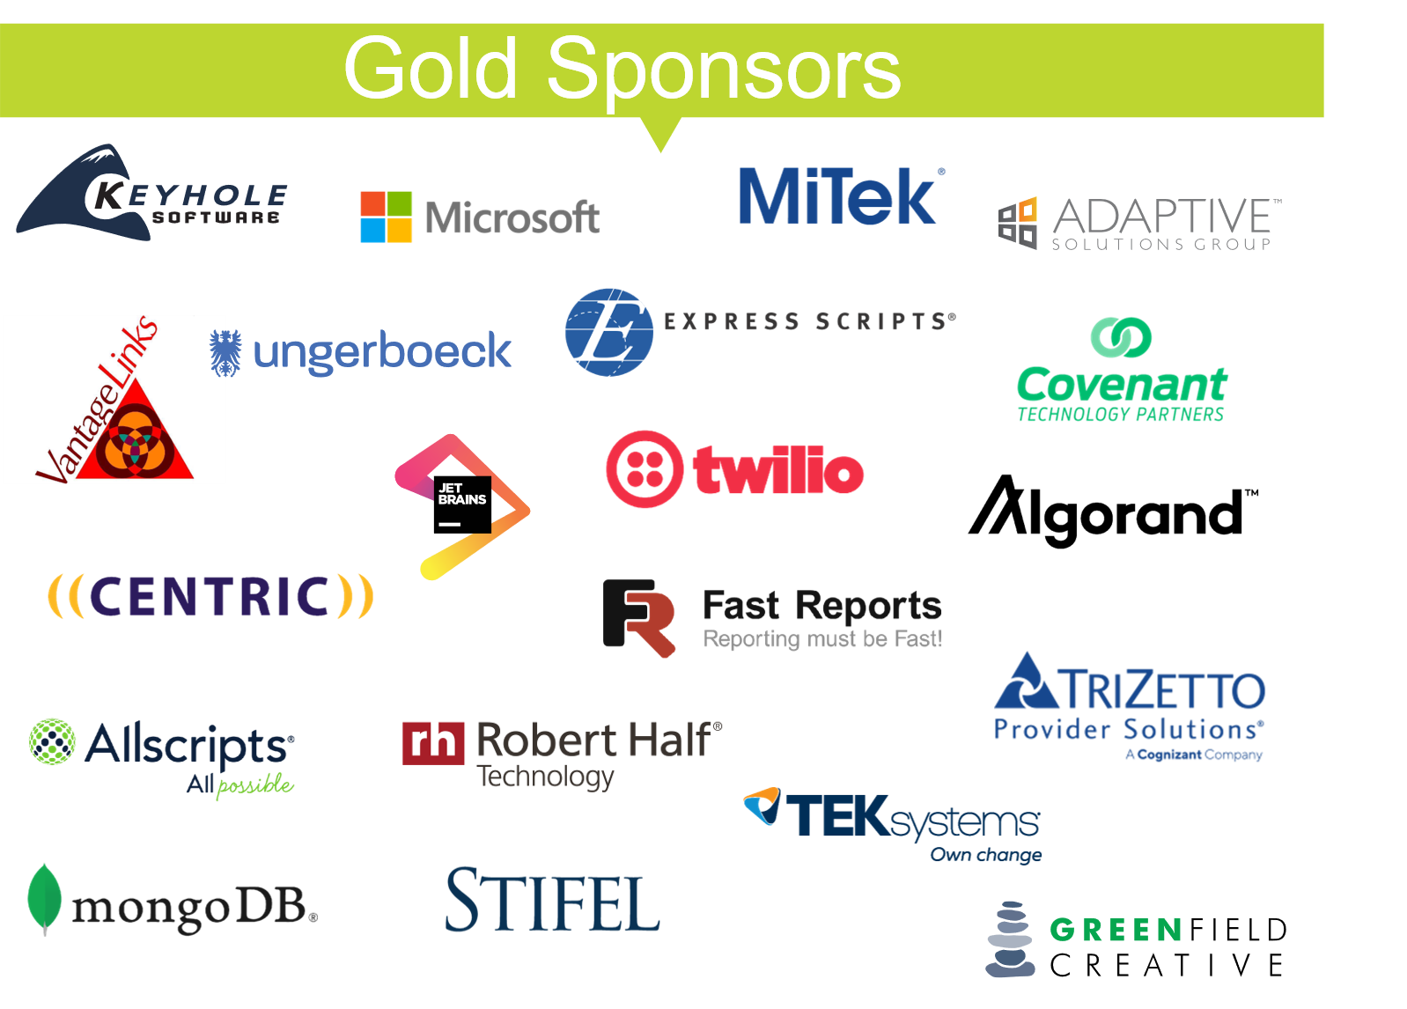
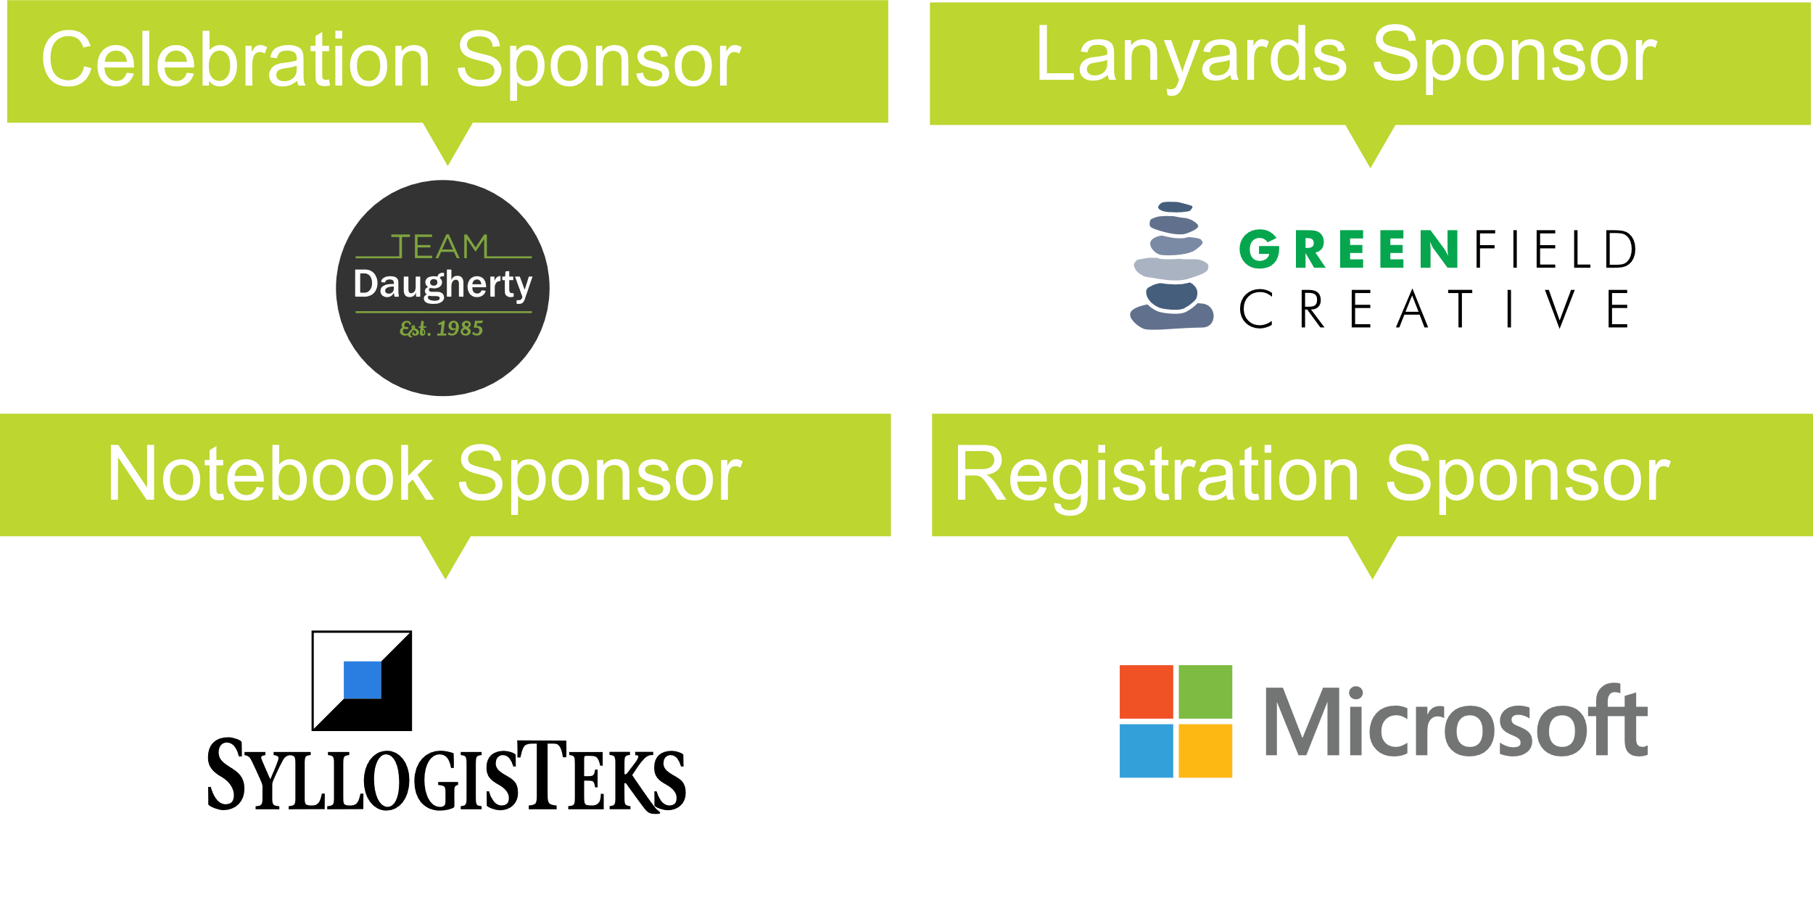
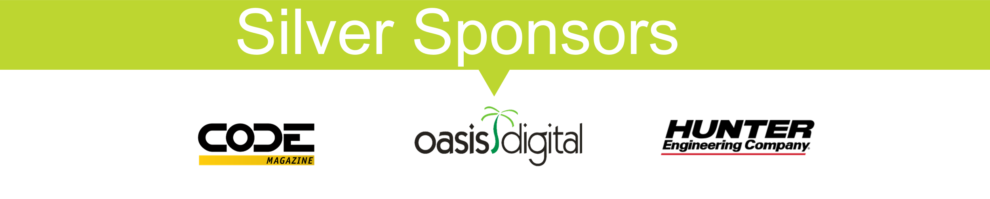

Slide 3
Who Am I?
My name is Darren Hale.
I work at Clearent.
I’m easy to find online:
Twitter: @darrenhale
LinkedIn: https://linkedin.com/in/darrenhale
GitHub: https://github.com/haled
Email: darren@clearent.com

Slide 4
The Challenge (or more about me)
Constantly improve coding technique.
Test Drive new code creation.
Keep tests straightforward and easy to understand. (Tests should define what the code does.)
Keep code as simple as possible. (Hard things should be hard and easy things should not be hard.)
Object-oriented thinking is ingrained in my being.

Slide 5
Intro to Functional Programming
Jim Weirich did a live coding exercise to explain functional programming. Magic!
https://www.infoq.com/presentations/Y-Combinator/
Pointed to higher-level approach to code.

Slide 6
What Is Functional Programming?
Object Oriented Programming
Central construct is a class.
Functional Programming
Central construct is a function.
C#
Central construct is a class.
Functions are first-class citizens.

Slide 7
Characteristics of Functional Programs
Purity
Same inputs ALWAYS produces same output.
Is easy to test.

Slide 8
Pure Code Examples
public int Sample1()
{
return 42;
}
public int Sample2(int a, int b)
{
return a + b;
}
public int Sample3(int a, int b)
{
int z = a + b;
Console.WriteLine(z);
return z;
}

Slide 9
Impure Code Examples #1
public int CurrentSeconds()
{
return DateTime.Now.Second;
}
public string GetGreeting(string name)
{
return "Hello " + name + " the current time is " + DateTime.Now;
}

Slide 10
Impure Code Examples #2
public Sum GetSum(int a, int b)
{
if(a < 0 || b < 0)
{
return null;
}
else
{
return new Sum(a + b);
}
}
public int GetSum2(int a, int b)
{
if(a < 0 || b < 0)
{
throw new Exception("I don't do negatives.");
}
else
{
return a + b;
}
}

Slide 11
Characteristics of Functional Programs
Purity
Easier to Reason About
Create functions that work on similar items.
Allows for a fluent call style.
Allows code to read like prose.
(Appropriate for series of steps triggered by an event.)

Slide 12
Easier to Read Example
public void Configure(IApplicationBuilder app, IHostingEnvironment env)
{
app.UseHttpsRedirection()
.UseAuthentication()
.UseCors()
.UseMvc();
}

Slide 13
Characteristics of Functional Programs
Purity
Easier to Reason About
Create functions that work on similar items.
Allows for a fluent call style.
Allows code to read like prose.
(Appropriate for series of steps triggered by an event.)
Immutability
Things don’t change.
Stateless

Slide 14
Immutability
// Mutation
public MathProblem Addition(MathProblem prob)
{
var z = prob.X + prob.Y;
prob.X = z;
return prob;
}
// Immutable
public MathProblem Subtraction(MathProblem prob)
{
MathProblem result = new MathProblem();
result.X = prob.X + prob.Y;
return result;
}

Slide 15
Characteristics of Functional Programs
Purity
Easier to Reason About
Immutability
Consistent Behavior
Can codify some “boilerplate” behavior.
Codify team conventions and practices.
<Code in future slides.>

Slide 16
Characteristics of Functional Programs
Purity
Easier to Reason About
Immutability
Consistent Behavior
Sophisticated Re-use
Composing functions from other functions.
Higher-order abstractions.
<Code in future slides.>

Slide 17
C# and Functional Programming
Functions as First-Class Citizens
Define functions as data.
Pass functions as data.
Functions passed as parameters to other functions.
Functions as return types from other functions.

Slide 18
Functions as First-Class Citizens
private delegate decimal MathCalculator(int val); // Define function as data
public decimal Square(int x)
{
return (decimal) x * x;
}
// Pass function as data
// Functions passed as parameters to other functions
public decimal CalcCircleArea(Func<decimal,int> rSquared, int radius)
{
return 3.14159m * rSquared(radius);
}
// Function as a return type
public Func<decimal> CalcCircleAreaFunction(int radius)
{
return () => 3.14159m * Square(radius);
}

Slide 19
Functional Constructs in C#
Delegates
Action
Functions
Lambdas
Extension Methods

Slide 20
Delegates
A delegate is a type that represents a reference to a method.
public delegate int AddTwoFunction(int val);
AddTwoFunction adder = AddTwo;

Slide 21
Functions
Func<T,TResult>
The above definition is for a function that takes T and returns TResult.
Func<int, long> AddTwoFunction;
public static long AddTwo(int x)
{
return (long) x + 2;
}

Slide 22
Action
An Action is a delegate with no return value and up to 16 parameters.
public Action<string> PrintMessage;
public static void MessagePrinter(string value)
{
Console.WriteLine(value);
}
PrintMessage = MessagePrinter;
PrintMessage = Console.WriteLine;

Slide 23
Lambdas
A lambda expression is an expression that has an expression as its body or a statement block as its body.
int[] nums = {0, 1, 2, 3, 4, 5};
var doubles = nums.Select(x => x * 2);
services.AddApiVersioning(p =>
{
p.AssumeDefaultVersionWhenUnspecified = true;
p.ReportApiVersions = true;
});

Slide 24
Lambdas (cont’d.)
public static decimal CalcCircleArea(Func<int,long> rSquared, int radius)
{
decimal pi = 3.14159m;
return pi * rSquared(radius);
}
Func<int, long> Square = x => x * x;
var area = CalcCircleArea(Square, 5);
var otherArea = CalcCircleArea(x => (long) x * x, 7);
public static void RecordMessage(Func<string> generator, string message)
{
Console.WriteLine(generator + message);
}
RecordMessage(() => "Parse string.".Substring(2, 4), " do you see the parsing?");

Slide 25
More Examples
public static long Triple(int value)
{
return value * 3;
}
public delegate long Multiplier(int value);
static Multiplier tripler = Triple;
public static void PrintMath(Func<int, long> calculator, int suppliedValue)
{
var result = calculator(suppliedValue);
Console.WriteLine("The math operation on " + suppliedValue + " resulted in " + result);
}
public static void PrintMathTyped(Multiplier calculator, int suppliedValue)
{
var result = calculator(suppliedValue);
Console.WriteLine("The math operation on " + suppliedValue + " resulted in " + result);
}
public static void Main(string[] args)
{
PrintMath(Triple, 4);
PrintMath(x => x * 4, 4);
PrintMathTyped(tripler, 5); // Func and delegate are different types
}

Slide 26
Why Use It in OO Programs
Re-use Algorithms
Higher-Order Abstractions
Performance Improvements
Simplify Testing

Slide 27
Real-World Application
Refactoring

Slide 28
Refactoring - Normal
public decimal CalcPayment(int amount, int length)
{
decimal payment = 0.0m;
if(length != 0)
{
var rawPayment = (decimal) amount / length;
payment = rawPayment + (rawPayment * 0.03m);
}
return payment;
}
public decimal CalcPaymentRefactored(int amount, int length)
{
decimal payment = 0.0m;
if (length != 0)
{
payment = DeterminePayment(amount, length);
}
return payment;
}
public decimal DeterminePayment(int amt, int len)
{
return (decimal) amt / len;
}

Slide 29
Real-World Application
“Outside In” Refactoring
=>

Slide 30
Refactoring – “Outside In”
public decimal CalcPayment(int amt, int len)
{
decimal payment = 0.0m;
if (len != 0)
{
var rawPayment = (decimal)amt / len;
payment = rawPayment + (rawPayment * 0.03m);
}
return payment;
}
public bool IsZero(int value)
{
return value == 0;
}
public decimal CalcPaymentRefactored(int amt, int len)
{
decimal payment = 0.0m;
var rawPayment = IsZero(len) ? 0.0m : (decimal)amt / len;
payment = rawPayment + (rawPayment * 0.03m);
return payment;
}

Slide 31
Try/Catch
public static string Calculate(int value)
{
decimal result = 0.0m;
var message = "Pending";
try
{
result = (decimal) 1 / value;
message = "Success";
}
catch (System.Exception e)
{
message = "Failure due to: " + e.Message;
}
return "The result is " + result
+ " with a message of " + message;
}
public static IResult TryCatch(Func<decimal> workload)
{
try
{
var result = new SuccessResult();
result.ResultValue = workload();
result.Message = "Success";
return result;
}
catch (System.Exception e)
{
var result = new FailedResult();
result.ResultValue = 0.0m;
result.Message = "Failure due to: " + e.Message;
return result;
}
}
var result = TryCatch(() => 1 / someValue);

Slide 32
Function Composition
public static long MultiplierWithTiming(int a, int b)
{
Console.WriteLine("Starting at " + DateTime.Now);
var result = a * b;
Console.WriteLine("Ending at " + DateTime.Now);
return result;
}
public static long AddWithTiming(int a, int b)
{
Console.WriteLine("Starting at " + DateTime.Now);
var result = a + b;
Console.WriteLine("Ending at " + DateTime.Now);
return result;
}

Slide 33
Function Composition
public static Func<dynamic> Timer(Func<dynamic> workload)
{
return () =>
{
Console.WriteLine("Start time: " + DateTime.Now);
var result = workload();
Console.WriteLine("End time: " + DateTime.Now);
return result;
};
}
public static int Multiply(int x, int y)
{
return x * y;
}
public static void Main(string[] args)
{
Func<dynamic> Multiplier = Timer(() => Multiply(4, 5));
Console.WriteLine("Timed result is " + Multiplier());
}

Slide 34
Fun with Function Composition
public static void Main(string[] args)
{
var nums = new List<int> { 1, 2, 3, 4, 5, 6 };
Func<dynamic> ListMultiplication = () =>
{
return nums.Aggregate((x, y) => Multiply(x, y));
};
Func<dynamic> TimedMultiplication = Timer(ListMultiplication);
var result = TimedMultiplication();
Console.WriteLine("The result is -> " + result);
Console.ReadLine();
}

Slide 35
Summary
What is functional programming?
Functional constructs in C#
Taste of How to Apply Functional Programming Concepts

Slide 36
Thank You!
My name is Darren Hale.
I work at Clearent.
I’m easy to find online:
Twitter: @darrenhale
LinkedIn: @darrenhale
GitHub: https://github.com/haled
Email: darren@clearent.com
References:
Jim Weirich Talk: https://www.infoq.com/presentations/Y-Combinator/
Kathleen Dollard Talk: https://www.ustream.tv/recorded/114916291

