Slide 1
TOMCAT INSTALLATION
CONFIGURATION IN ECLIPSE

Slide 2
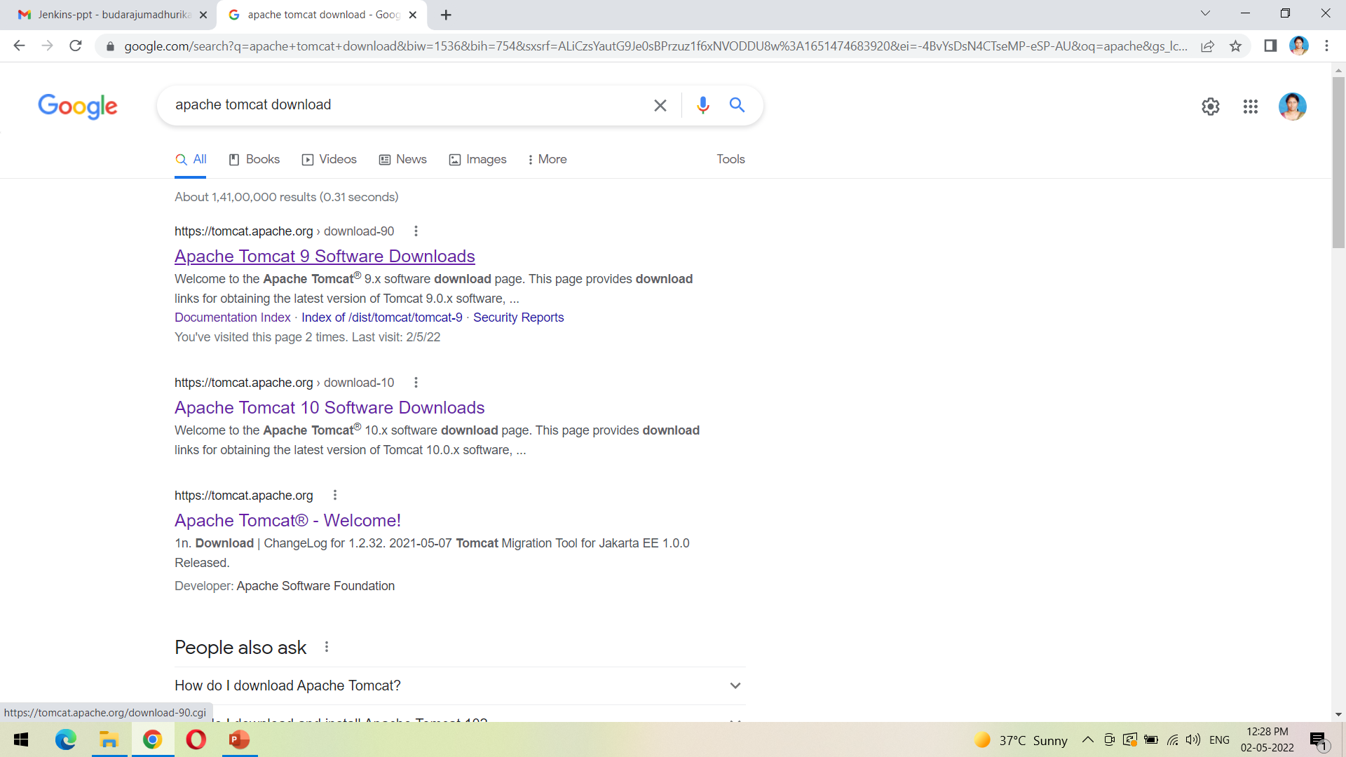
Download the tomcat from the first link as shown

Slide 3
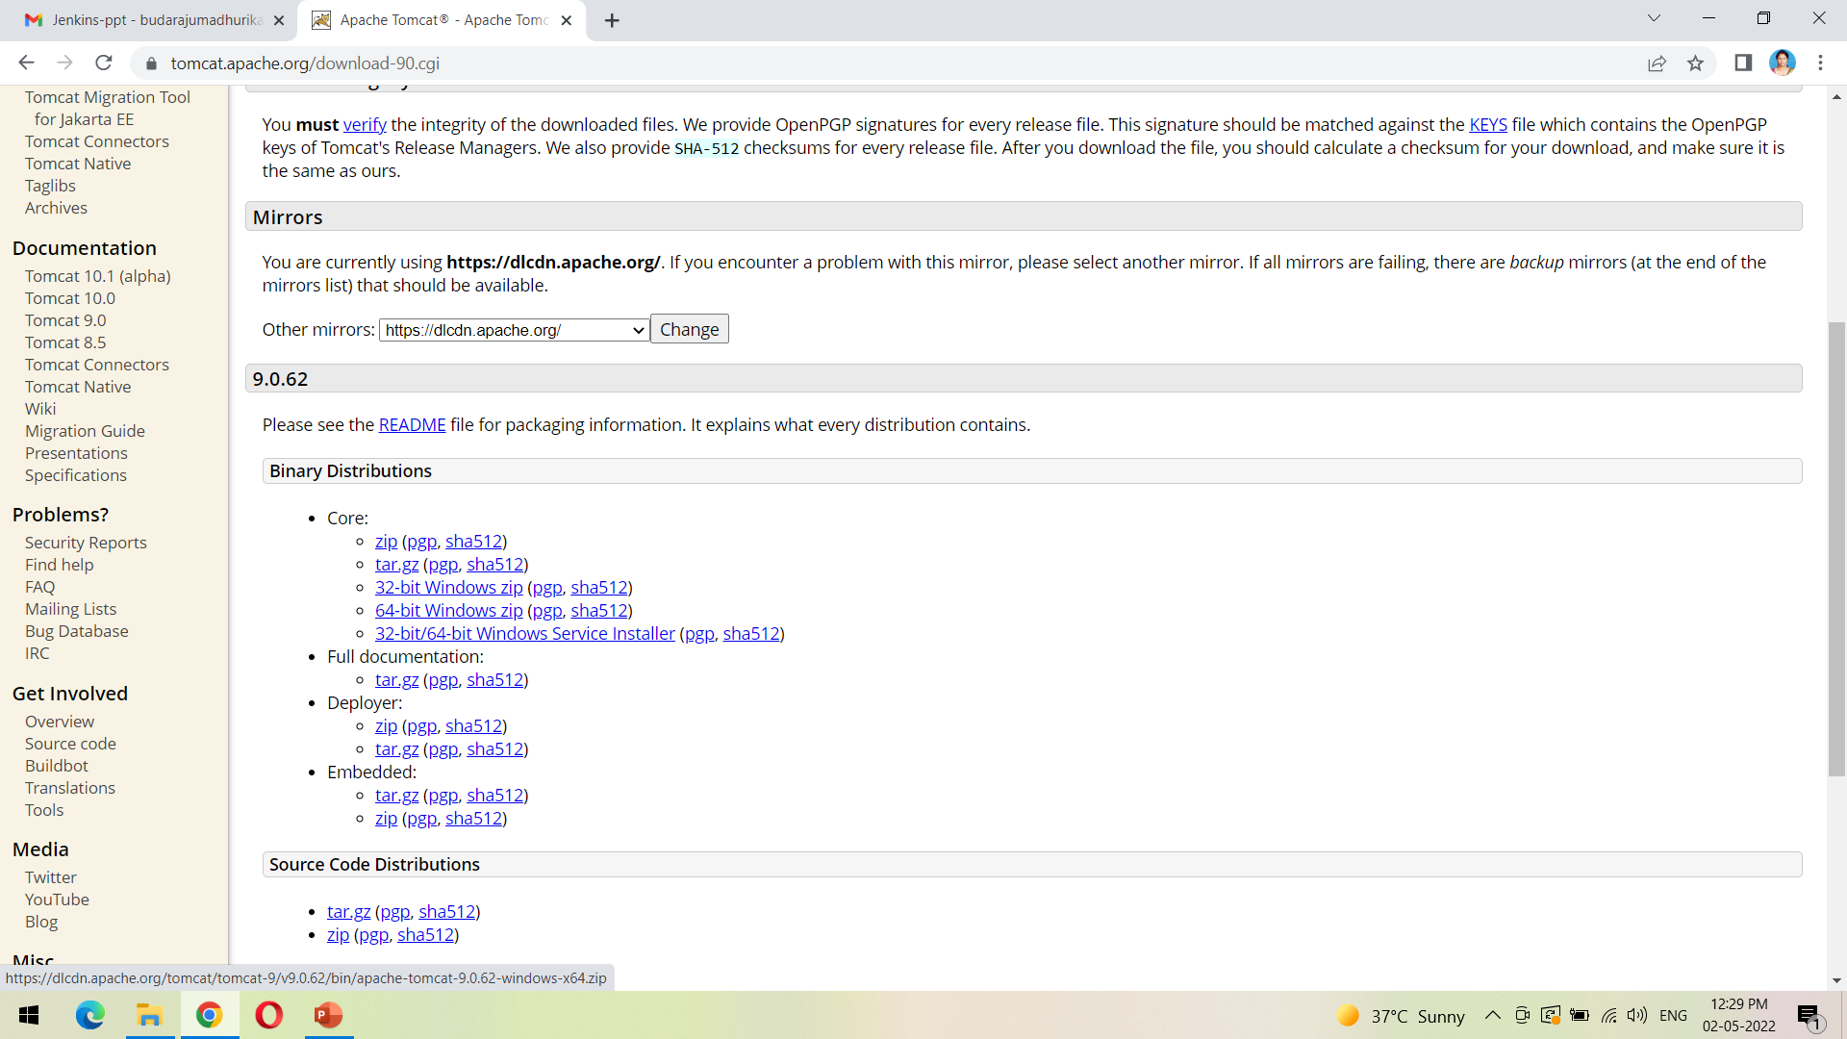
Click on the following link 64-bit windows zip to download the zip file

Slide 4
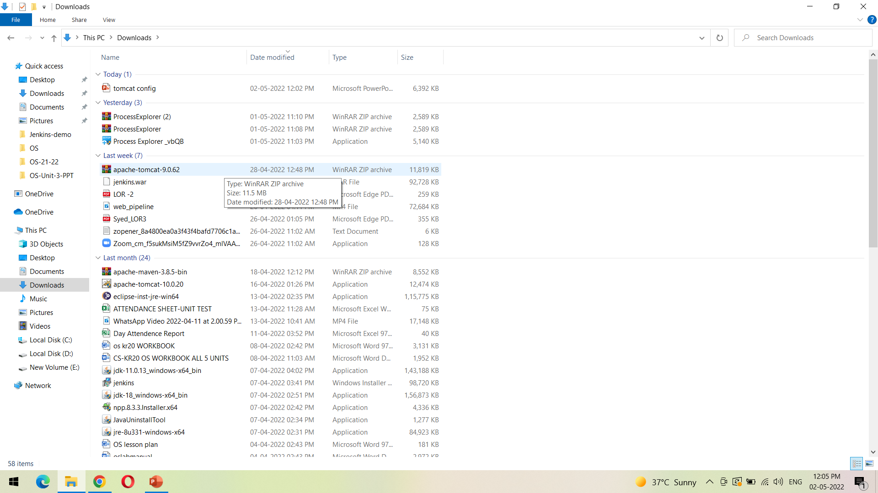
We can view the downloaded file from Downloads folder as shown

Slide 5
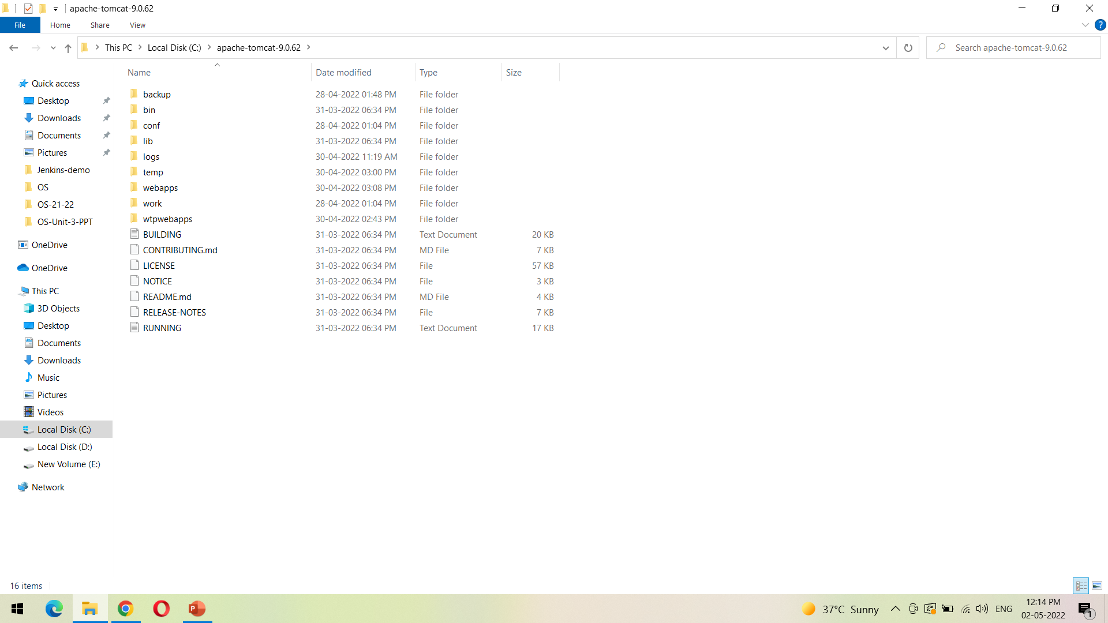
Unzip the downloaded file into the path shown

Slide 6
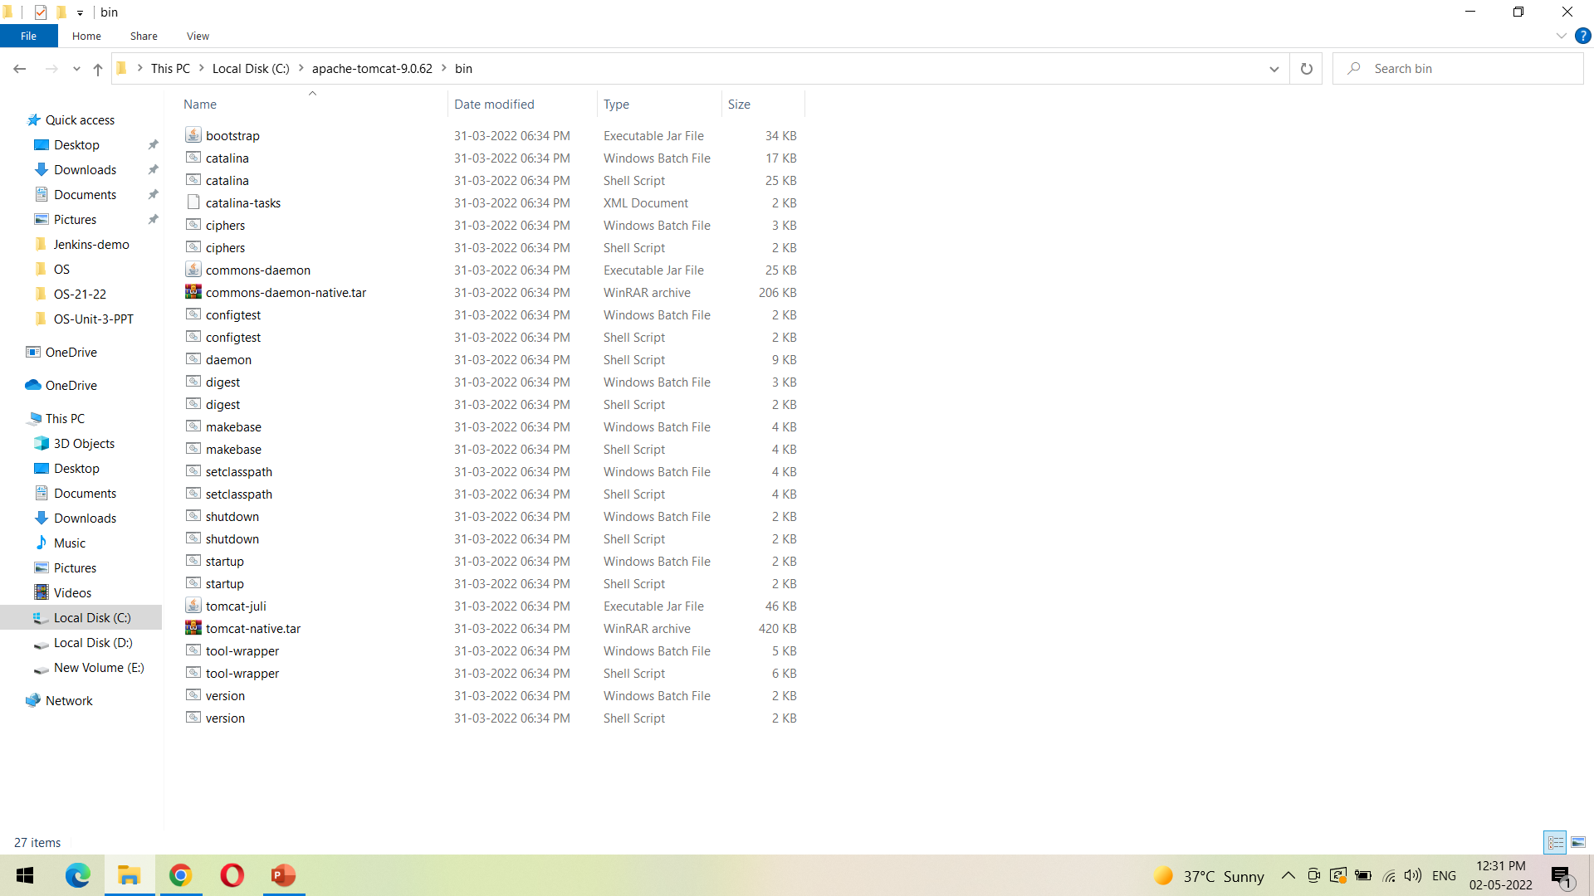
Go to the bin folder and click on startup as shown to start the Tomcat server

Slide 7
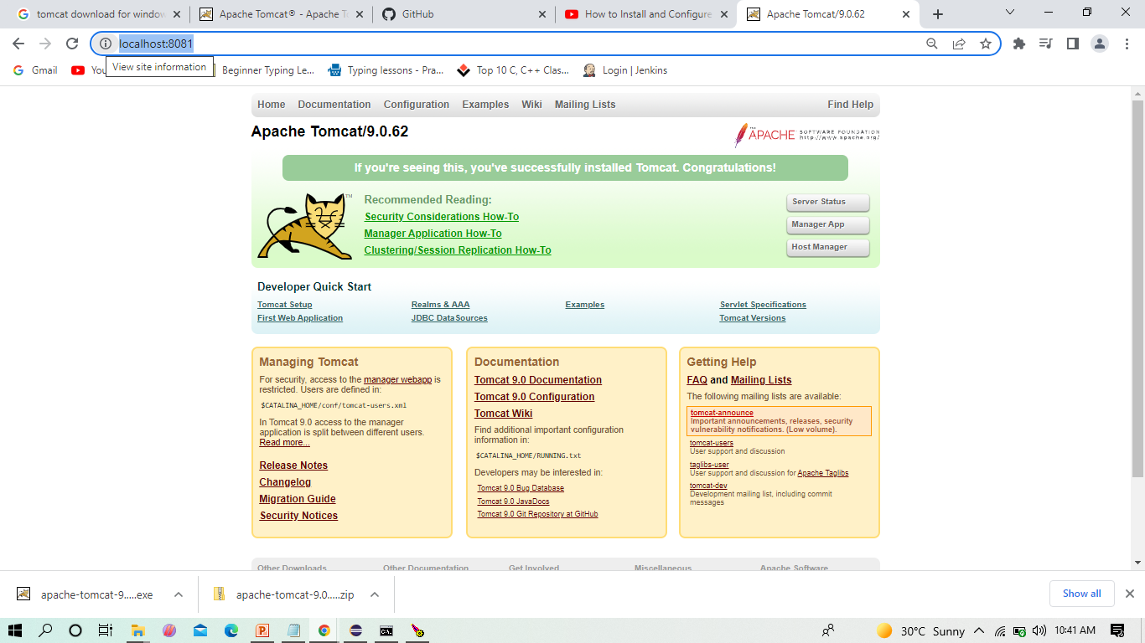
After starting the server, do not close the cmd, If we click on localhost:8081, the Tomcat page will be displayed as followed

Slide 8
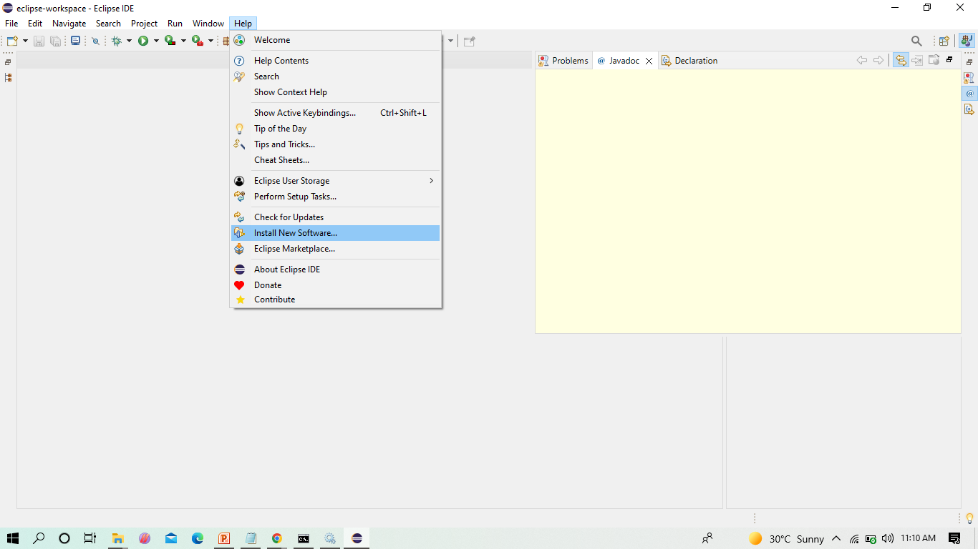
To install Tomcat server into eclipse

Slide 9
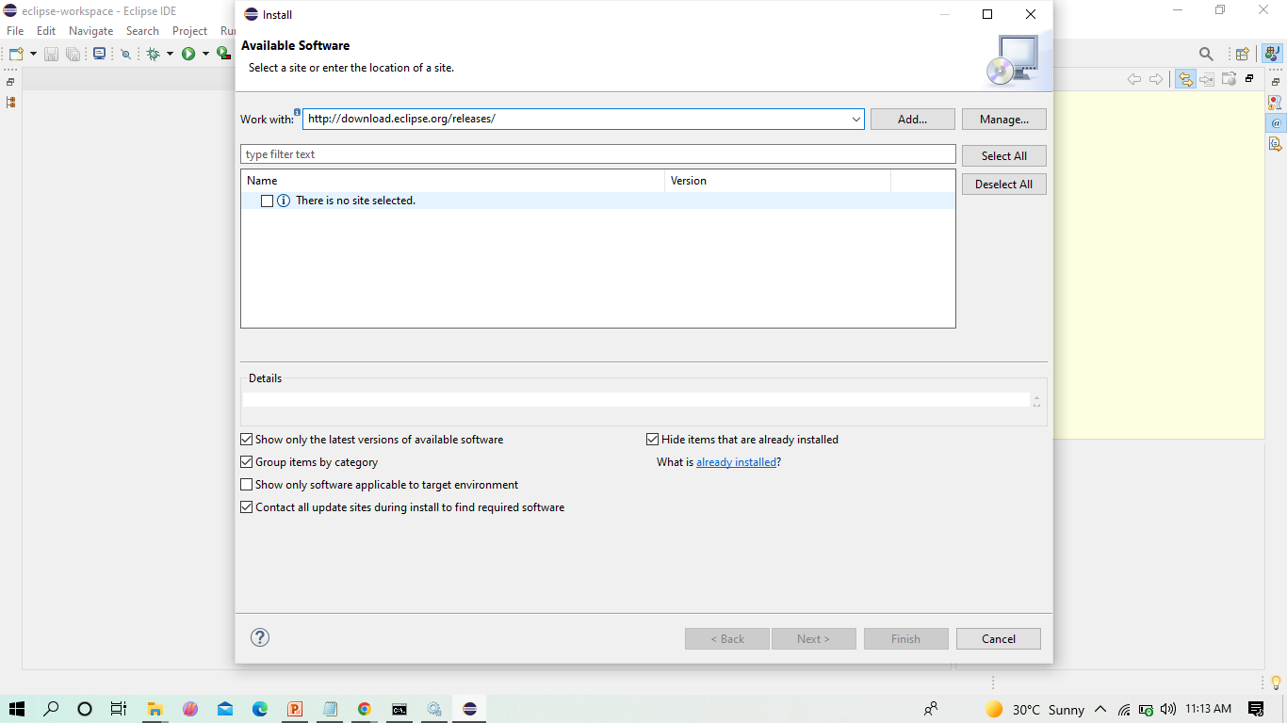
Before installing server into eclipse, we need to add Java EE to the eclipse IDE

Slide 10
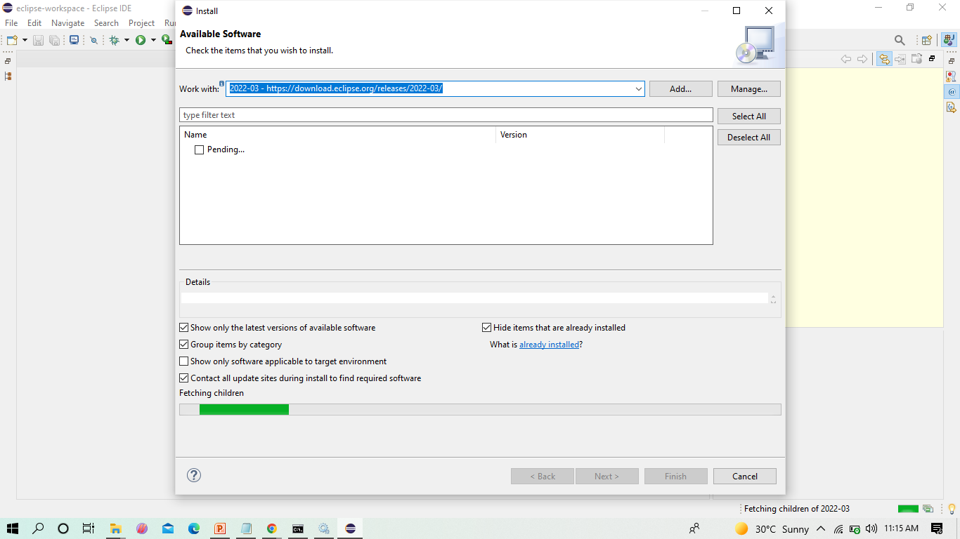
Click on the drop down menu in Work with and select the following from the list

Slide 11
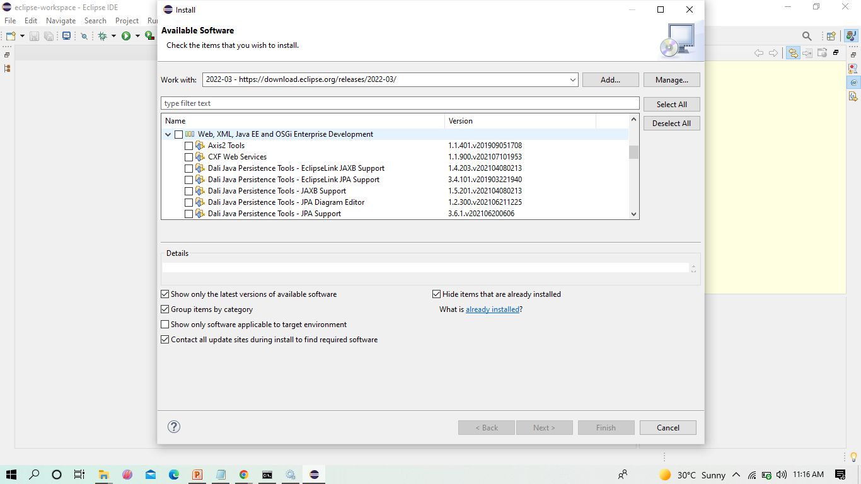
Check the Web,XML,JAVA EE box to install the latest software into eclipse in order to execute the dynamic web projects, maven web projects. Etc.

Slide 12
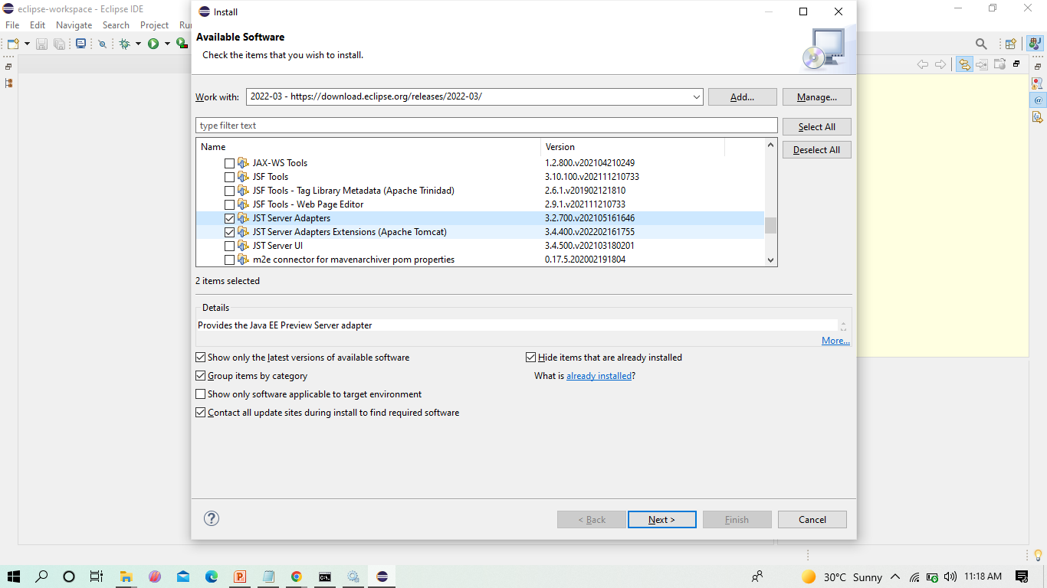
Since we develop only Maven web project in DevOps, we can only check the shown two and click on next

Slide 13
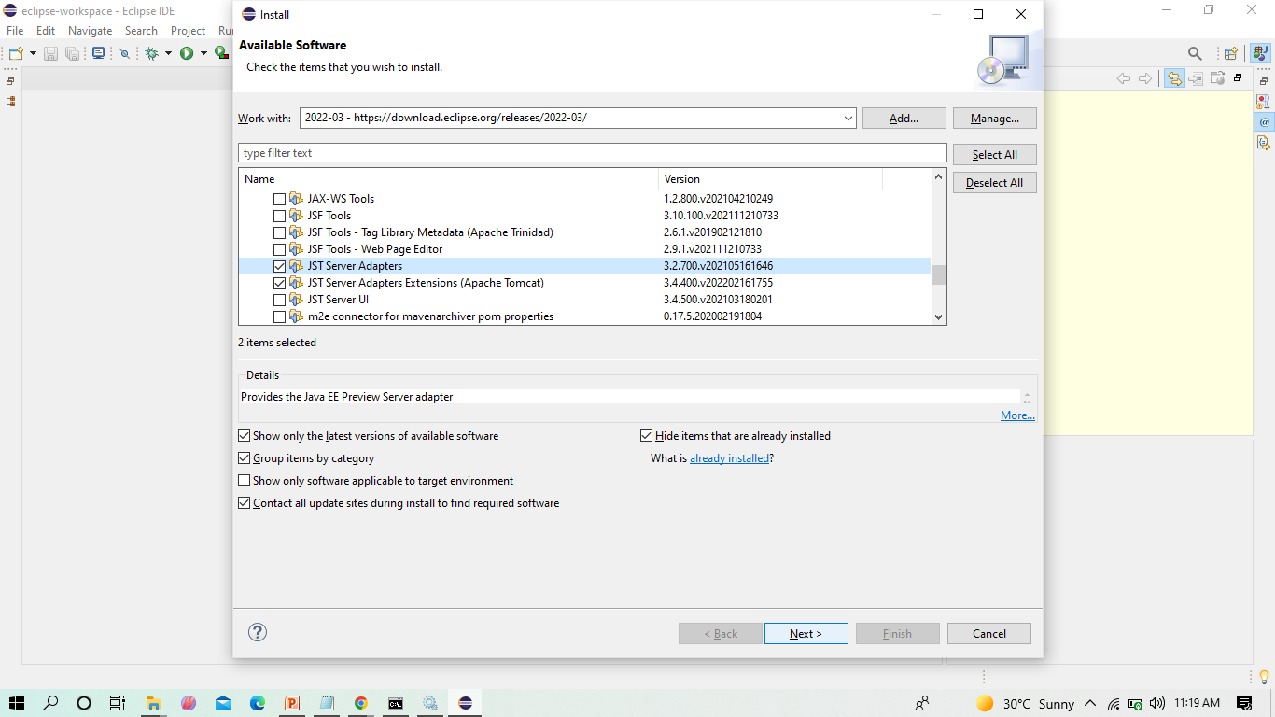
Here enable the JST Adapter and JST server adapter

Slide 14
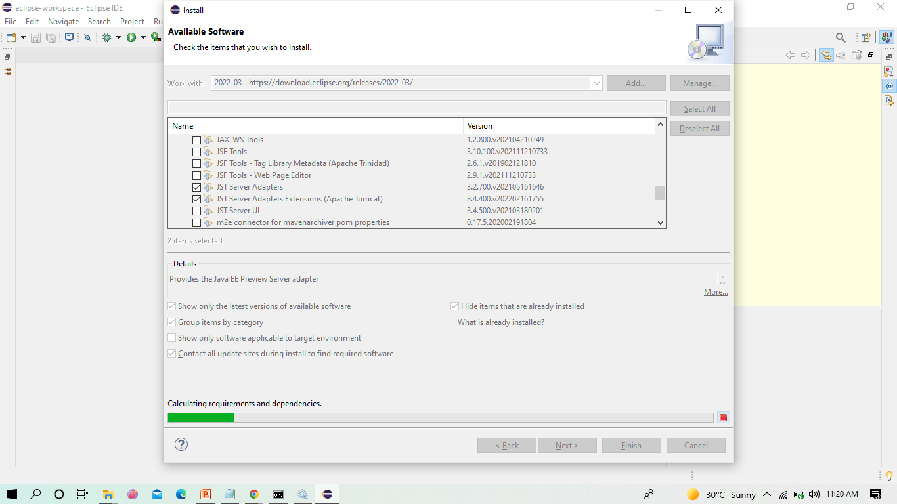
Install them

Slide 15
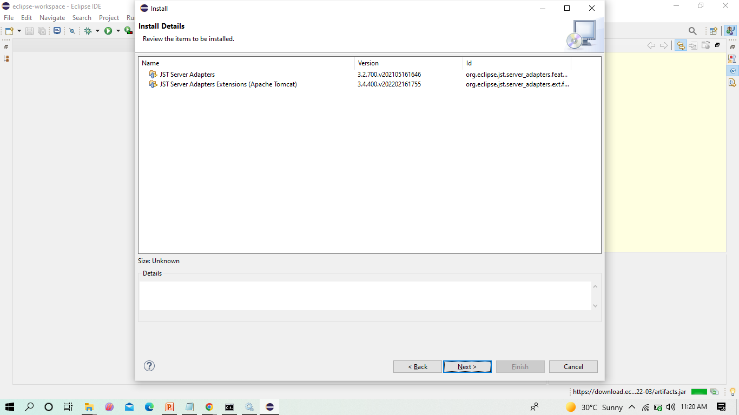
Click on -> Next

Slide 16
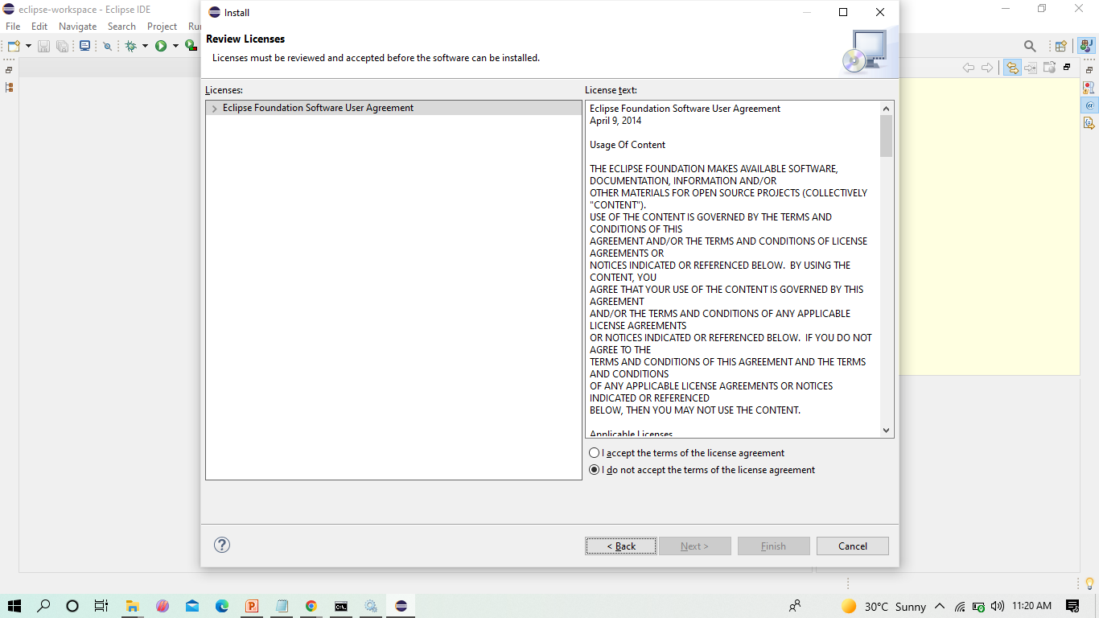
Select on -> I agree

Slide 17
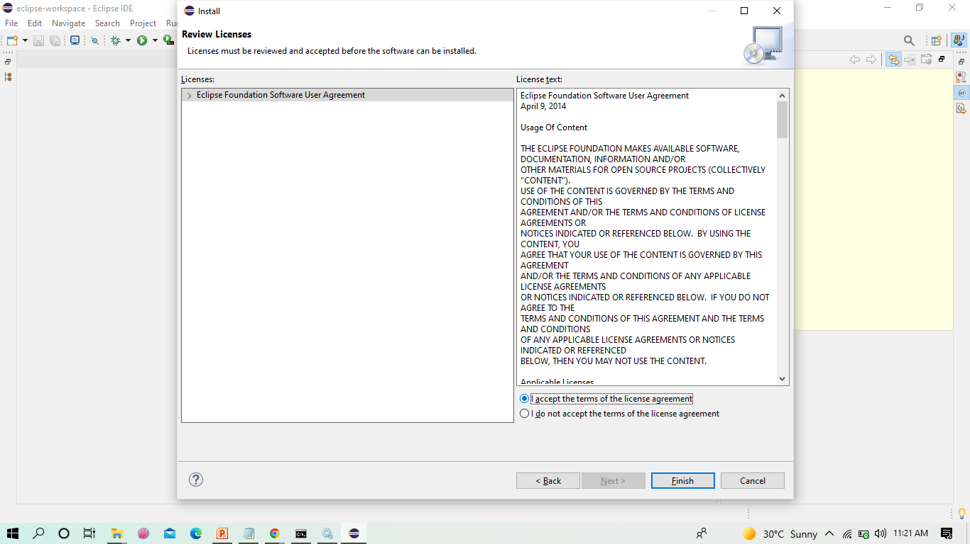
Select on -> I accept -> Finish

Slide 18
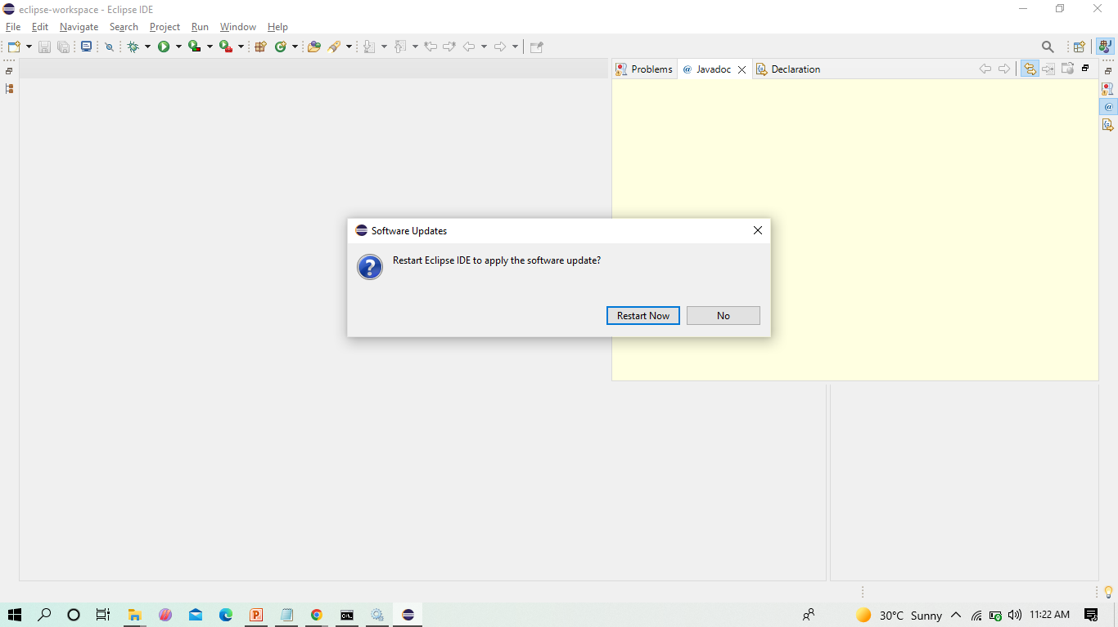
Restart the eclipse IDE

Slide 19
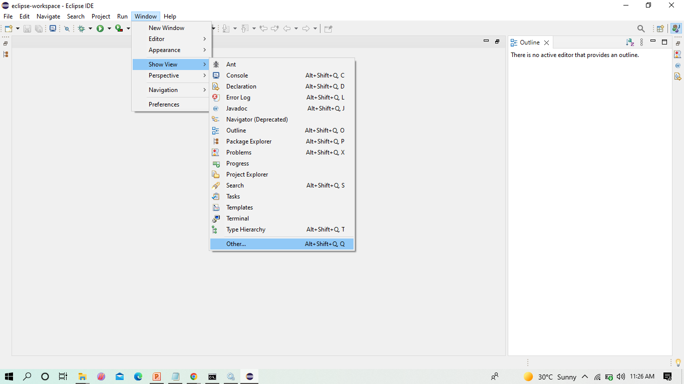
After the shown installation, check whether server is available in eclipse as shown

Slide 20
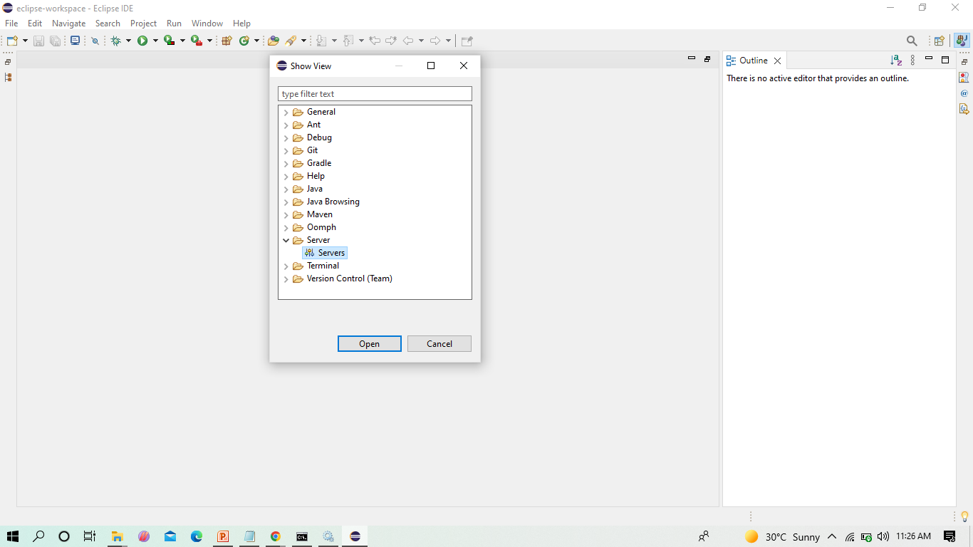
In Show View, we can now see Servers

Slide 21
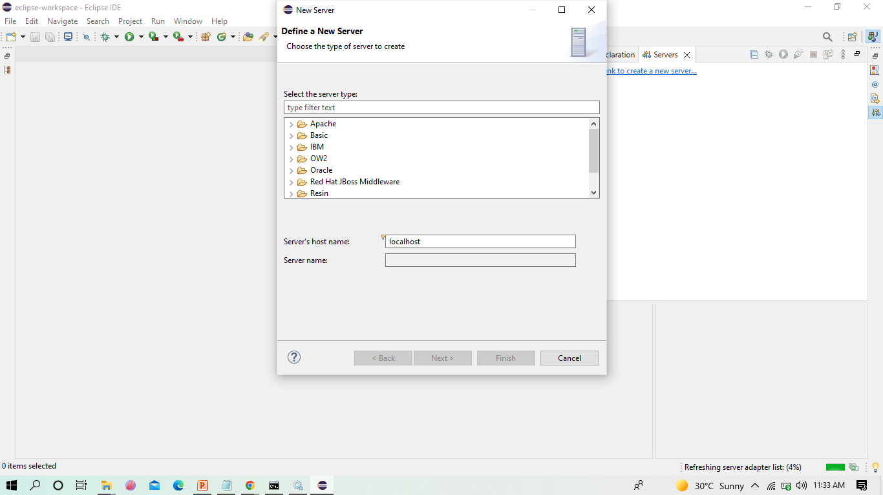
Click on Apache folder

Slide 22
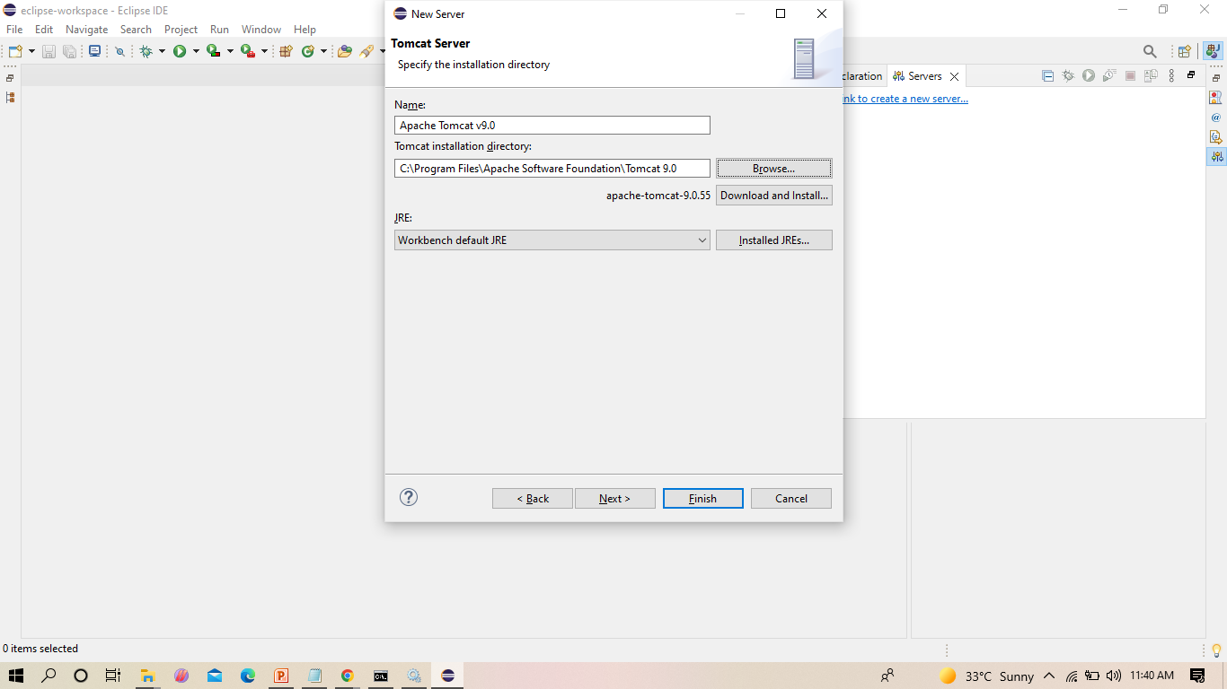
Browse the Tomcat folder available in your local system as shown

Slide 23
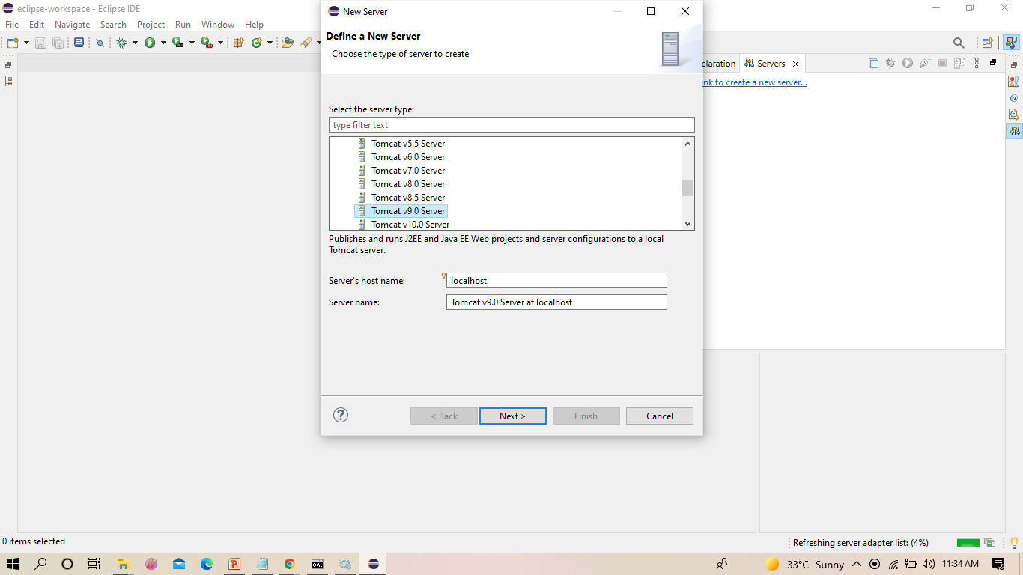
Select Tomcat V 9 as shown

Slide 24
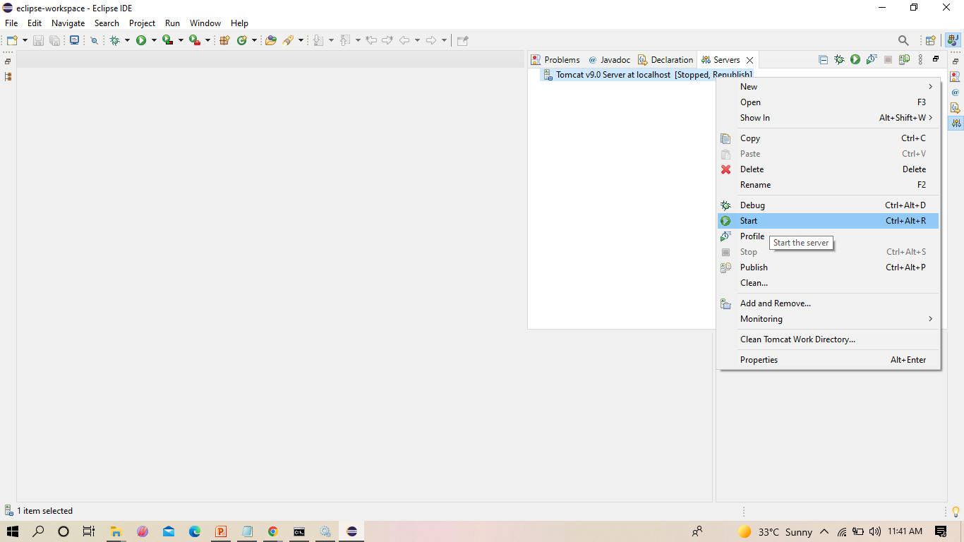
From now on we can start Tomcat server from Eclipse IDE as shown

Slide 25
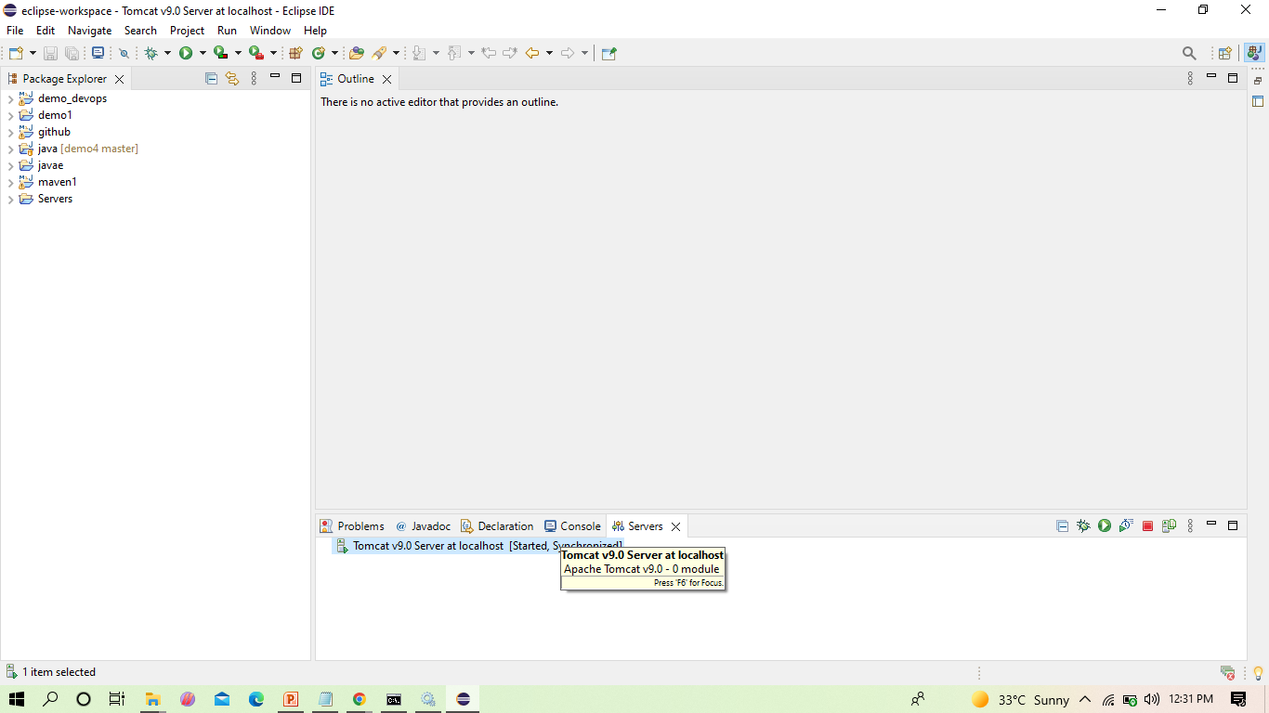
We can now see that the server is started
Double click on it

Slide 26
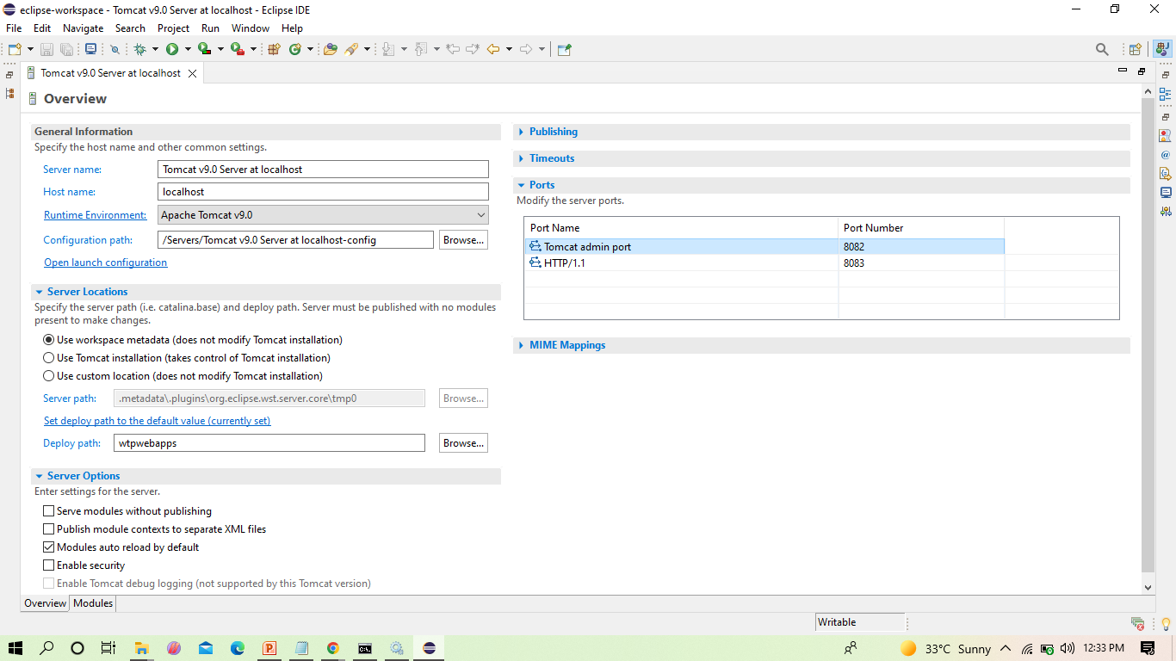
The next step is to change the port number of the Tomcat as Jenkins uses 8080, as shown

Slide 27
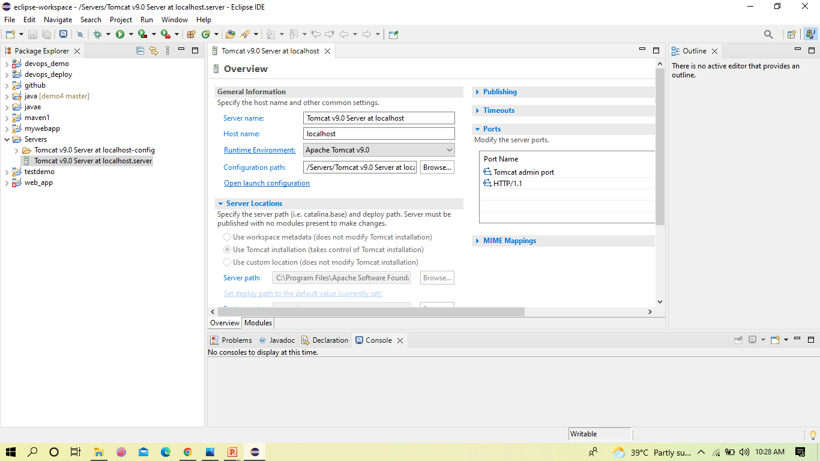
In server locations make sure second option is selected

Slide 28
Copy the following text in the location shown in the below slides
<role rolename="admin-gui,manager-gui ,manager-script,manager-jmx,manager-status"/>
<user username=“admin" password="1234"roles="manager-gui, admin-gui ,manager-script"/>

Slide 29
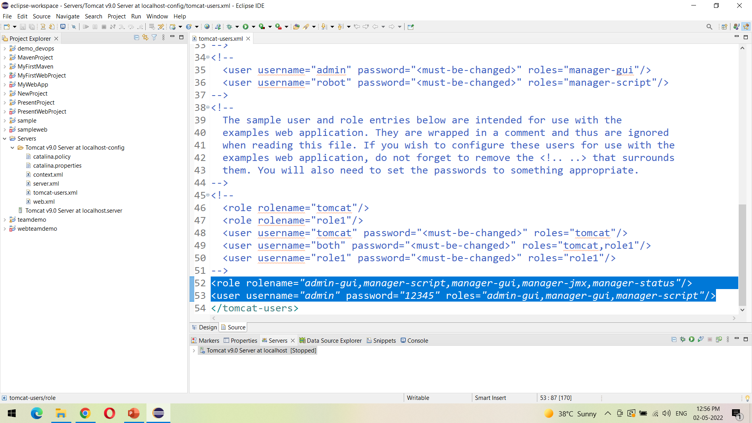
Open the tomcat-users.xml file as show, and add the highlighted text in the last

Slide 30
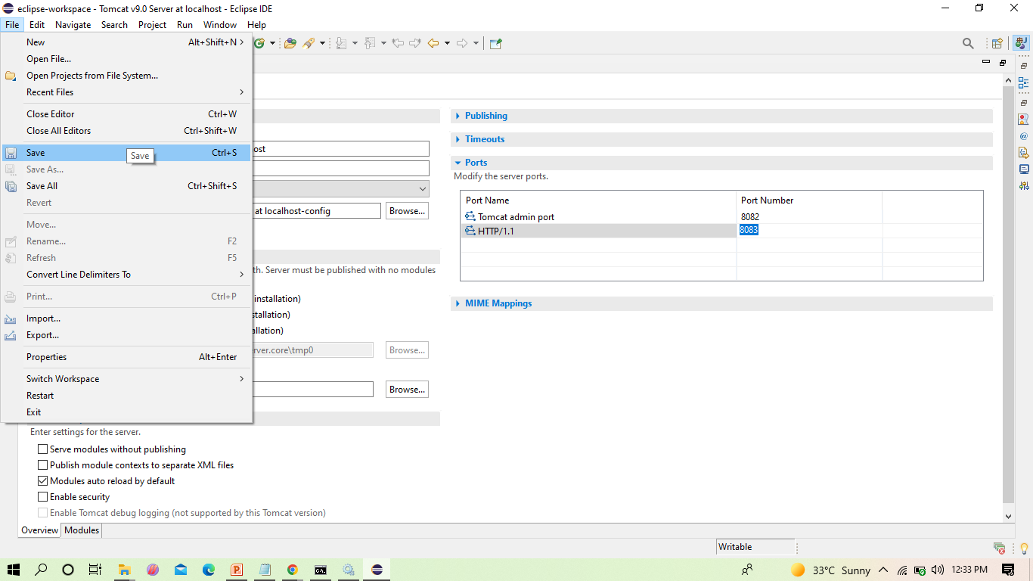
After the changes, click on save

Slide 31
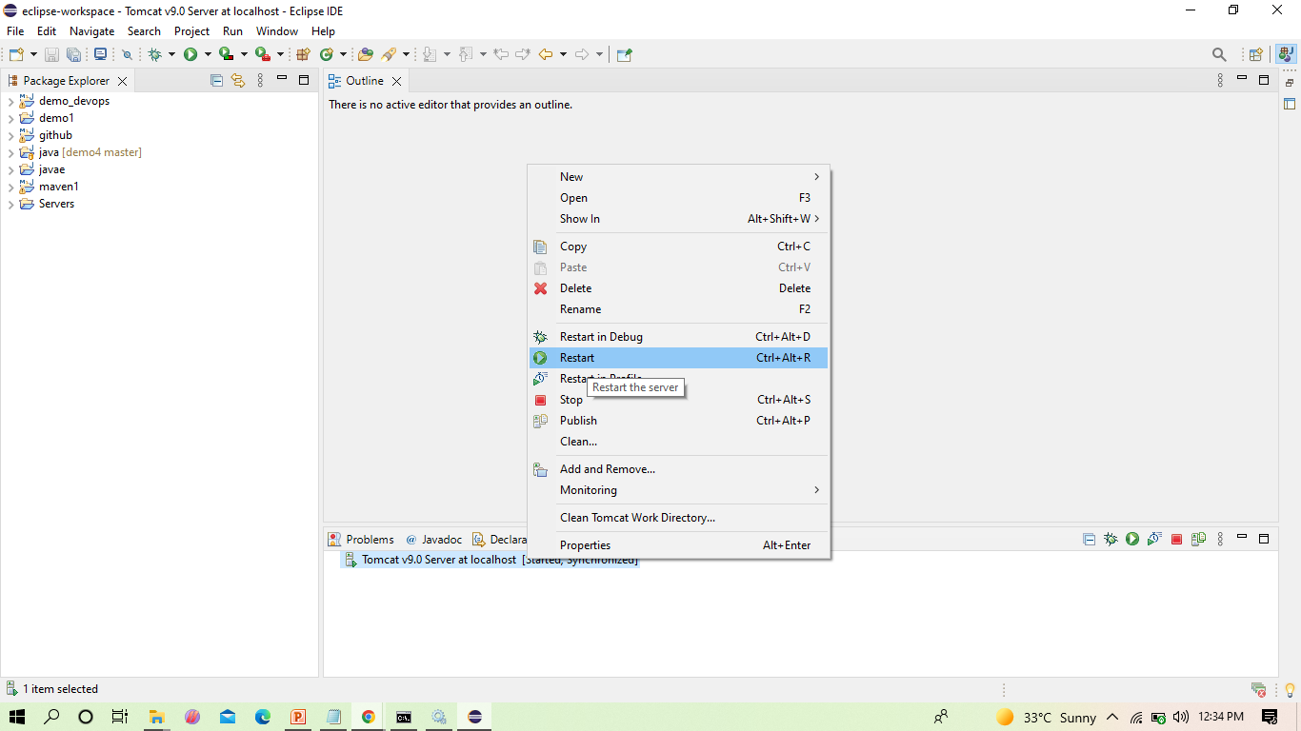
Now restart the server

Slide 32
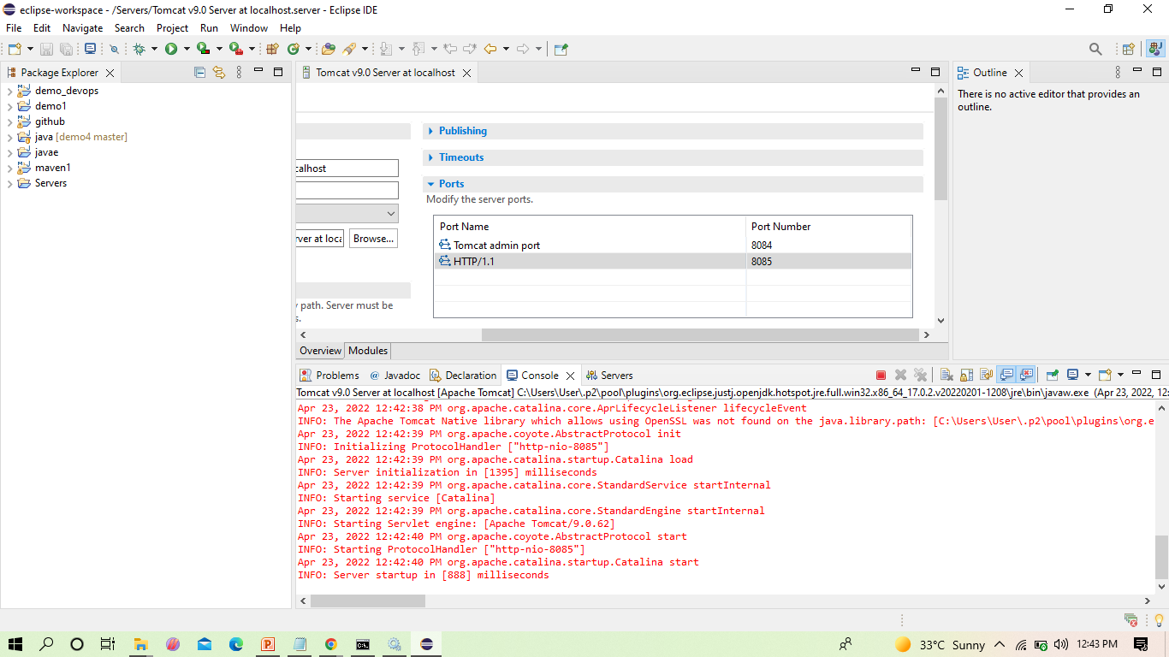
The server gets restarted as shown

Slide 33
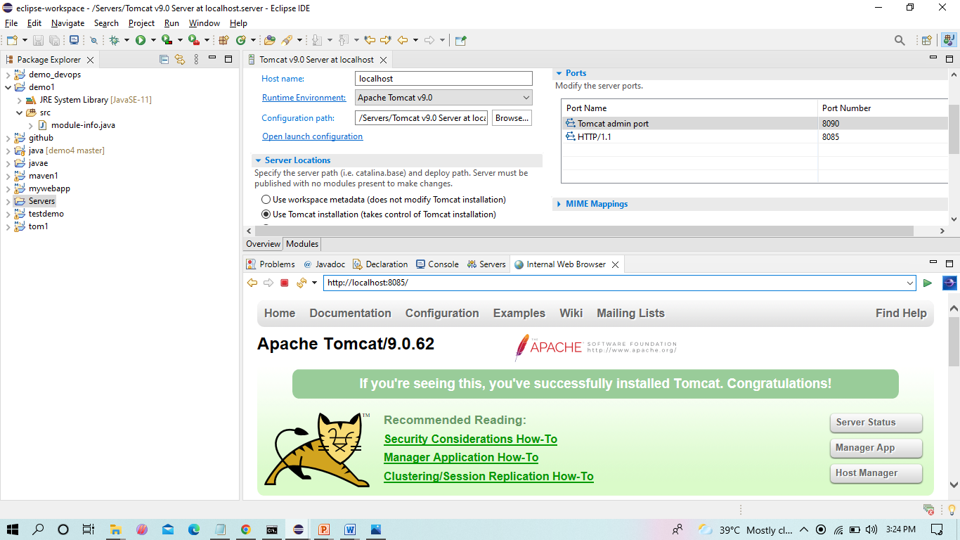
We can see the Tomcat is successfully running on the new port number

