Slide 1
BLUESTOCK FINTECH
Mutual Fund Analytics
Capstone Project Presentation
Haleema Janna | Remote Data Analytics Intern | August 2026

Slide 2
Problem & Objective
The Problem
The Objective
Bluestock Fintech needed a clear, data-driven view of the mutual fund industry — spanning 40 AMFI-registered schemes — to understand AUM trends, SIP growth, investor behavior, and fund performance, without a structured analytics pipeline or dashboard in place.
Build a reliable ETL pipeline from raw AMFI data to a clean, queryable database
Quantify fund performance using CAGR, Sharpe/Sortino, Alpha/Beta, and Drawdown
Design an interactive Power BI dashboard for AUM, SIP, and investor analytics
Deliver reusable, documented code and a professional final report
Bluestock Fintech — Mutual Fund Analytics Capstone
2

Slide 3
Data Sources
10 AMFI-format CSV files, ~87,000+ rows, Jan 2022 – May 2026
File | Description | Rows
01_fund_master.csv | Fund metadata — house, category, plan, expense ratio | 40
02_nav_history.csv | Daily NAV per scheme | ~46,000
03_aum_by_fund_house.csv | Quarterly AUM by fund house | 90
04_monthly_sip_inflows.csv | Industry-wide monthly SIP inflow trends | 48
07_scheme_performance.csv | Returns, risk ratios, expense ratio per scheme | 40
08_investor_transactions.csv | Individual investor transaction records | ~32,800
10_benchmark_indices.csv | Daily Nifty50 / Nifty100 index values | 8,050
Plus 3 more source files and live NAV data from the mfapi.in public API for 6 benchmark schemes.
Bluestock Fintech — Mutual Fund Analytics Capstone
3

Slide 4
Pipeline Architecture
1. Ingest
2. Clean
3. Build DB
4. Analyze
5. Visualize
Load 10 raw CSVs
Validate AMFI codes
40/40 matched
Forward-fill NAV gaps
Standardize text fields
Validate ranges
SQLite star schema
2 dim + 4 fact tables
bluestock_mf.db
10 SQL queries
EDA notebook
Performance metrics
Power BI dashboard
4 pages + drill-through
Slicers & tooltips
Orchestrated end-to-end by a single master script: Scripts/run_pipeline.py
Star Schema: dim_fund (40 rows) · dim_date (1,608 rows) → fact_nav (64,320) · fact_transactions (32,778) · fact_performance (40) · fact_aum (90)
Bluestock Fintech — Mutual Fund Analytics Capstone
4

Slide 5
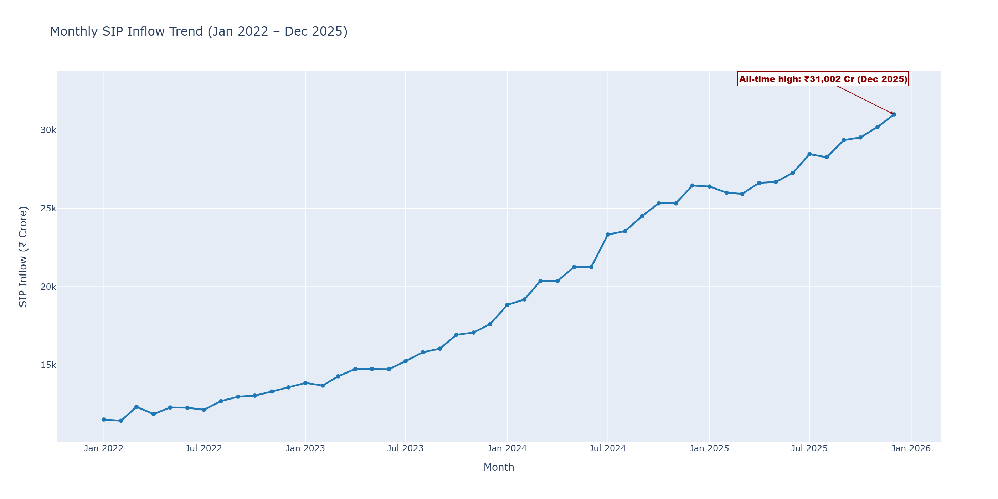
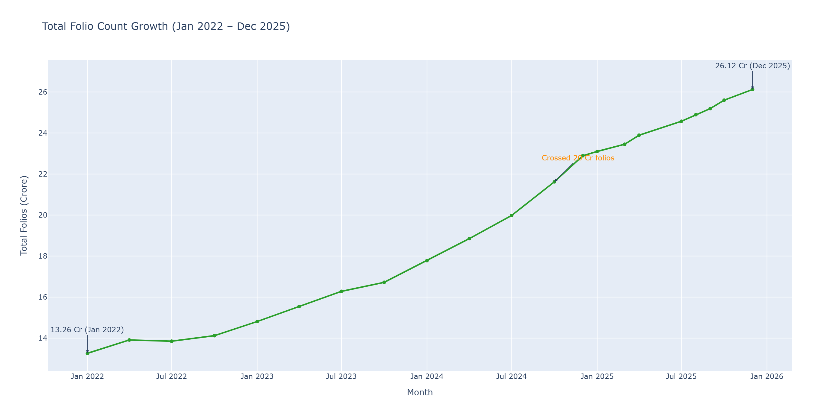
EDA Highlight: Retail Participation Growth
Monthly SIP inflows grew from ~₹11,500 Cr (Jan 2022) to an all-time high of ₹31,002 Cr (Dec 2025) — a 2.7x increase
Total investor folios nearly doubled, from 13.26 Cr to 26.12 Cr, crossing 20 Cr in late 2024
Both metrics show the same inflection point around 2023 — new folios and rising SIP contributions move together
Bluestock Fintech — Mutual Fund Analytics Capstone
5

Slide 6
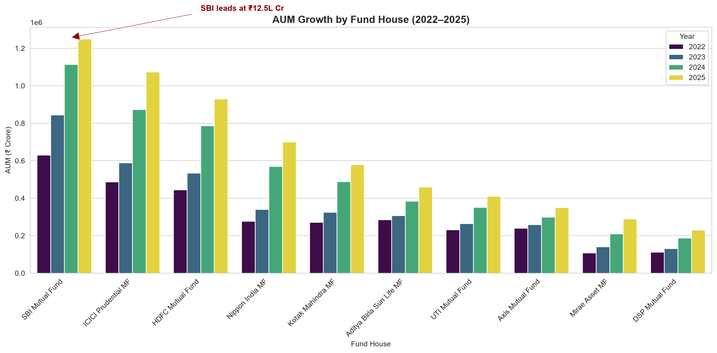
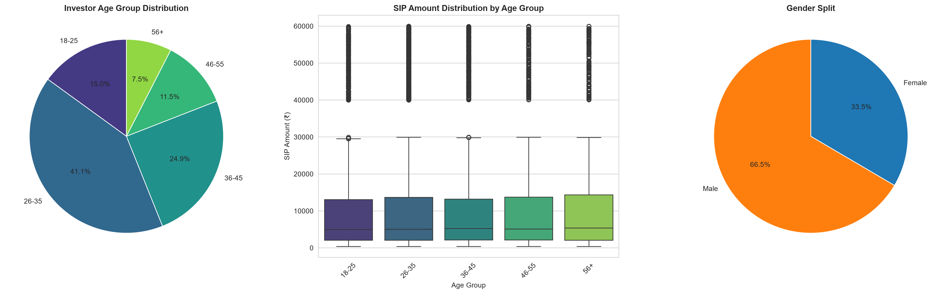
EDA Highlight: Industry Growth & Investor Profile
26–35 age group leads at 41.1% of investors. Gender split is 66.5% male vs. 33.5% female — a target area for financial inclusion outreach.
SBI Mutual Fund leads industry AUM at ₹12.5L Cr (2025), nearly double its 2022 level. Growth is broad-based across all top 10 fund houses, not concentrated in a single player.
Bluestock Fintech — Mutual Fund Analytics Capstone
6

Slide 7
Performance Metrics: Fund Scorecard
Scheme | Return | Sharpe | Alpha | Expense | Drawdown | Score
Mirae Asset Large Cap — Regular | 97.5 | 100.0 | 85.0 | 45.0 | 82.5 | 86.25
ICICI Pru Midcap — Regular | 90.0 | 92.5 | 95.0 | 65.0 | 40.0 | 82.88
Kotak Flexicap — Regular | 85.0 | 97.5 | 90.0 | 47.5 | 70.0 | 82.00
HDFC Mid-Cap Opportunities | 92.5 | 85.0 | 87.5 | 60.0 | 52.5 | 80.75
ICICI Pru Bluechip — Direct | 95.0 | 75.0 | 70.0 | 72.5 | 72.5 | 79.38
Mirae Asset Large Cap Fund tops the scorecard with a near-perfect Sharpe score (100/100) and strong return score (97.5/100), delivering consistent, risk-adjusted outperformance rather than just high raw returns.
Bluestock Fintech — Mutual Fund Analytics Capstone
7

Slide 8
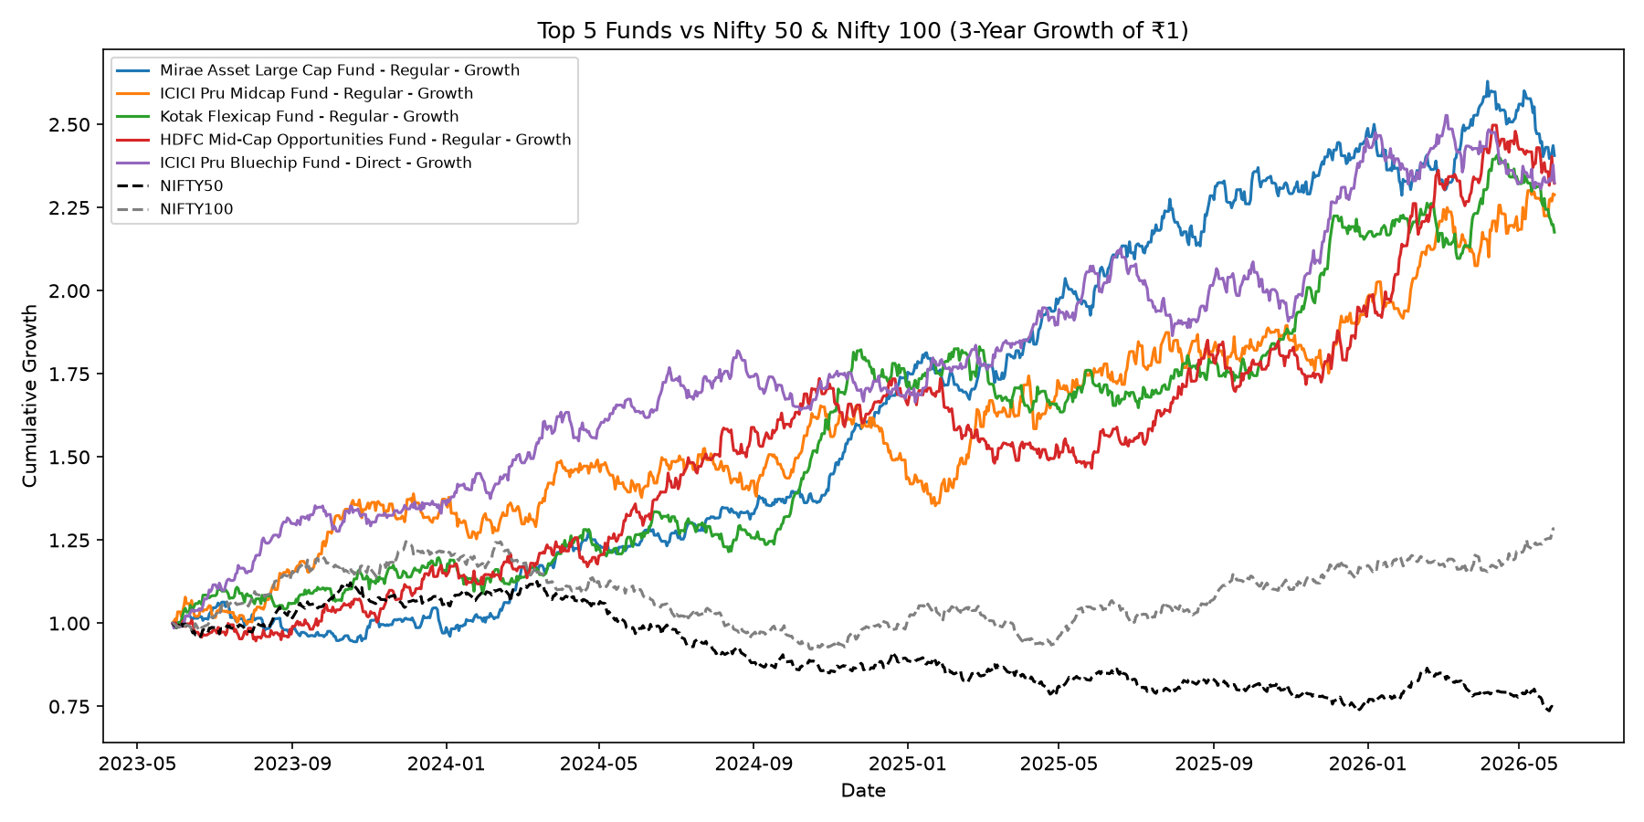
Performance Metrics: Beating the Benchmark
Bluestock Fintech — Mutual Fund Analytics Capstone
8

Slide 9
Performance Metrics: Advanced Risk Insights
Computed Historical VaR & CVaR (95%) across all 40 schemes to quantify single-day downside risk
Rolling 90-day Sharpe ratio shows risk-adjusted return fluctuates meaningfully over time — not a fixed number
97.8% of investors with 6+ SIPs flagged "at-risk" of discontinuation (gap > 35 days between contributions)
Sector concentration (HHI) analysis identifies which equity funds are diversified vs. concentrated

Slide 10
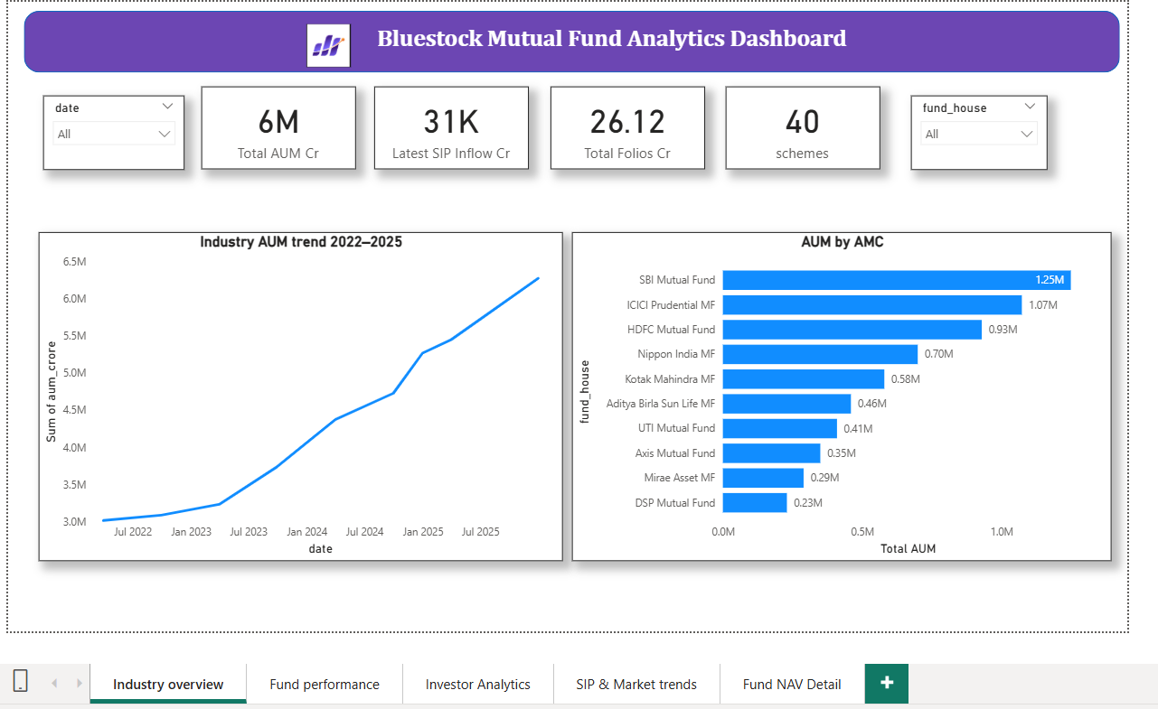
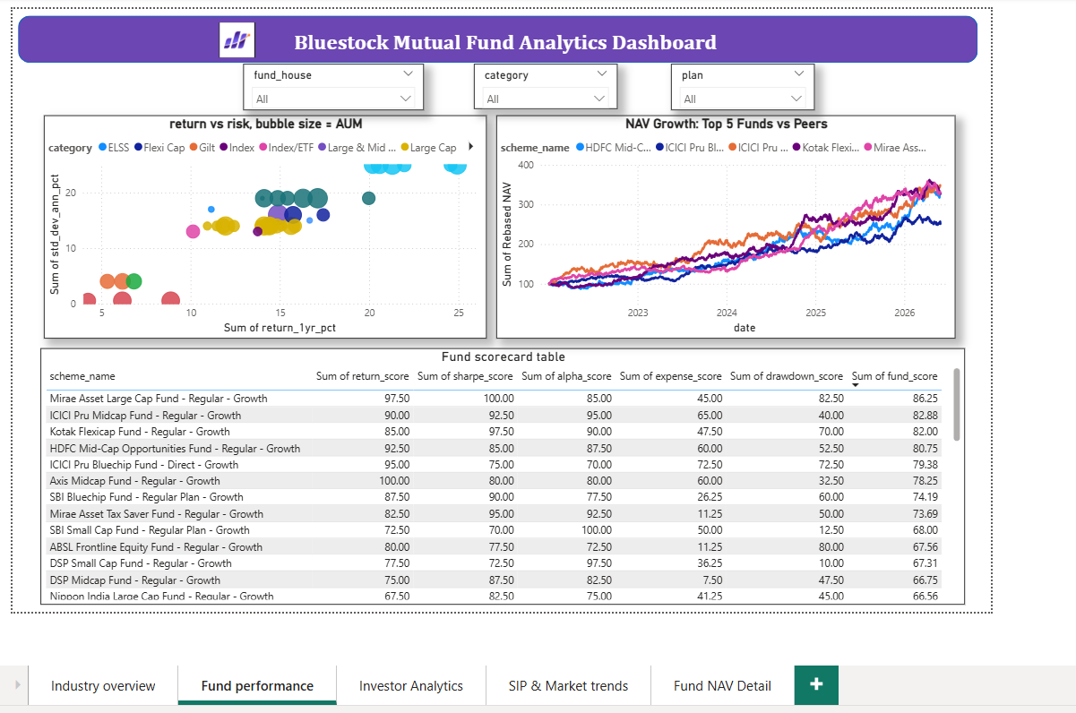
Dashboard: Industry Overview & Fund Performance
4-page interactive Power BI dashboard with KPI cards, AUM trends, a return-vs-risk scatter plot, and a sortable fund scorecard — plus drill-through to per-fund NAV detail.
Bluestock Fintech — Mutual Fund Analytics Capstone
9

Slide 11
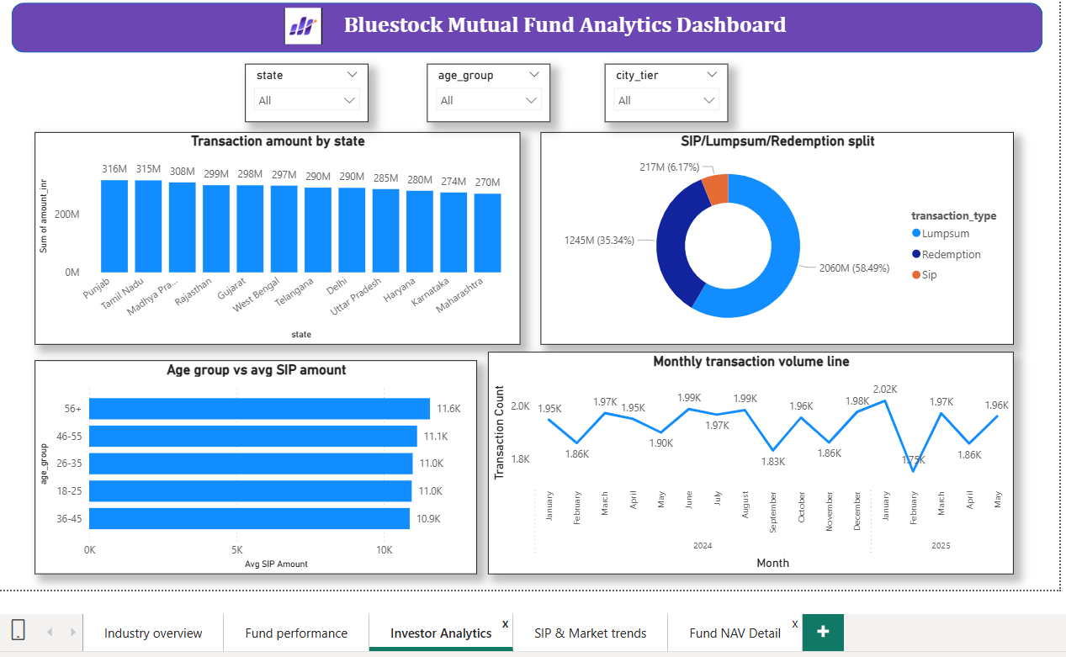
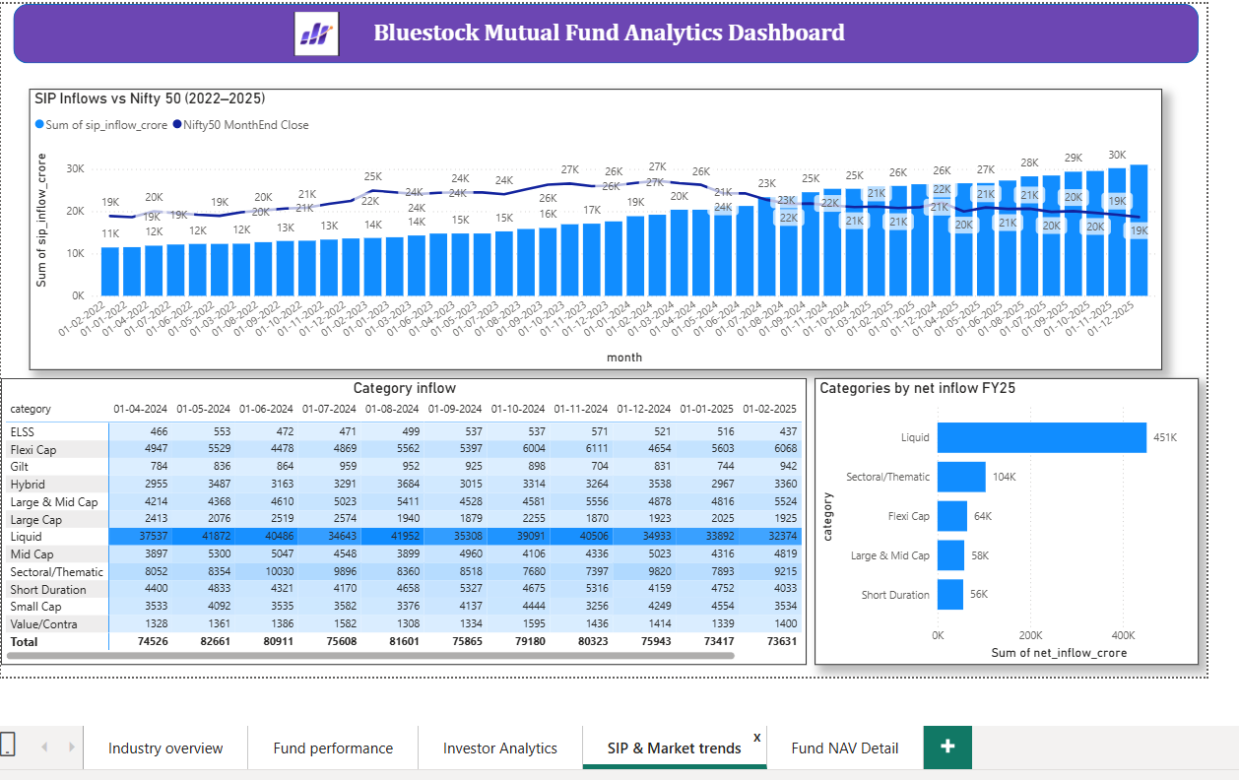
Dashboard: Investor Analytics & SIP Trends
Investor behavior by state, age, and transaction type — plus SIP inflow vs. Nifty50 trends and a category inflow heatmap, all filterable via slicers.
Bluestock Fintech — Mutual Fund Analytics Capstone
10

Slide 12
Key Findings
1
SBI Mutual Fund leads AUM
2
SIP inflows hit an all-time high
₹12.5L Cr, nearly double its 2022 level
₹31,002 Cr in Dec 2025, up 2.7x since 2022
3
Mirae Asset Large Cap tops the scorecard
4
Liquid funds win on risk-adjusted return
Fund Score 86.25/100 — best Sharpe + return combo
Sharpe ratios 5.1–7.7 vs. Small Cap's raw 20–23% returns
5
Folios doubled to 26.12 Cr
6
Gender gap in SIP participation
Crossed the 20 Cr milestone in late 2024
66.5% male vs. 33.5% female investors
Bluestock Fintech — Mutual Fund Analytics Capstone
11

Slide 13
Thank You
Questions & Discussion
Haleema Janna
github.com/haleemajanna/capstone-mutual-fund-analytics

