Slide 1

Sharing the Code we Make
aka OSS, Git, MIT & GPL2
Rod Walsh, November 2015

Slide 2
Some Important Goals
A quick working proto in 2 days
Maximise the chance of further development after 2 days by any of the HALE team
Maximise the impact of the 2 days by allowing others to build on our achievements
Minimise uncertainty in code sharing and access
So we need to think license & dissemination from the very start

Slide 3
Licensing is kind of easy
Proprietary/closed work is poor for HALE teams and useless for others
So some form of open source software OSS is appropriate
It wasn’t always as simple as this…
http://choosealicense.com/
A dual license MIT & GPL2 will maximise the developer base willing to use the code.

Slide 4
Dissemination: What we need
Internet-based
Ready to use right now
Multiple contributors at the same time
Persisting into the future
Backup with access to earlier versions
Code divergence
To experiment
To make variants based on the same platform
i.e. We need Software Version Control (aka SVC, SCM, Source Code Management)

Slide 5
Version Control – Beyond Dropbox
User 1 does update
Code base
Updated code base
pull
push
User 2 does update
Handle synchronisation
Manage conflicts

Slide 6
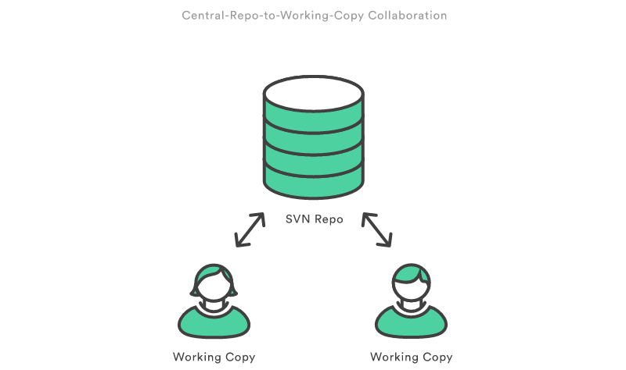
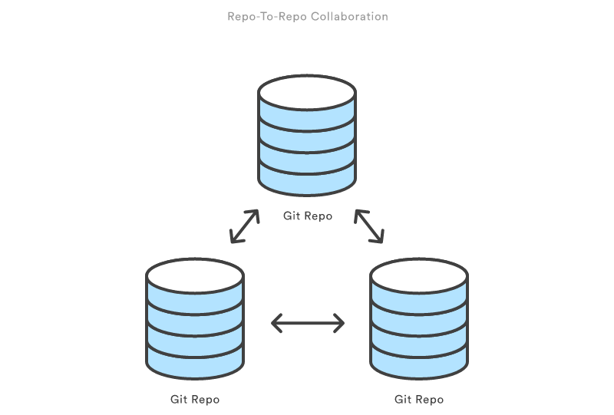
Git: The popular choice
Images from the excellent tutorials at:
https://www.atlassian.com/git/tutorials/

Slide 7
Git: Core Use During Hackathon
User 1 work
Code base
Updated code base
clone
pull
branch
push
merge
User 2 work
Same remote repository

Slide 8
Git Operations
git clone: clones a complete repository to a local machine (with full history and versions)
git branch: create a branch which could later be merged into the master branch (trunk in svn terminology)
git merge: merges a branch into the master
git push: pushes all your changes to the remote repository
git pull: pulls all the changes in a remote repository
(also init, checkout, add, commit, …)

Slide 9
Git Installation on PC
Command line tools…
Linux, e.g., sudo apt-get install git
Windows, download from https://git-scm.com/
Graphical Apps for Windows and Mac…
GitHub Desktop: https://desktop.github.com/
Source Tree: https://www.sourcetreeapp.com/
Help: https://help.github.com/categories/bootcamp/
Practice command line: https://try.github.io/
Reference: http://gitref.org/

Slide 10
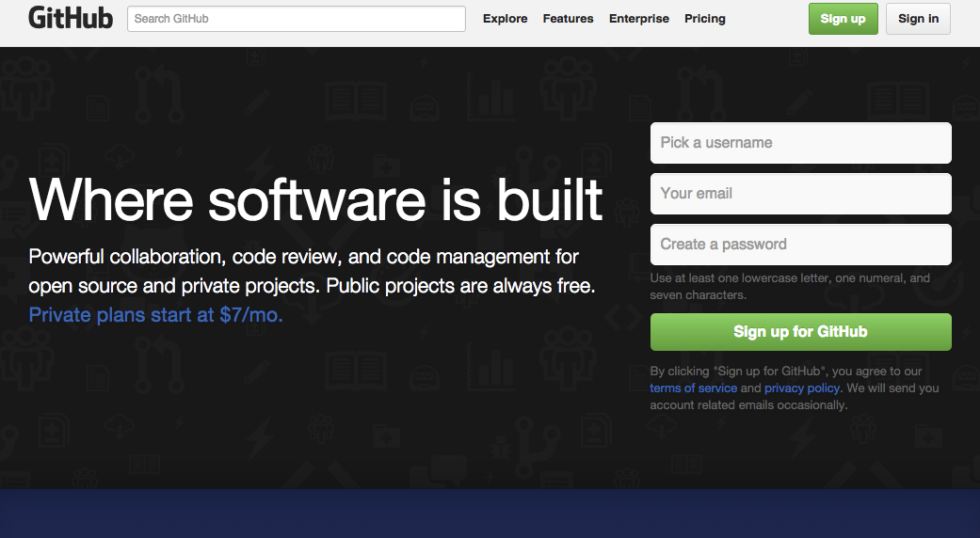
Github Accounts
1. Head to github.com
2. Sign up for an account

Slide 11
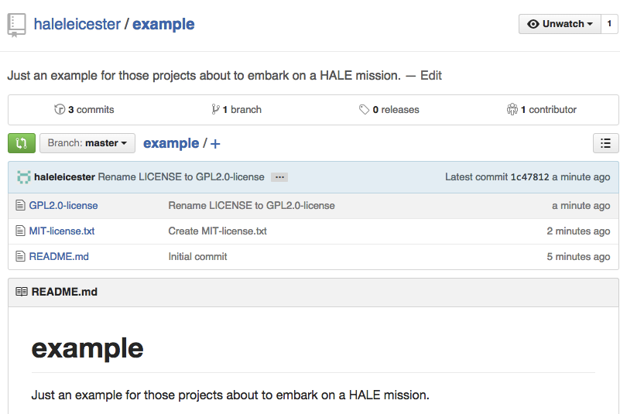
Github Projects
3. Decide on a repository name for your project
4. Create a list of contributors
We’ll create a repository under haleleicester & add contributors
https://github.com/haleleicester/example

Slide 12
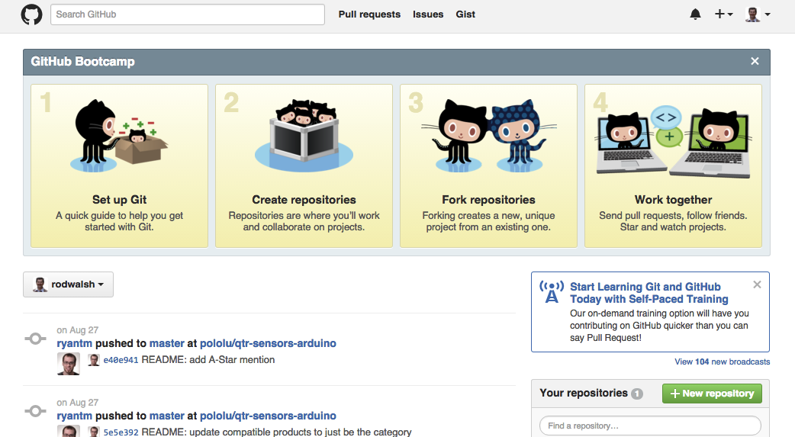
Github Repositories
Find repositories
Browse or add your own repositories

Slide 13
Summary
Share code efficiently during the hackathon
Make code available beyond the hackathon
Use git and github
Dual license MIT & GPL2
Have a look at:
https://github.com/haleleicester/example

