Slide 1



Analysis of Airline Media Claims
View in Power BI
Last data refresh:
4/29/2023 4:59:12 PM UTC
Downloaded at:
4/29/2023 10:27:15 PM UTC

Slide 2
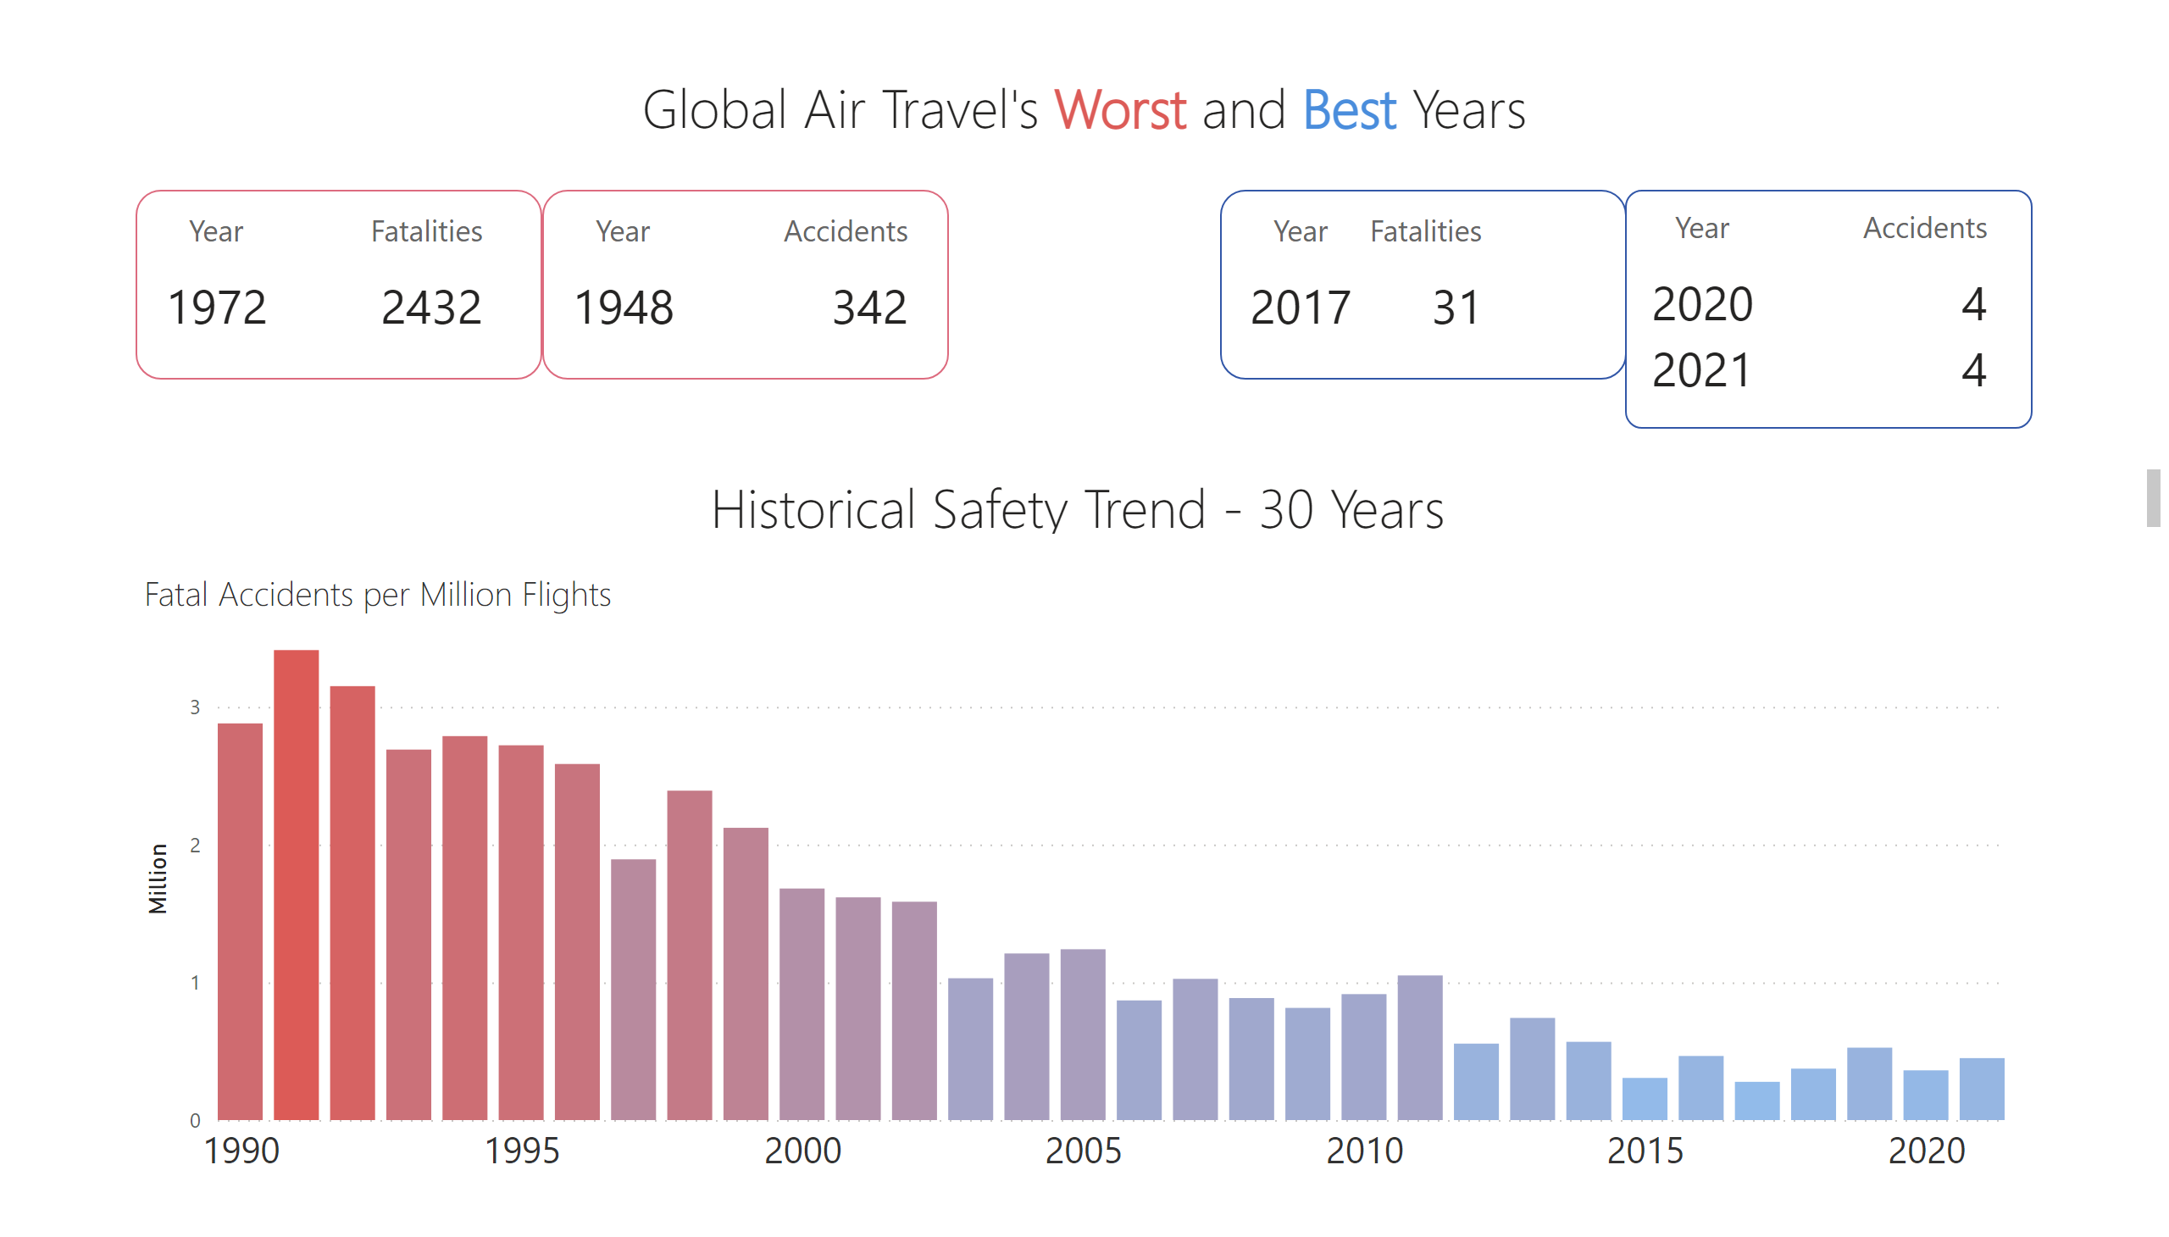
Global Overview
Notes:
Air Travel's Best Years
No alt text provided
Air Travel's Best Years
No alt text provided
textbox
No alt text provided
textbox
No alt text provided
Fatal Accidents per Million Flights
No alt text provided
Air Travel's Best Years
No alt text provided
Air Travel's Best Years
No alt text provided

Slide 3
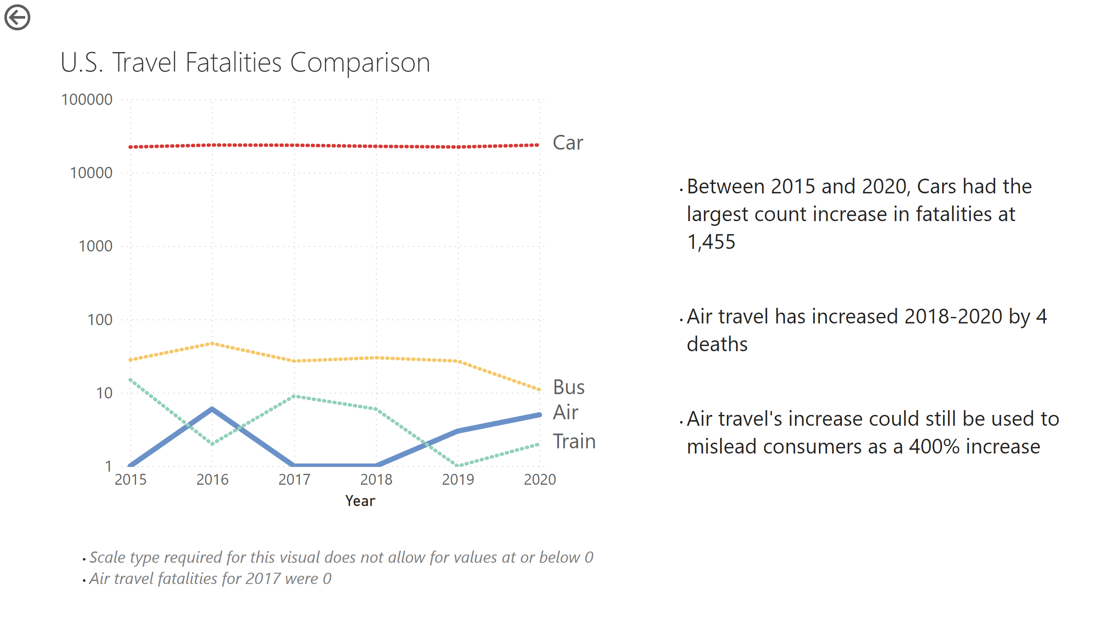
By Mode
Notes:
U.S. Travel Fatalities Comparison
No alt text provided
actionButton
No alt text provided
textbox
No alt text provided
textbox
No alt text provided

Slide 4
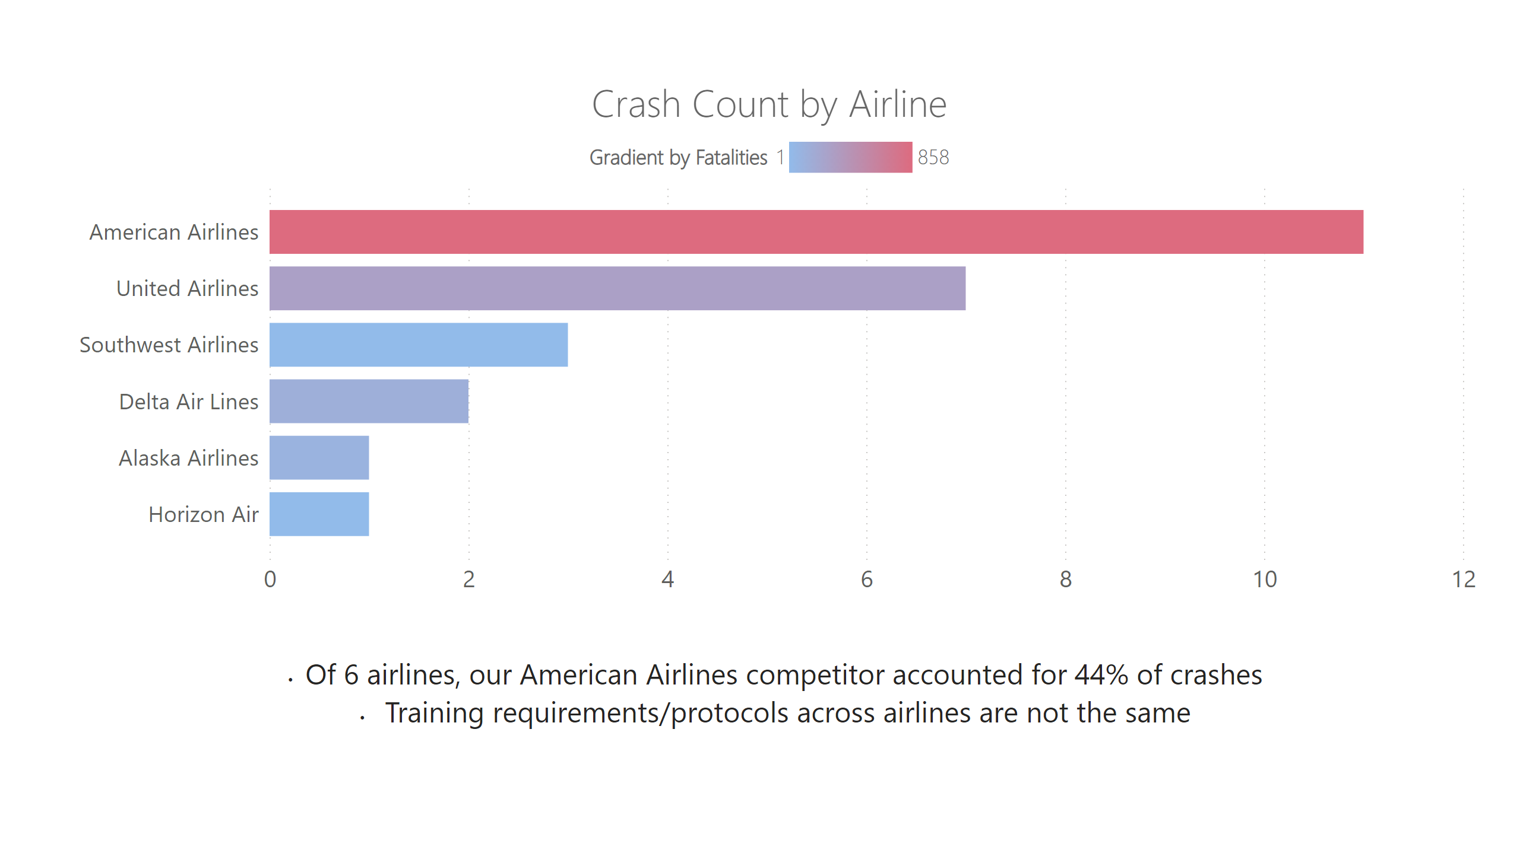
By Airline
Notes:
Crash Count by Airline
No alt text provided
textbox
No alt text provided

Slide 5
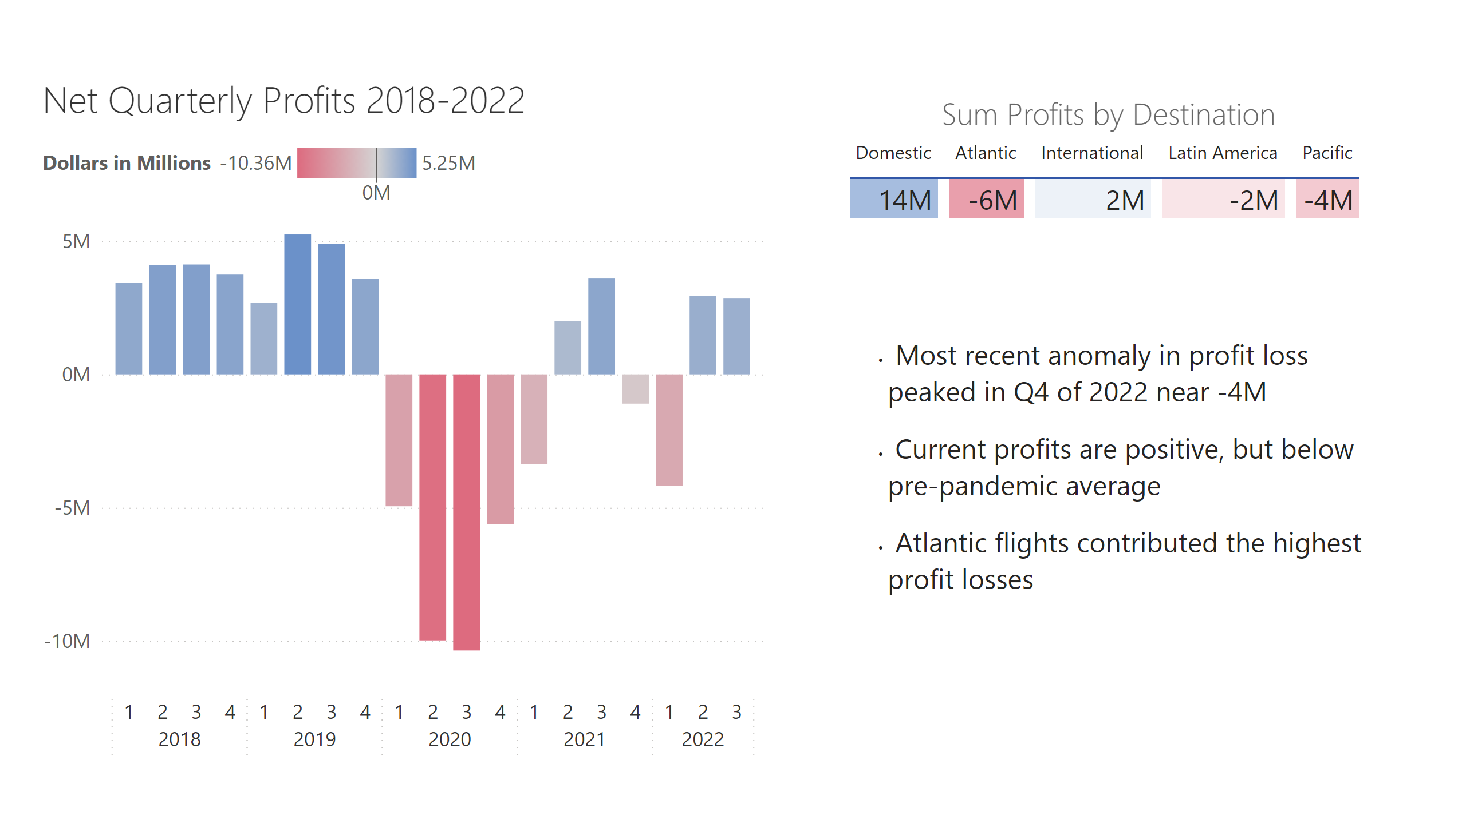
Profits
Notes:
Net Quarterly Profits 2018-2022
No alt text provided
textbox
No alt text provided
Sum Profits by Destination
No alt text provided

Slide 6
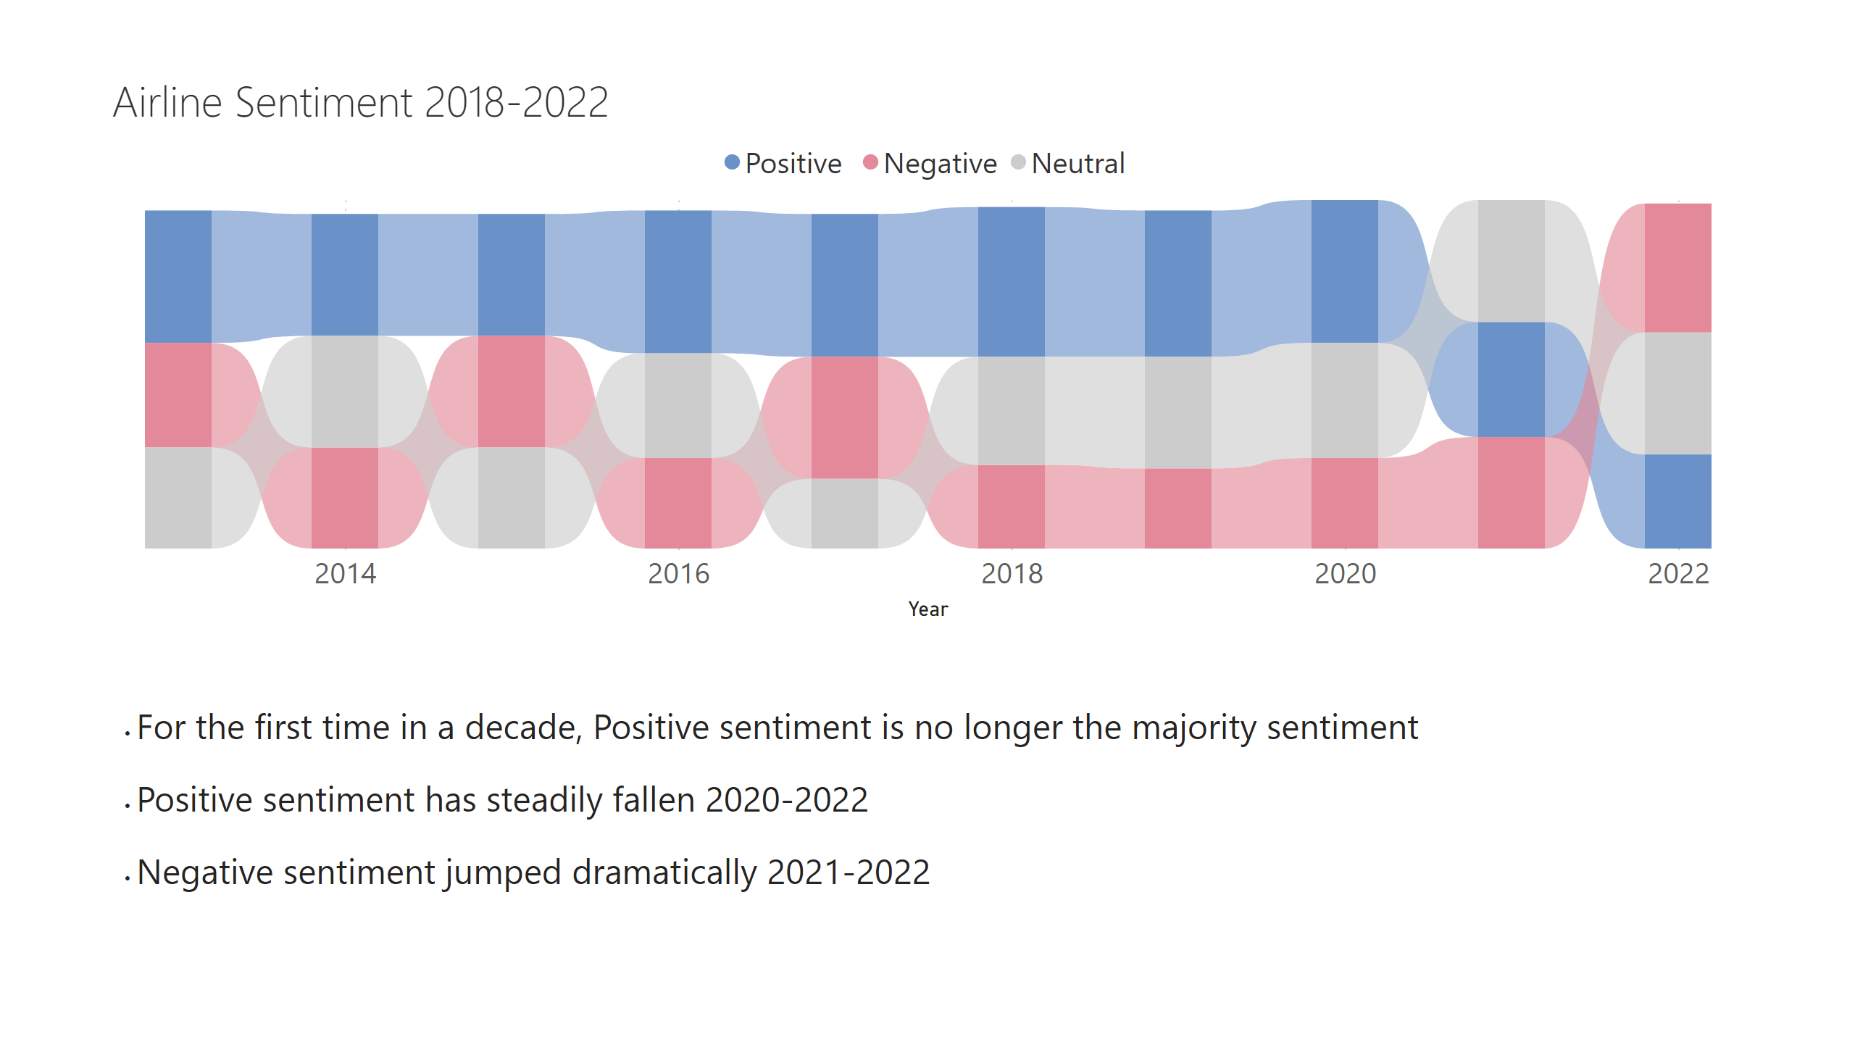
Sentiment
Notes:
Airline Sentiment 2018-2022
No alt text provided
textbox
No alt text provided

Slide 7
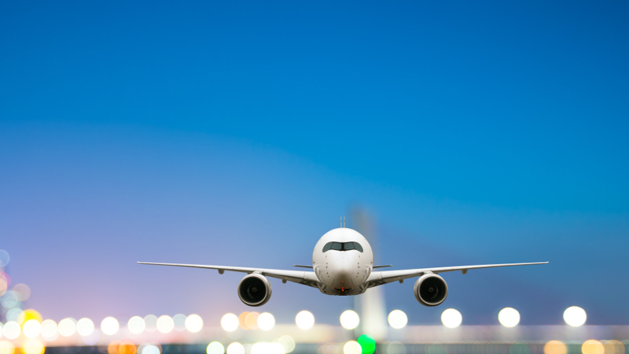
The Risk of Media Claims
Air Travel has never been safer
Profits have not fully recovered to pre-pandemic strength
Airline sentiment is at a 10yr low

Slide 8
Supplemental Data Sources
National Safety Council
https://injuryfacts.nsc.org/home-and-community/safety-topics/deaths-by-transportation-mode/
File Name/Sheet: Deaths by Mode/Transportation Mode Comparison Table
Dashboard Table Title: US Travel Fatalities
Bureau of Transportation Statistics
https://www.transtats.bts.gov/Data_Elements_Financial.aspx?Qn6n=K
File Name/Sheet: yearly_crash_data, Net Income
Dashboard Table Title: Net Quarterly Profits 2018-2022
Gallup
https://news.gallup.com/poll/1579/airlines.aspx
File Name/Sheet: yearly_crash_data, Airline Sentiment PC
Dashboard Table Title: Airline Sentiment

Slide 9
Essay
Since the finding of my first analysis suggested the claims were unfounded, I chose to limit visualizations to data finding that illustrated facts of safety, strategy, and risk. Most of my visualizations were best suited to bar charts, but I open the presentation with some cards to clarify the safest time to travel by air is now compared to nearly all other times. A line chart was again chosen to compare modes of transportation. A ribbon chart was used to create a striking and clear visual showing how sentiment has changed, and when. My presentation plan is to share how the data does not support a significant decrease in safety. By sharing illustrations on modes of transportation and rates across airlines, I will offer the executive team optional message strategies to defend the brand and industry. I will also make a case as to why, despite the facts, the negative campaign has arrived at a vulnerable time regarding profits and airline sentiment.
All but one of my visualizations relied on an opposing color scheme, often in gradient form red to blue. This seemed an intuitively good fit to illustrate both the intensity of rate comparisons, opposing sentiment, and profit losses/gains, always with blue representing the more desirable values (i.e., low fatalities, positive sentiment, etc.) Ethically, including airline comparisons of crashes/fatalities was a concern because the differences between airline crashes are in the single digits. However, when the visual was altered to include comparison of fatalities, it put the minor crash count differences in a new light. I felt it would be an error to not offer a clear strategic option to set the brand apart from a competitor. I chose to include key findings for many visuals, and to end with 3 main considerations.

