Slide 1
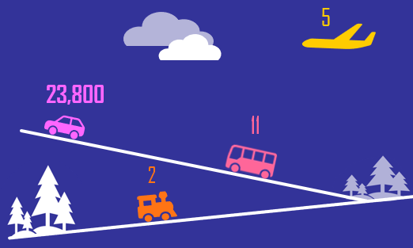
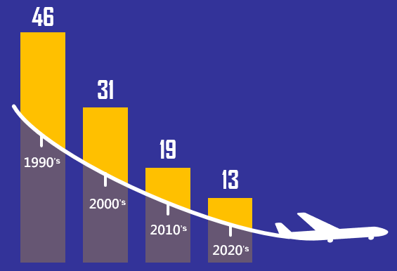


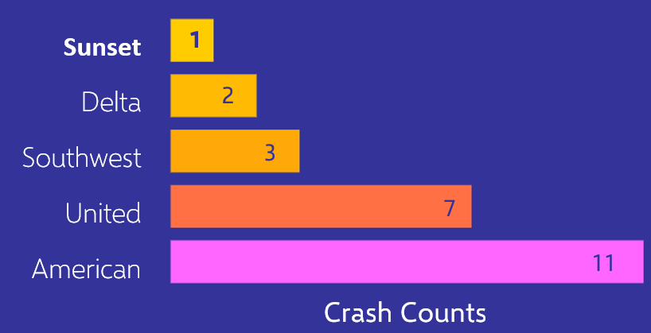



AIR-SCARE SURVIVAL GUIDE
2023
When comparing yearly fatalities, it’s easy to see why people choose to fly
The global average for accidents gets lower every year which means
“Now” is always the safest time to fly!
STEP 1
Get the Facts
What’s the Scare?
Commercial flights outnumber private flights 10 to 1 in the sky but they now account for nearly half the accidents
STEP 2
Fly Commercial
45%
of Accidents
* Excluding Military
A commercial ticket with Sunset Air is not only safer, but our consumer ratings put us ahead of the rest
STEP 3
Fly SUNSET AIR
Sources
http://aviation-safety.net * https://www.airlinequality.com/review-pages/a-z-airline-reviews/airline-review-ratings/ * https://injuryfacts.nsc.org/home-and-community/safety-topics/deaths-by-transportation-mode/

Slide 2
Sources
Accidents & Fatalities Data
http://aviation-safety.net
Deaths by Mode of Transportation
https://injuryfacts.nsc.org/home-and-community/safety-topics/deaths-by-transportation-mode/
Airline Rating Data
https://www.airlinequality.com/review-pages/a-z-airline-reviews/airline-review-ratings/
Essay
As a follow-up to my blog post, the over-arching theme of my infographic is somewhat, tongue-in-cheek with its title “Air-Scare Survival Guide”. I broke down my major points into ‘survival steps’ which put together clarify why flying is safe, what caused the scare, and why my airline is the safest choice. Each point was backed up with 2 visual elements with some written detail as needed to complete the story.
For this project task I wanted to grab attention by using more graphic or playful illustrations of data. Unlike internal teams, I wanted to rely as little as possible on groups of numbers and axes and other traditional chart qualities. Instead, I really tried to use size, color, and design to draw attention to each visualization’s most defining element. I chose to keep colors within my brand color scheme for “sunset”. I themed yellow to represent air-travel itself and the airline. Pink was used as the cautionary or opposing color. Colorful Icons with value labels were used to create a mock-travel-scene to compare fatality rates across modes. I though it was important to avoid the line chart because it contained more data than needed to make my point and it used a log scale axis, which is not ideal to me for this audience. I simplified my historical data by using decades instead of years and averages instead of individual values to quickly show the safety improvement trend. I chose icons illustrating the ratio of flight types to boost the context and impact of my pie chart which I kept as simple as possible. Bars again worked well compare crash counts across airlines.
The largest ethical concern I had was my choice of words around commercial vs non-commercial. Non-commercial is not actually a distinction in aviation and it includes more than just private jets. I chose to rely on the phrase “private flights” because it could give my audience a recognizable concept. I think this distinction would be much easier to discuss and clarify quickly in an audio format, and I intend to keep that in mind for our next project task.

