Slide 1



Internal_Dashboard_FigueroaHolly
View in Power BI
Last data refresh:
4/10/2023 6:12:47 AM UTC
Downloaded at:
4/10/2023 6:27:04 AM UTC

Slide 2
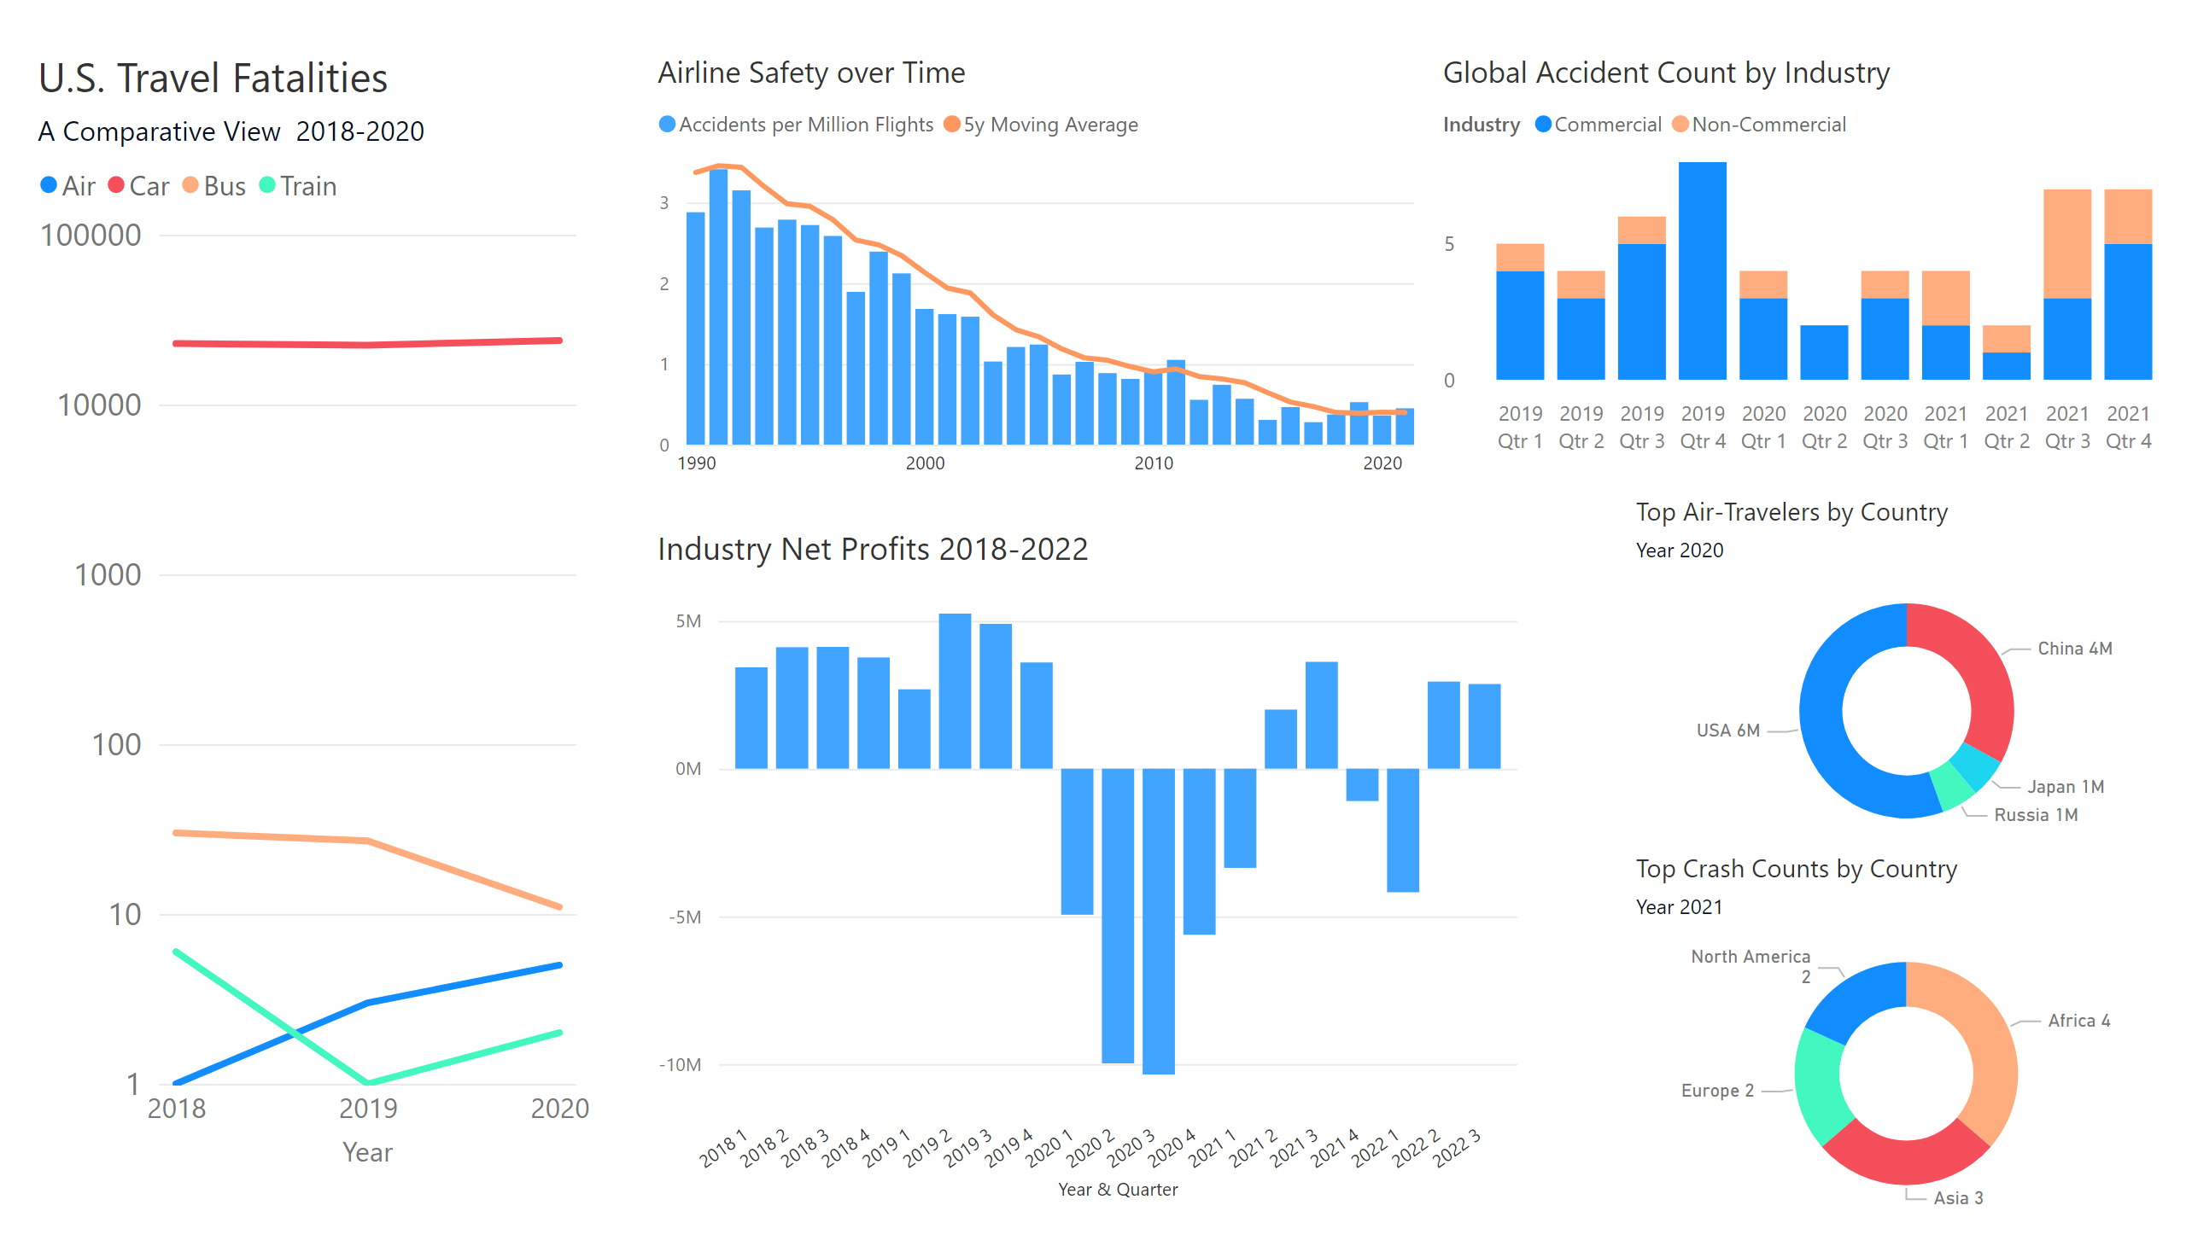
Page 1
Notes:
Airline Safety over Time
No alt text provided
Top Crash Counts by Country
No alt text provided
Top Air-Travelers by Country
No alt text provided
Industry Net Profits 2018-2022
No alt text provided
Global Accident Count by Industry
No alt text provided
U.S. Travel Fatalities
No alt text provided

