Slide 1



Week 5-6 Charts Holly Figueroa
Data Source https://www.kaggle.com/datasets/jehanzaibbhatti/sales-data
18 columns, 1000k+ rows, multi-data types, Sales Data
Github https://github.com/halepino/Data_Visualization.git
View in Power BI
Last data refresh:
4/9/2023 4:51:31 AM UTC
Downloaded at:
4/9/2023 4:52:19 AM UTC

Slide 2
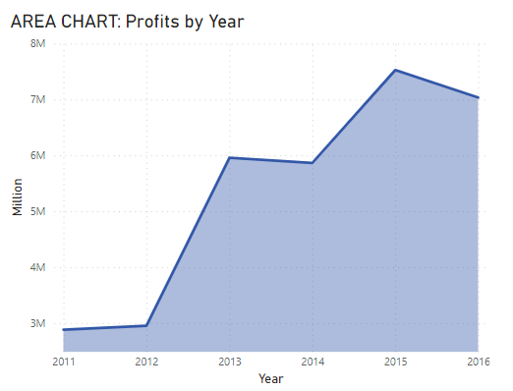
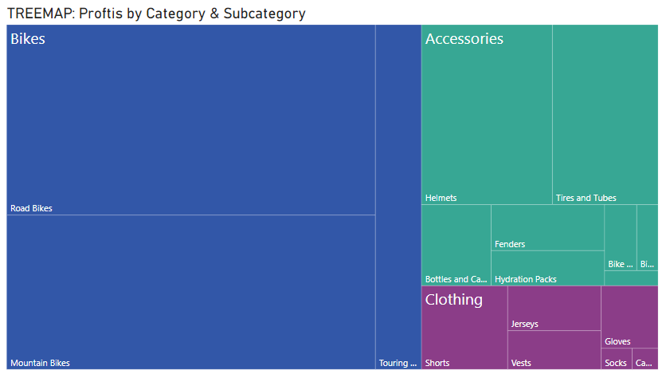
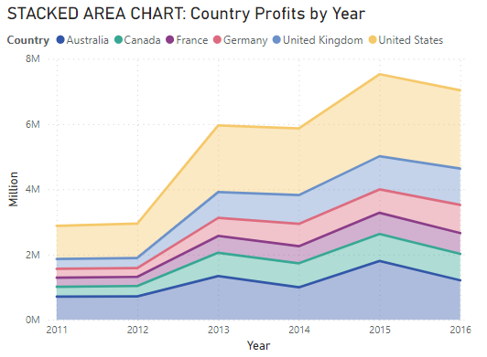
Page 1
Power BI
Notes:
LINE CHART: Revenue by Year
No alt text provided
STEP CHART: Revenue by Year
No alt text provided

Slide 3
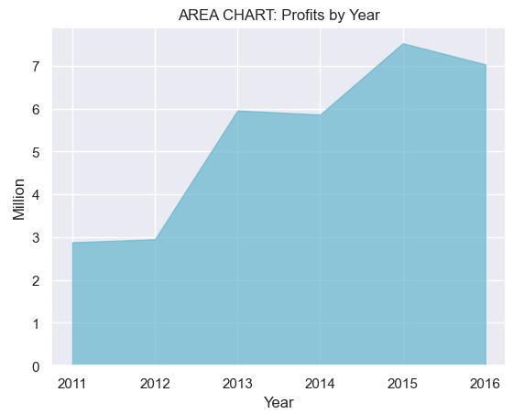
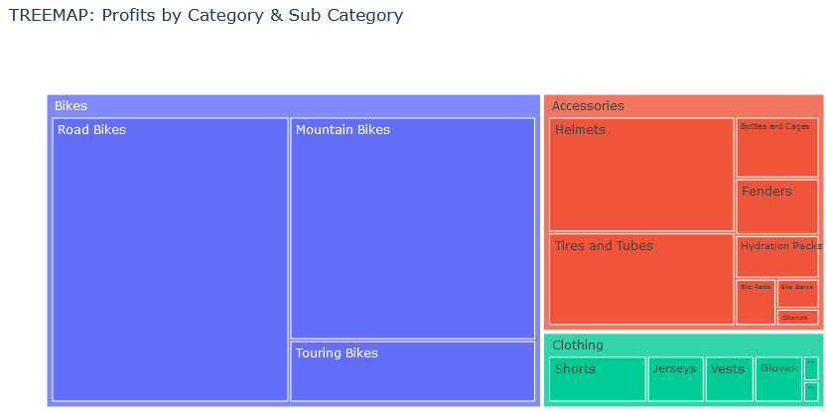
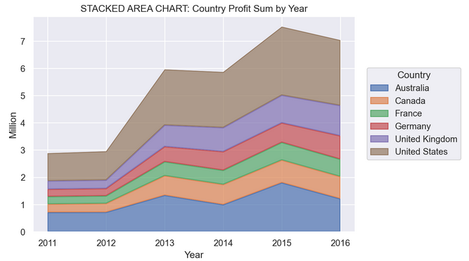
Python

Slide 4
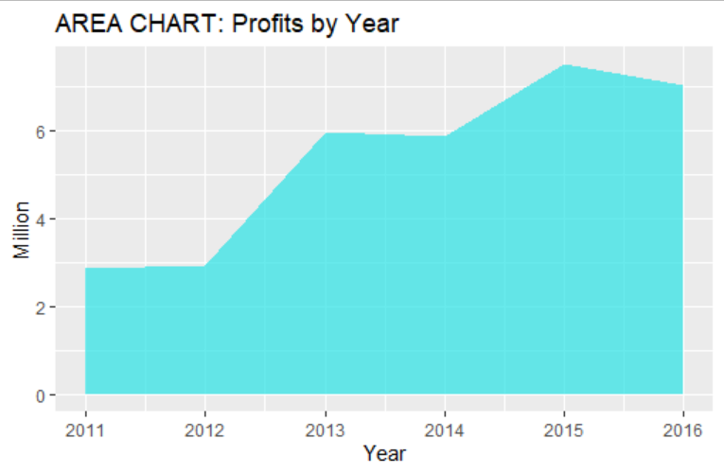
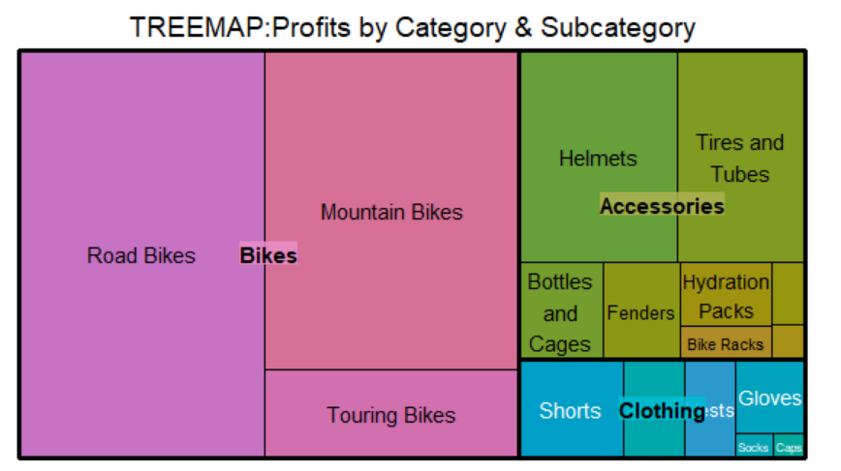
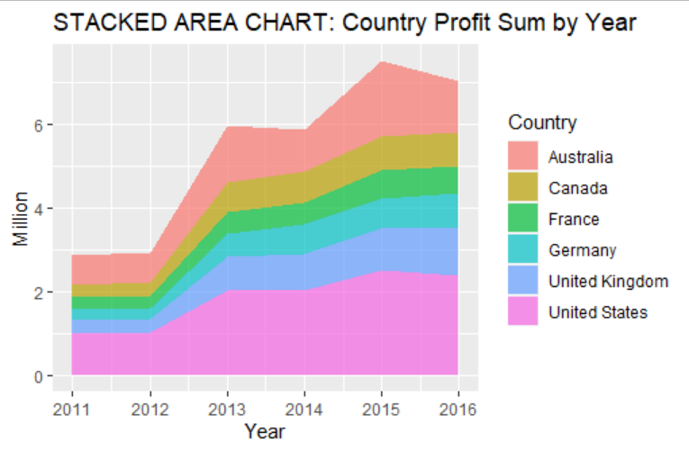
R-Studio

Slide 5
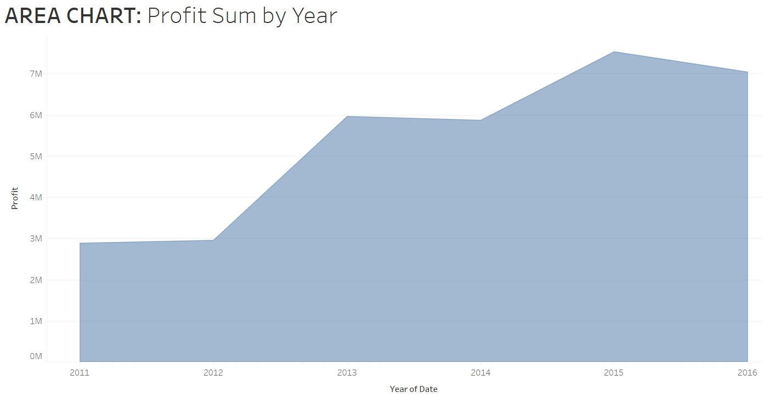
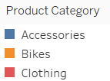
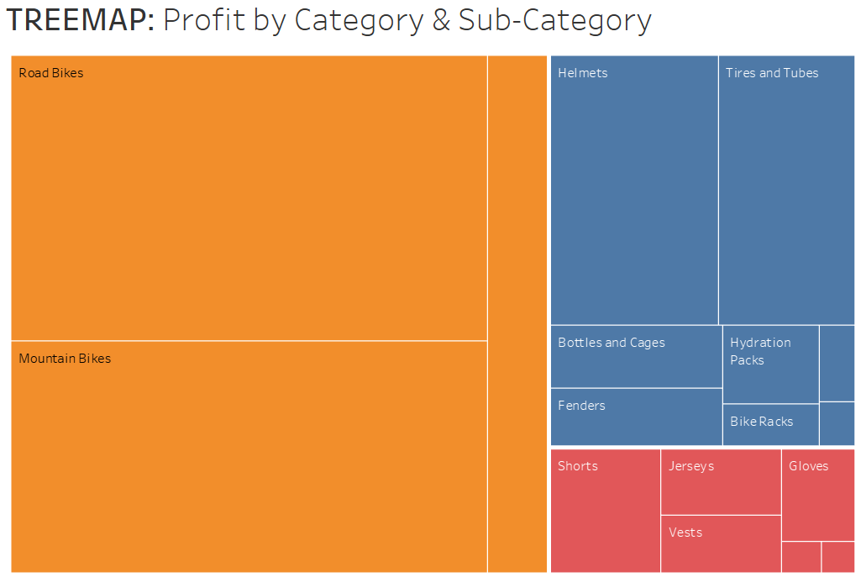
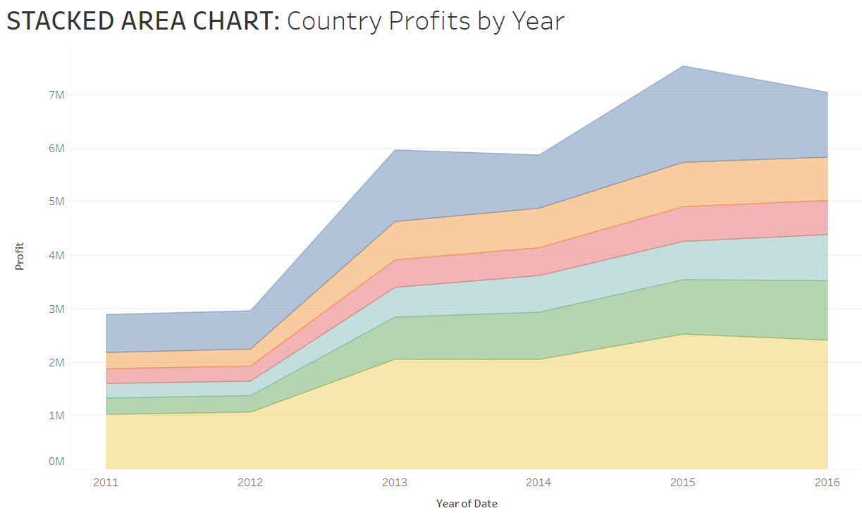
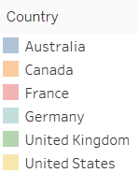
Tableau

