Slide 1



Week1_Charts DSC 640 Holly Figueroa
View in Power BI
Last data refresh:
3/19/2023 4:31:52 PM UTC
Downloaded at:
3/19/2023 4:33:11 PM UTC

Slide 2
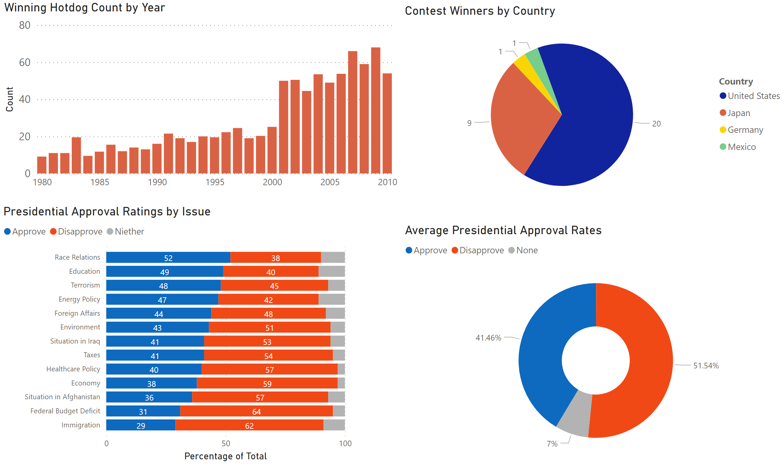
Power BI

Slide 3
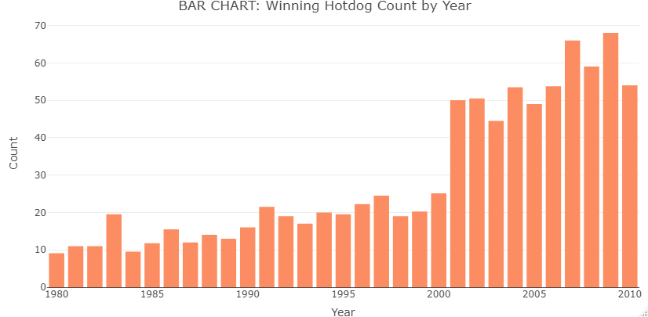
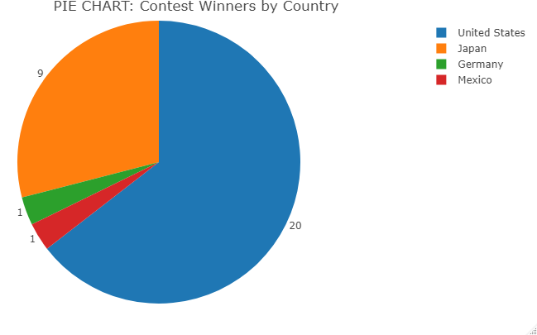
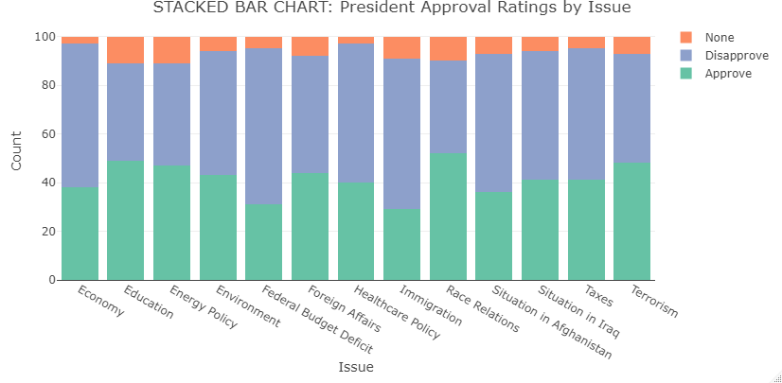
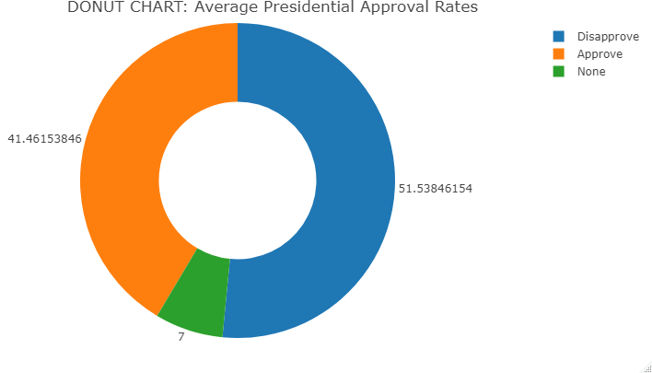
R-Programming

Slide 4
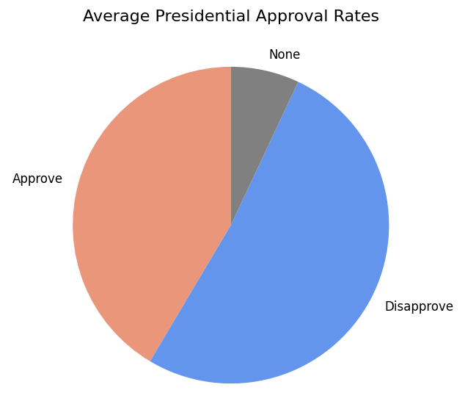
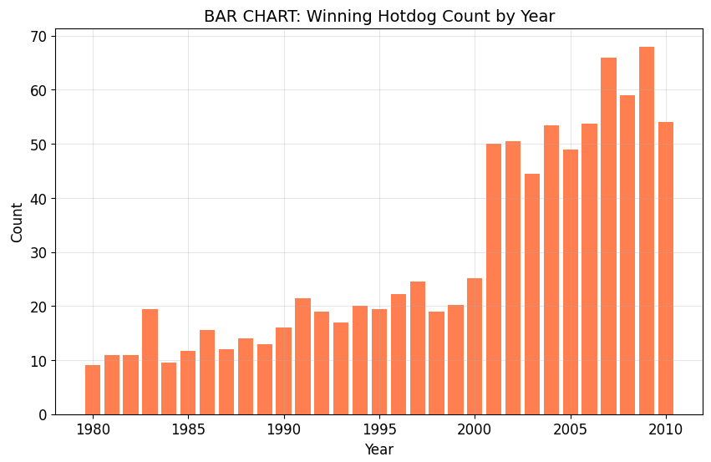
Python

Slide 5
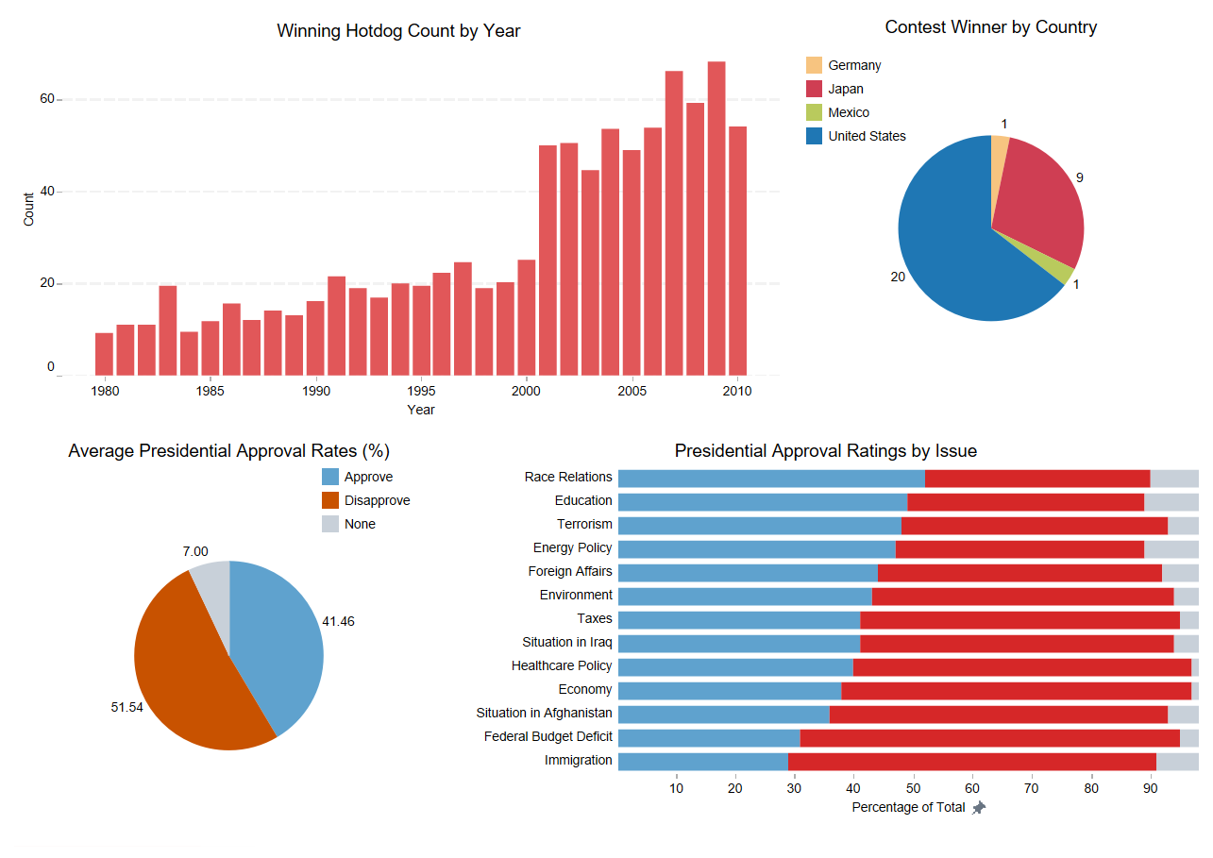
Tableau

