Slide 1
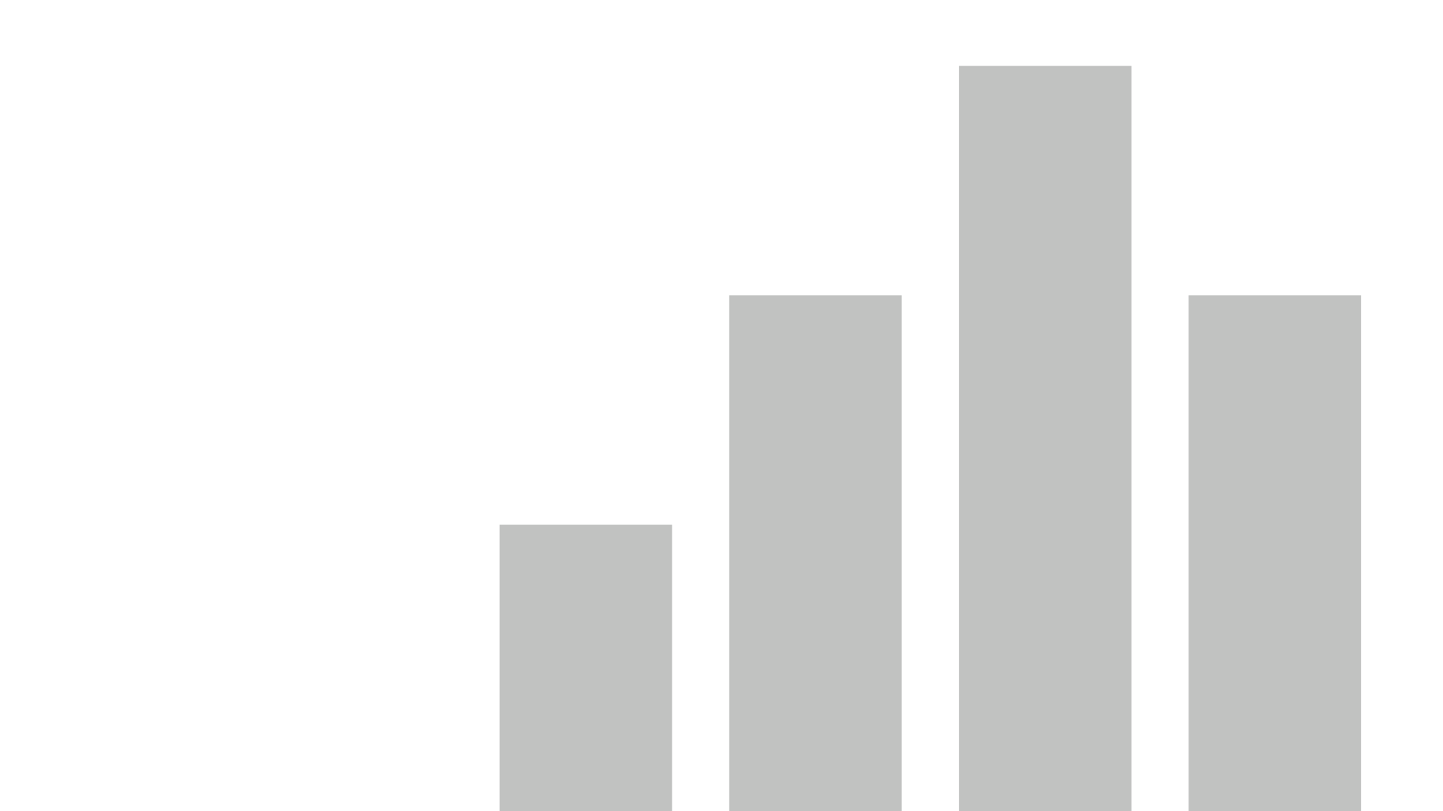


Week 5-6 Charts Holly Figueroa
Data Source
Github https://github.com/halepino/Data_Visualization.git
View in Power BI
Last data refresh:
4/9/2023 4:51:31 AM UTC
Downloaded at:
4/9/2023 4:52:19 AM UTC

Slide 2
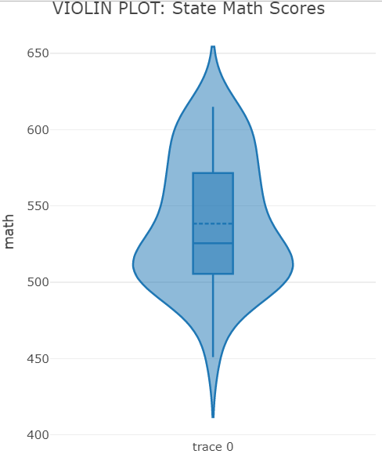
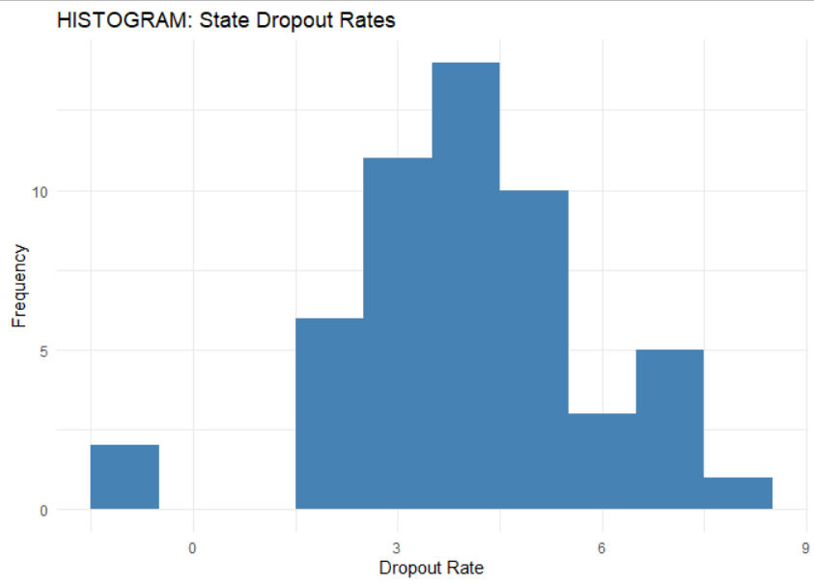
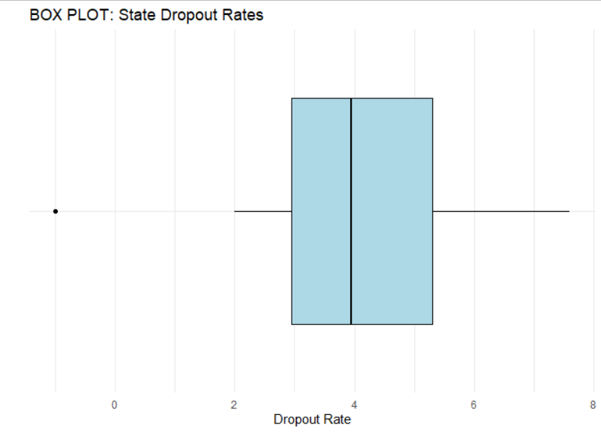
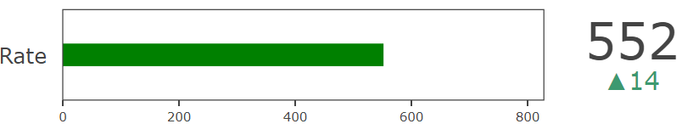
R-Studio
BULLET CHART: Alabama Math Score & US Average as Target

Slide 3
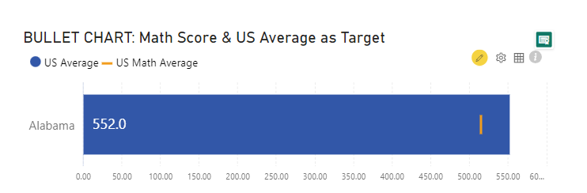
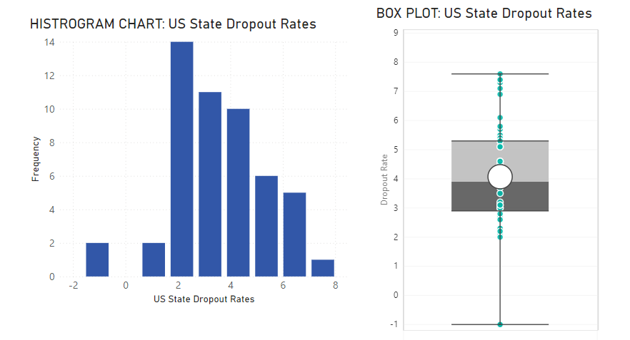
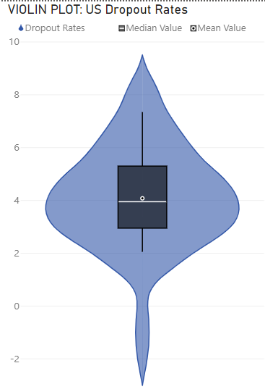
Page 1
Power BI
Notes:
LINE CHART: Revenue by Year
No alt text provided
STEP CHART: Revenue by Year
No alt text provided

Slide 4
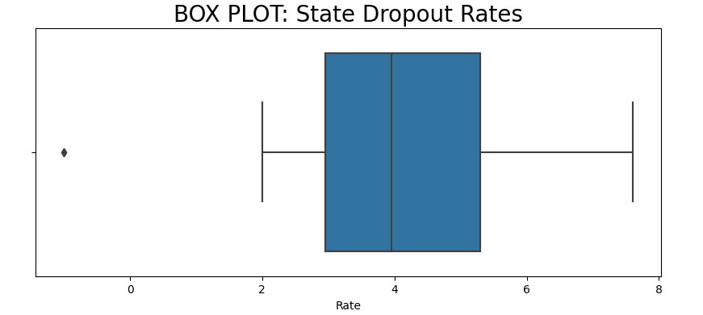
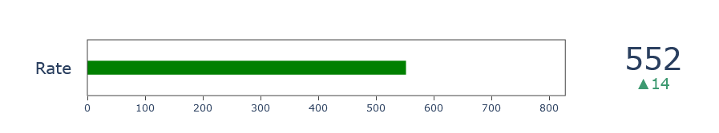
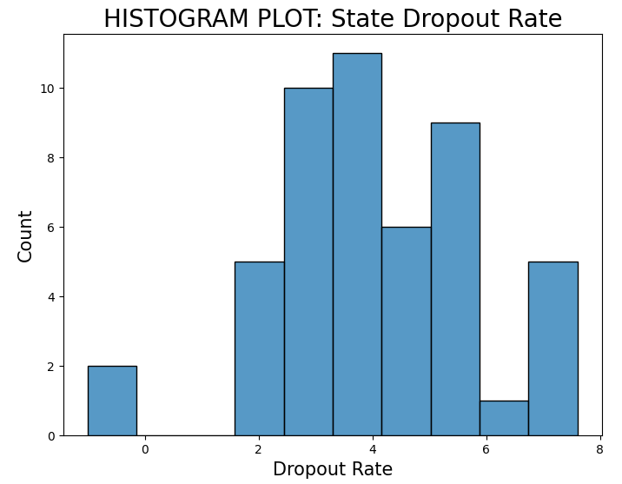
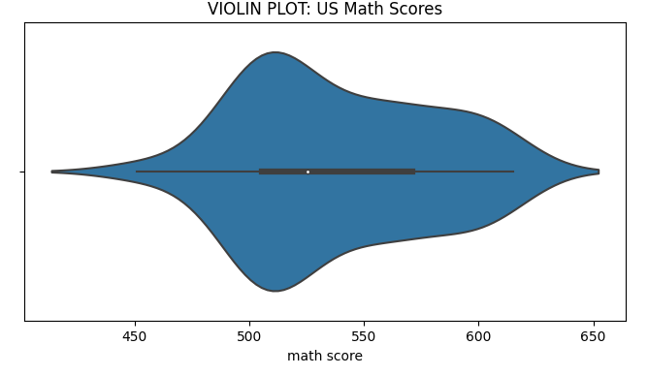
Python
BULLET CHART: Alabama Math Score & US Average as Target

