Slide 1
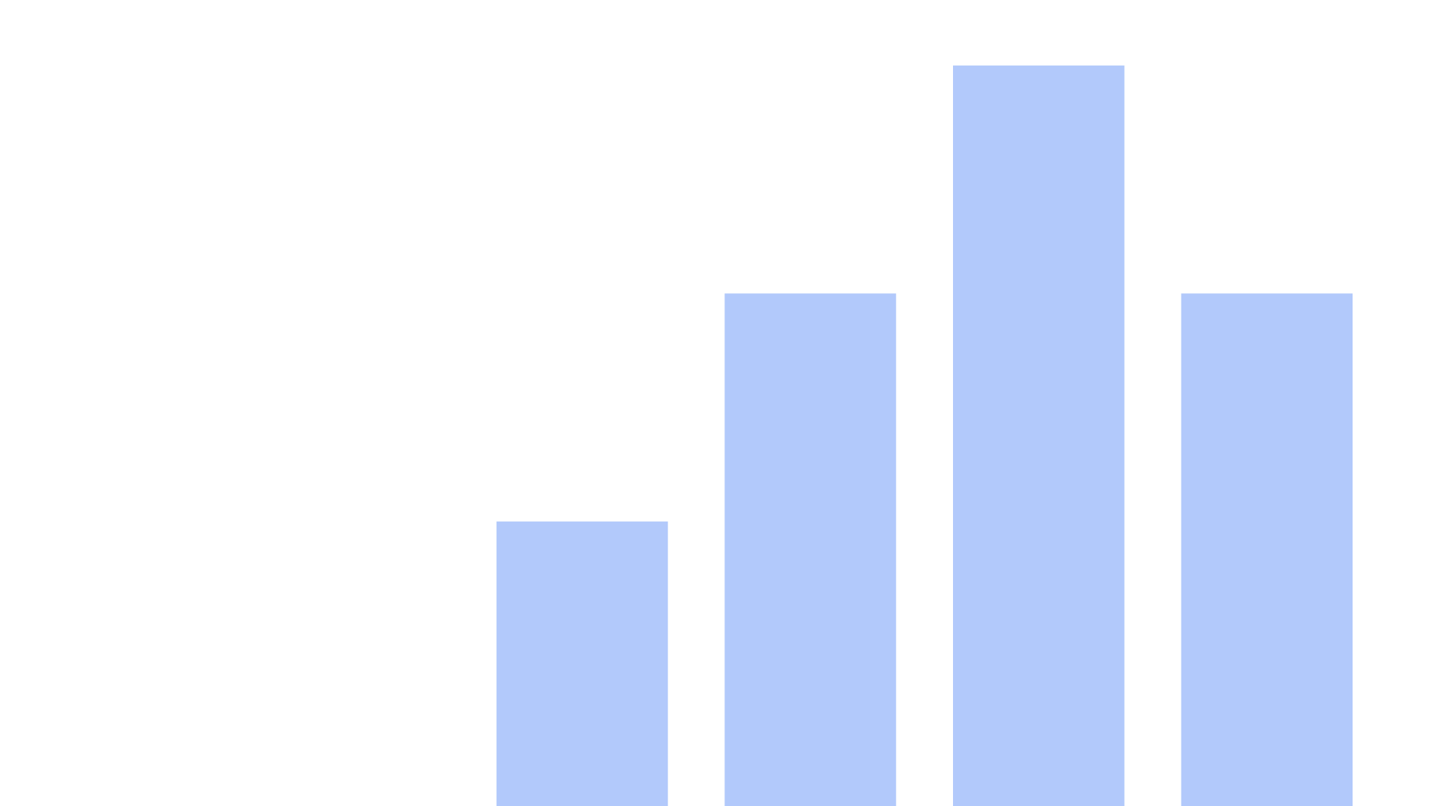


W7-8_HollyFigueroa Data File: ‘crime_ed_money.csv’ Data Source and Code Files: https://github.com/halepino/Data_Visualization.git
View in Power BI
Last data refresh:
5/8/2023 3:27:51 AM UTC
Downloaded at:
5/8/2023 3:30:55 AM UTC

Slide 2
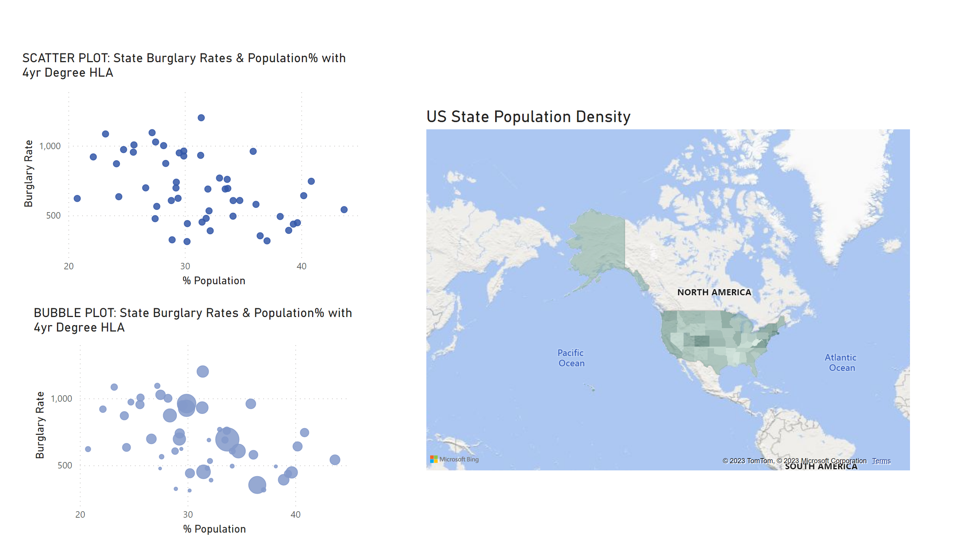
Scatter+Bubble
Power BI
Notes:
SCATTER PLOT: State Burglary Rates & Population% with 4yr Degree HLA
No alt text provided
BUBBLE PLOT: State Burglary Rates & Population% with 4yr Degree HLA
No alt text provided
US State Population Density
No alt text provided

Slide 3
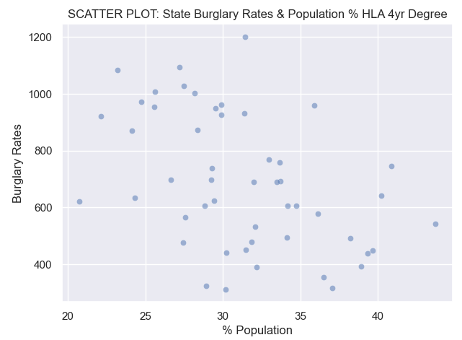
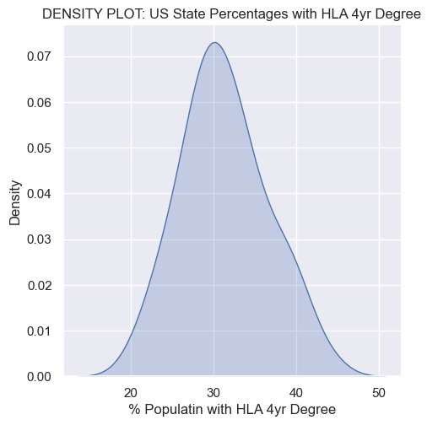
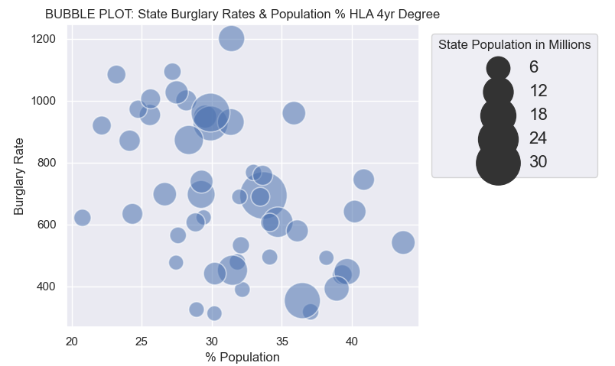
Python

Slide 4
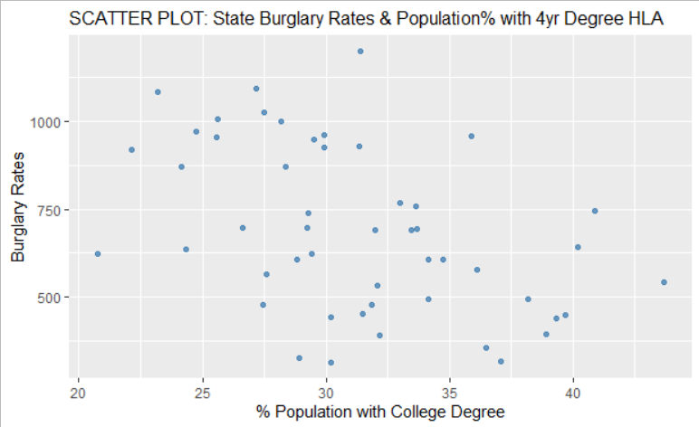
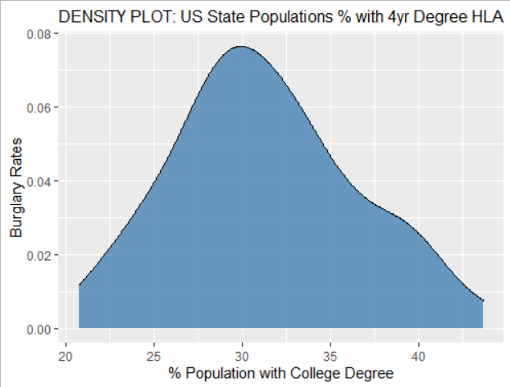
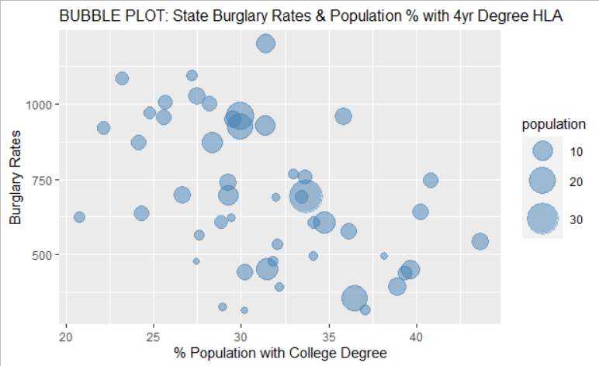
R Studio

