Slide 1


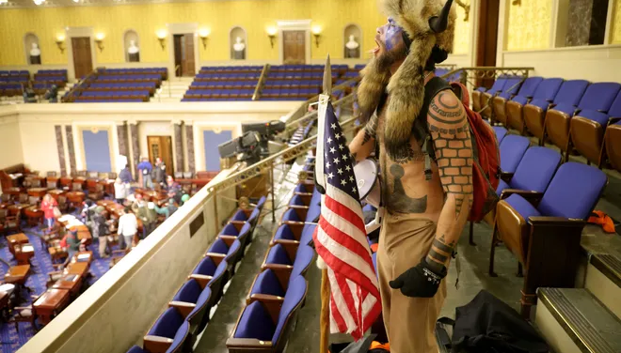
Exploratory Data Analysis: Extremism
DSC 530 Final Project
Author: Holly Figueroa

Slide 2
Data Source
2019 study that gained participants via Facebook ads
Sample size 2552
The survey gathered demographic information and included a long list of likert-scale questions which were then scored and/or scaled.
Data set made available through Harvard Dataverse available here:
https://dataverse.harvard.edu/dataset.xhtml?persistentId=doi:10.7910/DVN/ICTI8T

Slide 3
Does any relationship exist between scores for extremism and the other variables listed?
Hypothesis
Age | Respondent age | Continuous, age 16 and up
Gender | Respondent Gender | Male (0) Female (1)
Religious Affiliation | Nominal/Categorical | 6 categories total
Social Media Use | Standardized sum score based on likert-responses | Negative-Positive Scale Less to more social media use
Extremism Score | Sum Score PCA scaled/standardized based on likert responses | 0-10 Scale Least extreme (0)
Political Leaning | Standardized sum score based on likert responses | Right-of-center(- values) Left-of-center (+values)
Racism Scale | Standardized score based on likert responses | Higher values ( - values) Lower values (+ values)

Slide 4

Measuring Extremism
Our target variable of interest is extremism, or extremist attitudes. Likert questions aimed at capturing these attitudes are based on J.M. Berger’s extensive writings on the topic. His work explains extreme attitudes (political, racial, religious etc) all relate to perceptions of in-groups and out groups. In the extreme, people come to believe the “success of us is inseparable from hostile acts against them”
“Using violence is the most effective way to create a better society”
0 - Strongly Agree
1 - Somewhat Agree
2 - Neither Agree or Disagree
3 - Somewhat Disagree
4 - Strongly Disagree

Slide 5
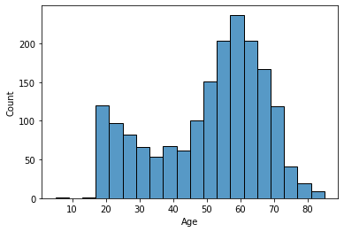
Age Summary
Continuous variable
Bimodal
Moderate negative skew (-0.53)
Age range 16-85 years old
Mean age 50
Mode age 57
One outlier - 5yr old participant
likely a typo (removed)

Slide 6
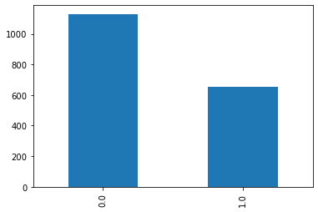
Gender Summary
Male Female
Nominal variable
Coded 0-1 (male/female)
Almost 2x more male participants
Male total 1130
Female total 654
1784 complete responses

Slide 7
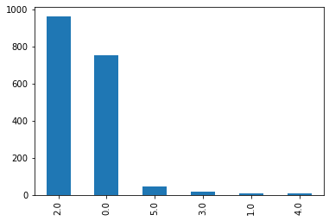
Religious Affiliation Summary
0 = Christian (753) 1 = Buddhist (9) 2 = I am not religious (964) 3 = Jewish (17) 4 = Muslim (8) 5 = Other (47)
Nominal variable
2255 total responses
Mode 2
76% responded 2 or 0
< 50 count for all other responses

Slide 8
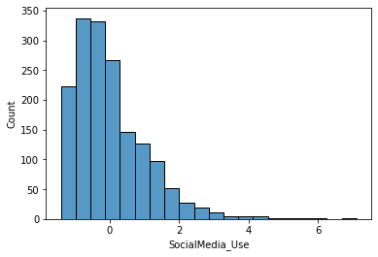
Social Media Use Summary
Standardized continuous variable
High positive skew (1.53)
Leptokurtic (kurt = 3.92)
Range -1.4 to 7.1
75% of values are under 1
Mode -0.33
Mean 0.02
Median 0.21

Slide 9
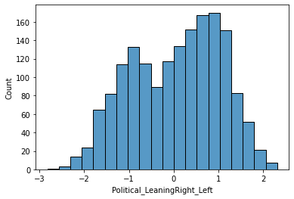
Political Leaning Summary
Right Leaning Left Leaning
Standardized continuous variable
Negative values (right of center)
Positive values (left of center)
Bimodal distribution
Score range -2.82 to 2.31

Slide 10
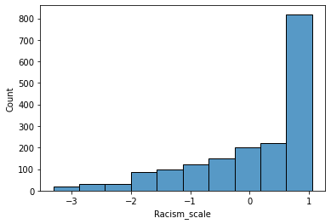
Racism Scores Summary
Standardized scores
Negative values (higher racism)
Positive values (lower racism)
Range -3.31 to 1.06
Median 0.03
Mode 1.05
> 25% of scores were under 0

Slide 11
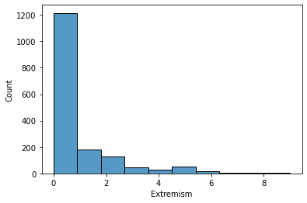
Extremism Scores Summary
Strong positive skew (2.25)
Scaled 0-10
0 being least extreme
Resulting scores ranged from 0 - 9
Over 75% scored at 1.06 or less
Mode 0
Median 0
*Here, higher scores/outlier scores represent the target of interest

Slide 12
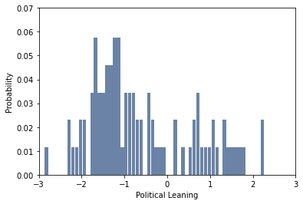
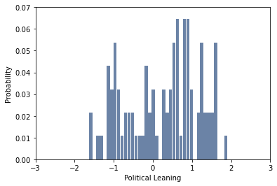
PMF Exploration Extremism & Politics
Sample was split based on Extremism Scores to explore differences in Political Leaning
Extremism Scores => 4
Extremism Scores < 4
Right of Center Views Left of Center Views
Right of Center Views Left of Center Views
Respondents scoring for extremism at 4 or higher were split from respondents scoring below 4. The less extreme sample was then subsampled to visually compare PMFs with equal sample sizes. To explore differences easier – a combined PMF was created

Slide 13
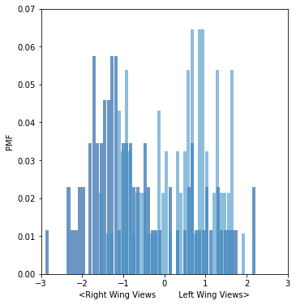
PMF Exploration Extremism & Politics
Combined PMFs for Political Leaning
Higher Extremism Scores (dark)
Lower Extremism Scores (light)
Substantial overlap
High probabilities for right of center views more concentrated with higher extremism scores
Higher probabilities for left of center views more concentrated with lower extremism scores
Strongest values for right wing views populated only by probabilities for higher extremism scores
Suggests slight increase in chances those with higher extremism scores hold right leaning political view

Slide 14
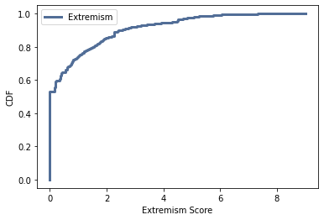
CDF Exploration Extremism Scores
80% of Extremism scores were <= 2
Our target of interest, those with high extremism scores, represents only a small fraction of respondents
Reflects the rarity of the phenomena

Slide 15
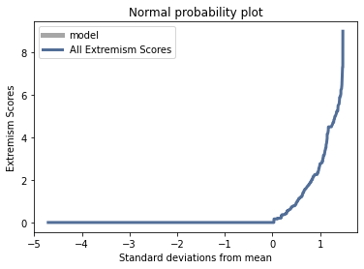
Normal Probability Plot Extremism Scores
Plot for extremism scores is not normal. Not diagonal showing equal probabilities across responses.
Data not well suited for a linear model
Reflects skew in scores where only small proportion scored higher for extremism
* Negative values reflect higher extremism scores

Slide 16
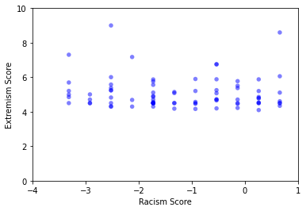
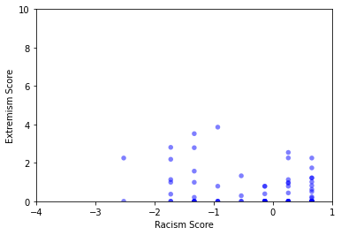
Scatter Plots Extremism & Racism
Sample was split based on extremism scores to explore differences in racism scores
Higher Extremism ( > 4 )
Lower Extremism ( < = 4 )
Negative values for racism = higher racism
Higher racism scores (negative values) reflected in plot for higher extremism
Lower Extremism concentrated higher on the scale ( lower racism scores)
Plots suggest that higher racism scores may be related to higher extremism scores

Slide 17
Extremism & Racism
Covariance Results
-0.41
Kendall’s Tau Results
Ran on full data set after dropping na values
n = 1448
Tau = -0.179
p-value = < 0.000
Diff Means Test Results
Data split by Extremism Score
n = 93
Higher Extremism Mean Racism Score = - 0.96
Lower Extremism Mean Racism Score = - 0.05
p-value = 0.0
Conclusion
Scores for extremism & racism appear to vary together
The difference in means for racism scores between groups with higher and lower extremism scores is significant
Analysis supports we reject the null hypothesis that extremism scores have no relationship to racism scores
Based on the scaling, the results suggest those with more racist sentiments are more likely to hold extremist views

Slide 18
Multiple Regression Analysis
Model Predictors | Trial & Error Notes
Gender | A Boolean for males was explored, but results did not support inclusion.
Age | Age squared was tested for a potential non-linear relationship, but results did not support this.
Racism Score | Racism scores improved prediction in conjunction with the Boolean below. Neither on their own did as well.
Racism Score < 0 TRUE | Boolean variable created for higher racism scores.
Political < -1 TRUE | Boolean for right wing political views. Political leaning scores in general did not lend much prediction power. The Boolean improved prediction significantly.

Slide 19
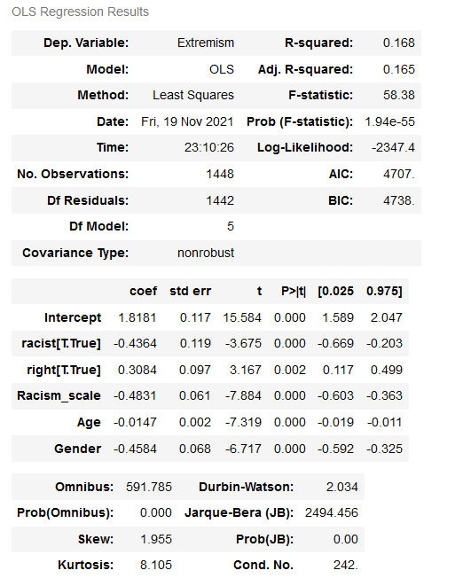
Multiple Regression Analysis
The resulting model includes 5 variables with significant p-values
Results show only a modest power of prediction (Adusted R2) at approx. 17%
F statistic supports rejecting the null hypothesis
Prob (F-stat) shows the model overall has p-value well under 0.000

Slide 20
Conclusion
The analyses completed suggests that the null hypothesis be rejected for some of the variables explored. Stronger racist attitudes appear related to more extremist beliefs. Analysis also suggested political views may be related to higher chances of holding extremist beliefs.
The regression analysis conducted found weak, however significant, coefficients between extremism scores and respondents age and gender.
The regression model with the most predictive power was found only after including variables representing strong attitudes for race and right-of-center political views.
Variables for religious affiliation and social media were not shown to have significant relation to extremism scores

