Slide 1
Predict the appropriate location of a new bar
The Battle of Neighborhoods (Week 2)
October 9, 2020

Slide 2
Background
Talking about typical Mexican drinks is an interesting topic for many people. The love for drinks like tequila, mezcal, and even pulque has always come from Mexicans. But Mexico, in addition to these so, has a huge variety of famous drinks that range from simple fresh waters to a called Tuba made with the flower of coconut trees in Colima and Nayarit.

Slide 3
Problem
Knowing this, we can say that it would be competitive to start a beverage business, more specifically a bar.
We need to find a place in the center of Mexico City, close to the busiest liquor sales places but that in turn has a certain distance from them to reduce competitiveness.

Slide 4
Data acquisition
First of all, we must collect data from the entire beverage business in Mexico City, including its name, identification (address, latitude, longitude) and then look for the one that is most frequented by people. For active data we use FourSquare and apply folio to visualize a particular beverage business in which we will observe customer "traffic" and predict the appropriate location of a new bar in the city.

Slide 5
Solution
Once the data is obtained, the following is to transform, and group the data so that we can locate those bars near the center of Mexico City that are more crowded.

Slide 6
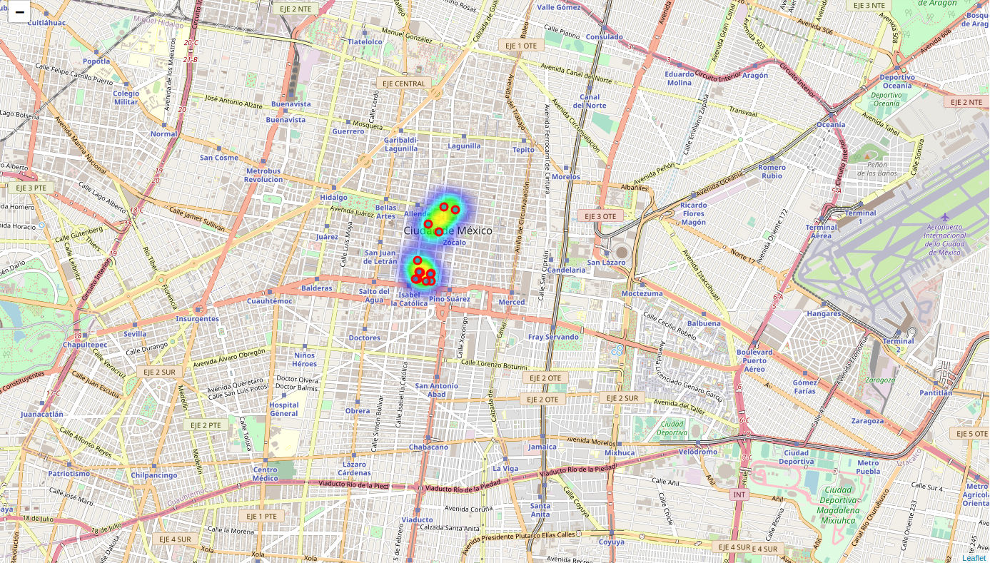
Results
As results we can see that in the first instance we find the busiest bars in the center of Mexico City.

Slide 7
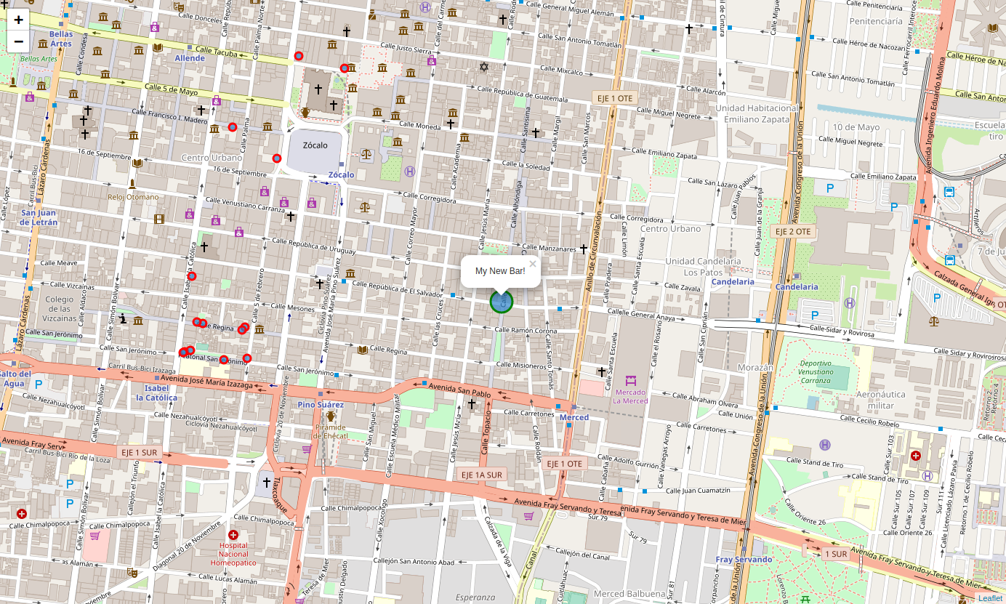
Results
After this and making the necessary calculations we can discover the hypothetical best place to create a new bar in the center of Mexico City.

Slide 8
Conclusion
In this project, we study the data acquired from Foursquare to analyze it and obtain the most popular liquor sales sites in the center of Mexico City. Thanks to this we were able to analyze and discover the most suitable place to open a new bar near very important tourist sites and with reduced competitiveness.

