Slide 1
Shared Bicycle
Monte Carlo Simulation
By Jifu Zhao, Yunya Gu, Bo Zhao

Slide 2
Introduction
01
Introduction to the project
CONTENT
Monte Carlo Scenario
02
Scenario simulation
03
Visualization
Visualization of the variables
04
Result
Result and limitation

Slide 3
Introduction
Introduce shared bicycles and the project

Slide 4
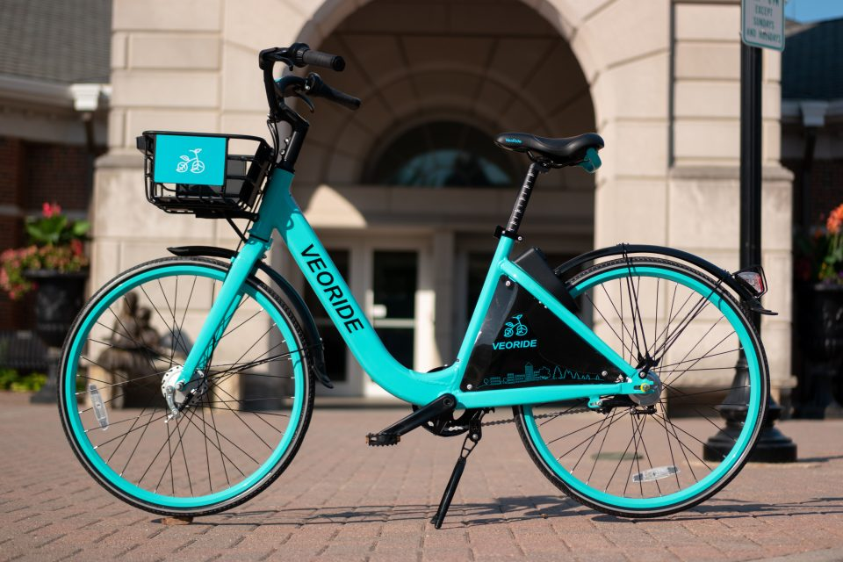
What is shared bike?
These bikes were created by the company VeoRide, a bike sharing company established in March 2017.
Each bike is equipped with GPS, has a self-locking mechanism and can be accessed with a phone app, Riders pay through the app.

Slide 5
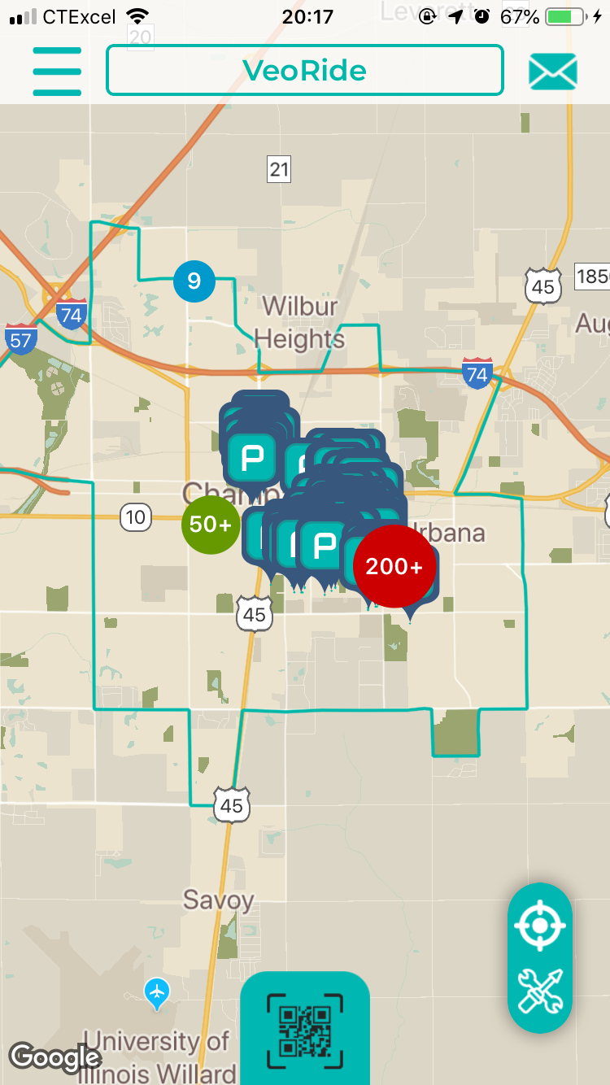
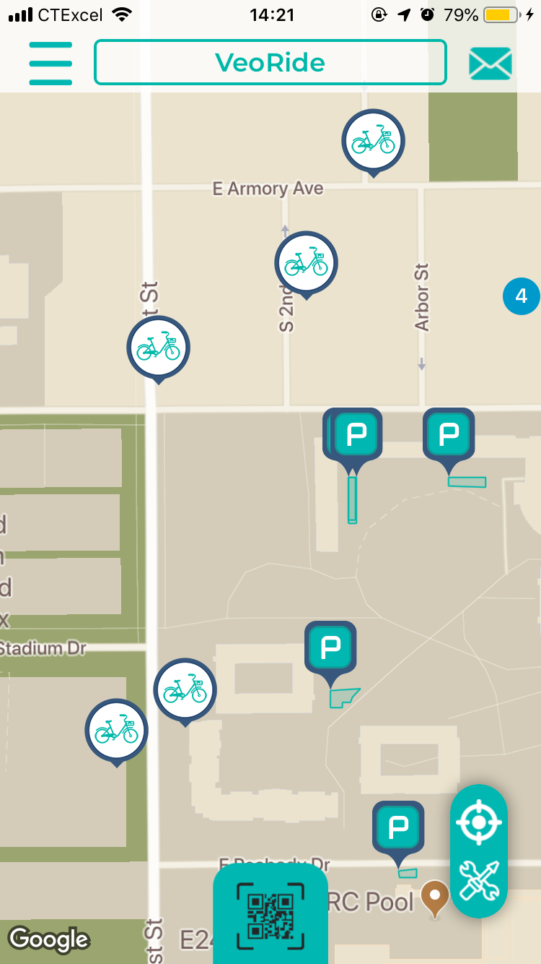
About Veoride app

Slide 6
The purpose of this project
For shared bicycles, it's important to design the management strategy such that the cost can be minimized and the profit is maximized. Two most important factors are number of bicycles and the charge rate for students.
In this project, we want to study the best number of bicycles and charge rate for shared bicycles. Since there are some uncertainties, one way is to use the Monte Carlo simulation. Thus, under certain assumptions, this study analyzes the influence of number of bicycles and charge rate on the profit of shared bicycle program.

Slide 7
Monte Carlo
Scenario
Simulate the revenue with different number of bicycles and charge rate

Slide 8
uncertainty
Number of students who are willing to take the ride
-Poisson distribution with given expectation
-the expectation should be inversely related to charge rate
Duration of the trip
-typically between 5 minutes and 30 minutes
Whether or not the willing students can get bicycles immediately
-Bernoulli distribution with p

Slide 9
Other variables and assumptions
Other variables
Assume there are 50,000 students in total
Number of bicycles: 200, 300, 400, 500, 600, 700, 800
Charge rate: $0.01/min, $0.02/min, $0.03/min, $0.04/min, $0.05/min, $0.06/min
Percentage of students who are willing to take the bicycle: 0.0010, 0.0009, 0.0008, 0.0007, 0.0006, 0.0005
assumptions
Cost for bicycles is fixed number per bicycle per day
Don't consider other uncertainties such as weather effects

Slide 10
Visualization
Visualization of the variables

Slide 11
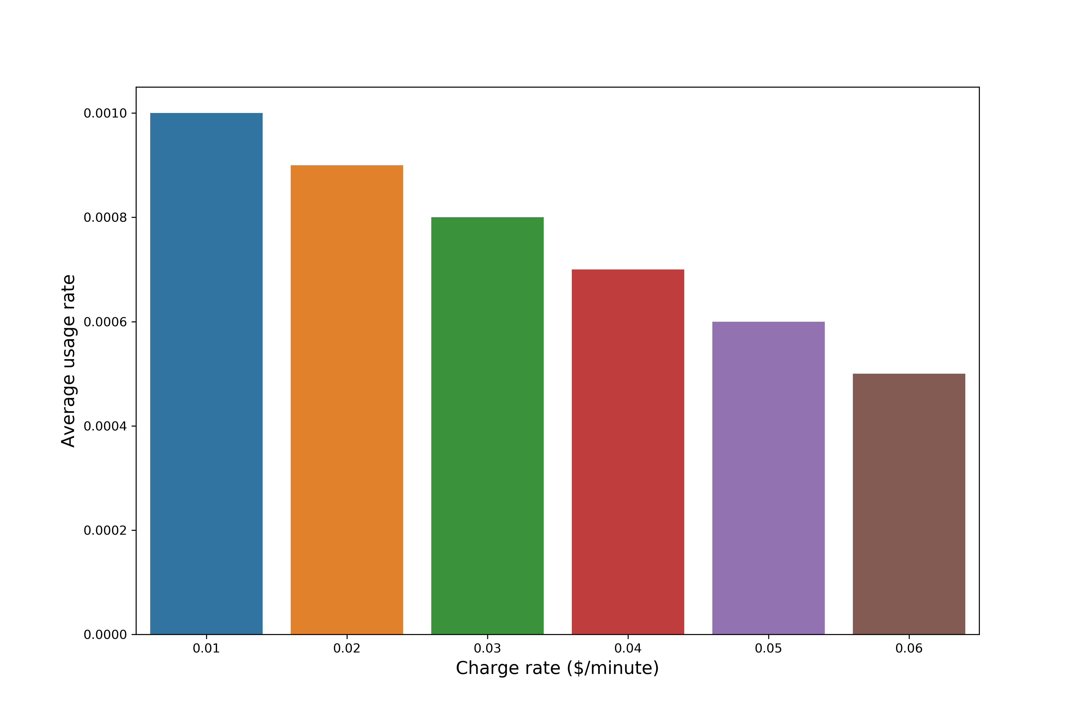
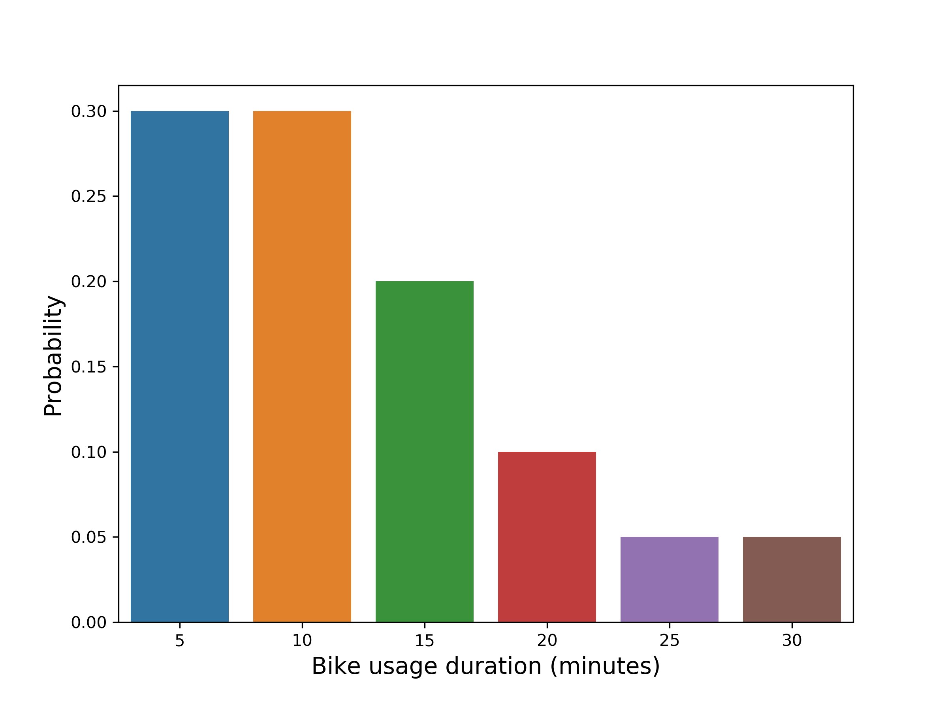
Visualization about the variables
usage rate vs. charge rate
probability of bike usage duration
charge rate rates = 0.01, 0.02, 0.03, 0.04, 0.05, 0.06
usage = 0.0010, 0.0009, 0.0008, 0.0007, 0.0006, 0.0005
duration times = 5, 10, 15, 20, 25, 30
probability = 0.3, 0.3, 0.2, 0.1, 0.05, 0.05

Slide 12
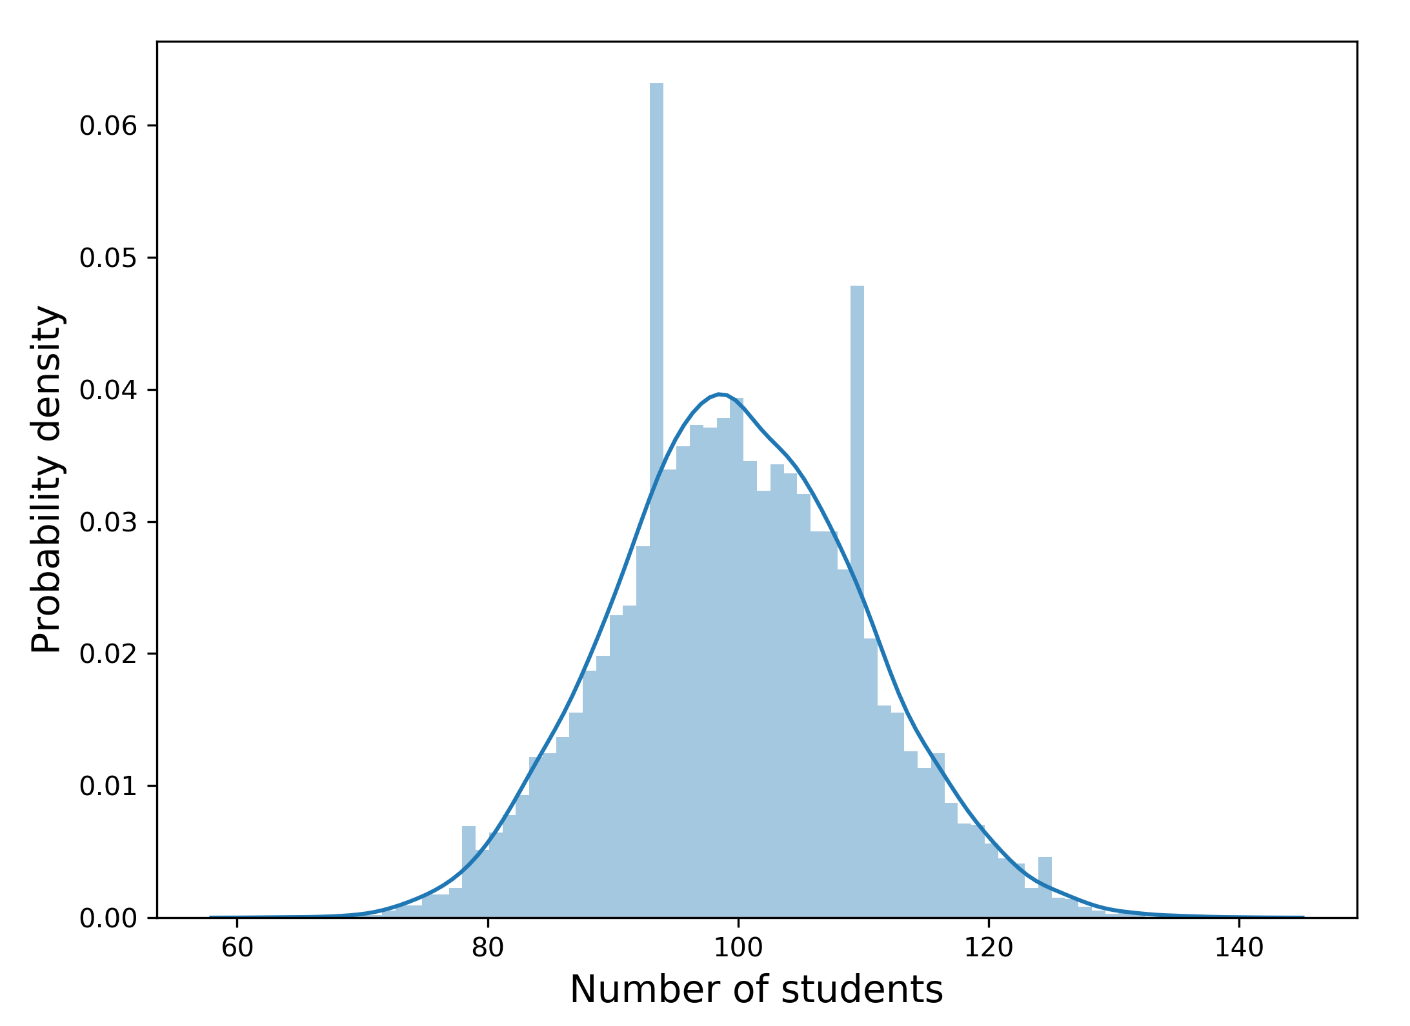
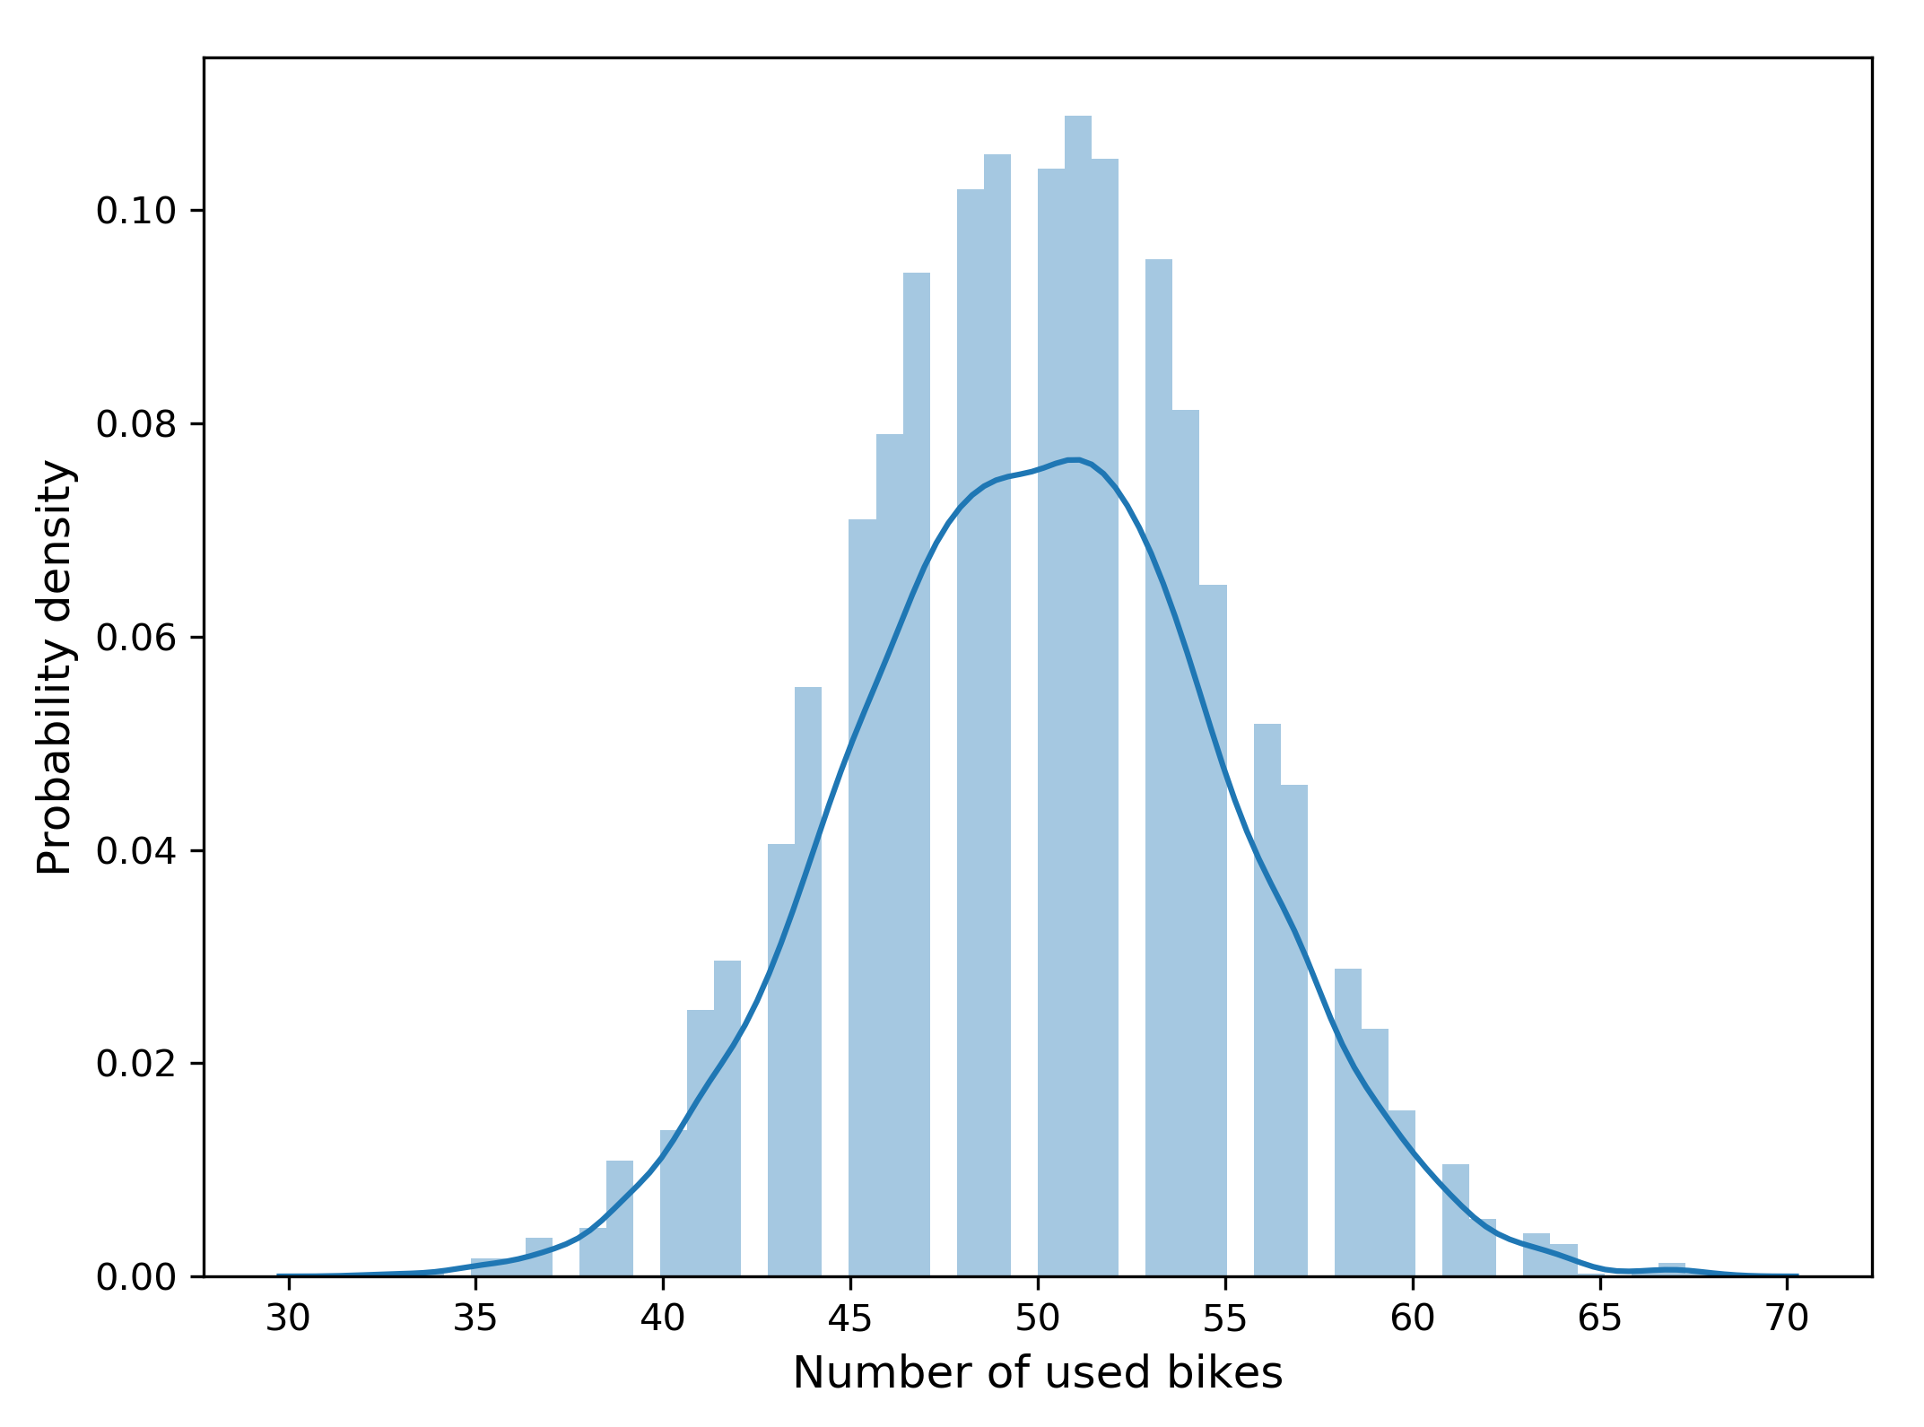
Visualization about the variables
Poisson distribution
binomial distribution

Slide 13
Result
Show the simulation result and limitation

Slide 14
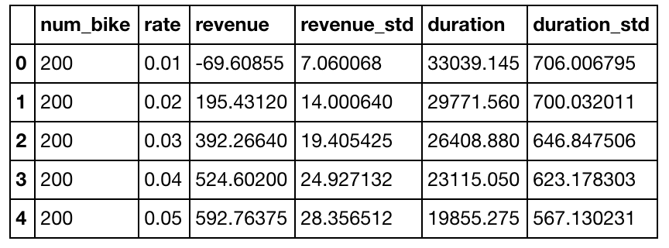
Result
The table below shows the simulation result when the number of bikes = 200 with different charge rate.

Slide 15
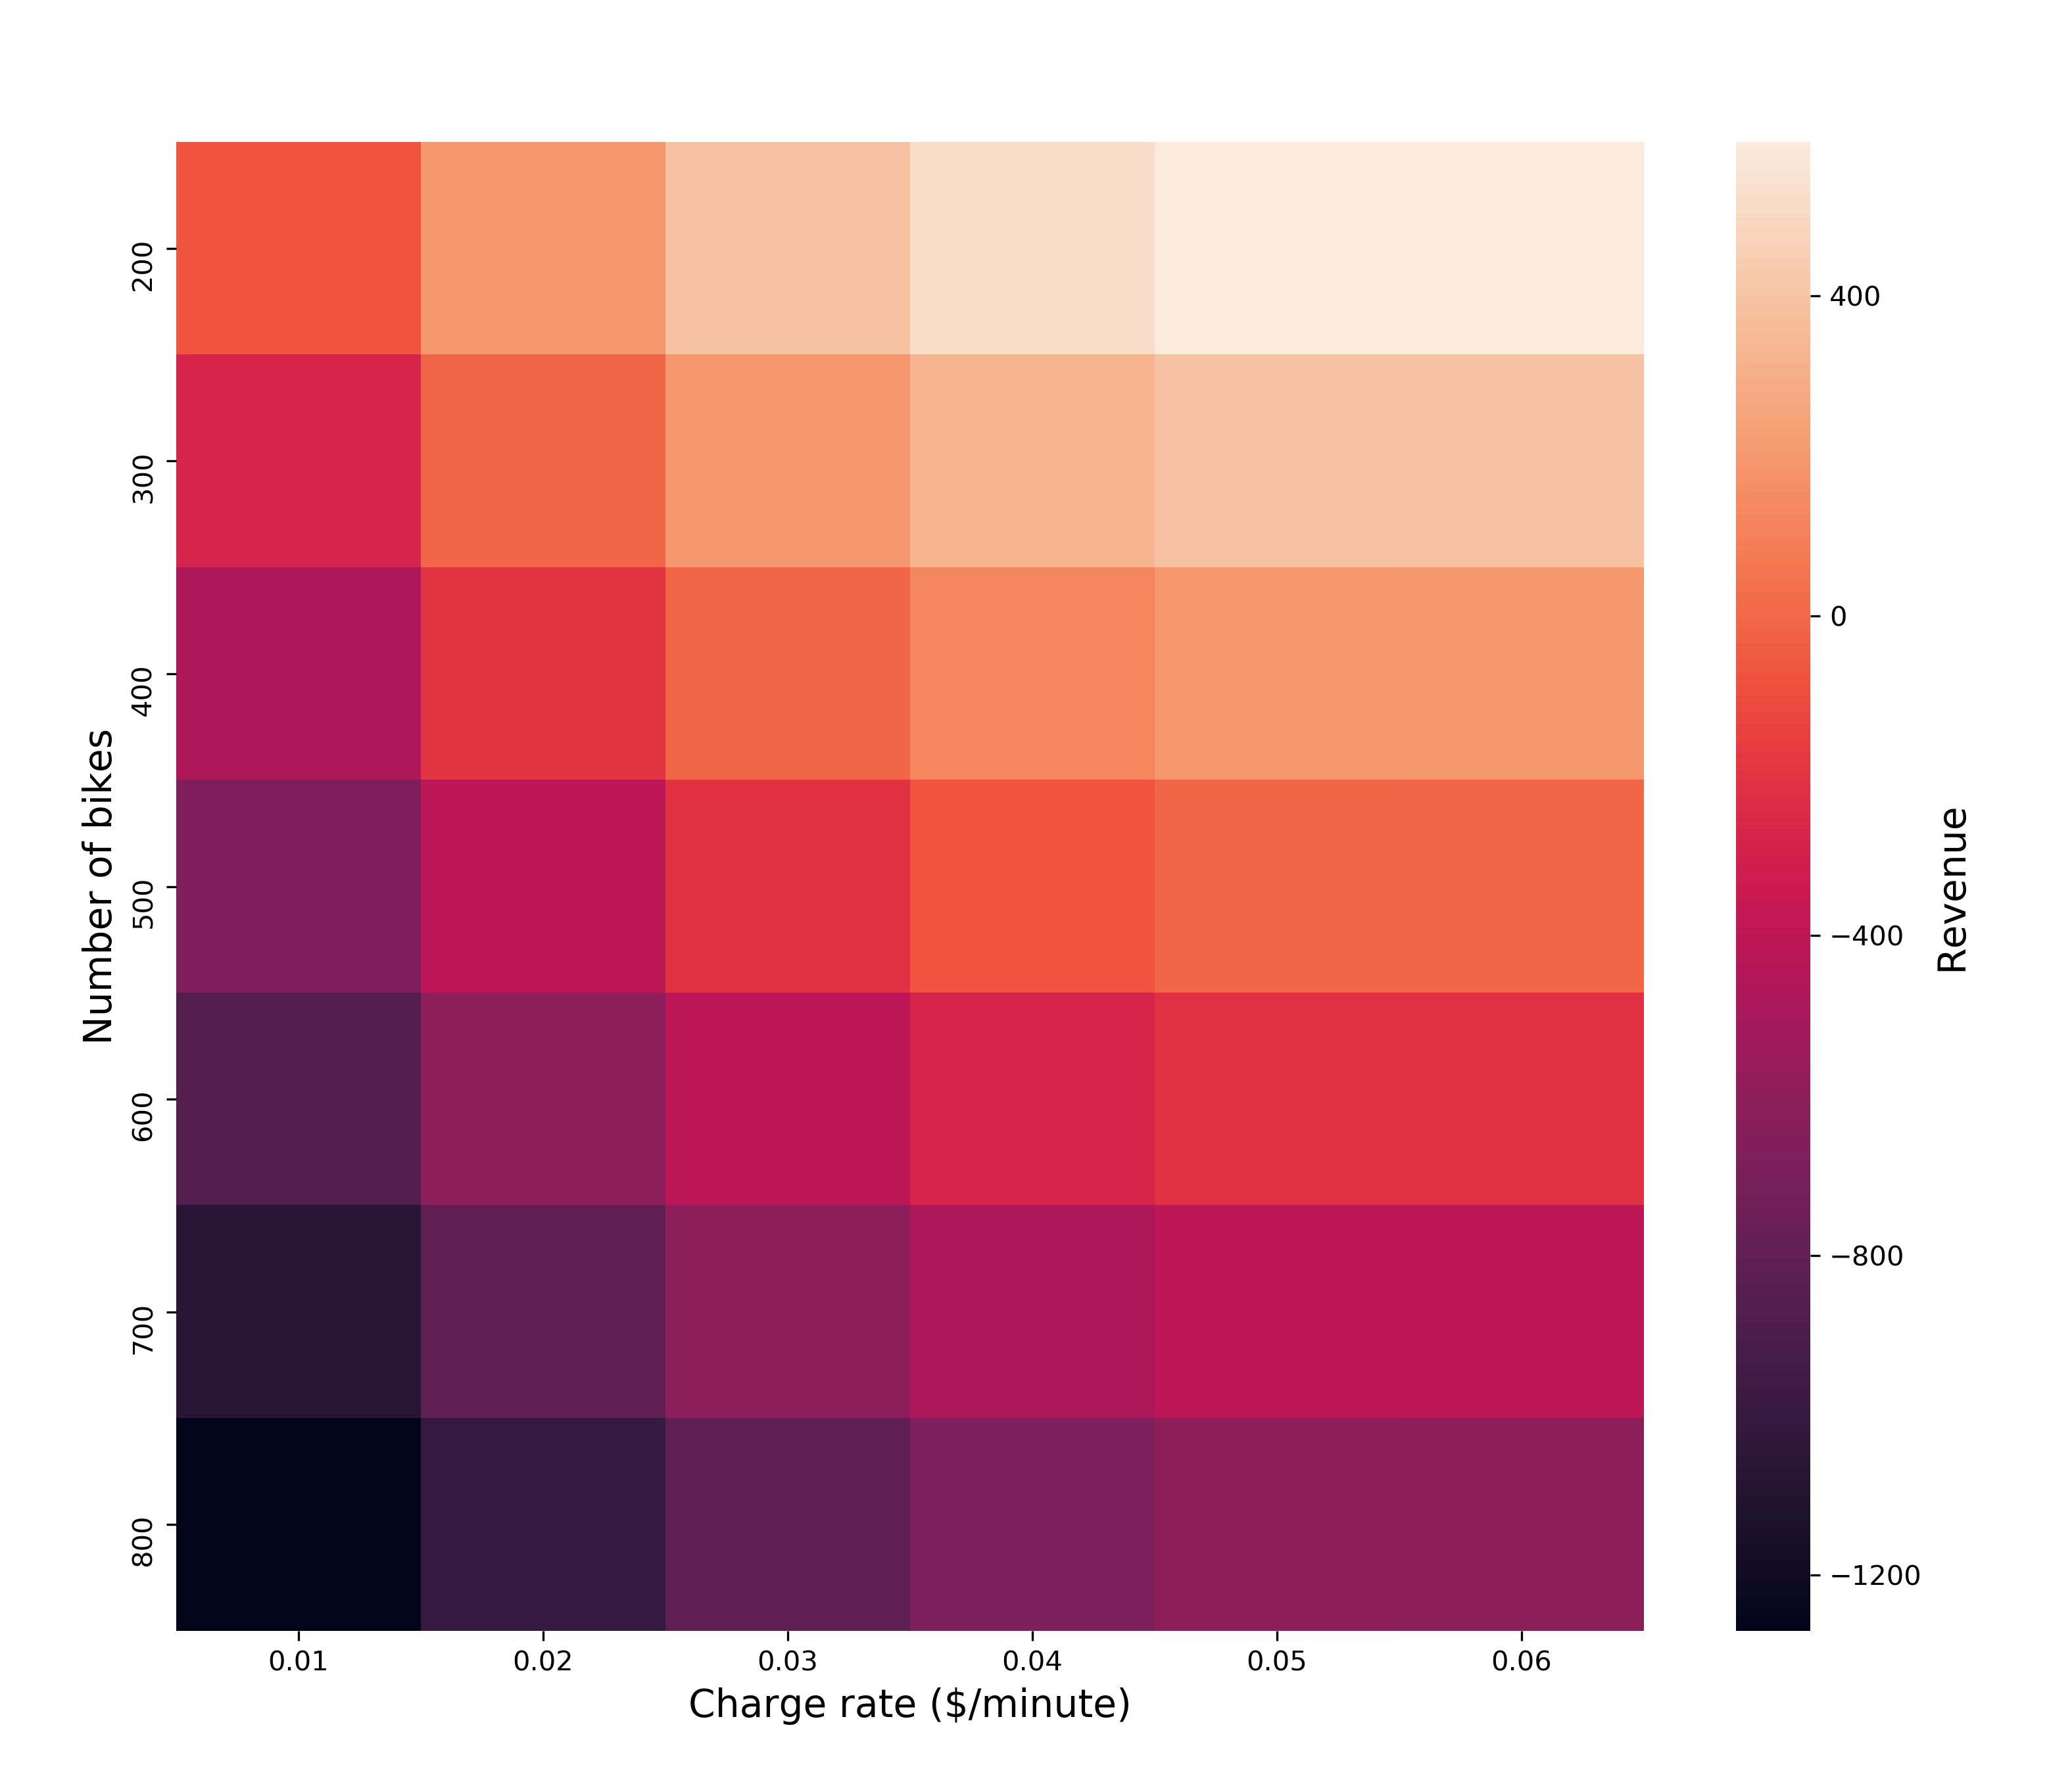
Result
The plot shows the relationship between the revenue and the pair of bike number and charge rate, according to the plot, it’s clear that when bike number is less than 300, revenue is positive, and with the charge rate increasing, revenue become larger.

Slide 16
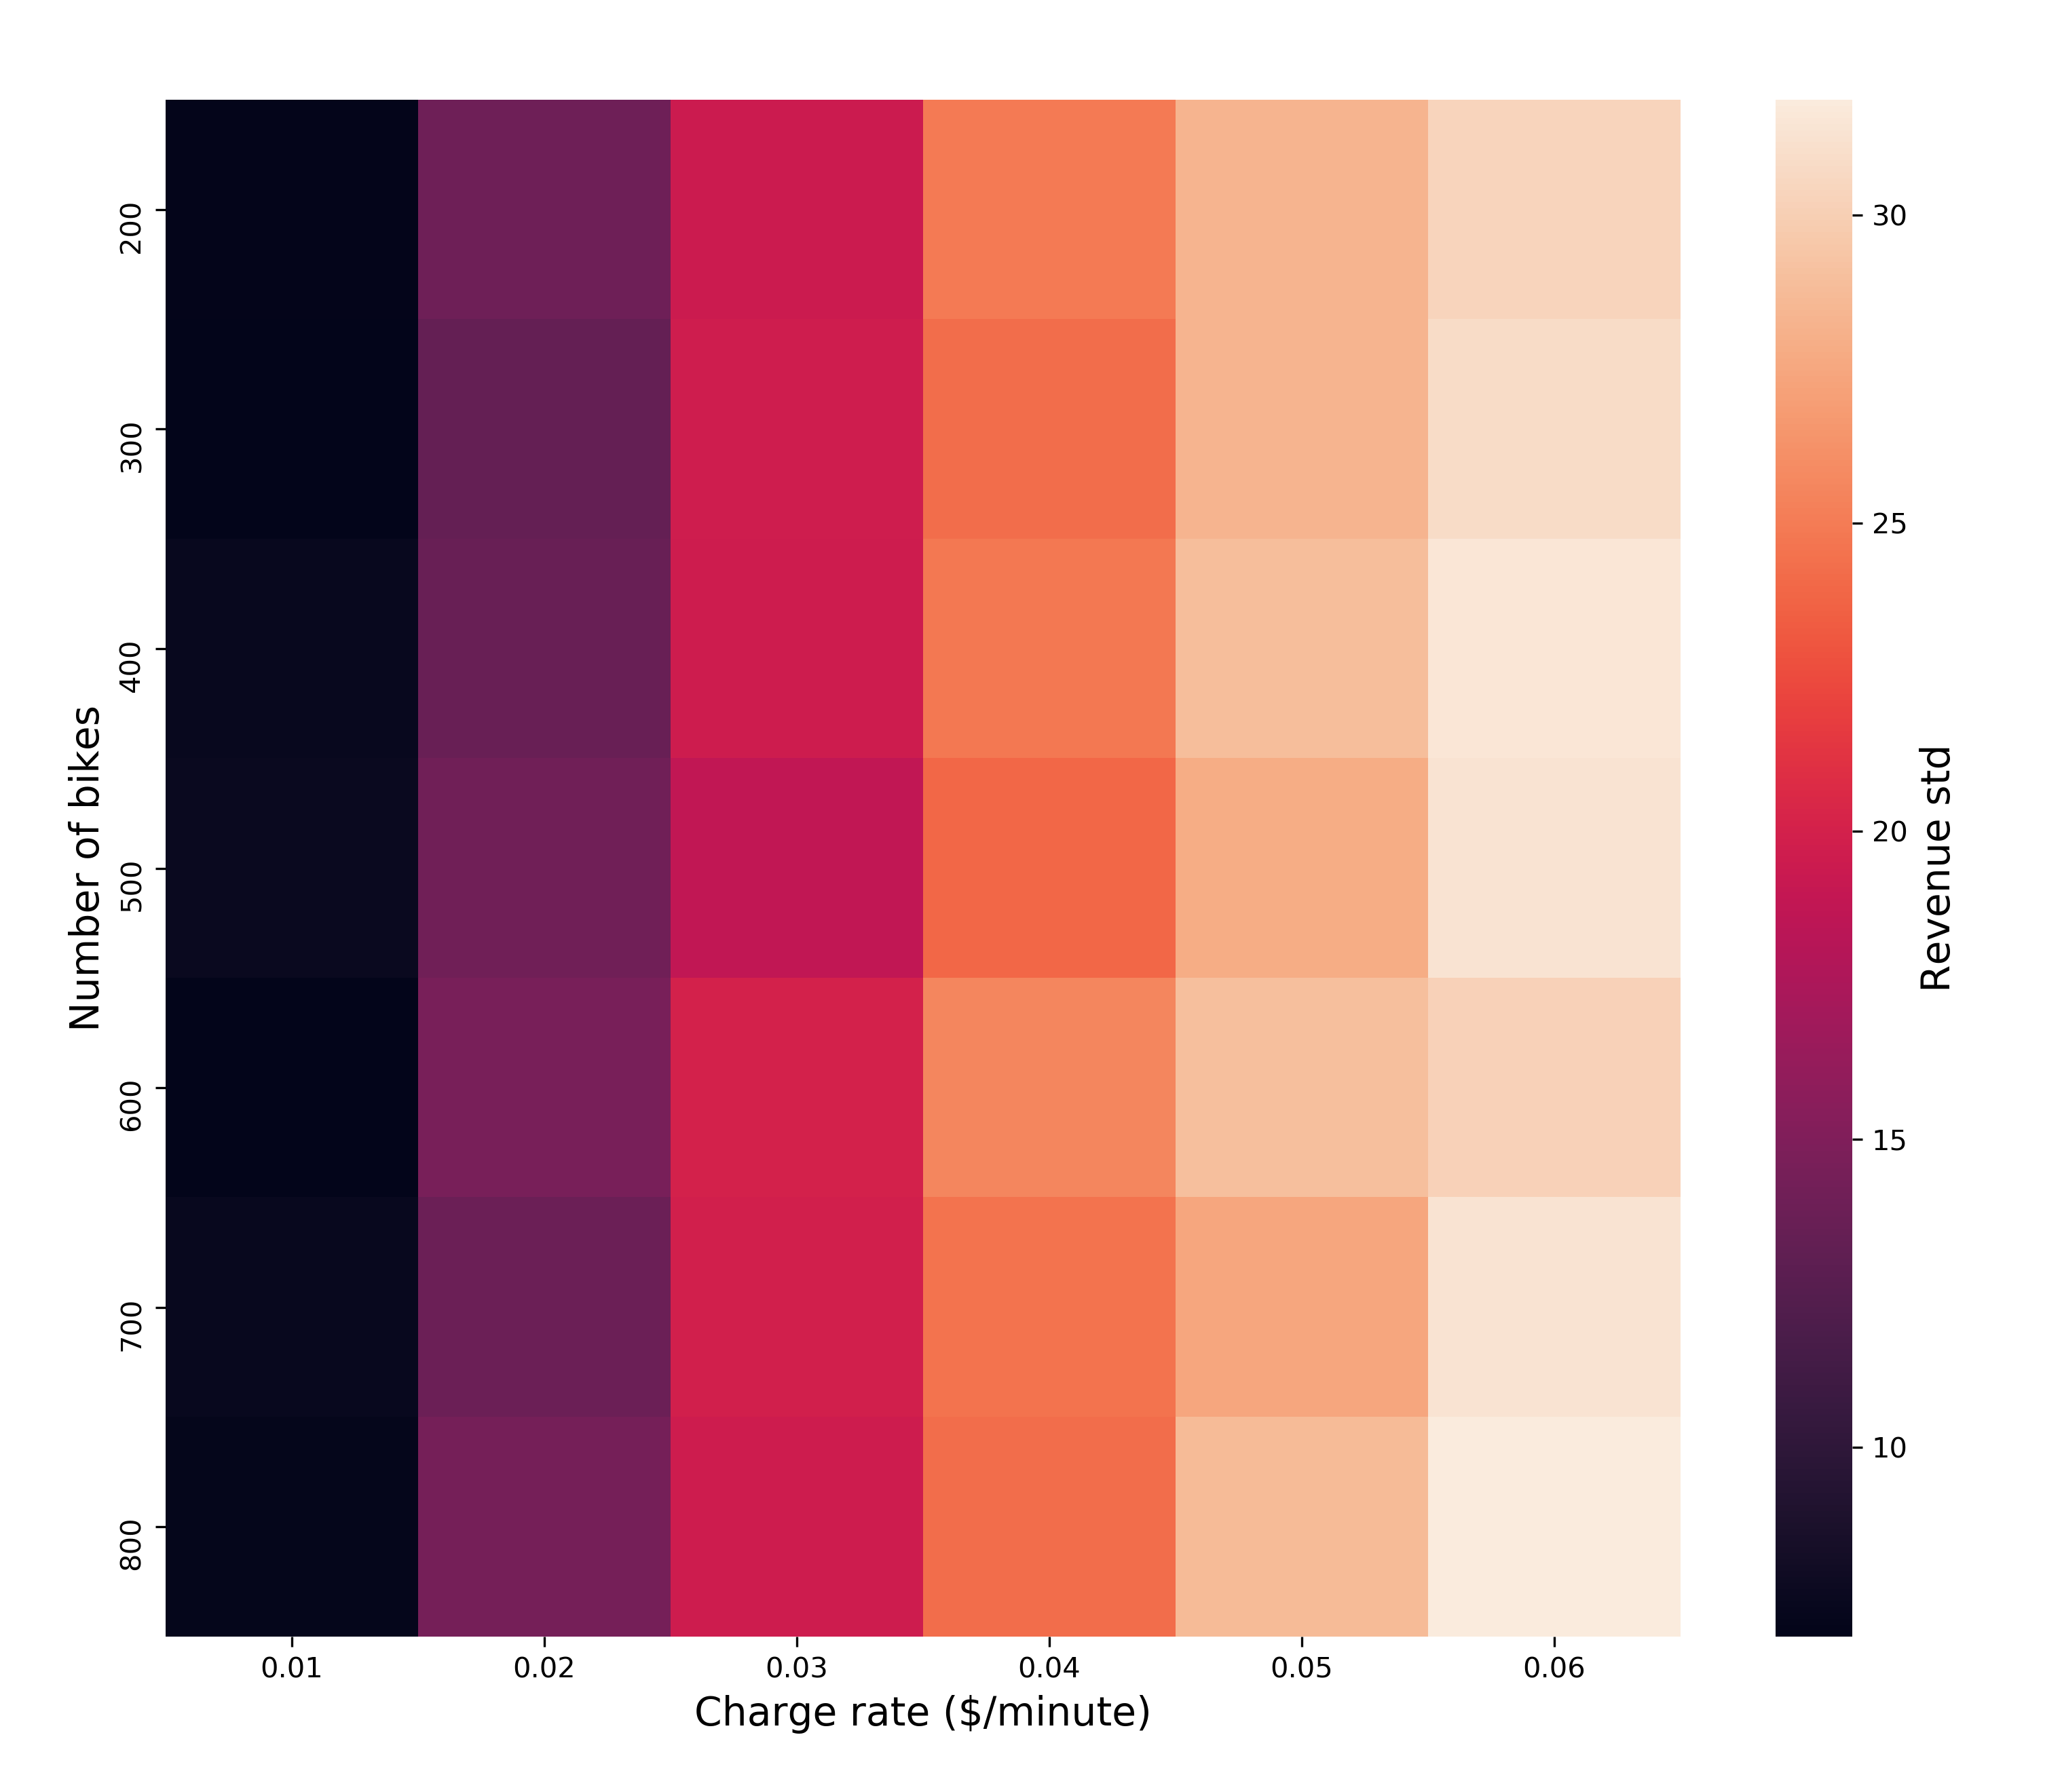
Result
The plot shows the relationship between revenue standard deviation and the pair of bike number and charge rate.
From the plot, we can see that when charge rate is 0.01, revenue doesn’t fluctuate significantly.

Slide 17
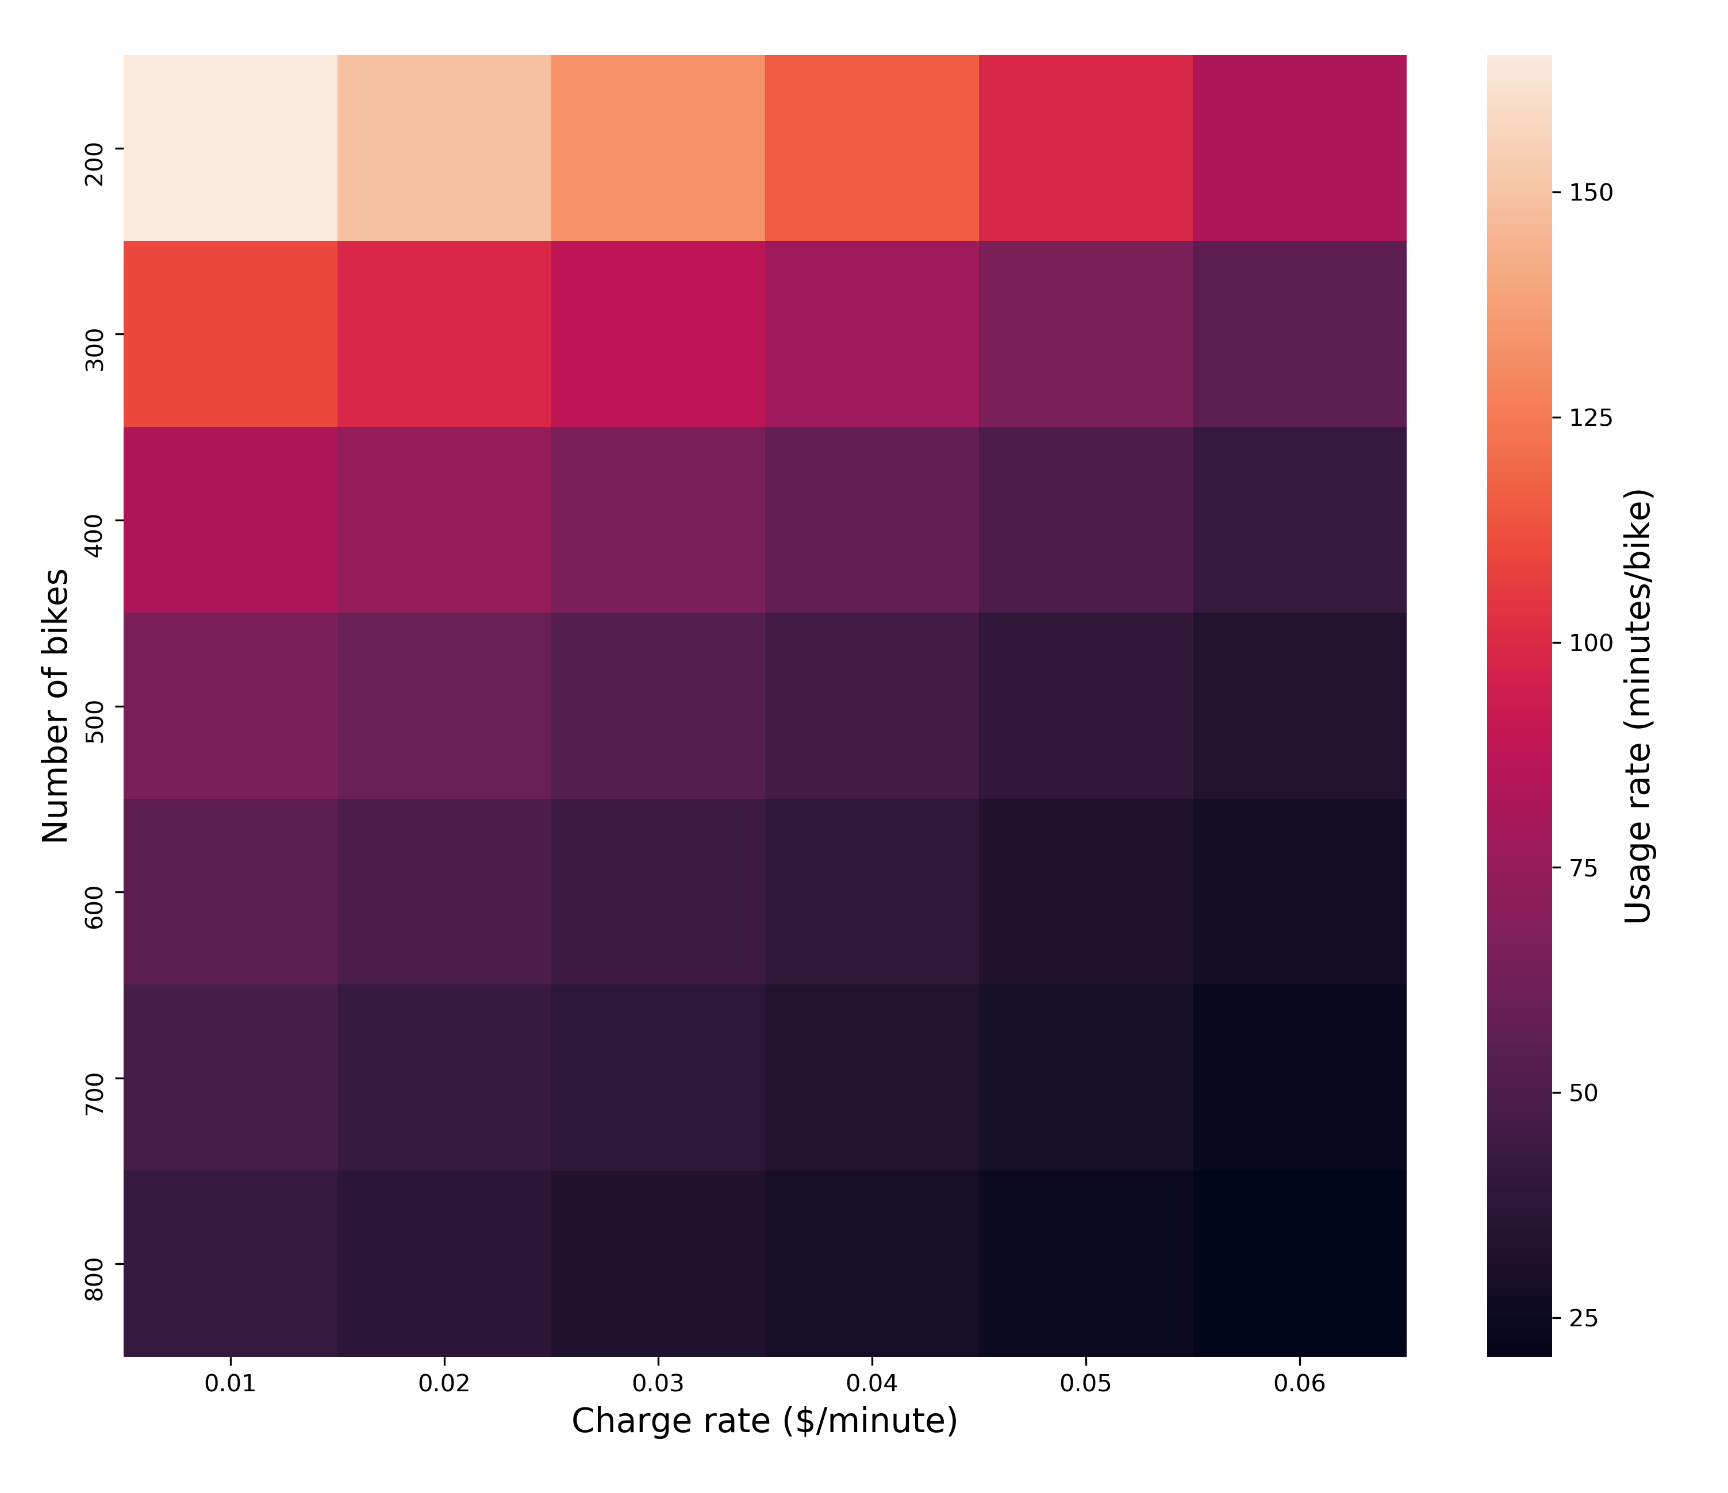
Result
The plot shows the relationship between usage rate and the pair of bike number and charge rate.
From the plot, we can see that fewer bikes and less charge rate result in higher usage rate.

Slide 18
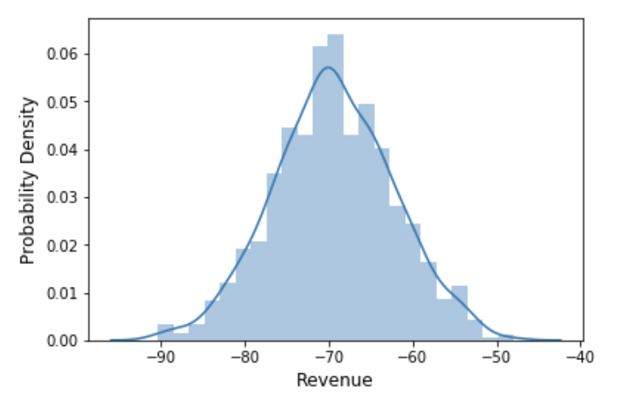
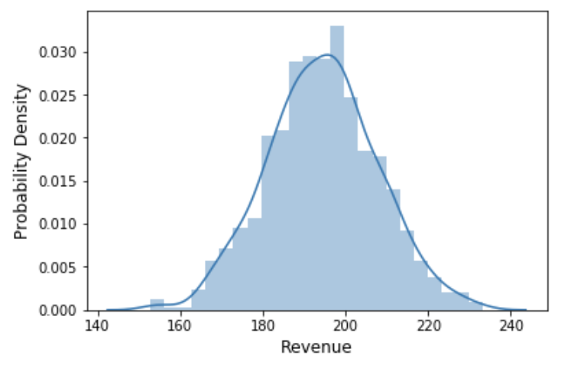
Case Result
Number of bikes = 200
Simulate 1000 times to see the probability density plot of revenue
charge rate = 0.01/min
charge rate = 0.02/min

Slide 19
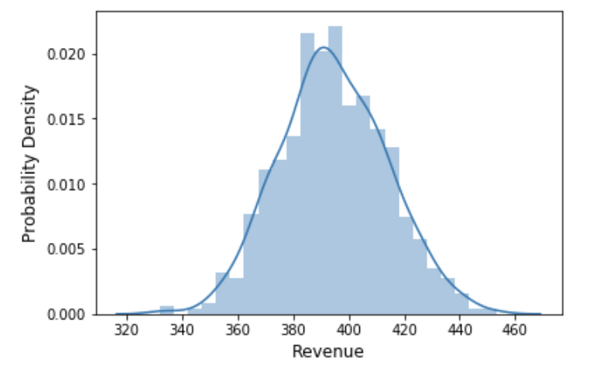
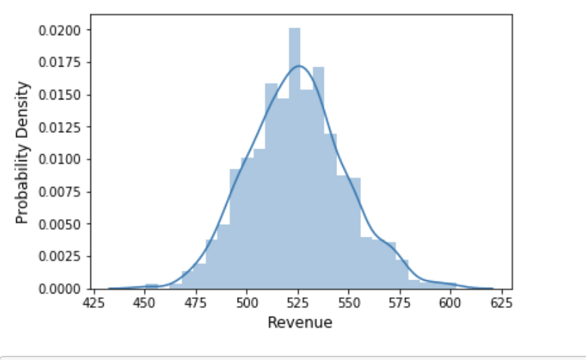
Case Result
Number of bikes = 200
charge rate = 0.03/min
charge rate = 0.04/min

Slide 20
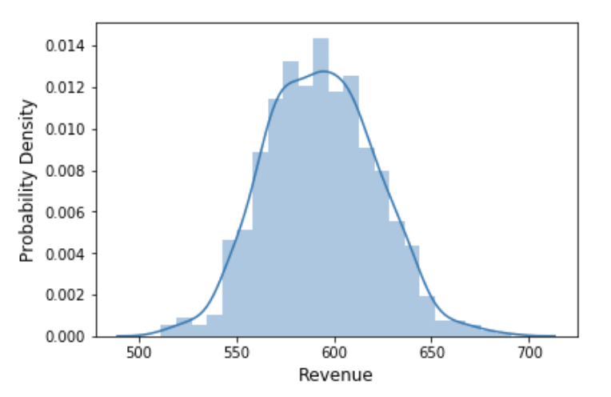
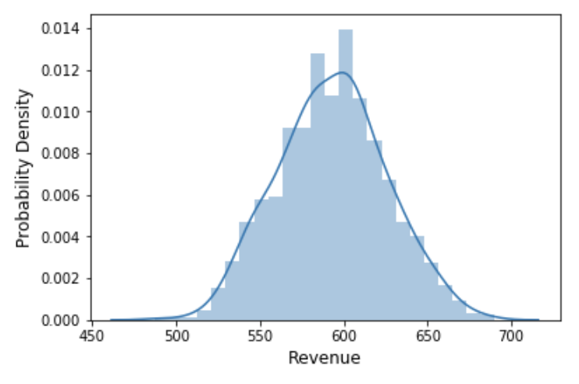
Case Result
Number of bikes = 200
charge rate = 0.03/min
charge rate = 0.04/min

Slide 21
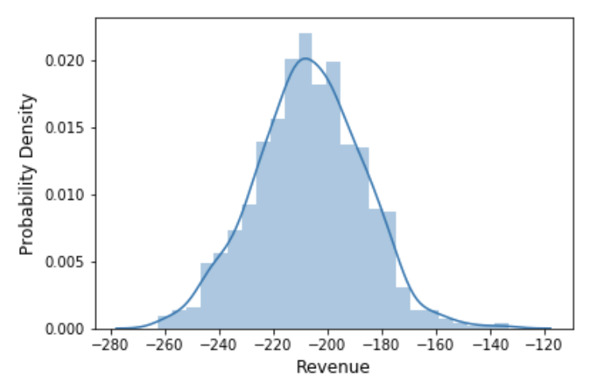
Case Result
Number of bikes = 500
charge rate = 0.03/min

Slide 22
limitation
When considering whether or not the willing students can get bicycles immediately, we use Bernoulli distribution with p, but this probability are not random.
We assume that the cost for bicycles is a fixed number per bicycle per day, but in fact it is a changing value affected by bicycle condition and may include other fees like maintenance cost.

Slide 23
THANKS

