Slide 1
Shared Bicycle
Monte Carlo Simulation
By Jifu Zhao, Yunya Gu, Bo Zhao

Slide 2
Introduction
01
Introduction to the project
CONTENT
Monte Carlo Scenario
02
Scenario simulation
03
Visualization
Visualization of the variables
04
Result
Result and conclusion

Slide 3
Introduction
Introduction shared bicycles and the project

Slide 4
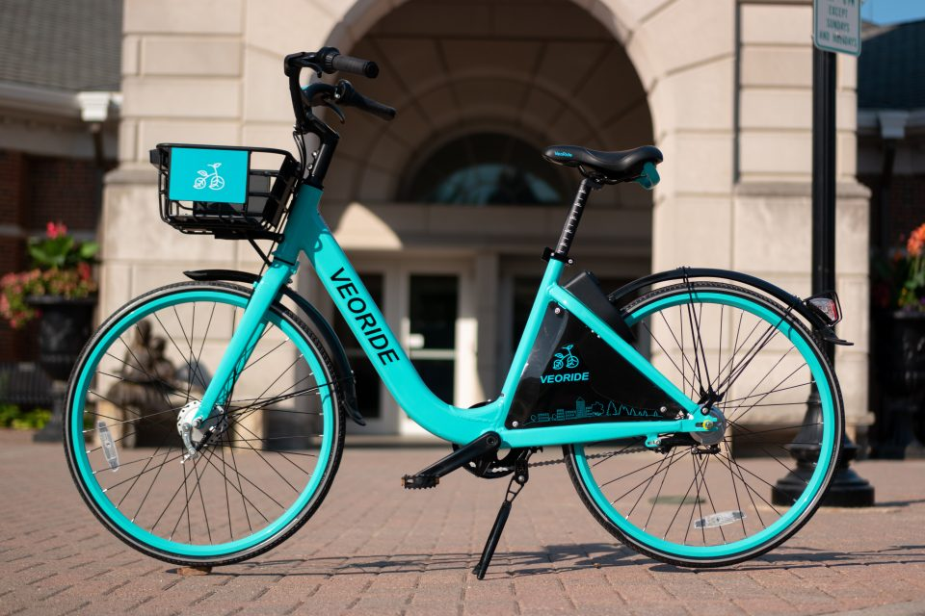
What is shared bike?
These bikes were created by the company VeoRide, a bike sharing company established in March 2017.
Each bike is equipped with GPS, has a self-locking mechanism and can be accessed with a phone app, Riders pay through the app.

Slide 5
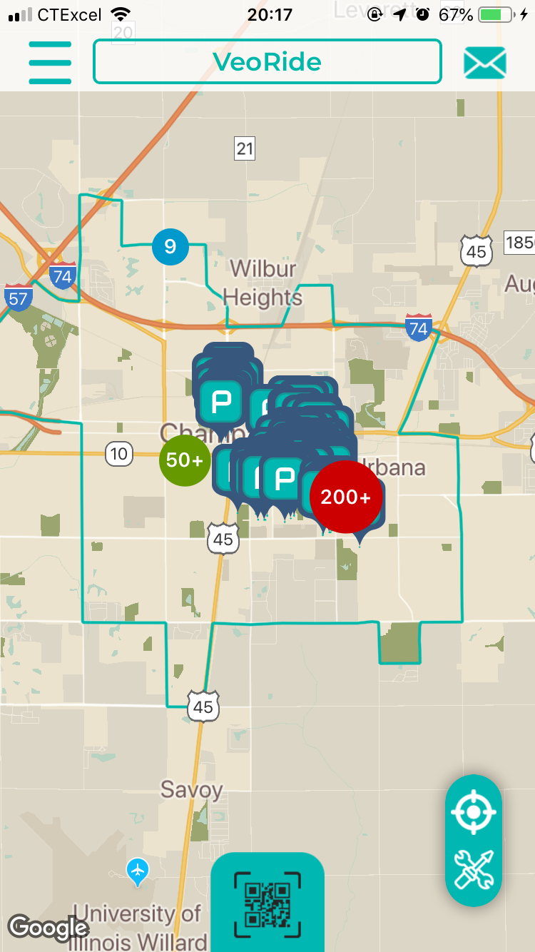
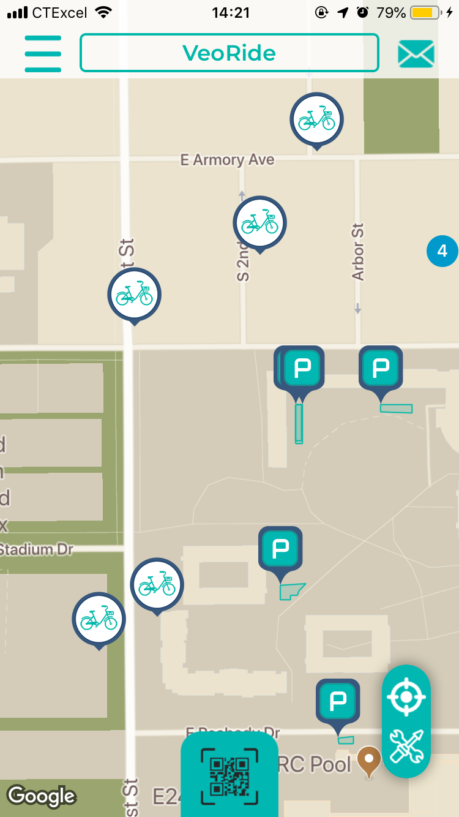
About Veoride app

Slide 6
The purpose of this project
For shared bicycles, it's important to design the management strategy such that the cost can be minimized and the profit is maximized. Two most important factors are number of bicycles and the charge rate for students.
In this project, we want to study the best number of bicycles and charge rate for shared bicycles. Since there are some uncertainties, one way is to use the Monte Carlo simulation. Thus, under certain assumptions, this study analyzes the influence of number of bicycles and charge rate on the profit of shared bicycle program.

Slide 7
Monte Carlo
Scenario
Simulate different number of bicycles and charge rate for shared bicycles

Slide 8
uncertainty
Number of students who are willing to take the ride
-Poisson distribution with given expectation
-the expectation should be inversely related to charge rate
Duration of the trip
-typically between 5 minutes and 30 minutes
Whether or not the willing students can get bicycles immediately
-Bernoulli distribution with p

Slide 9
Other variables and assumptions
Other variables
Assume there are 50,000 students in total
Number of bicycles: 100, 200,
Charge rate: $0.02/min, $0.03/min, $0.04/min
Percentage of students who are willing to take the bicycle: 0.01%, 0.008%, 0.006%
assumptions
Cost for bicycles is fixed number per bicycle per day
Don't consider other uncertainties such as weather effects

Slide 10
Visualization
Visualization of the variables

Slide 11
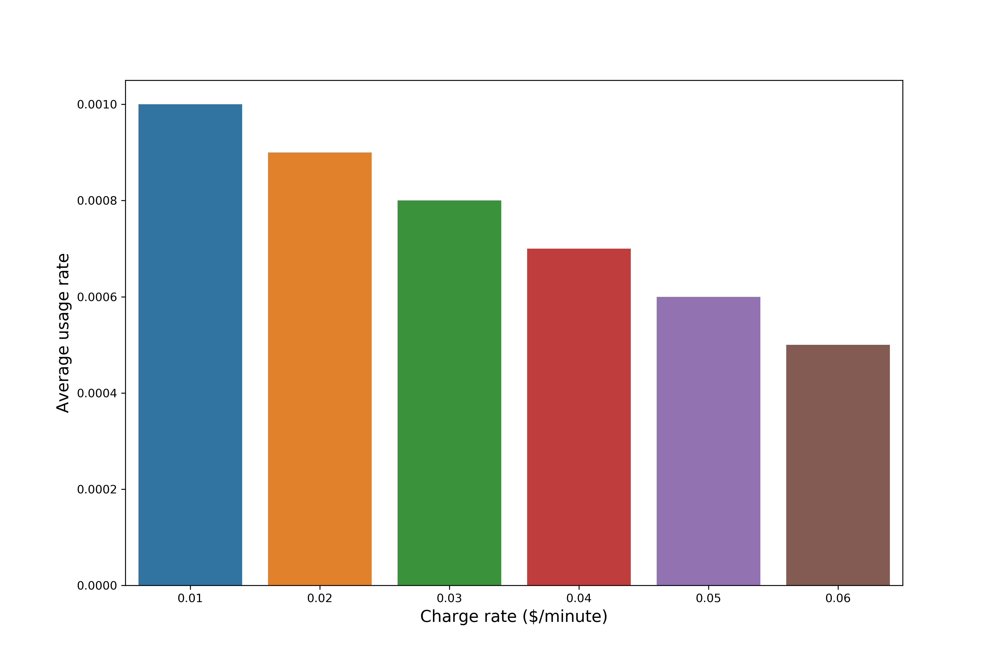
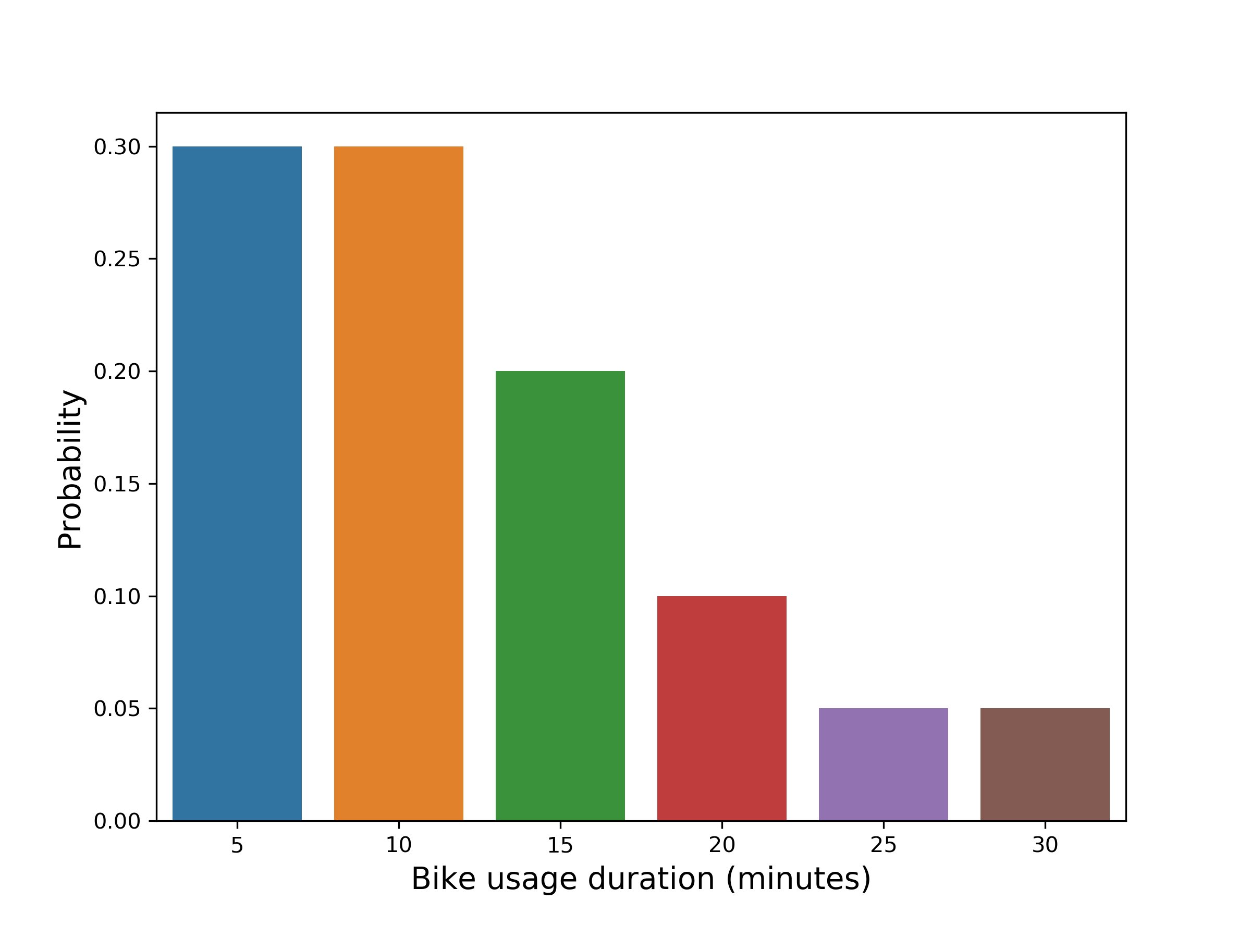
Visualization about the variables
usage rate vs. charge rate
probability of bike usage duration

Slide 12
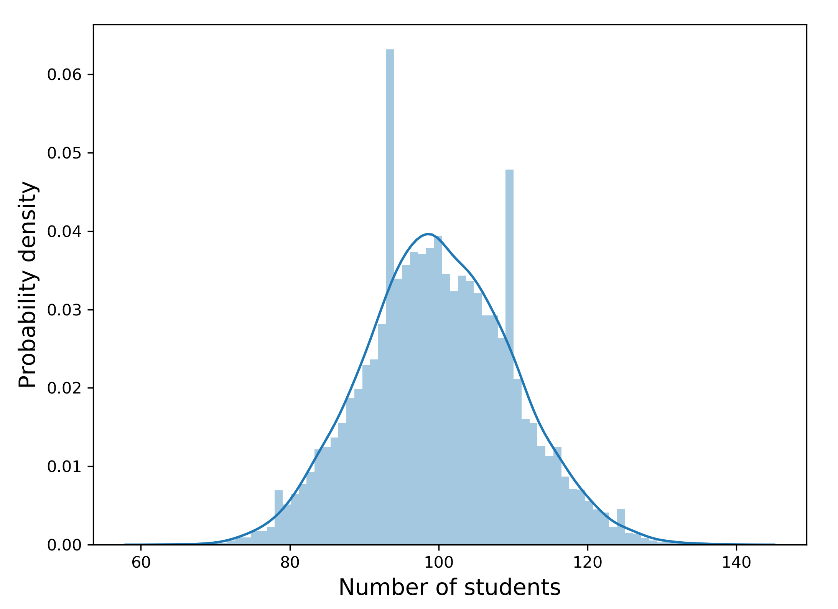
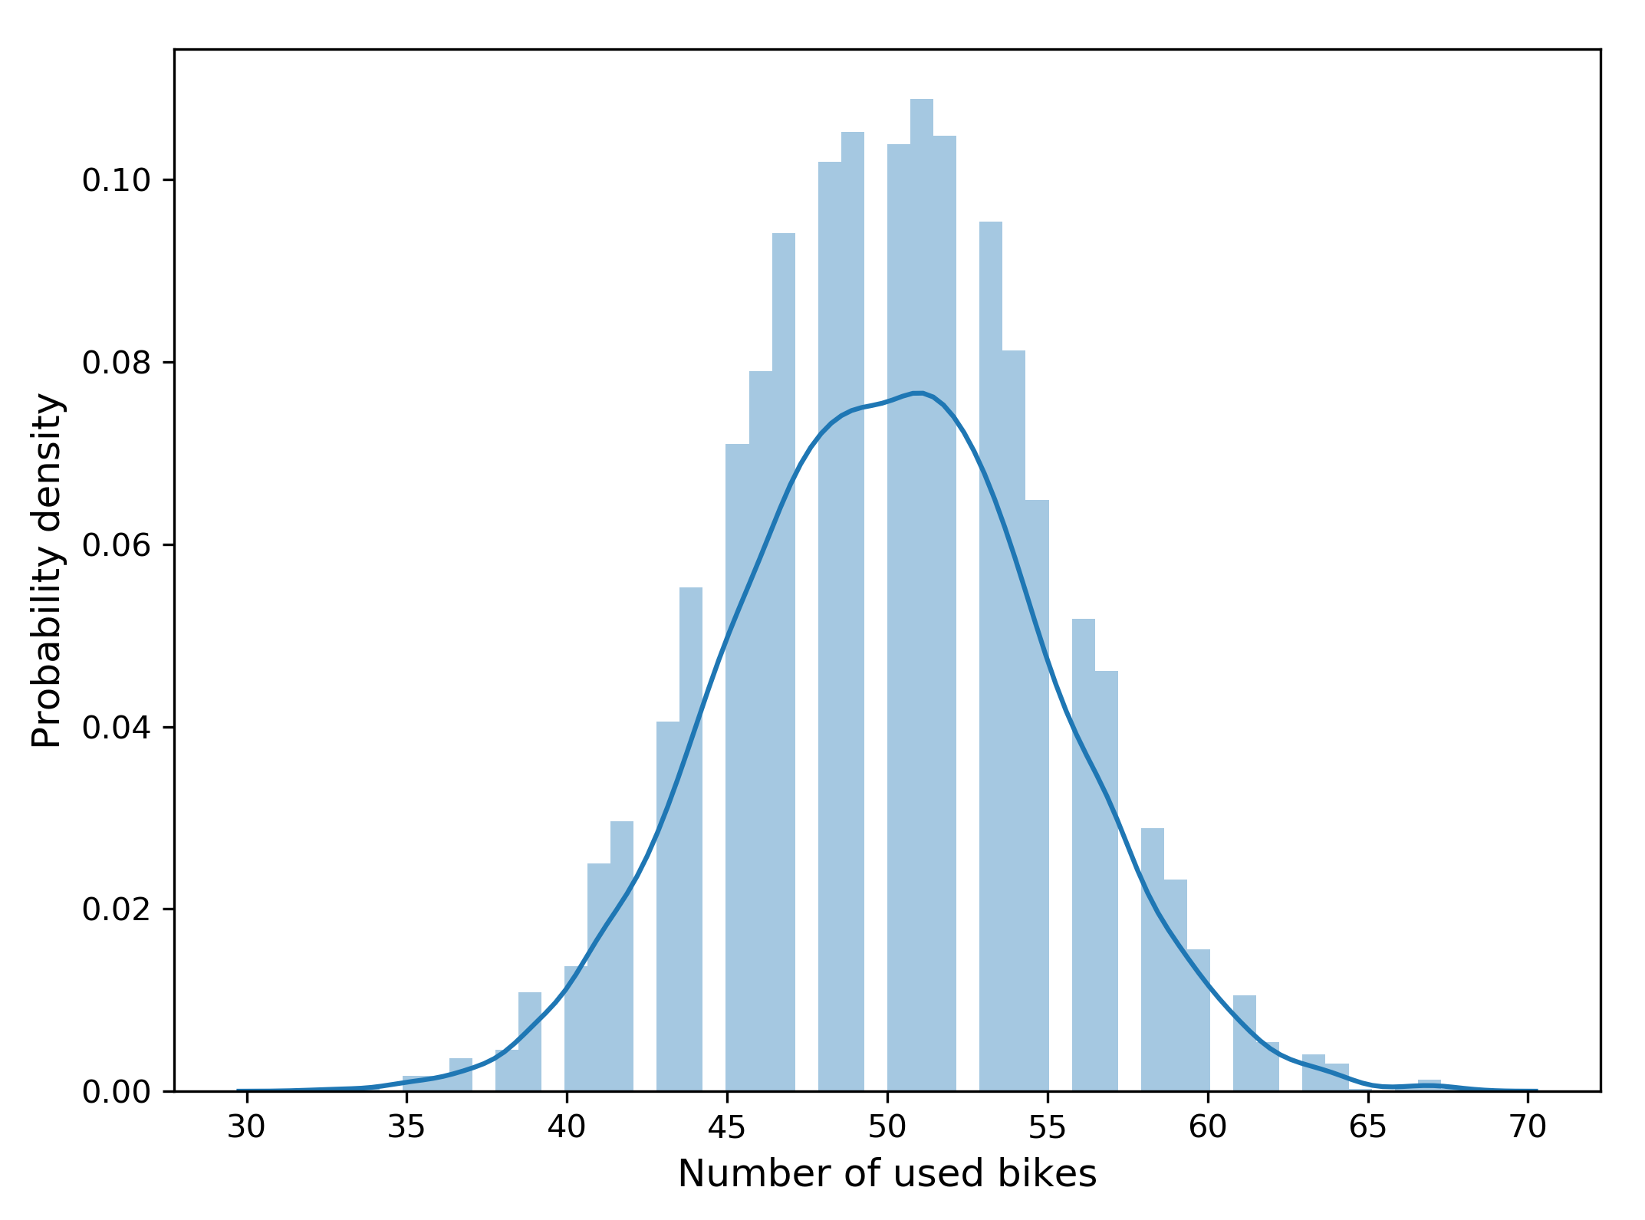
Visualization about the variables
Poisson distribution
binomial distribution

Slide 13
Result
Show the simulation result and conclusion

Slide 14
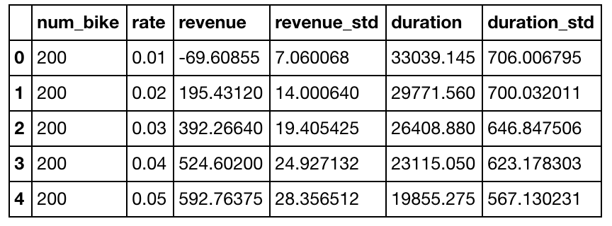
Result
The table below shows the simulation result when the number of bikes = 200 with different charge rate.

Slide 15
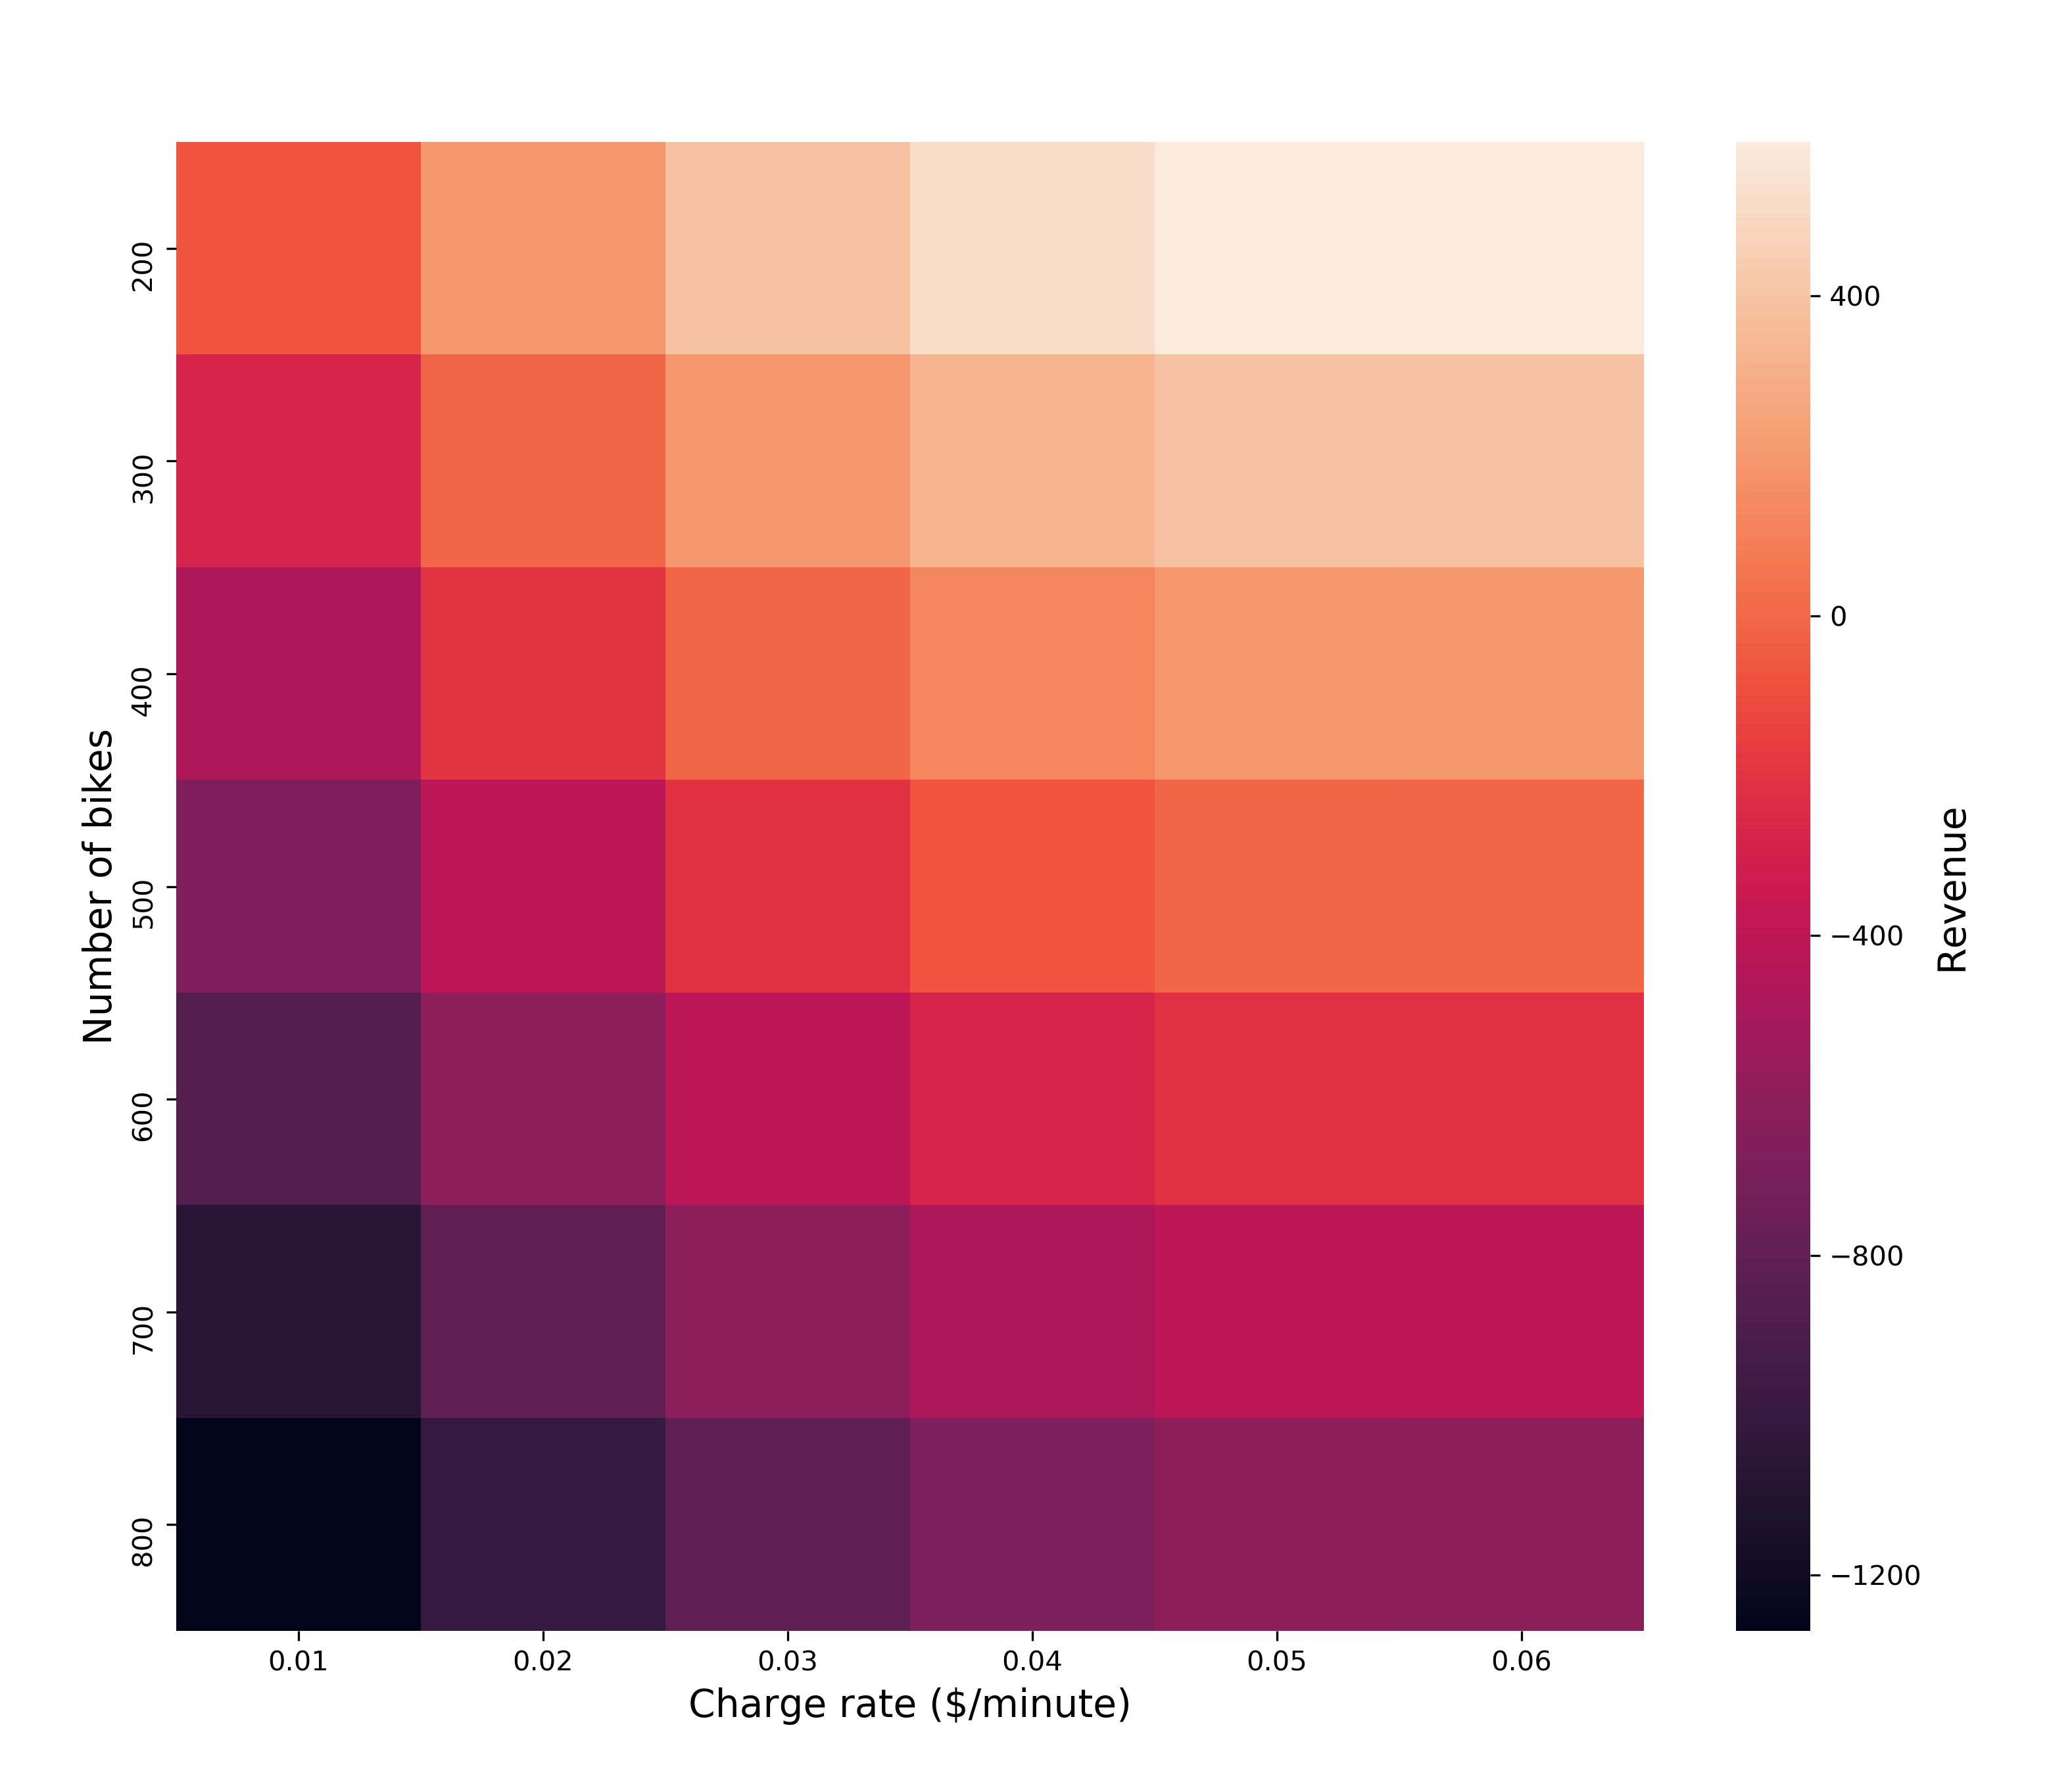
Result

Slide 16
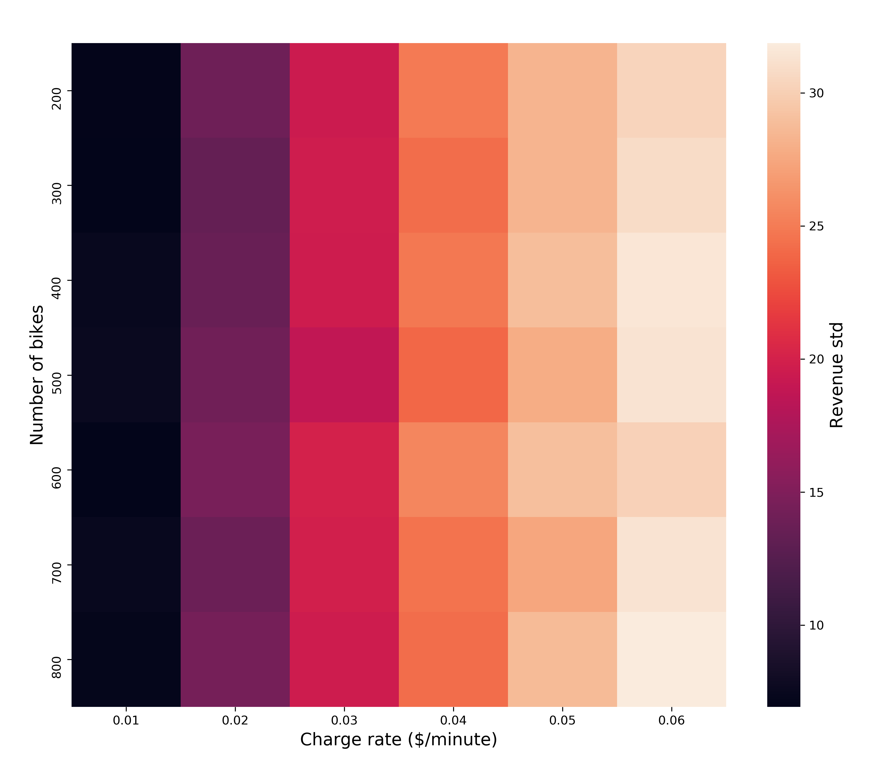
Result

Slide 17
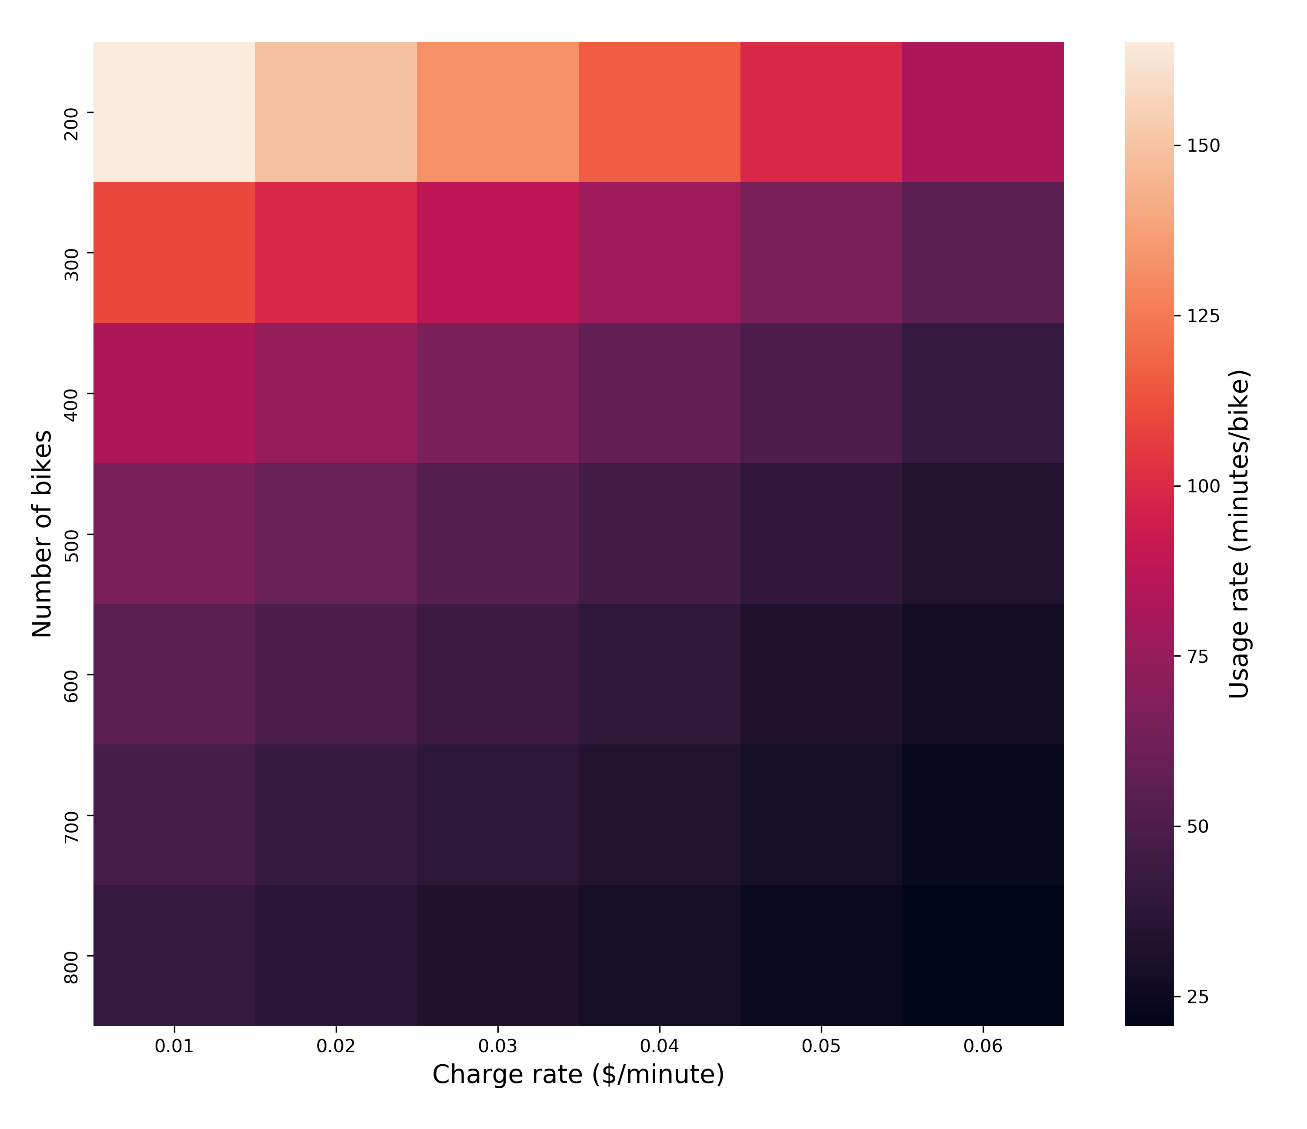
Result

Slide 18
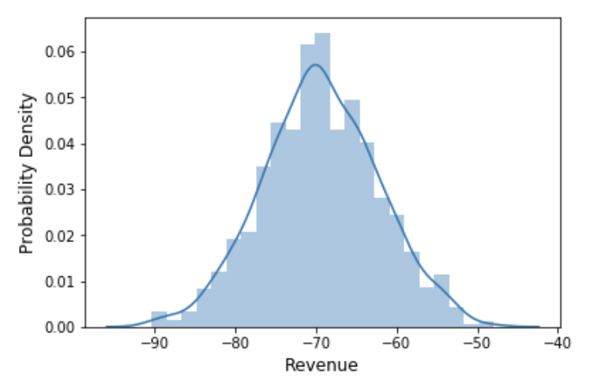
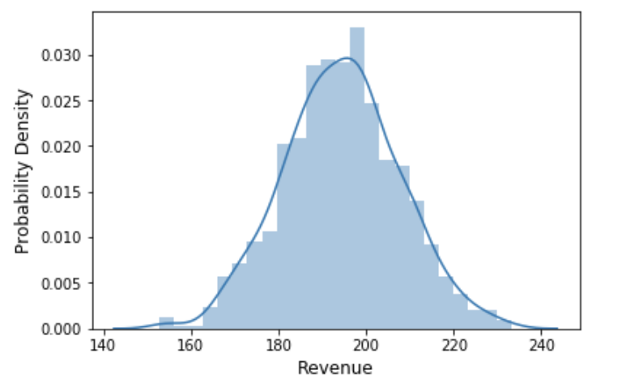
Case Result
Number of bikes = 200
Simulate 1000 times to see the probability density plot of revenue
charge rate = 0.01/min
charge rate = 0.02/min

Slide 19
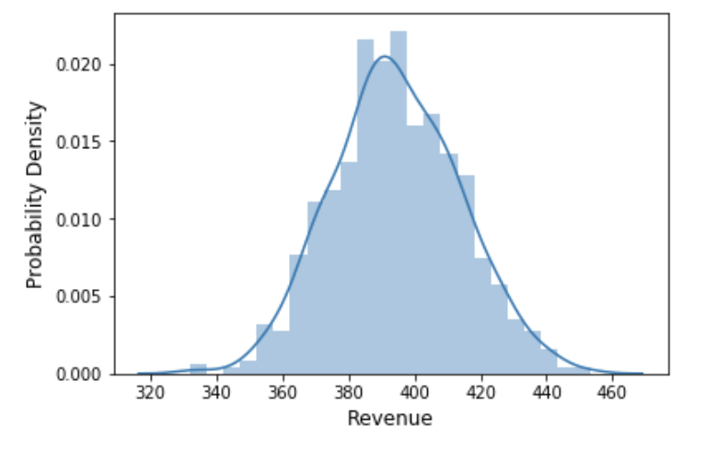
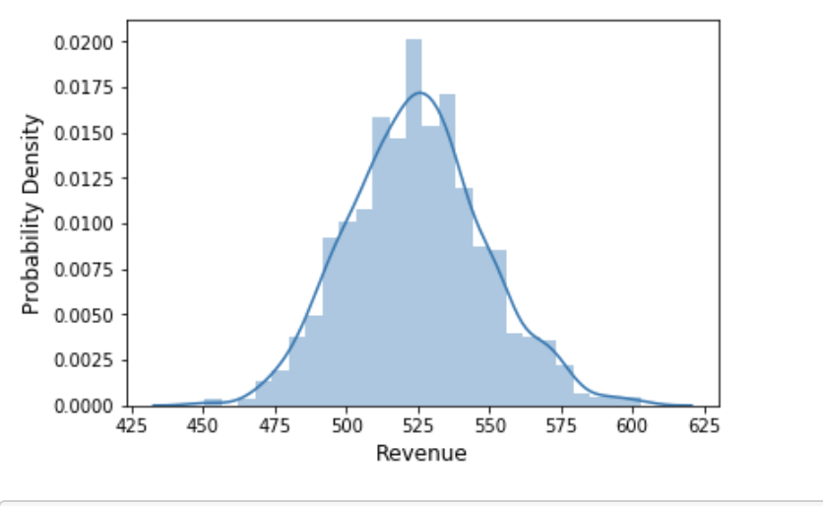
Case Result
Number of bikes = 200
charge rate = 0.03/min
charge rate = 0.04/min

Slide 20
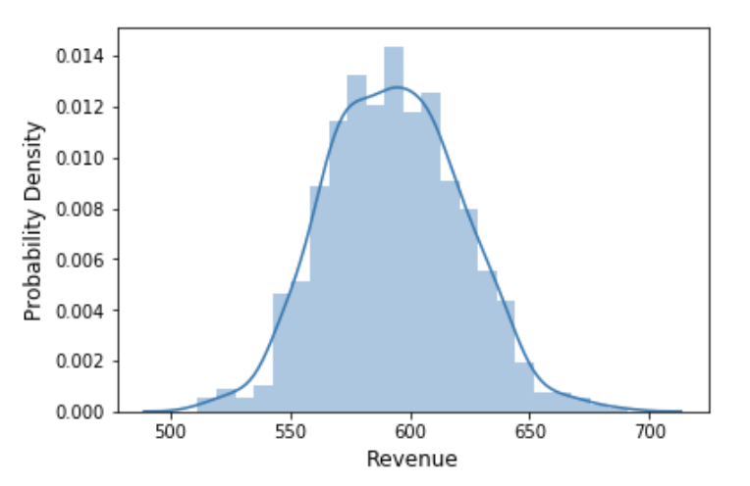
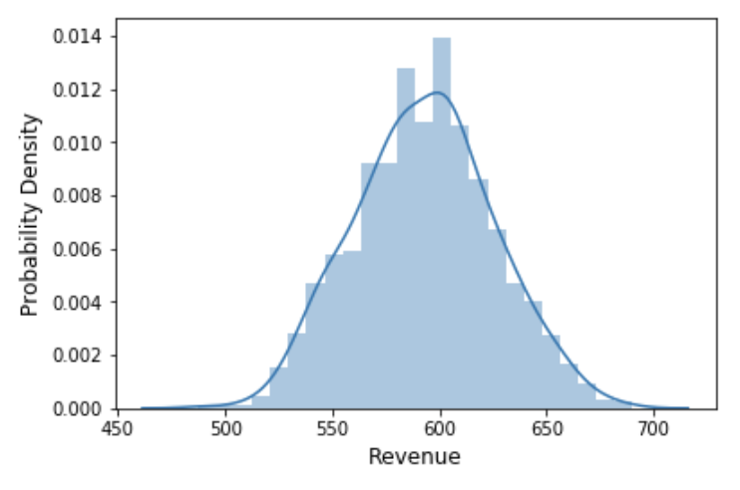
Case Result
Number of bikes = 200
charge rate = 0.03/min
charge rate = 0.04/min

Slide 21
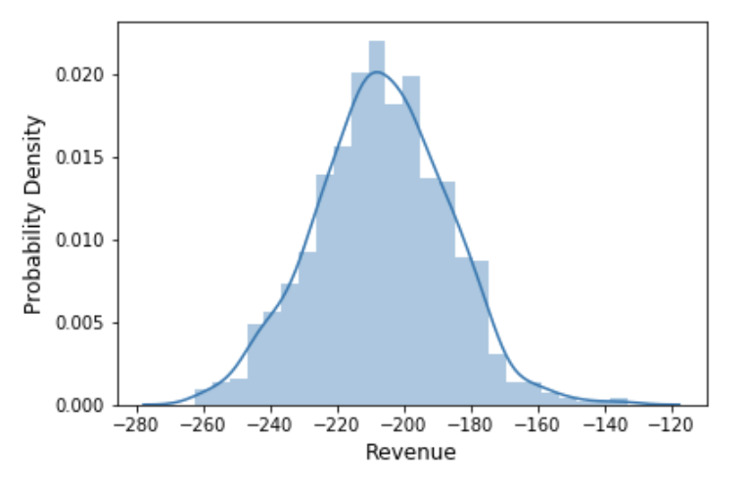
Case Result
Number of bikes = 500
charge rate = 0.03/min

Slide 22
Conclusion & limitation
Conclusion
Limitation
When considering whether or not the willing students can get bicycles immediately, we use Bernoulli distribution with p, but this probability may change based on the student’s location and the weather condition
We assume that the cost for bicycles is a fixed number per bicycle per day, but in fact it is a changing value affected by bicycle condition and may include other fees like maintenance cost.

Slide 23
THANKS

