Slide 1
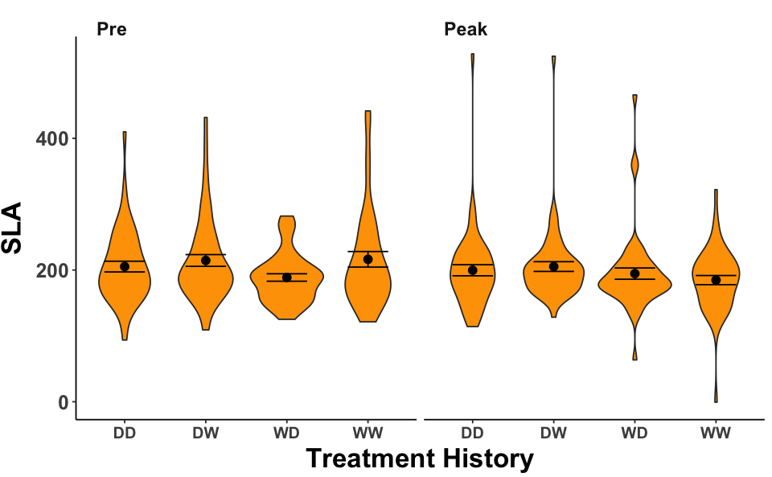
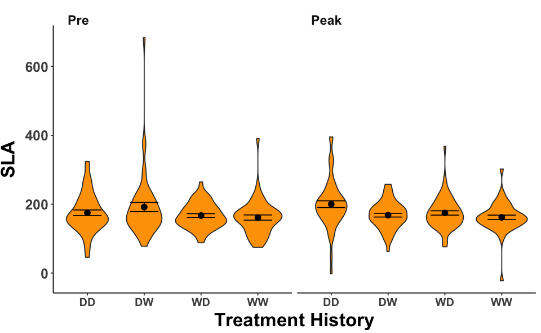
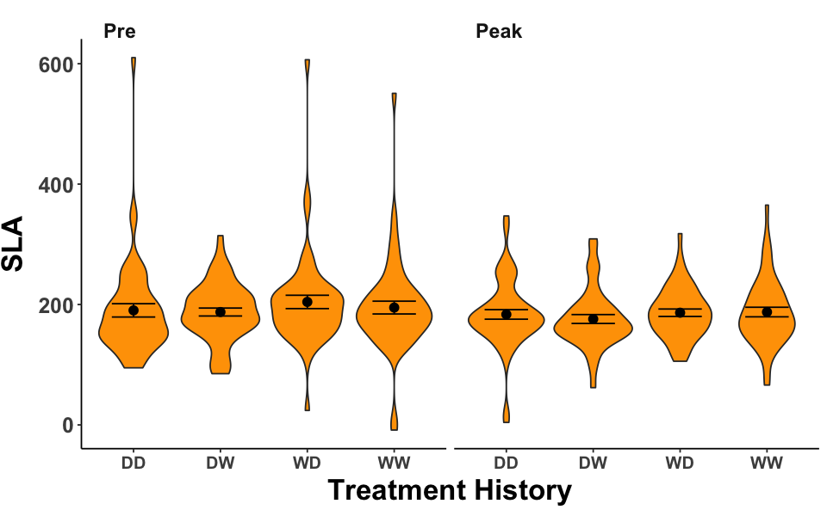
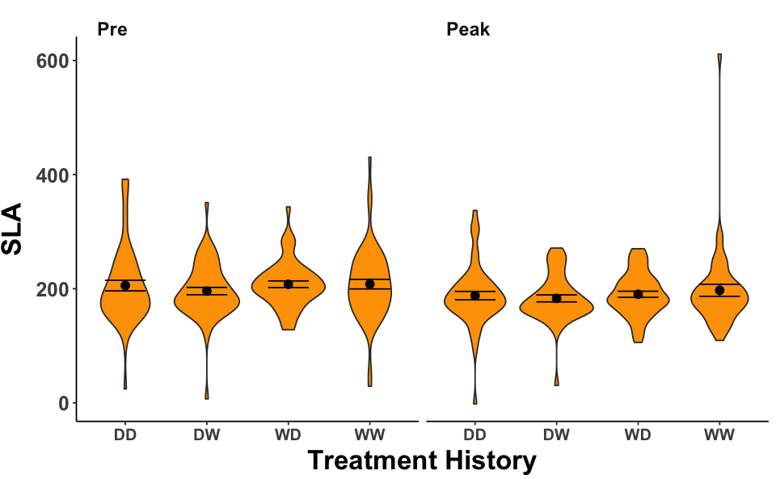
North Wet
North Dry
No sign.
TrtHis p < 0.01
Yr*TrtHis p < 0.1
DD broader
South Wet
South Dry
No sign.
Yr p = 0.04
Smaller, thicker leaves peak

Slide 2
North Wet
North Dry
TrtHis p = 0.04
TrtHis p = 0.03
South Wet
South Dry
No sign.
No sign.
Notes:
North wet:
#pre-peak DD p < 0.001
#peak DD-WW p < 0.001 DD heavier than WW
#peak DD-DW p < 0.001 DW heavier than DD
#peak DD-WD p < 0.001 DD heavier than WD
#pre DD-WW p = 0.09 DD heavier than WW
North Dry:
#pre-peak DD p < 0.001 Peak is heavier
#peak DD-WW p < 0.001
#peak DD-DW p < 0.001
#peak DD-WD p < 0.001
#DD is heavier than all others in peak

Slide 3
North
No Sign.
South
No Sign.

Slide 4
North
TrtHis p = 0.002
South
TrtHis p = 0.04
Year p = 0.03
DD peak germinates earlier than DD pre
Peak DD germinates earlier than peak WW
Peak DW germinates later than WD, DD
Peak WD germinates earlier than DD
Peak DD germinates earlier than DD pre
Peak DD germinates earlier than WW and DW
Peak DD germinates later than WD
Notes:
We are just beginning to understand population-level responses to extreme climatic perturbations. Populations of the same species from different climatic regions can have different ancestral traits that have evolved via local adaptation and this can alter their evolutionary trajectories when exposed to similar selection pressures. My thesis examines how populations of Mimulus (Erythranthe) cardinalis (scarlet monkeyflower) from historically different climates respond to a severe drought, using a resurrection approach to grow ancestral and descendant individuals in a common environment. Plants were grown in either wet or dry treatments. Populations in the north (historically wetter and less variable) do not show clear evolutionary changes at the macro-morphological scale (e.g. date of flowering, specific leaf area), while central (intermediate climate) and southern populations (historically drier and more variable) evolve toward dehydration avoidance (later flowering time and lower specific leaf area). These differences might be attributed to differences at micro-morphological scale, where northern populations evolved greater plasticity in stomatal density and palisade mesophyll thickness, trending toward dehydration avoidance and potentially allowing macro-morphological traits to remain stabilized. Southern populations began drought avoidant, but evolved further along this trajectory, resulting in a trade-off for photosynthesis under wet conditions. Interestingly, these alterations in leaf architecture resulted in photosynthetic homeostasis across dry treatments and populations. Thus, although at the macro-scale northern populations did not show a clear trend, anatomical features provided more insight into how physiology and phenology could be maintained. For southern populations that showed a clear evolutionary change in phenology, micro-scale measurements reveal that this is a result of further specialization to drought. In addition to this, differences across northern and southern population evolutionary trajectories can also be attributed to adaptive lags and transgenerational plasticity. Climate of 1- to 2-years prior, and not positive autocorrelation in climate, can often better explain macro-morphological changes observed for northern populations under dry treatments. In contrast, there was no pattern for immediate climate history on southern population responses to current treatment. This suggests that past climates are better indicators of the phenology of the current year rather than phenotypic responses to the present climate in the north but not in the south. In an additional resurrection experiment, northern and southern populations were grown for 3 generations under either wet or dry treatments. This was to assess the role of non-genetic inheritance (epigenetics and maternal accumulative stress memory) on phenotypes. Northern populations were more likely to exhibit epigenetic differences (flower number, specific leaf area), while southern populations were not. Both regions evolved maternal accumulative stress memory for germination rate, meaning droughted maternal plants had earlier germinating offspring than wet material plants.

Slide 5
North Wet
No sign
North Dry
PrePeak p = 0.08
PrePeak p = 0.08
South Wet
South Dry
No sign.

Slide 6
North Wet
No sign
North Dry
PrePeak o = 0.09
History p = 0.09
South Wet
No sign
South Dry
PrePeak o = 0.09
History p = 0.09

Slide 7
North Wet
Yr*TrtHis p = 0.095
North Dry
TrtHis p = 0.065
Peak DD has the most flowers
Peak DD more than pre DD
And peak DD more than all others
DW has more flowers in pre
WW has more flowers than DD in peak
Peak DD more than pre DD
South Wet
South Dry
No sign.
No sign.

Slide 9
North
South
Trt < 0.001
Trt = 0 .08
Year = 0.06

Slide 10
North Wet
No sign
South Wet
No sign
North Dry
Trt = 0.01
Year*Trt = 0.03
South Dry
Year = 0.04

Slide 11
North Wet
Trt = 0.01
South Wet
Trt = 0.06
North Dry
No sign.
South Dry
Trt = 0.02

Slide 12
North Wet
Trt = 0.09
South Wet
Year*Trt = 0.01
North Dry
No sign.
Year*Trt < 0.001
South Dry

Slide 13
North Wet
Trt = 0.02
South Wet
No sign.
South Dry
Trt = 0.03
North Dry
No sign

Slide 14
North Wet
Trt < 0.01
South Wet No sign.
South Dry No sign.
North Dry
Trt = 0.07

