Slide 1
Programming Project P2PChat
2018/19 COMP3234

Slide 2
Objectives
An assessment task related to ILO4 [Implementation] – “be able to demonstrate knowledge in using Socket Interface to design and implement a network application”.
A learning activity to support ILO1, ILO2a, ILO2d, & ILO4.
The goals of this programming project are:
to get a solid experience in using Socket functions to implement a real-life protocol;
to get a good understanding of how a text-based networking protocol works as well as how to implement one.

Slide 3
Teamwork or Individual work
You can form a team of two to work on the assignment
You can work on your own but you have to show that you are capable to work individually (e.g., good grades in the programming courses)
Here is the URL to the registration page on the course’s Moodle site:
http://moodle.hku.hk/mod/feedback/view.php?id=1375884
Register with us on or before March 6 and we shall release the groupings on March 7

Slide 4
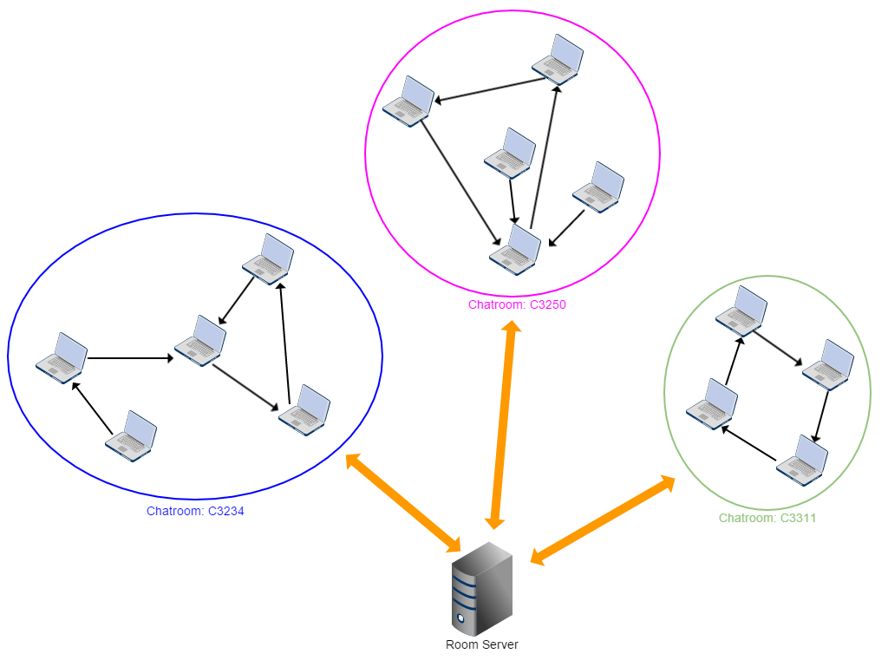
System Overview
The peers form their own network and distribute their chat messages amongst the group.
Room server only acts as a registry to keep track of the list of active chatroom groups and their membership lists.

Slide 5
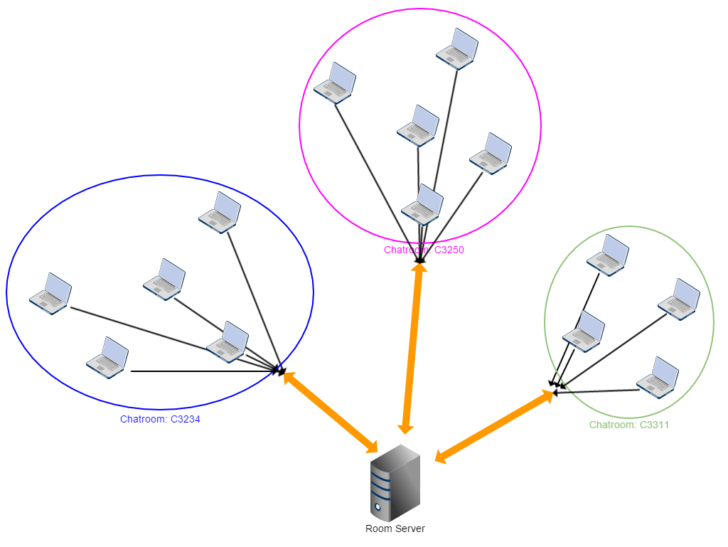
Traditional Centralized Chat Server
The room server does all the things: managing chatroom groups and their membership lists, receiving all chat messages and broadcasting the messages to all members in the group

Slide 6
Task
Develop an instant chat program which
uses a P2P unstructured overlay network for message exchanges between peers
interacts with a Room server to find/create a chatroom group and discovers membership information
Given
The executable binary of the Room server program – room_server
Protocol used by the P2PChat peers and the Room server
The UI framework of the P2PChat program – P2PChat-UI.py

Slide 7
Structure of the Project
Stage One (9 points)
Stage Two (9 points)
Focus on the interactions between P2PChat program and the Room server
Focus on the interactions between P2PChat peers
Focus on the formation and upkeep of the P2P overlay network
Focus on the UDP Poke function between P2PChat peers

Slide 8
P2PChat program
To run the program,
python3 P2PChat.py <roomserver_address> <roomserver_port> <myport>
roomserver_address – IP address or hostname of the Room server
roomserver_port – the listening port number of the Room server
myport – the listening port number used by this P2PChat peer for both TCP and UDP communications

Slide 9
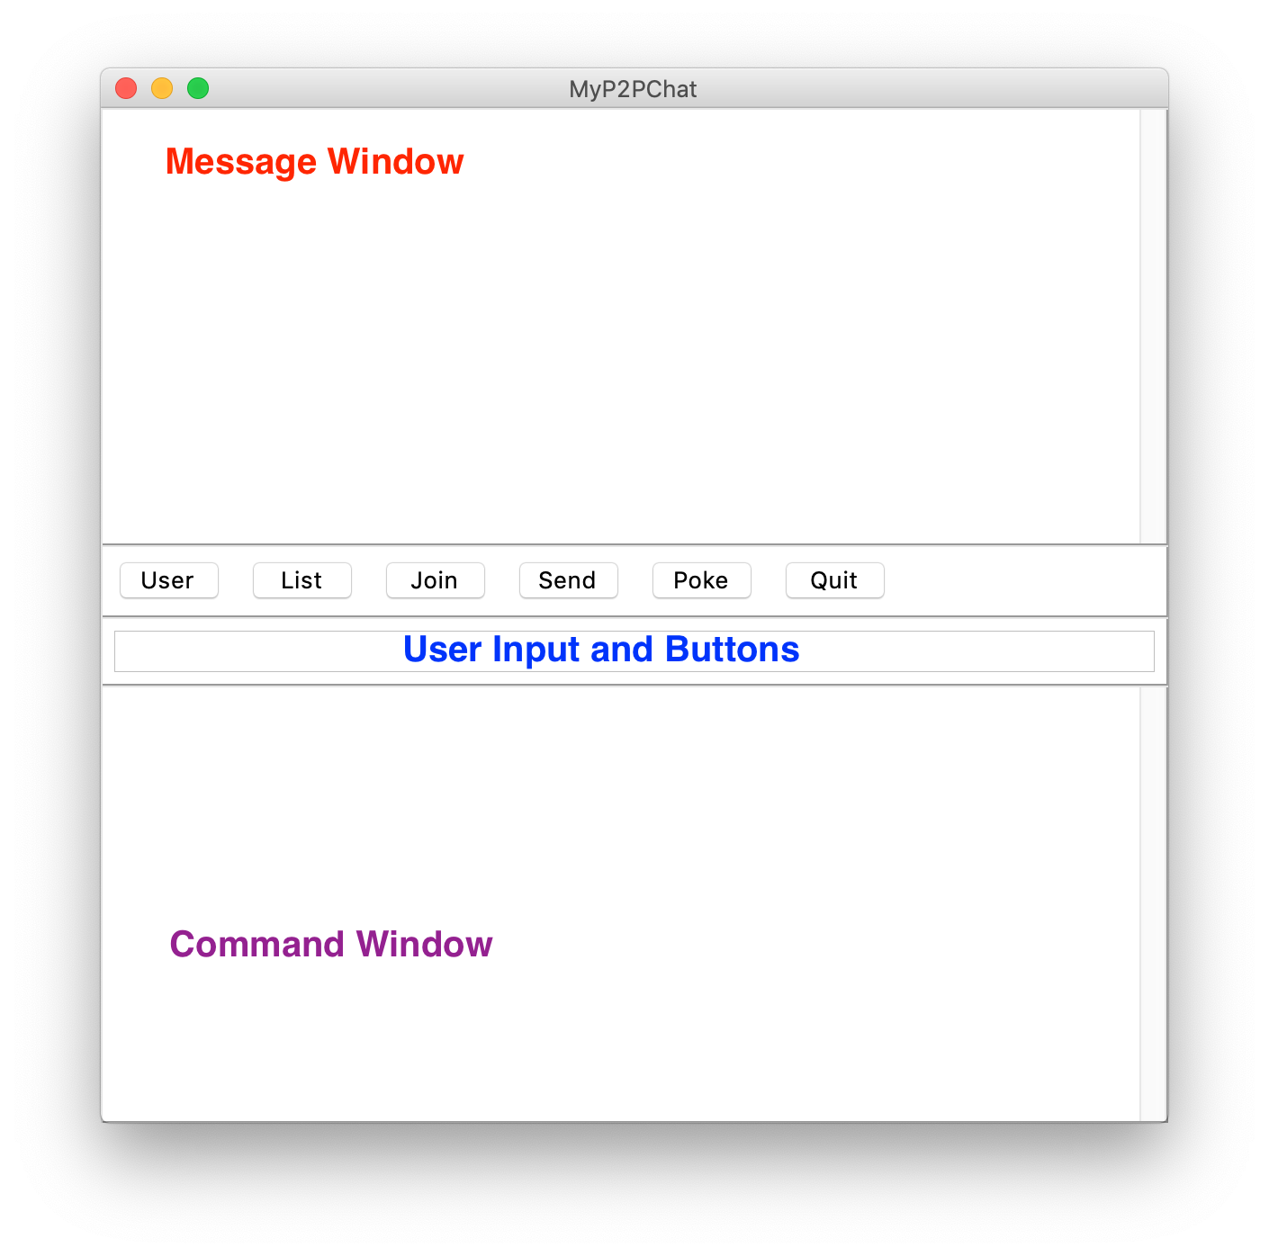
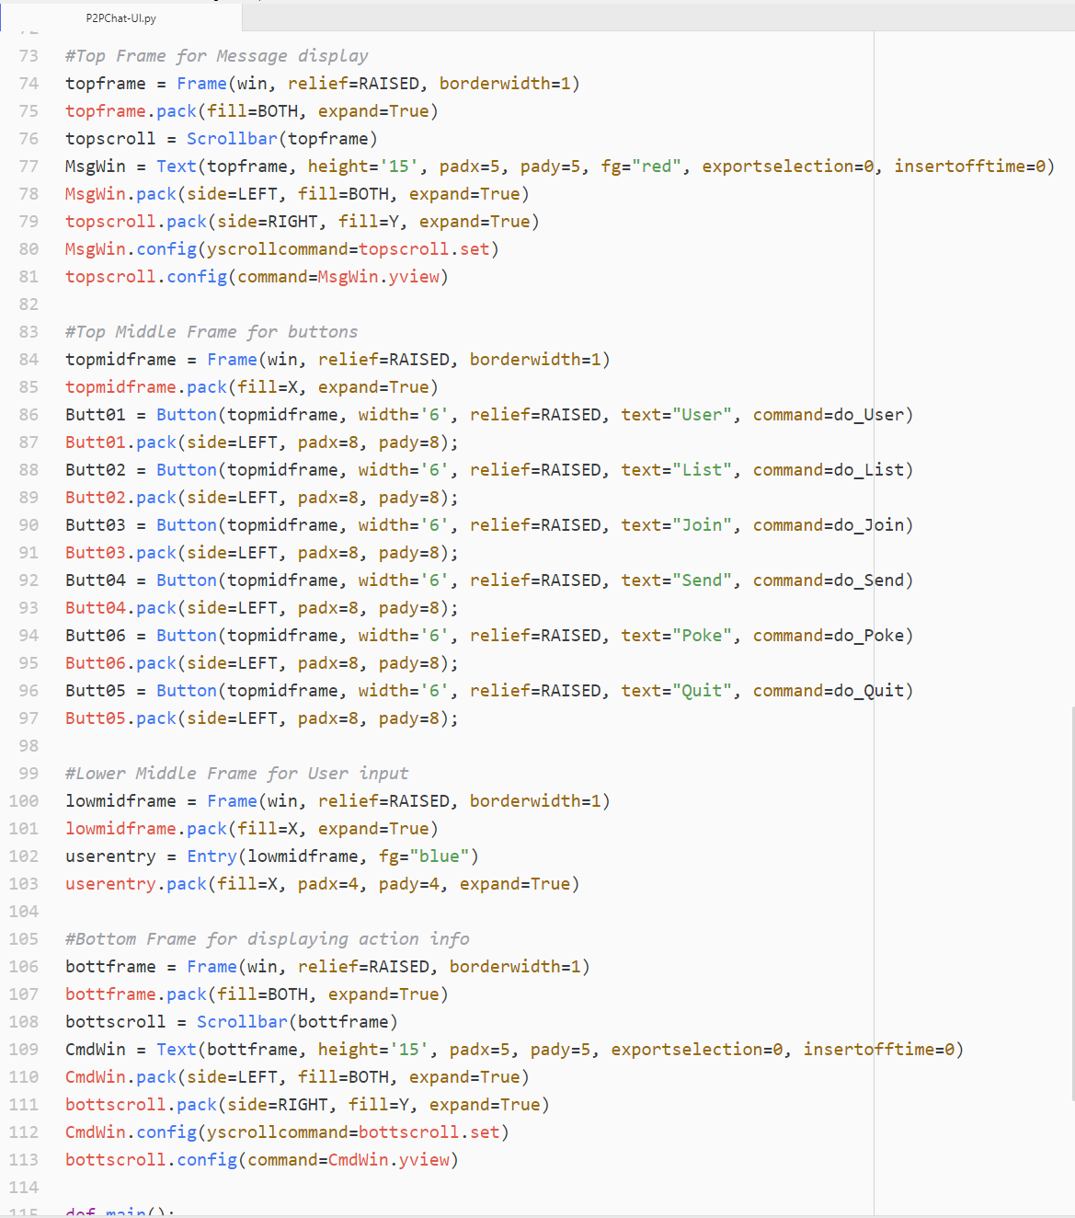
UI of P2PChat program
this is the place where all chat messages are displayed
This is the place for displaying system messages that show what actions/events have happened

Slide 10
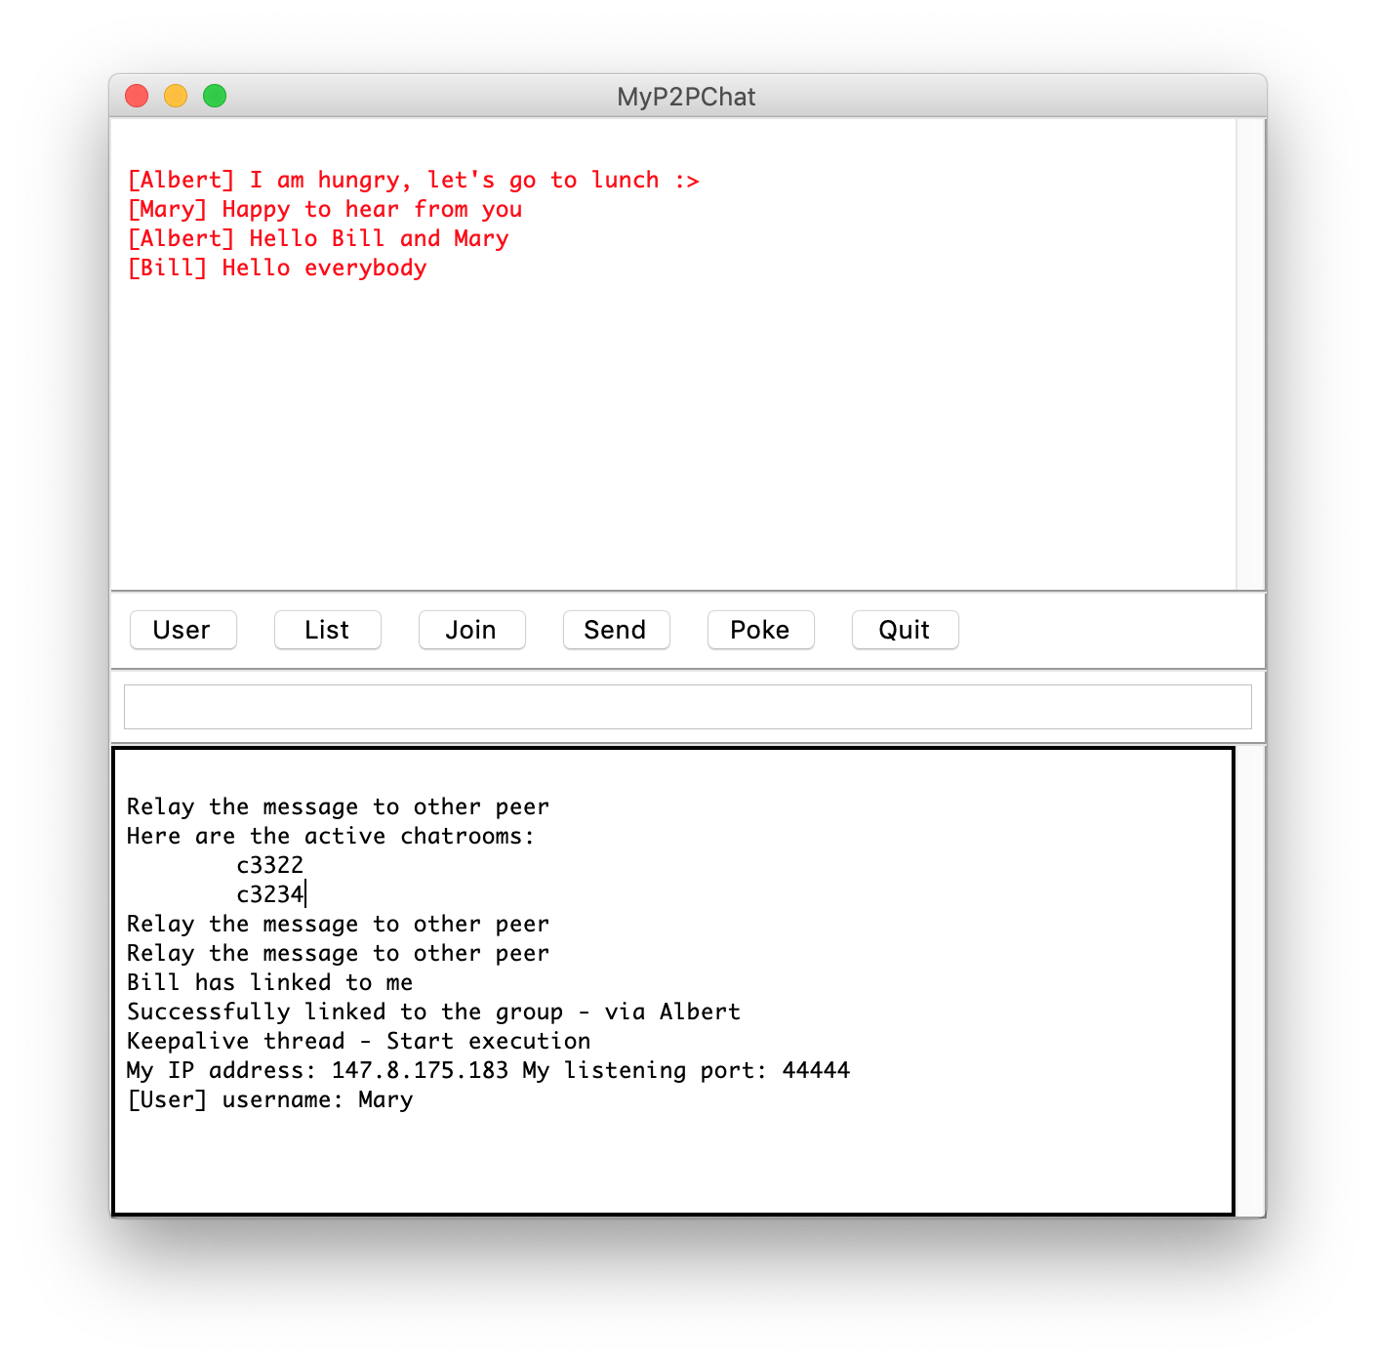
Display info / msg to UI
Display text contents to:
Command Window
CmdWin.insert(1.0, “\nSystem message to be displayed”)
1.0 – means the first line first character
\n – adds a newline in the first line; thus, always displays texts in the second line of the display
Message Window
MsgWin.insert(1.0, “\nChat message to be display”)

Slide 11
Interact with end-user
Each button has its associated function
Your task is to complete those functions and others

Slide 12
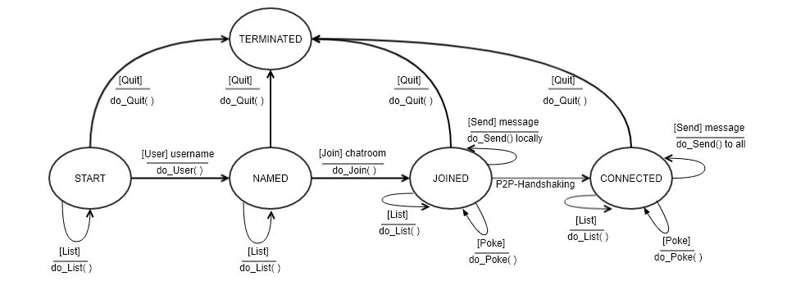
State Diagram of P2PChat

Slide 13
Communication Protocol
L::\r\n
P2PChat
Room
server
List
do_List()
G::\r\n
L::\r\n
P2PChat
Room
server
List
do_List()
G:c3311:c3234::\r\n

Slide 14
Communication Protocol
Tony
J:c3234:Tony:147.8.175.180:50012::\r\n
P2PChat
Room
server
Join
do_Join()
M:13631095706086584736:Tony:147.8.175.180:50012:Fay:147.8.175.181:50011:
James:147.8.147.190:50010::\r\n
Tony’s initial msgID
P:c3234:Tony:147.8.175.180:50012:0::\r\n
Fay’s current msgID
S:2::\r\n
P2PChat
P2P Handshaking
Fay

Slide 15
Communication Protocol
Tony
J:c3234:Tony:147.8.175.180:50012::\r\n
P2PChat
Room
server
Join
do_Join()
M:13631095706086584736:Tony:147.8.175.180:50012:Fay:147.8.175.181:50011:
James:147.8.147.190:50010::\r\n
J:c3234:Fay:147.8.175.181:50011::\r\n
P:c3234:Tony:147.8.175.180:50012:0::\r\n
S:2::\r\n
P2PChat
Fay’s member list does not have Tony’s info
Fay

Slide 16
Communication Protocol – Keepalive
J:c3234:Tony:147.8.175.180:50012::\r\n
P2PChat
Room
server
Tony
M:13631095706086584736:Tony:147.8.175.180:50012:Fay:147.8.175.181:50011:James:147.8.147.190:50010::\r\n
Every 20 seconds

Slide 17
Communication Protocol
T:c3234:7480358062723406625:Tony:1:25:Good to chat with you all::\r\n
P2PChat
P2PChat
Send
do_Send()
Tony
Fay
inputstr = “Tony”+Tony’s IP+Tony’s listening port
HID = sdhm_hash(inputstr)
T:c3234:7480358062723406625:Tony:1:25:Good to chat with you all::\r\n
P2PChat
James

Slide 18
Communication Protocol
T:c3234:7480358062723406625:Tony:1:25:Good to chat with you all::\r\n
P2PChat
P2PChat
Send
do_Send()
Tony
Fay
How about James does not have any info about Tony?
T:c3234:7480358062723406625:Tony:1:25:Good to chat with you all::\r\n
J:c3234:James:147.8.147.190:50010::\r\n
Room
server
P2PChat
M:13631095706086584736:Tony:147.8.175.180:50012:Fay:147.8.175.181:50011:
James:147.8.147.190:50010::\r\n
James

Slide 19
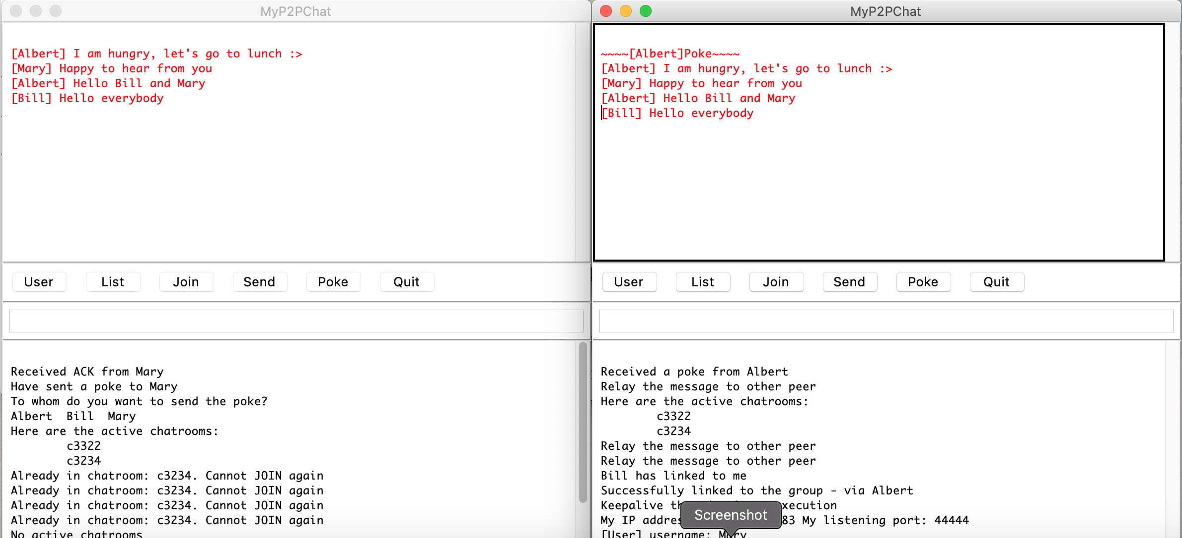
Communication Protocol - Poke
Mary

Slide 20

Communication Protocol - Poke
P2PChat
P2PChat
Poke
do_Poke()
Tony
Fay
K:c3234:Tony::\r\n
A::\r\n
P2PChat
James

Slide 21
Formation of Overlay Network
Chatroom c3234
P2PChat forms its network on top of TCP connections
TCP supports bidirectional communication
“Backward link”
A P2PChat peer (server) has a TCP connection which is initiated by another peer
“Forward link”
A P2PChat peer (client) initiates a TCP connection to another peer
CONNECTED
James
CONNECTED
Carrie
CONNECTED
Mary
CONNECTED
Peter
CONNECTED
Jane
CONNECTED
Michael

Slide 22
Formation of Overlay network
Mary
Carrie
Michael
James
Jane
Peter
For a newly JOINED peer, it has the latest membership list from Room server
Apply hash() and sort() to the list
Carrie
Michael
James
Jane
Mary
Peter
Locate its current index in the list
Start from next member s
While not exhausting the list
if already has a linkage with s
s ← next member after s
else
initiate a TCP connection to s
run the P2P handshaking
if succeeded
stop
else
s ← next member after s
Endwhile
If not succeeded, schedule to retry establishing the forward link
JOINED
Mary
CONNECTED
P2P handshaking
Peter

Slide 23
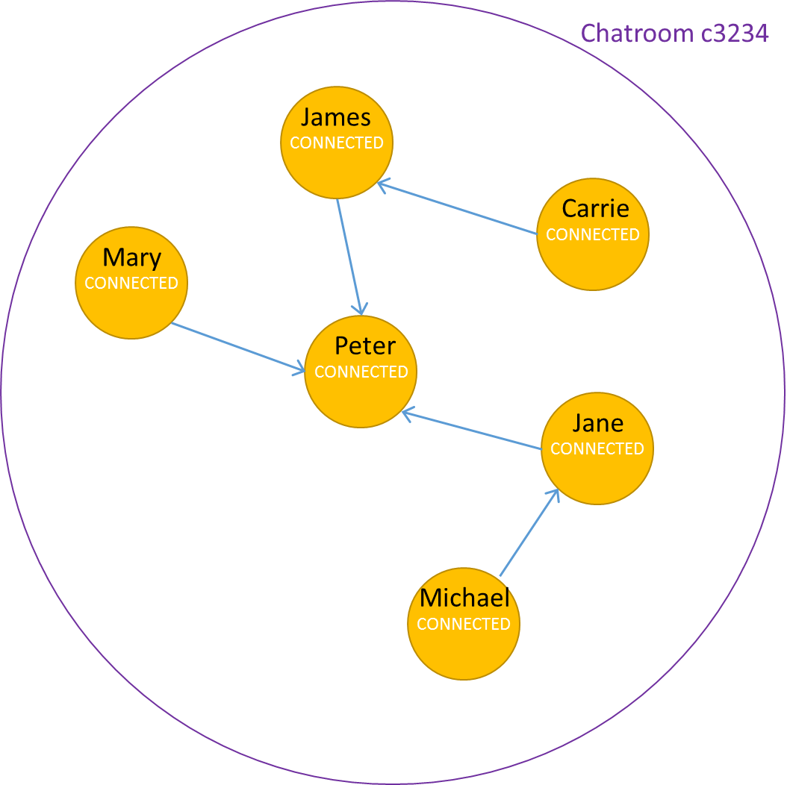


Upkeep of Overlay network
An important criteria – a P2PChat peer should have one “forward link”
Retry to set up forward link, but already has a backward link
Try another member in the list

Slide 24
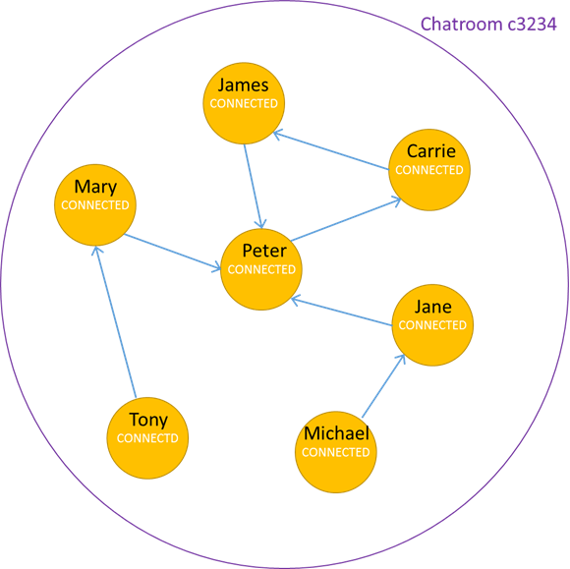
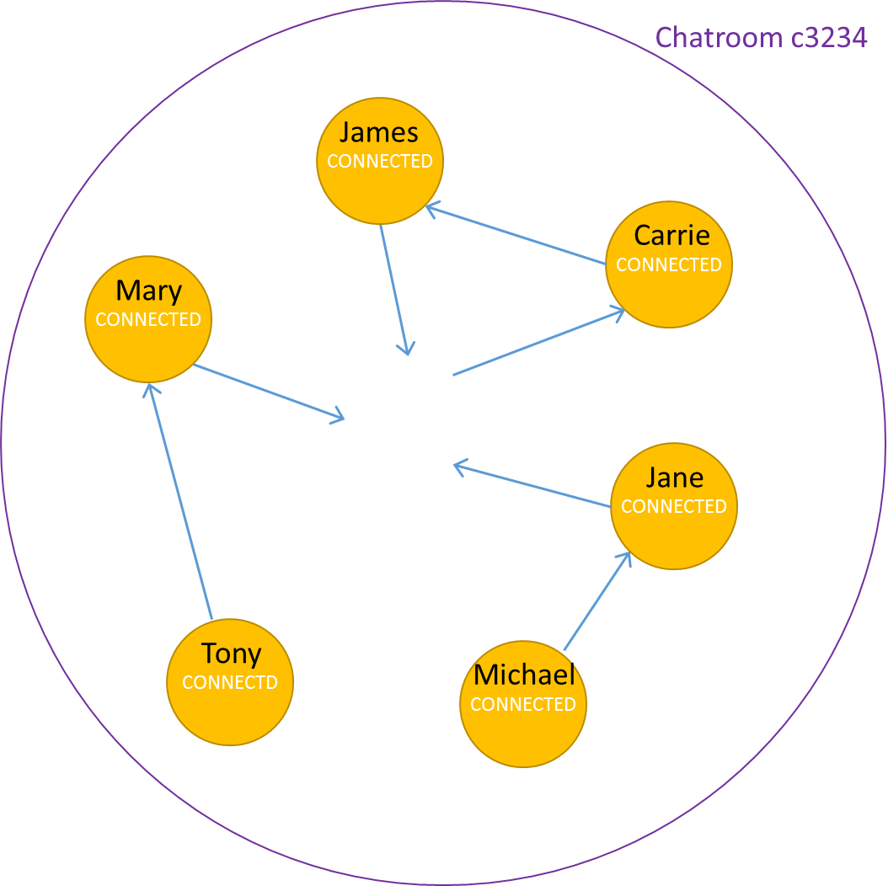
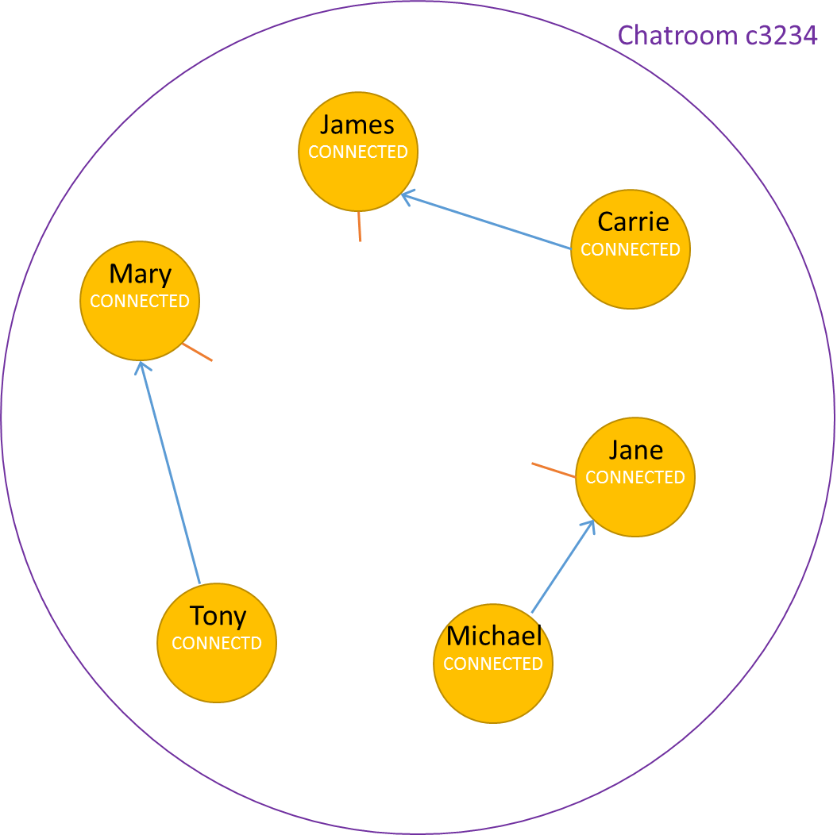
Upkeep of Overlay network
Peter left the chatroom group
Mary, James, and Jane lose their forward links. Now we have a broken network.
They ought to search for a new forward link.

Slide 25
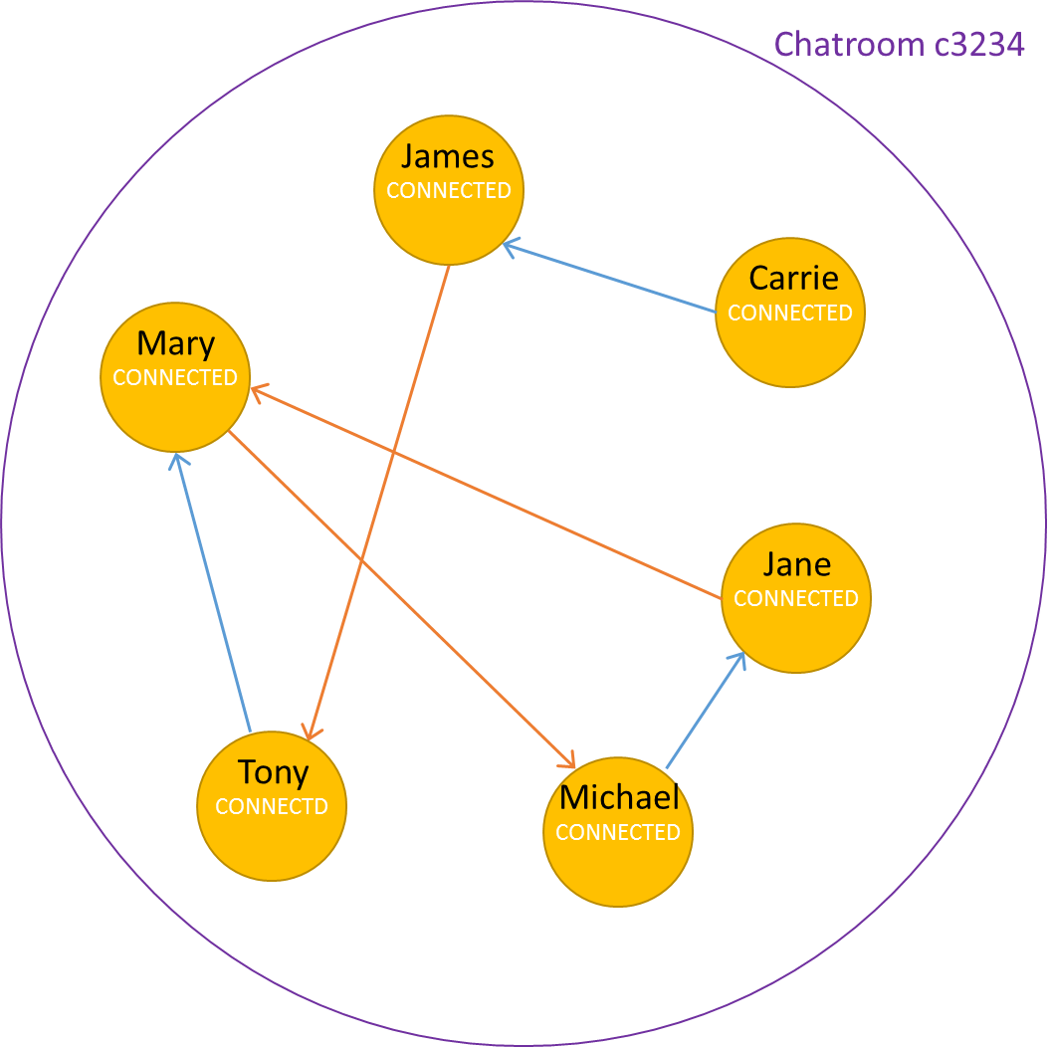
Upkeep of Overlay network
Use the logic, everyone tries to find a suitable peer to connect to; this helps to keep the overlay network intact

Slide 26
Distribute messages across Overlay network
Based on a concept called Flooding
Chatroom c3234
If have seen that message (ID) from that origin peer before, discard it and don’t display.
CONNECTED
James
CONNECTED
Carrie
CONNECTED
Mary
CONNECTED
Peter
CONNECTED
If haven’t seen that message (ID) from that origin peer before, forward it and display to MsgWin.
Jane
CONNECTD
Tony
CONNECTED
Michael
Every message sent by a peer has a different ID

Slide 27
Distribute messages across Overlay network
Chatroom c3234
CONNECTED
James
CONNECTED
Carrie
CONNECTED
Mary
CONNECTED
Peter
CONNECTED
Jane
CONNECTD
Tony
CONNECTED
Michael

Slide 28
Stage One
Deadline: March 26, 2019 (Tuesday)
Final Cut-off: same time as the final submission
Optional Submission but recommended
Name your program file as: P2PChat-stage1.py
Add necessary documentation (i.e. comments)
Complete the implementation of the following functions:
do_User()
do_List()
part of the do_Join() function
Initial JOIN request
Keepalive procedure
do_Poke()

Slide 29
Stage Two
Final Deadline: April 16, 2019 (Tuesday) at 5:00pm
Also is the Cut-off time of stage one submission.
Submission
Name your program file as: P2PChat.py
Add necessary documentation
Complete remaining features
do_Send()
do_Quit()
Formation and upkeep of P2P overlay network
Relay messages to connected peer(s) using Flooding

Slide 30
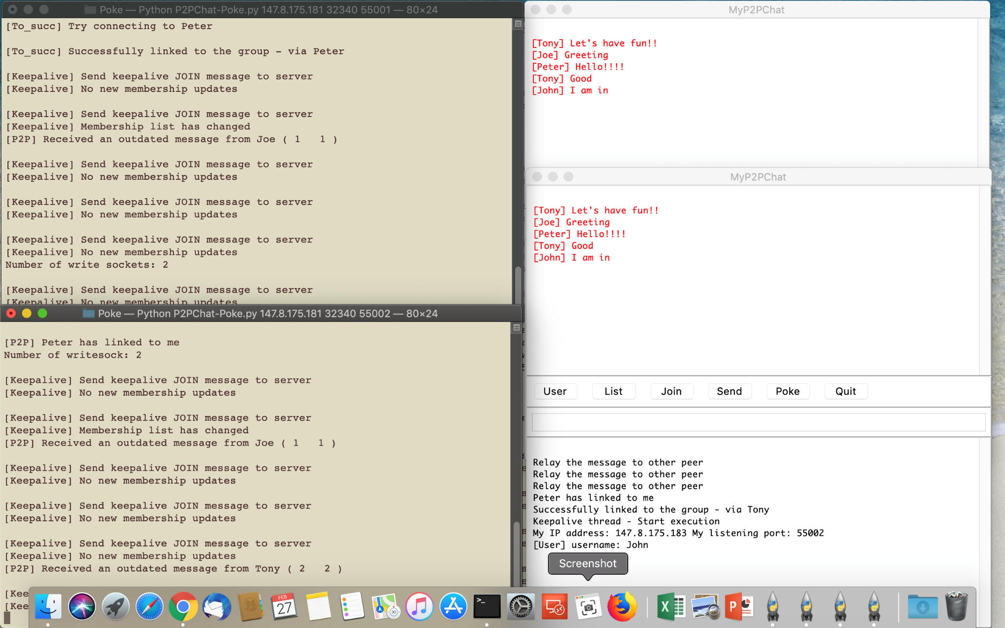
Output messages
You can have any kind of debug messages showing in the console terminal
Show what action or event has just happened in the Command Window

Slide 31
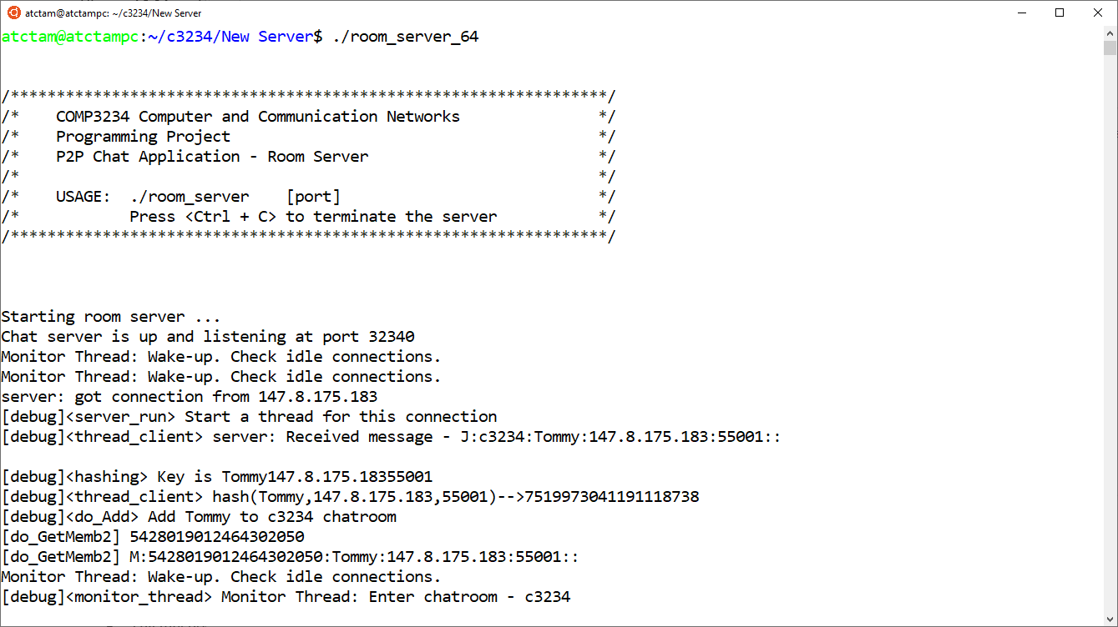
Computer Platform
You should develop and test your P2PChat program in any platform installed with Python 3.6 or 3.7
Mac OS, Linux, Windows
Executable binaries of Room server program
room_server_64.zip – compiled under 64-bit Ubuntu 18.04
room_server_mac.zip – compiled under 64-bit Mac OS X 10.14
After downloaded the zip file to corresponding system, run any archive utility program to extract the binary file
You may have to use "chmod" command to set the execution bit

Slide 32
Grading Policy
The tutors will first test your final submission after the project deadline
If your program fully complies with the project specification, your team will get all marks for all two stages
Otherwise, the tutors will test your Stage one submission (if any) to give marks
After submission of Stage one program, if you want to know whether your program works correctly, your team is welcome to make an appointment with the tutors and demonstrate your program to the tutors

Slide 33
Grading Rubric
Documentation (1 point) | Include required program and student’s info at the beginning of the program Use good code convention and include necessary comments to clearly indicate the logic of the program
Stage 1 (8 points) | Correctness of the [ User ] button (1.5 points) Correctness of the [ List ] button (1.5 points) Correctness of the P2PChat-Roomserver interactions (3 points) Correctness of the [ Poke ] button (2 points)
Stage 2 (9 points) | Correctness of the [ Quit ] button (1 point) Correctness of the [ Send ] button (2 points) Correct interactions between multiple P2PChat peers under normal situation (3 points) Correct responses and interactions between multiple P2PChat peers with peers leaving and rejoining the chatroom network (3 points)

