Slide 1
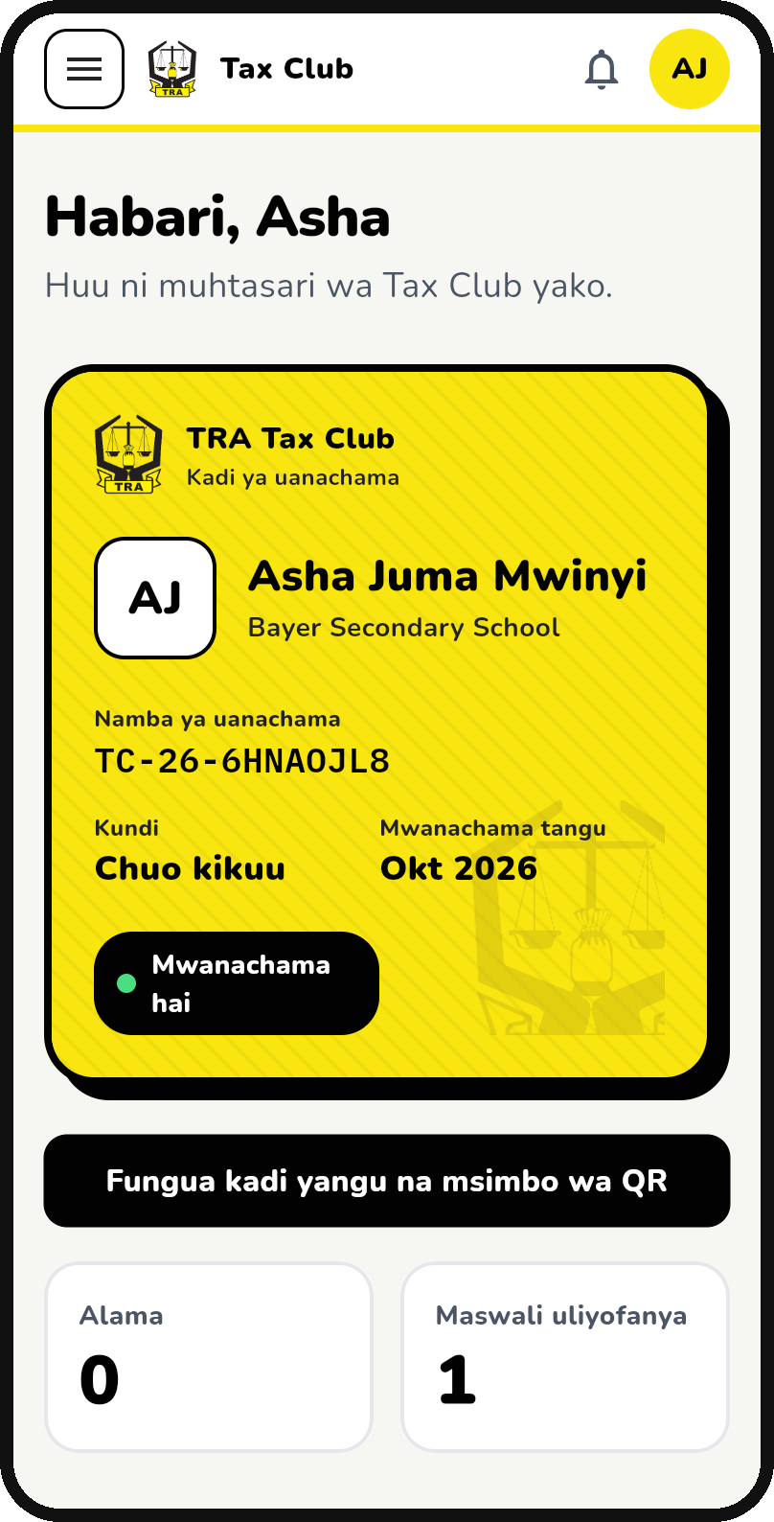

TRA Tax Club Digital Platform
TANZANIA REVENUE AUTHORITY
Building Tanzania's next generation of voluntary taxpayers, from primary school to university
Presentation to TRA Management · October 2026
Notes:
Purpose: ask management to adopt the Tax Club platform as TRA's channel for school and university taxpayer education, and to approve the pilot. The app on the right is the real Tax Club app in Kiswahili, already running on the test server club.flux.co.tz.

Slide 2




In brief: Tax Clubs go digital, nationwide
Why
What is ready
What TRA gains
What we ask
Tax habits form at school. Today's students are tomorrow's employees, traders and professionals, and they carry what they learn home.
One TRA platform for every club: website, Android and iPhone app, and an Administration Portal. Built and running on a test server.
A wider future taxpayer base, a receipt-demanding generation, live data on every club, and direct engagement with youth across all regions.
Approve a pilot with 10 institutions, name a business owner, and approve hosting on TRA infrastructure.
Decision today: approve the pilot so students can use Tax Club from March 2027.
Notes:
The whole story on one slide: why, what is ready, what TRA gains, and the decision we need today. The rest of the deck explains each point.

Slide 3



Why Tax Club: compliance starts at school
Future taxpayers
Ambassadors at home
Students become employees, entrepreneurs, professionals and leaders. Shaping their attitude to tax now costs far less than enforcement later.
Members learn to demand and issue EFD receipts and pass the habit to classmates, parents and family businesses.
Closing the education gap
Tax builds the nation
TRA itself reports a large tax-education gap. Many taxpayers still do not understand the taxes that affect their businesses.
Students see that taxes pay for their schools, roads and hospitals, building trust and voluntary compliance.
TRA established Tax Clubs in secondary schools and Tax Associations in colleges and universities to foster a culture of voluntary tax compliance (TRA Tax Club Corner).
Notes:
Key message: Tax Club is an investment in voluntary compliance. TRA's own Tax Club objectives are to prepare future taxpayers and tax experts, to spread tax knowledge to families, and to build the culture of demanding and issuing receipts. TRA's taxpayer education managers have publicly described a large tax education gap.

Slide 4

Clubs exist, but TRA cannot see or grow them
Today
With the Tax Club platform
Paper registers kept by each patron
Verified digital membership and a QR membership card
One-off visits by regional officers
Year-round lessons, quizzes and events on the phone
Content differs from region to region
One curriculum, reviewed and approved by TRA
No national picture of clubs or members
Live statistics by region, institution and category
Graduates are lost to the programme
Alumni network and mentorship for new members
Mainly secondary schools and universities
Primary school to university, in Kiswahili and English
Notes:
The clubs already exist and regional offices already visit them, but the work is manual and invisible at national level. The platform turns each of these gaps into something TRA can manage and measure.

Slide 5
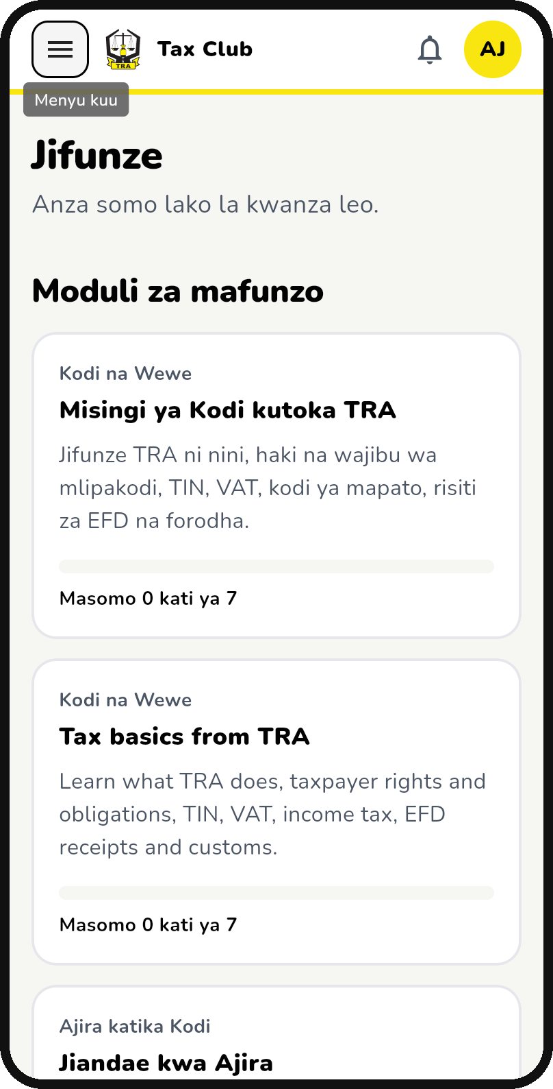



One platform, four doors, the same TRA content
Public website
Lessons, events and answers anyone can read. Found on Google.
Android & iPhone app
Members join, learn, take quizzes and carry their card.
Member web portal
The same member area on any computer or school lab.
Administration Portal
TRA officers, coordinators and patrons run the programme.
Kiswahili first, with English · works on low-cost Android phones
Notes:
Everything runs from one TRA system, so a lesson approved once appears on the website, the app and the member portal at the same time. Screens shown: the member home with the digital membership card, and the learning modules.

Slide 6





The member journey: join, learn, lead
01
02
03
04
05
06
Join
Verified
Learn
Test
Take part
Grow
Choose school level and institution. College and university students give their TIN, or register for one on TRA's portal.
The club patron and the TRA regional coordinator confirm the member. Under-18s need a guardian's consent.
Short TRA lessons: TIN, VAT, EFD receipts, customs, taxpayer rights.
Timed quizzes earn points, badges and a place on the leaderboard.
Events, Taxpayers' Day, competitions and Ask TRA, with QR check-in.
Certificates, opportunities, then alumni and mentors for new members.
Notes:
This is the path every member follows. Step 1 now includes primary schools, and college and university students must give a TIN. Those without one are sent straight to TRA's online TIN registration, which widens the taxpayer base from day one.

Slide 7
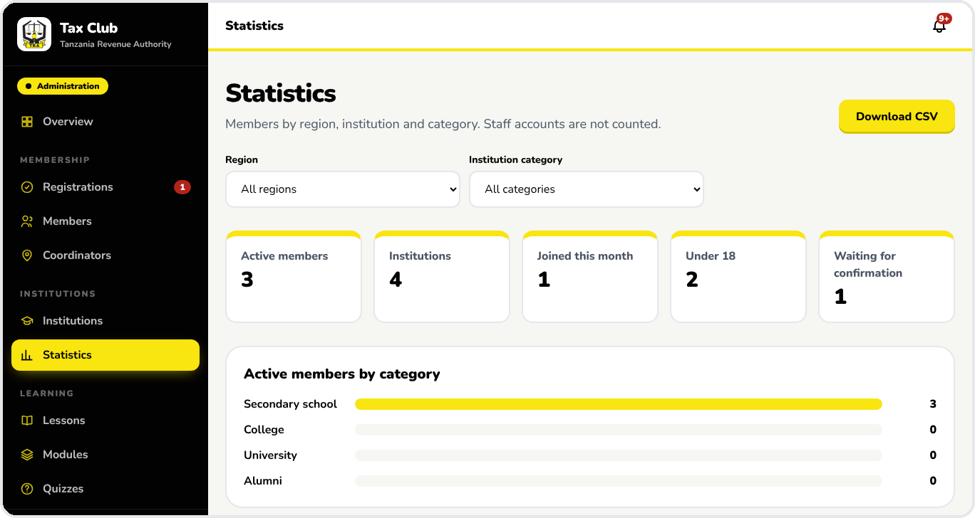
TRA stays in control of the programme
Registry of institutions and Tax Clubs, with CSV import
Patrons and regional coordinators verify members
Every lesson, quiz and event is reviewed before it is published
SMS broadcasts and reminders to chosen regions or schools
Competitions, rewards and verifiable certificates
Full audit trail of every officer action
Live statistics by region, institution and category, exportable to Excel
Notes:
Management does not lose control of the message: nothing reaches students without TRA review and approval, coordinators only see their regions, and every officer action is logged.

Slide 8

Benefits for students, schools and TRA
Students
Schools & patrons
TRA
Free, practical tax and money skills
Points, badges and certificates
Career opportunities and mentors
A voice: Ask TRA and feedback
Ready-made, approved lesson material
Simple member management
Recognition in national competitions
Club activity they can report
Reach every region at low cost
A consistent national message
Data to plan and report outreach
Early relationship with future taxpayers
Notes:
Each group gets something concrete. For TRA the main benefit is scale: a single officer can reach thousands of students through the app, instead of one school per visit.

Slide 9
What TRA will achieve, and how we will measure it
Outcome
How the platform delivers it
Measured on the platform (KPI)
Wider taxpayer base
College and university members join with a TIN; those without one are guided to TRA's TIN registration.
TINs given at registration · clicks to TIN registration
A culture of voluntary compliance
Every member learns their rights and duties, VAT and EFD receipts, through approved lessons.
Lessons completed · quiz pass rate · receipt campaign entries
Deeper engagement with youth
Two-way contact through Ask TRA, feedback, events and competitions.
Questions answered · event attendance by QR · competition entries
Evidence for planning
Real-time data replaces manual returns from regional offices.
Active members and clubs by region · growth per term
Year-one targets for each KPI to be set by management with the Taxpayer Services and Education team.
Notes:
Every KPI here is already captured by the platform, so progress can be reported every quarter without extra data collection. We recommend management sets year-one targets after the pilot.

Slide 10

How Tax Club supports TRA's CP7
CP7 priority
Tax Club contribution
Widen the taxpayer base
TIN at registration for college and university members; future taxpayers known early
Deepen taxpayer engagement
Year-round two-way contact with students, patrons and families in every region
Strengthen digital tax systems
A digital TRA channel for education, built for TRA hosting and security standards
E-invoicing and EFD receipts
Receipt lessons, quizzes and campaigns create a generation that demands receipts
Staff capacity
Regional officers get tools, content and data instead of paperwork
Support Vision 2050
Builds the tax-literate, compliant citizens the national vision depends on
CP7 priorities as publicly reported at the plan's launch. Wording to be confirmed against the official CP7 document before presenting.
Notes:
CP7 priorities reported at launch include strengthening digital tax systems, widening the taxpayer base, improving e-invoicing and stamp management, deepening taxpayer engagement and investing in staff capacity, in support of National Development Vision 2050. Before presenting, replace these labels with the exact strategic objective names and numbers from the official CP7 document, so management sees the plan in its own words.

Slide 11




Built safely for children and to government standards
Safeguarding minors
Moderation
Guardian consent for under-18s, confirmed by the patron. Minors are shown by first name only, and cannot be contacted by adults they do not know.
Reports, automatic hiding, blocked words and a safeguarding team for urgent cases. Mentors of minors need a background check.
Security
Privacy and inclusion
Two-step sign-in for staff, role-based access by region, and a full audit log. Ready for TRA ICT security review.
Collects only what is needed, in line with Tanzania's personal data protection law. Kiswahili first, with English.
Notes:
Because many members are children, safety was built in from the start, not added later. The platform is ready for review by TRA ICT Security and the Data Protection Officer.

Slide 12
Where we are today
5
3
2
222
releases built: membership, learning, events, community, alumni
channels: website, Android and iPhone app, Administration Portal
languages: Kiswahili and English
automated tests run on every change
Ready for TRA testing now
Test site: club.flux.co.tz · Android test app available · iPhone build needs a TRA Apple developer account. Remaining before launch: load real institutions and patrons, TRA user acceptance testing, security review and move to TRA hosting.
Notes:
The original plan put production go-live in September 2027. The core platform is already built, so the remaining work is mainly TRA-side: acceptance testing, security review, hosting and loading real data.

Slide 13
Going forward: pilot, launch, then scale
Nov – Dec 2026
Jan – Feb 2027
Mar 2027
Apr 2027
2027/28
Prepare
Set up
Pilot
Launch
Scale
TRA user acceptance testing
ICT security and DPO review
Move to TRA hosting
Load institutions and patrons
Train regional coordinators
Approve first lessons and quizzes
10 institutions across regions
Primary, secondary, college, university
Weekly feedback and fixes
Google Play and App Store
National launch campaign
First national quiz competition
All regions and Zanzibar
Link TIN check to TRA systems
Push notifications, annual awards
Pilot and store-launch dates follow the delivery plan (pilot 1 Mar 2027, store launch 12 Apr 2027).
Notes:
Longer term: work with the Ministry of Education and PO-RALG to bring Tax Club into every primary and secondary school, link the TIN field to TRA's registration system so it is checked automatically, and make the national Tax Club competition an annual event, for example around Taxpayers' Day.

Slide 14
Decisions requested from management today
1
Approve the pilot
10 institutions from March 2027, covering primary, secondary, college and university.
2
Name the business owner
Taxpayer Services and Education to own the programme, content and regional coordinators.
3
Approve TRA hosting and review
Host in the TRA data centre, after TRA ICT Security and DPO sign-off.
4
Approve the operating budget
SMS, Google Play and Apple developer accounts, rewards and certificates.
5
Partner with education authorities
Engage the Ministry of Education and PO-RALG to reach every school.
Notes:
These five decisions unlock the pilot. Items 1 to 3 are needed before December so testing and hosting can finish in time for the March pilot.

Slide 15
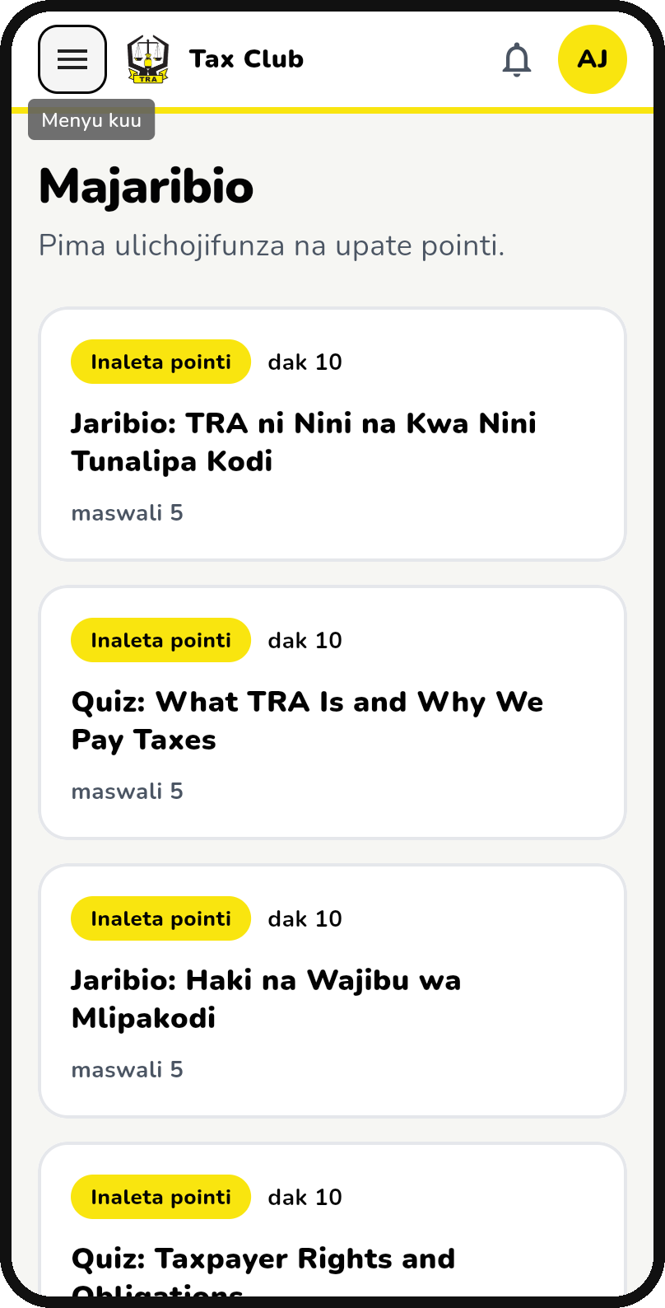
Asante sana
Kodi hujenga shule, barabara na hospitali zetu. Tax Club builds the people who will pay for them.
Questions and live demo: club.flux.co.tz
Notes:
Offer a live demo on a phone: join as a student, open a lesson, take a quiz and show the membership card, then show the officer's statistics page.

