Slide 1
Army Institute of Technology, Pune
Forest Fire Detection using Satellite Imagery
Veer Abhimanyu Pawan Phalak
Durgendra Nath Vighnesh Tiwari
6th September 2019

Slide 2
Aim & Objectives
Forest Fires are not a sudden incidents they occur in steps and the focus is to detect it in latest possible stage.
Detecting features directly from a raw image is not so efficient as compared to doing same after applying image processing over it.
The colour quantized image give us best extracted features from any raw image which leads to a better model performance.
Detecting nearby local areas to find the sensitivity of incident.
Providing an optimal solution recover the fire.

Slide 3
Project Introduction
Forest fire is a major concern as it causes huge damage to environment. Forest fire detection and coming up with optimal solution is a challenge.
Technique that proved to be best for forest fire detection is pseudo-color processing for infrared forest-fire image.
Imagery of the entire land surface of earth at 3-5 meter resolution are available and a coarse-resolution imagery from Landsat(30 meter pixels) or MODIS (250 meter pixels).

Slide 4
Project Workflow

Slide 5
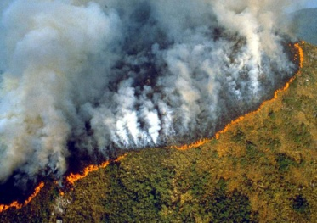
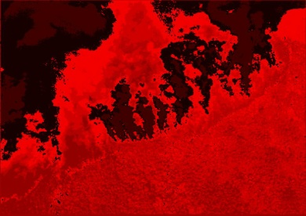
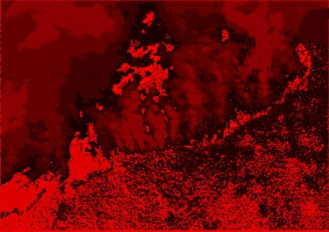
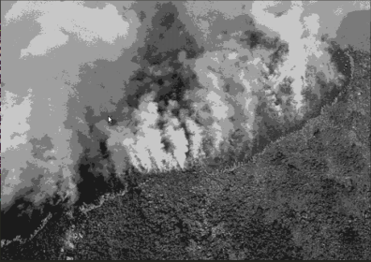
input_image(224x224)
Image_Processing
Mask-RCNN
GoogleNet
ResNet-50
Fire Detection and Optimal Solution

Slide 6
Pseudo Color Image Processing
Pseudo-colour enhancement technique dealing with different grey-scale transforms of the grey image into different colours with different linear or nonlinear mapping functions, making it easier to identify image details with more precision.
The wild-fire image typically includes flame(burning part of the fire), some fire (out part of the fire), smoke coverage area, the background or not burning part of the fire.
Flame can be divided into three parts: outer flame, inner flame, and centre of the flame. The temperature of outer flame is the highest, followed with in flame, then the centre of the flame, resulting in the gray level of flame image distributes in a certain form.

Slide 7
Principles of Forest-Fire Image Coloring
We divide the image into two regions: the foreground of the image, including flames, some of fire, areas covered by smoke, and the background.
The gray values of the foreground concentrate between 0 and 128, according to gray value, we change the gray value of pixels into the values between white and yellow.
The smaller of the grey value, the more light-coloured, the greater of the grey value, the more darken-coloured.
The greater of the gray value the deeper of the red colour, the smaller of gray colour, the lighter of the red colour.

Slide 8
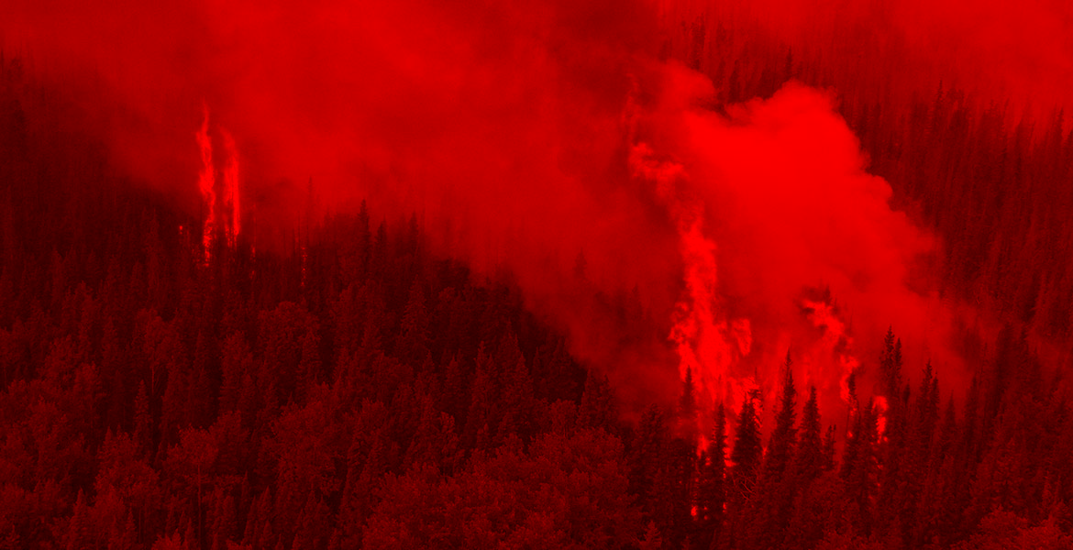
Fig 1 : R component of Normal image

Slide 9
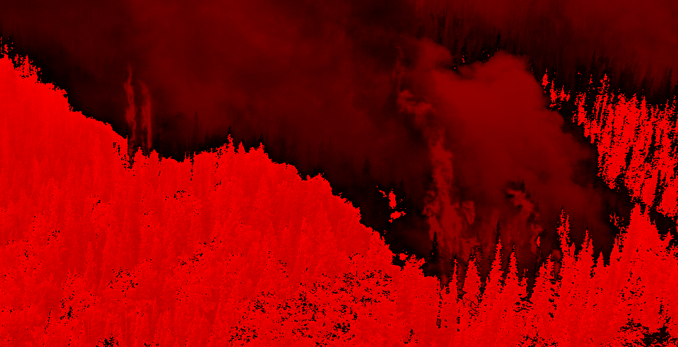
Img 2 : Pseudo colour based filtered image

Slide 10
Histogram partial equalization
•The background or burning parts of the forest - fire infrared images occupy most of the gray-scale. Flame, some fire, smoke parts occupy less.
• When the contrast between the background and objectives of forest-fire image is strong. The histogram distribution concentrates in the high gray level, the colour-coded pseudo-colour image is easy-to-saturated;
• When the contrast is weak, and the histogram distribution concentrates in the low gray level, background of the coded image is blur, and its details are loss seriously.
• The gray levels of the area covered by smoke is in the middle gray-scale, due to the impact of light and other factors, they may become higher.
• The area covered by smoke may mistake for part of the flame. For the above factors, it proposes the partial histogram equalization to reduce the error and increase the effect of pseudo-colour processing.

Slide 11
Histogram partial equalization
Histogram statistical analysis is carried out, and based on the gray value distribution, we divide it into different local histograms.
We analyze the rates of local histogram of the gray changing and its corresponding gray-scale, do partial equilibrium to the histogram the gray value of which is at around 128, because the gray value around 128 is the division of the area covered by smoke and background.
Using this algorithms for infrared image processing smoke, background and flames can be clearly distinguished.
Displaying the three parts of the flame vividly, the target part of the flame’s colour is close to the actual flame’s colour, gradation of the image is clear, and it is easy to judge the level of the fire.

Slide 12
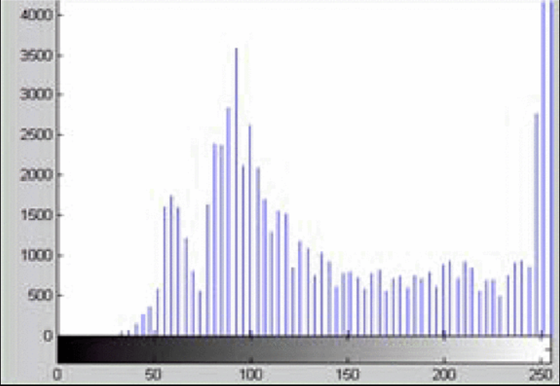
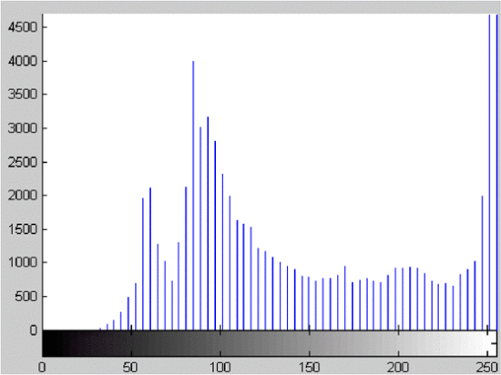
Fig 4 : Histogram equalized b/w 120 to 150 of red colour
Fig 3 : Histogram distribution of Red colour after pseudo colour image processing

Slide 13
MASK R-CNN
1)Mask R-CNN extends Faster R-CNN to pixel-level image segmentation.The key point is to decouple the classication and the pixel-level mask
prediction tasks.
2) Based on the framework of Faster R-CNN, it added a third branch for
predicting an object mask in parallel with the existing branches for
classification and localization.
3) The mask branch is a small fully-connected network applied to each
RoI , predicting a segmentation mask in a pixel-to-pixel manner.

Slide 14
MASK R-CNN NETWORK ARCHITECTURE
Fig 5: 2 Stage Architecture

Slide 15
MASK R-CNN RESULT
Fig 6: Masked Result [2]

Slide 16
GoogLeNet
Main goal of using GoogLeNet is to detect the fire from satellite imagery.
For faster and real time detection of fire on satellite imagery , GoogleNet ensures efficiency of computation.
12 times lesser parameters than AlexNet and significantly more accurate than AlexNet.
Lower memory-use and lower power-use acutely important for mobile devices.
Computational cost less than 2X compared to AlexNet.

Slide 17
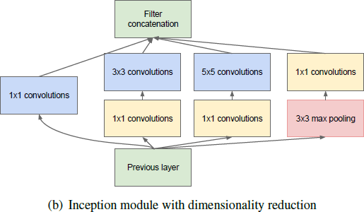
Working of GoogLeNet
Fig 7. Inception module in GoogLeNet

Slide 18
Resnet-50
Instead of learning a direct mapping of x to y with a function H(x) (A few stacked non-linear layers). Let us define the residual function using F(x) = H(x)-x, which can be re-framed into H(x) = F(x)+x, where F(x) and x represents the stacked non-linear layers and the identity function(input=output) respectively.
Deeper neural networks are more difficult to train. We present a residual learning framework to ease the training of networks that are substantially deeper than those used previously.
We explicitly reformulate the layers as learning residual functions with reference to the layer inputs, instead of learning unreferenced functions.

Slide 19
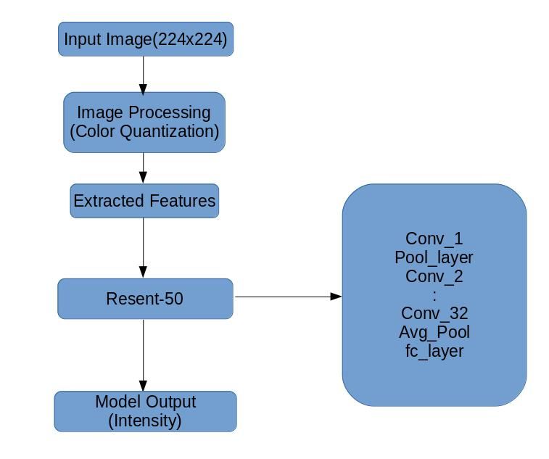
Resnet-50 Model Architecture

Slide 20
Implementation Satellites KEEP CLAM AND CLICK IMAGES, RESNET is on WORK.

Slide 21
Hyperparameter Tunning
Learning rate
No.of epochs
Batch Size
Activation Function
No. of Hidden Layers
Weight Initialization
Feature extraction

Slide 22
Dataset Details
Planet: Understanding the Amazon from Space.
Size : 34 GB
Type : .tif files
Provider : Planet and SCCON

Slide 23
Applications of Satellite Imagery
There are currently over 4500 satellites orbiting the Earth. Over 600 of them are regularly taking pictures of the Earth’s surface. The best available resolution is 25cm per pixel, which means that 1 pixel covers a square of 25cm x 25cm. This translates to a person taking about 3 pixels on an image.
Object Detection over earth’s surface is an interesting task to keep an eye over activities.
Traffic Monitoring, Intrusion Surveillance, Ship Detection on Oceans, Advancing Agriculture is huge field of study which enriches farmers activity.

