Slide 1


Army Institute of Technology College of Engineering Department of Information Technology
Project Based Seminar (Oral) Presentation
On
Using Machine Learning for Image-Based Plant Disease Detection
By
T150228525 and Manish Kumar
T150228527 and Manoj Kumar
T150228529 and Nikhil Kumar
T150228531 and Nitin Bisht
Guide
Dr. Sangeeta Jadhav

Slide 2
Contents
Project Group
Project Motivation
Introduction
Literature Survey
Support Vector Machine
Applications/advantages
Conclusions
References

Slide 3
Project Details
Project Title :- Using Machine Learning for Image- Based Plant Disease Detection.
Project Domain :- Machine Learning
Project Group Members:
T150228525,Manish Kumar
T150228527,Manoj Kumar
T150228529,Nikhil Kumar
T150228531,Nitin Bisht

Slide 4
Motivation
As agriculture struggles to support the rapidly growing global population, plant disease reduces the production and quality of food.
There are many cases of chronic and catastrophic losses, but on average account for 39% of the production of the main food crops.
Crop diseases are a major threat to but their rapid identiﬁcation remains diﬃcult in many parts of the world due to the lack of the necessary infrastructure.
The combination of increasing global smartphone and recent advances in computer vision made possible by deep learning has paved the way for smartphone-assisted disease diagnosis food security.

Slide 5
Problem statement
The naked eye observation of experts is the main approach adopted in practice for detection and identiﬁcation of plant diseases . But ,this requires continuous monitoring of experts which might be prohibitively expensive in large farms.
The problem aims to make a single model for disease detection on large scale and should be implemented with help of the combination of increasing global smartphone penetration and recent advances in computer vision made possible by deep learning has paved the way for smartphone-assisted disease diagnosis

Slide 6
Aim and Objectives of the Project
AIM:-
We are going to make a hybrid model to decide the disease present on leaf by using the reference of different type of models and their consensus decision.
Objective:-
We will use Large image dataset of Diagnose plant from Data Village.
The model wii be built on technology such as CNN,SVM and Resnet etc.

Slide 7
Project and Seminar Topics
Project Title :Using Machine Learning for Image- Based Plant Disease Detection.
Manoj Kumar :- Support Vector Machine.
Manish Kumar :- Convolutional Neural Network.
Nitin Bisht :- Optimization of CNN.
Nikhil Kumar :- ResNet.

Slide 8
Introduction
Convolutional neural network.
AlexNet
GoogleNet
Inception Module
Experimental configuration.
Hyperparameter tuning.

Slide 9
Literature Survey/Related work
Sr.No | Reference Name (Write Paper Title | Seed Idea/ Work description | Problems found | Any other criteria
1. | Deep Neural Networks Based Recognition of Plant Diseases by Leaf Image Classification (May 2016) | Attained accuracy of 96.4% using Caffe framework
2. | Deep learning models for plant disease detection and diagnosis | Used 5 types of CNN architectures . Able to attain 99.53% accuracy. | Not able to give noticeable accuracy when images contain finger , shoes and portion of dieses in not centric.
3. | Plant Leaf and Disease Detection by Using HSV Features and SVM Classifier ( Nov 2009) | Attained accuracy of 91.2% using SVM classifier.

Slide 10
Continued..
Sr.No | Reference Name (Write Paper Title | Seed Idea/ Work description | Problems found | Any other criteria
4. | Deep Neural Networks Based Recognition of Plant Diseases by Leaf Image Classification (May 2016) | Attained accuracy of 96.4% using Caffe framework. Affine transformations were applied to express translations and rotations | not able to deploy and did not work on different data set.
5. | Using Deep Learning for Image-Based Plant Disease Detection | 14 crop species and 26 diseases 99.35% | when tested on a set of images taken under conditions different from the images used for training, the model's accuracy is reduced substantially, to just above 31%.
6. | Disease detection on the leaves of the tomato plants by using deep learning | Use robotic arm for image capturing and were able to attain almost 100% accuracy | Tested only on tomato plant. Traning and testing images were taken under control matter

Slide 11
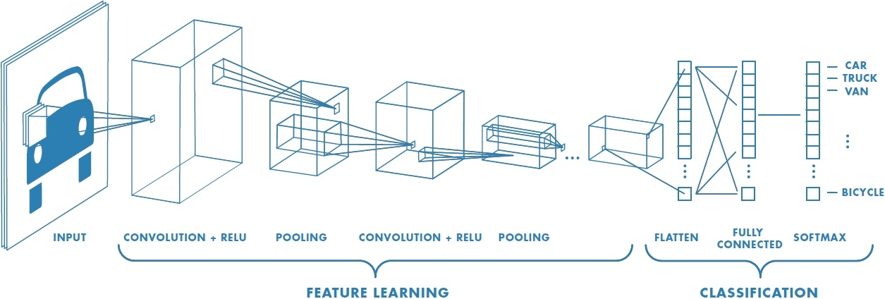
Convolutional neural network
A Convolutional Neural Network (CNN) is comprised of one or more convolutional layers (often with a subsampling step) and then followed by one or more fully connected layers as in a standard multilayer neural network.
The architecture of a CNN is designed to take advantage of the 2D structure of an input image (or other 2D input such as a speech signal). This is achieved with local connections and tied weights followed by some form of pooling which results in translation invariant features.
Another benefit of CNNs is that they are easier to train and have many fewer parameters than fully connected networks with the same number of hidden units.

Slide 12
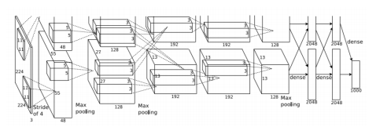
AlexNet
The AlexNet architecture follows the same design pattern as the LeNet-5 architecture from the 1990s.
The LeNet-5 architecture variants are usually a set of stacked convolution layers followed by one or more fully connected layers. The convolution layers optionally may have a normalization layer and a pooling layer right after them, and all the layers in the network usually have ReLu nonlinear activation units associated with them.
AlexNet consists of 5 convolution layers, followed by 3 fully connected layers, and finally ending with a softMax layer.

Slide 13
GooleNet
The GoogleNet architecture on the other hand is a much deeper and wider architecture with 22 layers, while still having considerably lower number of parameters in the network than AlexNet .
An application of the network in network architecture in the form of the inception modules is a key feature of the GoogleNet architecture.
The inception module uses parallel 1 1, 3 3, and 5 5 convolutions along with a max-pooling layer in parallel, hence enabling it to capture a variety of features in parallel.

Slide 14
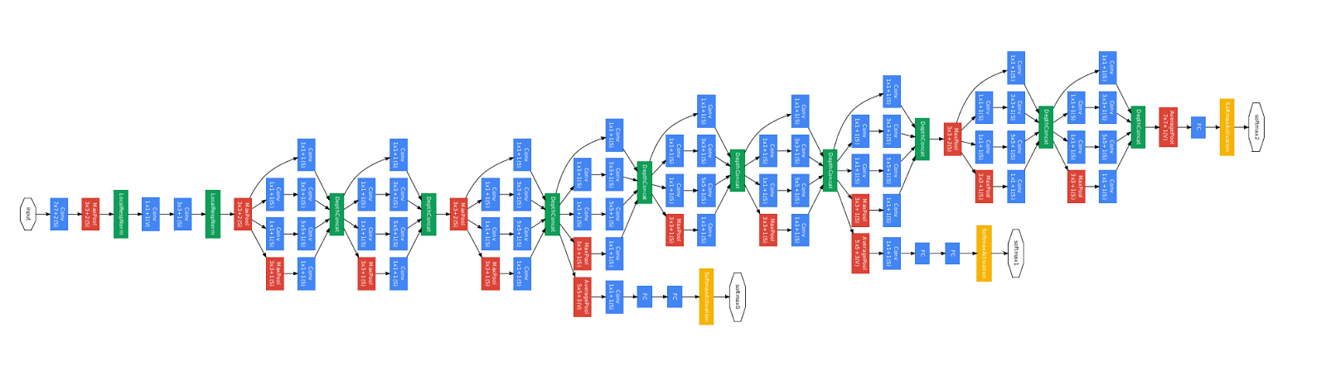
GooleNet Architecture

Slide 15
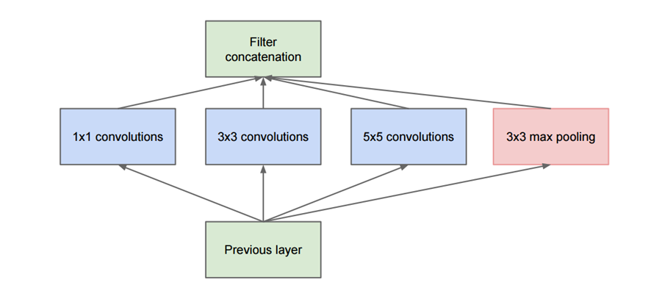
Inception Module
The Inception Module is based on a pattern recognition network which mimics the animal visual cortex. After presenting several examples of images, the network gets used to small details, middle sized features or almost whole images if they come up very often

Slide 16
Hyperparameters
Learning Rate
Number of Epochs
Batch Size
Activation function
Weight initialization
Feature engineer techniques.

Slide 17
Experimental Configurations
Choice of deep learning architecture:
(a) AlexNet.
(b) GoogLeNet.
2. Choice of dataset type:
(a)Color.
(b) Gray Scale.
(c) Leaf Segmented.
3. Choice of training-testing set distribution:
(a)Train: 80%, Test: 20%
(b) Train: 60%, Test: 40%,
(c) Train: 40%, Test: 60%,
(d) Train: 50%, Test: 50%
(e) Train: 20%, Test: 80%

Slide 18
Conclusion
Convolutional neural network (CNNs) are widely used in pattern- and image recognition problems as they have a number of advantages compared to other techniques.
CNN have different popular architecture which are state of the art artificial neural network. Though it require huge computation power to train a CNN but while testing the results are generated very fast. API like tensor- flow even helps to deploy android apps which can run on smart phones.
With continuous increasing computation power we can train and test our models in cloud platforms.
Since CNN provide both feature learning and classification , we are not required to do much of feature extraction and data transformations.
But Affine transformation showed a noticeable increase in accuracy.

