Slide 1
english influence on german language
EXPLORING DENGLISH THROUGH DATA AND NLP
Notes:
Hi everyone, I’m Sirinya and today I want to take you on a personal and linguistic journey.
As someone learning standard German while working in tech (?) I’ve started noticing some fascinating overlaps.
For instance, in interviews, I often hear people say “APIs” instead of ”Schnittstelle” or use “downloaden” rather than “herunterladen”.
That got me to wondering – how common is this in the media? How much English is creating into German? Is this a glitch – or is this part of a bigger trend?
And what does it say about identify, aspiration and global influence in language?
(1 min)
Today I’ll be sharing a data-driven exploration of how English has influenced the German language, specifically through what often termed as Denglish.
We’ll look at:
- How often English words appear in German articles
- Why they are used
What this tells us about culture, tone and identity in the media
100k+ German articles (a massive dataset)
Custom loanword detection (spaCy, regex, langdetect)
Sentiment analysis (using BERT)
Yearly trends, domain insights, and correlations
Filtering, cleaning, and text analysis pipelines
Top word lists and interactivity (e.g., Family Fortunes slide!)
Confidence intervals + statistical framing

Slide 2

research questions
HYPOTHESIS
English is used more in positive, aspirational or professional contexts.
RESEARCH QUESTIONS
Has English loanword usage in German increased over time?
Is there a relationship between sentiment and loanwords?
Notes:
A loanword is a word borrowed from one language and used in another, often unchanged, like in English we have Zeitgeist (spirit of the time/culture mood), Doppelgänger (lookalike).
Denglisch is what happens when German absorbs English words.
These aren’t just technical questions – they reflect real-life experiences.
These questions helped me investigate a hunch: That English might be used not just randomly, but strategically.
Especially when media wants to sound “modern”, “global”, or “successful”.
Is English seen as more modern or aspirational?
Why use “Startup” over “Jungunternehmen”?
That’s what we’re here to unpack.
(45 secs)
I explored two key questions:
Has English loanword usage in German increased over time?
Is there a relationship between sentiment and the presence of English loanwords?
Thesis: English usage in German media is rising and seems to be tied to aspiration, branding and professionalism.
These are the guiding question for my analysis. These questions helped me stay focused throughout the pipeline
I wanted to explore and get to a better understanding about whether English usage is growing in German journalism.
Also, whether there’s a tone or sentiment attached to using English words.
Thesis:
English usage has grown due to globalisation and appear more often in tech/business content.
English usage in German news media is increasing and it appears linked to aspirational tone, professionalism, and global branding; not just convenience.
English usage has grown due to globalisation and appears more often in tech/business content

Slide 3

data & pipeline
SCRAPED ARTICLES FROM BUSINESSINSIDER.DE
> 100, 000
2011 - 2025
TOOLS
spaCy
langdetect
regex
filters
sentiment analysis
Notes:
I picked Business Insider German because its tone is modern, tech-forward and aspirational.
It’s a great case study because it targets business readers, tech-savy users and aspirational professionals, exactly where we might expect English to sneak in.
The pipeline let me filter for true linguistic mixing – not just noise like “footer” or “cookie”.
The result: a structured dataset with tone, year and English word density per article.
(1 min)

Slide 4
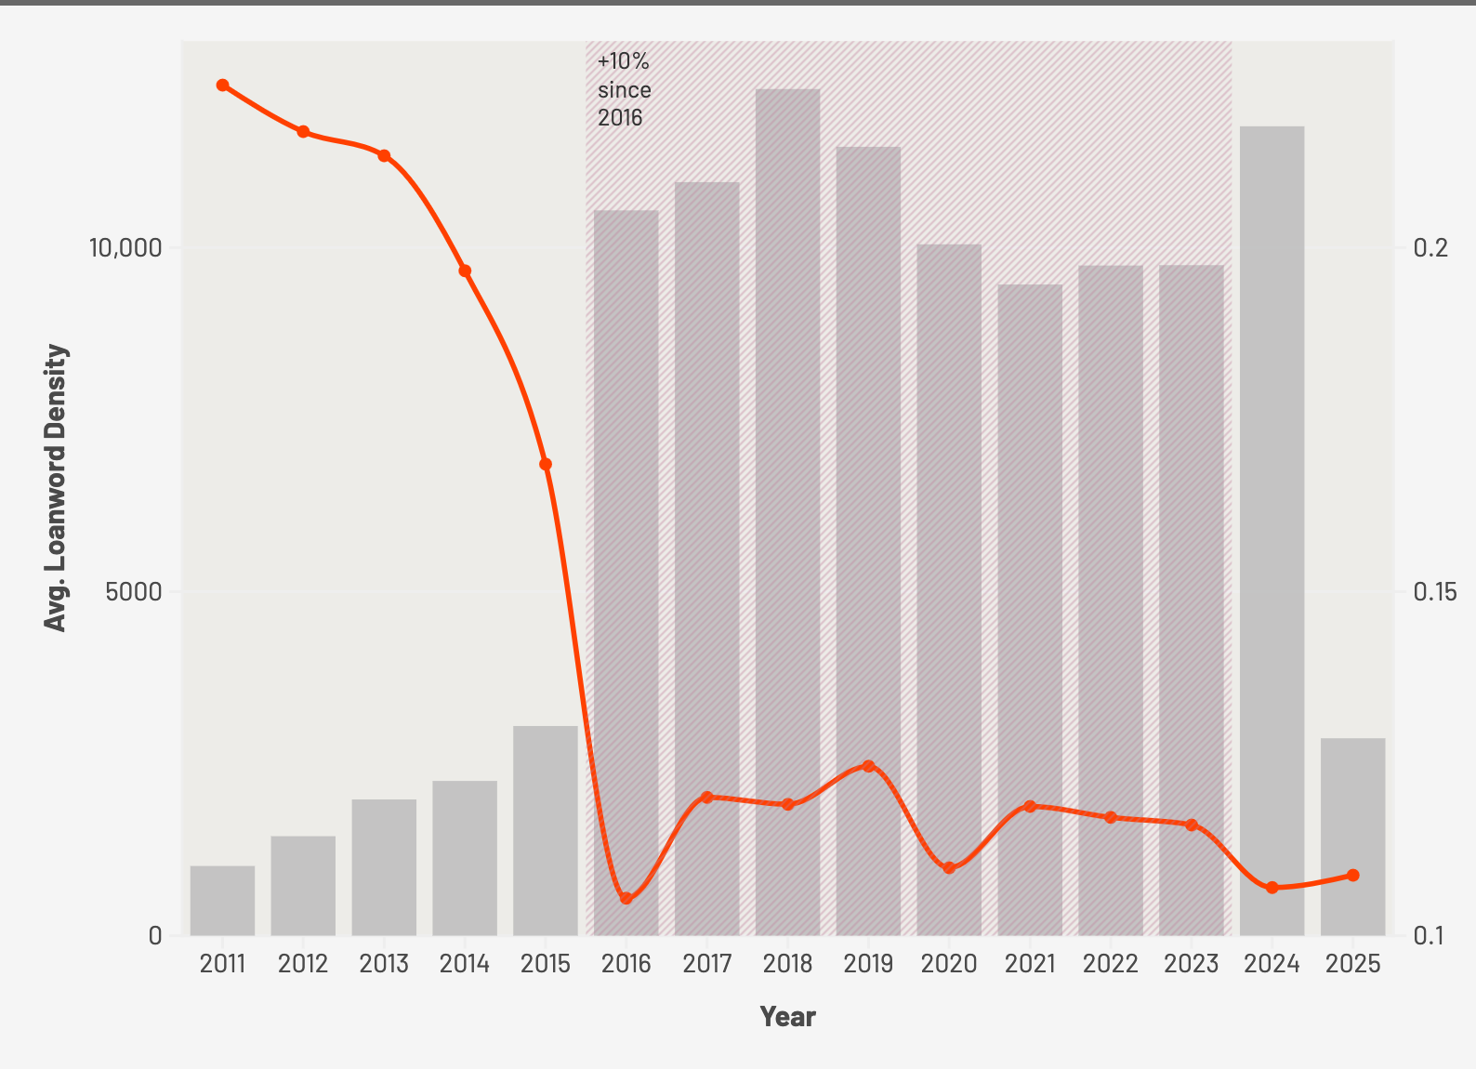

loanword usage over time
LOANWORD USAGE INCREASED BY ~10% FROM 2015 TO 2022
Notes:
We see a fascinating decline in the density of English loanwords starting in 2011. It drops sharply through 2016, then flattens. This may reflect changing editorial values, shifting cultural tone, or even the impact of world events. From 2020 onward, English words seem to stabilize in usage – possible signalling that these words are no longer “foreign” but part of the everyday vocabulary in German business reporting.
This chart shows how English density changed over time.
Since 2015 we see a steady trend – a 10% increase in the average use of English words per article.
(45 secs)
Possible interpretations:
Cultural Shifts:
Initial drop 2011 - 2016 may reflect a broader effort in journalism or politics to preserve linguistic identity – or react against the saturation of Denglish.
Economic / Domain Influence
BusinessInsider.de covers tech / business – which tend to use loanwords.
The steadiness post 2020 may reflect normalisation of terms rather than trendiness.
COVID-19 Impact
2020’s dip could reflect language simplification and clarity in journalism during crisis reporting fewer brand / marketing terms.

Slide 5
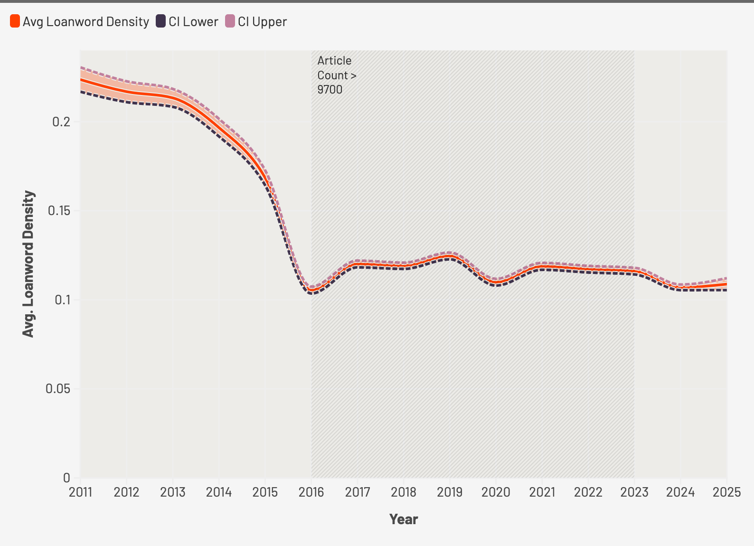
+ confidence interval
The confidence interval shows this is statistically significant
Notes:
The shaded area shows a 95% confidence interval, which means we can be quite sure this trend isn’t just random noise.
The bars shaded area and from the previous slide, that’s the number of articles per year. More articles means tighter statistical confidence, which supports the reliability of this upward trend.
(45 secs)
Plot: Line chart + 95% confidence interval (2011 – 2025)
Insight:
Loanword density has nearly doubled since

Slide 6
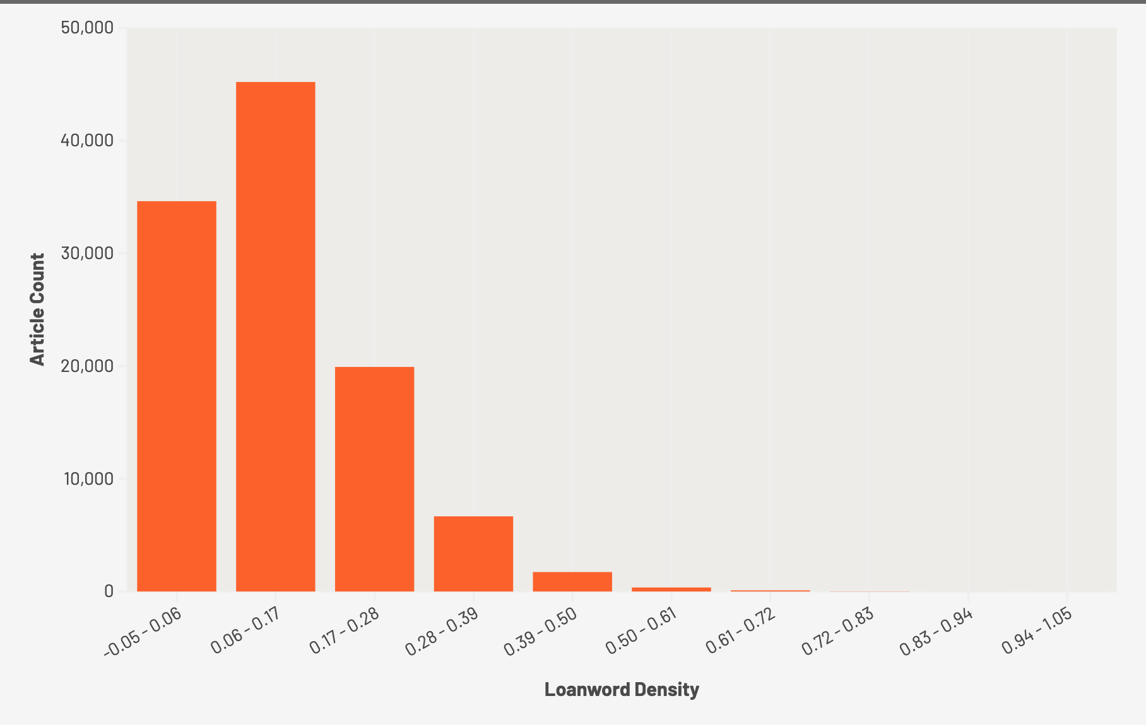

distribution of loanwords
Most German articles use low to moderate English density
Notes:
Insight: Most articles use < 20% English, but some do go much higher.
This histogram shows how Denglischy these articles are. Most of them have a little English under 20% of the words.
But there is a long tail – articles that are very English heavy. Often in tech business or start up content.
This histogram shows how loanword usage is distributed across all the articles.
You can see that most articles fall into the lower density range, between 0 – 20%. That means English words are present – but they’re sprinkled into otherwise German content.
As we move right along the X-axis, loanword usage drops sharply. Very few articles go beyond 40% - these are likely exceptions, such as tech or startup-related pieces.
This suggest that while Denglisch is visible, it not overwhelming, it’s used strategically, perhaps to sound modern, international or trendy, but not to replace German entirely.
This histogram of loanword density reveals how English loanwords are distributed across all the scraped German-language articles.
Key Observations:
1. Most articles have low loanword density.
The majority of articles fall between 0.0 and 0.2, meaning less than 20% of their words are English loanwords.
This suggests that German dominates and English is used sparingly in most content.
2. Sharp drop after 0.2.
There’s a steep decline in the number of articles with density beyond 0.2
Only a small number of articles contain higher proportions of English loanwords.
3. Outliers beyond 0.4
A tiny fraction of articles have loanword density above 0.4 - these are likely heavily influenced by English (e.g. product review, tech/start-up lingo, social media-heavy articles)

Slide 7
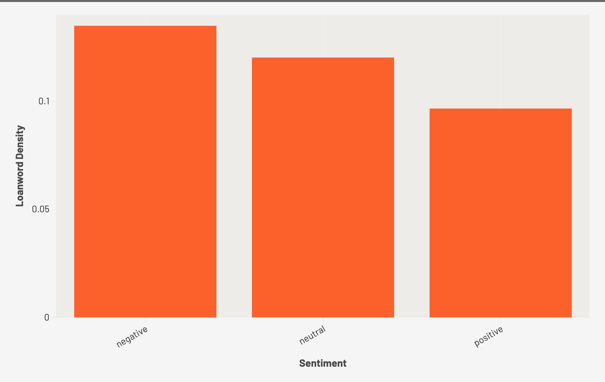

sentiment
Negative sentiment articles still use the most English
Notes:
Here’s something unexpected – this chart shows that articles with a negative tone tend to use more English loanwords than neutral or positive ones.
Why might that be? One theory is that negative stories often involve global tech, finance or scandal – topics where English dominates. This data breaches, “whistleblowing”, “shutdowns”, “crashes”.
By contrast, positive stories may be more personal or local – less jargon-heavy and more natively German in tone.
It raises a question: is English being used not just for global alignment but also for delivering bad news with a “cooler-tone”?
Hook:
Does English make bad news sound more serious – or more detached?
Interpretation:
This chart shows the average loanword density (i.e. how many English words appear per article) grouped by sentiment.
Negative articles have the highest average loanword usage
Neutral articles sit in the middle
Positive articles use the fewest English loanwords on average

Slide 8
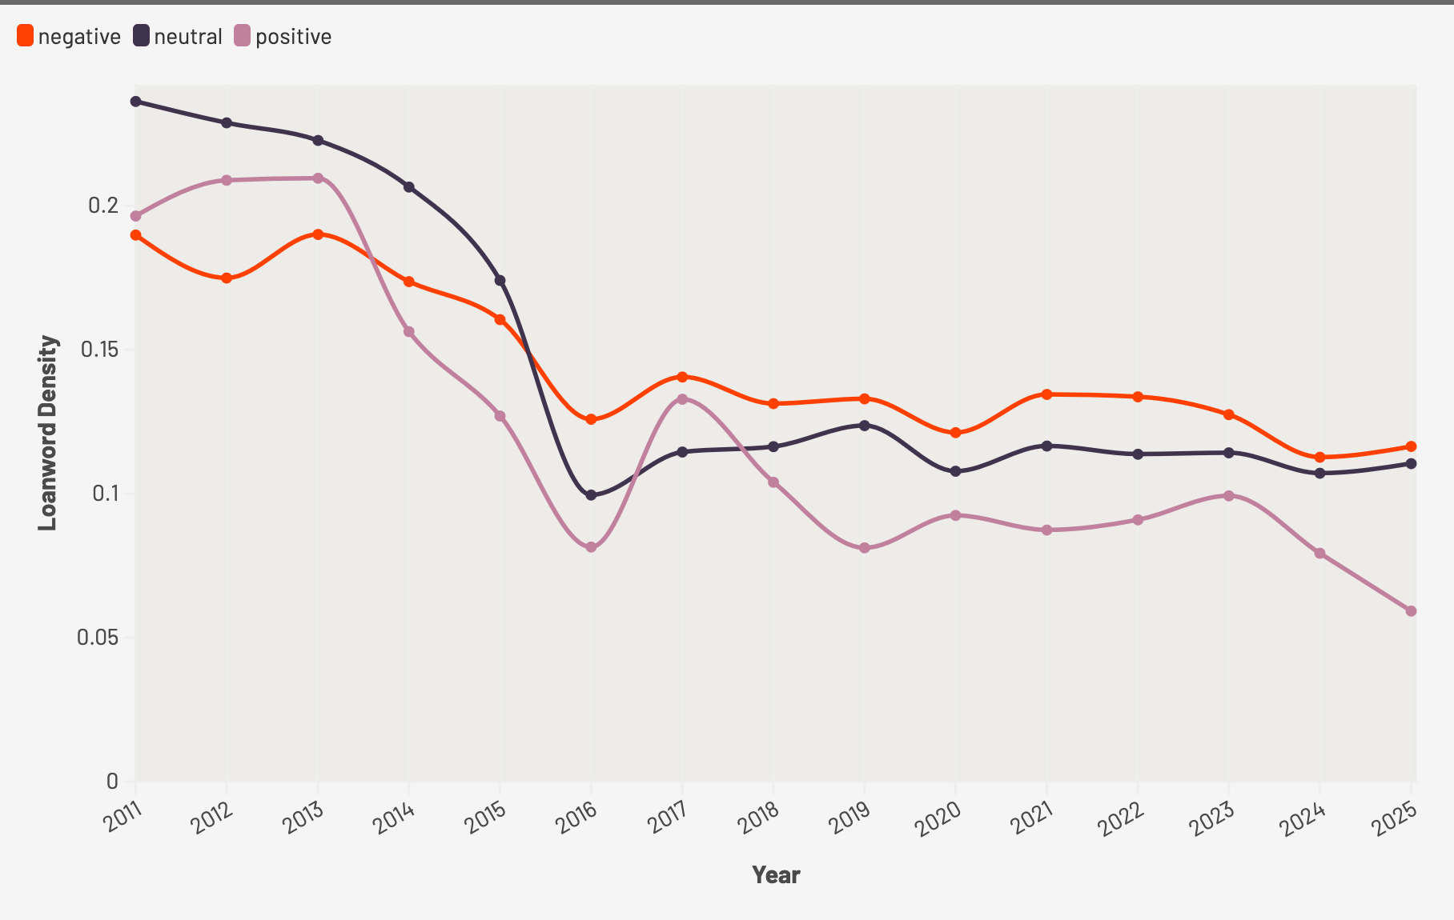
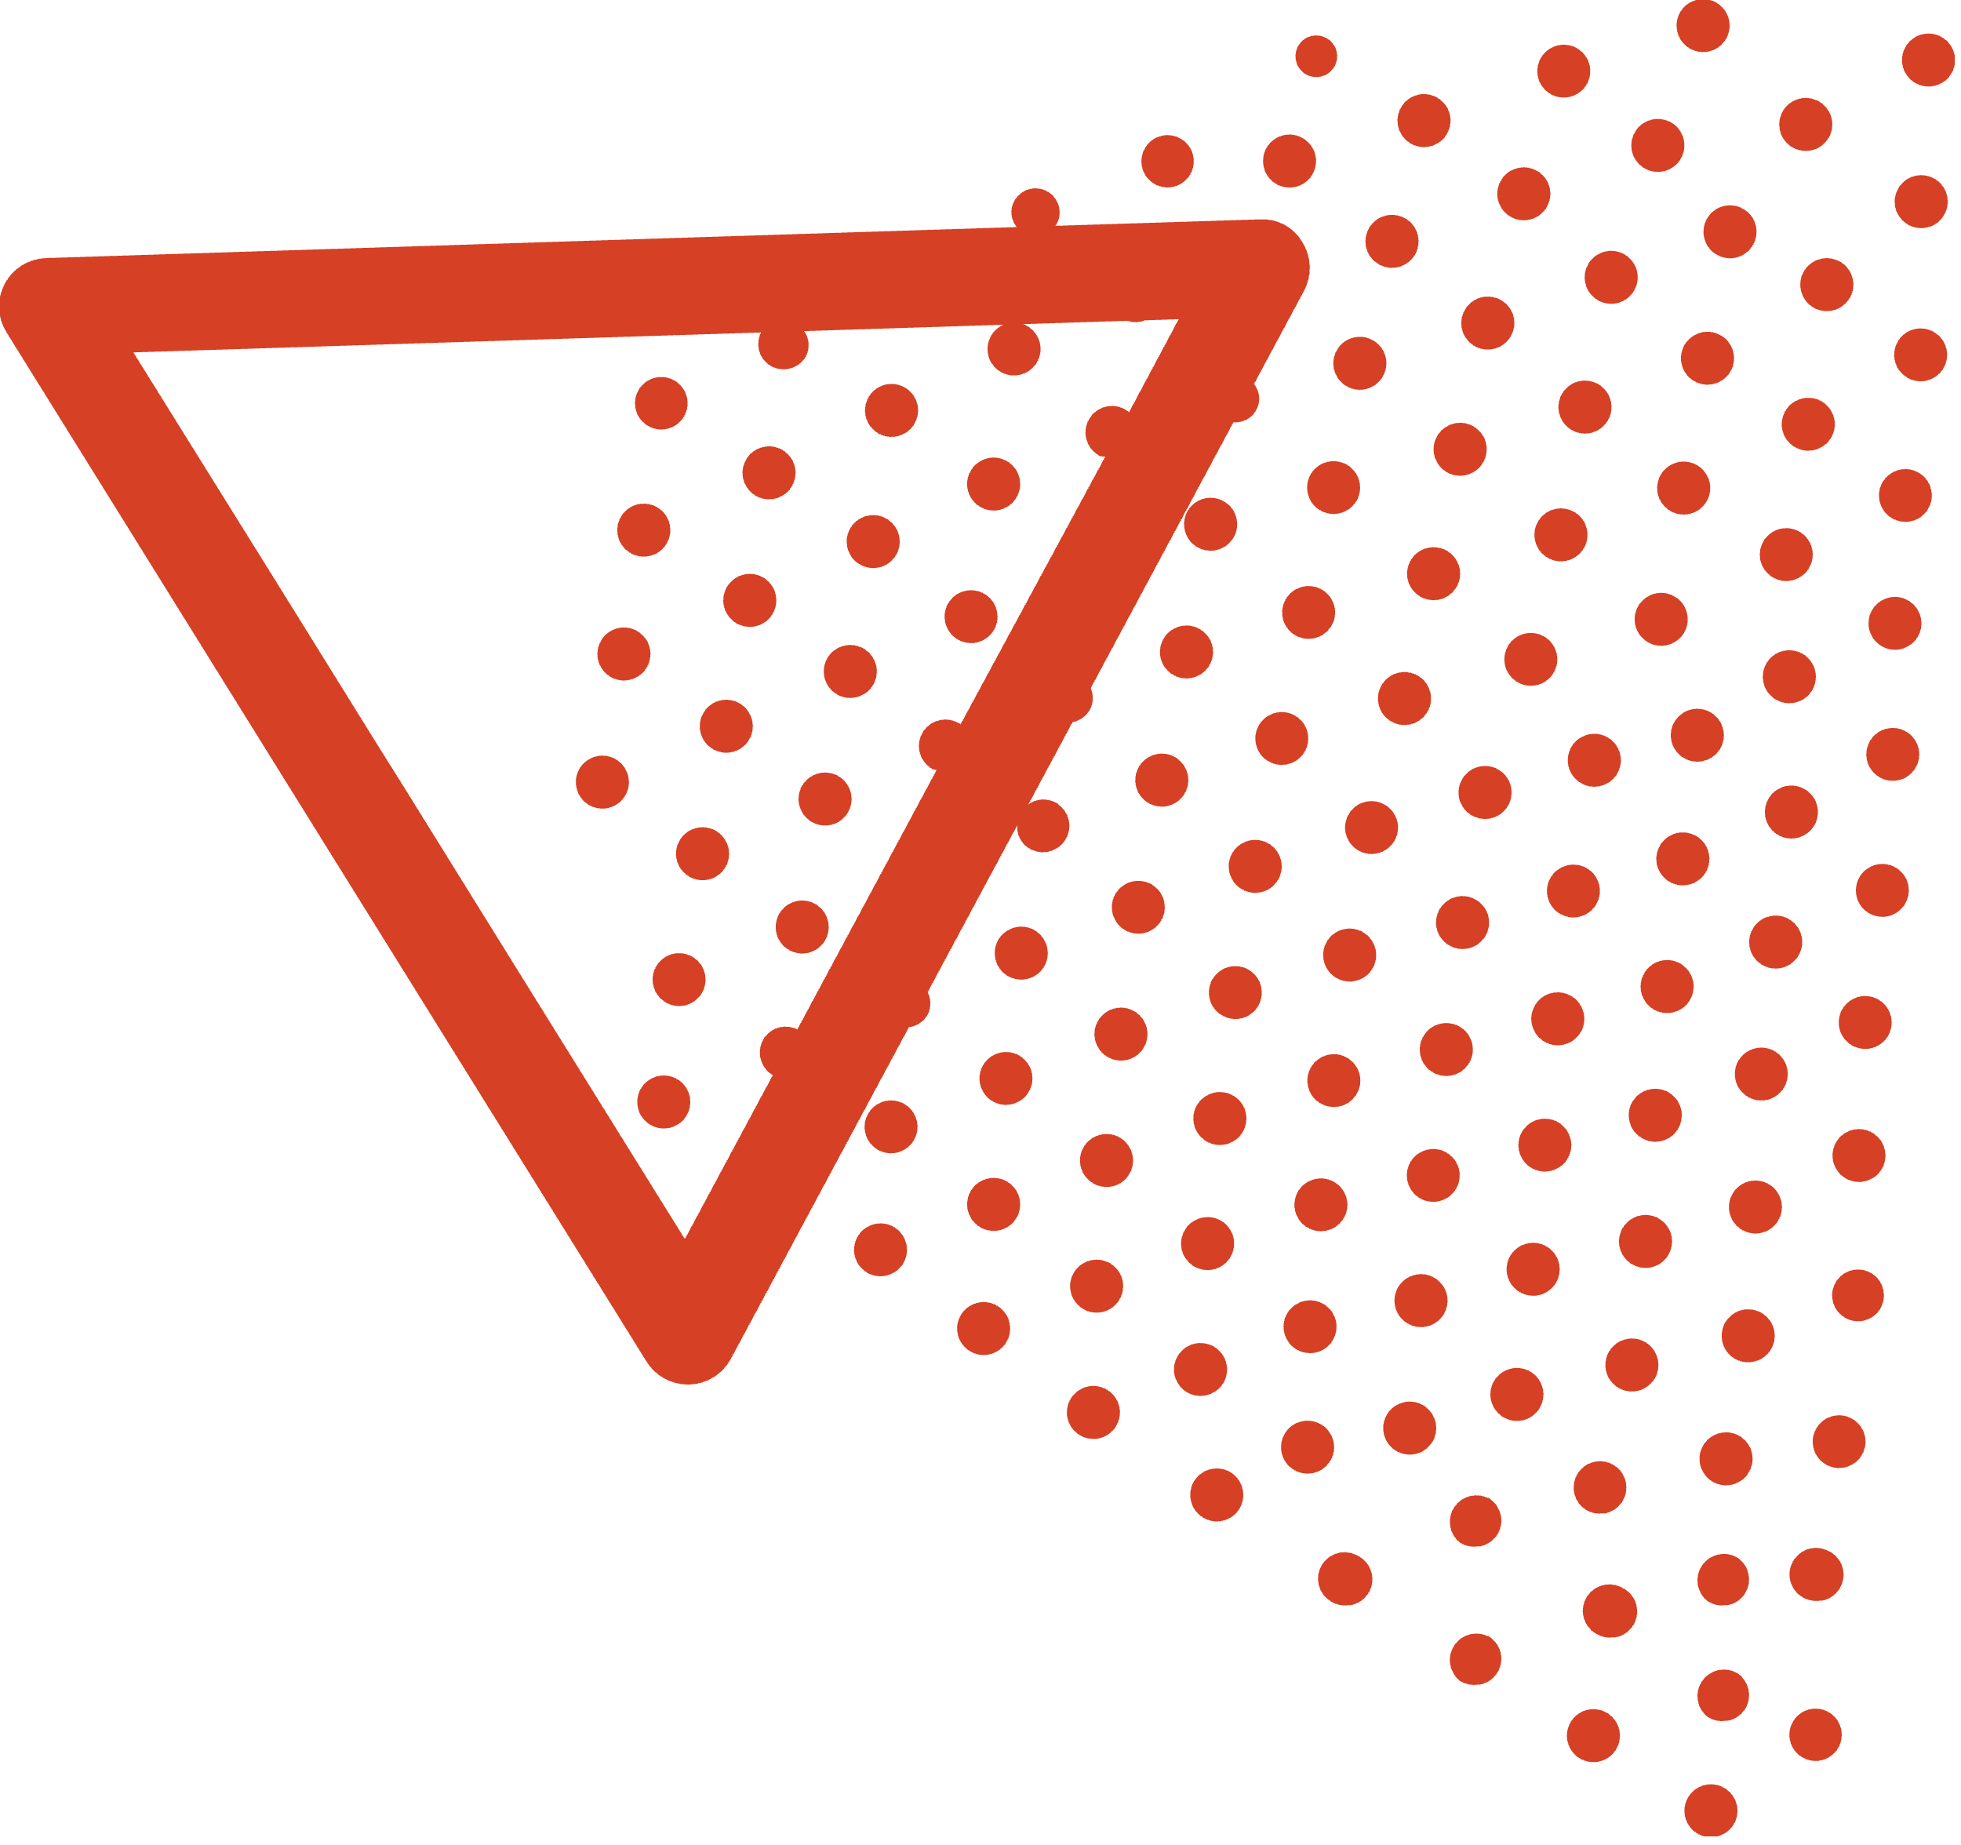
sentiment
The gap is growing — sentiment may shape linguistic style
Notes:
Here, we’re looking at how loanword usage varies by sentiment over time.
You can see that English loanwords were more common across the board a decade ago, but have dropped across all types.
Interestingly, negative sentiment articles consistently use more English than positive or neutral ones – which could reflect a certain critical framing, especially around global or tech-related issues.
Positive sentiment articles use the least English – suggesting perhaps a return to more traditional or domestic language when the tone is optimistic.
This widening gap shows that loanwords aren’t just sprinkled randomly. They may play a role in how emotion or tone is conveyed.
----
Here, we’re looking at how loanword usage varies by sentiment over time.
You can see that English loanwords were more common across the board around a decade ago, especially between 2011–2016. But since then, loanword usage has declined — this could reflect changes in editorial style, reader preferences, or a broader media shift.
Now notice the difference by sentiment:
Negative articles consistently use more English than positive or neutral ones.
Positive articles, on the other hand, tend to use less English — maybe when the tone is optimistic, writers lean into native German to express pride or tradition.
And the gap is growing. By 2025, that distance between positive and negative sentiment loanword usage is even wider than it was in 2011.
So this suggests that English words aren’t just sprinkled randomly — they may serve a function in how emotion, criticism, or aspiration is framed in the media.
----
This is a multi-line time series, where:
Each line show how loanword usage (measured by density) has changed over time for articles with that sentiment type.
Key Insights:
All Sentiments Decline Over Time
Between 2011 and 2016 loanword density for all sentiments are higher
After 2016 there’s a noticeable drop across all three sentiment categories
This might suggest a stylistic or change in editorial policy – possibly a response to public feedback or media regulations (speculation)
Negative Articles Use More English
Negative sentiment articles consistently show higher loanword density than neutral or positive ones
This might suggest that English terms are used in critical or problem-based reporting - such as coverage of tech scandals, policy issues etc
Positive Articles Use Less English
Positive sentiment articles consistently have the lowest loanword density
Possible interpretation: native (standard) German is preferred when describing national pride, heritage or optimistic topics
The Gap is Growing
By 2025, the gap between positive vs. negative sentiment loanword usage is larger than it was in 2011
Suggests increasing polarisation in the way English is deployed in emotional framing

Slide 9
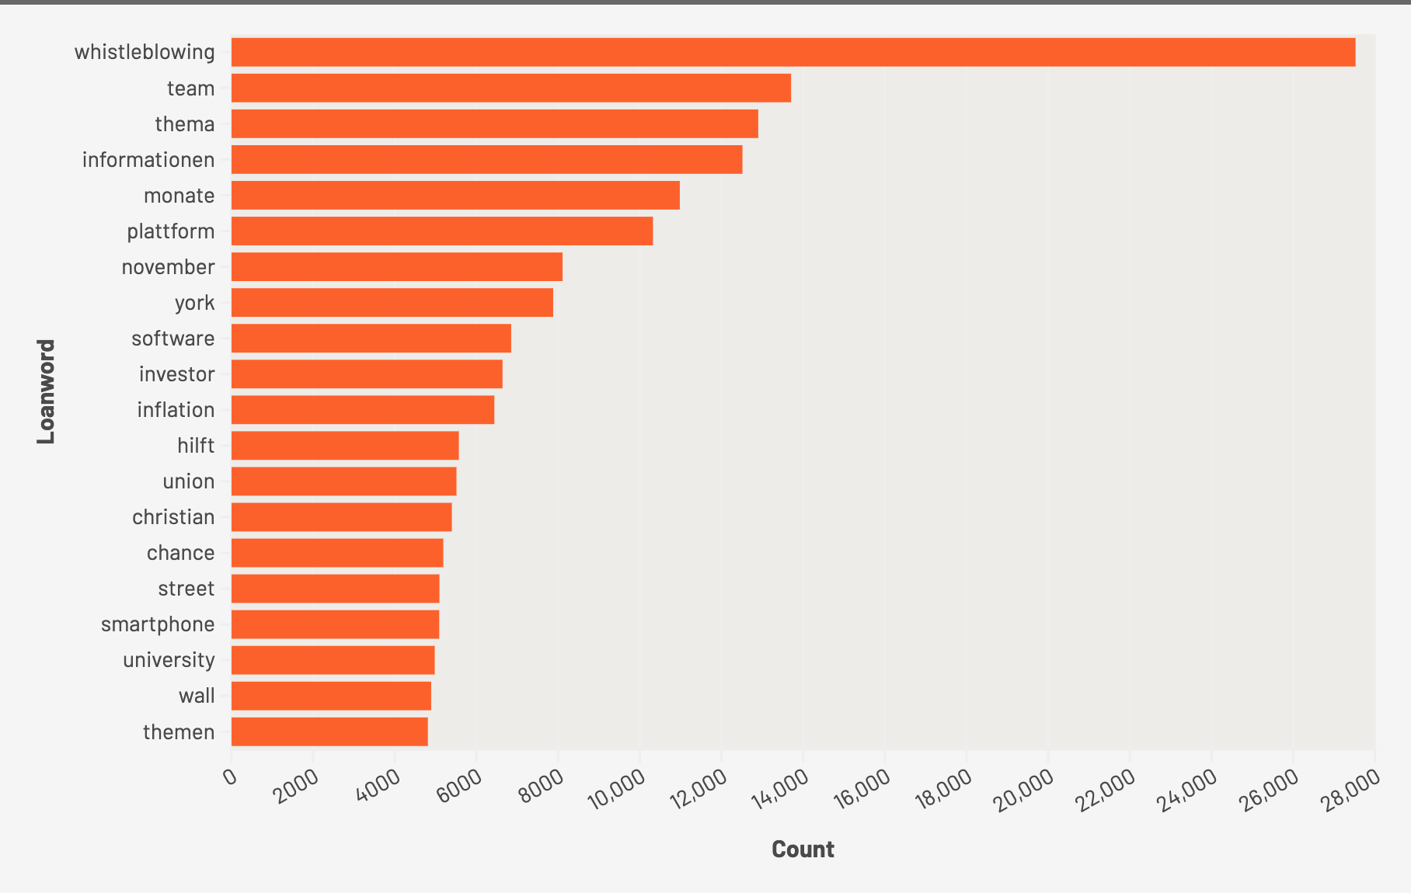
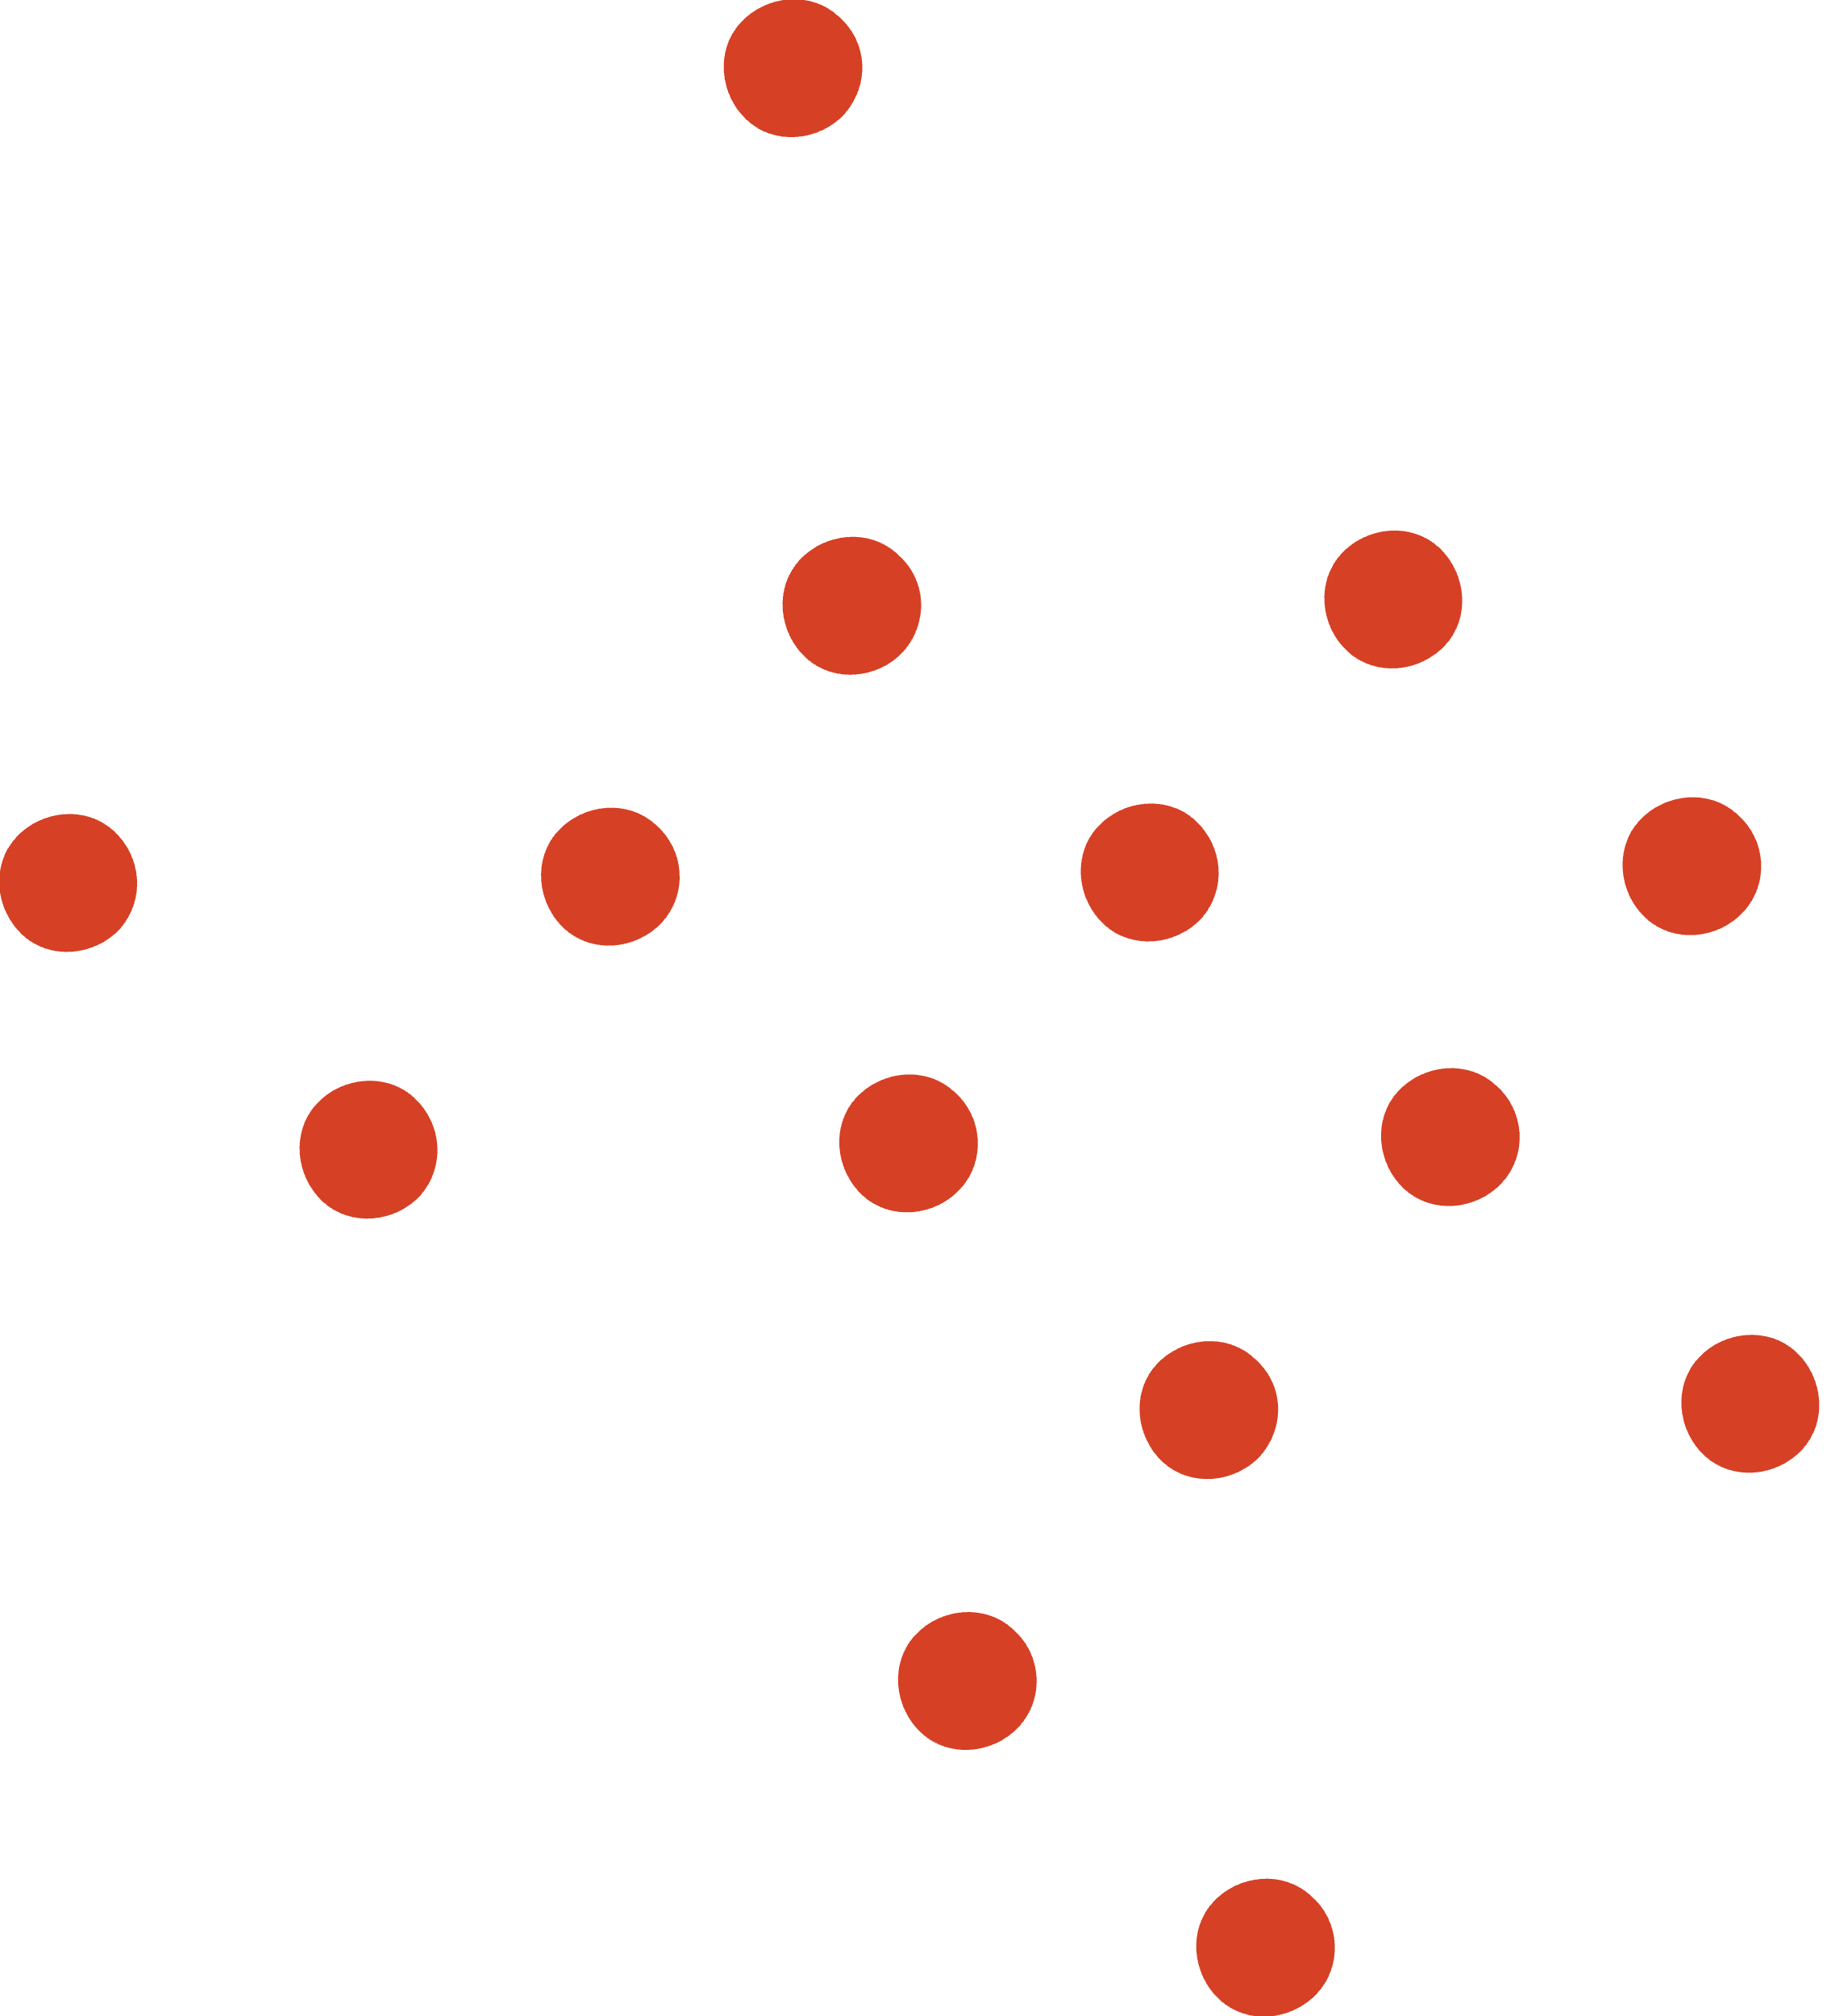
top 20 loanwords
These are the most frequent English loanwords. Many displace German alternatives — possibly because they sound more modern, international, or efficient.
Notes:
Let’s take a look at which English loanwords show up most often.
Unsurprisingly, we see business and tech language dominate – terms like team, platform, software and investor.
At the very top is whistleblowing, which has no perfect German equivalent and is often use din political or investigative reporting.
You’ll notice proper nouns like York, wall or Christian – these reflect English names or concepts that don’t get translated.
This chart helps us see how Denglisch is not random – it tends to cluster around specific themes: business, tech, international news and cultural references.
This is a horizonal bar chat showing the top English (or English-like) words used in German articles from businessinsider.de. The longer the bar, the more often the word appeared in the dataset.
Key Observations:
“whistleblowing” is by far the most frequent – likely due to its niche untranslatable nature in German media.
Words like “team”, “software”, ”platform” and investor are extremely common in tech, business and corporate contexts.
Some entries like “York”, “wall” may stem from proper nouns like New York or Wall Street
Terms like “smartphone” and “university” reflect modern global concepts where the English term is either more familiar or more stylish.
There are terms such as “Christian” and “hilft” which are false positives and aren’t true loanwords.

Slide 10
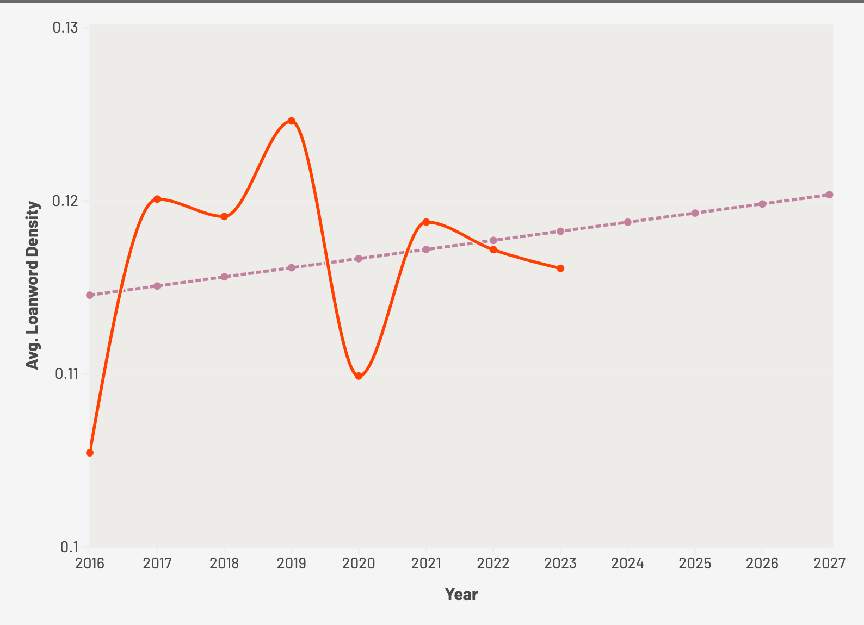

forecasting future usage
Loanword usage is set to rise. It suggests English is becoming embedded, not just trendy.

Slide 11

Conclusion & Takeaways
Insight: English loanwords are shaping modern German
Trend: Denglisch is steadily rising in German media
Density: Business content shows the highest concentration
Emotional framing: Sentiment suggest English adds positive tone or perceived authority
Limitations: One source site (businessinsider.de) limits domain diversity
Notes:
To wrap up:
English loanwords are rising in German news – especially in tech, business, and positive-tone content.
This suggests a shift not just in language but in identity and branding.
I used both quantitative and qualitative methods to show how deep this goes.
Importantly we used statistical tools like the 95% confidence internal to ensure our findings.
Like the growth in loanword density – are robust and meaningful not just random.
In the future, adding more sites and modelling adoption trends could deepen even further
As a learner, this has helped me see how language evolves – and how English and German aren’t rivals but collaborators
Next steps:
Add more sources (e.g. Reddit, tech blogs, news).
Model prediction: can we forecast loanword adoption?
Thank you

Slide 12
guess the word
FAMILY FORTUNES MINI GAME
placeholder
placeholder
placeholder
placeholder
placeholder
Notes:
Before I show you the top 10 words from the data. Lets have a quick game.
Can you guess the top 5 most common English words in German articles?
Let’s play a quick game of Family Fortunes. Based on the articles scraped from Business Insider, what do you think were the top 5 most common English loanwords?
Slide 7: Audience Round – Guess the Top 5
Interactive Moment: What Are the Most Common English Words?
🧠 Mini Game: 'Family Fortunes' Style
Invite the audience to guess the top 5 most frequent English loanwords in the dataset
🖼️ Visual Game Board:
1. __________ 2. __________ 3. __________ 4. __________ 5. __________🎙️ Prompt: “Let’s play a quick game! Based on 30,000+ German articles scraped from Business Insider, what do you think were the top 5 most common English loanwords?”
📣 As they guess:
Fill in correct answers one by one
Reveal the full list
📊 Then transition to: A bar chart of actual top 10 loanwords (frequency-based)
🎯 This interactive moment will build energy and make your findings more memorable.

