Slide 1
Annabel Lee
Electrical Engineering for Theater
PRESENTED BY
DATE
CONTEXT
Annabel Lee
October 2026
Portfolio review

Slide 2
Wearables that light the stage
01
abLED costumes, from breadboard to curtain call

Slide 3
Engineering in service of the story
APPROACH
Start from the scene: what should the audience feel?
Build hardware that survives eight shows a week
Hand the controls to the operator, not the engineer
Theater
Embedded
PCB Design
Fabrication

Slide 4
Two audiences, one costume
THE BRIEF
What the stage asks for
What the circuit delivers
Reads from the back row
Silent, cool, invisible
Cue-accurate, every night
144 addressable LEDs
Wireless OSC cues
A battery that lasts Act II

Slide 5
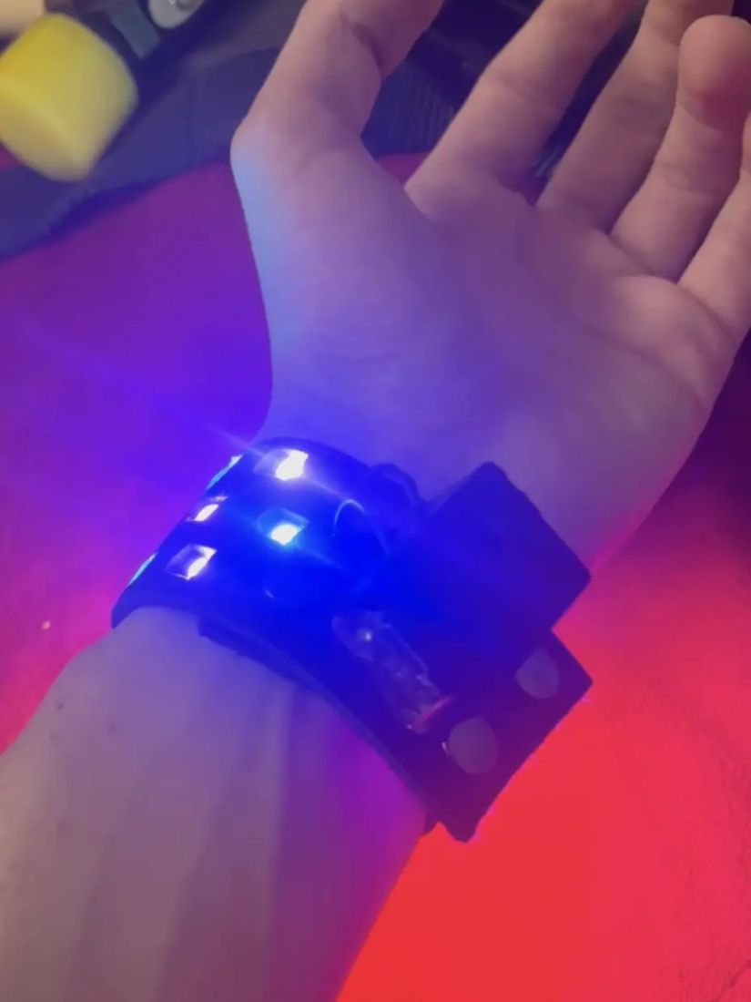
Costume lighting, sewn in
ABLED V1
The first wearable: an LED cuff driven by a microcontroller hidden in the sleeve, cued from the booth.
Fig. 01 —
abLED cuff during tech rehearsal

Slide 6
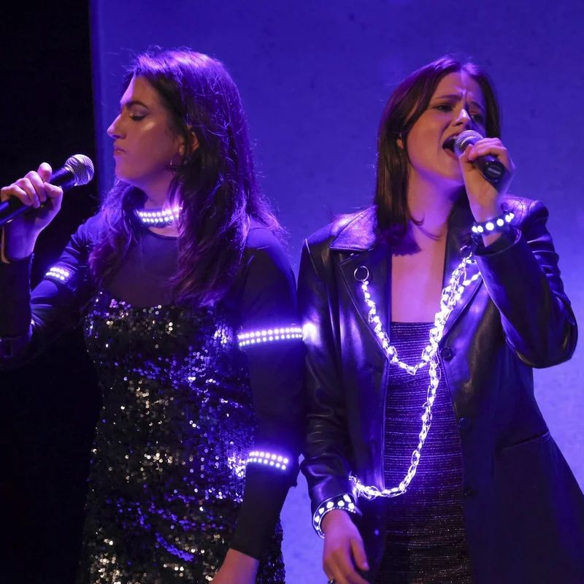
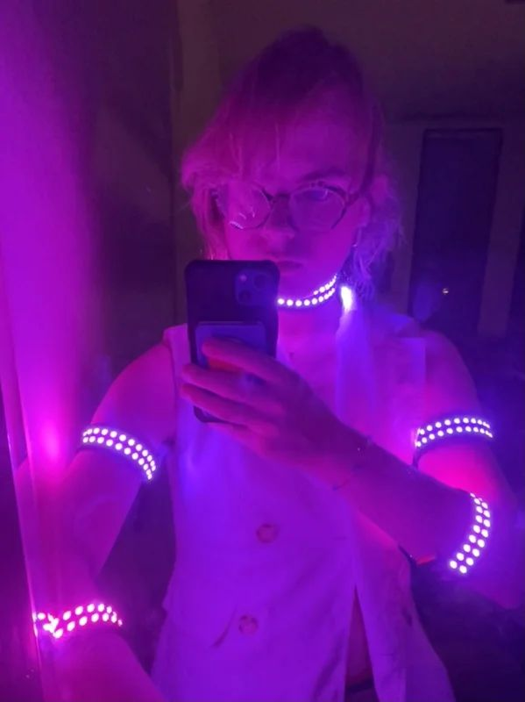
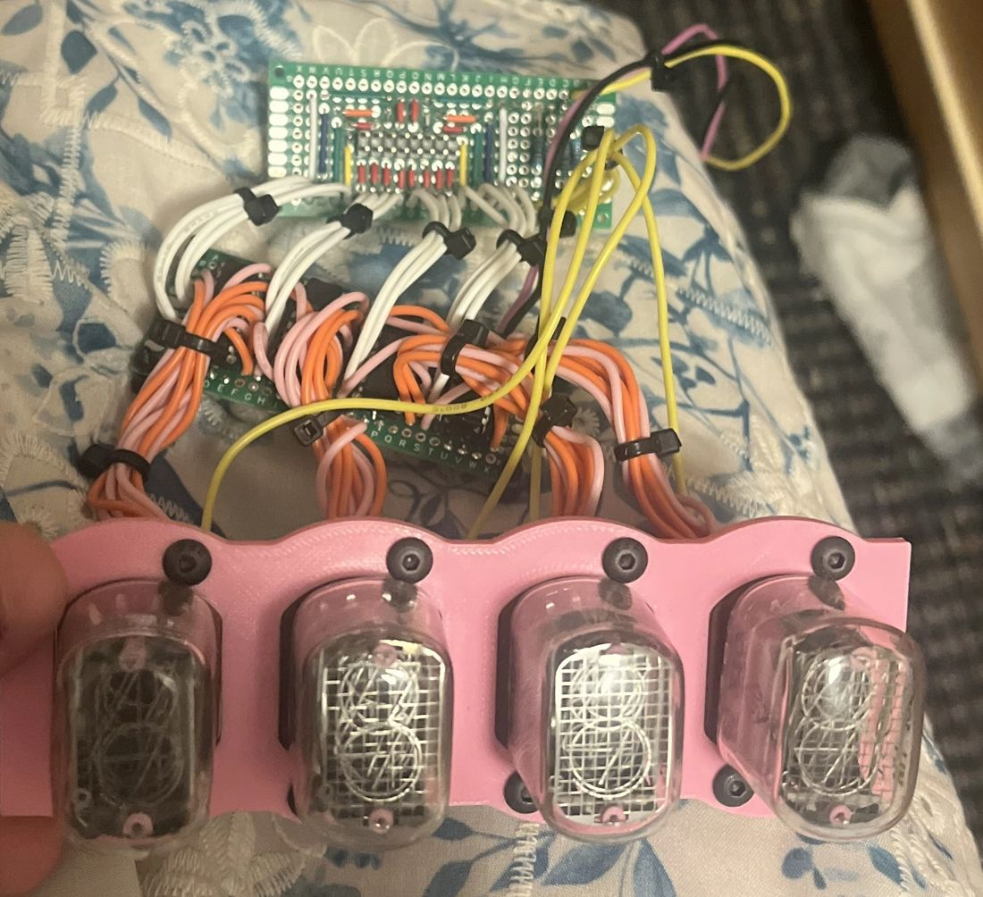
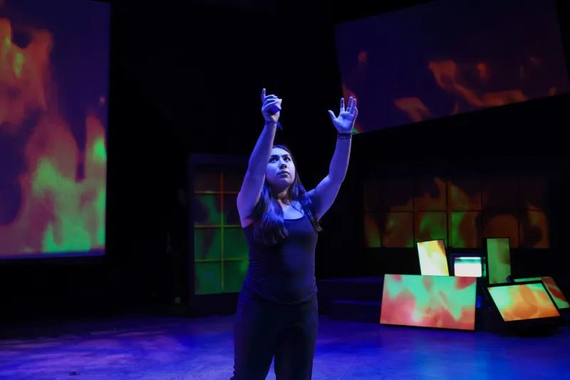
Selected work
Theater · Embedded · 2022–2026

Slide 7
Nixie Clock
PROJECT
2024
PCB Design
Six glowing tubes, a hand-routed driver board, and a USB-C supply stepped up to 170 V.
Skills
KiCad layout
Shift registers
USB-C power
High voltage
Enclosure CNC
DATE
COMPLEXITY
ROLE
2024
High
Solo build

Slide 8
The best tech is the tech the audience never notices.
— a rule I build by

Slide 9
Five years of building
BY THE NUMBERS
26
7
5
PROJECTS
DISCIPLINES
YEARS
Documented builds on the portfolio
From theater to PCB design to CS
Of making, 2022 through 2026

Slide 10
Six disciplines, one portfolio
TODAY
Theater — GOOD (2025)
Embedded — abLED wearables
DSP — FPGA synth
Each colour matches the tag bar on the site, so sections stay coded throughout.
PCB Design — Nixie clock
Fabrication — wedding arch
CS — gooey control center

Slide 11
Recent projects
BUILD LOG
Project | Year | Tag | Notes
abLED v1 | 2023 | Theater | First wearable
Nixie Clock | 2024 | PCB Design | Hand-routed driver
FPGA Synth | 2024 | DSP | Verilog oscillators
Poem Box | 2024 | Fabrication | Laser-cut gift
gooey | 2026 | CS | Control center for TheaterGWD

Slide 12
thank you
Electrical Engineering for Theater
please hire me :)
halfsohappy@gmail.com · annabel-lee.xyz · github.com/halfsohappy

