Slide 1
gooey
annieData control center for TheaterGWD
Tech week · Oct 2026
3 devices · 24 messages · 6 scenes
listening on :9000

Slide 2
Messages & Scenes
SCENE 02
02 /
How a sensor reading becomes a lighting cue.

Slide 3
Why rebuild annieOSC?
Overview
Config payloads now travel as one argument, not split on spaces
The reply feed is always visible instead of buried under a tab
Every TheaterGWD command has a form: clone, rename, move, solo
Built for theater operators, not as a generic OSC tool

Slide 4
Send, then see
Layout
Live Feed
19:57:30 RECV /gyro/x 0.0206
19:57:31 SEND /scene/act2/start
19:57:31 RECV /status act2 run
19:57:32 BRDG /qlab/go 14
19:57:33 RECV /accel/y -0.002
Controls on the left: messages, scenes, direct sends
Replies stream in on the right as they happen
Operators confirm a cue without switching tabs
5 messages · 2.1 msg/s

Slide 5
From generic tool to control center
Before / After
annieOSC
gooey
BEFORE
AFTER
Tabs hide the feed
Status config sends nothing
Clone & rename by hand
Split panel, feed always on
Proper status config form
Dedicated clone/rename forms

Slide 6
One show, at a glance
Dashboard
LISTEN PORT
DEVICES
SCENES
9000
3
6
Where devices send their replies
Costume packs on the show network
Grouped messages, started per cue

Slide 7
Script console
Scripting
>>> dev = device("costume-1")
>>> dev.msg("accelX").enable()
RECV /status/accelX enabled
>>> dev.scene("act2").start()
RECV /status/scene act2 running
>>> scenes()
{'act2': {'period': 50, ...}}

Slide 8
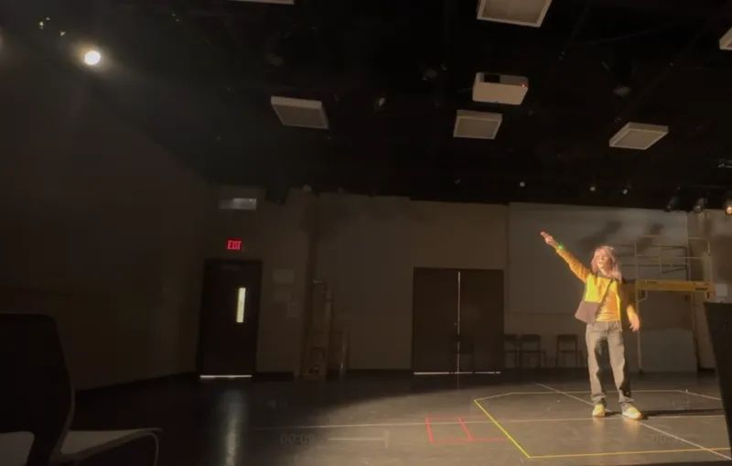
Running the booth
In the room
TECH REHEARSAL
The operator watches the stage, not the laptop. Status dots and the feed answer “did that cue land?” at a glance.

Slide 9
Welcome to annieData
Onboarding
Add a device using the + button above
Click its tab and choose Query to load its config
Create messages and scenes to start sending OSC
Take a tour!

Slide 10
Controls on the left. The feed is always visible.
— the split-panel rule

Slide 11
thanks!
questions? the feed is open
Restore

