Slide 1
Thesis notebook
Sensors, scenes and a costume that cues itself
Annabel Lee
October 2026
draft v0.3 — still sketching

Slide 2
Prototyping the wearable
2
Three boards, two failures, one keeper.

Slide 3
What tech week taught me
FIELD NOTES
Sweat is a design constraint: seal every connector
Operators trust what they can see, so show the feed
Battery math always loses to a long Act II

Slide 4
Sensor placement
Wrist IMU
Sternum IMU (chosen)
Easy to wire
Reads gestures well
Snags on props
Hidden under costume
Tracks whole-body motion
One cable run

Slide 5
From motion to light
1
2
3
Sense
Map
Send
The IMU reports orientation 100 times a second
A scene scales the value into a cue range
OSC hits the lighting desk on the show network
latency budget: under 20 ms end to end

Slide 6
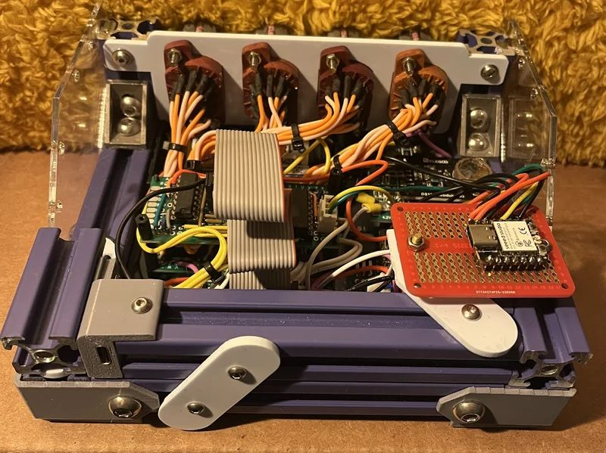
Driver board, rev 2
BENCH
Hand-wired shift registers before the PCB came back. Ugly, but it proved the timing.
it works!! (mostly)

Slide 7
Status board
In progress
Done
Costume harness, rev 3 fitting
OSC bridge to the lighting desk
Next
Blocked
Scene editor in gooey
Waiting on the 170 V supply parts

Slide 8
Draw it badly first. Then build it properly.
— notebook, page one

Slide 9
Signal path
IMU
ESP32
gooey
Desk
Wi-Fi · OSC over UDP

Slide 10
thanks!
pages from a work in progress
halfsohappy@gmail.com · annabel-lee.xyz

