Slide 1
Calculator

Slide 2
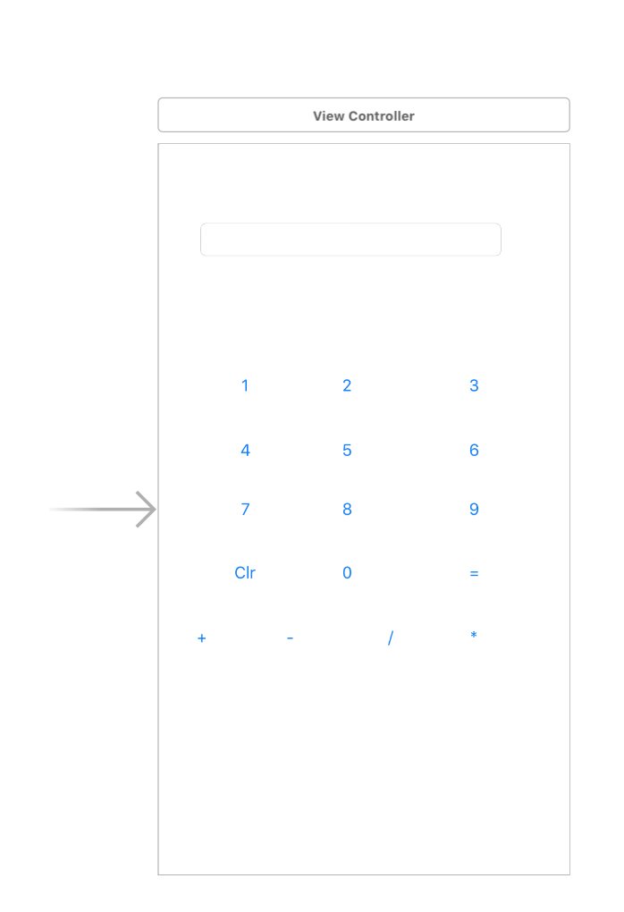
My First Calculator
var firstNumber = ""
var secondNumber = ""
var operand=""
var result:String=""

Slide 3
Clear
var firstNumber = ""
var secondNumber = ""
var operand=""
var result:String=""
@IBAction func myClr(_ sender: AnyObject) {
myText.text=""
result=""
firstNumber = ""
secondNumber = ""
operand=""
result=""
}

Slide 4
Numbers
@IBAction func myone(_ sender: AnyObject) {
if result=="" {
myText.text="1"
result="1"
}
else{
result=result+"1"
myText.text=result
}
}

Slide 5
Sumbols
@IBAction func myAdd(_ sender: AnyObject) {
firstNumber=result
myText.text=result+"+"
operand="+"
result=""
}

Slide 6
Equal
@IBAction func myEqual(_ sender: AnyObject) {
let firstNumberInt:Double=Double(firstNumber)!
let secondNumberInt:Double=Double(result)!
var finalResult:Double=0
if operand=="+"{
finalResult=firstNumberInt+secondNumberInt
}
myText.text=""
myText.text=String(finalResult)
}

