Slide 1
TREELINE
A three-pronged system for Halifax's urban forest
Report → Score → Route
Prepared for the Urban Forest Master Plan · City of Halifax

Slide 2

Trees still get managed one ticket at a time
1
2
3
Reactive by default
One flat priority field
No routing between sites
A tree only gets attention after a resident calls it in — there's no proactive scan for risk before it becomes an emergency.
Cityworks priority (1–4) doesn't account for how long a ticket has sat open, what's nearby, or how the tree is actually failing.
Hundreds of open “Trees” requests are worked in whatever order they arrive — not the order that gets crews there fastest.
TreeLine closes this with one pipeline: a way in for residents, a way to rank what matters, and a way to route the work.
02

Slide 3


01
User Reporting Tool
The front door — residents flag a tree in under a minute
New Report
Photo + GPS in one tap
A resident snaps the tree, drops a pin, and picks a condition tag (fallen limb, lean, storm damage, dead) — no account or app-store hunt required.
Duplicates merge automatically
Reports within ~2 m of an existing ticket are folded into it instead of opening a fresh case for the same tree.
✓ Location detected
Duke St. · near Duke St. Cohn School
Fallen limb
Lean / risk
Dead
Status comes back to the resident
Open → Scored → Scheduled → Done. The person who reported it can see it move, closing the loop 311 leaves open.
Notes
Large limb down over the sidewalk after last night's wind.
Submit Report
03

Slide 4

02
Digital Arborist
The judgment layer — turns four data sources into one ranked list
Priority
Cityworks 1–4 field, direct from the request
URGENCY SCORE
Age
Priority × w1 + Age × w2
Days since the ticket was opened — older climbs the list
+ Safety × w3 + Condition × w4
Safety risk
Proximity to schools, sidewalks, roads, power lines
Every score ships with its own explanation — “Priority 2 + 47 days open + 30 m from a school” — so an arborist can see why, and override it.
Condition
Species, lean, decay and storm damage from inspection
+ a density bonus when several scored trees sit within 50–100 m of each other
Rescored every morning as new reports, weather, and crew feedback come in.
04

Slide 5

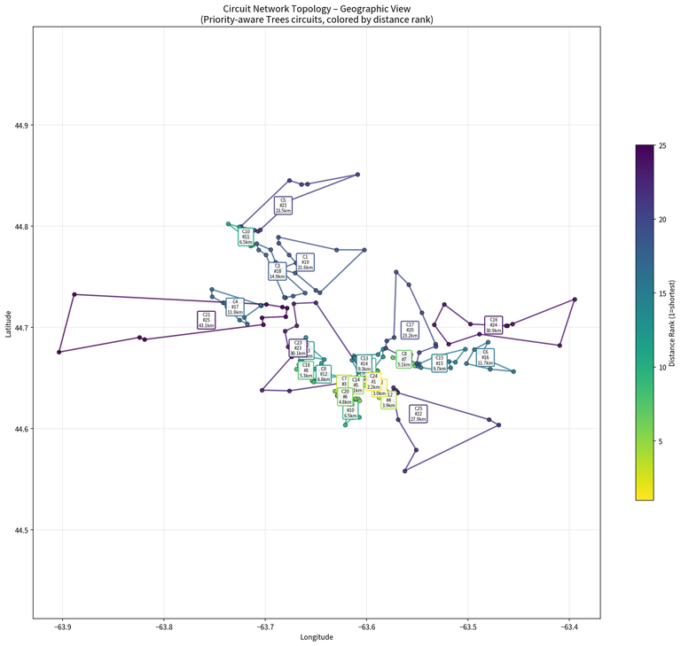
03
Digital Mapping & Logistics
The backend that turns a ranked list into a route a crew can actually drive
Cluster, then seed
Scored trees within ~50–100 m are grouped into work packages of 8–12, each seeded by its highest-urgency tree.
Solve the route, not just the list
A short TSP pass turns each package into a drivable loop — not a list of addresses in ticket order.
Rank the circuits themselves
Circuits are ordered by total urgency, so crews always start on today's highest-priority loop first.
25 priority-seeded circuits generated for the municipality this cycle
Live output: circuits colored by seed priority and travel-distance rank
05

Slide 6


One pipeline, three systems, a healthier canopy
TreeLine closes the loop the Urban Forest Master Plan needs — from a resident's phone to a crew's route, and back again.
Report
Score
Route
Crew
Learn
Feedback loop — completed work refines tomorrow's scores
Human-in-the-loop throughout — arborists can always override the score or the route.
06

