Slide 1
CNN to detect covid in Chest x-rays
Haider Ali

Slide 2
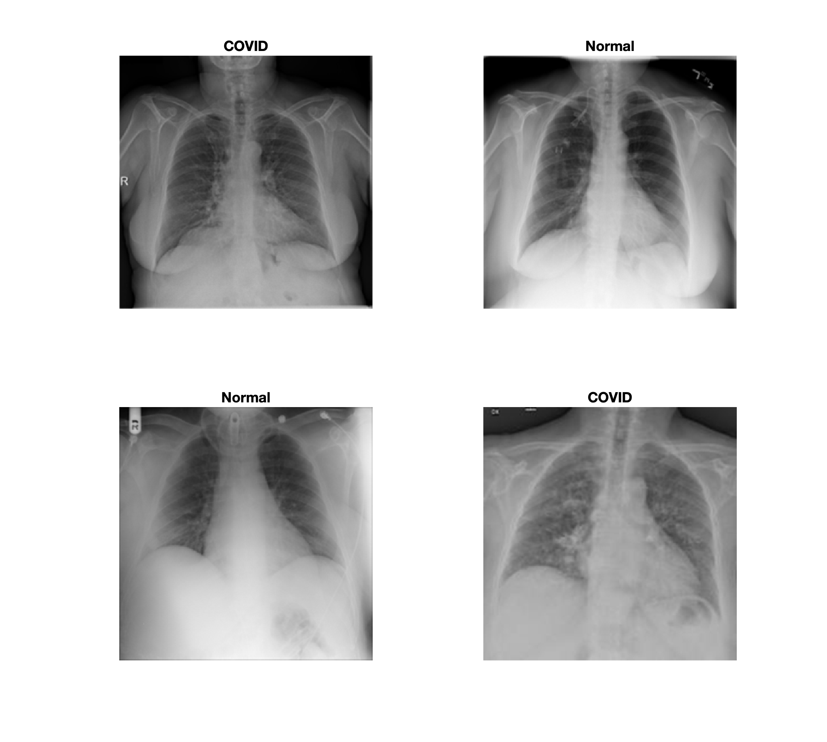
A Look at the Data…
Classes | Num Images
COVID | 3616
Viral Pneumonia | 1345
Lung Opacity | 6012
Normal | 10192
- Chest X-Ray images for COVID-19 Cases
- Dataset also includes Normal and Viral Pneumonia images
- These data were compiled from a list of sources
- I got them from Kaggle
Classes | Num Images
COVID | 3590
COVID test | 26
Normal | 10100
Normal test | 92

Slide 3
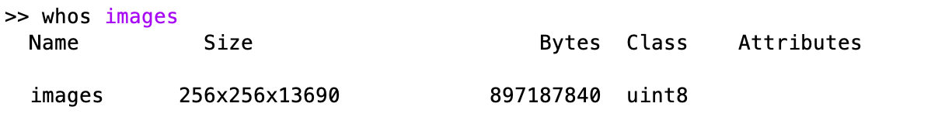
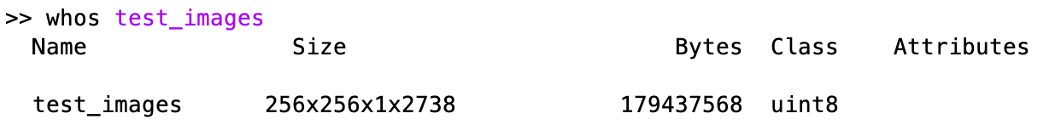
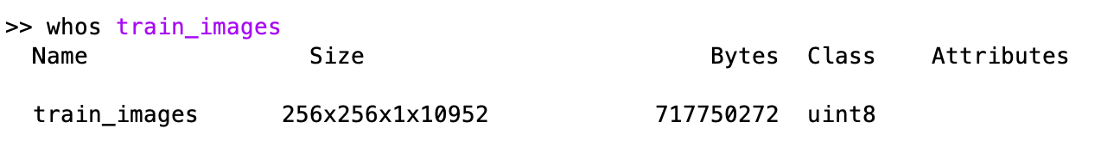
Issues when Loading Data
Started off with following Lab 11
Instead of using ImageDataStore, I manually read all the images into memory since there weren’t that many
Randomized because all the data was in order, i.e. all the covid images then all the normal images
Split the data manually. 80% train and 20% test

Slide 4
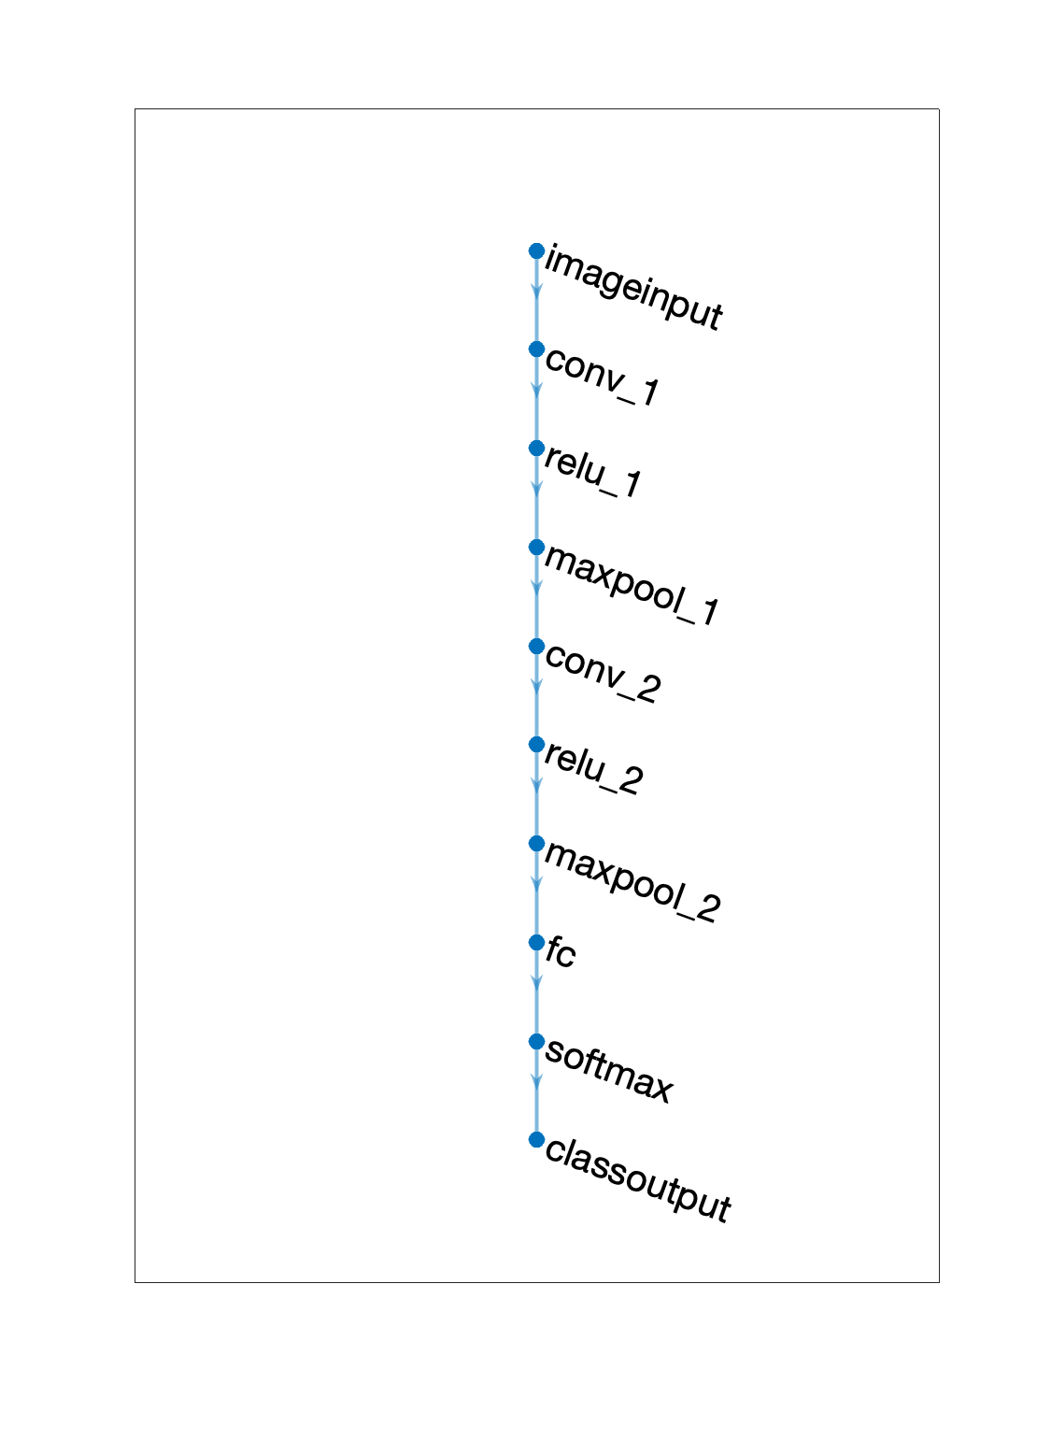
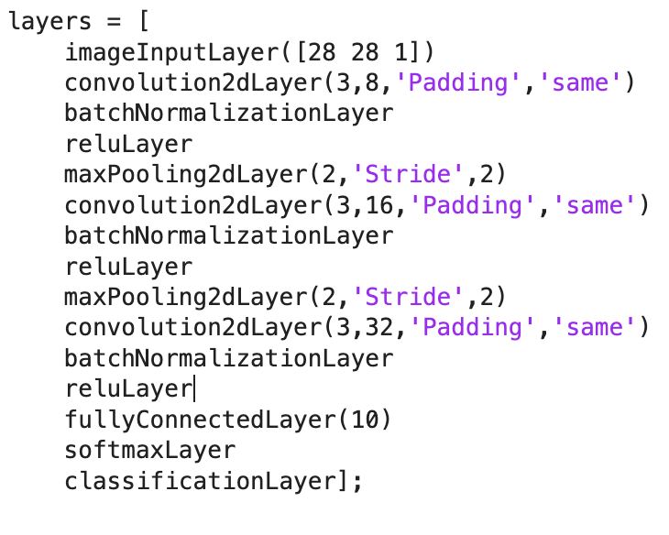
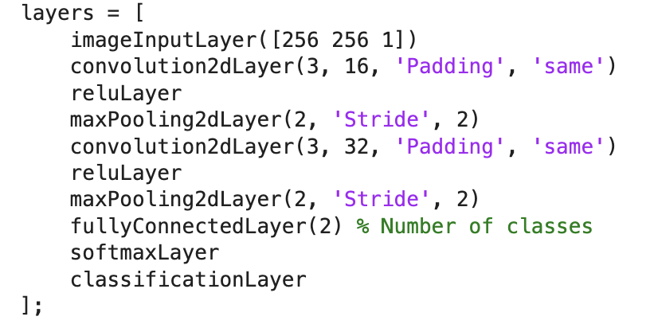
A Look at the Network…
Very Simple Model
Simpler than the MNIST network we used in the tutorial
Larger starting images and feature maps

Slide 5
Issues when Training
Kept getting the same error that said: Error using trainNetwork Number of observations in X and Y disagree.
Invalid training data. Responses must be a vector of categorical responses, or a cell array of categorical response sequences.
Had to modify my data importing
Frustration

Slide 6
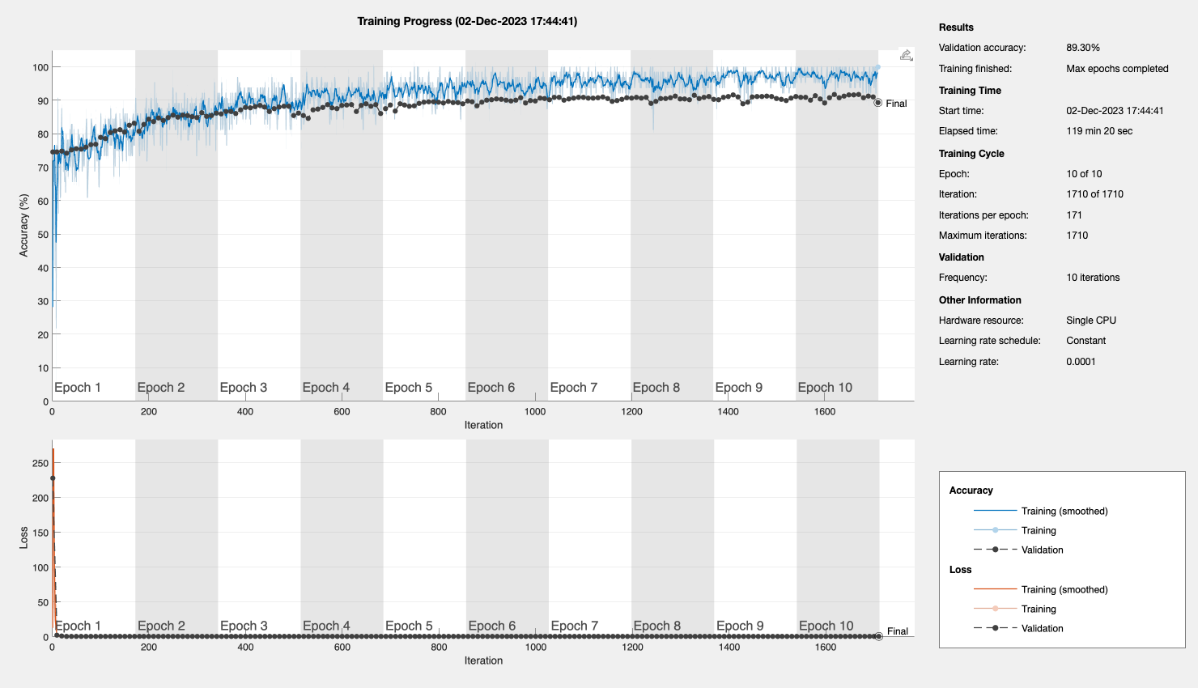
Training Plot

Slide 7
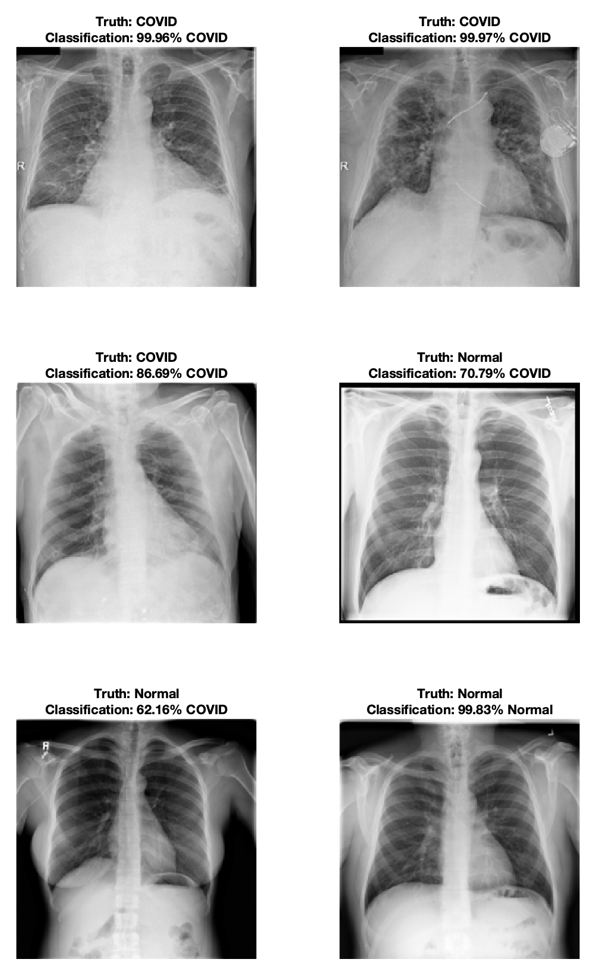
Testing Images
Classes | Num Images
COVID | 3590
COVID test | 26
Normal | 10100
Normal test | 92
Seems to do pretty bad, only classified one of the normal images as normal
Accuracy on all 118 unseen images: 84.75%
90% accuracy on the validation set

