Slide 1
Forms, User input & Validation
Getting that precious user input

Slide 2

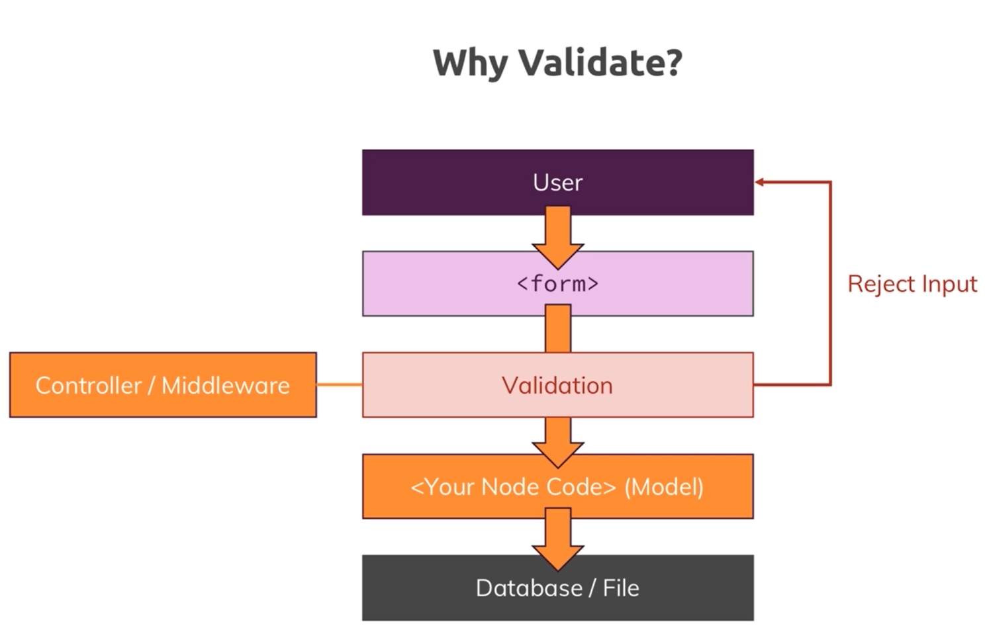



Why validate?

Slide 3
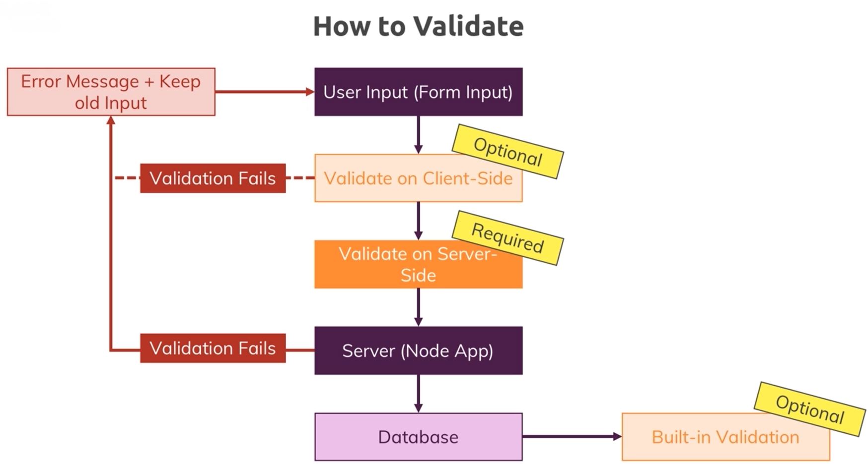
How to validate?

Slide 4
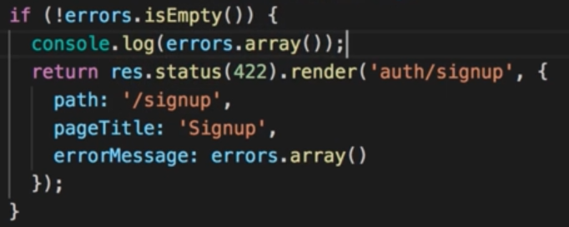
Setup Basic Validation

Slide 5
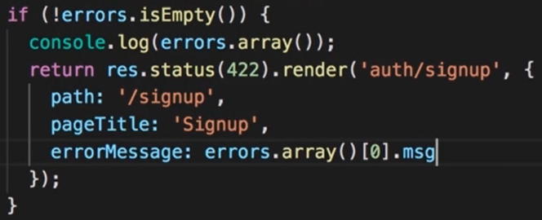
Using Validation Error Messages

Slide 6
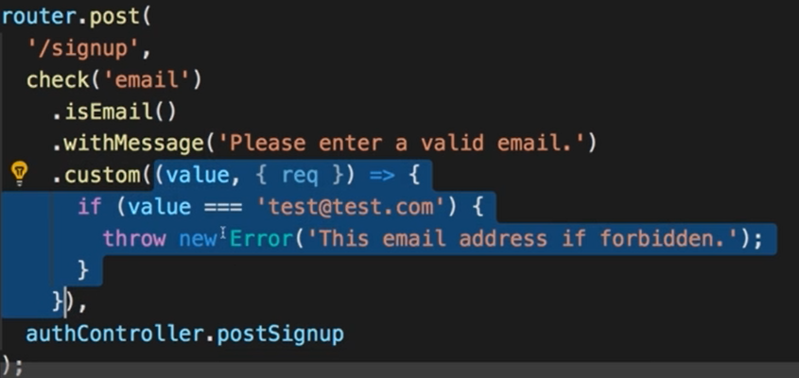
Built-in Custom Validators

