Slide 1










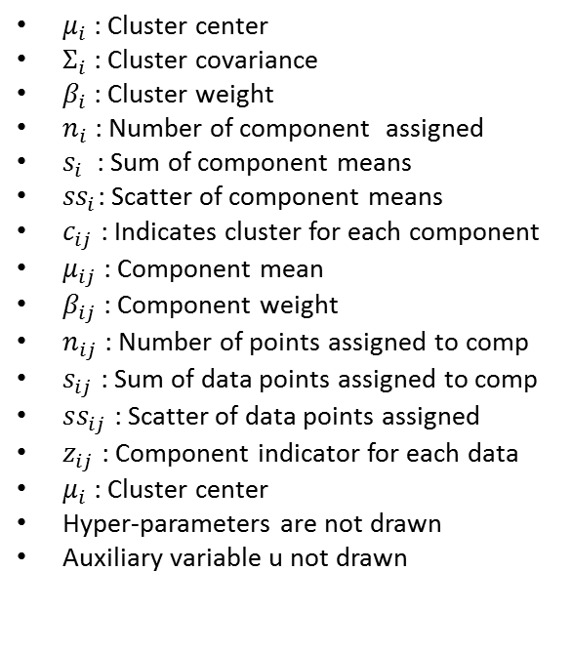




$$β_{i}$$
$$μ_{i}$$
$$Σ_{i}$$
$$n_{i}$$
$$s_{i}$$
$${ss}_{i}$$
$μ_{i}$ : Cluster center
$Σ_{i}$ : Cluster covariance
$β_{i}$ : Cluster weight
$n_{i}$ : Number of component assigned
$s_{i}$ : Sum of component means
${ss}_{i}$: Scatter of component means
$c_{ij}$ : Indicates cluster for each component
$μ_{ij}$ : Component mean
$β_{ij}$ : Component weight
$n_{ij}$ : Number of points assigned to comp
$s_{ij}$ : Sum of data points assigned to comp
$ss_{ij}$ : Scatter of data points assigned
$z_{ij}$ : Component indicator for each data
$μ_{i}$ : Cluster center
Hyper-parameters are not drawn
Auxiliary variable u not drawn
$$c_{ij}$$
$$μ_{ij}$$
$$β_{ij}$$
$$n_{ij}$$
$$s_{ij}$$
$${ss}_{ij}$$
$$NC$$
$$z_{ij}$$

Slide 2
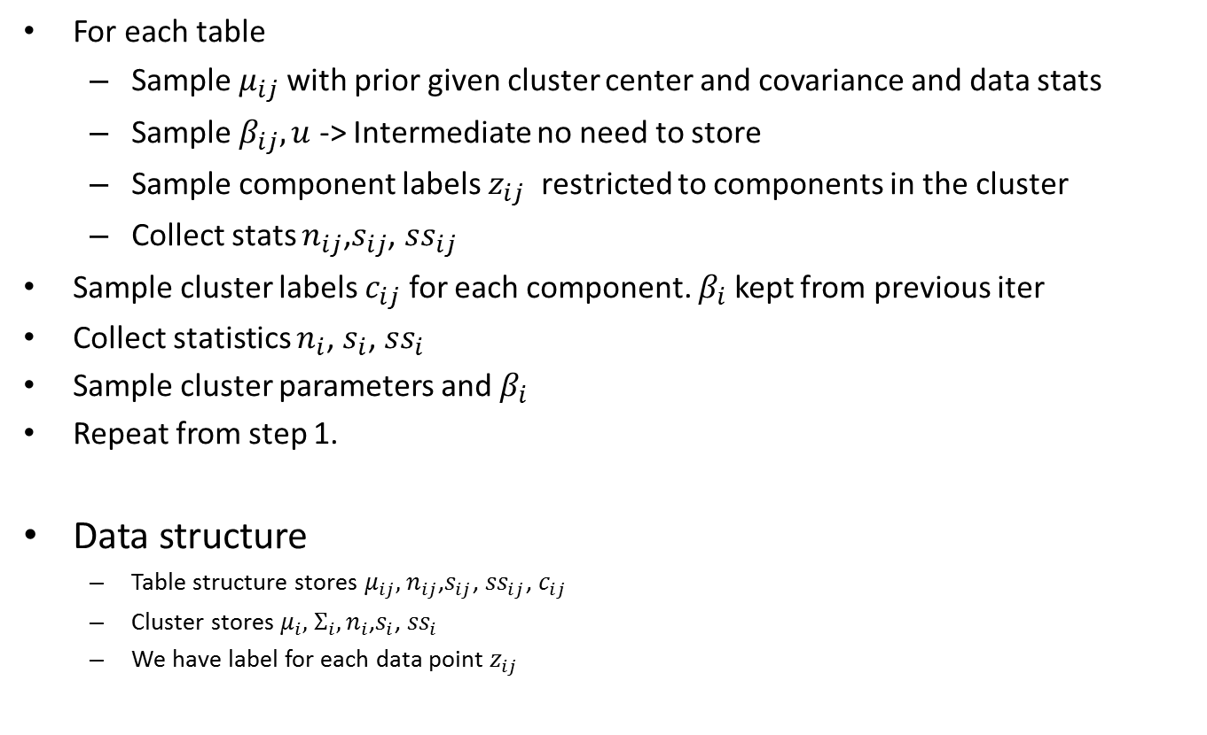
Algorithm
For each table
Sample $μ_{ij}$ with prior given cluster center and covariance and data stats
Sample $β_{ij},u$ -> Intermediate no need to store
Sample component labels $z_{ij}$ restricted to components in the cluster
Collect stats $n_{ij}$,$s_{ij}$, ${ss}_{ij}$
Sample cluster labels $c_{ij}$ for each component. $β_{i}$ kept from previous iter
Collect statistics $n_{i}$, $s_{i}$, ${ss}_{i}$
Sample cluster parameters and $β_{i}$
Repeat from step 1.
Data structure
Table structure stores $μ_{ij},$ $n_{ij}$,$s_{ij}$, ${ss}_{ij}$, $c_{ij}$
Cluster stores $μ_{i},$ $Σ_{i}, n_{i}$,$s_{i}$, ${ss}_{i}$
We have label for each data point $z_{ij}$

Slide 3

Distributions
$μ_{ij}$ ~ N($μ_{i}$, $Σ_{i}$/$κ_{1}$)* N($\overline{x}$, $Σ_{i}$/$n$)
cij=k ~

