Slide 1
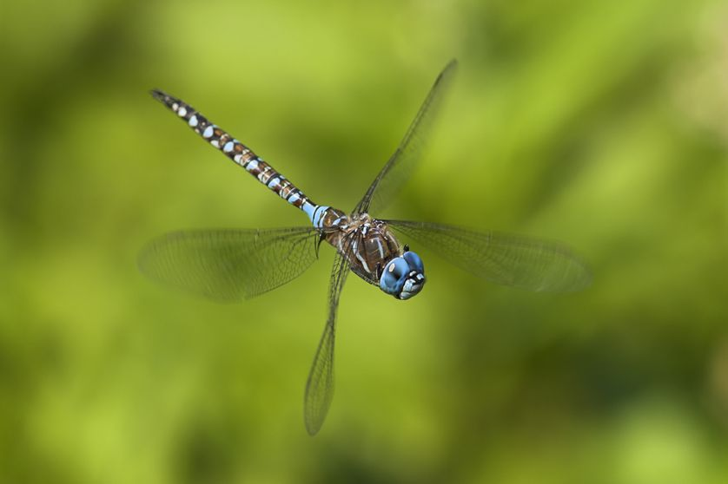
Dragonfly-Like Robot
Halil İbrahim Uğurlu

Slide 2
Outline
Assumptions
Frame assignments
Dynamics
Jacobian
Control
Simulation Results

Slide 3
Assumptions
Robot centered coordinates: heading → x, left → y and upside → z.
There is a body and tail connected to it with a revolute joint.
There are four wings connected to body with two dof joints. Roll (x) and Pitch (y) rotations allowed according to robot centered coordinates.
Airfoils are flat.
Mass of airfoils are very small with respect to body, neglected when the dynamics of body been considered.
The flicker of airfoils are very rapid, the average force is used when the dynamics of body been considered.
Each airfoil can make an average equivalent force acting on body from center of gravity of airfoil at initial position of foil according to Roll and Pitch motion characteristics.
Airfoil be exposed to air friction proportional to its velocity square and normal surface area which is controlled by roll and pitch angles.

Slide 4
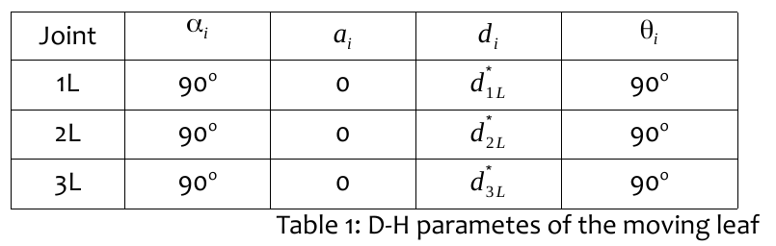
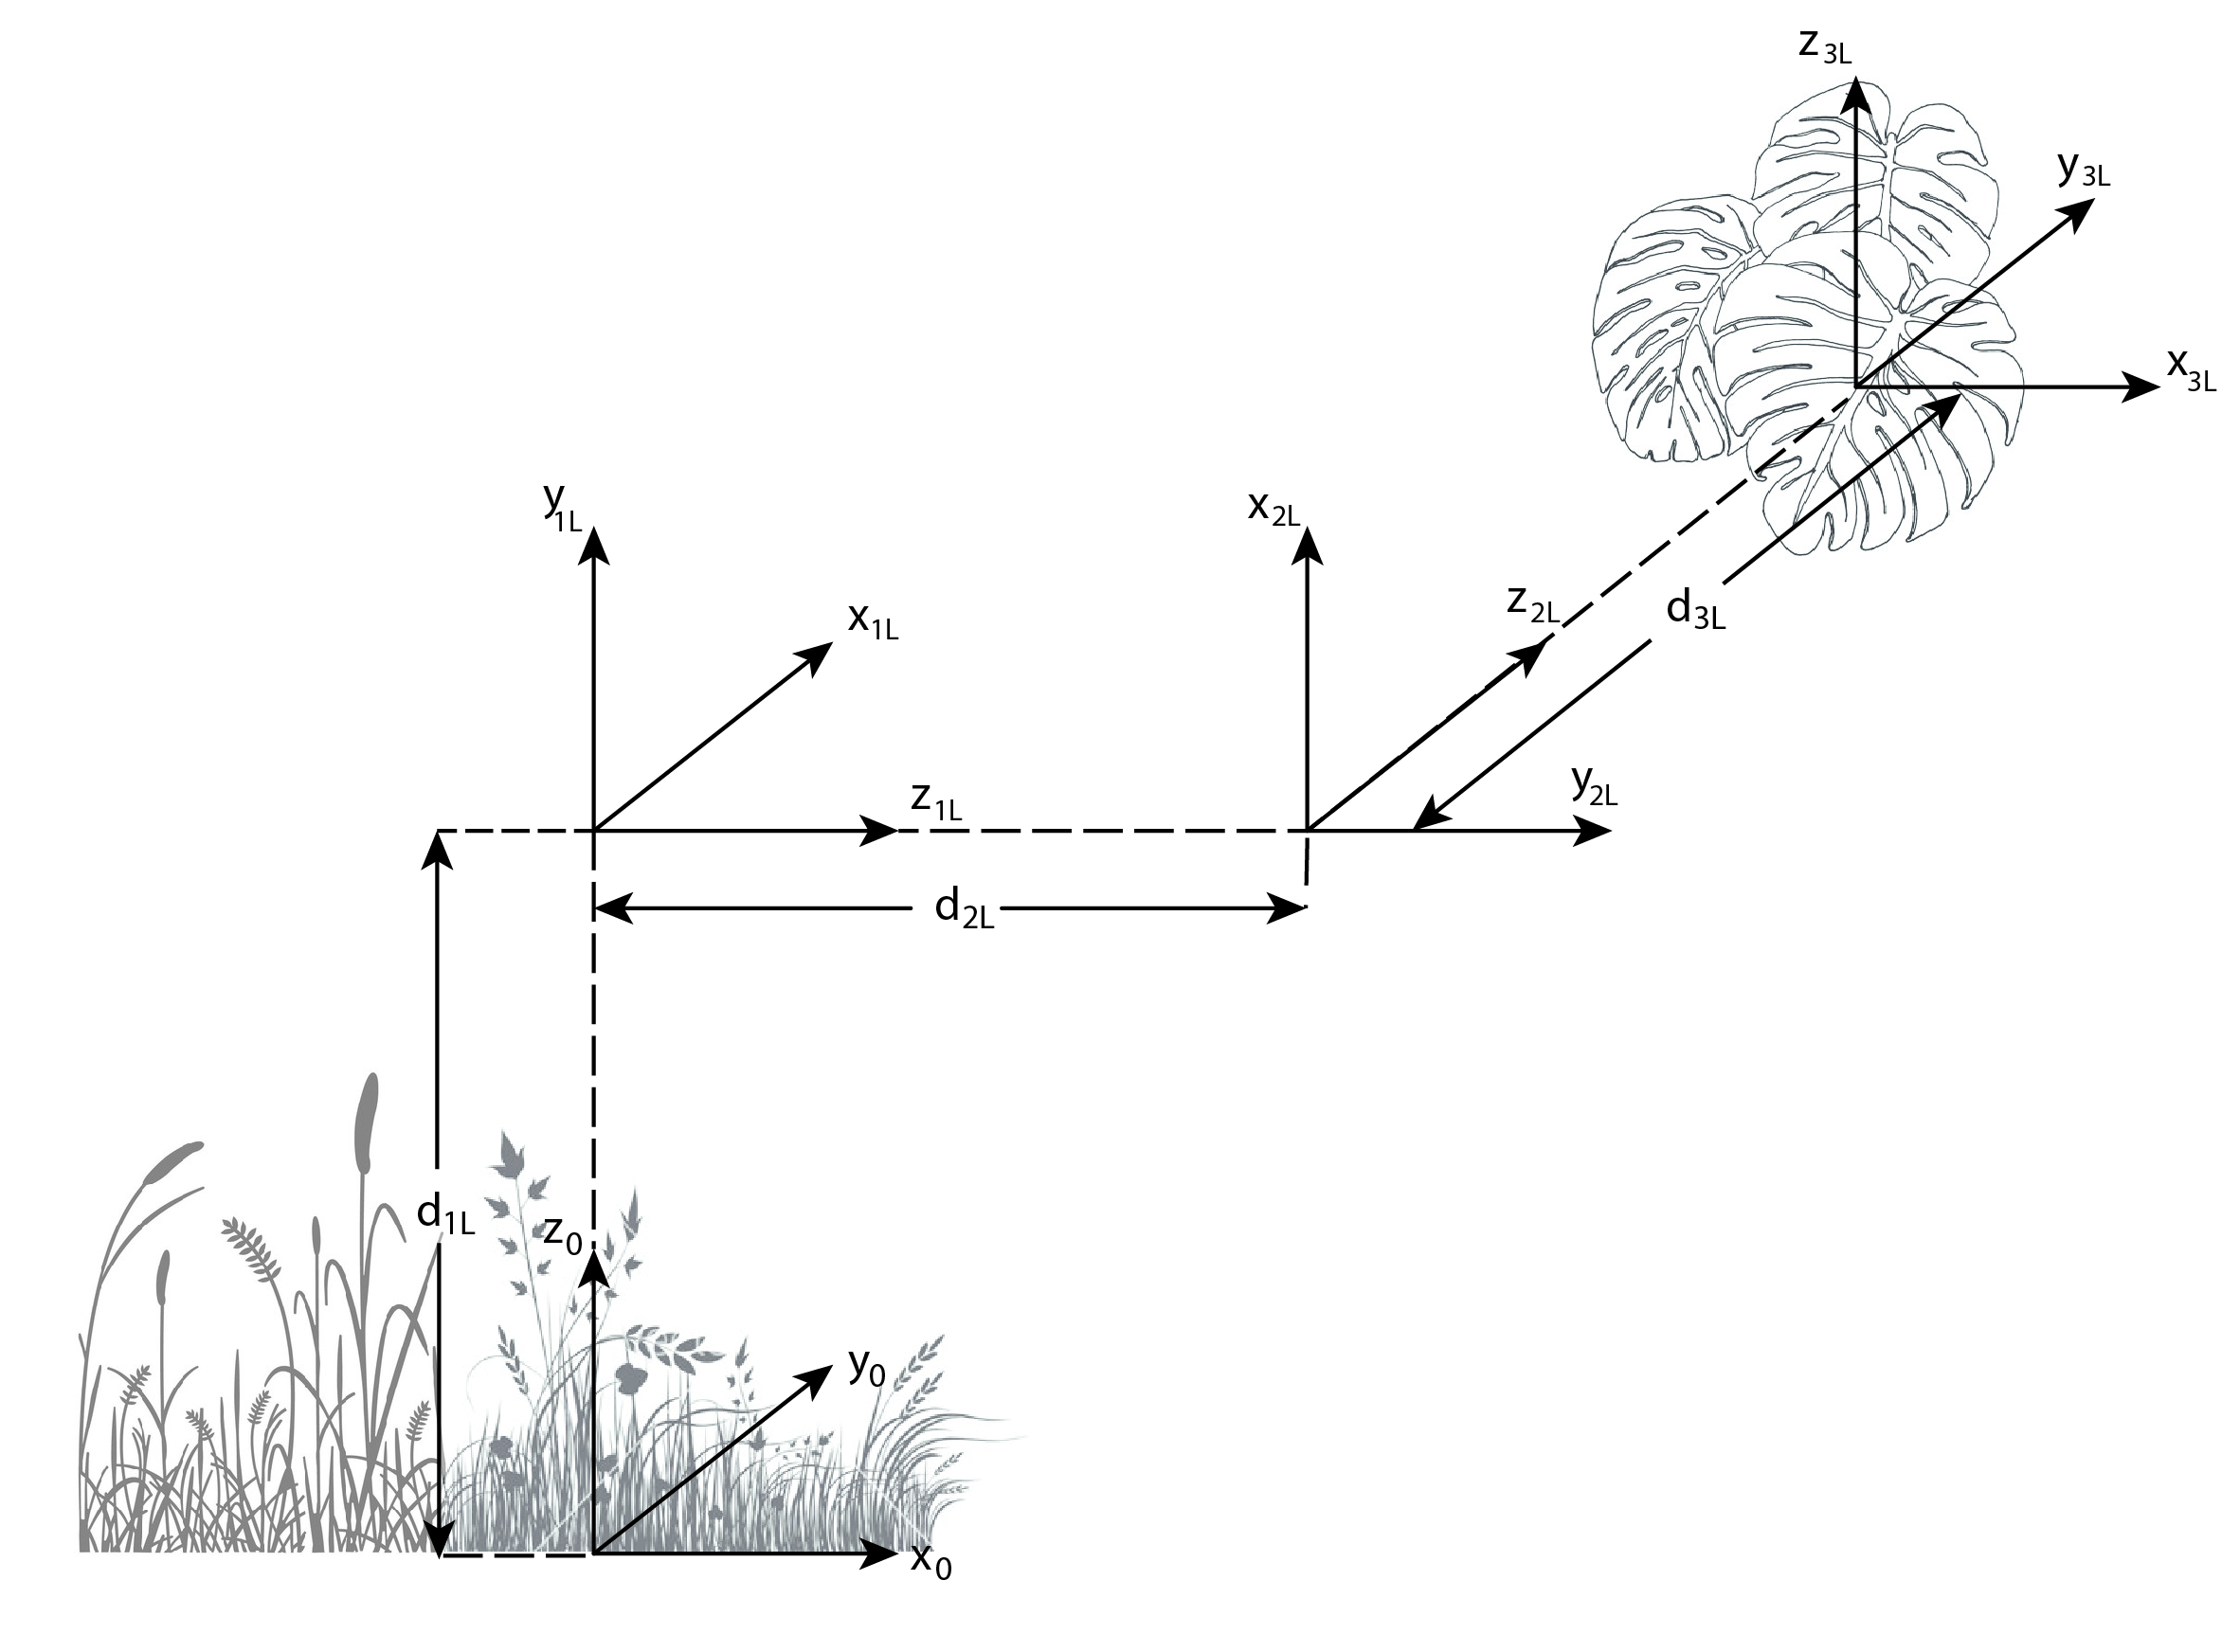
Frame Assignments

Slide 5
Dragonfly assignments

