Slide 1

INTRODUCTION TO WEB DEVELOPMENT
AND HTML
<Lecture 1>
Rommel Anthony Palomino
Summer 2011

Slide 2


What is a Web Developer?
Rommel AB Palomino - Summer 2011

Slide 3
Agenda
  History of the Internet
  web 2.0
  What is web development today
  Technology part of it
    Client Side Coding
    Server Side Coding
  Testing
  Career in Web development
Rommel AB Palomino - Summer 2011

Slide 4
History of the Internet
Beginning
- In 1960s, the U.S. military tried to find a stable and fault-tolerant communication method.
Internet
▫The term “Internet” was coined in the 1980s after the invention of Transmission Control Protocol/ Internet Protocol (TCP/IP).
Interconnected computer network.
HTML
- How to share documentations?
- In 1989, Berners-Lee wrote a proposal - an Internet-based hypertext system.
- He is also the director of W3C (Word-Wide Web Consortium).
First Web Brower
▫NCSA’s Mosaic came out in 1993.
Rommel AB Palomino - Summer 2011

Slide 5



History of the Internet
- More browsers appeared:
- dotcom boom: dotcom companies were getting richer and richer in the stock market by the end of the millenium....
Rommel AB Palomino - Summer 2011

Slide 6
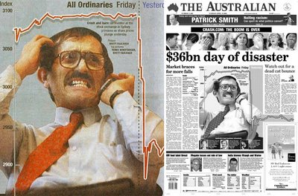
Internet History
- 2000-2002: dotcom bust! ..... ouch!
Rommel AB Palomino - Summer 2011

Slide 7






Web 2.0
Rommel AB Palomino - Summer 2011

Slide 8
Web 2.0 (cont'd)
  Before web 2.0, web was a warehouse of static pages
  Platform of collaboration
  Web 1.0?
  Crowdsourcing: Users are co-developers
  World is no longer described by the Web. The Web is becoming the world itself
Rommel AB Palomino - Summer 2011
Notes:
- web 2.0 is not a software, nor application
- crowdsourcing: large group of people can create a collective work whose value far exceeds that provided by any of the individual participants

Slide 9
Web 2.0 (cont'd)
Web 2.0
  Blogs
  Social Networking
  Wikis
  Audio/Video Sharing
  RSS
  Webcast/Podcast
Web 1.0:
  Static websites
  Emails
  Forums
  Basic search engines
  Groups
  Newsletters
Rommel AB Palomino - Summer 2011

Slide 10
What is Web development today
  What platform/devices will your site be accessible on?
  How upgradeable will our web site be?
  How visible will our site be to search engines?
  How much bandwidth will our site be wasting?
  Will our website expose us to the risk of legal action?
Rommel AB Palomino - Summer 2011

Slide 11
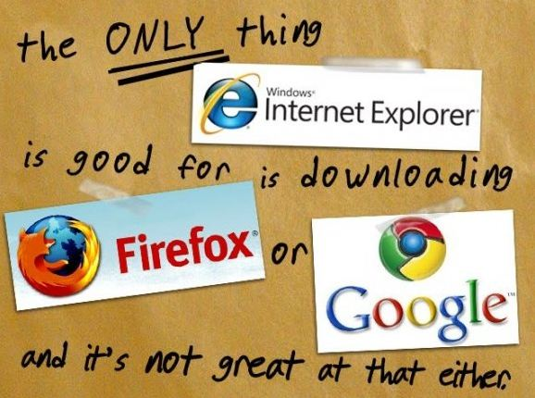
Did you know that...
Internet Explorer has lost market from 91.35% to 58.27% while Firefox, and the new Google Chrome now have 22.80% and 9.23% respectively... (1)
Rommel AB Palomino - Summer 2011
(1) Net Applications statistics 2004 Q4 to 2010 Q4

Slide 12
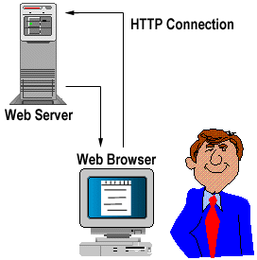
Server and Client side coding
  Web development comprises of server-side coding and client-side coding
  Server-side coding
    PHP
    ASP
    ASP.NET
    CGI and/or Perl
    J2EE
    Python, e.g. Django
    Ruby, e.g. Ruby on Rails
  Client-side coding
    CSS
    HTML & DHTML
    XHTML
    Javascript
    Flash
    SilverLight
Rommel AB Palomino - Summer 2011

Slide 13
Testing
  Unit + Integration + System testing
  Security
  Performance, Load/Stress
  HTML/CSS validation
  Usability
  Accessibility
Rommel AB Palomino - Summer 2011

Slide 14
Career in Web development
  Server-side coding (coding)
  UI and UX (design)
  System Administration (networking)
  SEO and SEM (Marketing+analysis)
  Technical Support (Troubleshooting)
Rommel AB Palomino - Summer 2011

Slide 15

Did you know that...
China's population of Internet users jumped by nearly a third to 384 million at the end of 2010...
Rommel AB Palomino - Summer 2011

Slide 16
Introducing HTML, XHTML, CSS
HTML
- HyperText Markup Language.
- The language for describing the structure of Web pages.
XHTML
- Extensible HyperText Markup Language.
- A variant of HTML that uses the syntax of XML, the Extensible Markup Language.
- XHTML has all the same elements (for paragraphs, etc.) as the HTML variant, but the syntax is slightly different
Rommel AB Palomino - Summer 2011

Slide 17
Introducing HTML, XHTML, CSS
Cascading Style Sheets (CSS)
In general, Cascading Style Sheets are combined with HTML to define style implementations such as font size, color, text position, etc.
Rommel AB Palomino - Summer 2011

Slide 18
HTML
HTML Standards:
  HTML 2.0: (1994) was developed by the IETF's HTML Working Group, which closed in 1996. It set the standard for core HTML features based upon current practice in 1994.
  HTML 3.0: (1996) W3C's first recommendation . Added tables, applets, text-flow around images, superscripts and subscripts. Provides backwards compatibility with HTML 2.0
Rommel AB Palomino - Summer 2011

Slide 19
HTML
  HTML 4.1: (1997) W3C's recommendation. Fixes issues found with previous versions.
  XHTML 1.0: (2000) reformulation of HTML 4.01 in XML, and combines the strength of HTML 4 with the power of XML.
  HTML5: (curr. dev) cross-platform, canvas, geolocation, supports modern web app, etc.
Rommel AB Palomino - Summer 2011

Slide 20
HTML: Basic Tags, Elements and Attributes
HTML Element: represents an html structure and generally consists of an start and end tag.
<p>
This is an Element
</p>
HTML Tag: Use to mark up the start and end of an element. End tags consist of an opening angle bracket followed by a forward slash, the element name, and a closing angle bracket.
</p>
Rommel AB Palomino - Summer 2011

Slide 21
HTML: Basic Tags, Elements and Attributes (con't)
HTML Attribute: defines a property of an element. It is on the form of "attribute=value"
<form name="my_form">
Rommel AB Palomino - Summer 2011

Slide 22
HTML: Basic Tags, Elements and Attributes (con't)
HTML Elements:
  <html></html> : defines the whole HTML document.
  <head></head>: can include scripts, instruct the browser where to find style sheets, provide meta information, and more.
  <body><body>: defines the body of the HTML document
  <title></title>: defines the title of the document
  <p></p>: defines a paragraph
  <h1></h1>: defines a heading
Rommel AB Palomino - Summer 2011

Slide 23
An Example... Hands-on!
<html>
<head>
<title> My First Web Page </title>
</head>
<body>
<p> Hello World !!! </p>
</body>
</html>
Rommel AB Palomino - Summer 2011

Slide 24
Questions?
There are 10 types of people in this world:
those who understand Binary and those who don't
Rommel AB Palomino - Summer 2011

