Slide 1

INTRODUCTION TO WEB DEVELOPMENT
AND HTML
Rommel Anthony Palomino
Summer 2011
Lecture 2

Slide 2
HTML Tags and elements
<p>Here is a paragraph</p>
Start tag
Content
End tag

Slide 3
HTML Elements
Links: <a></a>
<a href=“http://www.google.com“> Search </a>
Images: <img>
<img src=“myPicture.jpg” width=“300” height”100”/>
Lines: <hr/> It is used to separate content
  <p> my paragraph </p>
  <hr/>
  <p> another paragraph </p>

Slide 4
Nesting tags
<p><strong>Here is a paragraph.</strong></p>
Good
<p><strong><em>Here is a paragraph.</em></strong></p>
<p><strong><em>Here is a paragraph. </strong></em></p>
Bad

Slide 5
Empty Elements
HTML Elements with no content. They can be closed in the start tag.
Example:
<br> : line break

Slide 6
HTML Tips
Always use lowercase tags: <p> <P>
Always quote attribute values:
<form name = “myForm” >
Use lowercase attributes:
<img height=“100”>

Slide 7
XHTML
All tags and attributes must be in lowercase and must always be closed.
XHTML always requires an end tag.
i.e.: A carriage return
  HTML: <br>
  XHTML: <br></br>

Slide 8
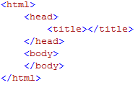
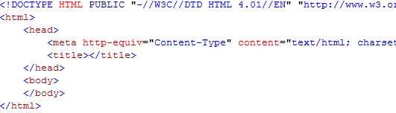
HTML vs. XHTML
HTML
Use less strict rules.
XHTML
Use more strict rules.

Slide 9
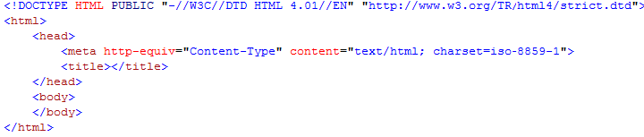
XHTML (outline)
DTD
Namespace & Language Declaration

Slide 10
XHTML (language format)
Character set listings
  From Part 1 to Part 16
  Ex: English – Part 1, Hungarian – Part 2, French – Part 15 …
  Reference
    http://en.wikipedia.org/wiki/ISO/IEC_8859

Slide 11


Other meta-tags
Language set
Title
Author
Robots
Keyword

Slide 12
Questions?

