Slide 1

INTRODUCTION TO WEB DEVELOPMENT AND HTML
Lecture 06: Tables - Spring 2011

Slide 2
Outline
Introducing Tables
Basic Table Elements and Attributes
Advance Tables
Accessibility Issues with Tables
Exercise

Slide 3
Introducing Tables

Slide 4
Introducing Tables
Think of grids, or spreadsheets in a web page.
They consist of rows and columns.
The interception of a row and a column is called a “cell”
  Row: set of cells in the same line from left to right
  Column: line of cells going from top to bottom
The XHTML element is:
  <table>

Slide 5
The <table> element
A table is written out row by row.
A row is contained inside a <tr> element
<tr>: table row
Each cell is written inside the row element using a <td> element.
<td>: table data

Slide 6
The <table> element
A table is written out row by row.
A row is contained inside a <tr> element
<tr>: table row
Each cell is written inside the row element using a <td> element.
<td>: table data

Slide 7
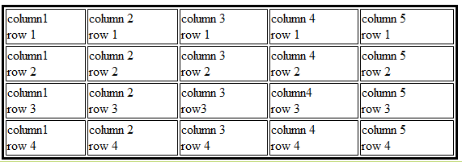
The <table> element (cont’d)
<table border=“1”>
<tr>
<td> column 1, row 1</td>
<td> column 2, row 1</td>
…
</tr>
<tr>
<td> column 1, row 2</td>
<td> column 2, row 2</td>
…
</tr>
….
</table>
Indicates the start of a table
Indicates the start of a row
Table data (cell)
Indicates the end of a row

Slide 8
A slightly more complex example
Go to:
..\web-dev.localhost\table-slightly-complex.html

Slide 9
Basic Table Elements and Attributes

Slide 10
The <table> element attributes
<table>: contains
  All of the universal attributes
  Basic event attributes for scripting
Deprecated attributes:
  align: indicates where the table should be align (left, center, right). Text flows around the table when uses align.
  bgcolor: sets the background color for the table
  border: it will create a border around the table and each cell
  cellpadding: create a space between cell and its content.
  cellspacing: create space between borders of each cell
  width: specify the width of the table in pixels, or as a percentage

Slide 11
The <tr> element attributes
<tr>: contains
  align: specifies the position of the content of all the cells in the row (left, center, right, justify).
  bgcolor: sets the background color of the row
  valign: specified the vertical alignment of the contents of each cell in the row. (top, middle, bottom, baseline)
  *All of these attributes have been deprecated in favor of CSS

Slide 12
The <td> and <th> attributes
Every cell is represented by either:
  <td>: cells containing table data
  <th>: cells containing table headings
By default:
  <td>: bold font, horizontally aligned in the center of the cell
  <td>: left-aligned, not in bold.
Any styles that these attributes have will override settings for the table and for row elements.

Slide 13
The <td> and <th> attributes
align(*): sets the horizontal alignment for the content of the cell (left, right, center, justify)
bgcolor (*): sets the background color for the cell.
colspan: specify how many columns of the table a cell will span across.
rowspan: specifies the number of rows of the table a cell will span across.
height(*): specifies the height of a cell
width(*): specified the width of a cell
valign(*): specifies vertical alignment (top, middle, bottom)

Slide 14
Advance Tables

Slide 15
Advance Tables
Splitting table into three sections
  head
  body
  foot
Captioning tables
Using rowspan and colspan
Grouping columns using <colgroup>
Sharing attributes between unrelated columns using <col> element

Slide 16
Splitting up Tables
Can be divided into three parts: head, body and foot
  <thead>: to create a separate table header
  <tbody>: to indicate the main bod
  <tfoot>: to create a separate table footer
<tfoot> must appear before <tbody>

Slide 17
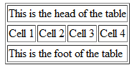
Example using <thead>, <tbody>, <tfoot>
<table>
<thead>
<tr>
<td colspan="4">This is the head of the table</td>
</tr>
</thead>
<tfoot>
<tr>
<td colspan="4">This is the foot of the table</td>
</tr>
</tfoot>
<tbody>
<tr>
<td>Cell 1</td>
<td>Cell 2</td>
<td>Cell 3</td>
<td>Cell 4</td>
</tr>
</tbody>
</table>

Slide 18
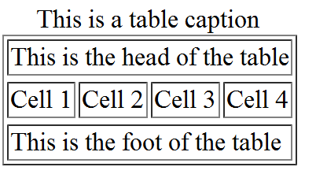
<table>: The <caption> element
Indicates the caption of the table. The caption must be between the <caption> tags, and immediately after <table> and before the first row.
<table border="1">
<caption>This is a table caption</caption>
…
…

Slide 19
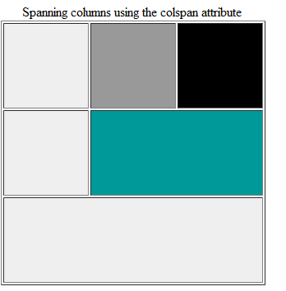
Spanning columns: the colspan attribute

Slide 20
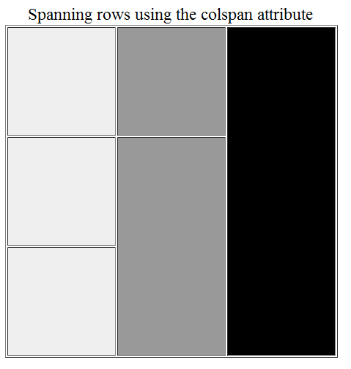
Spanning rows: the rowspan attribute

Slide 21
Grouping columns: The <colgroup> element
It groups one or more adjacent columns into a group.
It uses the <colgroup> element to create groups
This allows to format different group of columns rather than formatting each column at a time.

Slide 22
Example of grouping columns
<table>
<colgroup span=“8” class=“mainColumns” />
<colgroup span=“2” class=”subTotalColumns” />
<colgroup span=“3” class=”totalColumns” />
<tr>
<td>…<td>
…

Slide 23
Questions?
Before the exercise

Slide 24
Exercises
Do exercise on course website
Create an image with hotspots

