Slide 1

INTRODUCTION TO WEB DEVELOPMENT AND HTML
Lecture 07: Forms - Spring 2011

Slide 2
Outline
Introducing Forms
The <form> element
Focus
Sending form data to the server
Exercise

Slide 3
Introducing Forms

Slide 4
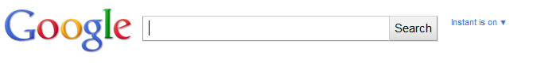
Introducing Form
Any form is declared using the <form> element
Any <form> element can contain other XHTML elements
Once users enter information into the form, they submit the form data to a web server.

Slide 5
Introducing Forms (Cont’d)
Data is sent to the server in name/value pairs
name is the form control name
Value is what the use has entered of the value of the option selected
<form action=”http://www.example.org/search.aspx” method=”get”>
  <h3>Search the site</h3>
  <input type=”text” name=”txtSearchItem” />
  <input type=”submit” value=”Search” />
</form>

Slide 6
Introducing Forms (Cont’d)
The <form> element carries an attribute called action whose value is the URL of the page on the web server that handles search requests.
The method attribute meanwhile indicates which HTTP method will be used in getting the form data to the server.

Slide 7
Creating a Form: the <form> element
A <form> element can contain any other markup such as paragraphs, heading and so on.
A <form> element cannot contain another <form> element
Every form should carry at least two attributes:
  action
  method

Slide 8
The action Attribute
Indicates what happens to the data when is ubmitted
Usually a page or a program on a web server
For example:
  A login form containing a username and a password can be send to a PHP, JSP, or ASP pages that will execute a program and will return an action such as allowing you to log in, or rejecting you.
  <form action=”http://www.example.org/login.php”>

Slide 9
The method Attribute
Form data can be sent to the server in two ways, each corresponding to an HTTP method:
  get : sends data as part of the URL
  post : hides data in the HTTP headers

Slide 10
The id Attribute
Identifies uniquely a <form> element within a page.
Good practice: is to give every <form> element an id attribute, because many forms make use of style sheets and scripts, which may require the use of the id attribute to identify the form.

Slide 11
The onsubmit Attribute
At some point, you have probably filled in a form on a web site, and then, as soon as you have clicked the button to send the form data (even before the page is sent to the server), a message is shown telling you that you have missed entering some data, or entered the wrong data.
When a user clicks a submit button, something called an event fires.
This event can be a script to be executed such as a JavaScript code that will check for the validity of your form data before sending it to the webserver.

Slide 12
The onsubmit Attribute (cont’d)
on the <form> element might look like this:
  onsubmit=”validateFormDetails( );”
validateFormDetails( ) function should have been defined in the document already.
So when the user clicks the submit button, this function will be called and run.

Slide 13
The onsubmit Attribute (cont’d)
Two advantages:
  The user does not have to wait the extra time it would take for the page to be sent to the server and then returned if there are any errors.
  The server does not have to deal with as much error checking as it would if the checks by the browser had not been performed.

Slide 14
The onreset Attribute
Some forms contain a reset button that empties the form of all details.
When this button is pressed, an onreset event fires and a script can be run.

Slide 15
White Spaces and the <form> element
You should also be aware that, when a browser comes across a <form> element it often creates extra white space around that element.
To avoid the extra space created, you can try either placing the <form> element near the start or end of the document

Slide 16
Form Controls

Slide 17
Form Controls
Text input controls
Buttons
Checkboxes and radio buttons
Select boxes (sometimes referred to as drop-down menus) and list boxes
File select boxes
Hidden controls

Slide 18
Text Inputs
The most famous text input box is the one right in the middle of the Google home page.
Three types of text input:
  Single-line
  Password
  Multi-line text

Slide 19
Text Inputs
Single Line text input controls: <input>
  Used for items that require only one line of user input, such as search boxes or e-mail addresses.
  They are created using the <input> element whose value type attribute has a value of text.

Slide 20
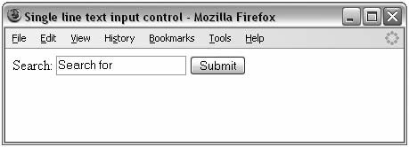
Text Inputs
<form action=”http://www.example.com/search.php” method=”get” name=”frmSearch”>
Search:
<input type=”text” name=”txtSearch” value=”Search for” size=”20”
maxlength=”64” />
<input type=”submit” value=”Submit” />
</form>

Slide 21
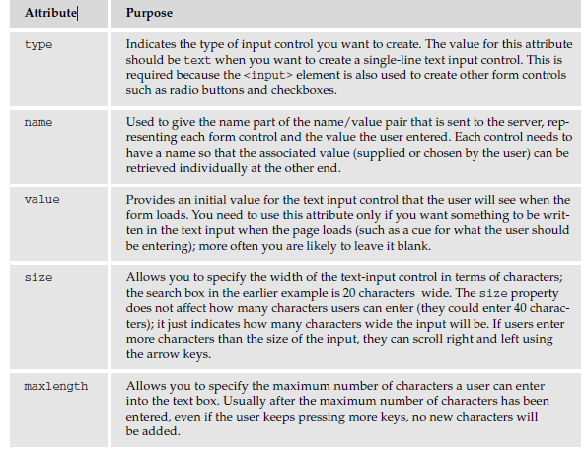
The text input attributes

Slide 22
Password Input Controls
If you want to collect sensitive data such as passwords and credit card information, you should use the password input.
The password input masks the characters the user types on the screen by replacing them with either a dot or asterisk.
Password input controls are created almost identically to the single-line text input controls, except that the type attribute on the <input> element is given a value of password.

Slide 23
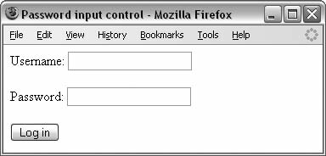
Password Input Controls (Cont’d)
Here you can see an example of a login form that combines a single-line text input control and a password input control.
<form action=”http://www.example.com/login.aspx” method=”post”>
Username:
<input type=”text” name=”txtUsername” value=”“ size=”20” maxlength=”20” />
<br />
Password:
<input type=”password” name=”pwdPassword” value=”“ size=”20” maxlength=”20” />
<input type=”submit” value=”Submit” />
</form>

Slide 24
Password Input Controls (Cont’d)
While passwords are hidden on the screen, they are still sent across the Internet as clear text.
In order to make them secure you should use an SSL connection between the client and server.

Slide 25
Multiple-Line Text Input Controls
If you want to allow a visitor to your site to enter more than one line of text, you should create a multipleline text input control using the <textarea> element.

Slide 26
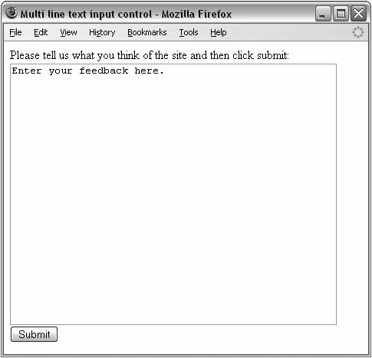
Multiple-Line Text Input Controls (Cont’d)
<form action=”http://www.example.org/feedback.asp” method=”post”>
Please tell us what you think of the site and then click submit:<br />
<textarea name=”txtFeedback” rows=”20” cols=”50”>
Enter your feedback here.
</textarea>
<br />
<input type=”submit” value=”Submit” />
</form>

Slide 27
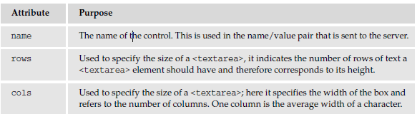
Multiple-Line Text Input Controls (Cont’d)
Multi-line text input control Attributes:

Slide 28
Buttons
Buttons are most commonly used to submit a form, although they are sometimes used to clear or reset a form and even to trigger client-side scripts..
You can create a button in three ways:
  Using an <input> element with a type attribute whose value is submit, reset, or button
  Using an <input> element with a type attribute whose value is image
  Using a <button> element
With each different method, the button will appear slightly different.

Slide 29
Buttons: using <input type=“”>
submit, which creates a button that automatically submits a form
reset, which creates a button that automatically resets form controls to their initial values
button, which creates a button that is used to trigger a client-side script when the user clicks that button

Slide 30
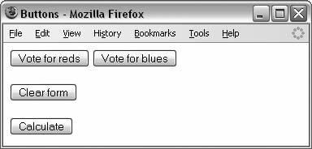
Buttons: using <input type=“”>
<input type=”submit” name=”btnVoteRed” value=”Vote for reds” />
<input type=”submit” name=”btnVoteBlue” value=”Vote for blues” />
<br /><br />
<input type=”reset” value=”Clear form” /> <br /><br />
<input type=”button” value=”Calculate” onclick=”calculate()” />

Slide 31
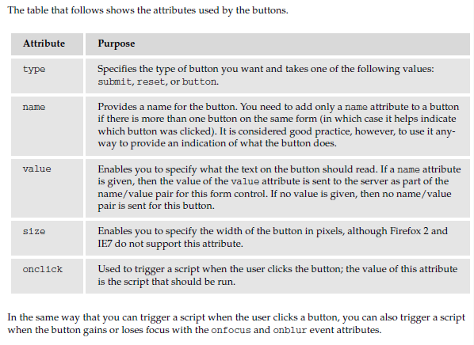
Buttons attributes

Slide 32
Using images for Buttons
You can use an image for a button rather than using the standard button that a browser renders for you.
<input type=“image” src=“submit.jpg” alt=”Submit” name=”btnImageMap” />
src: Specifies the source of the image file.
alt: Provides alternative text for the image. This will be displayed when the image cannot be found

Slide 33
Using images for Buttons (Cont’d)
If the image button has a name attribute, when you click it, the browser sends a name/value pair to the server.
The name will be what you provide for the name attribute and the value will be a pair of x and y coordinates for where on the button the user clicked

Slide 34
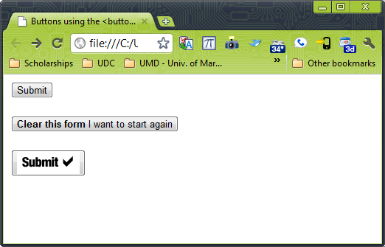
Using images for Buttons (Cont’d)
<form action="http://www.example.org/feedback.php" method="post">
<button type="submit">Submit</button>
<button type="reset"><b>Clear this form</b> I want to start again</button>
<button type="button"><img src="submit.gif" alt="submit" /></button>
</form>

Slide 35
Creating Buttons: the <button> element
The <button> element is a more recent introduction that allows you to specify what appears on a button between an opening <button> tag and a closing </button> tag.
You can include textual markup or image elements between these tags.

Slide 36
Example: the <button> element
<button type=“submit”>Submit</button>
<br /><br />
<button type=“reset”><b>Clear this form</b> I want to start again</button>
<br /><br />
<button type=“button”><img src=”submit.gif” alt=”submit” /></button>

Slide 37
Checkboxes
Checkboxes are just like the little boxes that you have to check on paper forms.
They can be either on or off.
When they are checked they are on and the user can simply toggle between on and off positions by clicking the checkbox

Slide 38
Checkboxes (Cont’d)
Checkboxes can appear:
  Individually, with each having its own name, or
  As a group of checkboxes, that share a control name and allow users to select several values for the same property.

Slide 39
Checkboxes (Cont’d)
They are ideal when:
  Provide a simple yes or no response with one control (such as accepting terms and conditions or subscribing to an e-mail list)
  Select several items from a list of possible options (such as when you want a user to indicate all of the skills they have from a given list)

Slide 40
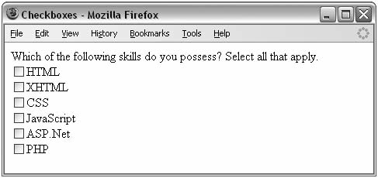
Checkboxes (Cont’d)

Slide 41
Checkboxes (Cont’d)
<form action=”http://www.example.com/cv.aspx” method=”get” name=”frmCV”>
Which of the following skills do you possess? Select all that apply.
<input type=”checkbox” name=”chkSkills” value=”html” />HTML <br />
<input type=”checkbox” name=”chkSkills” value=”xhtml” />XHTML <br />
<input type=”checkbox” name=”chkSkills” value=”CSS” />CSS<br />
<input type=”checkbox” name=”chkSkills” value=”JavaScript”/> JavaScript<br />
<input type=”checkbox” name=”chkSkills” value=”aspnet” />ASP.Net<br />
<input type=”checkbox” name=”chkSkills” value=”php” />PHP
</form>

Slide 42
Checkboxes (Cont’d)
If someone selects more than one skill there will be several name/value pairs sent to the server that all share the same name.
How you process multiple checkboxes with the same name depends on how you send the data to the server.
  If you use HTTP get to send the data, then the selected checkbox will be sent as part of the URL in the query string.
  If you use the HTTP post method, however, then you’ll get an array that you can loop through representing the checked options.

Slide 43
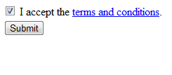
Single Checkbox

Slide 44
Single Checkbox code
<form action=”http://www.example.org/accept.php” name=”frmTandC” method=”get”>
<input type=”checkbox” name=”chkAcceptTerms” checked=”checked” />
I accept the <a href=”terms.htm”>terms and conditions</a>.
<br />
<input type=”submit” />
</form>
Note how the <input> element that creates this checkbox does not carry a value attribute. In the absence of a value attribute, the value is on.
The attribute checked, with a value of checked, indicates that when the page loads the checkbox this is selected.

Slide 45
The <input> Element Attributes: checkbox
type:
  Indicates that you want to create a checkbox.
name:
  Gives the name of the control. Several checkboxes may share the same name, but this should only happen if you want users to have the option of selecting several items.
value:
  The value that will be sent to the server if the checkbox is selected.
checked:
  Indicates that when the page loads, the checkbox should be selected.

Slide 46
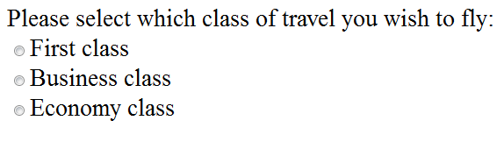
Radio Buttons

Slide 47
Radio Buttons (Cont’d)
Similar to checkboxes in that they can be either on or off, but there are two key differences:
  When you have a group of radio buttons that share the same name, only one of them can be selected. Once one radio button has been selected, if the user clicks another option, the new option is selected and the old one deselected.
  You should not use radio buttons for a single form control where the control indicates on or off because once a lone radio button has been selected it cannot be deselected again (without writing a script to do that).

Slide 48
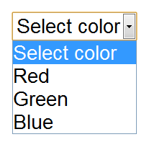
Radio Buttons (Cont’d)
Radio buttons are ideal if you want to provide users with a number of options from which they can pick only one.
An alternative is using a drop-down select box that allows users to select only one option from several.

Slide 49
Radio Buttons or a Select Box?
Your decision between whether to use a select box or a group of radio buttons depends on three things:
Users expectations: If your form models a paper form where users would be presented with several checkboxes, from which they can pick only one, then you should use a group of radio buttons.
Seeing all the options: If users would benefit from having all the options in front of them before they pick one, you should use a group of radio buttons.
Space: If you are concerned about space, a drop-down select box will take up far less space than a set of radio buttons.

Slide 50
Radio Buttons: <input> element
The <input> element is again used to create radio buttons.
type attribute should be given a value of radio.

Slide 51
Radio Button code
<form action=”http://www.example.com/flights.aspx” name=”frmFlightBooking” method=”get”>
Please select which class of travel you wish to fly: <br />
<input type=”radio” name=”radClass” value=”First” />First class <br />
<input type=”radio” name=”radClass” value=”Business” />Business class <br />
<input type=”radio” name=”radClass” value=”Economy” />Economy class <br />
</form>

Slide 52
Radio Button Attributes
type:
  To indicate that you want a radio button form control.
name:
  The name of the form control.
value:
  Used to indicate the value that will be sent to the server if this option is selected.
checked:
  Indicates that this option should be selected by default when the page loads.

Slide 53
Select Boxes
A drop-down select box allows users to select one item from a drop-down menu.
Drop-down select boxes can take up far less space than a group of radio buttons.

Slide 54
Select Boxes (Cont’d)
Drop-down select boxes can also provide an alternative to single-line text input controls where you want to limit the options that a user can enter.
  For example to indicate a country where the user lives. This would limit the value to USA to someone from here rather than having to deal with different values people write such as U.S.A., U.S., United States of America, or North America.

Slide 55
Select Box Example
<select name=”selColor”>
  <option selected=”selected” value=“”>Select color</option>
  <option value=”red”>Red</option>
  <option value=”green”>Green</option>
  <option value=”blue”>Blue</option>
</select>

Slide 56
Select Box Example (Cont’d)
The text between the opening <option> element and the closing </option> tags is used to display options to the user
The value that would be sent to the server if that option is selected is given in the value attribute.
Notice that the first <option> element does not have a value and that its content is Select color
  This is to indicate to the user that he or she must pick one of the color choices.

Slide 57
The <select> element Attributes
The <select> element is the containing element for a drop-down list box.
name:
  The name for the control.
size:
  Can be used to present a scrolling list box, as you will see shortly. Its value would be the number of rows in the list that should be visible at the same time.

Slide 58
The <option> element Attributes
Inside any <select> element you will find at least one <option> element.
value:
  The value that is sent to the server if this option is selected.
selected:
  Specifies that this option should be the initially selected value when the page loads. in order to be valid XHTML you should give this attribute a value of selected.

Slide 59
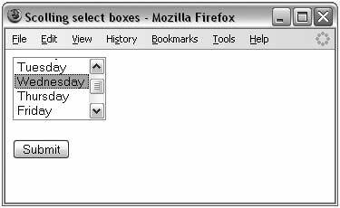
Creating Scrolling Select Boxes
You just need to add the size attribute to a select box.

Slide 60
Scrolling Select Boxes Example
<form action=”http://www.example.org/days.aspx” name=”frmDays” method=”get”>
  <select size=”4” name=”selDay”>
    <option value=”Mon”>Monday</option>
    <option value=”Tue”>Tuesday</option>
    <option value=”Wed”>Wednesday</option>
    <option value=”Thu”>Thursday</option>
    <option value=”Fri”>Friday</option>
    <option value=”Sat”>Saturday</option>
    <option value=”Sun”>Sunday</option>
  </select>
  <br /><br /><input type=”submit” value=”Submit” />
</form>

Slide 61
Selecting Multiple Options
The multiple attribute allows users to select more than one item from a select box.
The value of the multiple attribute should be the word multiple in order for it to be valid XHTML.

Slide 62
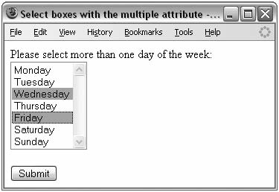
Selecting Multiple Options Example

Slide 63
Selecting Multiple Options Example code
<form action=”http://www.example.org/days.aspx” method=”get” name=”frmDays”>
Please select more than one day of the week:<br />
  <select name=”selDays” multiple=“multiple”>
    <option value=”Mon”>Monday</option>
    <option value=”Tue”>Tuesday</option>
    <option value=”Wed”>Wednesday</option>
    <option value=”Thu”>Thursday</option>
    <option value=”Fri”>Friday</option>
    <option value=”Sat”>Saturday</option>
    <option value=”Sun”>Sunday</option>
  </select>
<input type=”submit” value=”Submit”>
</form>

Slide 64
Grouping options: the <optgroup> element
If you have a very long list of items in a select box, you can group them together using the <optgroup> element, which acts just like a container element for all the elements you want within a group.
The <optgroup> element can carry a label attribute whose value is a label for that group of options

Slide 65
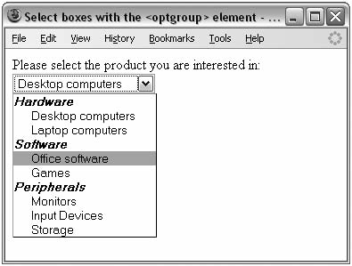
The <optgroup> Element Example

Slide 66
The <optgroup> Element Example code
Please select the product you are interested in:<br />
  <select name=”selInformation”>
    <optgroup label=”Hardware”>
      <option value=”Desktop”>Desktop computers</option>
      <option value=”Laptop”>Laptop computers</option>
    </optgroup>
    <optgroup label=”Software”>
      <option value=”OfficeSoftware”>Office software</option>
      <option value=”Games”>Games</option>
    </optgroup>
    <optgroup label=”Peripherals”>
      <option value=”Monitors”>Monitors</option>
      <option value=”InputDevices”>Input Devices</option>
      <option value=”Storage”>Storage</option>
    </optgroup>
  </select>

Slide 67
File Select Boxes
Allows a user to upload a file to your web site from his or her computer.
This is created using the <input> element with the type attribute file

Slide 68
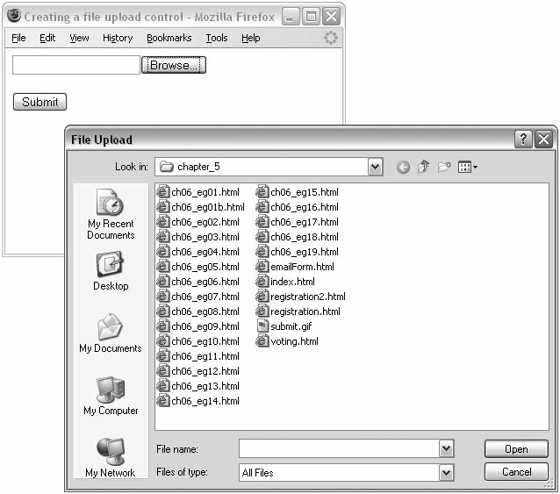
File Select Boxes Example

Slide 69
File Select Boxes Example code
<form action=”http://www.example.com/imageUpload.php” method=”post”
name=”fromImageUpload” enctype=”multipart/form-data”>
  <input type=”file” name=”fileUpload” accept=”image/*” />
  <br /><br />
  <input type=”submit” value=”Submit” />
</form>

Slide 70
The enctype attribute
The enctype attribute has been added to the <form> element with a value of multipart/form-data so that each form control is sent separately to the server.
This is required on a form that uses a file upload box.

Slide 71
Hidden Controls
They are used to pass information between pages without the user seeing it.
Users cannot see them in the web page displayed in the browser,. However, if they were to look at the source code for the page they would be able to see the values in the code.
For a name and value can still be sent to the server for a hidden form control, the hidden control must carry name and value attributes.

Slide 72
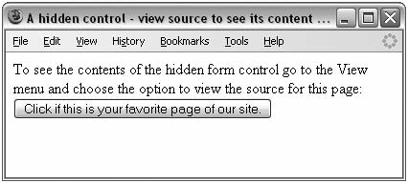
Hidden Controls (Cont’d)
You create a hidden control using the <input> element whose type attribute has a value of hidden

Slide 73
<form action=”http://www.example.com/vote.aspx” method=”get” name=”fromVote”>
  <input type=”hidden” name=”hidPageSentFrom” value=”home page” />
  <input type=”submit” value=”Click if this is your favorite page of our site.” />
</form>

Slide 74
Exercises
Do exercise posted on course website

