Slide 1

INTRODUCTION TO WEB DEVELOPMENT AND HTML
Lecture 08: Frames - Spring 2011

Slide 2
Outline
Grouping Forms
Introducing Frames
The <frameset> element
The <frame> element
The <noframes> element
Nested Frames
Floating or Inline Frames with <iframe>
Exercise

Slide 3
Introducing Forms

Slide 4
Introducing Frames
Frames divide a browser into several separate pieces or panes.
Each pane containing a separate XHTML page.
A frameset is a collection of frames in the browser window.

Slide 5
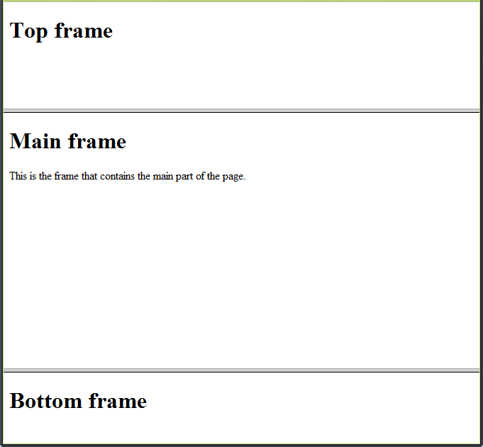
Introducing the Frameset

Slide 6
Introducing the Frameset (Cont’d)
To create a frameset document, first you need the <frameset> element, which is used instead of the <body> element.
The frameset defines the rows and columns your page is divided into. Each frame is then represented by a <frame> element.
The <noframes> element provides a message for users whose browsers do not support frames.

Slide 7
Introducing the Frameset (Cont’d)
<?xml version=”1.0” encoding=”iso-8859-1”?>
<!DOCTYPE html PUBLIC “-//W3C//DTD XHTML 1.0 Frameset//EN”
“http://www.w3.org/TR/xhtml1/DTD/xhtml1-frameset.dtd”>
<html>
<head><title>Frames example</title></head>
<frameset rows=”150, *, 100”>
  <frame src=”top_frame.html” />
  <frame src=”main_frame.html” />
  <frame src=”bottom_frame.html” />
  <noframes><body>This site uses a technology called frames. Unfortunately, your browser does not support this technology. Please Please upgrade your browser and visit us again!</body>
  </noframes>
</frameset>
</html>

Slide 8
Introducing the Frameset (Cont’d)
There should not be markup between the closing </head> tag and the opening <frameset> tag.
<frameset> attributes:
  rows: rows of the frameset
  cols: columns of the frameset
  <frameset rows=“150, *, 100”>
  Indicates that there are three rows:
    The first row is 150 pixels high
    The third row is 100 pixels high
    The second row is taking the rest of the page.

Slide 9
Introducing the Frameset (Cont’d)
<noframes>
  It is used when the browser does not support frames.
  A <body> element should be placed between those tags before introducing any text.
  The text between the <body></body> tags will be shown.

Slide 10
Introducing the Frameset (Cont’d)
  <frameset rows=“1*, 2*, 3*”>
  Indicates that there are three rows:
    The first row takes one sixth of the page
    The second row takes two sixth of the page.
    The third row takes three sixth of the page.

Slide 11
Introducing the Frameset (Cont’d)
  <frameset border=“1”>
  Indicates that the frameset will have a border of 1 pixel

Slide 12
The <frame /> element
They are inside the <frameset> element
Indicate a URL, using the src attribute, of the document that will be loaded into that frame
<frame src=”top_frame.html” />
  In this example, “top_frame.html” will be loaded in this frame.
In this example, three separate documents are displayed:
  top_frame.html
  main_frame.html
  bottom_frame.html

Slide 13
The <frame /> element (Cont’d)
<frame name=“main_frame” />
Indicates the name of a frame. It is used to indicate which frame a document should be loaded into.
Specially important when you want to create links in one frame that load pages into a second frame.

Slide 14
The <frame /> element (Cont’d)
<frame noresize=“noresize” />
Prevents that a frame can be resized.
Helps control the predetermined layout of the page
<frame scrolling=“yes” />
Allows the use of a scrollbar on the frame. Three values:
  Yes: frame uses a scrollbar
  No: frame does not use a scrollbar
  Auto: browser should only include scrollbar when content does not fit in the frame.

Slide 15
Creating Links between Frames
Use it when:
  When your navigation bar is rather large in size (such as thumbnails of photographs in a gallery). By using frames, the user does not need to reload the navigation bar each time he or she views a new page.
  When your main document is very long and the navigation bar provides shortcuts to parts of the main document (acting like a table of contents that is always in view).
  When you do not want to reload the whole page.

Slide 16
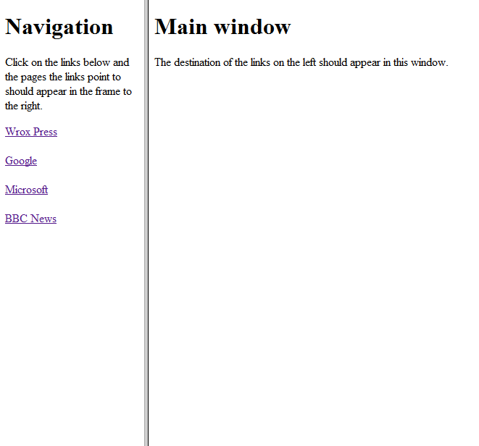
Creating Links between Frames (Cont’d)

Slide 17
Creating Links between Frames (Cont’d)
<frameset cols=”200, *”>
  <frame src=”frames/linksNav.html” />
  <frame src=”frames/linksMain.html” name=”main_page” />
</frameset>
There are two columns, and only one row (by default)
First column is 200 pixels. Second one takes remainder.
First column has the navigation bar
Second one has the main part of the page in which links will be loaded

Slide 18
linksNav.html
<a href=”http://www.wrox.com” target=”main_page”>Wrox Press</a><br /><br />
<a href=”http://www.google.com” target=”main_page”>Google</a><br /><br />
<a href=”http://www.microsoft.com” target=”main_page”>Microsoft</a><br /><br />
<a href=”http://news.bbc.co.uk/” target=”main_page”>BBC News</a><br /><br />

Slide 19
Creating Links between Frames (Cont’d)
The target attribute indicates where the links should be loaded.
Also, the target attribute can take these values:
  _self: Loads the page into the current frame
  _blank: Loads a page into a new browser window
  _parent: Loads the page into the parent window. In the case of a single frameset is the main browser window (and the page will replace all the frames), or in nested frames it replaces the frame that frameset lives inside.
  _top: Loads the page into the browser window, replacing any current frames

Slide 20
Nesting Frames
Just replace a <frame> element by a <frameset> element.
<frameset rows=”*, 300, *”>
  <frame src=”frames/top_frame.html” />
  <frameset cols=”*, 400, *”>
    <frame src=”frames/blank.html” />
    <frame src=”frames/main_frame.html” />
    <frame src=”frames/blank.html” />
  </frameset>
  <frame src=”frames/bottom_frame.html” />
</frameset>

Slide 21
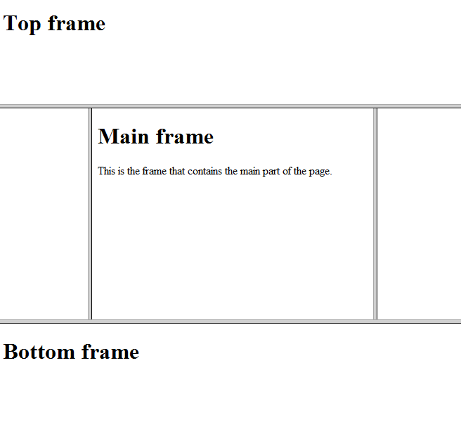
Nesting Frames (Cont’d)

Slide 22
When to use frames?
Only in very few and extremely needed circumstances. In other words, very rarely.
Other few cases:
  When you want to display a lot of content in one single page and you cannot split the document into separate pages
  When you have a lot of data in one part of the page that you do not want the user to have to reload while another part of the page changes.
    i.e.: a photography site where you have lots of thumbnails in one frame, and the main picture in another

Slide 23
Frames: Pros and Cons
Advantages:
  Load and reload single panes without having to reload the entire contents of the browser window.
  More than one HTML document can be displayed in the same browser
  Each frame is independent of the others

Slide 24
Frames: Pros and Cons (Cont’d)
Disadvantages*:
  Frames will not be supported in future versions of HTML
  Frames are difficult to use
  The web developer must keep track of more HTML documents
  The browser’s back button might not work as expected
  Search engines will not index properly frameset sites
  * www.w3schools.com

Slide 25
Exercises
Do exercise posted on course website

