Slide 1

INTRODUCTION TO WEB DEVELOPMENT AND HTML
Lecture 09: Cascade Style Sheets - Spring 2011

Slide 2
Outline
Introducing CSS
CSS Properties
Controlling Fonts
Text Formatting
Exercise

Slide 3
Introducing CSS

Slide 4
Introducing CSS
CSS works by allowing you to associate rules with the elements that appear in the document.
selector declaration
p {font-family: arial;}
Property value
  The selector, which indicates which element or elements the declaration applies to (if it applies to more than one element, you can have a comma-separated list of several elements)
  The declaration, which sets out how the elements should be styled

Slide 5
Introducing CSS (Cont’d)
The declaration is also split into two parts, separated by a colon:
A property, which is the property of the selected element(s) that you want to affect, in this case the font-family property.
A value, which is a specification for this property; in this case it is the Arial typeface

Slide 6
Introducing CSS: Example
h1, h2, h3 {
  font-weight: bold;
  font-family: arial, verdana, sans-serif;
  color: #000000;
  background-color: #FFFFFF;}
The h1, h2, and h3 elements will be written in a bold Arial font, and this will be written in black with a white background

Slide 7
Basic Example: Hands on!
Open:
  Lec09_eg01.html
We are going to create a CSS to apply on that document. The rules to apply are:
  body {
  color:#000000; /*font color: black*/
  background-color:#ffffff; /*background color: white*/
  font-family: arial, verdana, sans-serif; }
  h1 {font-size:18pt;} /*font size for h1*/
  p {font-size:12pt;} /*font size for p*/

Slide 8
Basic Example: Hands on!
table {
  background-color:#efefef;
  border-style:solid;
  border-width:1px;
  border-color:#999999;}
  th {
  background-color:#cccccc;
  font-weight:bold;
  padding:5px;} /*space between content and edge of cell*/

Slide 9
Basic Example: Hands on!
td {padding:5px;}
td.code {
  font-family:courier, courier-new, serif;
  font-weight:bold;}

Slide 10
Inheritance
One of the powerful features of CSS is that many of the properties that have been applied to one element will be inherited by child elements.
Child elements are contained within the element that the rules were declared upon.
The rules applied to a child element will overwrite any rule apply to its parent element.

Slide 11
How to add CSS rules
In two places inside the XHTML document:
  Inside the <head> element, contained with a <style> element
  As a value of a style attribute on any element that can carry the style attribute
In a separate style sheet, or external style sheet using the <link> element.

Slide 12
How to add CSS rules (Cont’d)
When the style sheet rules are held inside a <style> element in the head of the document, they are referred to as an internal style sheet.
<head>
  <title>Internal Style sheet</title>
  <style type=”text/css”>
    body {
      color:#000000;
      background-color:#ffffff;
      font-family:arial, verdana, sans-serif; }
      h1 {font-size:18pt;}
      p {font-size:12pt;}
  </style>
</head>

Slide 13
How to add CSS rules (Cont’d)
When style attributes are used on XHTML elements, they are known as inline style rules. For example:
<td style=”font-family:courier; padding:5px; border-style:solid; border-width:1px; border-color:#000000;”>
However, this attribute has been deprecated in Transitional XHTML!

Slide 14
The <link> element
The <link /> element is always an empty element that describes the relationship between two documents.
It can be used in several ways, not just style sheets.
the <link /> element must carry three attributes: type, rel, and href.

Slide 15
The <link> element (Cont’d)
<link rel=”stylesheet” type=”text/css” href=”../css/interface.css” />
The rel attribute is required and specifies the relationship between the document containing the link and the document being linked to.
The type attribute specifies the MIME type of the document being linked to.
The href attribute specifies the URL for the document being linked to.

Slide 16
Advantages of External CSS
The same style sheet can be reused by all of the web pages in your site.
Because the style rules are written only once, rather than appearing on every element or in every document, the source documents are smaller
You can change the appearance of several pages by altering just the style sheet rather than each individual page.
The style sheet can act as a style template to help different authors achieve the same style of document without learning all of the individual style settings.

Slide 17
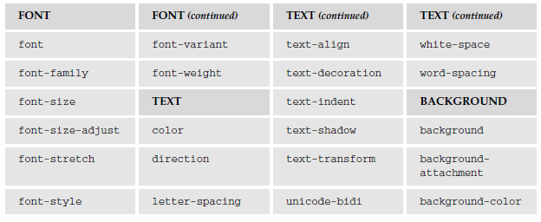
CSS Properties

Slide 18
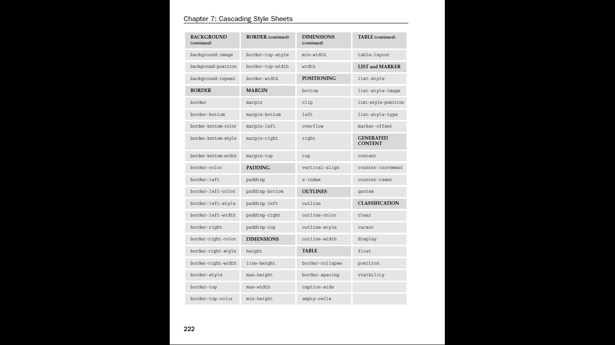
CSS Properties (Cont’d)

Slide 19
CSS Properties (Cont’d)

Slide 20
Controlling Fonts
Several properties allow you to control the appearance of text in your documents. These can be split into two groups:
Those that directly affect the font and its appearance
Those that have other formatting effects upon the text

Slide 21
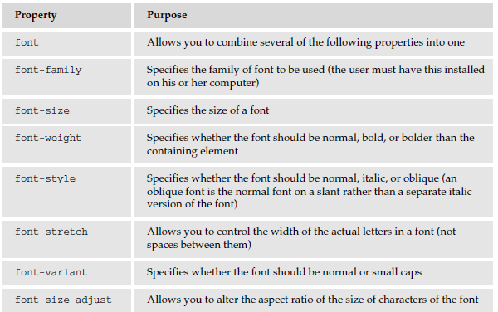
Properties Directly Affecting the Font

Slide 22
The font-size property
The font-size property enables you to specify a size for the font.
A value for this property can be specified in:
  Absolute size
    xx-small x-small small medium large x-large xx-large
  Relative size
    smaller larger
  Length
    Any of these units of length: px em ex pt in cm pc mm
  Percentage (in relation to parent element)
    2% 10% 25% 50% 100%

Slide 23
The font-weight Property
The possible values for font-weight are:
normal bold bolder lighter 100 200 300 400 500 600 700 800 900
For example:
  p.one {font-weight:normal;}
  p.two {font-weight:bold;}
  p.three {font-weight:bolder;}
  p.four {font-weight:lighter;}
  p.five {font-weight:100;}
  p.six {font-weight:200;}

Slide 24
The font-style Property
The font-style property allows you to specify that a font should be normal, italic, or oblique.
For example:
  p.one {font-style:normal;}
  p.two {font-style:italic;}
  p.three {font-style:oblique;}

Slide 25
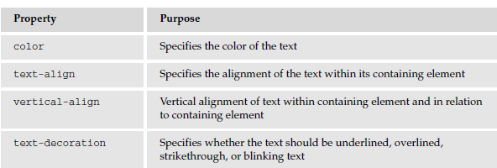
Text Formatting
In addition to the font properties, you can use several properties to affect the appearance or formatting of your text.

Slide 26
The color property
The color property allows you to specify the color of the text.
For example:
p {color:#ff0000;} /*Paragraph is red*/

Slide 27
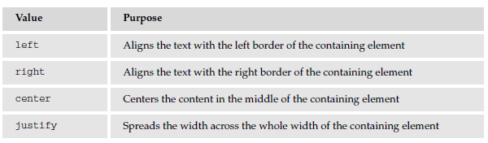
The text-align Property
It aligns the text within its containing element or the browser window

Slide 28
The vertical-align Property
It allows you to control their vertical positioning within the containing element.
It is useful when working with inline elements, in particular images and portions of text
For example:
span.footnote {vertical-align:sub;}

Slide 29
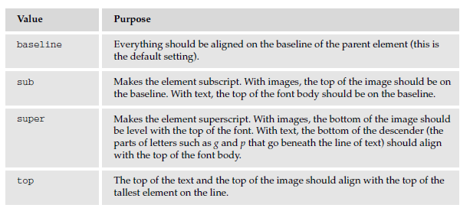
The vertical-align Property

Slide 30
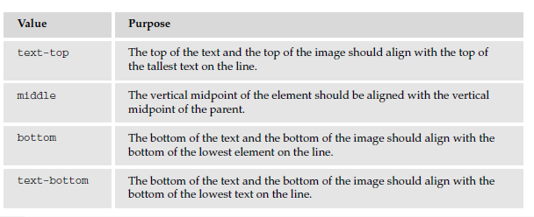
The vertical-align Property (Cont’d)

Slide 31
The word spacing Property
The word-spacing property sets the gap between words
span.wider {word-spacing:20px;}

Slide 32
Text Pseudo Classes
They allow you to render either the first letter or the first line of an element in a different way than the rest of that element.
  The first letter Pseudo-Class: (first-letter)
    Allows you to specify a rule just for the first letter of an element
    p.pageOne:first-letter {font-size:42px;}
  The first line Pseudo-Class: (first-line)
    allow you to render the first line of any paragraph differently from the rest of the paragraph.
    p:first-line {font-weight:bold;}

Slide 33
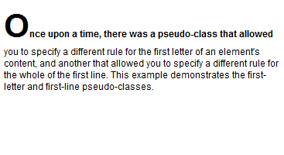
Text Pseudo Classes: Example

Slide 34
Exercises
Do exercise posted on course website

