Slide 1

INTRODUCTION TO WEB DEVELOPMENT AND HTML
Lecture 10: A Deeper Look at CCS- Spring 2011

Slide 2
Outline

Slide 3
A Deeper look at CSS

Slide 4
Universal Selector
The universal selector is an asterisk; it is like a wildcard and matches all element types in the document.
        * { }

Slide 5
The Type Selector
The type selector matches all of the elements specified in the comma-delimited list.
It allows you to apply the same rules to several elements.
        h1, h2, p { }
If you have the same rules that apply to several elements, this technique can lead to a smaller style sheet, saving bandwidth and load on your server.

Slide 6
The Class Selector
The class selector allows you to match a rule with an element carrying a class attribute whose value you specify in the class selector.
For example:
<p class="BackgroundNote">
This paragraph contains an aside.
</p>

Slide 7
The Class Selector (Cont’d)
You can use a class selector in one of two ways here:
Assign a rule that applies to any element that has a class attribute whose value is BackgroundNote, like so, simply preceding the value of the class attribute with a period:
.BackgroundNote {}
Or Create a selector that selects only the <p> elements that carry a class attribute with a value of BackgroundNote (not other elements) like so:
p.BackgroundNote {}

Slide 8
The ID Selector
The id selector works just like a class selector, but works on the value of id attributes.
Rather than using a period before the value of the id attribute, a hash or pound sign (#) is required.
For example:
<p id="abstract"> A Paragraph</p>
can be identified with this selector.
p#abstract { }
Because the value of an id attribute should be unique within a document, this selector should apply only to the content of one element.

Slide 9
The Child Selector
The child selector matches an element that is a direct child of another.
For example:
td>b { }
In this case it matches any <b> elements that are direct children of <td> elements

Slide 10
The Descendent Selector
The descendent selector matches an element type that is a descendent of another specified element, at any level of nesting.
For the descendent selector the combinator is the space. For example:
table b { }
In this case, the selector matches any <b> element that is a child of the <table> element, which means it
would apply to <b> elements both in <td> and <th> elements.

Slide 11
The Adjacent Sibling Selector
An adjacent sibling selector matches an element type that is the next sibling of another.
For example:
h1+p { }
This makes the first paragraph after any level 1 heading a different style.
For this example, this would apply only to the <p> element directly after a heading.

Slide 12
Using Child and Adjacent Sibling Selector
They both are very important because they can reduce the number of class attributes you need to add into an XHTML document.

Slide 13
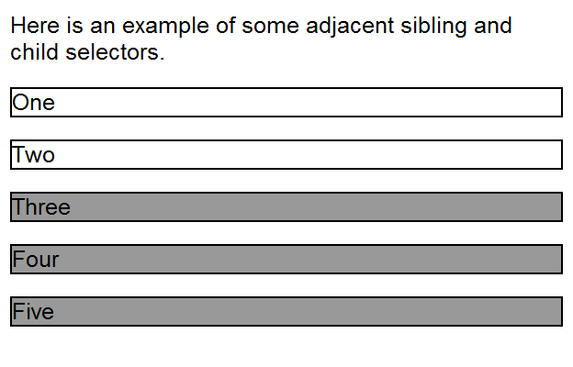
Using Child and Adjacent Sibling Selector (Cont’d)
Look at the following example:

Slide 14
Using Child and Adjacent Sibling Selector (Cont’d)
The three different paragraph styles are as follows:
The first paragraph has no border or background color.
The paragraphs inside the <div> element all have borders.
The last three paragraphs have a gray background.

Slide 15
Without Child and Adjacent Sibling Selectors
XHTML:
<p>Here is an example of some adjacent sibling and child selectors.</p>
<div>
<p class="style1">One</p>
<p class="style1">Two</p>
<p class="style2">Three</p>
<p class="style2">Four</p>
<p class="style2">Five</p>
</div>
CSS:
p.style1{
border:1px solid black;
}
p.style2{
border:1px solid black;
background-color: gray;
}

Slide 16
Using Child and Adjacent Sibling Selector (Cont’d)
XHTML:
<p>Here is an example of some adjacent sibling and child selectors.</p>
<div>
<p>One</p>
<p>Two</p>
<p>Three</p>
<p>Four</p>
<p>Five</p>
</div>
CSS:
div>p {
border:1px solid black;}
p+p+p {
background-color:gray;}

Slide 17
Attribute Selectors
Attribute selectors enable you to use the attributes that an element carries in the selector.
You can use attribute selectors in several ways, as shown in the next table:

Slide 18
Attribute Selectors (Cont’d)
Name | Example | Matches
Existence selector | p[ id ] | Any <p> element carrying an attribute called id
Equality selector | p[ id = "summary" ] | Any <p> element carrying an attribute called id whose value is summary
Space selector | p[class ~= "XHTML"] | Any <p> element carrying an attribute called class, whose value is a list of space-separated words, one of which is exactly the same as XHTML.
Hyphen selector | p[language |= "en"] | Any <p> element carrying an attribute called language whose value begins with en and is followed with a hyphen (it is designed for use with language attributes).

Slide 19
Attribute Selectors (Cont’d)
Name | Example | Matches
Prefix selector (CCS3) | p[ attr^="b" ] | Any <p> element carrying any attribute whose value begins with b.
Substring selector (CSS3) | p[ attr*="on"] | Any <p> element carrying any attribute whose value contains the letters on.
Sufix selector (CSS3) | p[ attr$="x"] | Any <p> element carrying any attribute whose value contains the ends in the letter x.

Slide 20
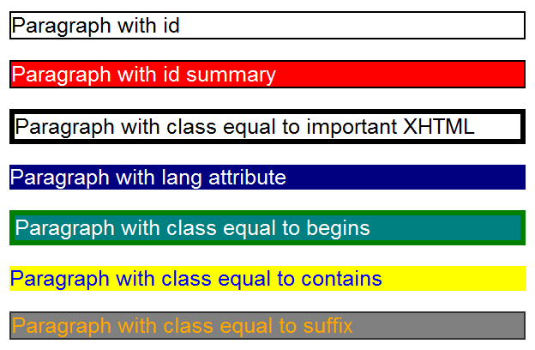
Attribute Selectors Example

Slide 21
Attribute Selectors Example: XHTML
<p id="introduction">Paragraph with id</p>
<p id="summary">Paragraph with id summary</p>
<p class="important XHTML">Paragraph with class equal to important XHTML</p>
<p lang="en-us">Paragraph with lang attribute</p>
<p class="begins">Paragraph with class equal to begins</p>
<p class="contains">Paragraph with class equal to contains</p>
<p class="suffix">Paragraph with class equal to suffix</p>

Slide 22
Attribute Selectors Example: CSS
p[id] {border:1px solid #000000;}
p[id=summary] {background-color:#999999;}
p[class~=XHTML] {border:3px solid #000000;}
p[lang|="en"] {color:white; background-color:black;}
p[class^="b"] {border:3px solid #333333;}
p[class*="on"] {color:#ffffff; background-color:#333333;}
p[class$="x"] {border:1px solid #333333;}

Slide 23
The Box Model
Every element gets treated as a box in CSS
Remembering this will really help you understand how to create attractive layouts with CSS.
Property | Description
border | Every box has a border (even if you do not see it) Separates the edge of the box from other boxes
margin | Distance between the edge of a box and the box next to it
padding | Space between the content of the box and its border

Slide 24
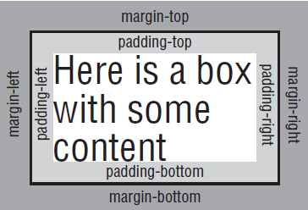
The Box Model (Cont’d)

Slide 25
The Box Model (Cont’d)
The padding and margin properties are especially important in creating white space, which is the space between parts of the page, in your designs

Slide 26
The Box Model (Cont’d)
Note that:
When a bottom margin of one element meets the top margin of another, only the larger of the two will show
If they are the same size, the margin will be equivalent to the size of just one of the margins.
See next figure.

Slide 27
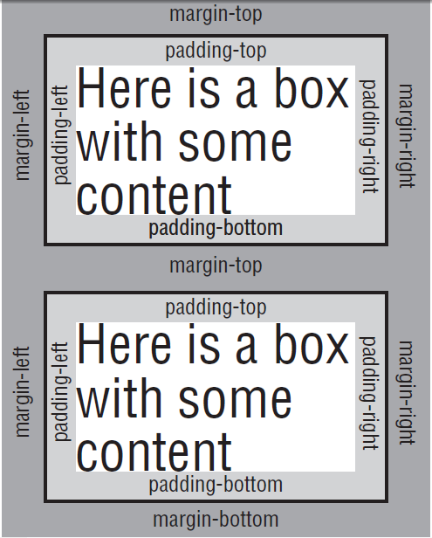
The Box Model (Cont’d)
Vertical margins of two adjacent boxes collapsing

Slide 28
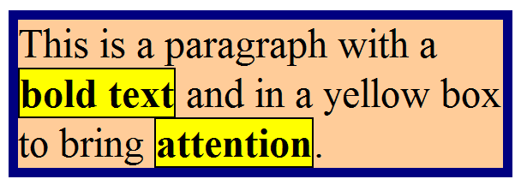
The Box Model (Cont’d)
A block element will also, by default, take up the full width of the page for the box model (or the element it is contained within)
An inline element will take up only as much space as it needs.

Slide 29
The Border Properties
The border properties allow you to specify how the border of the box representing an element should look.
There are three properties of a border you can change:
  border-color: to indicate the color a border should be
  border-style: to indicate whether a border should be a solid, dashed, or double line, or one of the other possible values
  border-width: to indicate the width a border should be

Slide 30
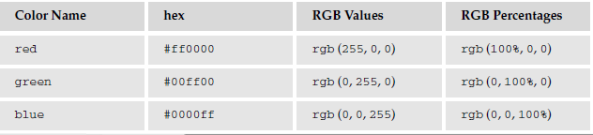
border-color property
The border-color property allows you to change the color of the border surrounding a box.
The value can be a hex code for the color or a color name
It can also be expressed as values for red, green, and blue; between 0 and 255; or percentages of red green and blue.

Slide 31
border-color property
The color of the bottom, left, top, and right sides of a box’s border can be changed individually using the following properties:
  border-bottom-color
  border-right-color
  border-top-color
  border-left-color

Slide 32
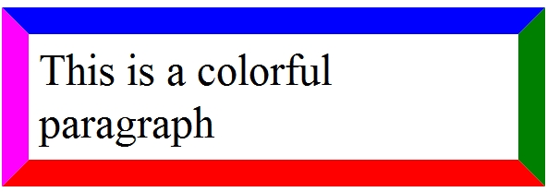
border-color property
p {
border-bottom-color: red;
border-top-color: blue;
border-right-color: green;
border-left-color: fuchsia;
border-style: solid;
}

Slide 33
border-style property
The border-style property allows you to specify the style of the border.
The default value for this property is none, so no border shows automatically.

Slide 34
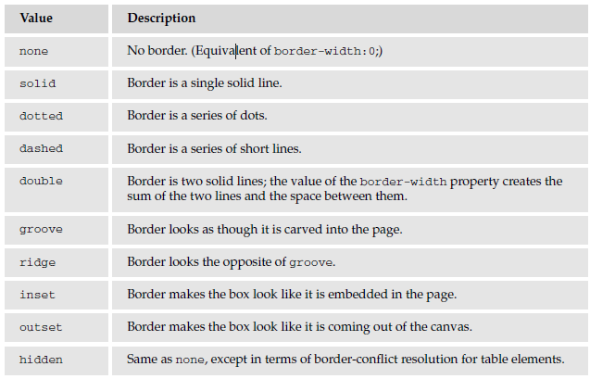
border-style property (cont’d)

Slide 35
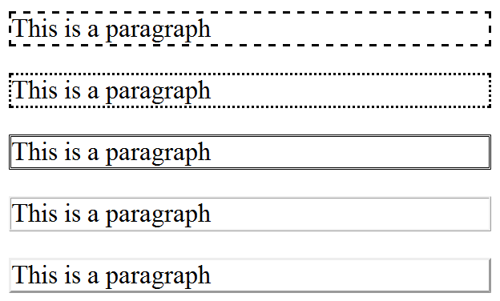
border-style property (cont’d)

Slide 36
border-style property (cont’d)
The style of the bottom, left, top, and right borders of a box can be changed using the following properties:
  border-bottom-style
  border-right-style
  border-top-style
  border-left-style

Slide 37
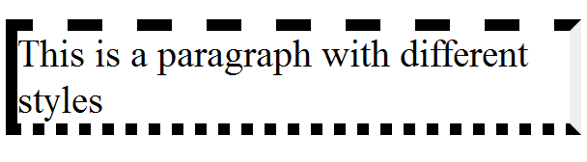
border-style property (cont’d)
border-top-style: dashed;
border-bottom-style: dotted;
border-right-style: inset;
border-left-style: solid;

Slide 38
border-width property
The border-width property allows you to set the width of your borders.
The value of the border-width property cannot be a percentage
It must be a length or one of the following values:
  thin
  medium
  thick

Slide 39
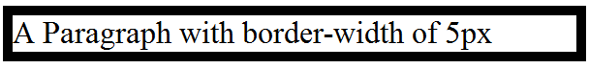
border-width property (Cont’d)
p {
border-width: 5px;
border-style: solid;
}

Slide 40
border-width property (Cont’d)
The width of the bottom, top, left, and right borders of a box can be changed using the following properties:
  border-bottom-width
  border-right-width
  border-top-width
  border-left-width

Slide 41
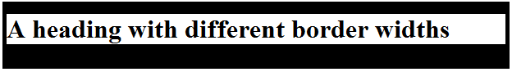
border-width property (Cont’d)
h1 {
border-top-width: 15px;
border-bottom-width: 30px;
border-left-width: 5px;
border-right-width: 5px;
border-style: solid;
}

Slide 42
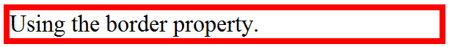
border property
The border property allows you to specify color, style, and width of lines in one property:
p { border: 4px solid red;}
In this shorthand, the values should not have anything (other than a space) between them.

Slide 43
border property
The three color, style, and width of lines can be specify individually for each side of the box in the same way using these properties:
  border-bottom
  border-top
  border-left
  border-right

Slide 44
The padding property
The padding property allows you to specify how much space should appear between the content of an element and its border.
The value of this attribute should be either a length, a percentage, or the word inherit.
If the value is inherit it will have the same padding as its parent element.
td {padding:5px;}

Slide 45
The padding property (Cont'd)
If a percentage is used, the percentage is of the containing box.
So, if the rule indicates the padding on the <body> element should be 10 percent, 5 percent of the browser window’s width will be inside the content of the <body> element on each side as padding.
5%
5%
5%
90%
5%

Slide 46
The padding property (Cont'd)
Alternatively, if the rule indicated that a <td> element should have a 10 percent padding in a cell that is 100 pixels square, there will be a 5-pixel padding around each side of the square inside the border.
100px
5px
Cell Contents
5px
5px
5px

Slide 47
The padding property (Cont'd)
You can specify different amounts of padding inside each side of a box using the following properties:
padding-bottom
padding-top
padding-left
padding-right

Slide 48
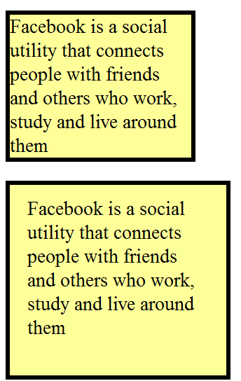
The padding property (Cont'd)
p {
background-color:#FFFF99;
border: black solid 4px;
width: 150px;
}
p.extra-padding{
padding-top: 10px;
padding-bottom: 30px;
padding-left: 15px;
padding-right: 15px;
}

Slide 49
The margin property
The margin property is the gap between boxes, and its value is either a length, a percentage, or inherit.
Remember that two boxes whose vertical margins touch each other will also collapse into each other.
So, the distance between the blocks is not the sum of the margins, but only the greater of the two margins.
if both are equal, the margin will have the size of any of those.

Slide 50
The margin property (Cont'd)
You can also set different values for the margin on each side of the box using the following properties:
margin-bottom
margin-top
margin-left
margin-right

Slide 51
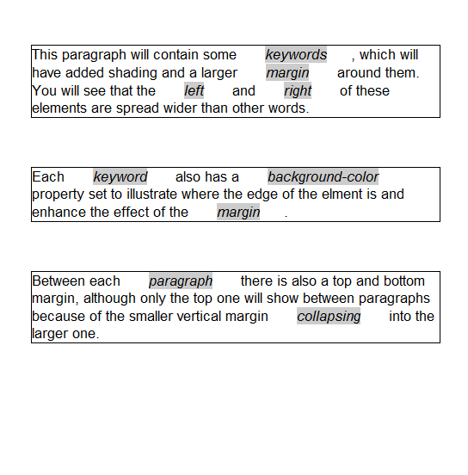
The margin property Example

Slide 52
The margin property Example: CSS
body {
color:#000000;
background-color:#ffffff;
font-family:arial, verdana, sans-serif;
font-size:12px;}
p {
margin-top:40px;
margin-bottom:30px;
margin-left:20px;
margin-right:20px;
border-style:solid;
border-width:1px;
border-color:#000000;}
em {
background-color:#cccccc;
margin-left:20px;
margin-right:20px;}

Slide 53
The margin property Example: XHTML
<p>This paragraph will contain some <em>keywords</em>, which will have added shading and a larger <em>margin</em> around them. You will see that the <em>left</em> and <em>right</em> of these elements are spread wider than other words.</p>
<p>Each <em>keyword</em> also has a <em>background-color</em> property set to illustrate where the edge of the elment is and enhance the effect of the <em>margin</em>.</p>
<p>Between each <em>paragraph</em> there is also a top and bottom margin, although only the top one will show between paragraphs because of the smaller vertical margin <em>collapsing</em> into the larger one.</p>

Slide 54
The margin property Example: CSS

Slide 55
Questions?

