Slide 1

INTRODUCTION TO WEB DEVELOPMENT AND HTML
Lecture 11: Deeper into CSS - Spring 2011

Slide 2
Outline
The min and max width and height properties
The overflow property
Presentation of links
Background of documents

Slide 3
The max-width and min-width properties
The max-width and min-width properties allow you to specify a maximum and a minimum width for a box.
div { min-width:200px;
max-width:500px;
padding:5px;
border:1px solid #000000;}

Slide 4
The min-heigh and max-height
The min-height and max-height properties correspond with the min-width and max-width properties, but specify a minimum height and maximum height for the box.
div { min-height:50px;
max-height:200px;
padding:5px;
border:1px solid #000000;}

Slide 5
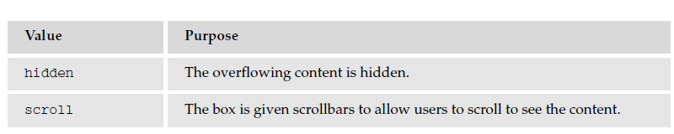
The overflow property
div { max-height:75px;
max-width:250px;
padding:5px;
margin:10px;
border:1px solid #000000;}
div.one { overflow:hidden;}
div.two { overflow:scroll;}

Slide 6
Presentation of Links

Slide 7
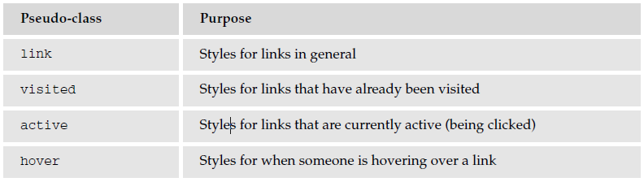
CSS on links

Slide 8
CSS on links: Common properties to use
color: to change colors of links.
text-decoration: to control whether the link is underlined or not.
background-color: Highlights the link, as if it had been highlighted with a highlighter pen.

Slide 9
Backgrounds of documents

Slide 10
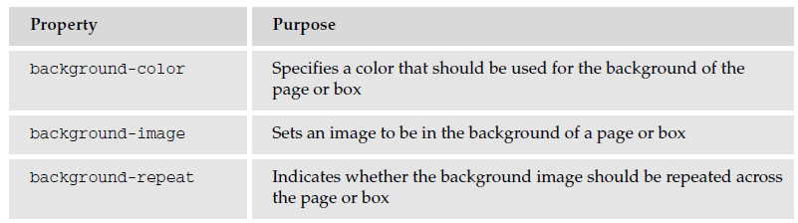
Backgrounds

Slide 11
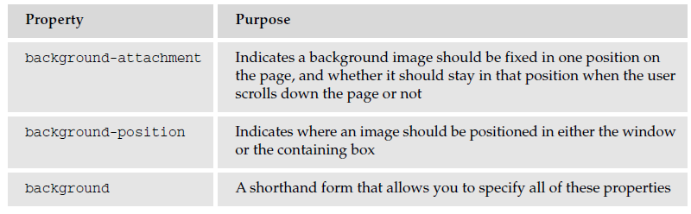
Backgrounds (Cont'd)

Slide 12
Background-color
body {background-color:#cccccc; color:#000000;}
b {background-color:#FF0000; color:#FFFFFF;}
p {background-color: rgb(255,255,255);}

Slide 13
Background-image
body {
background-image: url(images/background.gif); }

Slide 14
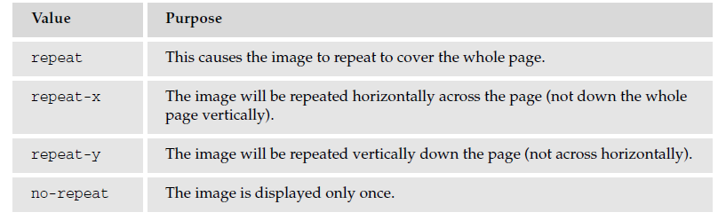
Background-repeat
body {
background-image: url(“images/background_small.gif”);
background-repeat: repeat-x;
background-color: #ffffff;}

Slide 15
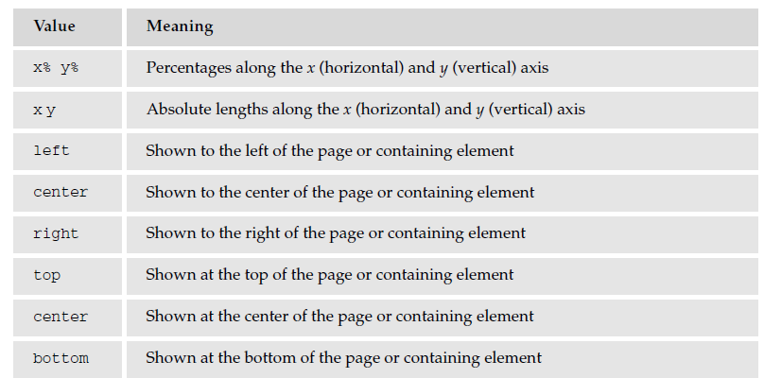
Background-position

Slide 16
Background-position Example
body {
  background-image: url(“images/background_small.gif”);
  background-position: 50% 20%;
  background-repeat: no-repeat;
  background-color: #eaeaea; }

Slide 17
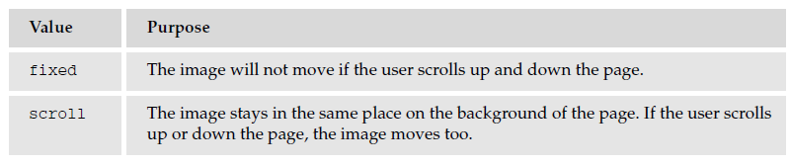
Background attachment
The background-attachment property allows you to specify an image known as a watermark.
The key difference with this setting is that the background image can stay in the same position even when the user scrolls up and down a page or scrolls with all of the other elements of the page.

Slide 18
Questions?

