Slide 1

INTRODUCTION TO WEB DEVELOPMENT AND HTML
Lecture 12: Advance CSS - Spring 2011

Slide 2
Outline
List Styles
Table Styles
Focus, Active, Before and After Pseudo-classes
Content and Counters
Display and Visibility
Positioning and Flow

Slide 3
List Styles

Slide 4
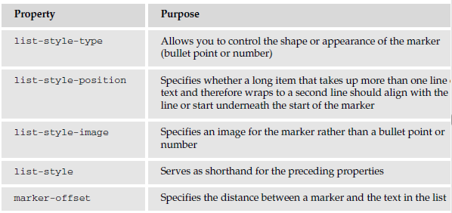
List Styles

Slide 5
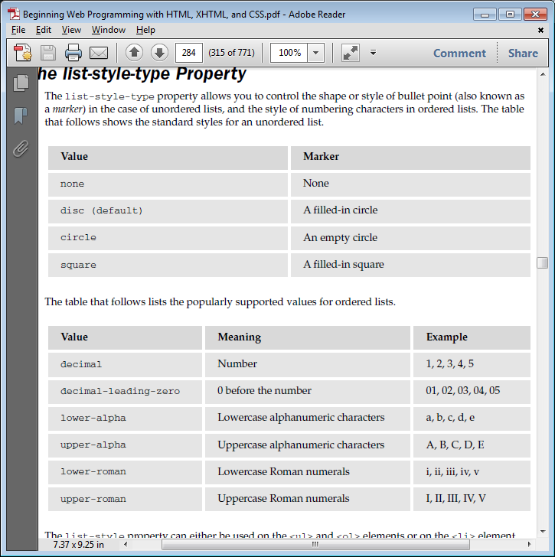
List-style-type for Unordered Lists

Slide 6
List-style-type for Ordered Lists

Slide 7
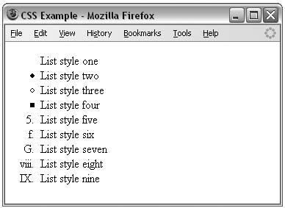
List Examples
li.a {list-style:none;}
li.b {list-style:disc;}
li.c {list-style:circle;}
li.d {list-style:square;}
li.e {list-style:decimal;}
li.f {list-style:lower-alpha;}
li.g {list-style:upper-alpha;}
li.h {list-style:lower-roman;}
li.i {list-style:upper-roman;}

Slide 8
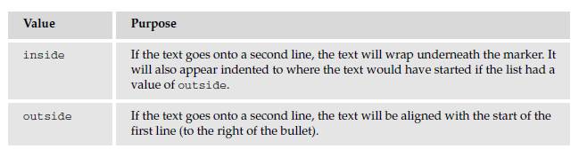
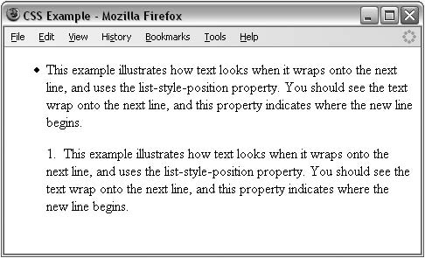
List-style-position
ul {list-style-position:outside; }
ol {list-style-position:inside; }

Slide 9
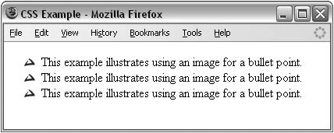
list-style-image
allows you to specify an image so that you can use your own bullet style.
li {list-style-image: url(“images/bulletpoint.gif”);}
If the image cannot be displayed, the browser should just display a dot rather than a broken image symbol.

Slide 10
Tables

Slide 11
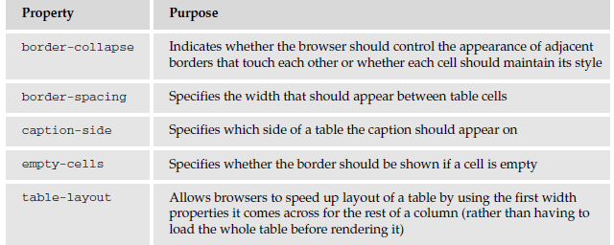
Table-specific properties

Slide 12
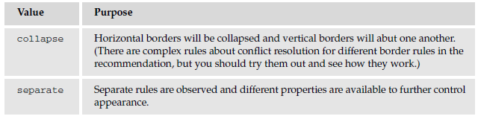
border-collapse
specifies whether the browser should display every border

Slide 13
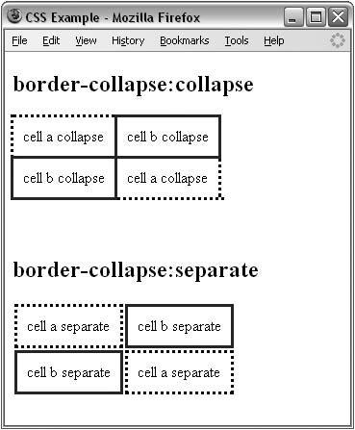
border-collapse Example
table.one {border-collapse:collapse;}
table.two {border-collapse:separate;}
td.a {border-style:dotted; border-width:3px;
border-color:#000000; padding: 10px;}
td.b {border-style:solid; border-width:3px;
border-color:#333333; padding: 10px;}

Slide 14
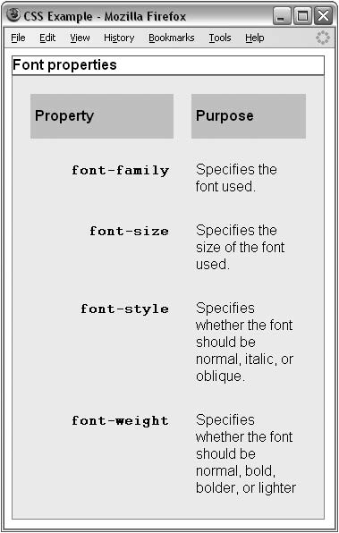
The border-spacing property
Specifies the distance that separates adjacent cells’ borders. Can receive either one or two values.
If one value is provided, it will apply to both vertical and horizontal borders:
td {border-spacing:15px;}
If two values are provided, the first refers to the horizontal spacing and the second to the vertical spacing:
td {border-spacing:2px; 4px;}

Slide 15
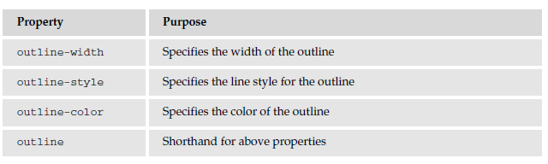
Outlines
Outlines are similar to borders, except in:
  An outline does not take up space
  Outlines do not have to be rectangular

Slide 16
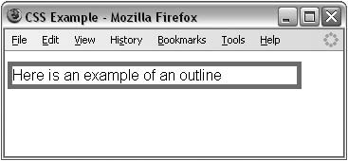
Outlines Example
input {outline-width:2px;}
input {outline-style:solid;}
input {outline-color:#ffoooo;}

Slide 17
The :focus and :active pseudo-classes
:focus: Change the style when an element gains focus
:active: Change the style when an element is active such as when a user clicks a link.
input: focus {outline: #ff0000 thick solid;}

Slide 18
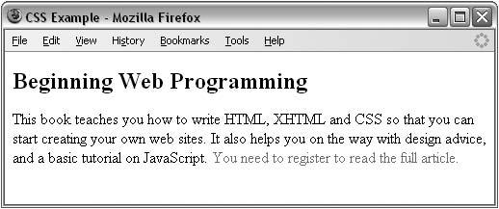
The :before and :after Pseudo-elements
Enable you to add text before or after each instance of an element or elements defined in a selector.
p.abstract:after {content: “You need to register to read the full article.”; color:#ff0000;}

Slide 19
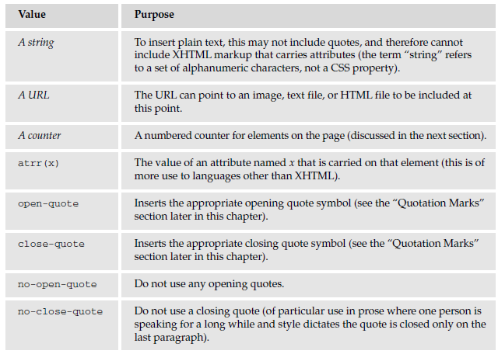
The content property

Slide 20
Counters
The counter() function is designed to allow you to create a counter that increments each time a browser comes across any specified element.
counter-reset: set counters to zero.
counter-increment: increase the counters every time that element is met

Slide 21
Counters Example
<body>
<h1> Introducing Web Technologies</h1>
<h2>Introducing HTML</h2>
<h2>Introducing CSS</h2>
<h2>Introducing XHTML</h2>
<h1> Structure of Documents</h1>
<h2>Text</h2>
<h2>Lists</h2>
<h2>Tables</h2>
<h2>Forms</h2>
</body>
body {counter-reset: chapter; counter-reset: section;}
h1:before {content: “Chapter “ counter(chapter) “: “;}
h1 {counter-increment: chapter; counter-reset: section;}
h2:before { content: counter(chapter) “.” counter
(section) “ “; }
h2 {counter-increment: section; }

Slide 22
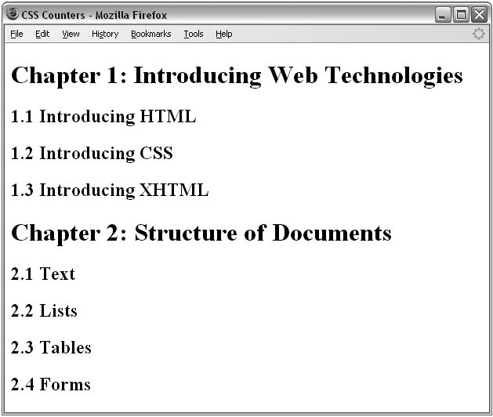
Counters Example (Cont'd)

Slide 23
Quotation Marks
The values open-quote and close-quote can be used with the content property to add quote marks before and after occurrences of specified elements.

Slide 24
Quotation Marks Example
<h1>Generated quotes</h1>
<p>Here are some quotes from Oscar Wilde:</p>
<blockquote>Consistency is the last refuge of the unimaginative.</blockquote>
<blockquote>If you want to tell people the truth, make them laugh, otherwise
they’ll kill you.</blockquote>
<blockquote>It is a very sad thing that nowadays there is so little useless
information.</blockquote>
blockquote:before {
content: open-quote;}
blockquote:after {
content: close-quote;}

Slide 25
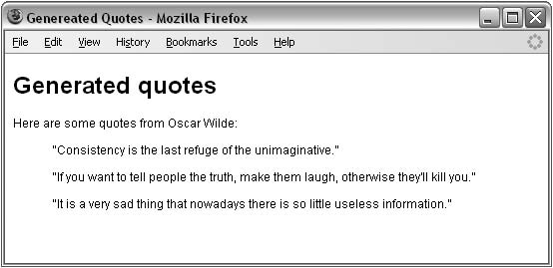
Quotation Marks Example

Slide 26
The display property
forces an element (or box) to be a different type of box than you might expect it to be.
display: block → make an inline box a block-level one.
display: inline → make a block-level box an inline one.
For example, <p> is a block-level box (block element):
p { display : inline }
After applying the above style, it would behave as an inline element or box.

Slide 27
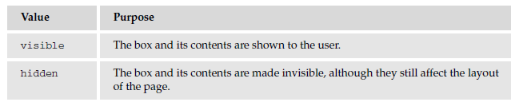
The visibility property
allows you to hide a box from view, although it still affects the layout of the page (even though its contents are not seen)

Slide 28
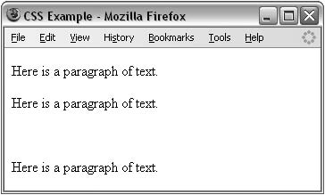
The visibility property Example
<body>
<p>Here is a paragraph of text.</p>
<p>Here is a paragraph of text.</p>
<p class=”invisible”>This paragraph of text should be invisible.</p>
<p>Here is a paragraph of text.</p>
</body>
p.invisible {
visibility: hidden;}

Slide 29
Positioning with CSS

Slide 30
Positioning with CSS
By default, elements are laid out on the page using what is known as normal flow.
In normal flow:
  block-level elements flow from top to bottom
  inline elements flow from left to right.

Slide 31
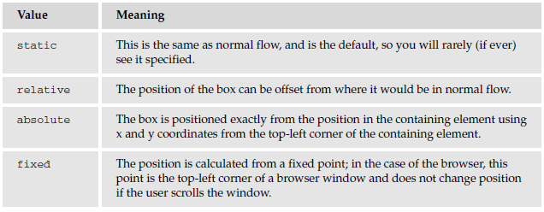
The position property
Allows you to specify a position for a box

Slide 32
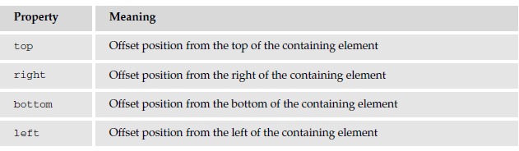
Box Offset properties
Indicates where the boxes should be positioned. It is used along with the position property values: relative, absolute, or fixed.
Each can take a value of a length, a percentage, or auto.

Slide 33
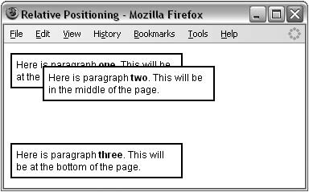
Relative Positioning
Takes an element and positions it in relation to where it would otherwise sit in normal flow.
It is displaced from that position by an amount given using the box offset properties
  p { border-style: solid;
  border-color:#000000;
  border-width:2px;
  padding:5px;
  background-color:#FFFFFF;}
  p.two {
  position: relative;
  left: 40px;
  top: -40px;}

Slide 34
Absolute Positioning
Completely removes an element’s content from normal flow, allowing you to fix its position.
The box offsets fix the position of a box relative to the containing block.
The containing block should be an element whose position property is set to relative or fixed.

Slide 35
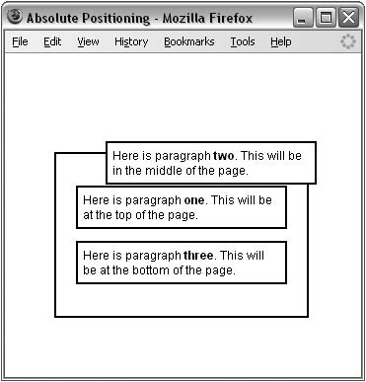
Absolute Positioning Example
div.page {
position: absolute;
left: 50px;
top : 100px; }
p {
background-color:#FFFFFF;
width:200px;}
p.two {
position: absolute;
left: 50px;
top: -25px;}

Slide 36
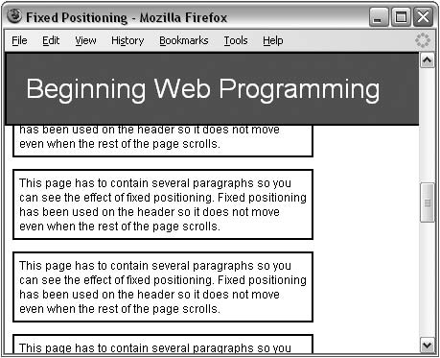
Fixed Positioning
Specifies that the content of the element should be completely removed from normal flow.
The box should not move when users scroll down the page.
Example:
div {
position: fixed;
top: 0px;
left: 0px;
}

Slide 37
The z-index property
Use to control which boxes, in relative or absolute position, should appear on top when they are overlapping each other.

Slide 38
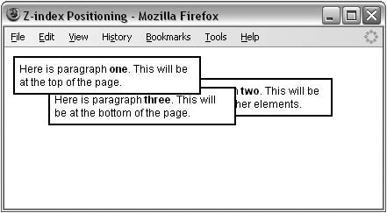
The z-index property Example
<p class=”one”>Here is paragraph <b>one</b>. This will be at the top of the page.</p>
<p class=”two”>Here is paragraph <b>two</b>. This will be underneath the other elements.</p>
<p class=”three”>Here is paragraph <b>three</b>. This will be at the bottom of the page.</p>
p.one {
z-index: 3;
position: absolute;
left: 0px; top: 0px;}
p.two {
z-index: 1;
position: absolute;
left: 150px; top: 25px;}
p.three {
z-index: 2;
position: absolute;
left: 40px; top: 35px;}

Slide 39
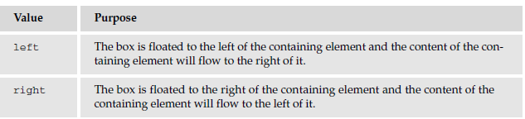
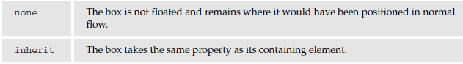
Floating using the float property
Allows you to take an element out of normal flow and place it as far to the left or right of a containing box as possible within that element’s padding.

Slide 40
Floating using the float property (cont'd)
Important!
Whenever you specify a float property, you should also set a width property indicating the width of the containing box that the floating box should take up.
Otherwise, it will automatically take up 100% of the width of the containing box leaving no space for things to flow around it, therefore making it just like a plain block-level element.

Slide 41
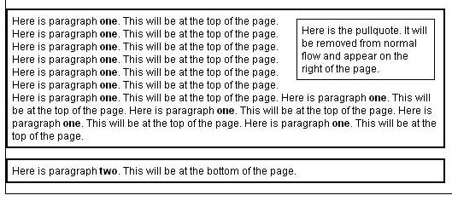
Floating using the float property Example
<h1> Heading</h1>
<p> <span class=”pullQuote”> Here is the pullquote….</span>
Here is paragraph <b>one</b>. This will be at the top of the page. …… at the top of the page. Here is paragraph
</b>. This will be at the top of the page.
</p>
<p> Here is paragraph <b>two</b>. This will be at the bottom of the page.</p>
p {
  border-style:solid;
  border-color:#000000;
  border-width:2px;
  padding:5px;
  background-color:#FFFFFF;
  width:500px;}
.pullQuote {
  float:right;
  width:150px;
  padding:5px;
  margin:5px;
  border-style:solid;
  border-width:1px; }

Slide 42
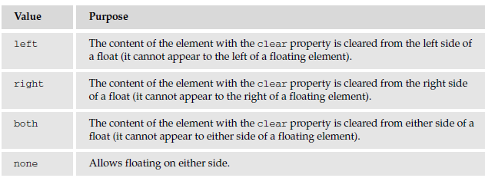
The clear property
It's especially helpful when working with boxes that are floated.
In case it is preferred that nothing sat next to the floated element, and that surrounding content be pushed underneath the floated element.

Slide 43
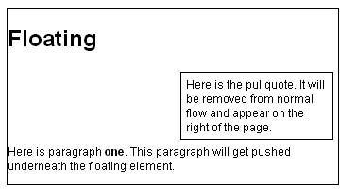
The clear property Example
<h1>Floating</h1>
<div class=”pullQuote”>Here is the pullquote. It will be removed from normal flow and appear on the right of the page.</div>
<p>Here is paragraph <b>one</b>. This paragraph will get pushed underneath the floating element. </p>
p {
clear: right;
background-color:#FFFFFF; }
div.pullQuote {
float: right;
padding: 5px;
margin: 5px;
width: 150px; }

Slide 44
Questions?

