Slide 1
Chapter 3
Describing Syntax and Semantics

Slide 2
Chapter 3 Topics
Introduction
The General Problem of Describing Syntax
Formal Methods of Describing Syntax
Attribute Grammars
Describing the Meanings of Programs: Dynamic Semantics
Copyright © 2012 Addison-Wesley. All rights reserved.
1-<number>

Slide 3
Introduction
Syntax: the form or structure of the expressions, statements, and program units
Semantics: the meaning of the expressions, statements, and program units
Syntax and semantics provide a language’s definition
  Users of a language definition
    Other language designers
    Programmers (the users of the language)
Copyright © 2012 Addison-Wesley. All rights reserved.
1-<number>
Notes:
Expressions int a = 2,,,,, (a+b)*5 islem onceligi
Statement: int a = 2; a++; printf(“hi”); if veya while
Blocks if {}
Soz dizimi ve anlam bilimi (farkli anlamlara gelebilir ifadeler, yanindaki bilgilerle anlamli olacaktir)

Slide 4
The General Problem of Describing Syntax: Terminology
A sentence is a string of characters over some alphabet
A language is a set of sentences
A lexeme is the lowest level syntactic unit of a language (e.g., *, sum, begin)
A token is a category of lexemes (e.g., identifier)
Copyright © 2012 Addison-Wesley. All rights reserved.
1-<number>

Slide 5
The General Problem of Describing Syntax: Example
index = 2 * count + 17;
The lexemes and tokens of this statement are
Lexemes Tokens
Index identifier
= equal_sign
2 int_literal
* mult_op
count identifier
+ plus_op
17 int_literal
; semicolon
Copyright © 2012 Addison-Wesley. All rights reserved.
1-<number>

Slide 6
Formal Definition of Languages
Recognizers
  A recognition device reads input strings over the alphabet of the language and decides whether the input strings belong to the language
  Example: syntax analysis part of a compiler
  - Detailed discussion of syntax analysis appears in
  Chapter 4
Generators
  A device that generates sentences of a language
  One can determine if the syntax of a particular sentence is syntactically correct by comparing it to the structure of the generator (grammar, BNF.. )
Copyright © 2012 Addison-Wesley. All rights reserved.
1-<number>
Notes:
Generator: uretm icin kurallara ihtiyac var bnf gibi

Slide 7
BNF and Context-Free Grammars
Context-Free Grammars
  Developed by Noam Chomsky in the mid-1950s
  Language generators (classes), meant to describe the syntax of natural languages
  Define a class of languages called context-free languages
Backus-Naur Form (1959)
  Invented by John Backus to describe the syntax of Algol 58
  BNF is equivalent to context-free grammars
Copyright © 2012 Addison-Wesley. All rights reserved.
1-<number>
Notes:
Neredeyse tum Prog dillerinin soz dizimi cfg sinifindandir

Slide 8
BNF Fundamentals
In BNF, abstractions are used to represent classes of syntactic structures--they act like syntactic variables (also called nonterminal symbols, or just terminals)
Terminals are lexemes or tokens
A rule has a left-hand side (LHS), which is a nonterminal, and a right-hand side (RHS), which is a string of terminals and/or nonterminals
<assign> −> <var> = <expression>
total = subtotal1 + subtotal2
Copyright © 2012 Addison-Wesley. All rights reserved.
1-<number>

Slide 9
BNF Fundamentals (continued)
Nonterminals are often enclosed in angle brackets
  Examples of BNF rules:
  <ident_list> → identifier | identifier, <ident_list>
  <if_stmt> → if <logic_expr> then <stmt>
Grammar: a finite non-empty set of rules
A start symbol is a special element of the nonterminals of a grammar
Copyright © 2012 Addison-Wesley. All rights reserved.
1-<number>

Slide 10
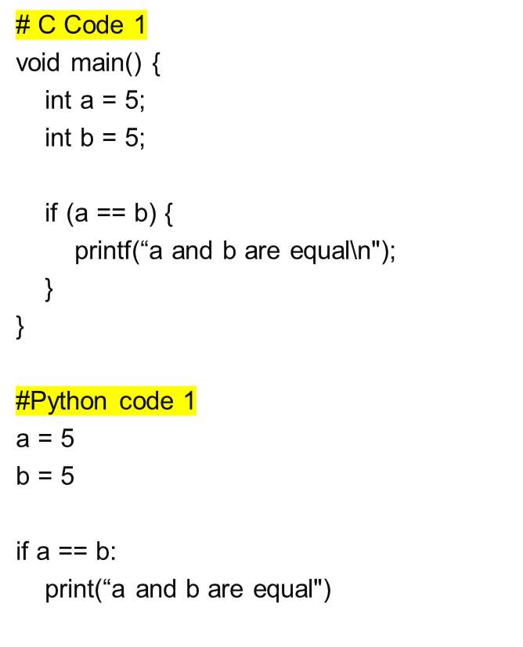
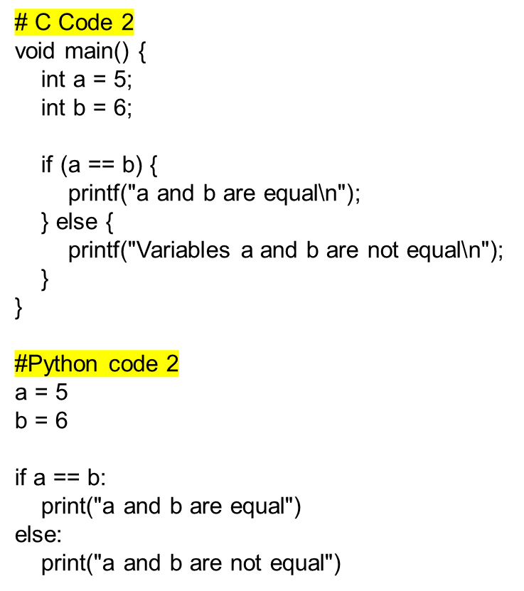
C and Python Code Examples
Copyright © 2012 Pearson Education. All rights reserved.
1-<number>

Slide 11
Describing Lists
Syntactic lists are described using recursion
<ident_list> → ident
| ident, <ident_list>
A derivation is a repeated application of rules, starting with the start symbol and ending with a sentence (all terminal symbols)
Copyright © 2012 Addison-Wesley. All rights reserved.
1-<number>
Notes:
Türetme, başlangıç sembolüyle başlayıp bir cümleyle (tum terminal sembolleri) biten kuralların tekrarlanan bir uygulamasıdır.

Slide 12
Example Grammar 1
<program> → <stmts>
<stmts> → <stmt> | <stmt> ; <stmts>
<stmt> → <var> = <expr>
<var> → a | b | c | d
<expr> → <term> + <term> | <term> - <term>
<term> → <var> | const
Copyright © 2012 Addison-Wesley. All rights reserved.
1-<number>

Slide 13
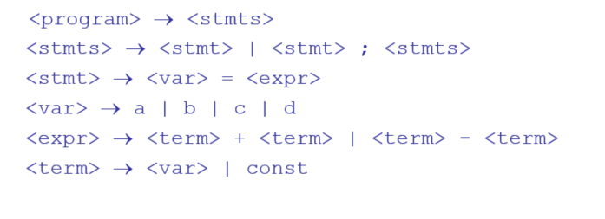
Example Derivation 1
<program> => <stmts> => <stmt>
=> <var> = <expr>
=> a = <expr>
=> a = <term> + <term>
=> a = <var> + <term>
=> a = b + <term>
=> a = b + const
Copyright © 2012 Addison-Wesley. All rights reserved.
1-<number>

Slide 14
Example Grammar 2
<program> → begin <stmt_list> end
<stmt_list> → <stmt>
| <stmt> ; <stmt_list>
<stmt> → <var> = <expression>
<var> → A | B | C
<expression> → <var> + <var>
| <var> – <var>
| <var>
Copyright © 2012 Pearson Education. All rights reserved.
1-<number>

Slide 15
Example Derivation 2
<program> => begin <stmt_list> end
=> begin <stmt> ; <stmt_list> end
=> begin <var> = <expression> ; <stmt_list> end
=> begin A = <expression> ; <stmt_list> end
=> begin A = <var> + <var> ; <stmt_list> end
=> begin A = B + <var> ; <stmt_list> end
=> begin A = B + C ; <stmt_list> end
=> begin A = B + C ; <stmt> end
=> begin A = B + C ; <var> = <expression> end
=> begin A = B + C ; B = <expression> end
=> begin A = B + C ; B = <var> end
=> begin A = B + C ; B = C end
Copyright © 2012 Pearson Education. All rights reserved.
1-<number>

Slide 16
Derivations
Every string of symbols in a derivation is a sentential form
A sentence is a sentential form that has only terminal symbols
A leftmost derivation is one in which the leftmost nonterminal in each sentential form is the one that is expanded
A derivation may be neither leftmost nor rightmost
Copyright © 2012 Addison-Wesley. All rights reserved.
1-<number>

Slide 17
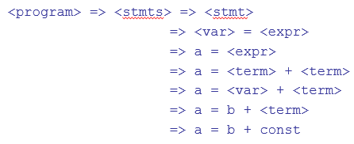
Parse Tree
A hierarchical representation of a derivation
<program>
<stmts>
<stmt>
<var>
=
<expr>
a
<term>
+
<term>
<var>
const
b
Copyright © 2012 Addison-Wesley. All rights reserved.
1-<number>

Slide 18
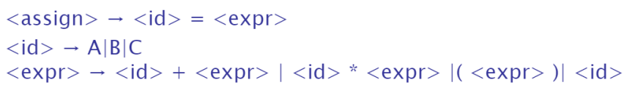
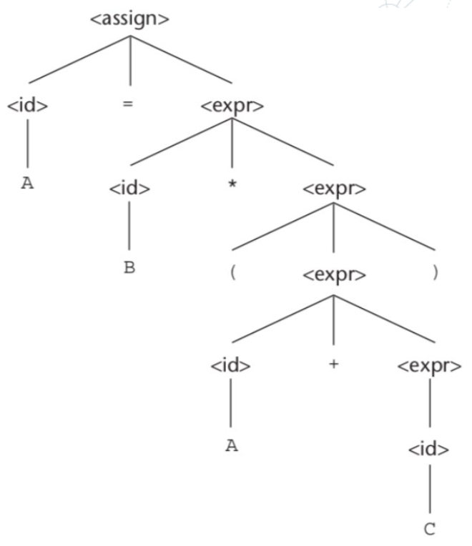
An Example Parse Tree
An example grammar and the hierarchical representation of a derivation
Copyright © 2012 Pearson Education. All rights reserved.
1-<number>

Slide 19
Ambiguity in Grammars
A grammar is ambiguous if and only if it generates a sentential form that has two or more distinct parse trees
Copyright © 2012 Addison-Wesley. All rights reserved.
1-<number>
Notes:
Bir dilbilgisi ancak ve ancak iki veya daha fazla farklı ayrıştırma ağacına sahip bir cümlesel form üretiyorsa belirsizdir

Slide 20
An Ambiguous Expression Grammar
<expr> → <expr> <op> <expr> | const
<op> → / | -
<expr>
<expr>
<expr>
<op>
<expr>
<expr>
<op>
<op>
<expr>
<expr>
<op>
<expr>
<expr>
<op>
<expr>
const
-
const
/
const
const
-
const
/
const
Copyright © 2012 Addison-Wesley. All rights reserved.
1-<number>

Slide 21

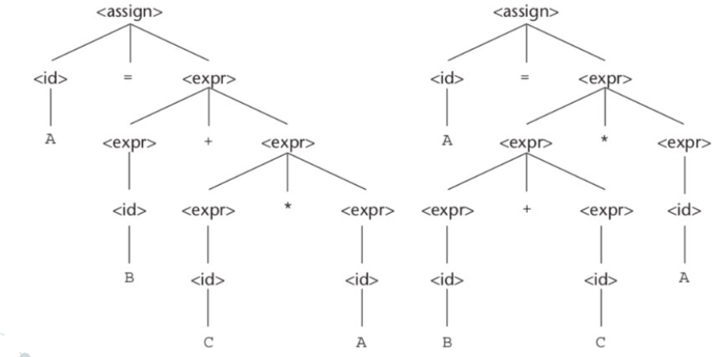
Ambiguity in Grammars contd.
A = B + C * A
Copyright © 2012 Pearson Education. All rights reserved.
1-<number>
Notes:
Right derived and left derived parse trees.

Slide 22
An Unambiguous Expression Grammar
If we use the parse tree to indicate precedence levels of the operators, we cannot have ambiguity
<expr> → <expr> - <term> | <term>
<term> → <term> / const| const
<expr>
<expr>
-
<term>
<term>
<term>
/
const
const
const
Copyright © 2012 Addison-Wesley. All rights reserved.
1-<number>
Notes:
Operatörlerin öncelik seviyelerini belirtmek için ayrıştırma ağacını kullanırsak belirsizlikle karşılaşamayız.

Slide 23
Associativity of Operators
Operator associativity can also be indicated by a grammar
<expr> -> <expr> + <expr> | const (ambiguous)
<expr> -> <expr> + const | const (unambiguous)
<expr>
<expr>
<expr>
+
const
<expr>
+
const
const
Copyright © 2012 Addison-Wesley. All rights reserved.
1-<number>

Slide 24
Extended BNF
Optional parts are placed in brackets [ ]
<proc_call> -> ident [(<expr_list>)]
Alternative parts of RHSs are placed inside parentheses and separated via vertical bars
<term> → <term> (+|-) const
Repetitions (0 or more) are placed inside braces { }
<ident> → letter {letter|digit}
Copyright © 2012 Addison-Wesley. All rights reserved.
1-<number>
Notes:
Doesnt influence the power of grammar definition, only increases readibility

Slide 25
BNF and EBNF
BNF
<expr> → <expr> + <term>
| <expr> - <term>
| <term>
<term> → <term> * <factor>
| <term> / <factor>
| <factor>
EBNF
<expr> → <term> {(+ | -) <term>}
<term> → <factor> {(* | /) <factor>}
Copyright © 2012 Addison-Wesley. All rights reserved.
1-<number>

Slide 26
Static Semantics
Context-free grammars (CFGs) cannot describe all of the syntax of programming languages
Categories of constructs that are trouble:
- Context-free, but cumbersome (e.g.,
types of operands in expressions)
- Non-context-free (e.g., variables must
be declared before they are used)
Copyright © 2012 Addison-Wesley. All rights reserved.
1-<number>
Notes:
CFG and BNF ile dilin tum yapisini tanimlamak zor. Ek kurallar ve semboller gerekir. Int a=8.9; BNF ile tanimlanamaz bu nedenle ek kural gerekir.

Slide 27
Attribute Grammars
Attribute grammars (AGs) have additions to CFGs to carry some semantic info on parse tree nodes
Primary value of AGs:
  Static semantics specification
  Compiler design (static semantics checking)
Copyright © 2012 Addison-Wesley. All rights reserved.
1-<number>
Notes:
Oznitelik grameri, BNF ile statik semantics tanimlayamama problem icin daha guclu bir mekaniza olarak tasarlanmistir. Amac, static semantics kurallarinin dogrulugunu tanimlamak ve kontrol etmektedir.
To define AG, static semantic spec and complier design needed to know.

Slide 28
Attribute Grammars : Definition
Def: An attribute grammar is a context-free grammar G = (S, N, T, P) with the following additions:
  For each grammar symbol x there is a set A(x) of attribute values
  Each rule has a set of functions that define certain attributes of the nonterminals in the rule
  Each rule has a (possibly empty) set of predicates to check for attribute consistency
Copyright © 2012 Addison-Wesley. All rights reserved.
1-<number>
Notes:
Nitelik hesaplama ve nitelik dogrulama fonksiyonlarina eklenen baglamdan bagimsiz grammerlerdir. Dogrulama fonk return false: int= int+double

Slide 29
Attribute Grammars: Definition
Let X₀ → X₁ ... X_{n} be a rule
Functions of the form S(X₀) = f(A(X₁), ... , A(X_{n})) define synthesized attributes
Functions of the form I(X_{j}) = f(A(X₀), ... , A(X_{n})), for i <= j <= n, define inherited attributes
Initially, there are intrinsic attributes on the leaves
Copyright © 2012 Addison-Wesley. All rights reserved.
1-<number>

Slide 30
Attribute Grammars: An Example
Syntax
  <assign> -> <var> = <expr>
  <expr> -> <var> + <var> | <var>
  <var> A | B | C
actual_type: synthesized for <var> and <expr>
expected_type: inherited for <expr>
Copyright © 2012 Addison-Wesley. All rights reserved.
1-<number>

Slide 31
Attribute Grammar (continued)
Syntax rule: <expr> → <var>[1] + <var>[2]
Semantic rules:
<expr>.actual_type ← <var>[1].actual_type
Predicate:
<var>[1].actual_type == <var>[2].actual_type
<expr>.expected_type == <expr>.actual_type
Syntax rule: <var> → id
Semantic rule:
<var>.actual_type ← lookup (<var>.string)
Copyright © 2012 Addison-Wesley. All rights reserved.
1-<number>
Notes:
Symbol table→ look up

Slide 32
Attribute Grammars (continued)
How are attribute values computed?
  If all attributes were inherited, the tree could be decorated in top-down order.
  If all attributes were synthesized, the tree could be decorated in bottom-up order.
  In many cases, both kinds of attributes are used, and it is some combination of top-down and bottom-up that must be used.
Copyright © 2012 Addison-Wesley. All rights reserved.
1-<number>
Notes:
Tüm öznitelikler miras alınmışsa, bu tamamen yukarıdan aşağıya, kökten yapraklara doğru ilerleyebilir. Alternatif olarak, tüm öznitelikler sentezlenmişse, yapraklardan köke doğru tamamen aşağıdan yukarıya doğru ilerleyebilir. Dilbilgimiz hem sentezlenmiş hem de miras alınmış özniteliklere sahip olduğundan, değerlendirme süreci tek bir yönde olamaz.

Slide 33
Attribute Grammars (continued)
<expr>.expected_type ← inherited from parent
<var>[1].actual_type ← lookup (A)
<var>[2].actual_type ← lookup (B)
<var>[1].actual_type =? <var>[2].actual_type
<expr>.actual_type ← <var>[1].actual_type
<expr>.actual_type =? <expr>.expected_type
Copyright © 2012 Addison-Wesley. All rights reserved.
1-<number>

Slide 34
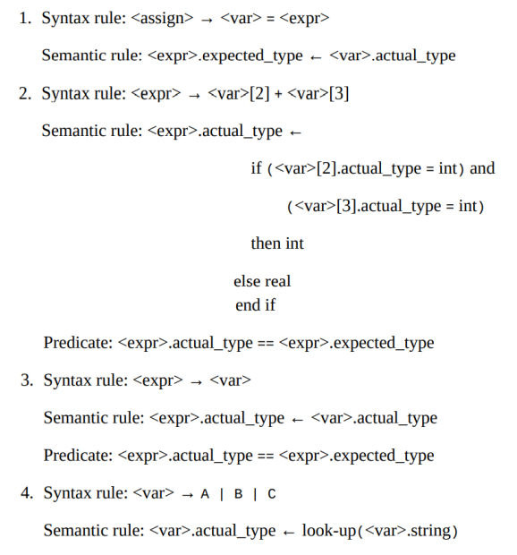
Copyright © 2012 Pearson Education. All rights reserved.
1-<number>

Slide 35
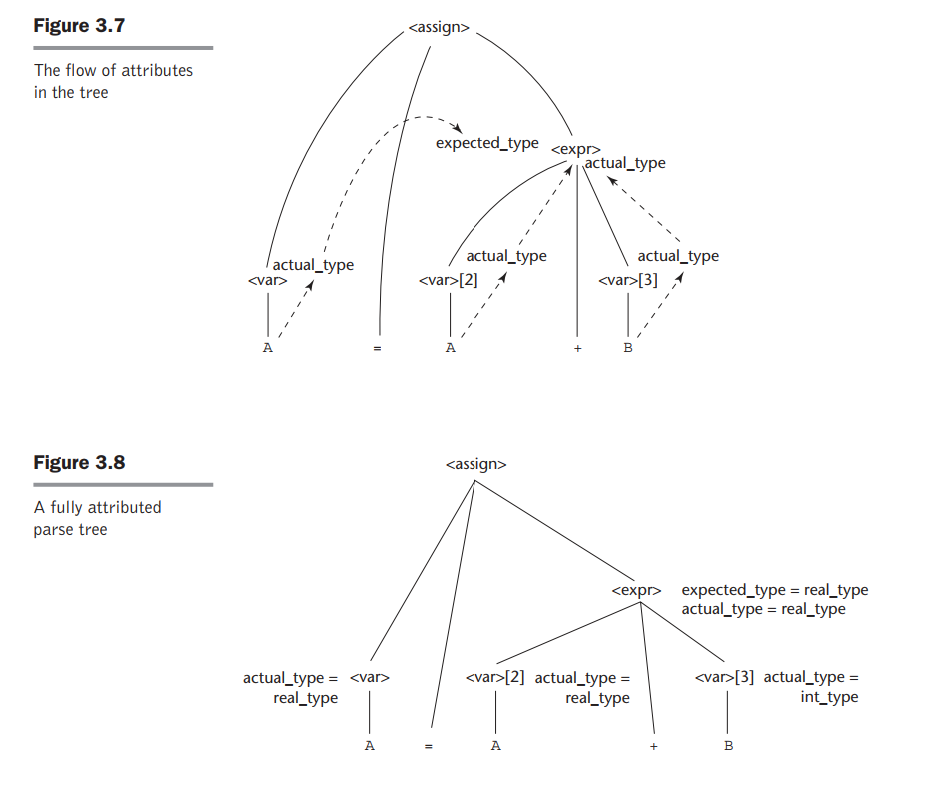
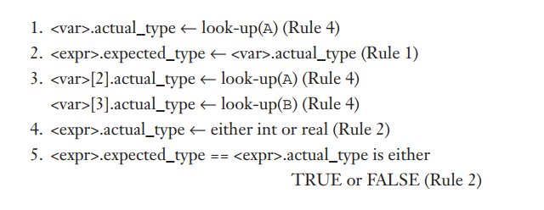
Copyright © 2012 Pearson Education. All rights reserved.
1-<number>

