Slide 1
Chapter 4
Lexical and Syntax Analysis

Slide 2
Chapter 4 Topics
Introduction
Lexical Analysis
The Parsing Problem
Recursive-Descent Parsing
Bottom-Up Parsing
Copyright © 2012 Addison-Wesley. All rights reserved.
1-<number>

Slide 3
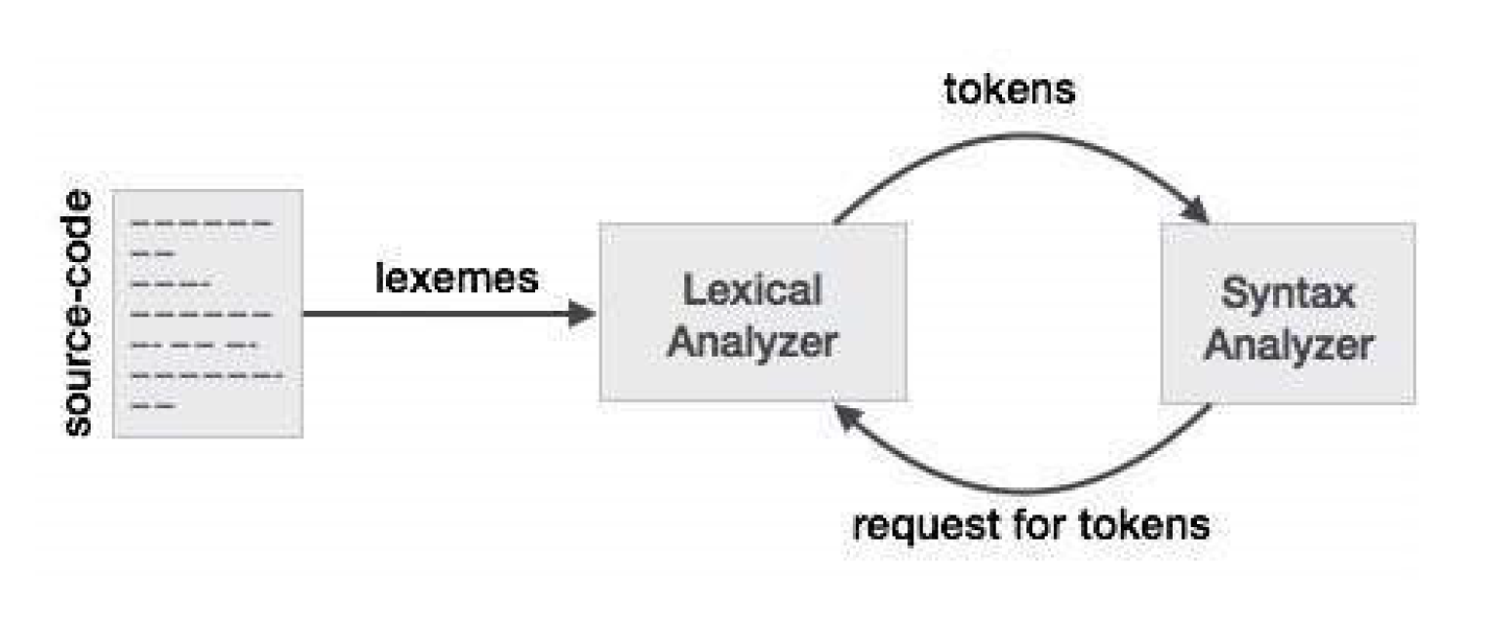
Introduction
Language implementation systems must analyze source code, regardless of the specific implementation approach
Nearly all syntax analysis is based on a formal description of the syntax of the source language (BNF)
Copyright © 2012 Addison-Wesley. All rights reserved.
1-<number>

Slide 4
Syntax Analysis
The syntax analysis portion of a language processor nearly always consists of two parts:
  A low-level part called a lexical analyzer (mathematically, a finite automaton based on a regular grammar)
  A high-level part called a syntax analyzer, or parser (mathematically, a push-down automaton based on a context-free grammar, or BNF)
Copyright © 2012 Addison-Wesley. All rights reserved.
1-<number>

Slide 5
Advantages of Using BNF to Describe Syntax
Provides a clear and concise syntax description
The parser can be based directly on the BNF
Parsers based on BNF are easy to maintain
Copyright © 2012 Addison-Wesley. All rights reserved.
1-<number>

Slide 6
Reasons to Separate Lexical and Syntax Analysis
Simplicity - less complex approaches can be used for lexical analysis; separating them simplifies the parser
Efficiency - separation allows optimization of the lexical analyzer
Portability - parts of the lexical analyzer may not be portable, but the parser always is portable
Copyright © 2012 Addison-Wesley. All rights reserved.
1-<number>

Slide 7
Lexical Analysis
A lexical analyzer is a pattern matcher for character strings
A lexical analyzer is a “front-end” for the parser
Identifies substrings of the source program that belong together - lexemes
  Lexemes match a character pattern, which is associated with a lexical category called a token
  sum is a lexeme; its token may be IDENT
  int value = 5;
  Tokens are: int (keyword), value(identifier), =(operator), 5 constant and ; (symbol)
Copyright © 2012 Addison-Wesley. All rights reserved.
1-<number>

Slide 8
Lexical Analysis (continued)
The lexical analyzer is usually a function that is called by the parser when it needs the next token
Three approaches to building a lexical analyzer:
  Write a formal description of the tokens and use a software tool that constructs a table-driven lexical analyzer from such a description
  Design a state diagram that describes the tokens and write a program that implements the state diagram
  Design a state diagram that describes the tokens and hand-construct a table-driven implementation of the state diagram
Copyright © 2012 Addison-Wesley. All rights reserved.
1-<number>

Slide 9
Lexical Analysis (continued)
In many cases, transitions can be combined to simplify the state diagram
  When recognizing an identifier, all uppercase and lowercase letters are equivalent
    Use a character class that includes all letters
  When recognizing an integer literal, all digits are equivalent - use a digit class
Copyright © 2012 Addison-Wesley. All rights reserved.
1-<number>

Slide 10
Lexical Analysis (continued)
Reserved words and identifiers can be recognized together (rather than having a part of the diagram for each reserved word)
  Use a table lookup to determine whether a possible identifier is in fact a reserved word
Copyright © 2012 Addison-Wesley. All rights reserved.
1-<number>

Slide 11
Lexical Analysis (continued)
Convenient utility subprograms:
  getChar - gets the next character of input, puts it in nextChar, determines its class and puts the class in charClass
  addChar - puts the character from nextChar into the place the lexeme is being accumulated, lexeme
  lookup - determines whether the string in lexeme is a reserved word (returns a code)
  ab12c or 1234
Copyright © 2012 Addison-Wesley. All rights reserved.
1-<number>

Slide 12
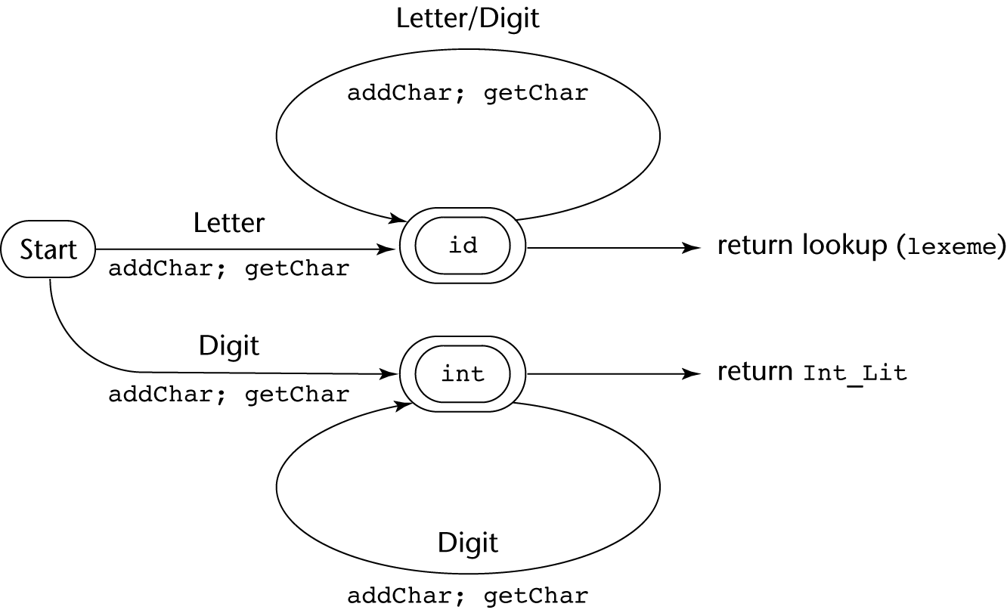
State Diagram
Copyright © 2012 Addison-Wesley. All rights reserved.
1-<number>

Slide 13
Lexical Analyzer
Implementation:
→ SHOW front.c (pp. 172-177)
- Following is the output of the lexical analyzer of
front.c when used on (sum + 47) / total
Next token is: 25 Next lexeme is (
Next token is: 11 Next lexeme is sum
Next token is: 21 Next lexeme is +
Next token is: 10 Next lexeme is 47
Next token is: 26 Next lexeme is )
Next token is: 24 Next lexeme is /
Next token is: 11 Next lexeme is total
Next token is: -1 Next lexeme is EOF
Copyright © 2012 Addison-Wesley. All rights reserved.
1-<number>

Slide 14
The Parsing Problem
Goals of the parser, given an input program:
  Find all syntax errors; for each, produce an appropriate diagnostic message and recover quickly
  Produce the parse tree, or at least a trace of the parse tree, for the program
Copyright © 2012 Addison-Wesley. All rights reserved.
1-<number>

Slide 15
The Parsing Problem (continued)
Two categories of parsers
  Top down - produce the parse tree, beginning at the root
    Order is that of a leftmost derivation
    Traces or builds the parse tree in preorder
  Bottom up - produce the parse tree, beginning at the leaves
    Order is that of the reverse of a rightmost derivation
Useful parsers look only one token ahead in the input
Copyright © 2012 Addison-Wesley. All rights reserved.
1-<number>
Notes:
Draw a parse tree and show left and right

Slide 16
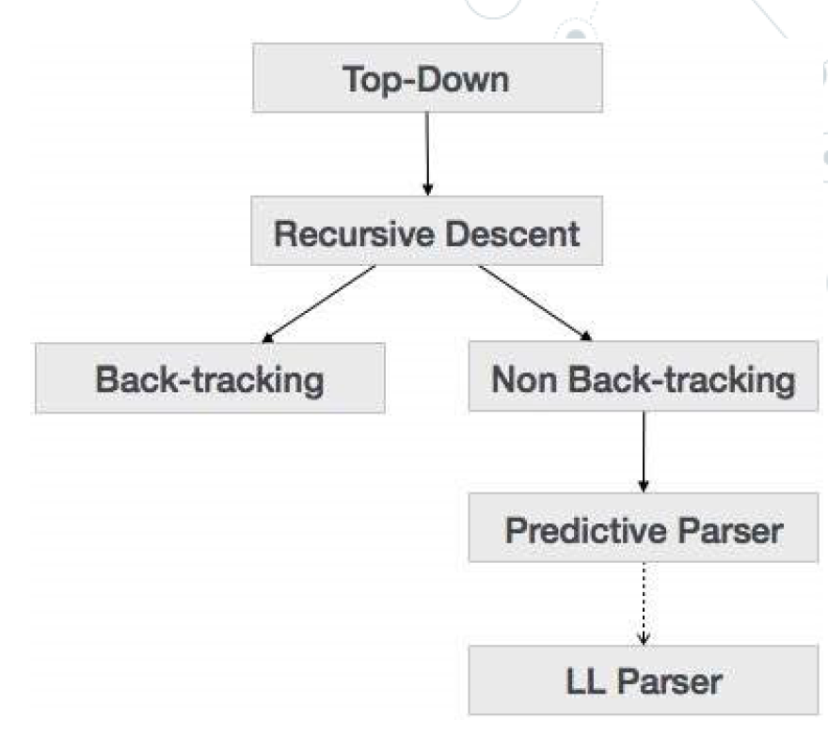
The Parsing Problem (continued)
Top-down Parsers
  Given a sentential form, xAα , the parser must choose the correct A-rule to get the next sentential form in the leftmost derivation, using only the first token produced by A
The most common top-down parsing algorithms:
  Recursive descent - a coded implementation
  LL parsers - table driven implementation
Copyright © 2012 Addison-Wesley. All rights reserved.
1-<number>

Slide 17
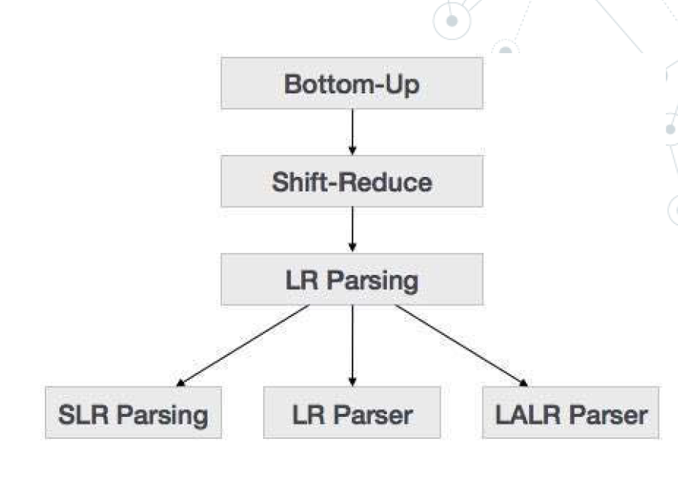
The Parsing Problem (continued)
Bottom-up parsers
  Given a right sentential form, α, determine what substring of α is the right-hand side of the rule in the grammar that must be reduced to produce the previous sentential form in the right derivation
  The most common bottom-up parsing algorithms are in the LR family
Copyright © 2012 Addison-Wesley. All rights reserved.
1-<number>

Slide 18
The Parsing Problem (continued)
The Complexity of Parsing
  Parsers that work for any unambiguous grammar are complex and inefficient ( O(n³), where n is the length of the input )
  Compilers use parsers that only work for a subset of all unambiguous grammars, but do it in linear time ( O(n), where n is the length of the input )
Copyright © 2012 Addison-Wesley. All rights reserved.
1-<number>
Notes:
Top down and bottom up parserlar karmasikligi azalatmak. Bu yontemler compile time’i azaltmak icin gelistirilmis.

Slide 19
Recursive-Descent Parsing
There is a subprogram for each nonterminal in the grammar, which can parse sentences that can be generated by that nonterminal
EBNF is ideally suited for being the basis for a recursive-descent parser, because EBNF minimizes the number of nonterminals
Copyright © 2012 Addison-Wesley. All rights reserved.
1-<number>
Notes:
Parserlar grammeri cozmeye calisiyor.

Slide 20
Recursive-Descent Parsing (continued)
A grammar for simple expressions:
<expr> → <term> {(+ | -) <term>}
<term> → <factor> {(* | /) <factor>}
<factor> → id | int_constant | ( <expr> )
Copyright © 2012 Addison-Wesley. All rights reserved.
1-<number>

Slide 21
Recursive-Descent Parsing (continued)
Assume we have a lexical analyzer named lex, which puts the next token code in nextToken
The coding process when there is only one RHS:
  For each terminal symbol in the RHS, compare it with the next input token; if they match, continue, else there is an error
  For each nonterminal symbol in the RHS, call its associated parsing subprogram
Copyright © 2012 Addison-Wesley. All rights reserved.
1-<number>

Slide 22
Recursive-Descent Parsing (continued)
/* Function expr
Parses strings in the language
generated by the rule:
<expr> → <term> {(+ | -) <term>}
*/
void expr() {
/* Parse the first term */
term();
/* As long as the next token is + or -, call
lex to get the next token and parse the
next term */
while (nextToken == ADD_OP ||
nextToken == SUB_OP){
lex();
term();
}
}
Copyright © 2012 Addison-Wesley. All rights reserved.
1-<number>

Slide 23
Recursive-Descent Parsing (continued)
This particular routine does not detect errors
Convention: Every parsing routine leaves the next token in nextToken
Copyright © 2012 Addison-Wesley. All rights reserved.
1-<number>

Slide 24
Recursive-Descent Parsing (continued)
A nonterminal that has more than one RHS requires an initial process to determine which RHS it is to parse
  The correct RHS is chosen on the basis of the next token of input (the lookahead)
  The next token is compared with the first token that can be generated by each RHS until a match is found
  If no match is found, it is a syntax error
Copyright © 2012 Addison-Wesley. All rights reserved.
1-<number>

Slide 25
Recursive-Descent Parsing (continued)
/* term
Parses strings in the language generated by the rule:
<term> -> <factor> {(* | /) <factor>)
*/
void term() {
/* Parse the first factor */
factor();
/* As long as the next token is * or /,
next token and parse the next factor */
while (nextToken == MULT_OP || nextToken == DIV_OP) {
lex();
factor();
}
} /* End of function term */
Copyright © 2012 Addison-Wesley. All rights reserved.
1-<number>

Slide 26
Recursive-Descent Parsing (continued)
/* Function factor
Parses strings in the language
generated by the rule:
<factor> -> id | (<expr>) */
void factor() {
/* Determine which RHS */
if (nextToken) == ID_CODE || nextToken == INT_CODE)
/* For the RHS id, just call lex */
lex();
/* If the RHS is (<expr>) – call lex to pass over the left parenthesis,
call expr, and check for the right parenthesis */
else if (nextToken == LP_CODE) {
lex();
expr();
if (nextToken == RP_CODE)
lex();
else
error();
} /* End of else if (nextToken == ... */
else error(); /* Neither RHS matches */
}
Copyright © 2012 Addison-Wesley. All rights reserved.
1-<number>

Slide 27
Recursive-Descent Parsing (continued)
- Trace of the lexical and syntax analyzers on (sum + 47) / total
Next token is: 25 Next lexeme is ( Next token is: 11 Next lexeme is total
Enter <expr> Enter <factor>
Enter <term> Next token is: -1 Next lexeme is EOF
Enter <factor> Exit <factor>
Next token is: 11 Next lexeme is sum Exit <term>
Enter <expr> Exit <expr>
Enter <term>
Enter <factor>
Next token is: 21 Next lexeme is +
Exit <factor>
Exit <term>
Next token is: 10 Next lexeme is 47
Enter <term>
Enter <factor>
Next token is: 26 Next lexeme is )
Exit <factor>
Exit <term>
Exit <expr>
Next token is: 24 Next lexeme is /
Exit <factor>
Copyright © 2012 Addison-Wesley. All rights reserved.
1-<number>

Slide 28
Bottom-up Parsing
The parsing problem is finding the correct RHS in a right-sentential form to reduce to get the previous right-sentential form in the derivation
Copyright © 2012 Addison-Wesley. All rights reserved.
1-<number>
Notes:
Agacin yaprak dugumlerinden baslayarak kok dugumune dogru ilerler. LR daha hizli calisan bir parser.

Slide 29
Bottom-up Parsing (continued)
Shift-Reduce Algorithms
  Reduce is the action of replacing the handle on the top of the parse stack with its corresponding LHS
  Shift is the action of moving the next token to the top of the parse stack
Copyright © 2012 Addison-Wesley. All rights reserved.
1-<number>
Notes:
Shift: sembolun kaydirilmasi (<------)
Shift reduce parsing is a process of reducing a string to the start symbol of a grammar.
Shift reduce parsing uses a stack to hold the grammar and an input tape to hold the string.

Slide 30
Bottom-up Parsing (continued)
Advantages of LR parsers:
  They will work for nearly all grammars that describe programming languages.
  They work on a larger class of grammars than other bottom-up algorithms, but are as efficient as any other bottom-up parser.
  They can detect syntax errors as soon as it is possible.
  The LR class of grammars is a superset of the class parsable by LL parsers.
Copyright © 2012 Addison-Wesley. All rights reserved.
1-<number>

Slide 31
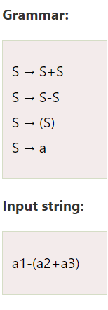
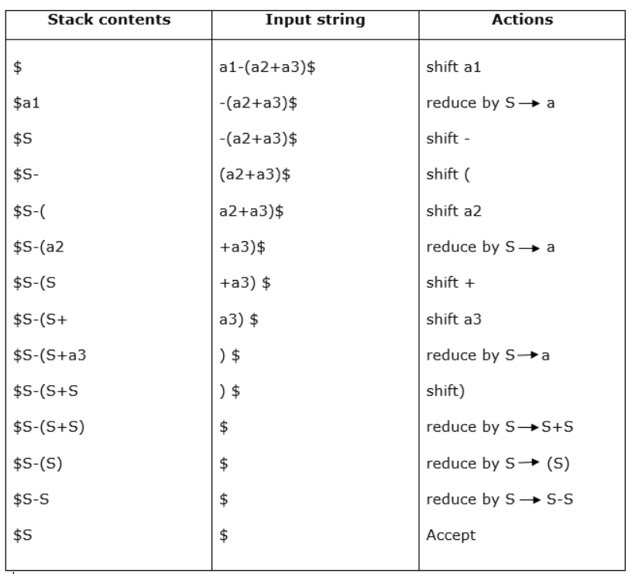
Copyright © 2012 Addison-Wesley. All rights reserved.
1-<number>
Notes:
Her indirgemede sembollerin yerini terminal olmayanlar alacaktır. Sembol üretimin sağ tarafı, terminal olmayan ise üretimin sol tarafıdır.

Slide 32
LL vs LR Parser
Starts with the start symbol(S).
Ends with start symbol(S).
LL Parser | LR Parser
First L of LL is for left to right and second L is for leftmost derivation. | L of LR is for left to right and R is for rightmost derivation.
It follows the left most derivation. | It follows reverse of right most derivation.
Using LL parser parser tree is constructed in top down manner. | Parser tree is constructed in bottom up manner.
Starts with the start symbol(S). | Ends with start symbol(S).
Copyright © 2012 Addison-Wesley. All rights reserved.
1-<number>
Notes:
LR: The best parser performance but use more source and can cause O(n3), more powerful than previously implemented algorithm and difficult to apply
LL: The most chosen solution in past

Slide 33
Summary
Syntax analysis is a common part of language implementation
A lexical analyzer is a pattern matcher that isolates small-scale parts of a program
  Detects syntax errors
  Produces a parse tree
A recursive-descent parser is an LL parser
  EBNF
Parsing problem for bottom-up parsers: find the substring of current sentential form
The LR family of shift-reduce parsers is the most common bottom-up parsing approach
Copyright © 2012 Addison-Wesley. All rights reserved.
1-<number>

