Slide 1
Chapter 6
Data Types

Slide 2
Chapter 6 Topics
Introduction
Primitive Data Types
Character String Types
User-Defined Ordinal Types
Array Types
Associative Arrays
Record Types
Tuple Types
List Types
Pointer and Reference Types
Type Checking
Strong Typing
Type Equivalence
Theory and Data Types
Copyright © 2012 Addison-Wesley. All rights reserved.
1-<number>

Slide 3
Introduction
A data type defines a collection of data objects and a set of predefined operations on those objects
A descriptor is the collection of the attributes of a variable
An object represents an instance of a user-defined (abstract data) type
One design issue for all data types: What operations are defined and how are they specified?
Copyright © 2012 Addison-Wesley. All rights reserved.
1-<number>

Slide 4
Primitive Data Types
Almost all programming languages provide a set of primitive data types
Primitive data types: Those not defined in terms of other data types
Some primitive data types are merely reflections of the hardware
Copyright © 2012 Addison-Wesley. All rights reserved.
1-<number>

Slide 5
Primitive Data Types: Integer
Almost always an exact reflection of the hardware so the mapping is trivial
There may be as many as eight different integer types in a language
Java’s signed integer sizes: byte, short, int, long
Copyright © 2012 Addison-Wesley. All rights reserved.
1-<number>
Notes:
https://www.ibm.com/docs/en/i/7.3?topic=programs-cobol-java-data-types

Slide 6
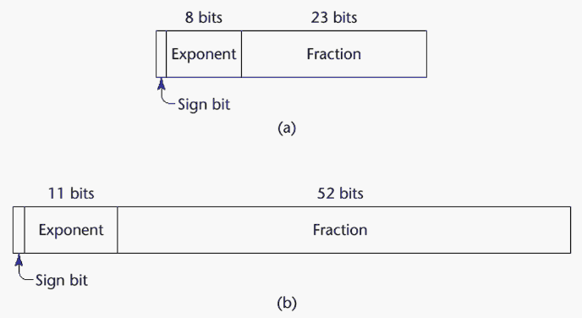
Primitive Data Types: Floating Point
Model real numbers
Languages for scientific use support at least two floating-point types (e.g., float and double; sometimes more
Usually exactly like the hardware, but not always
IEEE Floating-Point
Standard 754
Copyright © 2012 Addison-Wesley. All rights reserved.
1-<number>
Notes:
https://docs.oracle.com/javase/tutorial/java/nutsandbolts/datatypes.html#:~:text=double%3A%20The%20double%20data%20type,is%20generally%20the%20default%20choice.

Slide 7
Primitive Data Types: Complex
Some languages support a complex type, e.g., C99, Fortran, and Python
Each value consists of two floats, the real part and the imaginary part
Literal form (in Python):
(7 + 3j), where 7 is the real part and 3 is the imaginary part
Copyright © 2012 Addison-Wesley. All rights reserved.
1-<number>

Slide 8
Primitive Data Types: Decimal
For business applications (money)
  Essential to COBOL
  C# offers a decimal data type
Store a fixed number of decimal digits, in coded form (BCD)
Advantage: accuracy
Disadvantages: limited range, wastes memory
Copyright © 2012 Addison-Wesley. All rights reserved.
1-<number>

Slide 9
Primitive Data Types: Boolean
Simplest of all
Range of values: two elements, one for “true” and one for “false”
Could be implemented as bits, but often as bytes
  Advantage: readability
Copyright © 2012 Addison-Wesley. All rights reserved.
1-<number>

Slide 10
Primitive Data Types: Character
Stored as numeric codings
Most commonly used coding: ASCII
An alternative, 16-bit coding: Unicode (UCS-2)
  Includes characters from most natural languages
  Originally used in Java
  C# and JavaScript also support Unicode
32-bit Unicode (UCS-4)
  Supported by Fortran, starting with 2003
Copyright © 2012 Addison-Wesley. All rights reserved.
1-<number>

Slide 11
Character String Types
Values are sequences of characters
Design issues:
  Is it a primitive type or just a special kind of array?
  Should the length of strings be static or dynamic?
Copyright © 2012 Addison-Wesley. All rights reserved.
1-<number>

Slide 12
Character String Types Operations
Typical operations:
  Assignment and copying
  Comparison (=, >, etc.)
  Catenation
  Substring reference
Copyright © 2012 Addison-Wesley. All rights reserved.
1-<number>
Notes:
Substring:

Slide 13
Character String Type in Certain Languages
C and C++
  Not primitive
  Use char arrays and a library of functions that provide operations
SNOBOL4 (a string manipulation language)
  Primitive
  Many operations, including elaborate pattern matching
Fortran and Python
  Primitive type with assignment and several operations
Java
  Primitive via the String class
Perl, JavaScript, Ruby, and PHP
- Provide built-in pattern matching, using regular
expressions
Copyright © 2012 Addison-Wesley. All rights reserved.
1-<number>
Notes:
Regular Expression: metin içerisinde aranacak yazı ya da kodun bulunmasına yardımcı olur.

Slide 14
Character String Length Options
Static: COBOL, Java’s String class
Limited Dynamic Length: C and C++
  In these languages, a special character is used to indicate the end of a string’s characters, rather than maintaining the length
Dynamic (no maximum): SNOBOL4, Perl, JavaScript
Ada supports all three string length options
Copyright © 2012 Addison-Wesley. All rights reserved.
1-<number>

Slide 15
Character String Type Evaluation
Aid to writability
As a primitive type with static length, they are inexpensive to provide--why not have them?
Dynamic length is nice, but is it worth the expense?
Copyright © 2012 Addison-Wesley. All rights reserved.
1-<number>

Slide 16
Character String Implementation
Static length: compile-time descriptor
Limited dynamic length: may need a run-time descriptor for length (but not in C and C++)
Dynamic length: need run-time descriptor; allocation/deallocation is the biggest implementation problem
Copyright © 2012 Addison-Wesley. All rights reserved.
1-<number>

Slide 17
User-Defined Ordinal Types
An ordinal type is one in which the range of possible values can be easily associated with the set of positive integers
Examples of primitive ordinal types in Java
  integer
  char
  boolean
Copyright © 2012 Addison-Wesley. All rights reserved.
1-<number>

Slide 18
Enumeration Types
All possible values, which are named constants, are provided in the definition
C# example
  enum days {mon, tue, wed, thu, fri, sat, sun};
Copyright © 2012 Addison-Wesley. All rights reserved.
1-<number>

Slide 19
Evaluation of Enumerated Type
Aid to readability, e.g., no need to code a days as a number
Aid to reliability, e.g., compiler can check:
  operations (don’t allow colors to be added)
  No enumeration variable can be assigned a value outside its defined range
  Ada, C#, and Java 5.0 provide better support for enumeration than C++ because enumeration type variables in these languages are not coerced into integer types
Copyright © 2012 Addison-Wesley. All rights reserved.
1-<number>

Slide 20
Subrange Types
An ordered contiguous subsequence of an ordinal type
  Example: 12..18 is a subrange of integer type
Ada’s design
  type Days is (mon, tue, wed, thu, fri, sat, sun);
  subtype Weekdays is Days range mon..fri;
  subtype Index is Integer range 1..100;
  Day1: Days;
  Day2: Weekday;
  Day2 := Day1;
Copyright © 2012 Addison-Wesley. All rights reserved.
1-<number>

Slide 21
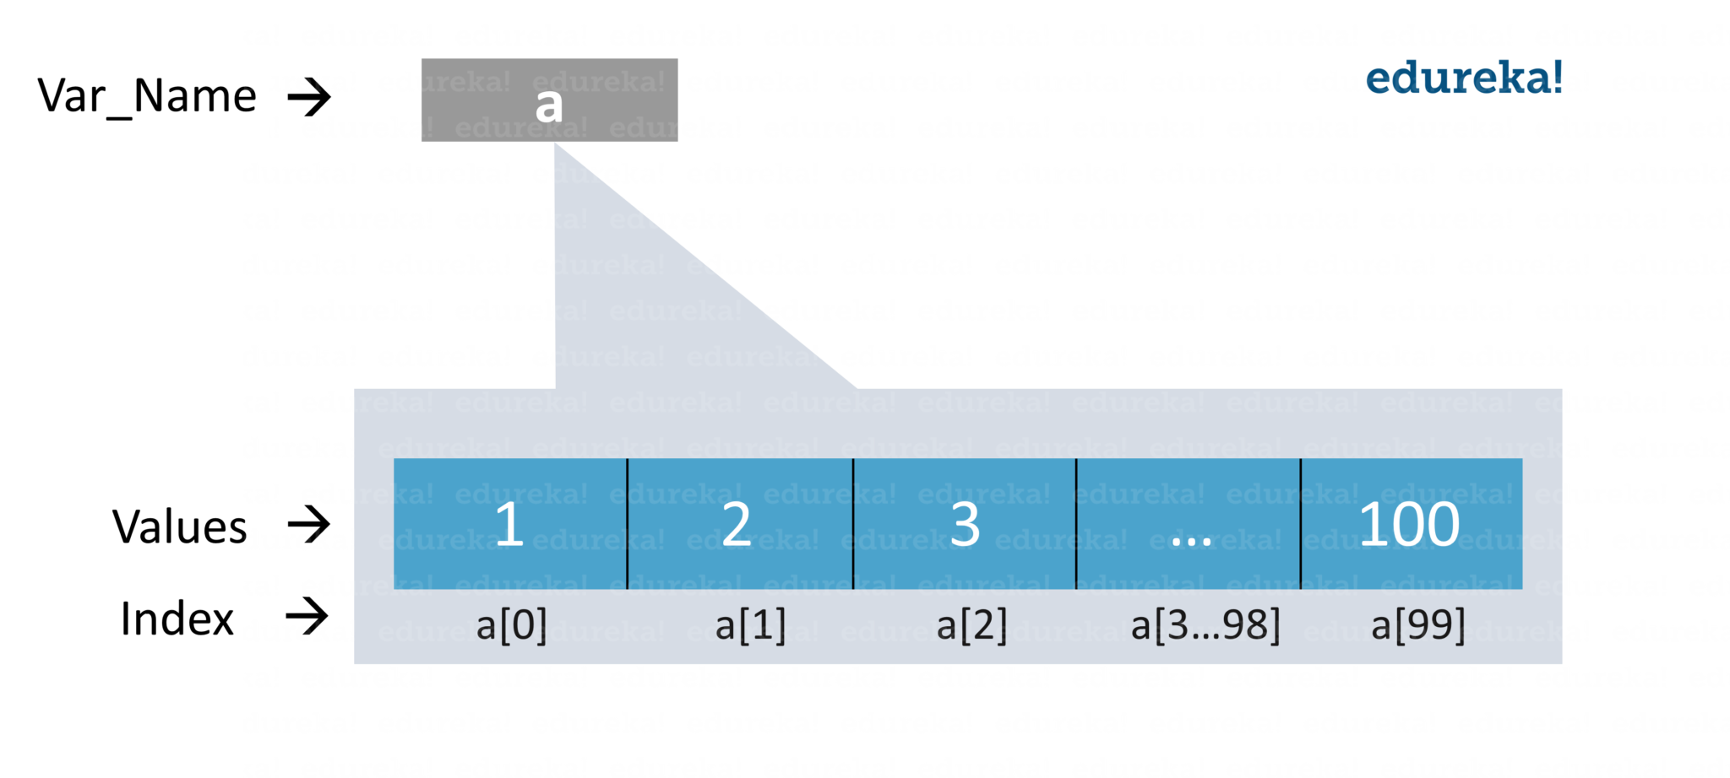
Array Types
An array is a homogeneous aggregate of data elements in which an individual element is identified by its position in the aggregate, relative to the first element.
Copyright © 2012 Addison-Wesley. All rights reserved.
1-<number>

Slide 22
Array Indexing
Indexing (or subscripting) is a mapping from indices to elements
array_name (index_value_list) → an element
Index Syntax
  Fortran and Ada use parentheses
    Ada explicitly uses parentheses to show uniformity between array references and function calls because both are mappings
  Most other languages use brackets
Copyright © 2012 Addison-Wesley. All rights reserved.
1-<number>

Slide 23
Arrays Index (Subscript) Types
FORTRAN, C: integer only
Java: integer types only
Index range checking
- C, C++, Perl, and Fortran do not specify
range checking
- Java, ML, C# specify range checking
Copyright © 2012 Addison-Wesley. All rights reserved.
1-<number>
Notes:
Arrayde kac elementi olacagini kontrol etmek icin bilmek gerekir. 10 acildiysa 10 oldugu bilinmeli

Slide 24
Subscript Binding and Array Categories
Static: subscript ranges are statically bound and storage allocation is static (before run-time)
  Advantage: efficiency (no dynamic allocation)
Fixed stack-dynamic: subscript ranges are statically bound, but the allocation is done at declaration time
  Advantage: space efficiency
Copyright © 2012 Addison-Wesley. All rights reserved.
1-<number>

Slide 25
Subscript Binding and Array Categories (continued)
Fixed heap-dynamic: similar to fixed stack-dynamic: storage binding is dynamic but fixed after allocation
-Advantage: flexibility (the size of an array need not be known until the array is to be used)
Heap-dynamic: binding of subscript ranges and storage allocation is dynamic and can change any number of times
  Advantage: flexibility (arrays can grow or shrink during program execution)
Copyright © 2012 Addison-Wesley. All rights reserved.
1-<number>

Slide 26
Subscript Binding and Array Categories (continued)
C and C++ arrays that include static modifier are static
C and C++ arrays without static modifier are fixed stack-dynamic
C and C++ provide fixed heap-dynamic arrays
C# includes a second array class ArrayList that provides fixed heap-dynamic
Perl, JavaScript, Python, and Ruby support heap-dynamic arrays
Copyright © 2012 Addison-Wesley. All rights reserved.
1-<number>

Slide 27
Array Initialization
Some language allow initialization at the time of storage allocation
  C, C++, Java, C# example
  int list [] = {4, 5, 7, 83}
  Character strings in C and C++
  char name [] = ″freddie″;
  Arrays of strings in C and C++
  char *names [] = {″Bob″, ″Jake″, ″Joe″];
  Java initialization of String objects
  String[] names = {″Bob″, ″Jake″, ″Joe″};
Copyright © 2012 Addison-Wesley. All rights reserved.
1-<number>

Slide 28
Heterogeneous Arrays
A heterogeneous array is one in which the elements need not be of the same type
Supported by Perl, Python, JavaScript, and Ruby
Copyright © 2012 Addison-Wesley. All rights reserved.
1-<number>

Slide 29
Array Initialization
C-based languages
  int list [] = {1, 3, 5, 7}
  char *names [] = {″Mike″, ″Fred″, ″Mary Lou″};
Python
  List comprehensions
  list = [x ** 2 for x in range(11) if x % 3 == 0]
  puts [0, 9, 36, 81] in list
Copyright © 2012 Addison-Wesley. All rights reserved.
1-<number>

Slide 30
Arrays Operations
APL provides the most powerful array processing operations for vectors and matrixes as well as unary operators (for example, to reverse column elements)
Ada allows array assignment but also catenation
Python’s array assignments, but they are only reference changes. Python also supports array catenation and element membership operations
Ruby also provides array catenation
Fortran provides elemental operations because they are between pairs of array elements
  For example, + operator between two arrays results in an array of the sums of the element pairs of the two arrays
Copyright © 2012 Addison-Wesley. All rights reserved.
1-<number>
Notes:
Array merge: https://www.w3schools.in/c-programming/examples/merge-two-arrays#google_vignette
https://www.javatpoint.com/how-to-merge-two-arrays-in-java
https://www.tutorialspoint.com/python-program-to-merge-two-arrays

Slide 31
Rectangular and Jagged Arrays
A rectangular array is a multi-dimensioned array in which all of the rows have the same number of elements and all columns have the same number of elements
A jagged matrix has rows with varying number of elements
  Possible when multi-dimensioned arrays actually appear as arrays of arrays
C, C++, and Java support jagged arrays
Fortran, Ada, and C# support rectangular arrays (C# also supports jagged arrays)
Copyright © 2012 Addison-Wesley. All rights reserved.
1-<number>
Notes:
https://www.javatpoint.com/jagged-array-in-java

Slide 32
Slices
A slice is some substructure of an array; nothing more than a referencing mechanism
Slices are only useful in languages that have array operations
Copyright © 2012 Addison-Wesley. All rights reserved.
1-<number>

Slide 33
Slice Examples ?
Python
  vector = [2, 4, 6, 8, 10, 12, 14, 16]
  mat = [[1, 2, 3], [4, 5, 6], [7, 8, 9]]
  vector (3:6) is a three-element array
  mat[0][0:2] is the first and second element of the first row of mat
Copyright © 2012 Addison-Wesley. All rights reserved.
1-<number>

Slide 34
Associative Arrays
An associative array is an unordered collection of data elements that are indexed by an equal number of values called keys
  User-defined keys must be stored
Built-in type in Perl, Python, Ruby, and Lua
Copyright © 2012 Addison-Wesley. All rights reserved.
1-<number>
Notes:
https://www.geeksforgeeks.org/associative-arrays-in-cpp/

Slide 35
Associative Arrays in Perl
Names begin with %; literals are delimited by parentheses
  %hi_temps = ("Mon" => 77, "Tue" => 79, "Wed" => 65, …);
Subscripting is done using braces and keys
  $hi_temps{"Wed"} = 83;
  Elements can be removed with delete
  delete $hi_temps{"Tue"};
Copyright © 2012 Addison-Wesley. All rights reserved.
1-<number>
Notes:
For access $ is used

Slide 36
Record Types
A record is a possibly heterogeneous aggregate of data elements in which the individual elements are identified by names
Copyright © 2012 Addison-Wesley. All rights reserved.
1-<number>

Slide 37
Definition of Records in COBOL
COBOL uses level numbers to show nested records; others use recursive definition
  01 EMP-REC.
  02 EMP-NAME.
  05 FIRST PIC X(20).
  05 MID PIC X(10).
  05 LAST PIC X(20).
  02 HOURLY-RATE PIC 99V99.
Copyright © 2012 Addison-Wesley. All rights reserved.
1-<number>

Slide 38
Tuple Types
A tuple is a data type that is similar to a record, except that the elements are not named
Used in Python, ML, and F# to allow functions to return multiple values
  Python
    Closely related to its lists, but immutable
    Create with a tuple literal
    myTuple = (3, 5.8, ′apple′)
    Referenced with subscripts (begin at 1)
    Catenation with + and deleted with del
Copyright © 2012 Addison-Wesley. All rights reserved.
1-<number>

Slide 39
Tuple Types (continued)
ML
val myTuple = (3, 5.8, ′apple′);
- Access as follows:
#1(myTuple) is the first element
F#
let tup = (3, 5, 7)
let a, b, c = tup This assigns a tuple to a tuple pattern (a, b, c)
Copyright © 2012 Addison-Wesley. All rights reserved.
1-<number>

Slide 40
List Types
Lists in LISP and Scheme are delimited by parentheses and use no commas
(A B C D) and (A (B C) D)
Data and code have the same form
As data, (A B C) is literally what it is
As code, (A B C) is the function A applied to the
parameters B and C
The interpreter needs to know which a list is, so if it is data, we quote it with an apostrophe
′(A B C) is data
Copyright © 2012 Addison-Wesley. All rights reserved.
1-<number>
Notes:
print[list[1][0]] -- >B

Slide 41
List Types (continued)
List Operations in Scheme
  CAR returns the first element of its list parameter
  (CAR ′(A B C)) returns A
  CDR returns the remainder of its list parameter after the first element has been removed
  (CDR ′(A B C)) returns (B C)
  - CONS puts its first parameter into its second parameter, a list, to make a new list
  (CONS ′A (B C)) returns (A B C)
  LIST returns a new list of its parameters
  (LIST ′A ′B ′(C D)) returns (A B (C D))
Copyright © 2012 Addison-Wesley. All rights reserved.
1-<number>

Slide 42
List Types (continued)
List Operations in ML
  Lists are written in brackets and the elements are separated by commas
  List elements must be of the same type
  The Scheme CONS function is a binary operator in ML, ::
  3 :: [5, 7, 9] evaluates to [3, 5, 7, 9]
Copyright © 2012 Addison-Wesley. All rights reserved.
1-<number>

Slide 43
List Types (continued)
Python Lists
  The list data type also serves as Python’s arrays
  Unlike Scheme, Common LISP, ML, and F#, Python’s lists are mutable
  Elements can be of any type
  Create a list with an assignment
  myList = [3, 5.8, "grape"]
Copyright © 2012 Addison-Wesley. All rights reserved.
1-<number>

Slide 44
List Types (continued)
Python Lists (continued)
  List elements are referenced with subscripting, with indices beginning at zero
  x = myList[1] Sets x to 5.8
  List elements can be deleted with del
  del myList[1]
  List Comprehensions – derived from set notation
  [x * x for x in range(6) if x % 3 == 0]
  range(6) creates [0, 1, 2, 3, 4, 5, 6]
  Constructed list: [0, 9, 36]
Copyright © 2012 Addison-Wesley. All rights reserved.
1-<number>

Slide 45
List Types (continued)
Haskell’s List Comprehensions
  The original
  [n * n | n <- [1..10]]
F#’s List Comprehensions
let myArray = [|for i in 1 .. 5 -> (i * i) |]
Both C# and Java supports lists through their generic heap-dynamic collection classes, List and ArrayList, respectively
Copyright © 2012 Addison-Wesley. All rights reserved.
1-<number>

Slide 46
Pointer and Reference Types
A pointer type variable has a range of values that consists of memory addresses and a special value
Provide the power of indirect addressing
Provide a way to manage dynamic memory
A pointer can be used to access a location in the area where storage is dynamically created (usually called a heap)
Copyright © 2012 Addison-Wesley. All rights reserved.
1-<number>

Slide 47
Design Issues of Pointers
What are the scope of and lifetime of a pointer variable?
What is the lifetime of a heap-dynamic variable?
Are pointers restricted as to the type of value to which they can point?
Are pointers used for dynamic storage management, indirect addressing, or both?
Should the language support pointer types, reference types, or both?
Copyright © 2012 Addison-Wesley. All rights reserved.
1-<number>
Notes:
Class obj = new class();
Obj=null; end the life C#
del var → python

Slide 48
Pointer Operations
Two fundamental operations: assignment and dereferencing
Assignment is used to set a pointer variable’s value to some useful address
Dereferencing yields the value stored at the location represented by the pointer’s value
  Dereferencing can be explicit or implicit
  C++ uses an explicit operation via *
  j = *ptr
  sets j to the value located at ptr
Copyright © 2012 Addison-Wesley. All rights reserved.
1-<number>

Slide 49
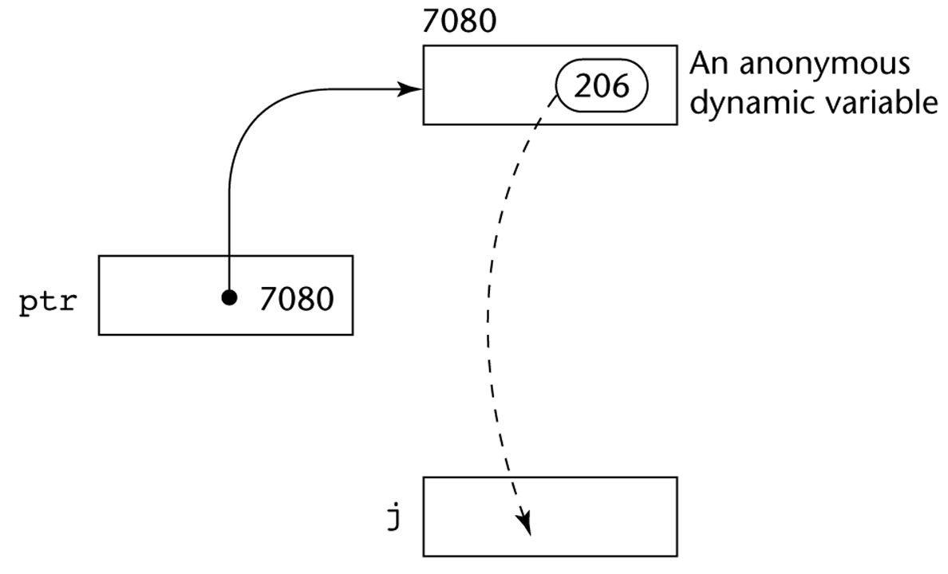
Pointer Assignment Illustrated
The assignment operation j = *ptr
Copyright © 2012 Addison-Wesley. All rights reserved.
1-<number>

Slide 50
Problems with Pointers
Dangling pointers (dangerous)
  A pointer points to a heap-dynamic variable that has been deallocated
Lost heap-dynamic variable
  An allocated heap-dynamic variable that is no longer accessible to the user program (often called garbage)
    Pointer p1 is set to point to a newly created heap-dynamic variable
    Pointer p1 is later set to point to another newly created heap-dynamic variable
    The process of losing heap-dynamic variables is called memory leakage
Copyright © 2012 Addison-Wesley. All rights reserved.
1-<number>
Notes:
A Memory Leak is a situation where there are objects present in the heap that are no longer used, but the garbage collector is unable to remove them from memory, and therefore, they're unnecessarily maintained. A memory leak is bad because it blocks memory resources and degrades system performance over time.

Slide 51
Pointers in C and C++
Extremely flexible but must be used with care
Pointers can point at any variable regardless of when or where it was allocated
Used for dynamic storage management and addressing
Pointer arithmetic is possible
Explicit dereferencing and address-of operators
Domain type need not be fixed (void *)
void * can point to any type and can be type
checked
Copyright © 2012 Addison-Wesley. All rights reserved.
1-<number>
Notes:
Adresleme 1000, 1004, 1008

Slide 52
Pointer Arithmetic in C and C++
float stuff[100];
float *p;
p = stuff;
*(p+5) is equivalent to stuff[5] and p[5]
*(p+i) is equivalent to stuff[i] and p[i]
Copyright © 2012 Addison-Wesley. All rights reserved.
1-<number>

Slide 53
Reference Types
C++ includes a special kind of pointer type called a reference type that is used primarily for formal parameters
  Advantages of both pass-by-reference and pass-by-value
Java extends C++’s reference variables and allows them to replace pointers entirely
  References are references to objects, rather than being addresses
C# includes both the references of Java and the pointers of C++
Copyright © 2012 Addison-Wesley. All rights reserved.
1-<number>
Notes:
https://www.geeksforgeeks.org/difference-between-call-by-value-and-call-by-reference/
https://www.javatpoint.com/call-by-value-and-call-by-reference-in-cpp-- OPT
https://www.javatpoint.com/reference-data-types-in-java -- OPT
In this function declaration, a and b are the formal parameters.
Actual parameters are the values that are passed to a function when it is called

Slide 54
Type Checking
Generalize the concept of operands and operators to include subprograms and assignments
Type checking is the activity of ensuring that the operands of an operator are of compatible types
A compatible type is one that is either legal for the operator, or is allowed under language rules to be implicitly converted, by compiler- generated code, to a legal type
  This automatic conversion is called a coercion.
A type error is the application of an operator to an operand of an inappropriate type
Copyright © 2012 Addison-Wesley. All rights reserved.
1-<number>
Notes:
https://www.geeksforgeeks.org/coercion-in-java/

Slide 55
Type Checking (continued)
If all type bindings are static, nearly all type checking can be static
If type bindings are dynamic, type checking must be dynamic
A programming language is strongly typed if type errors are always detected
Advantage of strong typing: allows the detection of the misuses of variables that result in type errors
Copyright © 2012 Addison-Wesley. All rights reserved.
1-<number>
Notes:
Tur hatalari her zaman tespit edilirse bir proglama dili guclu bir tur yonetimine sahiptir
Tur hatalariniyla sonuclanan degiskenlerin yanlis kullaniminin tespitine izin verir

Slide 56
Strong Typing
Language examples:
  C and C++ are not: parameter type checking can be avoided
  Ada is, almost (UNCHECKED CONVERSION is loophole)
  (Java and C# are similar to Ada)
Copyright © 2012 Addison-Wesley. All rights reserved.
1-<number>
Notes:
Unchecked conversion: acik tur cevirme nedeniyle

Slide 57
Name Type Equivalence
Name type equivalence means the two variables have equivalent types if they are in either the same declaration or in declarations that use the same type name
Easy to implement but highly restrictive:
  Formal parameters must be the same type as their corresponding actual parameters
Copyright © 2012 Addison-Wesley. All rights reserved.
1-<number>
Notes:
https://stackoverflow.com/questions/4486401/structural-equivalence-vs-name-equivalence
In this function declaration, a and b are the formal parameters.
Actual parameters are the values that are passed to a function when it is called

Slide 58
Structure Type Equivalence
Structure type equivalence means that two variables have equivalent types if their types have identical structures
More flexible, but harder to implement
Copyright © 2012 Addison-Wesley. All rights reserved.
1-<number>

Slide 59
Summary
The data types of a language are a large part of what determines that language’s style and usefulness
The primitive data types of most imperative languages include numeric, character, and Boolean types
The user-defined enumeration and subrange types are convenient and add to the readability and reliability of programs
Arrays and records are included in most languages
Pointers are used for addressing flexibility and to control dynamic storage management
Copyright © 2012 Addison-Wesley. All rights reserved.
1-<number>

