Slide 1
Subnational Food Price Prediction in East Africa
Integrating Climate, Conflict, and Socioeconomic Data at Admin2 Level
Kenya · Somalia | 2007–2025 | Monthly
Mar 11th

Slide 2
Data Sources
Category | Source | Variables | Resolution | Coverage
Target (Price) | WorldBank (From WFP) | Maize price, Sorghum price, Food Price Index | Admin2 mean | 2007–2026 KEN, SOM
Climate (Hydrology) | FLDAS (NASA - Famine Early Warning Systems Network (FEWS NET)) | Temperature, Soil Moisture, Precipitation, Evaporation (3-month Z-scores, 8 vars) | Admin2 (zonal mean) | 2007–2025
Vegetation | MODIS (Google Earth Engine) | NDVI(Normalized difference vegetation index) , LST (Land surface temperature), VHI(Vegetation index health) | Admin2 (zonal mean) | 2007–2025
Climate Indices | NOAA / BOM | NINO3.4(El nino/La nina), IOD, MEI, Western V Gradient | Global (broadcast) | 2007–2025
Conflict | ACLED | Event count, Fatalities | Point → Admin2 (spatial join) | 2007–2026
Population | WorldPop | Population density | 1km raster → Admin2 sum | 2020 snapshot
Cropland | ASAP (JRC) | Crop cover fraction | 250m raster → Admin2 mean | Static (2023)
*IOD - Indian Ocean Dipole is a climate pattern affecting the Indian Ocean.
*MEI - El Niño/Southern Oscillation (ENSO) index
*Western V gradient - a climate index measuring Pacific Ocean sea surface temperature (SST) differences, often linked to severe East African droughts

Slide 3
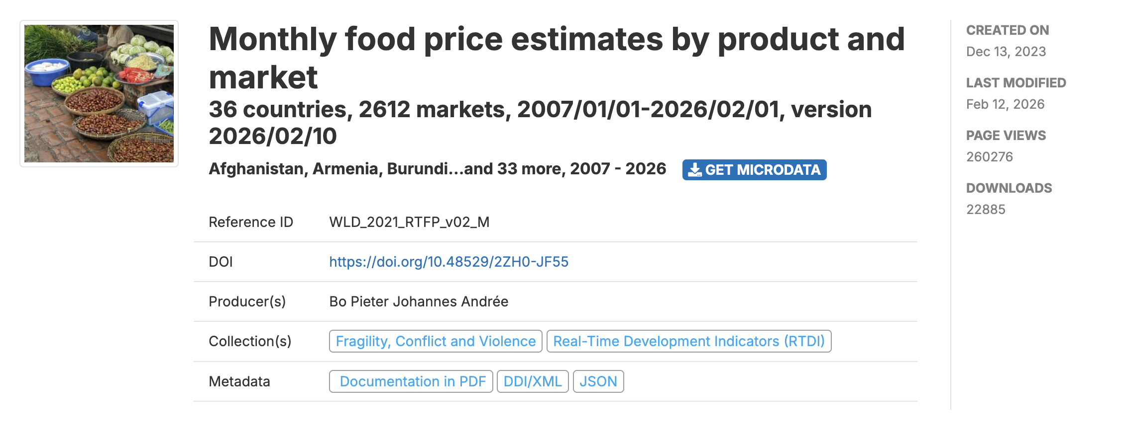
Data Sources (1) : Target data
Too much missing data in WFP price dataset
Needs an interpolation
No dataset on Ethiopia
Chain linear regression

Slide 4
Variable Design & Feature Engineering
Why these variables?
Feature groups (31 total at h=1)
FLDAS 3-month Z-scores: balance between noise (1m) and lag (6m)
Dropped redundant features to reduce multicollinearity:
RadT ↔ Tair (r=0.92), EVI ↔ NDVI (r=0.97)
SoilMoi00_40cm ≈ linear combo of 00_10 + 10_40
Total_Runoff ↔ Qs (r=0.93)
VHI kept as composite of VCI + TCI
Price / Autoregressive (15) — lag_1/2/3/6/12 + rolling mean/std + year-over-year change
FLDAS (8) — Temp, Soil Moisture (2 depths), Rainfall, Evap, Runoff (2), Water Balance
Vegetation (3) — NDVI, LST, VHI
Climate Indices (4) — NINO3.4, IOD, Western V, MEI
Conflict (2) — Event count, Fatalities
Key: All exogenous features (climate, conflict, vegetation) are lagged by forecast horizon h months → No data leakage: only information available at prediction time is used
Static (2) — Population, Crop cover fraction
Temporal (2) — sin/cos month encoding
Spatial ID (2) — Country, Admin2 (encoded)

Slide 5
Spatial Integration Strategy
All datasets unified to Admin2 level via GeoBoundaries polygons
Prices
→
Spatial join (point-in-polygon)
Merge order:
Per-country join to prevent cross-border misassignment
1. Skeleton: years × months × priced admins
2. ← Price aggregates (left join)
3. ← Population (left join on admin2)
4. ← Crop cover (left join on admin2)
5. ← ACLED conflict (left join on y/m/admin2)
6. ← FLDAS (left join on y/m/iso/admin2)
7. ← Vegetation (left join on y/m/iso/admin2)
8. ← Climate Indices (left join on y/m)
ACLED Conflict
→
Spatial join (point-in-polygon)
Centroid coordinates → Admin2 polygons
WorldPop
→
Zonal statistics (raster → polygon)
Sum population within Admin2 (all_touched=True)
Crop
→
Direct name match + fuzzy
GeoBoundaries names as canonical reference
FLDAS / Vegetation
→
Pre-aggregated to Admin2
Zonal mean from raster in preprocessing step
Climate Indices
→
Broadcast (global)
Same monthly value for all Admin2 regions

Slide 6
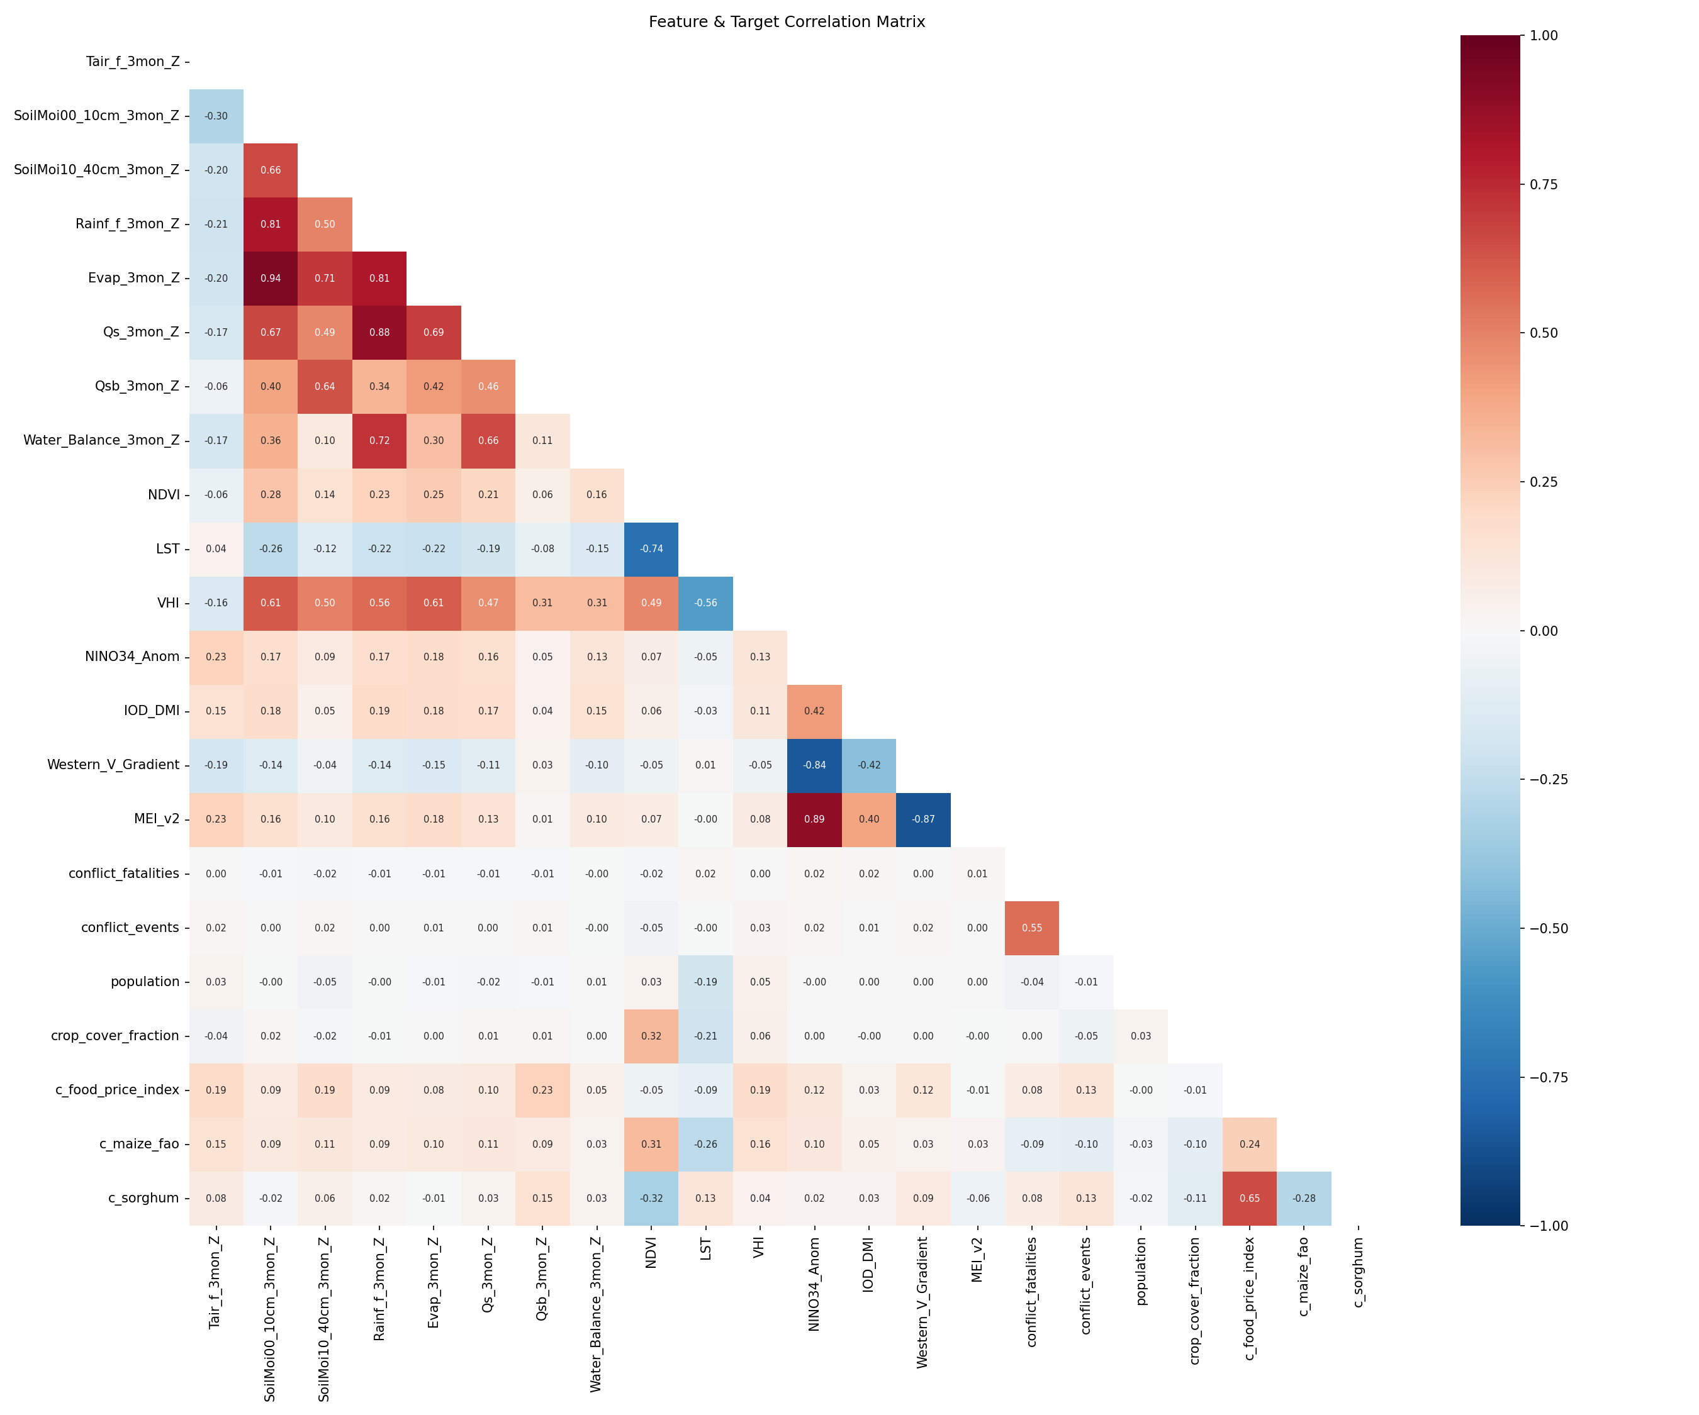
Final Merged Dataset
110
Admin2 regions (67 KEN + 43 SOM)
228
Months (2007-01 to 2025-12)
25,080
Total rows (110 × 228)
54
Columns (3 targets + 51 features)
0
Null values (100% complete)
Key design decisions:
298 Admin2 regions excluded — zero price observations (not WFP-monitored)
2026 rows dropped — future placeholder months with no feature data
Conflict NaN → 0 (no events = genuinely zero), Crop cover NaN → 0 (urban/desert)
All targets (food_price_index, maize, sorghum) have identical temporal coverage
Feature correlation matrix shows expected structure: • FLDAS soil moisture vars cluster together • NDVI inversely correlated with LST (r=-0.75) • Climate indices (NINO34, MEI) correlated (r=0.69) • Conflict weakly correlated with all other features

Slide 8
Model Design
XGBoost with Autoregressive Features
3 Targets: food_price_index, maize, sorghum
3 Horizons: h=1, h=2, h=3 months ahead
= 9 independent models
Temporal split: Train 2008–2023, Test 2024–2025
Early stopping on last 10% of train (≈2022–2023)
Leakage prevention
Price lags: only lag ≥ h available
h=1: lag_1,2,3,6,12
h=3: lag_3,6,12 only (lag_1,2 unknown)
Exogenous features: shifted by h months
e.g., h=3 uses NDVI, conflict from 3 months ago
Static features (population, cropland): always available
Raw 'year' excluded — tree models can't extrapolate trends
Autoregressive features dominate (~97%) — food prices are highly persistent. Exogenous features (climate, conflict) explain deviations from the trend — the signal that matters for early warning.

Slide 9
Performance: 3 Targets × 3 Horizons
Target | Horizon | R² | MAPE | KEN MAPE | SOM MAPE
Food Price Index | h = 1 | 0.946 | 2.3% | 2.4% | 2.2%
 | h = 2 | 0.900 | 3.3% | 3.7% | 2.7%
 | h = 3 | 0.849 | 4.3% | 5.1% | 3.0%
Maize | h = 1 | 0.988 | 4.2% | 3.2% | 5.7%
 | h = 2 | 0.977 | 6.1% | 4.7% | 8.4%
 | h = 3 | 0.969 | 7.3% | 5.8% | 9.7%
Sorghum | h = 1 | 0.965 | 5.6% | 3.1% | 9.5%
 | h = 2 | 0.937 | 8.2% | 5.0% | 13.2%
 | h = 3 | 0.918 | 10.8% | 7.9% | 15.3%
Food Price Index is easiest to predict (normalized, cross-country comparable).
Sorghum in Somalia is hardest (h=3: 15.3% MAPE) — high volatility, thinner markets.

Slide 10
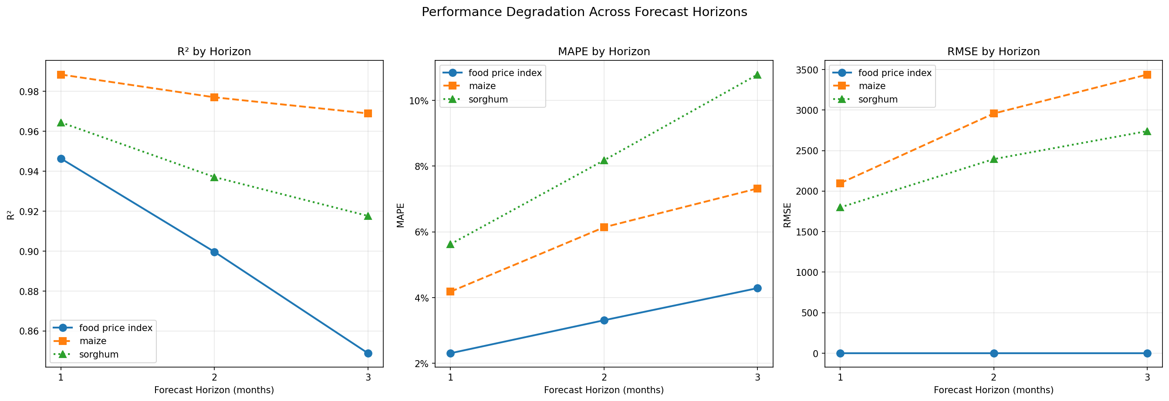
Performance Degradation Across Horizons

Slide 11
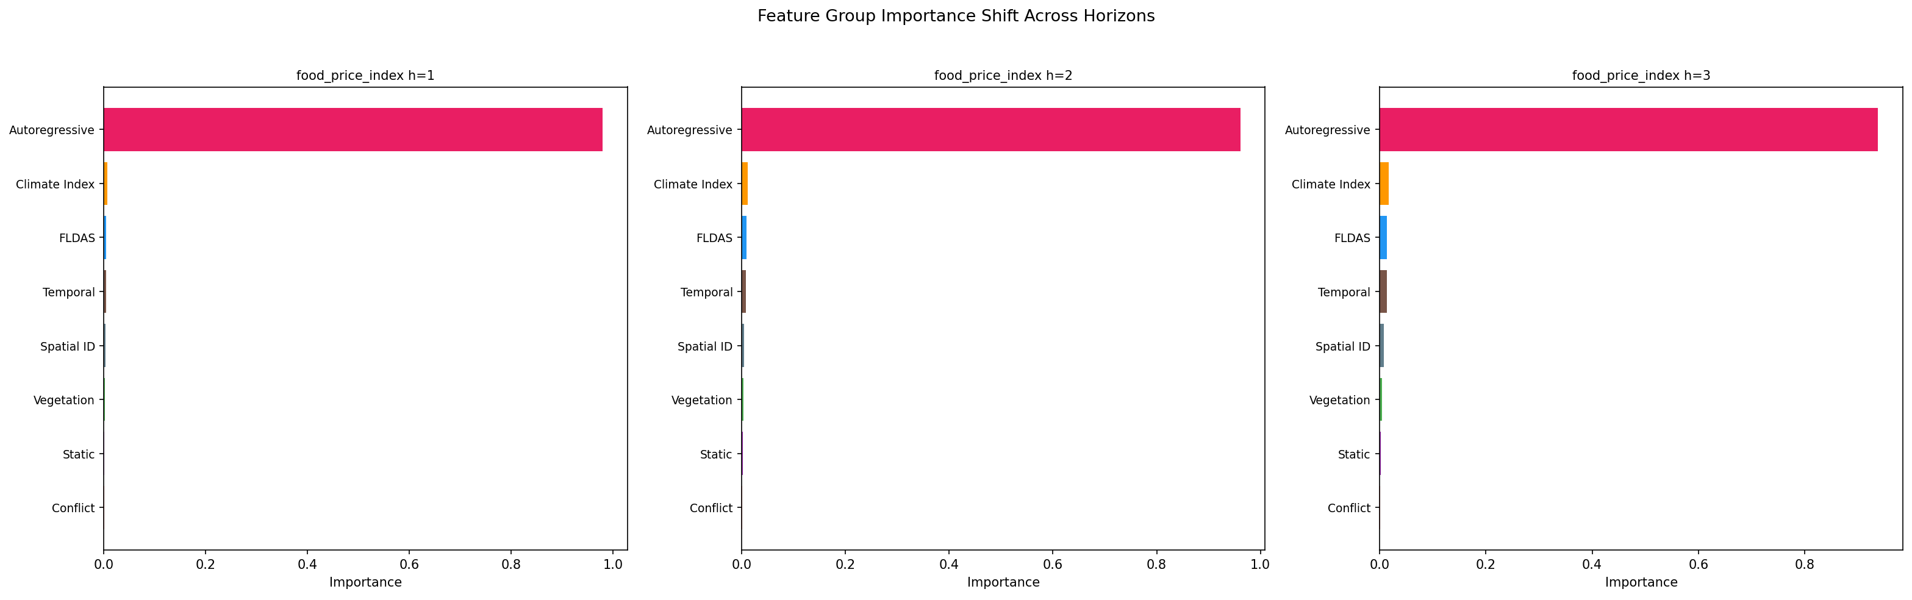
Feature Importance Shifts: h=1 → h=3
As forecast horizon grows, autoregressive importance drops (98% → 91%) and exogenous features gain weight. Climate indices and FLDAS roughly double their share. Maize h=3: country_iso jumps to 7% (KEN vs SOM price scale difference).

Slide 12
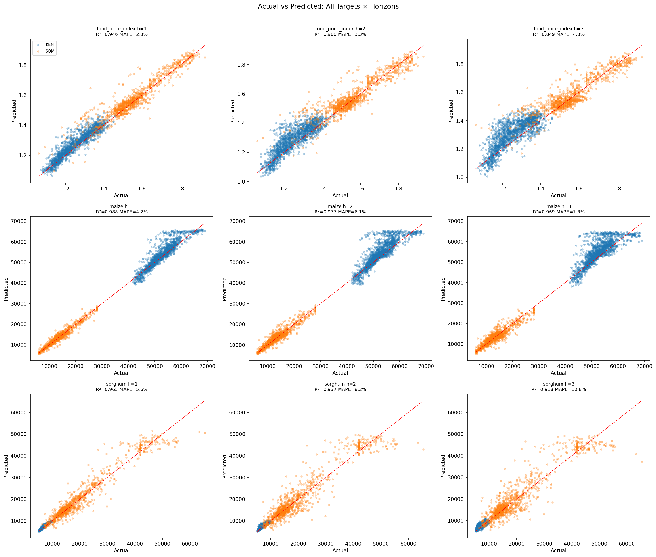
Actual vs Predicted

Slide 13
Actual vs Predicted

Slide 14
Actual vs Predicted

Slide 15
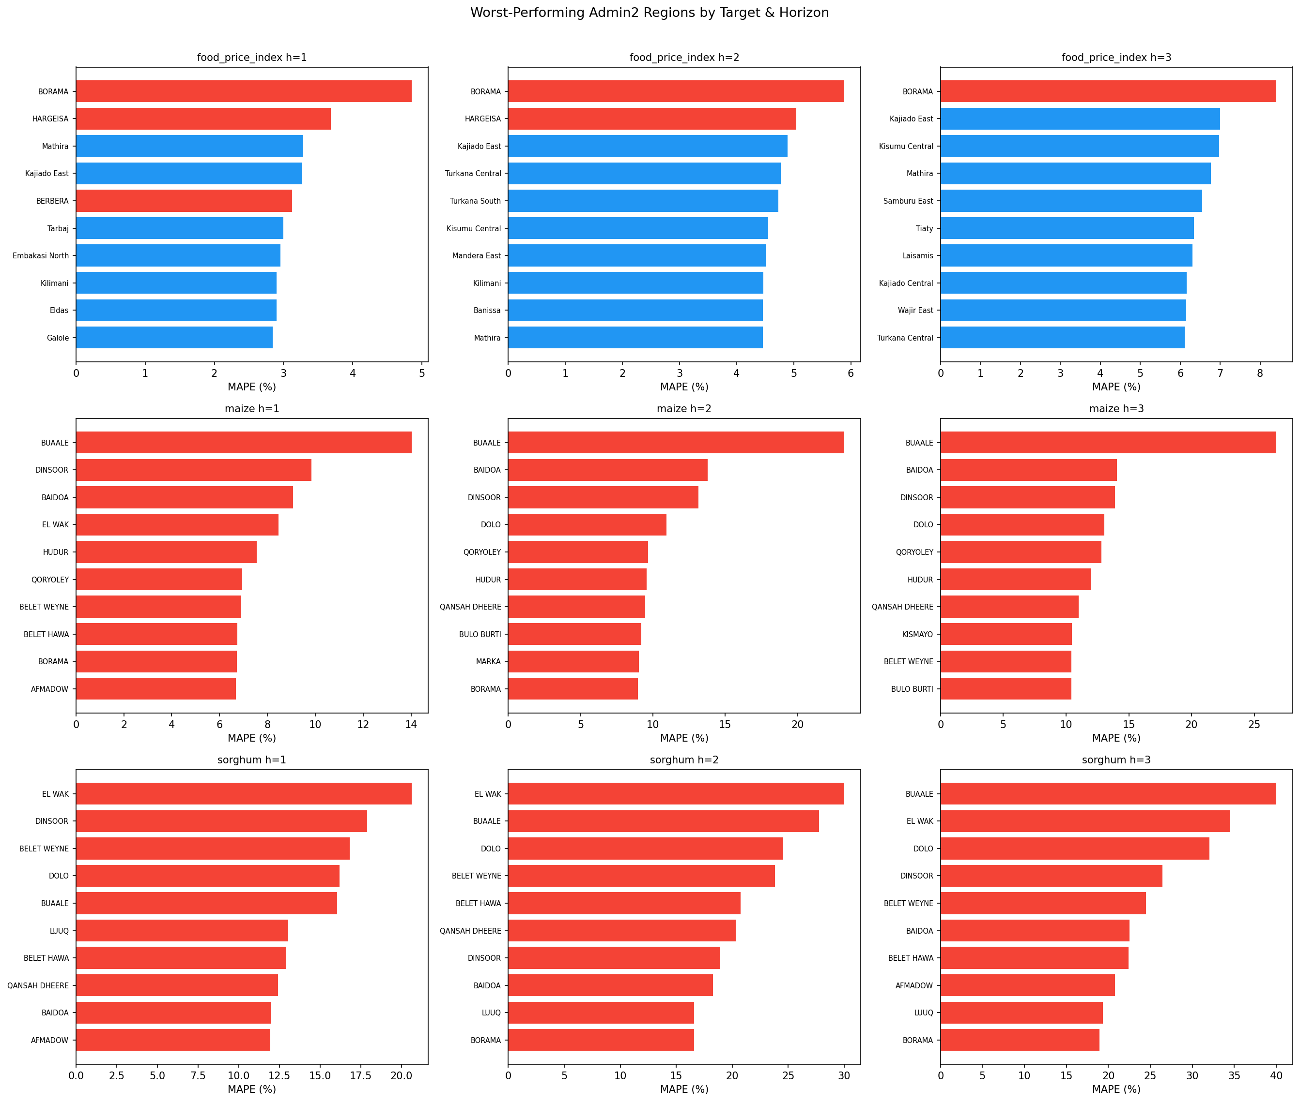
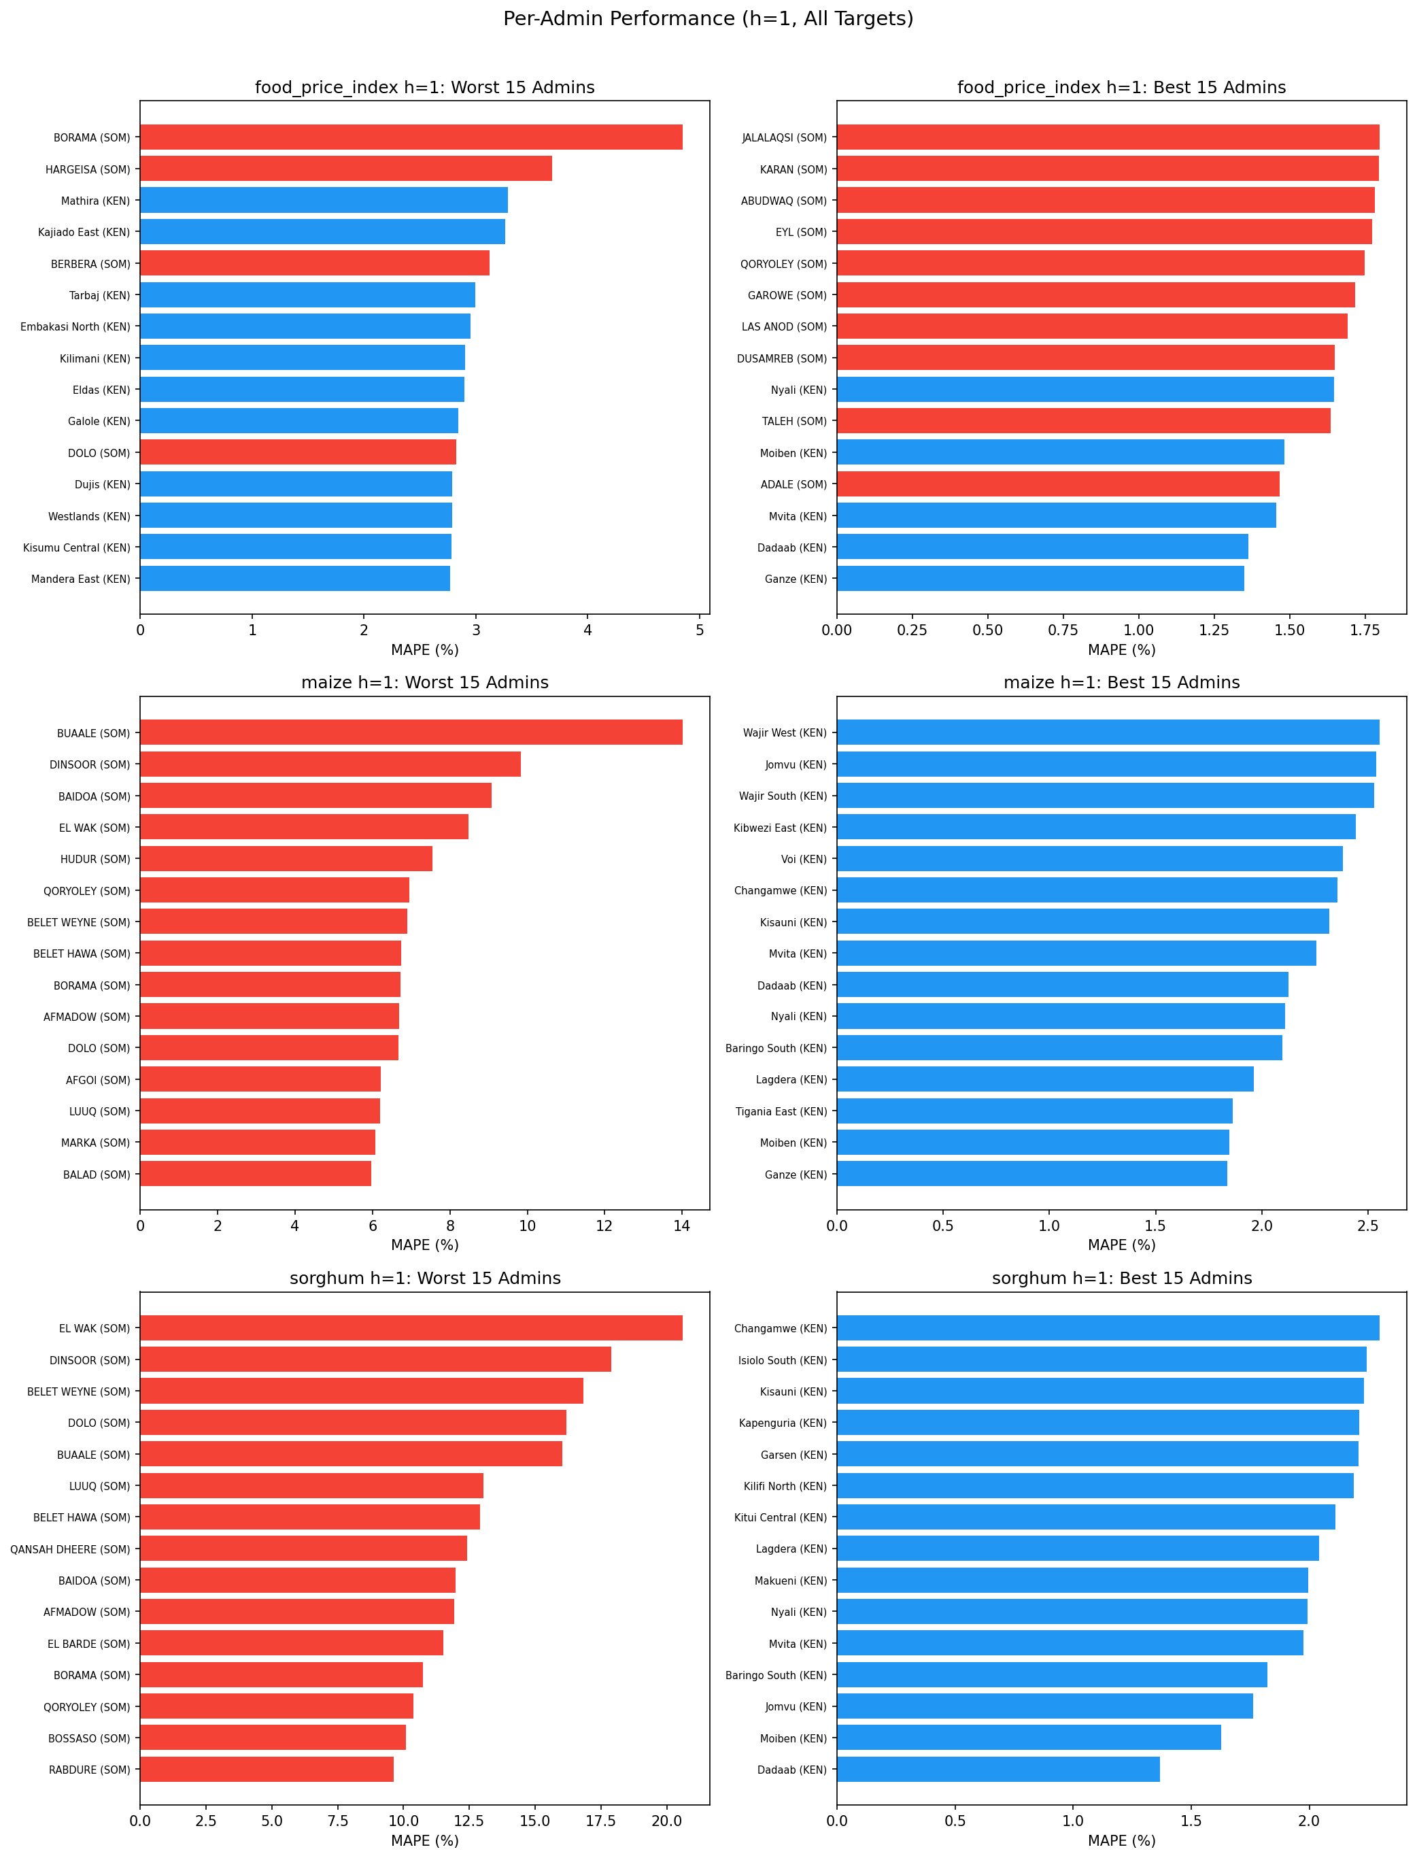
Where Does the Model Struggle?

Slide 16
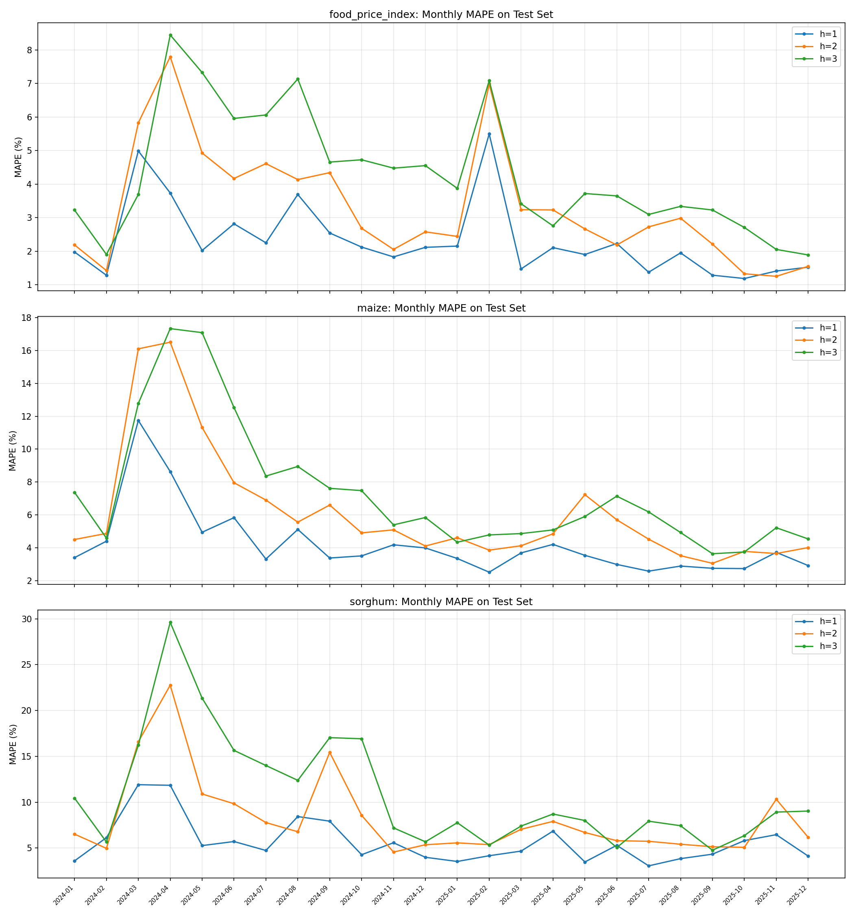
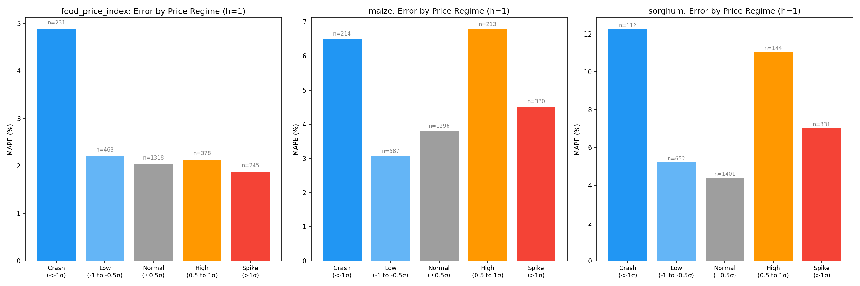
Temporal Error Patterns & Price Regime Analysis
Price crashes (<-1σ) and spikes (>+1σ) show higher MAPE — the model is better at predicting stable periods than extreme deviations.

Slide 17
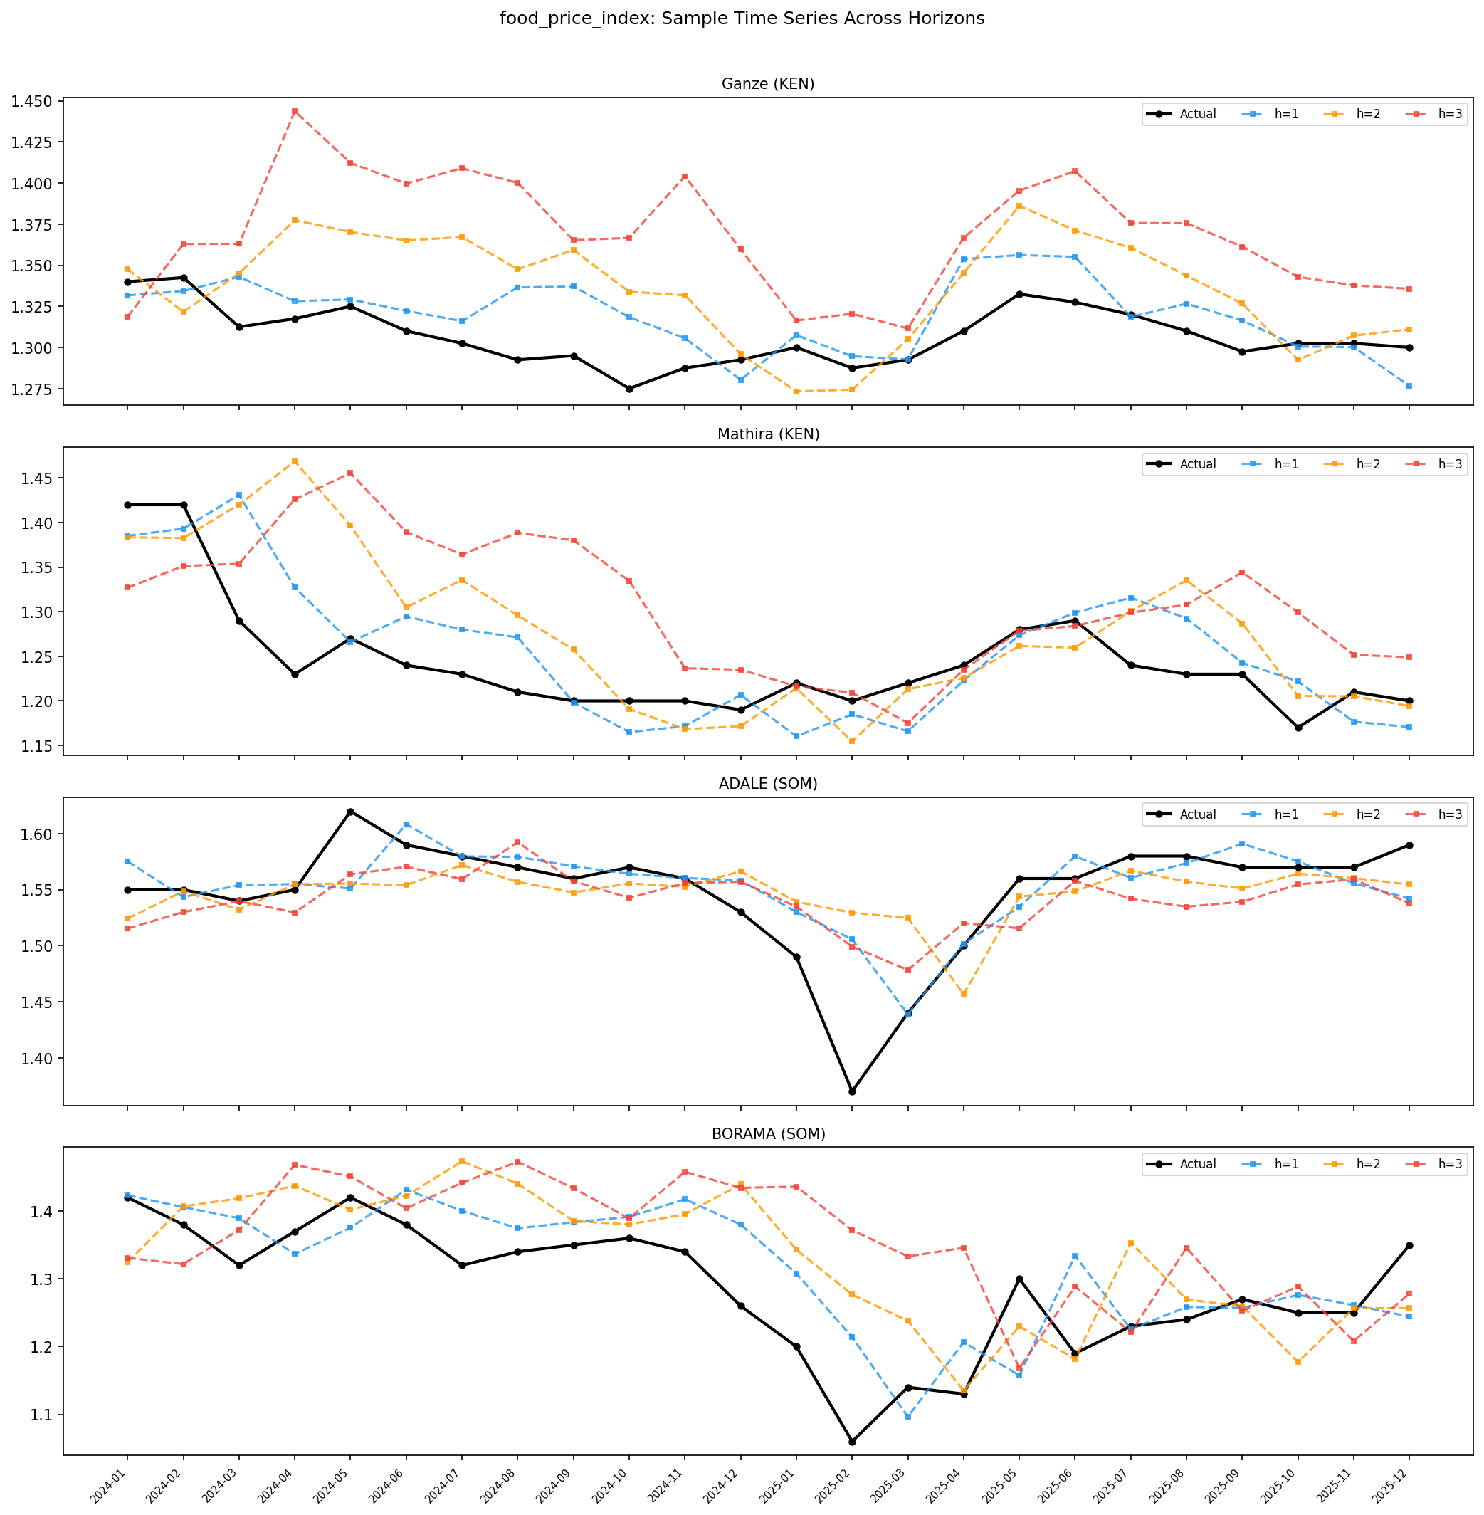
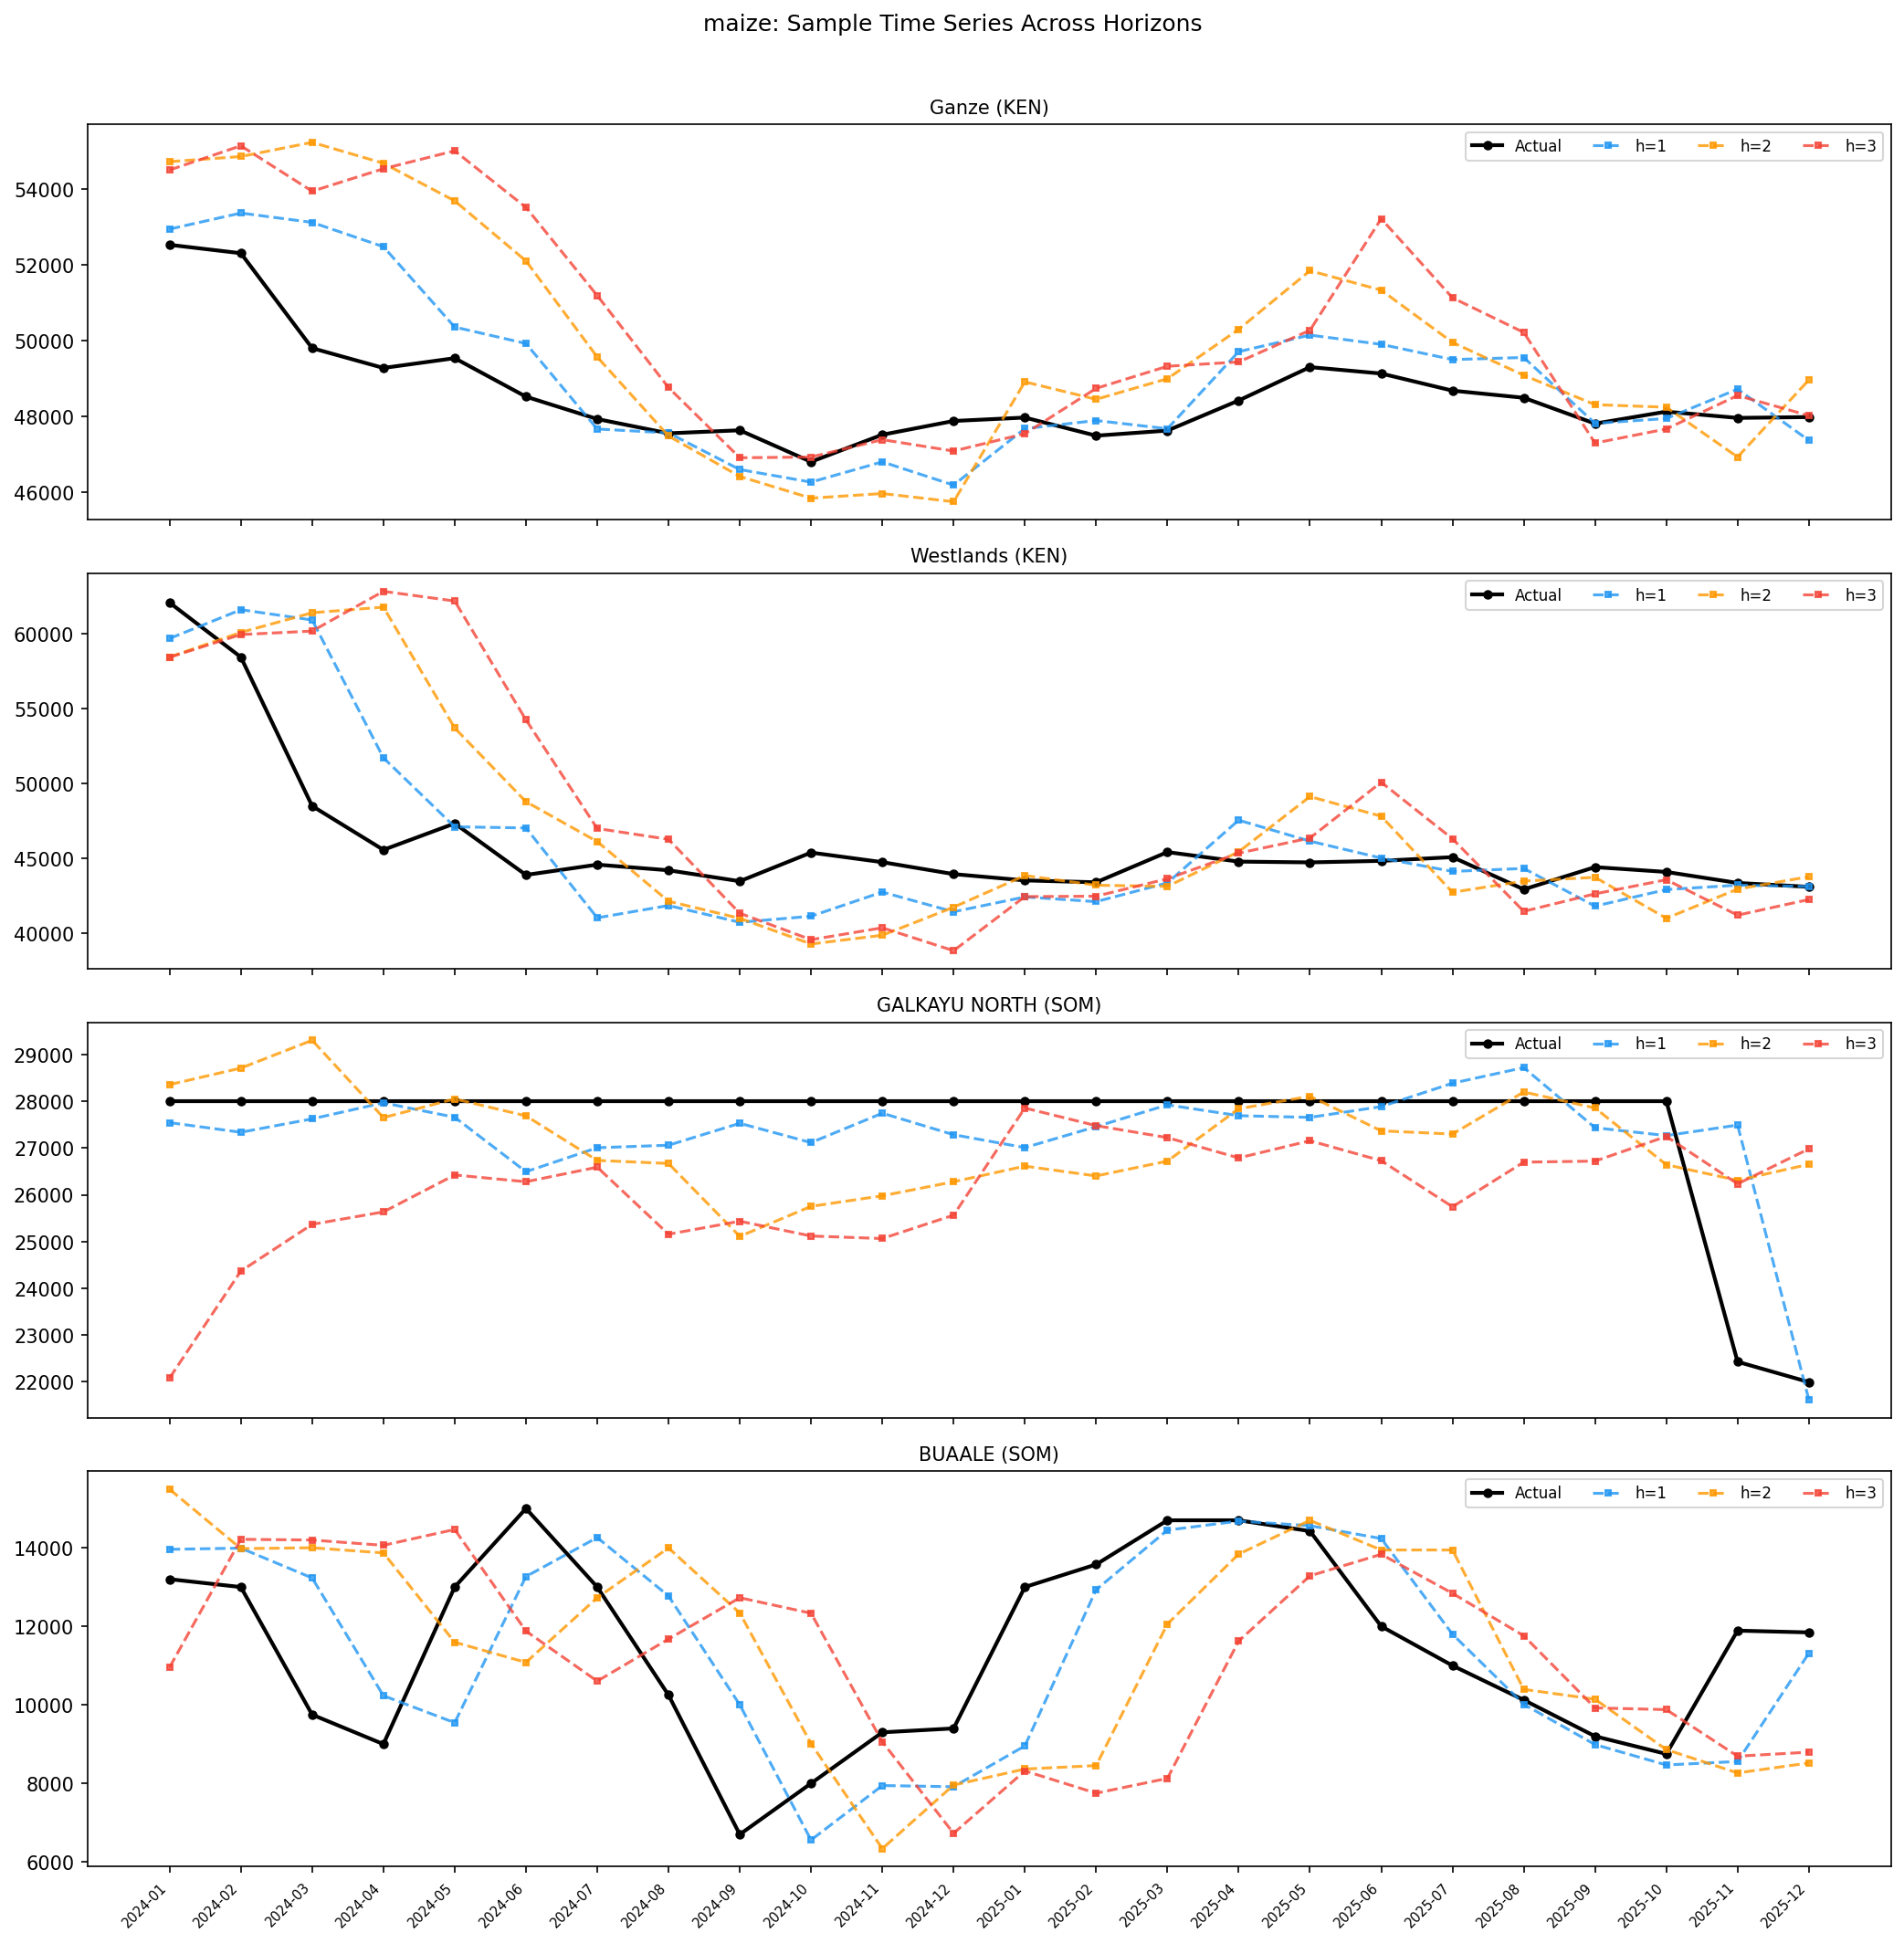
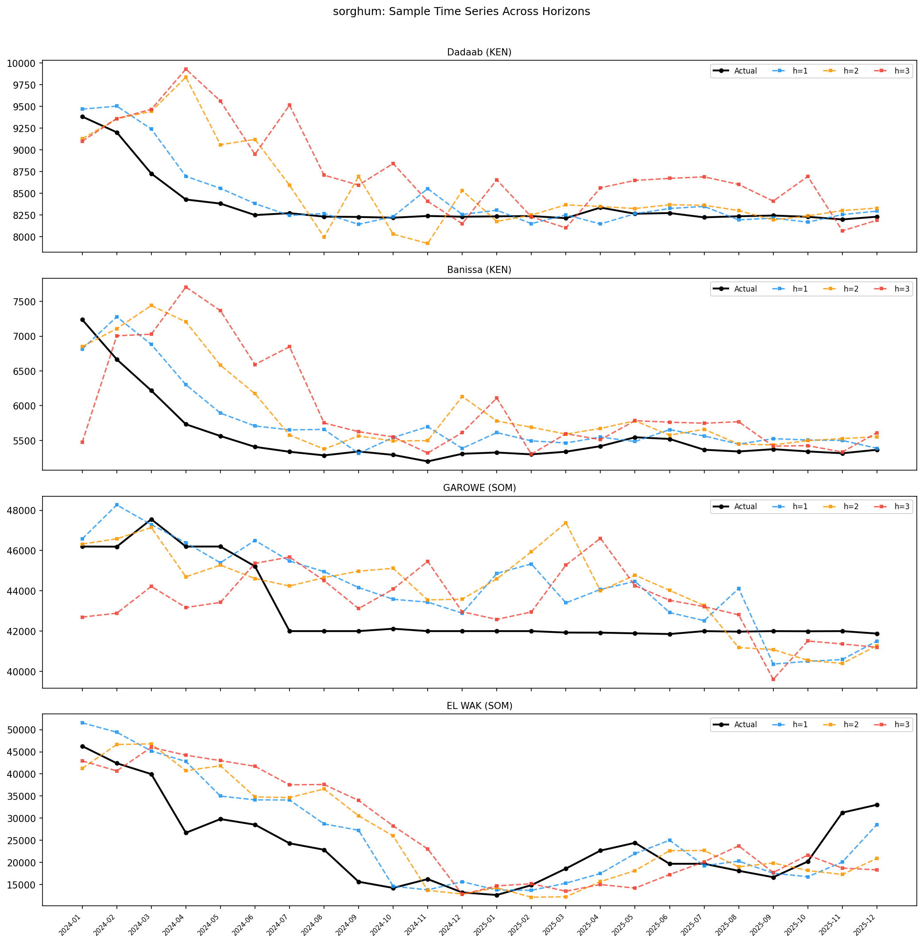
Sample Admin2 Time Series (Best & Worst)

Slide 18
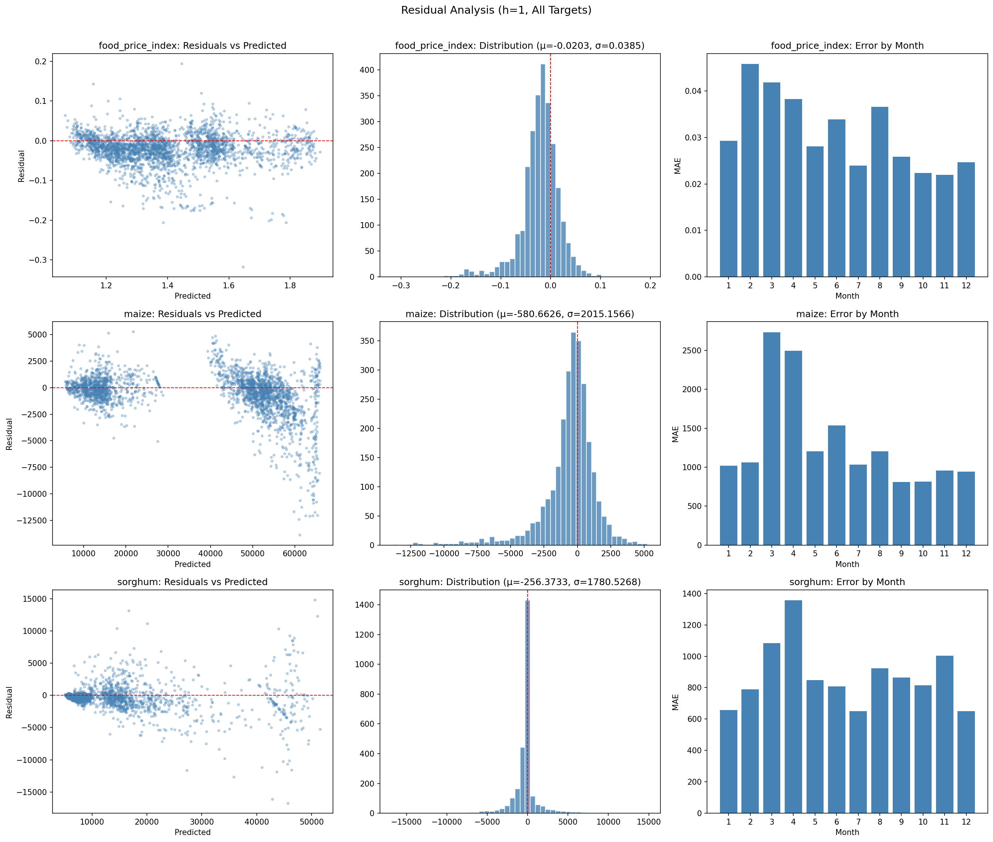
Residual Analysis (h=1)

Slide 19
Key Findings & Next Steps
Key Findings
Next Steps
Food prices are highly persistent — autoregressive
features dominate at ~97% importance (h=1)
Exogenous features gain importance at longer horizons
Climate indices + FLDAS double their share at h=3
Validates the climate → price transmission channel
Sorghum in Somalia is the hardest prediction task
h=3 MAPE: 15.3% (vs 5.1% for food_price_index KEN)
Higher volatility + thinner markets + conflict exposure
No data leakage — all features properly lagged by horizon
Leakage-free model performs as well as naïve version
Expand to Ethiopia (ETH)
Pipeline ready — needs Admin2 price data
Compare model architectures
LSTM / Transformer for temporal dependencies
LightGBM / CatBoost for tabular baseline
Expanding-window temporal CV
Test stability across crisis periods
(2011 Horn of Africa, 2020 COVID, 2022 Ukraine)
Early warning system prototype
Flag Admin2 regions with predicted price spike
Integrate FEWS NET IPC phase data

