Slide 1
Subnational Food Price Prediction in East Africa
Integrating Climate, Conflict, and Socioeconomic Data for Admin2-Level Forecasting
Kenya & Somalia | XGBoost (Gradient Boosting) | Spatio-Temporal Cross-Validation
Halim Jun · Donghee Lee · Sheldon Lu
Columbia University · Spring 2025

Slide 2
1
Problem Definition
Why predict food prices in East Africa?

Slide 3
Problem Definition
3 Targets
3 Horizons
2 Countries
Food Price Index Maize Sorghum
1 month ahead 2 months ahead 3 months ahead
Kenya Somalia Admin2 (district) level
Motivation
Key Challenges
East Africa: recurring droughts, conflict, economic shocks → food crises
Early warning systems require granular, forward-looking price forecasts
National-level data masks critical subnational (district-level) variation
Most studies ignore spatial autocorrelation (nearby regions influencing each other) leakage
8 heterogeneous data sources with different spatial/temporal resolutions
Spatial leakage: nearby districts have correlated prices
Temporal leakage: future data must never inform past predictions
Forecast accuracy naturally degrades at longer horizons (1→3 months)

Slide 4
2
Data Sources
8 heterogeneous datasets integrated

Slide 5
Data Sources
Category | Source | Provider | Key Variables | Resolution
Target (Food Prices) | WFP (World Food Programme) | UN WFP | Food Price Index, Maize, Sorghum | Market → District
Rainfall | CHIRPS (Satellite Rainfall) | UCSB | SPI (Drought Index) | 5km → District
Hydrology / Temperature | FLDAS (Land Surface Model) | NASA | Soil moisture, Air temp, Runoff, Evapotranspiration (8 vars) | District monthly
Vegetation Health | MODIS / AVHRR (Satellite Imagery) | NASA / NOAA | NDVI (Greenness), LST (Surface Temp), VHI (Vegetation Health) | District monthly
Global Climate | ENSO / IOD (Ocean-Atmosphere) | NOAA / IRI | El Nino Index, Indian Ocean Dipole, Multivariate ENSO Index | Global monthly
Conflict | ACLED (Conflict Event Data) | ACLED Project | Event count, Fatalities | Point → District
Agriculture | SPAM (Crop Presence Map) | CIMMYT | Crop cover fraction per district | 500m (static)
Population | WorldPop (Population Estimate) | WorldPop Hub | Population count per district | 1km (static)
All sources spatially aligned to district (Admin2) boundaries | Temporal coverage: 2007–2025

Slide 6
Data Collection Details
Automated Pipeline (Halim)
Additional Data (Donghee)
CHIRPS (satellite rainfall): Global monthly data from UCSB (~7GB)
FLDAS (land surface model): NASA soil moisture, temperature, runoff
ACLED (conflict events): Armed conflict database (API, 2019–2025)
WFP (food prices): Market price data via Humanitarian Data Exchange
WorldPop: Population density raster (1km resolution)
SPAM (crop presence): Crop coverage map (500m, CIMMYT)
FEWS NET IPC (food security severity classification)
NASA Black Marble (satellite night lights — economic proxy)
Dynamic World (Google Earth Engine land cover types)
World Bank Pink Sheet (global commodity price indices)
GeoBoundaries (official district boundary maps)
Climate Indices (El Nino, Indian Ocean Dipole from NOAA/IRI)
Note: World Bank macro indices & FEWS NET (food security) data processed but reserved for future expansion

Slide 7
3
Preprocessing & Merging
From raw data to a unified panel dataset

Slide 8
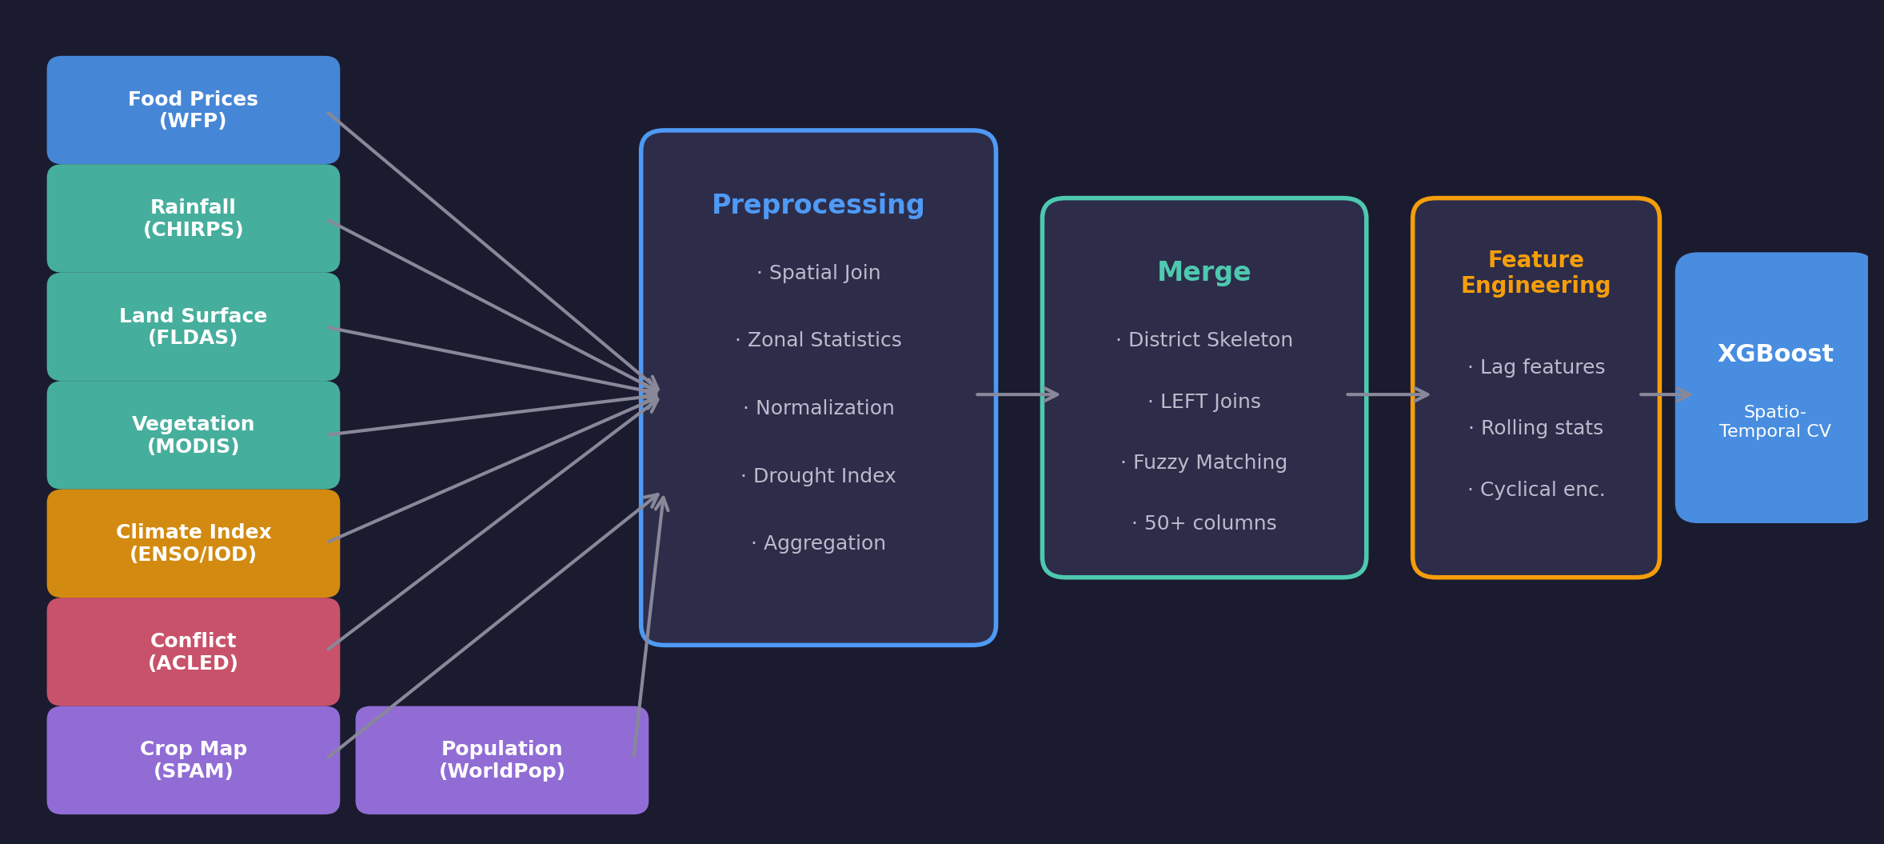
End-to-End Architecture

Slide 9
Preprocessing Pipeline
Food Prices (WFP) → District
Rainfall (CHIRPS) → Drought Index
Land Surface (FLDAS, 8 vars)
Spatial join: market lat/lon → district polygon
Mean price aggregation per district/month
Gamma distribution fit (30-yr calibration period)
Compute SPI (drought severity) per district
3-month moving average + Z-score normalization
Soil moisture, temperature, runoff, evaporation
Vegetation Health (MODIS/AVHRR)
Conflict Events (ACLED)
Static Features
NDVI (greenness), LST (surface temp), VHI (health)
District-level zonal mean aggregation
Point-in-polygon → district; sum fatalities + events
Missing months filled with 0 (no events recorded)
Crop map: 500m raster → crop fraction per district
Population: 1km raster → total count per district

Slide 10
Data Merging Strategy
1
2
3
4
5
Skeleton
→
Prices
→
Static
→
Conflict
→
Climate
Year × Month × District cartesian product
Food prices joined on (year, month, district)
Population + Crop cover joined on district
Conflict events on (year, month, district)
Land surface + Vegetation + Global climate indices
Spatial Reference
Name Matching
Final Output
GeoBoundaries district boundary maps (canonical)
Points-in-polygon for markets & conflict
Zonal statistics for raster (satellite) data
Per-country spatial join
Direct match on district name
Fuzzy matching (approximate string matching, ≥80%)
Manual override dictionary for known mismatches
e.g., 'Nairobi' city → 'Starehe' district
Unified Parquet dataset (columnar format)
~8,640 rows × 50+ columns
40 districts with price observations
Ready for feature engineering & modeling

Slide 11
4
Feature Engineering
Lag strategy and leakage prevention

Slide 12
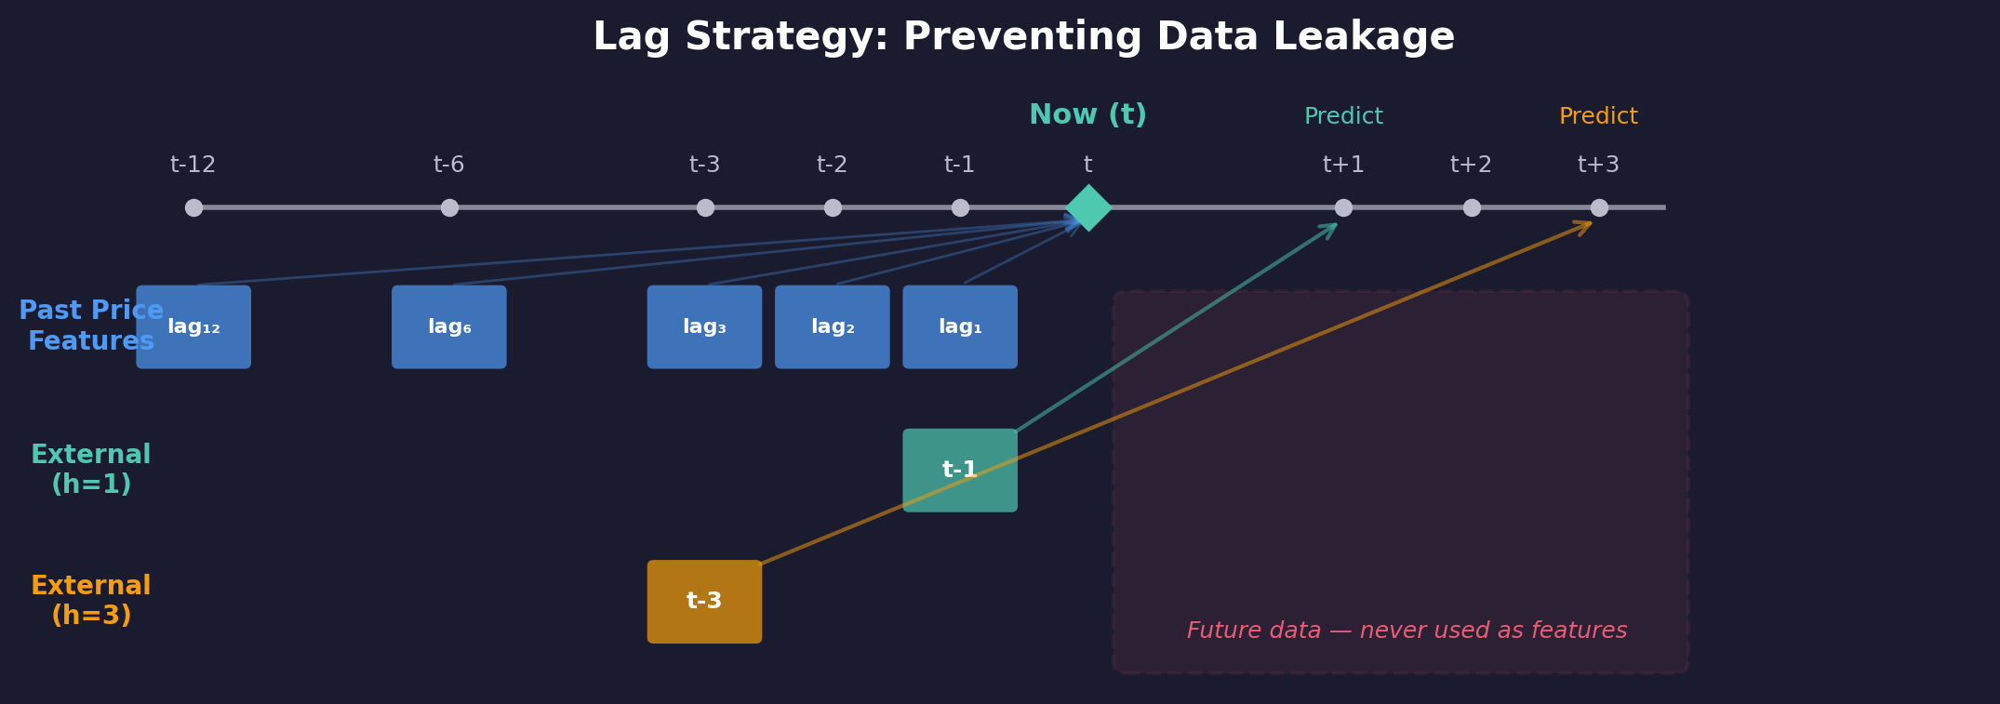
Lag Strategy & Feature Engineering
Past Price Features
External Feature Shift
Seasonal Encoding
Warmup Period
1,2,3,6,12 month lags + rolling averages + year-over-year
Climate/conflict features shifted by forecast horizon (prevents leakage)
Cyclical month encoding (sine/cosine transformation)
Drop first 12 months per district to build sufficient history

Slide 13
5
Modeling & Evaluation
XGBoost (Gradient Boosting) with Spatio-Temporal Cross-Validation

Slide 14
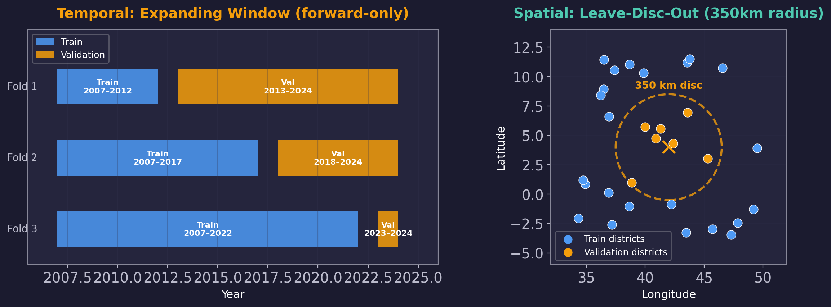
Spatio-Temporal Cross-Validation Design
XGBoost (Gradient Boosting)
n_estimators = 500
learning_rate = 0.05
max_depth = 6
min_child_weight = 5
subsample = 0.8
colsample_bytree = 0.8
reg_alpha = 0.1 (L1)
reg_lambda = 1.0 (L2)
early_stopping = 30 rounds
Combined Cross-Validation
5 spatial × 3 temporal = 15 folds per target × horizon → 135 total model fits (3 targets × 3 horizons × 15 folds)

Slide 15
6
Results
Model performance across targets and horizons

Slide 16
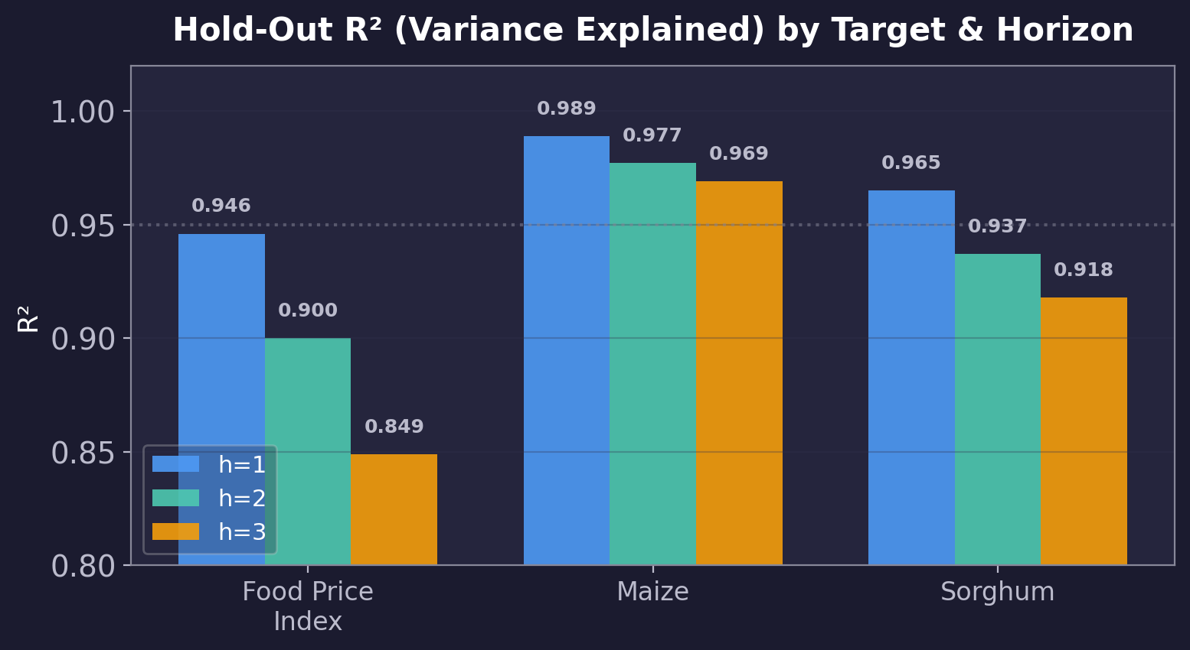
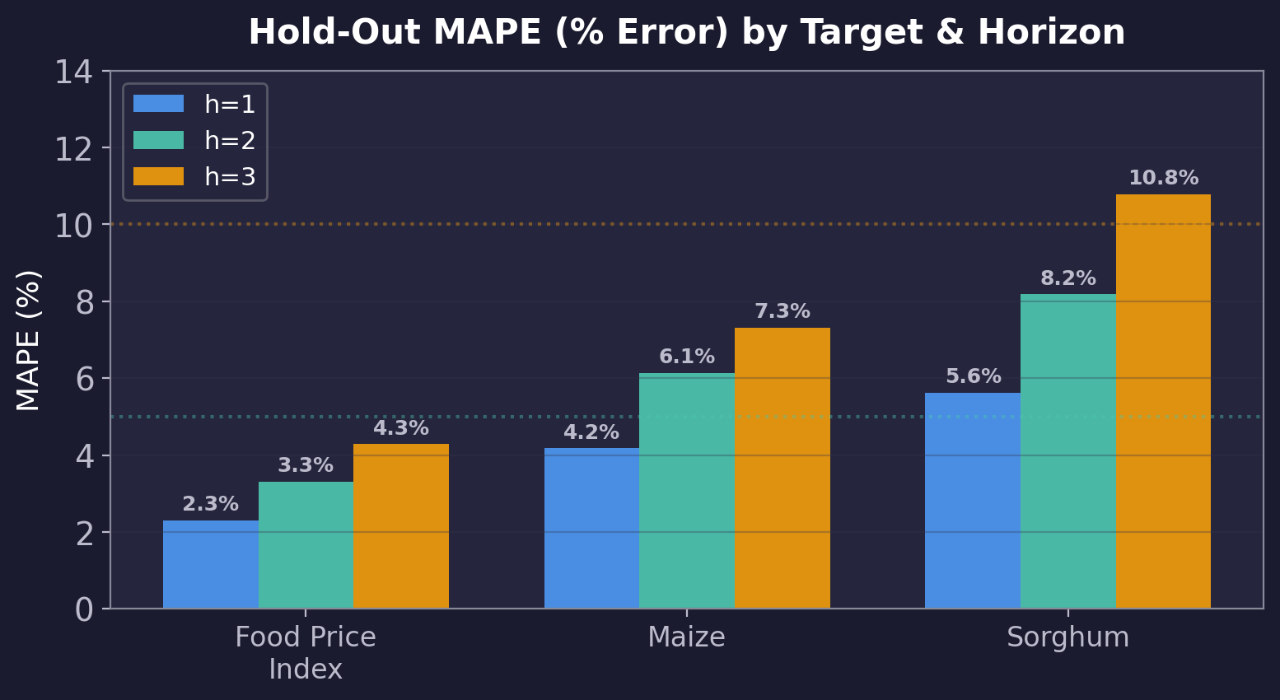
Hold-Out Test Results (2024+)
Train on all data before 2024, test on 2024+ — simulates real-world deployment

Slide 17
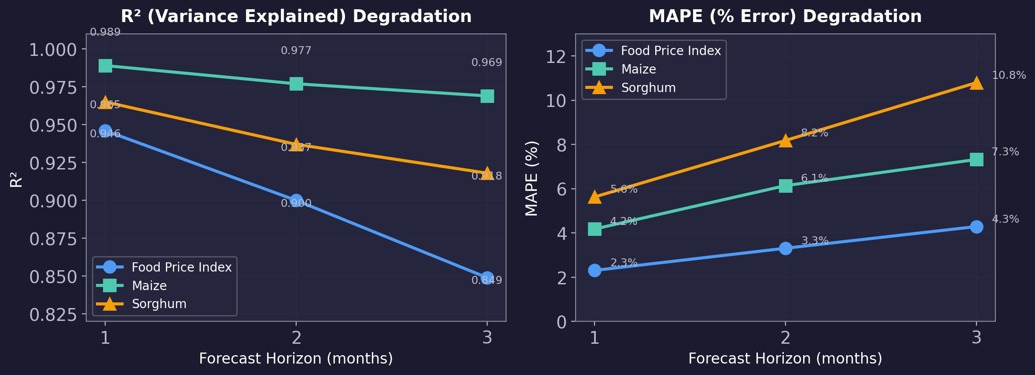
Horizon Degradation Analysis
Accuracy naturally degrades at longer forecast horizons | Food Price Index most stable | Sorghum most volatile

Slide 18
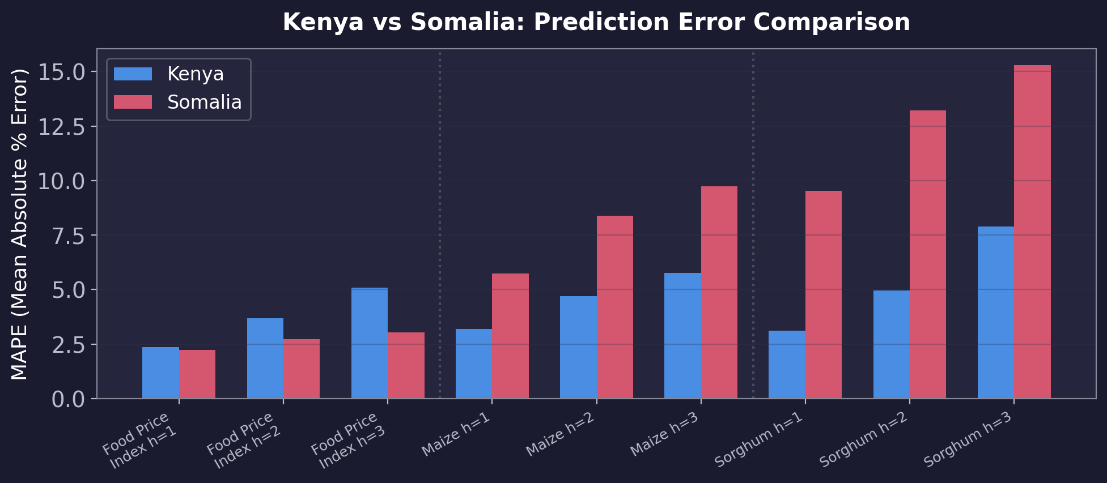
Kenya vs Somalia Performance
Kenya consistently more accurate than Somalia — likely due to higher data density, lower conflict, more stable markets

Slide 19
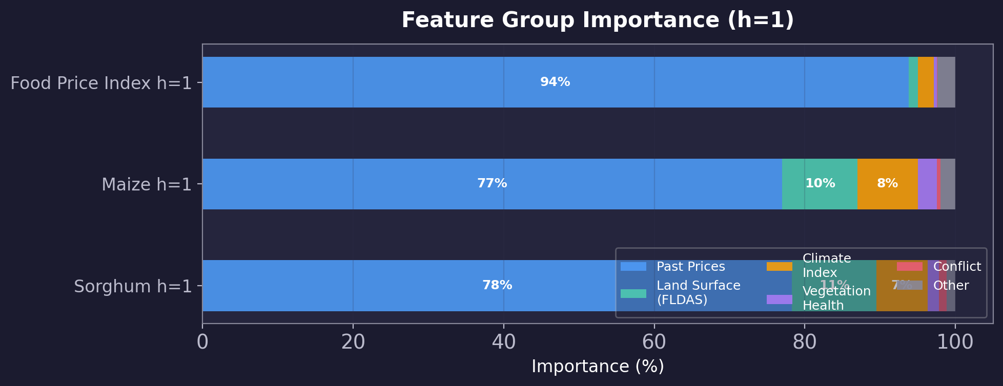
Feature Group Importance
Past price history dominates (77–94%) | Land surface & climate contribute 10–20% for commodity prices At longer horizons, external features (climate, conflict) gain relative importance

Slide 20
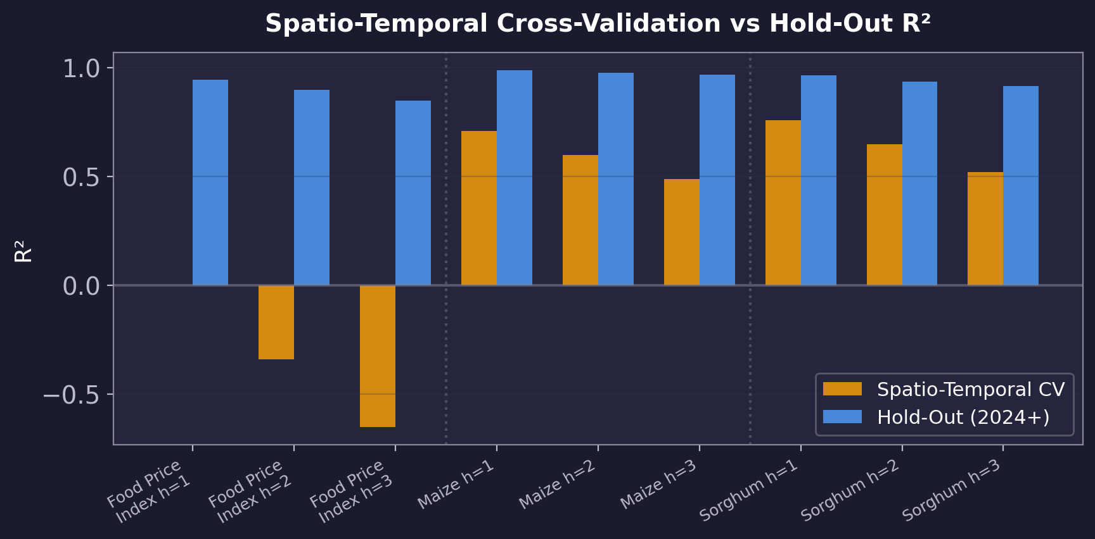
Spatio-Temporal CV vs Hold-Out Comparison
Spatio-Temporal CV is intentionally conservative (held-out districts were never seen during training) Hold-out reflects realistic deployment: train on all districts, predict future time periods

Slide 21
Detailed Spatio-Temporal CV Results
15 folds (5 spatial × 3 temporal) per target × horizon | 2025 excluded from CV
Target | Horizon | R² (Variance Explained) | MAPE (% Error) | RMSE (Prediction Error)
Food Price Index | h=1 | 0.00 ± 0.92 | 9.68% ± 6.57% | 0.189 ± 0.137
Food Price Index | h=2 | -0.34 ± 1.17 | 11.75% ± 7.29% | 0.219 ± 0.147
Food Price Index | h=3 | -0.65 ± 1.22 | 13.43% ± 7.38% | 0.243 ± 0.147
Maize | h=1 | 0.71 ± 0.34 | 7.99% ± 2.01% | 4,300 ± 2,859
Maize | h=2 | 0.60 ± 0.42 | 10.93% ± 2.13% | 5,133 ± 2,962
Maize | h=3 | 0.49 ± 0.47 | 13.33% ± 2.40% | 5,706 ± 2,938
Sorghum | h=1 | 0.76 ± 0.29 | 9.28% ± 5.60% | 3,469 ± 3,914
Sorghum | h=2 | 0.65 ± 0.33 | 13.26% ± 6.44% | 4,094 ± 4,194
Sorghum | h=3 | 0.52 ± 0.34 | 16.74% ± 6.77% | 4,673 ± 4,377

Slide 22
Key Takeaways
Multi-Source Integration
8 heterogeneous sources (climate, conflict, satellite, economic) → unified district-level panel for Kenya & Somalia
Rigorous Evaluation
Spatio-Temporal Cross-Validation (350km spatial separation × expanding time window, 2025 excluded) prevents data leakage
Strong Predictive Performance
Hold-out R² (variance explained) > 0.91 for all targets; Maize at 1-month achieves R² = 0.989
Country-Level Insights
Kenya predictions more accurate than Somalia — likely due to data availability, lower conflict, more stable markets
Forecast Horizon Trade-off
1-month forecast most reliable; 3-month forecast error (MAPE) increases by 5–10 percentage points

Slide 23
Thank You
Questions?
Halim Jun · Donghee Lee · Sheldon Lu
Columbia University · Spring 2025

