Slide 1
Subnational Food Price Prediction in East Africa
Integrating Climate, Conflict, and Socioeconomic Data for Admin2-Level Forecasting
Kenya & Somalia | XGBoost (Gradient Boosting) | Spatio-Temporal Cross-Validation

Slide 2
Project Overview
Dataset
Target
Model
8 data sources merged at Admin2 level
Format: Data type — Source
Climate (SPI) — CHIRPS
Soil moisture / temp — FLDAS
Vegetation (NDVI) — MODIS
Conflict events — ACLED
Food prices — WFP / World Bank
Food security (IPC) — FEWS NET
Night lights — NASA Black Marble
Crop fraction — Dynamic World
Admin2-level price prediction
at 1, 2, 3 month horizons
3 Target Variables:
Food Price Index
Maize (FAO)
Sorghum
Countries:
Kenya & Somalia
XGBoost (Gradient Boosting)
Evaluation:
Spatio-Temporal CV
(Leave-Disc-Out spatial folds
+ Expanding-window temporal)
Holdout evaluation (2024+)
Dashboard:
Next.js + FastAPI

Slide 3
Model & Performance
Improve the model performance with
Spatio/temporal cross validation
Performance
Spatio-Temporal CV Results
(metrics placeholder — add your
actual R², MAPE, RMSE here)
Holdout Evaluation (2024+)
(metrics placeholder — add your
actual results here)
Per-Country Breakdown
Kenya: (add metrics)
Somalia: (add metrics)
Spatial: Leave-Disc-Out (5 folds, 350km radius)
Temporal: Expanding window (3 folds)
Leakage Prevention
Price features: lag 1,2,3,6,12 months
+ rolling means/stds + YoY change
Exogenous features: ALL lagged by h months
(conflict, FLDAS, vegetation, climate)
12-month warmup: drops first 12 rows
per admin2 to build lag features

Slide 4
Challenges & Solutions
1
Data Unavailability
2
Feature Quality & Timeliness
Challenge
WFP price data is sparse and mixes
wholesale & retail prices
Solution
Utilized World Bank processed dataset
that applied chained linear regression
to impute missing subnational prices
(Andrée 2021, WB Working Paper 9886)
Challenge
Many datasets are not raw data but
already processed / modeled outputs -> Need to understand the dataset’s accuracy
Ex) Crop production, land cover type data
Solution
Thoroughly examined each source's
accuracy, methodology, and update cycle
(data available only up to
1 year ago is not useful for forecasting)

Slide 5
Future: Implementation Plan
Improve the Model
MLOps Pipeline Design
Advanced Spatial Feature Engineering
Current: Simple spatial join
(if from same zone/space -> merge)
Planned: More sophisticated features
Distance to nearest crop field
SPI (rainfall) of nearest crop field
Weighted spatial aggregation
Docker
Containerized environment
↓
Data Pipeline
Automated data ingestion & processing
↓
MLflow
ML experiment tracking & model registry
↓
Dashboard
User-facing prediction dashboard

Slide 6
APPENDIX
Why predict food prices in East Africa?

Slide 7
Problem Definition
Prediction of price
3 Horizons
2 Countries
Food Price Index Maize Sorghum
1 month ahead 2 months ahead 3 months ahead
Kenya Somalia Admin2 (district) level
Motivation
Key Challenges
East Africa: recurring droughts, conflict, economic shocks → food crises
Early warning systems require granular, forward-looking price forecasts
National-level data masks critical subnational (district-level) variation
Most studies ignore spatial autocorrelation (nearby regions influencing each other) leakage
8 heterogeneous data sources with different spatial/temporal resolutions
Spatial leakage: nearby districts have correlated prices
Temporal leakage: future data must never inform past predictions
Forecast accuracy naturally degrades at longer horizons (1→3 months)

Slide 8
Problem Definition
Prediction of price
3 Horizons
2 Countries
Food Price Index Maize Sorghum
1 month ahead 2 months ahead 3 months ahead
Kenya Somalia Admin2 (district) level
Motivation
Key Challenges
East Africa: recurring droughts, conflict, economic shocks → food crises
Early warning systems require granular, forward-looking price forecasts
National-level data masks critical subnational (district-level) variation
Most studies ignore spatial autocorrelation (nearby regions influencing each other) leakage
8 heterogeneous data sources with different spatial/temporal resolutions
Spatial leakage: nearby districts have correlated prices
Temporal leakage: future data must never inform past predictions
Forecast accuracy naturally degrades at longer horizons (1→3 months)

Slide 9
2
Data Sources
8 heterogeneous datasets integrated

Slide 10
Data Sources
Category | Source | Provider | Key Variables | Resolution
Target (Food Prices) | WFP (World Food Programme) | World Bank | Food Price Index, Maize, Sorghum | Market → District
Rainfall | CHIRPS (Satellite Rainfall) | UCSB | SPI (Drought Index) | 5km → District
Hydrology / Temperature | FLDAS (Land Surface Model) | NASA | Soil moisture, Air temp, Runoff, Evapotranspiration (8 vars) | District monthly
Vegetation Health | MODIS / AVHRR (Satellite Imagery) | NASA / NOAA | NDVI (Greenness), LST (Surface Temp), VHI (Vegetation Health) | District monthly
Global Climate | ENSO / IOD (Ocean-Atmosphere) | NOAA / IRI | El Nino Index, Indian Ocean Dipole, Multivariate ENSO Index | Global monthly
Conflict | ACLED (Conflict Event Data) | ACLED Project | Event count, Fatalities | Point → District
Agriculture | SPAM (Crop Presence Map) | CIMMYT | Crop cover fraction per district | 500m (static)
Population | WorldPop (Population Estimate) | WorldPop Hub | Population count per district | 1km (static)
All sources spatially aligned to district (Admin2) boundaries | Temporal coverage: 2007–2025

Slide 11
3
Preprocessing & Merging
From raw data to a unified panel dataset

Slide 12
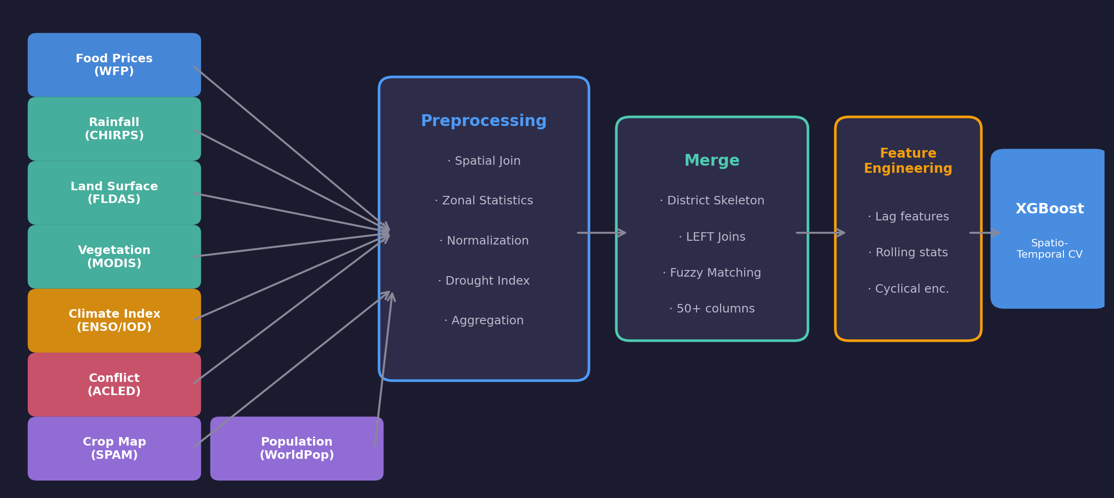
End-to-End Architecture

Slide 13
Preprocessing Pipeline
Food Prices (WFP) → District
Rainfall (CHIRPS) → Drought Index
Land Surface (FLDAS, 8 vars)
Spatial join: market lat/lon → district polygon
Mean price aggregation per district/month
Gamma distribution fit (30-yr calibration period)
Compute SPI (drought severity) per district
3-month moving average + Z-score normalization
Soil moisture, temperature, runoff, evaporation
Vegetation Health (MODIS/AVHRR)
Conflict Events (ACLED)
Static Features
NDVI (greenness), LST (surface temp), VHI (health)
District-level zonal mean aggregation
Point-in-polygon → district; sum fatalities + events
Missing months filled with 0 (no events recorded)
Crop map: 500m raster → crop fraction per district
Population: 1km raster → total count per district

Slide 14
Data Merging Strategy
1
2
3
4
5
Skeleton
→
Prices
→
Static
→
Conflict
→
Climate
Year × Month × District cartesian product
Food prices joined on (year, month, district)
Population + Crop cover joined on district
Conflict events on (year, month, district)
Land surface + Vegetation + Global climate indices
Spatial Reference
Name Matching
Final Output
GeoBoundaries district boundary maps (canonical)
Points-in-polygon for markets & conflict
Zonal statistics for raster (satellite) data
Per-country spatial join
Direct match on district name
Fuzzy matching (approximate string matching, ≥80%)
Manual override dictionary for known mismatches
e.g., 'Nairobi' city → 'Starehe' district
Unified Parquet dataset (columnar format)
~8,640 rows × 50+ columns
40 districts with price observations
Ready for feature engineering & modeling

Slide 15
4
Feature Engineering
Lag strategy and leakage prevention

Slide 16
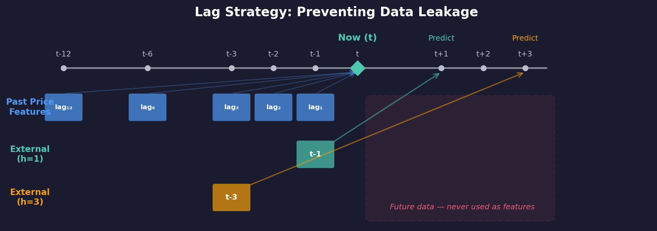
Lag Strategy & Feature Engineering
Past Price Features
External Feature Shift
Seasonal Encoding
Warmup Period
1,2,3,6,12 month lags + rolling averages + year-over-year
Climate/conflict features shifted by forecast horizon (prevents leakage)
Cyclical month encoding (sine/cosine transformation)
Drop first 12 months per district to build sufficient history

Slide 17
5
Modeling & Evaluation
XGBoost (Gradient Boosting) with Spatio-Temporal Cross-Validation

Slide 18
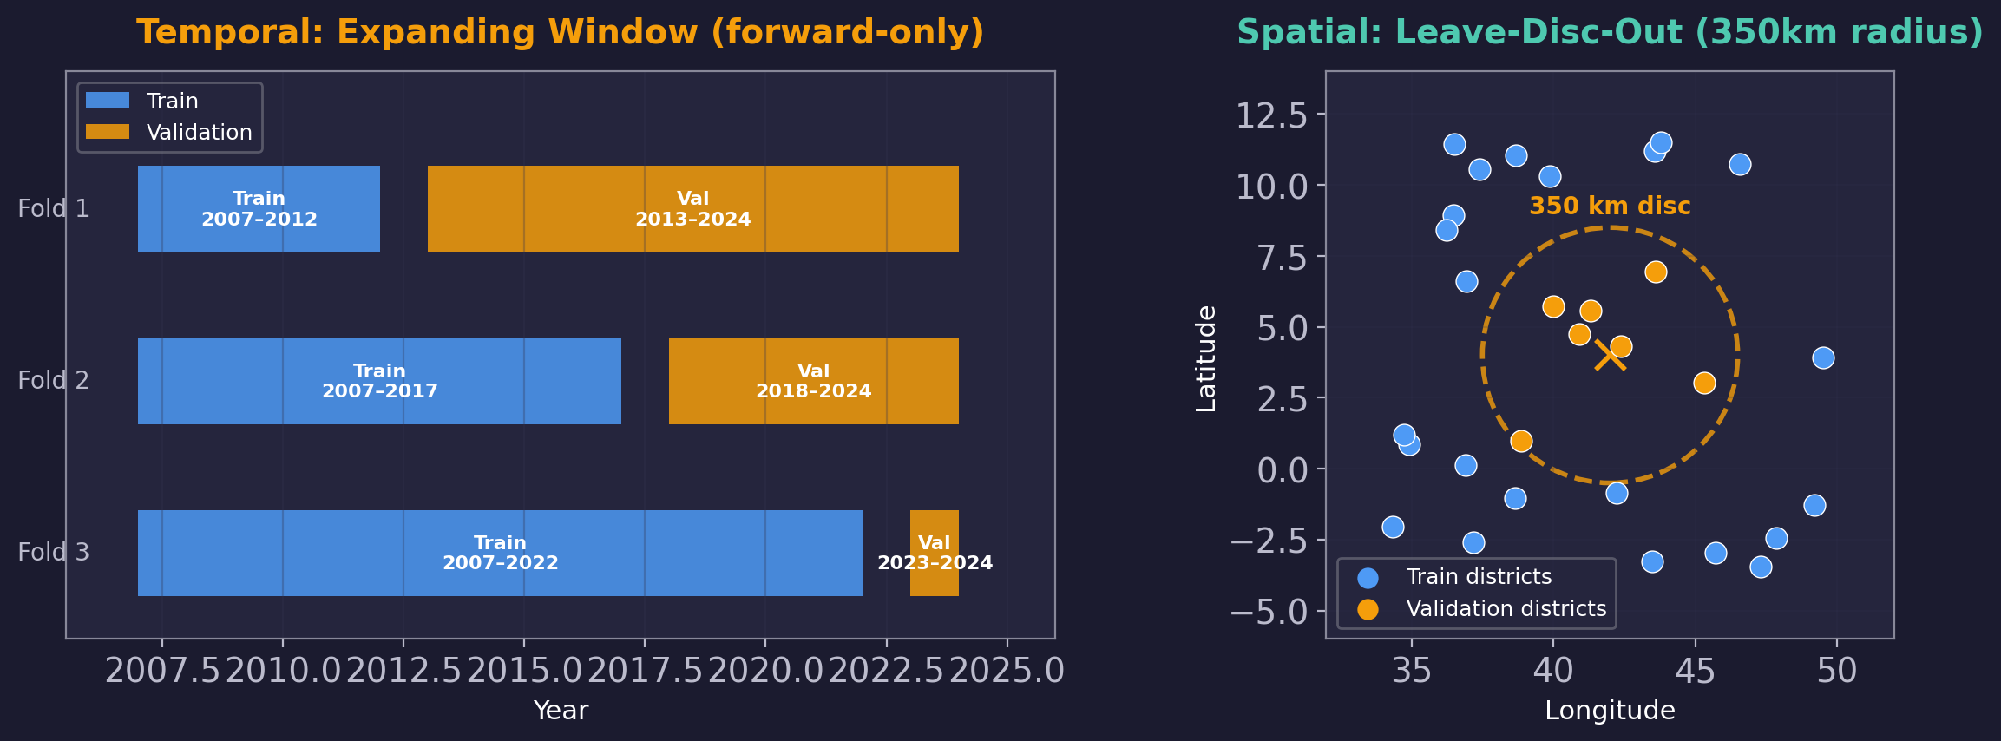
Spatio-Temporal Cross-Validation Design
XGBoost (Gradient Boosting)
n_estimators = 500
learning_rate = 0.05
max_depth = 6
min_child_weight = 5
subsample = 0.8
colsample_bytree = 0.8
reg_alpha = 0.1 (L1)
reg_lambda = 1.0 (L2)
early_stopping = 30 rounds
Combined Cross-Validation
5 spatial × 3 temporal = 15 folds per target × horizon → 135 total model fits (3 targets × 3 horizons × 15)

Slide 19
6
Results
Model performance across targets and horizons

Slide 20
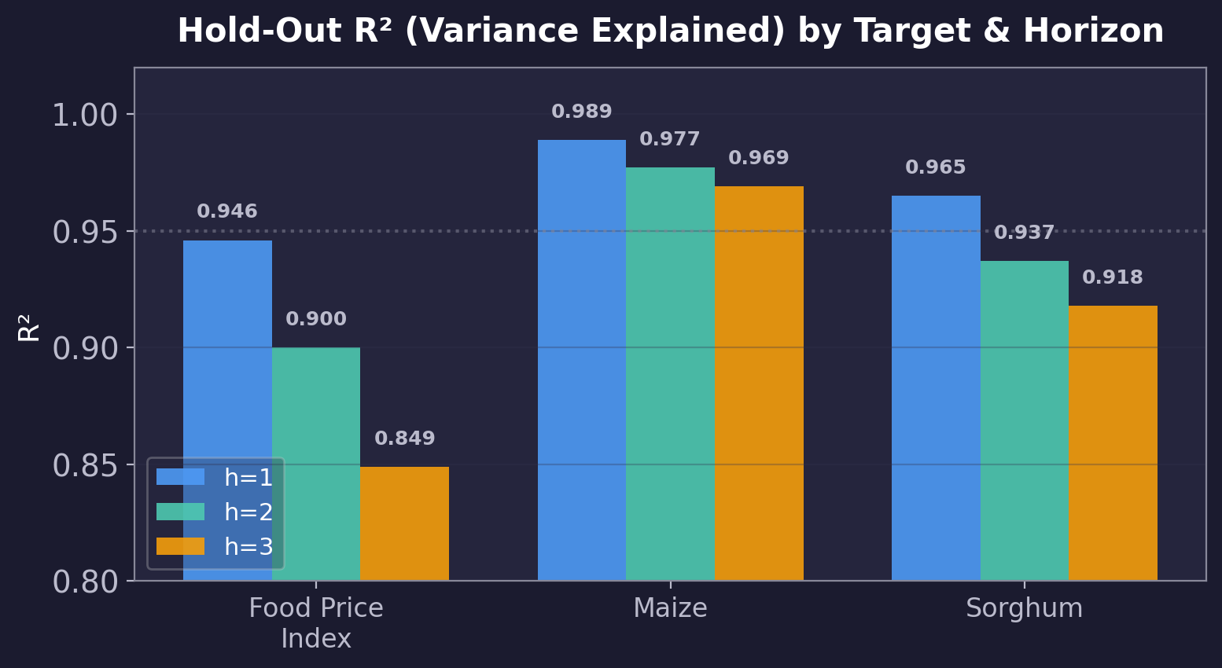
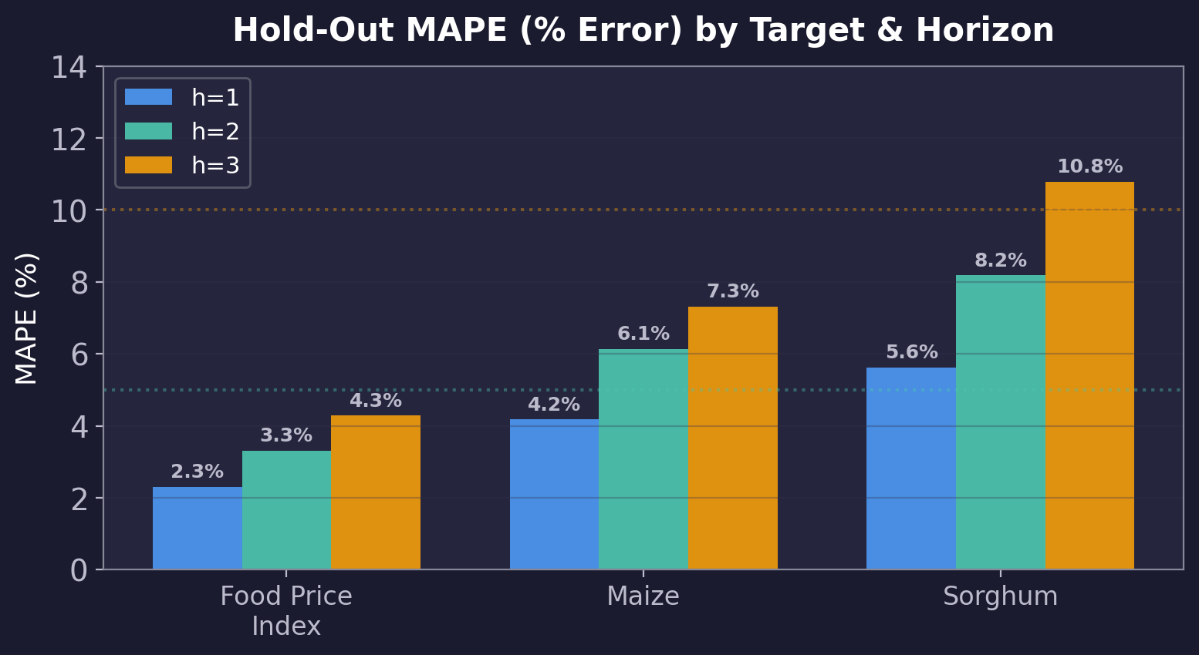
Hold-Out Test Results (2024+)
Train on all data before 2024, test on 2024+ — simulates real-world deployment

Slide 21
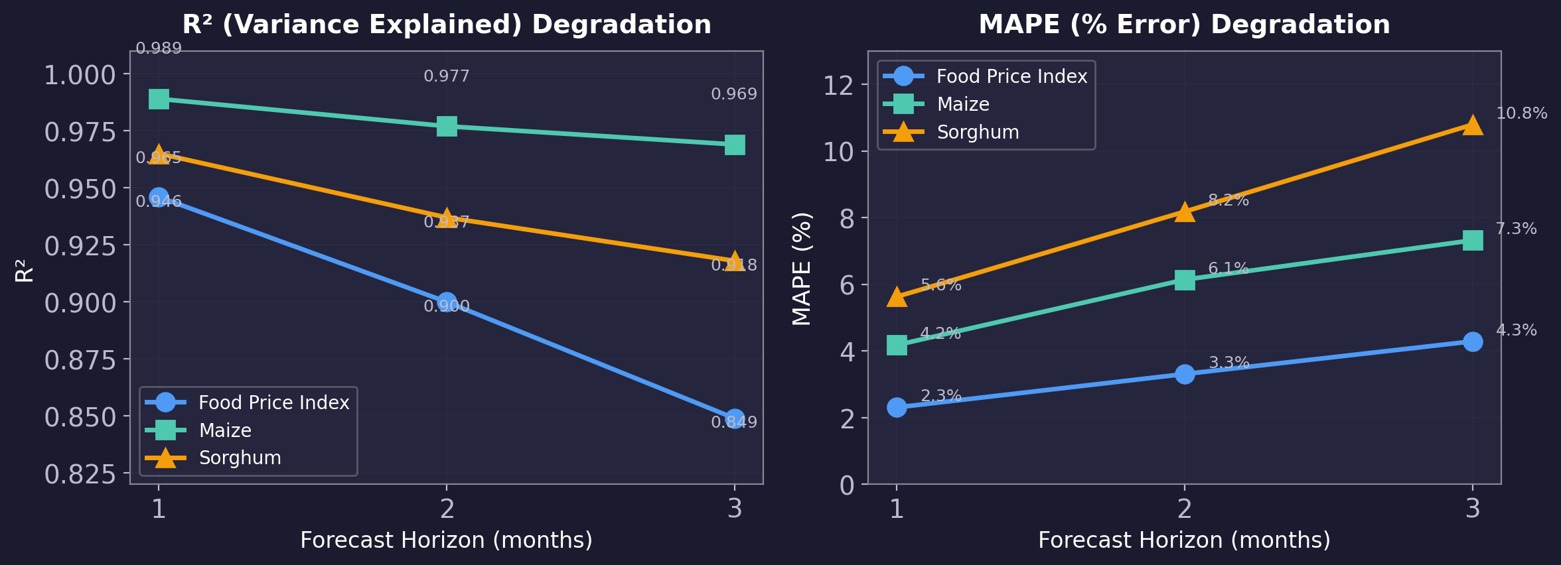
Horizon Degradation Analysis
Accuracy naturally degrades at longer forecast horizons | Food Price Index most stable | Sorghum most volatile

Slide 22
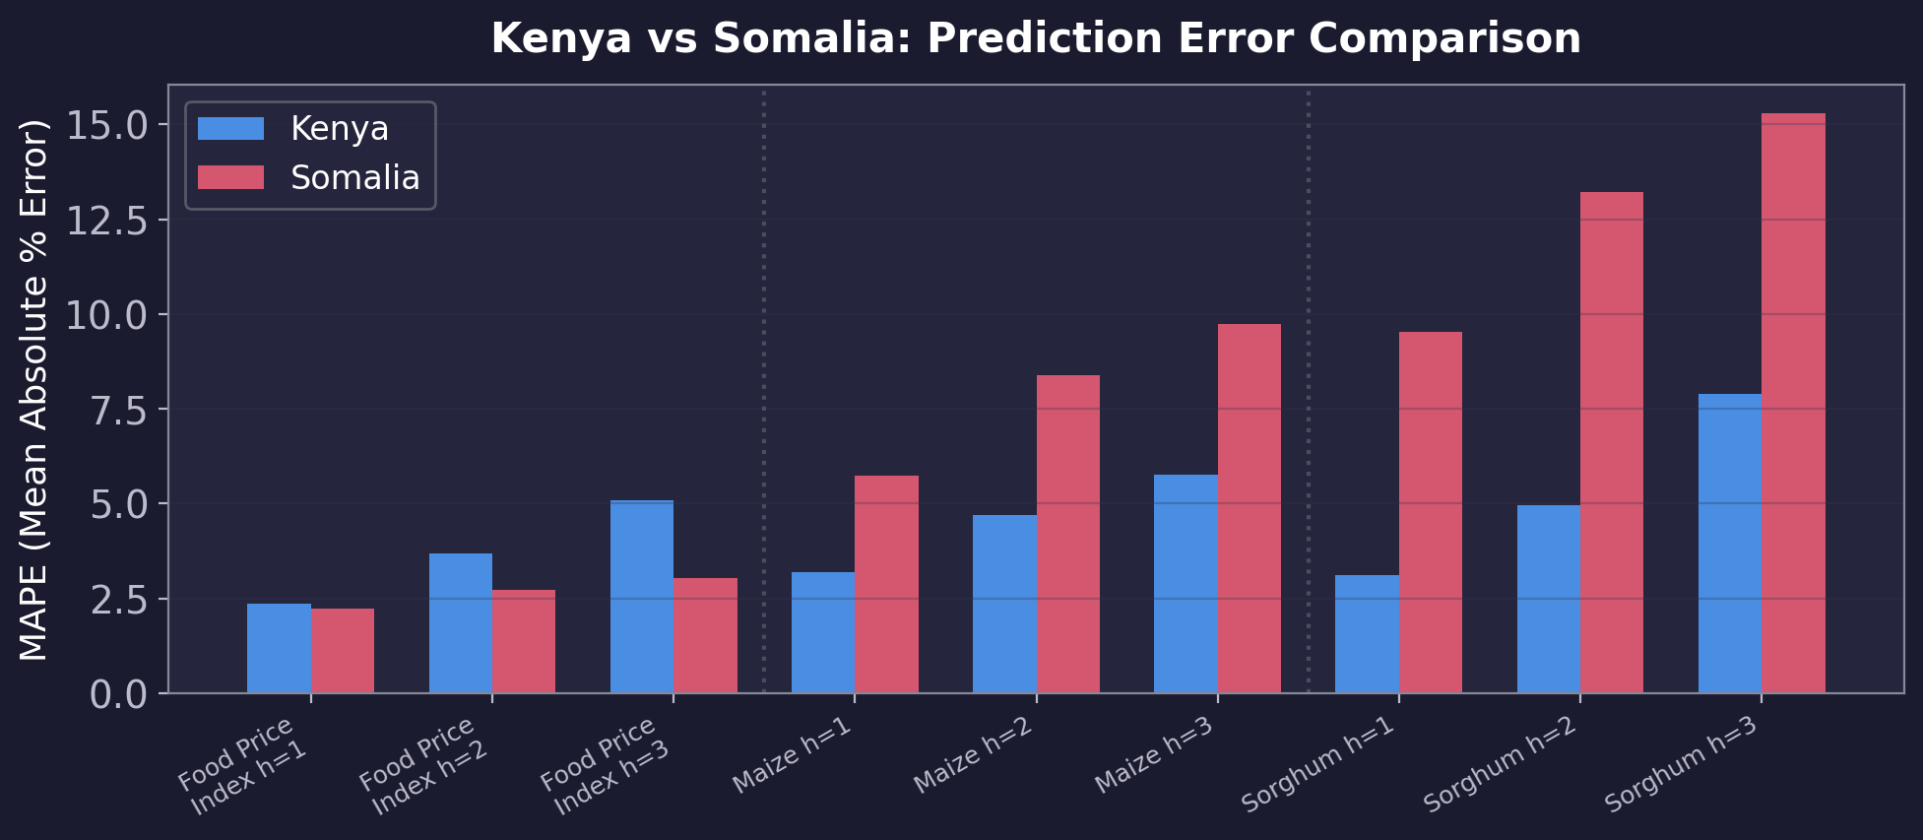
Kenya vs Somalia Performance
Kenya consistently more accurate than Somalia — likely due to higher data density, lower conflict, more stable markets

Slide 23
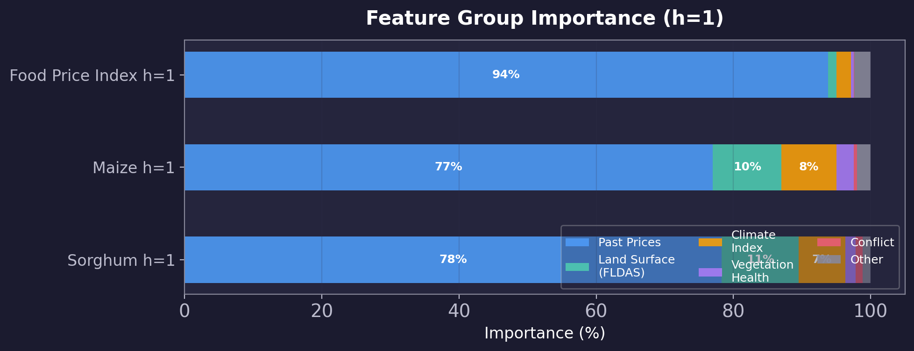
Feature Group Importance
Past price history dominates (77–94%) | Land surface & climate contribute 10–20% for commodity prices At longer horizons, external features (climate, conflict) gain relative importance

Slide 24
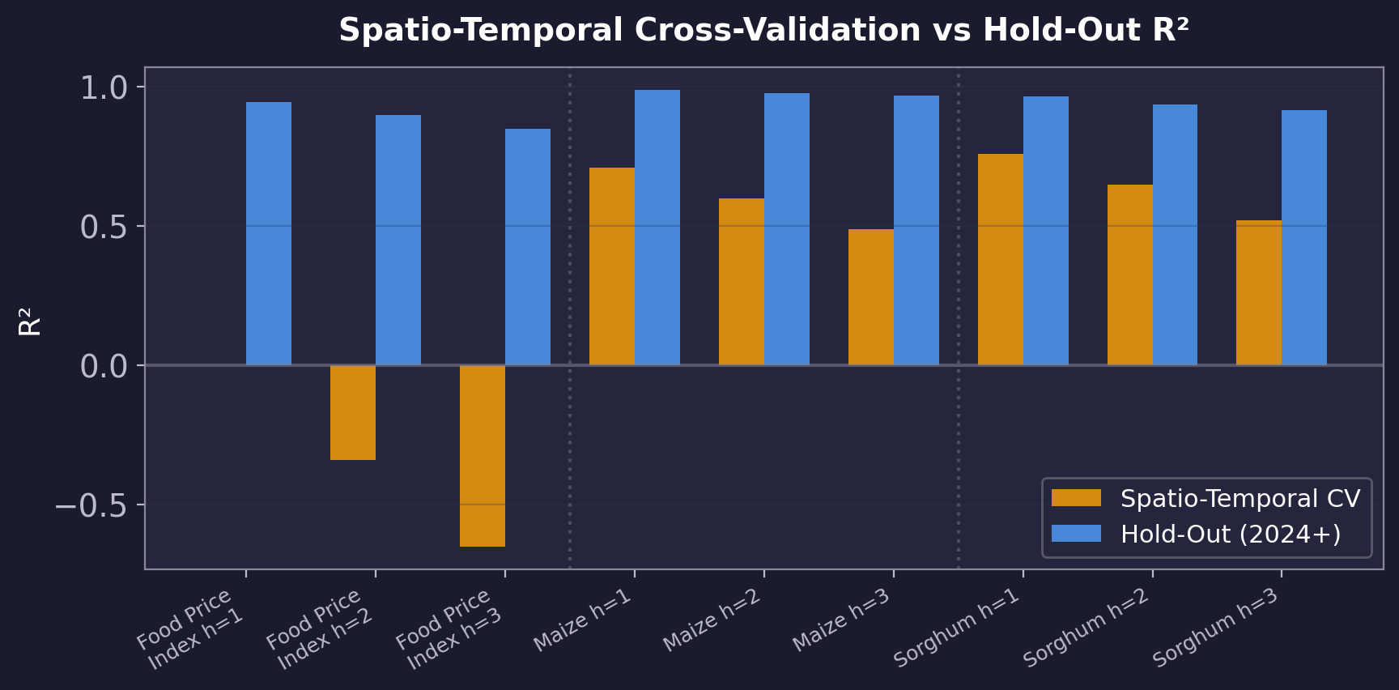
Spatio-Temporal CV vs Hold-Out Comparison
Spatio-Temporal CV is intentionally conservative (held-out districts were never seen during training) Hold-out reflects realistic deployment: train on all districts, predict future time periods

Slide 25
Detailed Spatio-Temporal CV Results
15 folds (5 spatial × 3 temporal) per target × horizon
Target | Horizon | R² (Variance Explained) | MAPE (% Error) | RMSE (Prediction Error)
Food Price Index | h=1 | 0.04 ± 0.82 | 9.86% ± 7.03% | 0.191 ± 0.142
Food Price Index | h=2 | -0.26 ± 1.00 | 11.85% ± 7.80% | 0.220 ± 0.153
Food Price Index | h=3 | -0.54 ± 1.02 | 13.43% ± 8.06% | 0.242 ± 0.156
Maize | h=1 | 0.77 ± 0.29 | 7.35% ± 2.67% | 3,732 ± 3,010
Maize | h=2 | 0.69 ± 0.32 | 10.01% ± 2.78% | 4,477 ± 3,050
Maize | h=3 | 0.61 ± 0.33 | 12.26% ± 3.15% | 4,987 ± 2,956
Sorghum | h=1 | 0.78 ± 0.27 | 9.01% ± 5.39% | 3,178 ± 3,458
Sorghum | h=2 | 0.67 ± 0.32 | 12.85% ± 6.42% | 3,797 ± 3,748
Sorghum | h=3 | 0.54 ± 0.33 | 16.20% ± 6.74% | 4,289 ± 3,857

Slide 26
Key Takeaways
Multi-Source Integration
8 heterogeneous sources (climate, conflict, satellite, economic) → unified district-level panel for Kenya & Somalia
Rigorous Evaluation
Spatio-Temporal Cross-Validation (350km spatial separation × expanding time window) prevents data leakage
Strong Predictive Performance
Hold-out R² (variance explained) > 0.91 for all targets; Maize at 1-month achieves R² = 0.989
Country-Level Insights
Kenya predictions more accurate than Somalia — likely due to data availability, lower conflict, more stable markets
Forecast Horizon Trade-off
1-month forecast most reliable; 3-month forecast error (MAPE) increases by 5–10 percentage points

Slide 27
Thank You
Questions?

