Slide 1
Subnational Food Price Prediction in East Africa
Integrating Climate, Conflict, and Socioeconomic Data for Admin2-Level Forecasting
Kenya & Somalia | XGBoost (Gradient Boosting) | Spatio-Temporal Cross-Validation

Slide 2
Project Overview
Dataset
Target
Model
8 data sources merged at Admin2 level
Format: Data type — Source
Climate (SPI) — CHIRPS
Soil moisture / temp — FLDAS
Vegetation (NDVI) — MODIS
Conflict events — ACLED
Food prices — WFP / World Bank
Food security (IPC) — FEWS NET
Night lights — NASA Black Marble
Crop fraction — Dynamic World
Admin2-level price prediction
at 1, 2, 3 month horizons
3 Target Variables:
Food Price Index
Maize (FAO)
Sorghum
Countries:
Kenya & Somalia
XGBoost (Gradient Boosting)
Evaluation:
Spatio-Temporal CV
(Leave-Disc-Out spatial folds
+ Expanding-window temporal)
Holdout evaluation (2024+)
Dashboard:
Next.js + FastAPI

Slide 3
Problem Definition
Prediction of price
3 Horizons
2 Countries
Food Price Index Maize Sorghum
1 month ahead 2 months ahead 3 months ahead
Kenya Somalia Admin2 (district) level

Slide 4
Model & Performance
Improve the model performance with
Spatio/temporal cross validation
Performance
Spatio-Temporal CV Results
(metrics placeholder — add your
actual R², MAPE, RMSE here)
Holdout Evaluation (2024+)
(metrics placeholder — add your
actual results here)
Per-Country Breakdown
Kenya: (add metrics)
Somalia: (add metrics)
Spatial: Leave-Disc-Out (5 folds, 350km radius)
Temporal: Expanding window (3 folds)
Leakage Prevention
Price features: lag 1,2,3,6,12 months
+ rolling means/stds + YoY change
Exogenous features: ALL lagged by h months
(conflict, FLDAS, vegetation, climate)
12-month warmup: drops first 12 rows
per admin2 to build lag features

Slide 5
Data Sources
Category | Source | Provider | Key Variables | Resolution
Target (Food Prices) | WFP (World Food Programme) | World Bank | Food Price Index, Maize, Sorghum | Market → District
Rainfall | CHIRPS (Satellite Rainfall) | UCSB | SPI (Drought Index) | 5km → District
Hydrology / Temperature | FLDAS (Land Surface Model) | NASA | Soil moisture, Air temp, Runoff, Evapotranspiration (8 vars) | District monthly
Vegetation Health | MODIS / AVHRR (Satellite Imagery) | NASA / NOAA | NDVI (Greenness), LST (Surface Temp), VHI (Vegetation Health) | District monthly
Global Climate | ENSO / IOD (Ocean-Atmosphere) | NOAA / IRI | El Nino Index, *Indian Ocean Dipole Multivariate ENSO(Elnino southern osciliation) Index | Global monthly
Conflict | ACLED (Conflict Event Data) | ACLED Project | Event count, Fatalities | Point → District
Agriculture | SPAM (Crop Presence Map) | CIMMYT | Crop cover fraction per district | 500m (static)
Population | WorldPop (Population Estimate) | WorldPop Hub | Population count per district | 1km (static)
All sources spatially aligned to district (Admin2) boundaries | Temporal coverage: 2007–2025
*irregular oscillation of sea surface temperatures

Slide 6
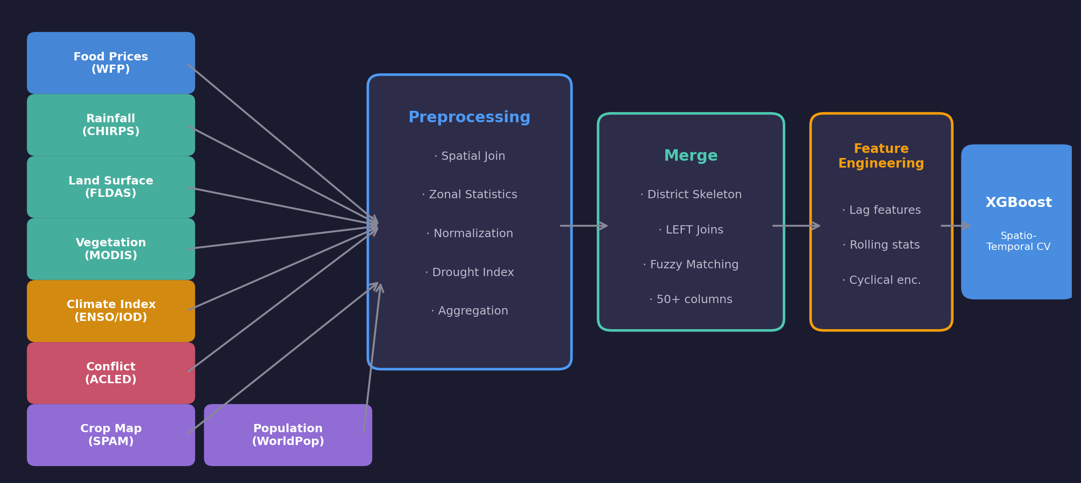
End-to-End Architecture

Slide 7
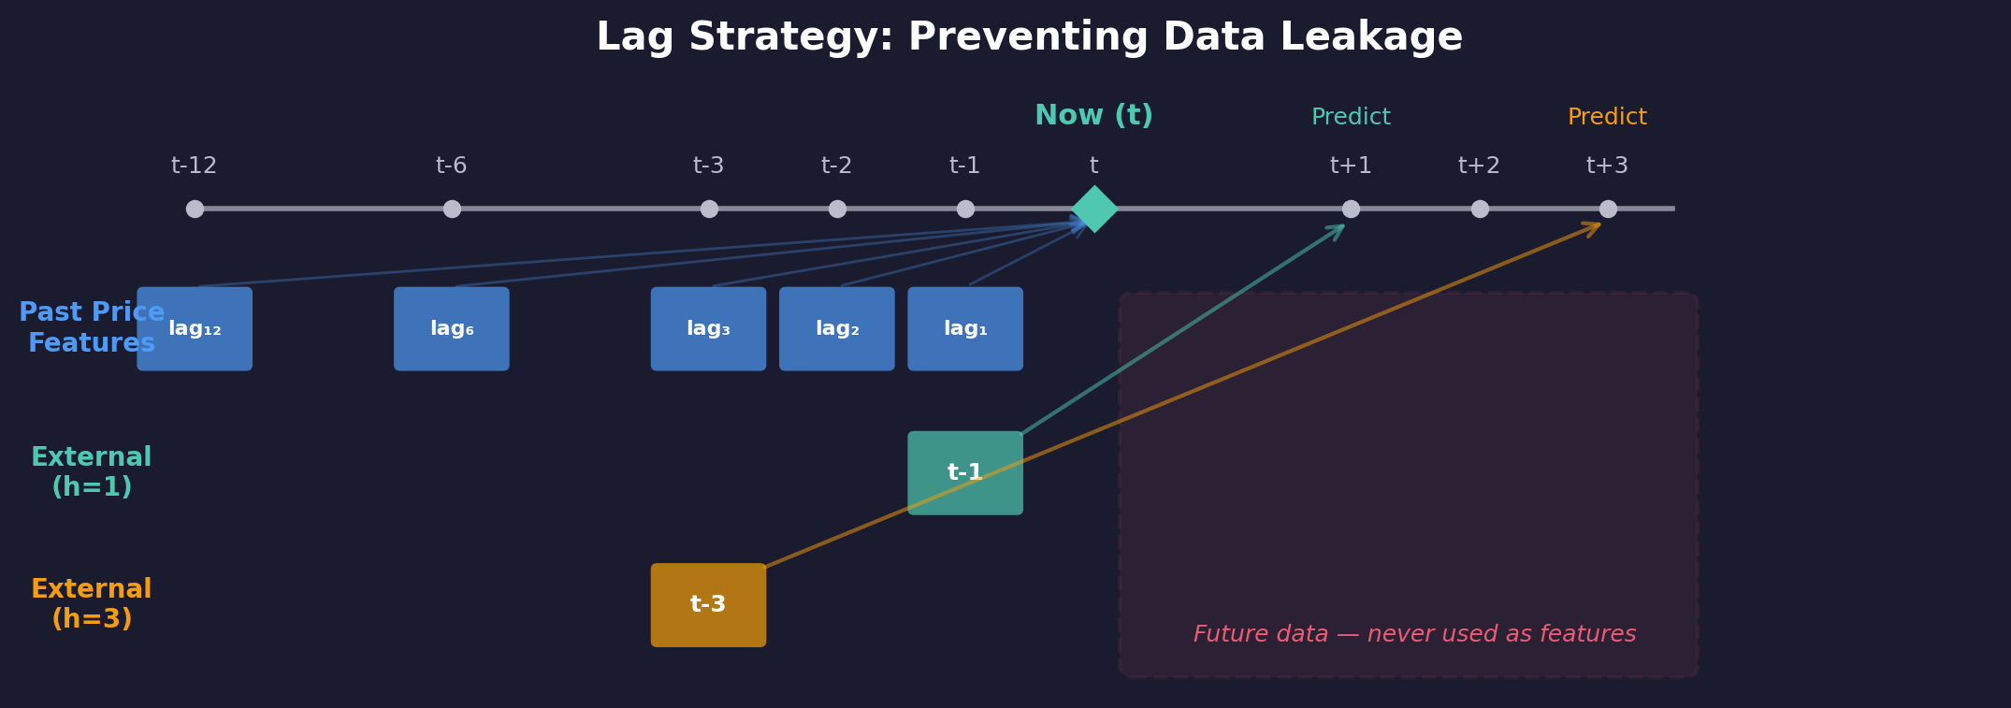
Lag Strategy & Feature Engineering
Past Price Features
External Feature Shift
Seasonal Encoding
Warmup Period
1,2,3,6,12 month lags + rolling averages + year-over-year
Climate/conflict features shifted by forecast horizon (prevents leakage)
Cyclical month encoding (sine/cosine transformation)
Drop first 12 months per district to build sufficient history

Slide 8
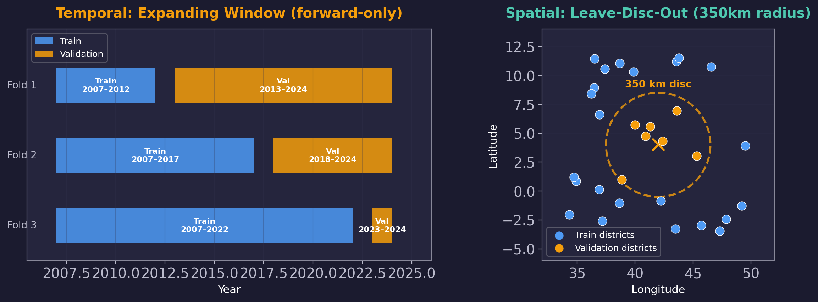
Spatio-Temporal Cross-Validation Design

Slide 9
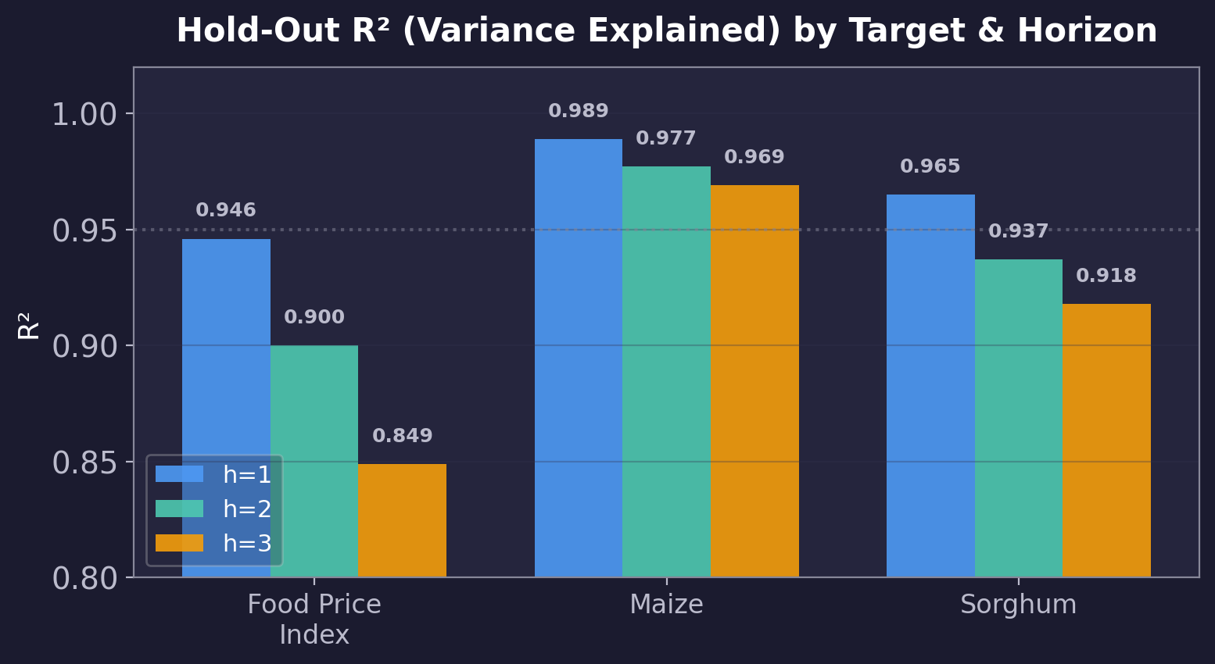
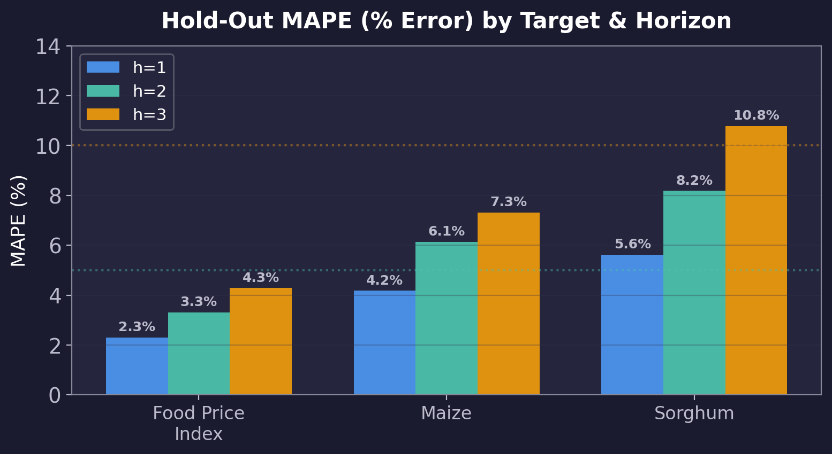
Hold-Out Test Results (2024+)
Train on all data before 2024, test on 2024+ — simulates real-world deployment

Slide 10
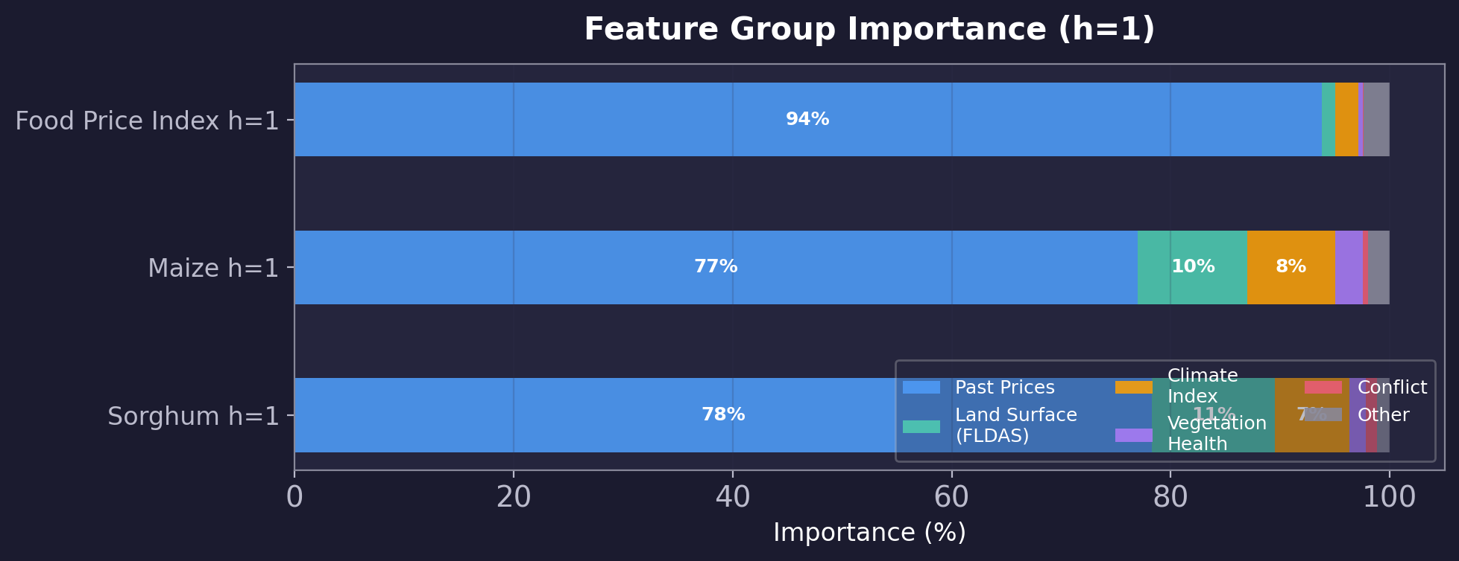
Feature Group Importance
Past price history dominates (77–94%) | Land surface & climate contribute 10–20% for commodity prices At longer horizons, external features (climate, conflict) gain relative importance

Slide 11
Detailed Spatio-Temporal CV Results
15 folds (5 spatial × 3 temporal) per target × horizon
Target | Horizon | R² (Variance Explained) | MAPE (% Error) | RMSE (Prediction Error)
Food Price Index | h=1 | 0.04 ± 0.82 | 9.86% ± 7.03% | 0.191 ± 0.142
Food Price Index | h=2 | -0.26 ± 1.00 | 11.85% ± 7.80% | 0.220 ± 0.153
Food Price Index | h=3 | -0.54 ± 1.02 | 13.43% ± 8.06% | 0.242 ± 0.156
Maize | h=1 | 0.77 ± 0.29 | 7.35% ± 2.67% | 3,732 ± 3,010
Maize | h=2 | 0.69 ± 0.32 | 10.01% ± 2.78% | 4,477 ± 3,050
Maize | h=3 | 0.61 ± 0.33 | 12.26% ± 3.15% | 4,987 ± 2,956
Sorghum | h=1 | 0.78 ± 0.27 | 9.01% ± 5.39% | 3,178 ± 3,458
Sorghum | h=2 | 0.67 ± 0.32 | 12.85% ± 6.42% | 3,797 ± 3,748
Sorghum | h=3 | 0.54 ± 0.33 | 16.20% ± 6.74% | 4,289 ± 3,857

Slide 12
Key Takeaways
Multi-Source Integration
8 heterogeneous sources (climate, conflict, satellite, economic) → unified district-level panel for Kenya & Somalia
Rigorous Evaluation
Spatio-Temporal Cross-Validation (350km spatial separation × expanding time window) prevents data leakage
Strong Predictive Performance
Hold-out R² (variance explained) > 0.91 for all targets; Maize at 1-month achieves R² = 0.989
Country-Level Insights
Kenya predictions more accurate than Somalia — likely due to data availability, lower conflict, more stable markets
Forecast Horizon Trade-off
1-month forecast most reliable; 3-month forecast error (MAPE) increases by 5–10 percentage points

Slide 13
Thank You
Questions?

