Slide 2
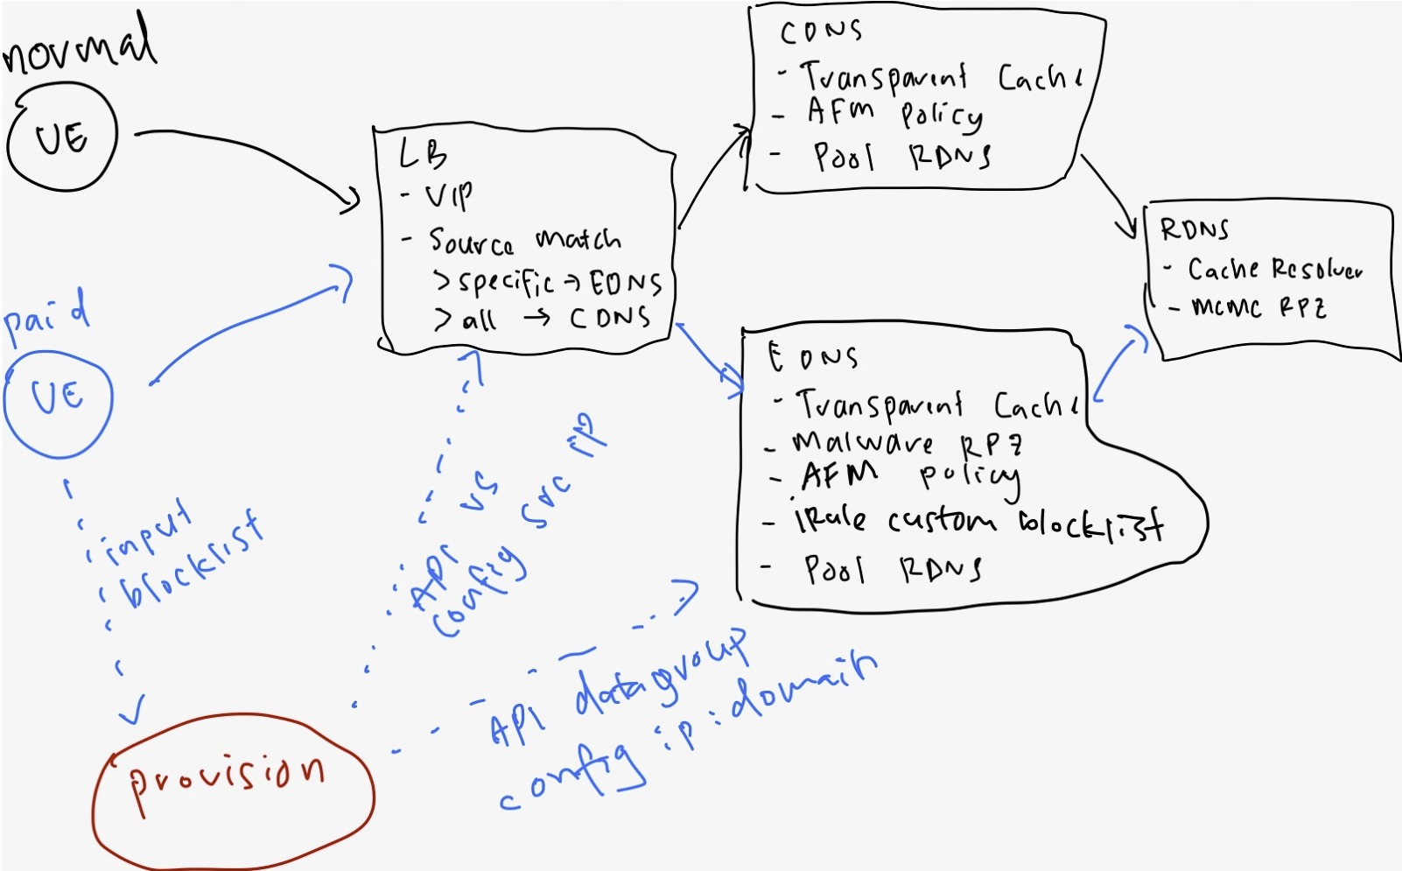
0.0.0.0/0
10.1.30.100
0.0.0.0/0

Slide 3
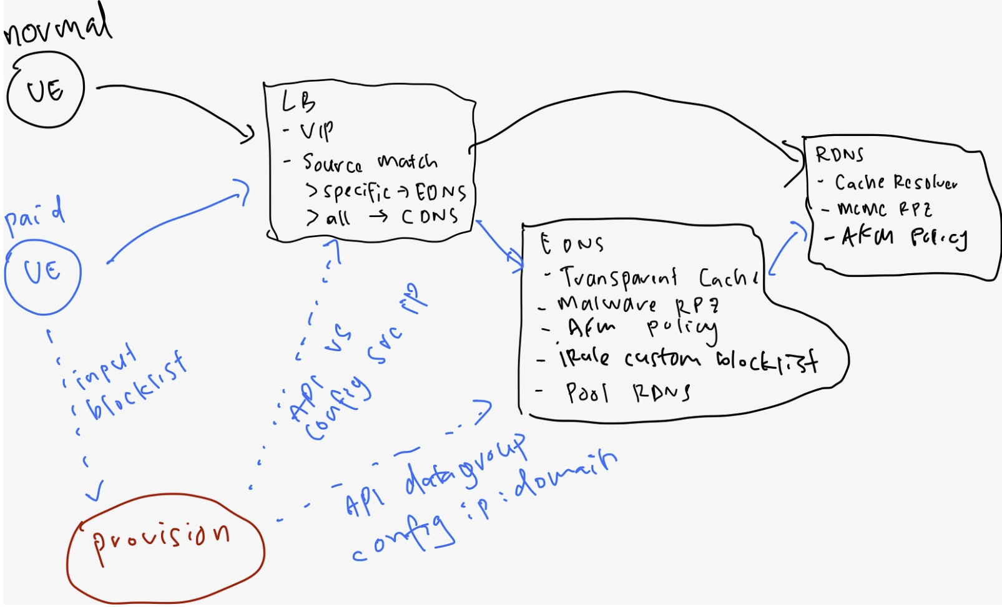
This can be router
C
400K
250K per r5900
Limit on datagroup = how many user – 10K per r5900
Limit on entry per datagroup = how many blocklist per user - 5k

Slide 4
r5900
Tenant 1 (24 vCPU or 22vCPU)
VS – CDNS
RPZ – MCMC
First level (2 customer)
PS to re-configure F5 to support EDNS
Malware pricing
Web app building
Second level
PS to configure r5900
Malware pricing
Web app building
Dedicated r5900
Tenant 2 (2vCPU or 4vCPU)
VS – EDNS
RPZ – Malware
Pool CDNS

