Slide 1
Lambda Expressions
Şevval MEHDER

Slide 2
A lambda expression:
[capture list](function arguments){
function body
};

Slide 3
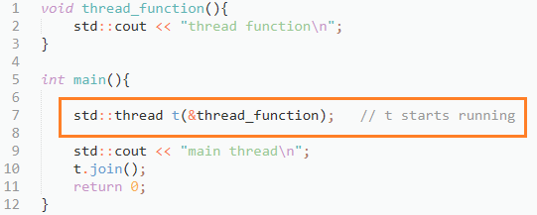

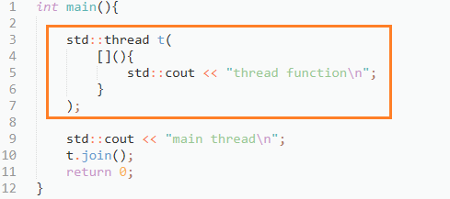

Slide 4
There are two default capture modes in C++11: by-reference and by-value
by-reference
by-value
[&](){}, which means capture any referenced variable by reference
[&number](){}, which means capture only variable number by reference
[=](){}, which means capture any referenced variable by copy
[index, &number](){}, which means capture variable number by reference, variable index by value

Slide 5
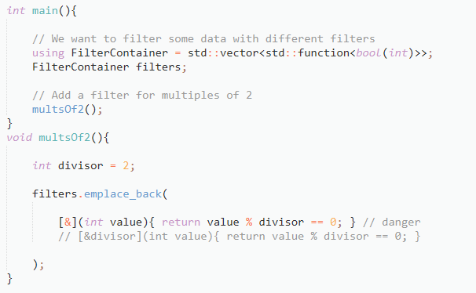
By-reference
Reference the divisor will dangle.
With [&divisor], it’s easier to see.

Slide 6
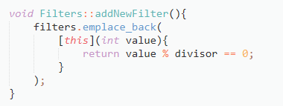
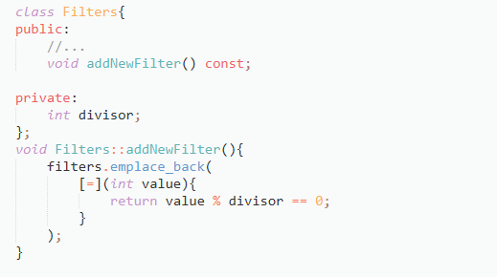
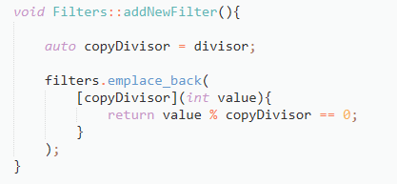
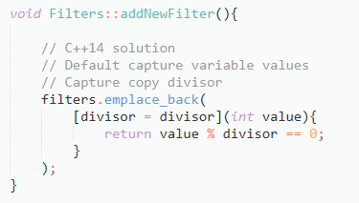
By-value
Captures apply only to non-static local variables in the scope where the lambda is created.
Either by value or reference the capture won’t compile

Slide 7
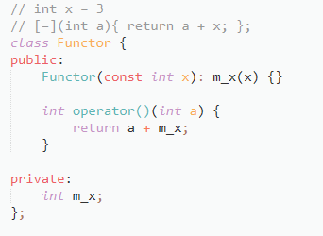
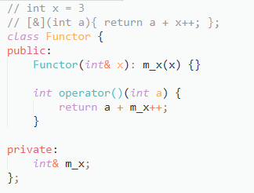
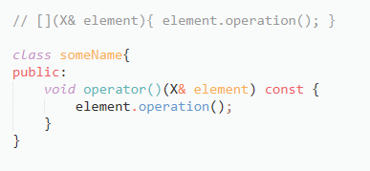
If you don’t capture any variables
Capturing by value
Capturing by reference
Details: https://web.mst.edu/~nmjxv3/articles/lambdas.html

