Slide 1
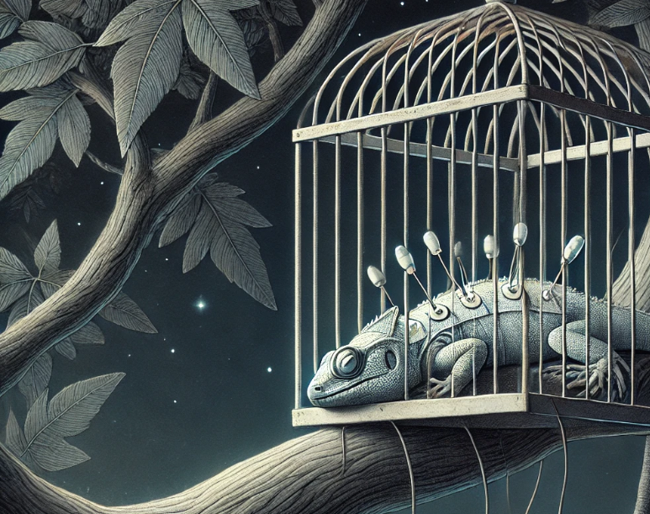
Sleeping Lizards
BSA Concluding project
Halit Baeloha
March 2025

Slide 2
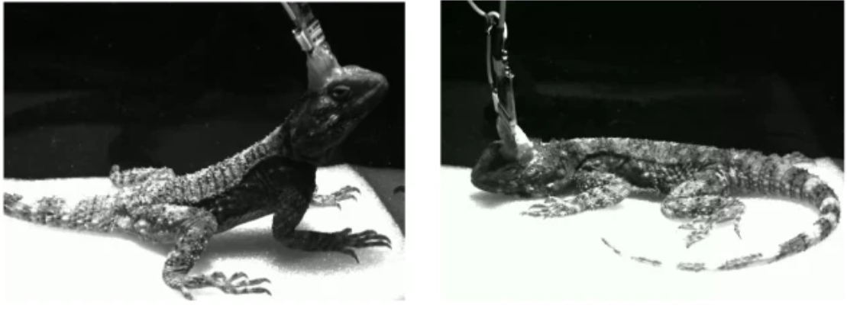
Biological relevance of the project
Sleep Architecture in Lizards:
Research indicates that some lizards exhibit two distinct phases during sleep:
Slow-Wave Sleep (SWS): This phase is characterized by a lower level of brain activity, similar to the deep, restorative sleep seen in mammals.
REM-like Sleep: Although lizards lack a neocortex like mammals, studies on species such as the bearded dragon suggest they can enter a state with rapid, irregular brain activity reminiscent of REM sleep. However, these episodes tend to be shorter and less pronounced than in mammals.
Albeck, N., Udi, D.I., Eyal, R. et al. Temperature-robust rapid eye movement and slow wave sleep in the lizard Laudakia vulgaris. Commun Biol 5, 1310 (2022).

Slide 3
pipeline
1
Load data in chunks
2
Divide data into epochs
3
Visualize the data and decision along the way
Down-sample from 32khz to 1000hz
Low pass filter with cutoff frequency of 100hz
Smoothing using gaussian filter
Calculate PSD per epoch
Decide per epoch what is the state using different thresholds
Check out my Git!
BSA_Project_final

Slide 4
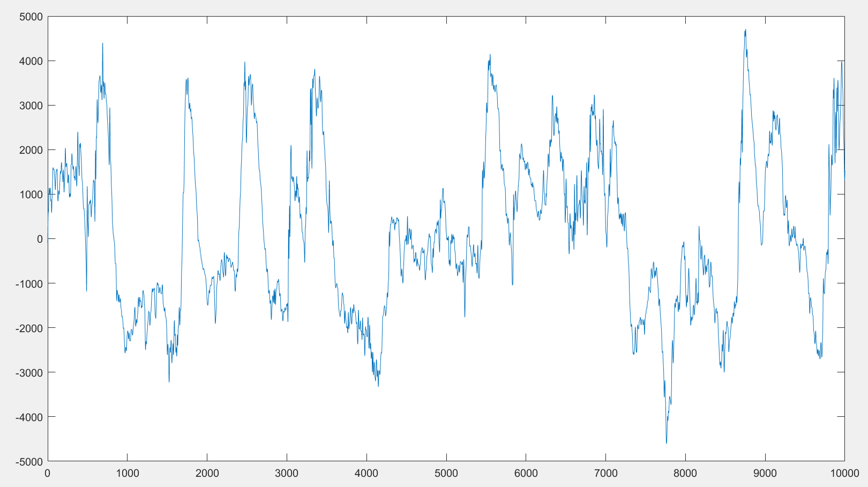
Before smoothing- after downsampling cut off and filtering
First 10,000 samples = 10,000/1000=10 seconds

Slide 5
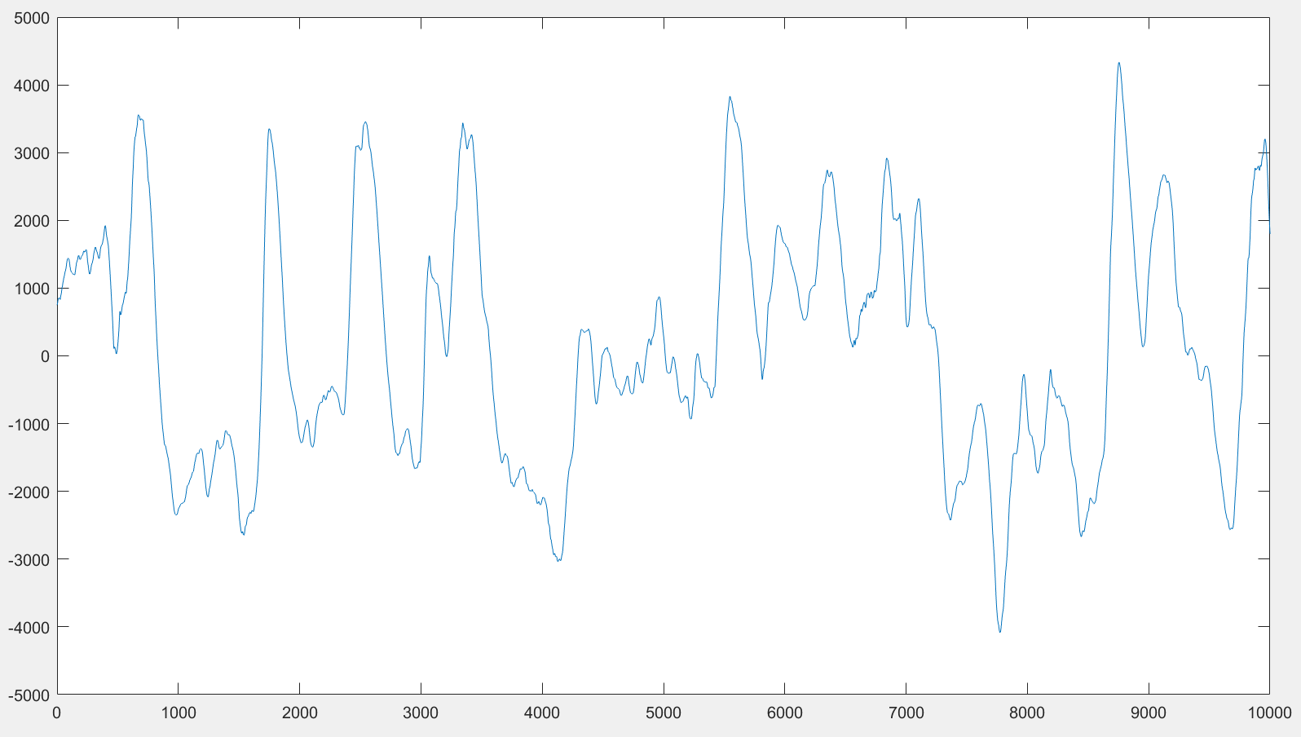
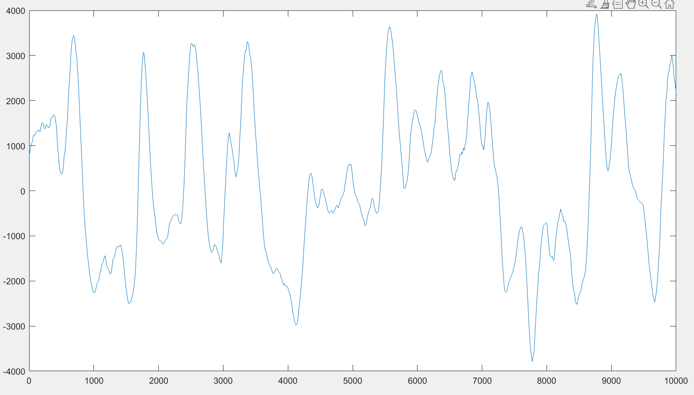
Using different smoothing approaches- moving average
Main motivation is to keep signal’s oscillations as close as possible to raw data, but reducing noise
First 10,000 samples = 10,000/1000=10 seconds

Slide 6
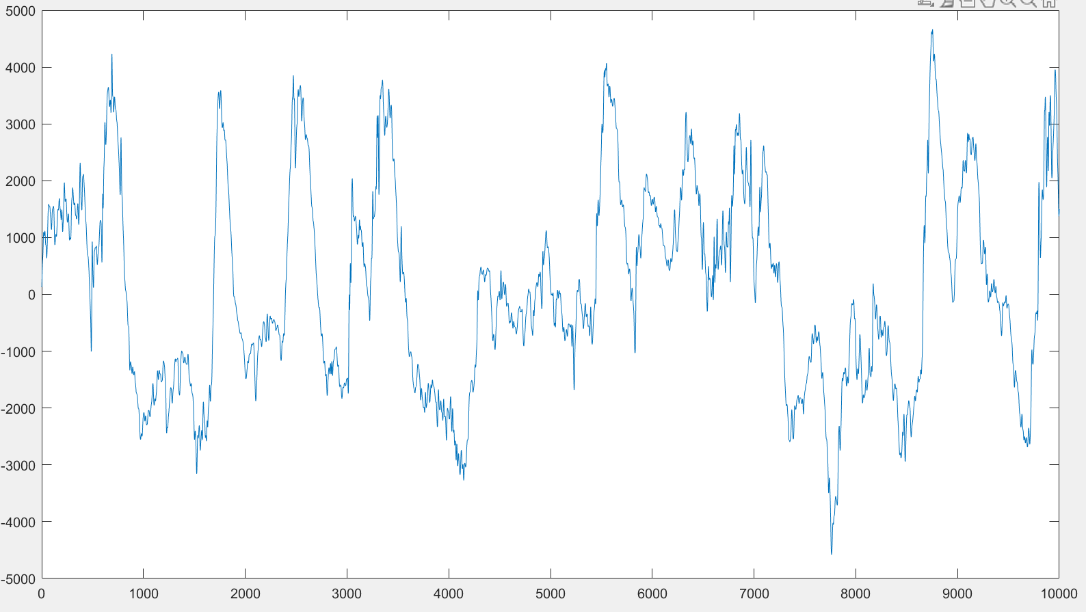
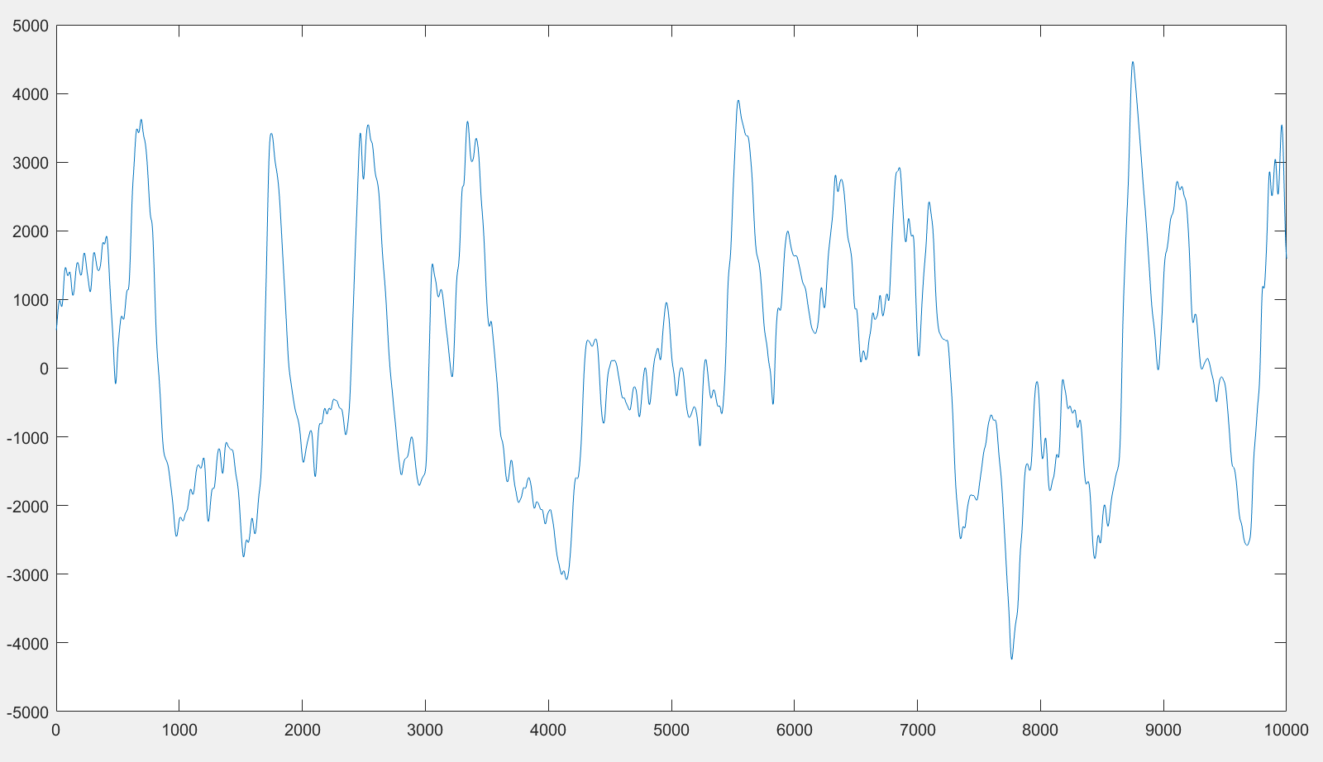
Using different smoothing approaches- gaussian filter
Main motivation is to keep signal’s oscillations as close as possible to raw data, but reducing noise
First 10,000 samples = 10,000/1000=10 seconds

Slide 7
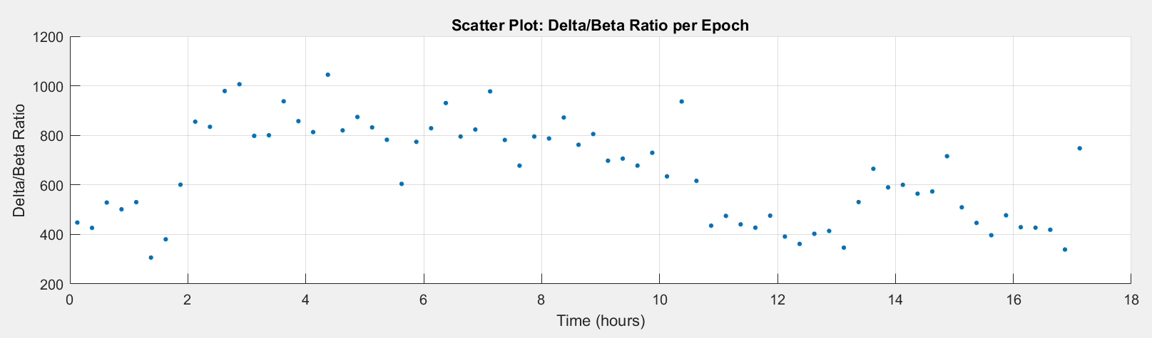
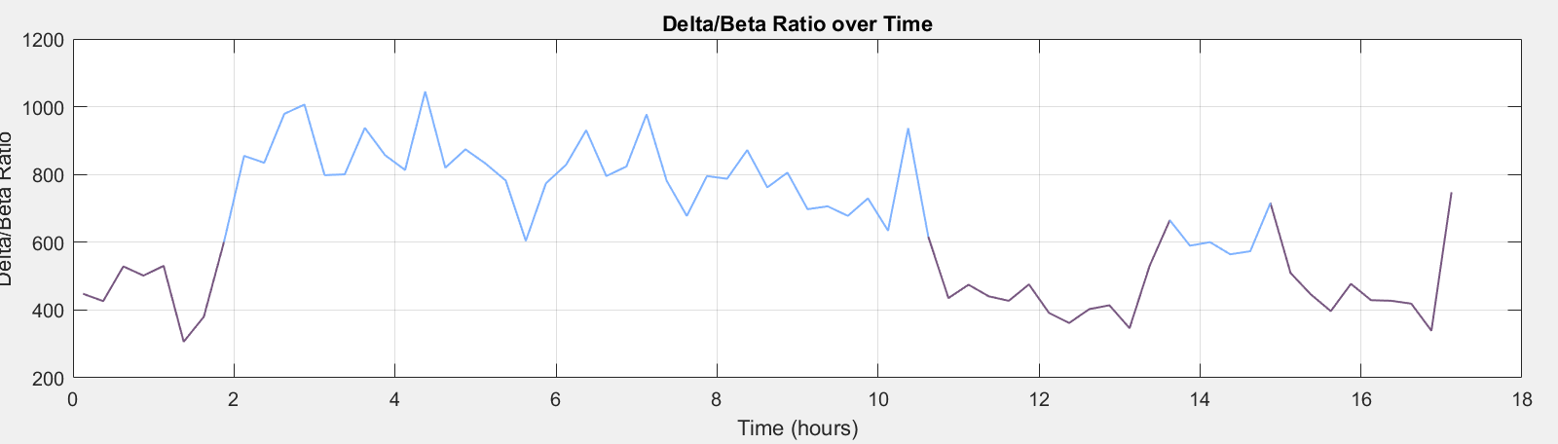
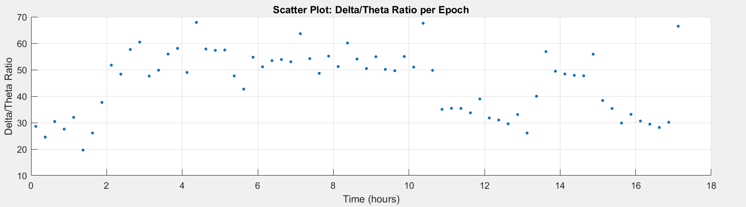
Identifying high and low arousal states
Epoch power ratio to check if I can distinct wake and sleep
Continuous representation to highlight the differences >580
Distinguish between NREM and REM
REM is dominated by theta activity

Slide 8
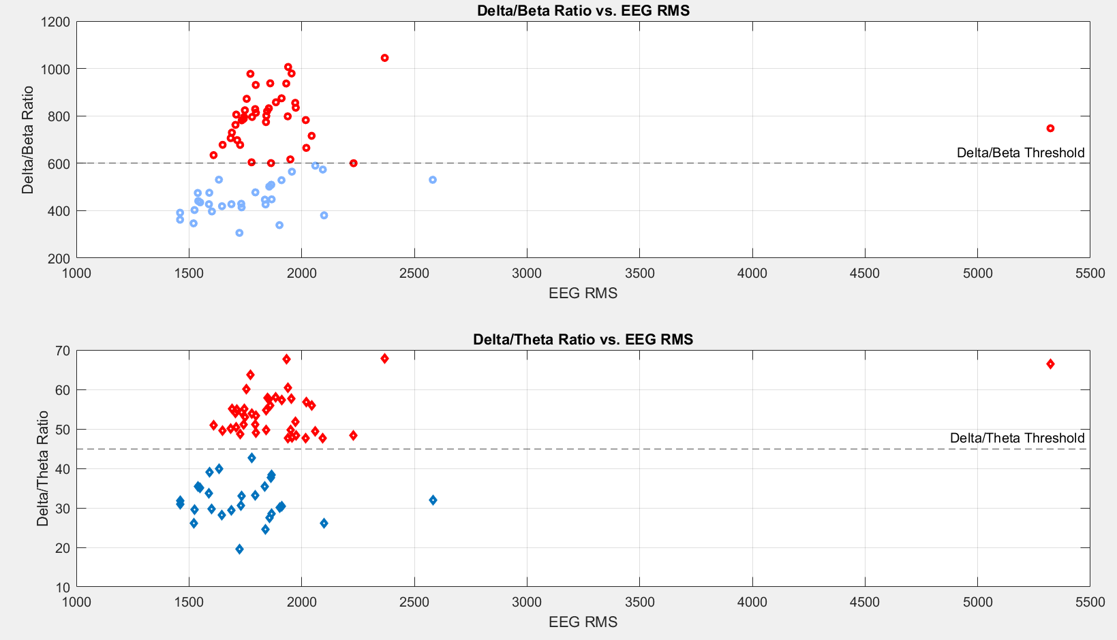
EEG RMS is not as sensitive in this case as I would have hoped…
NREM
WAKE
NREM
REM

Slide 9
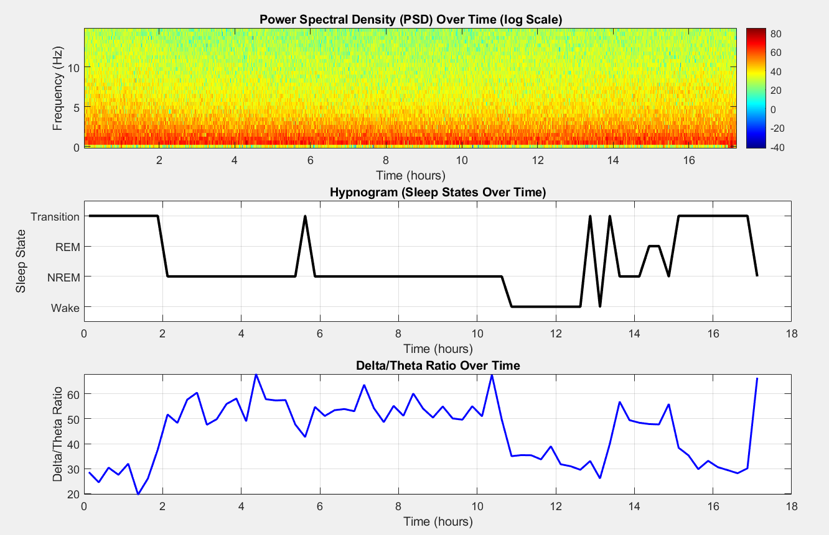

Slide 10
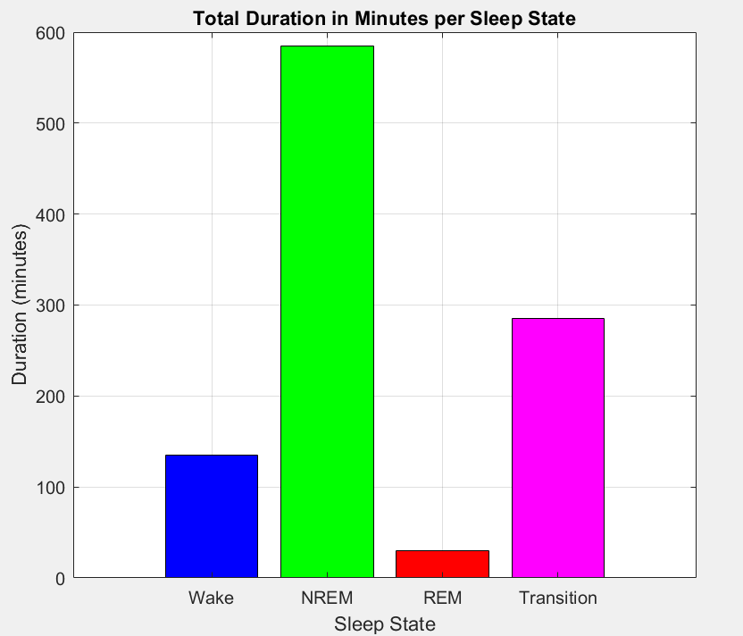
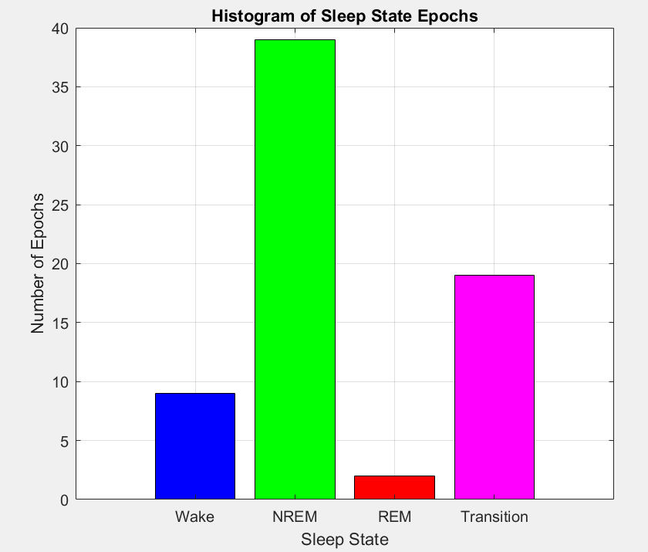
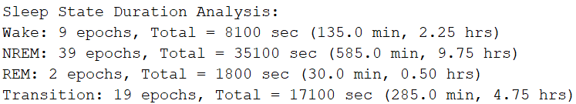
Finished analysis

