Slide 1
CvsP2
File created on: 3/15/2022 10:13:00 PM

Slide 2
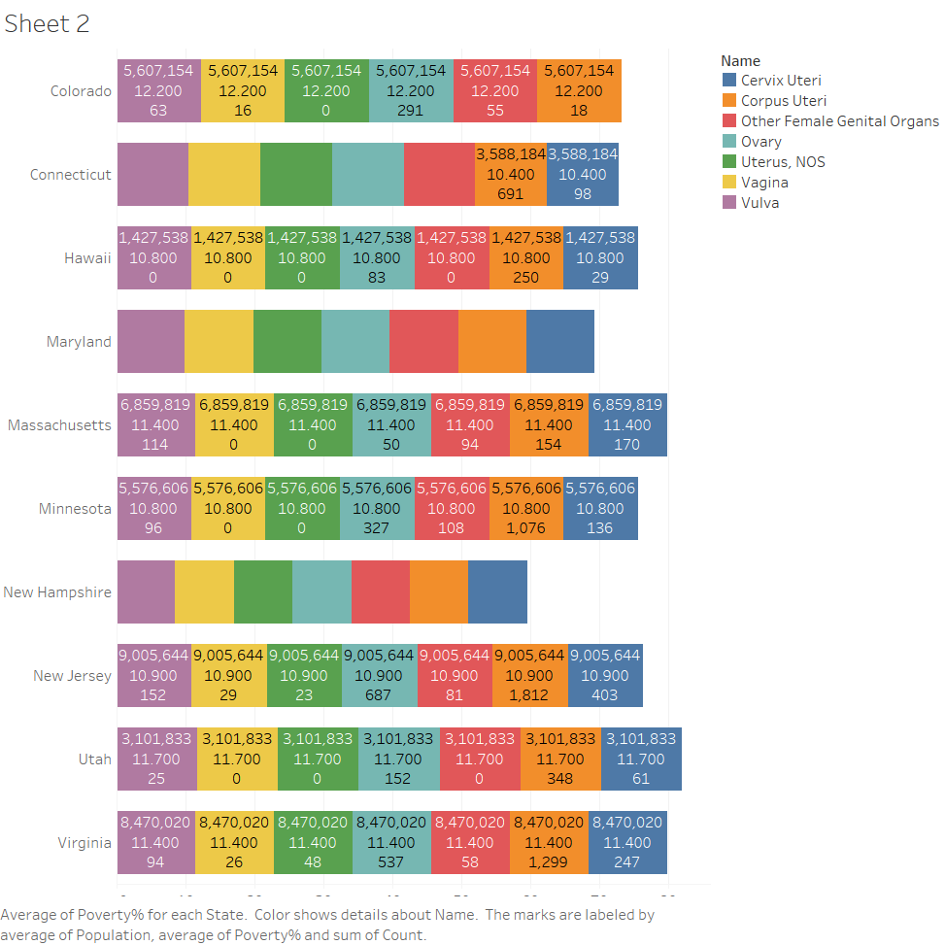

Slide 3
